Slide 1
USER STORIES
Test Fixture GUI Mockups
Main Window · Existing Test Found · Test Configuration · Calibration · EM Test · EM Analysis
Shear Test · Shear Analysis · Manual Test · Manual Analysis · Cyclical Test

Slide 2
FEATURE 1.1
Main Window

Slide 3
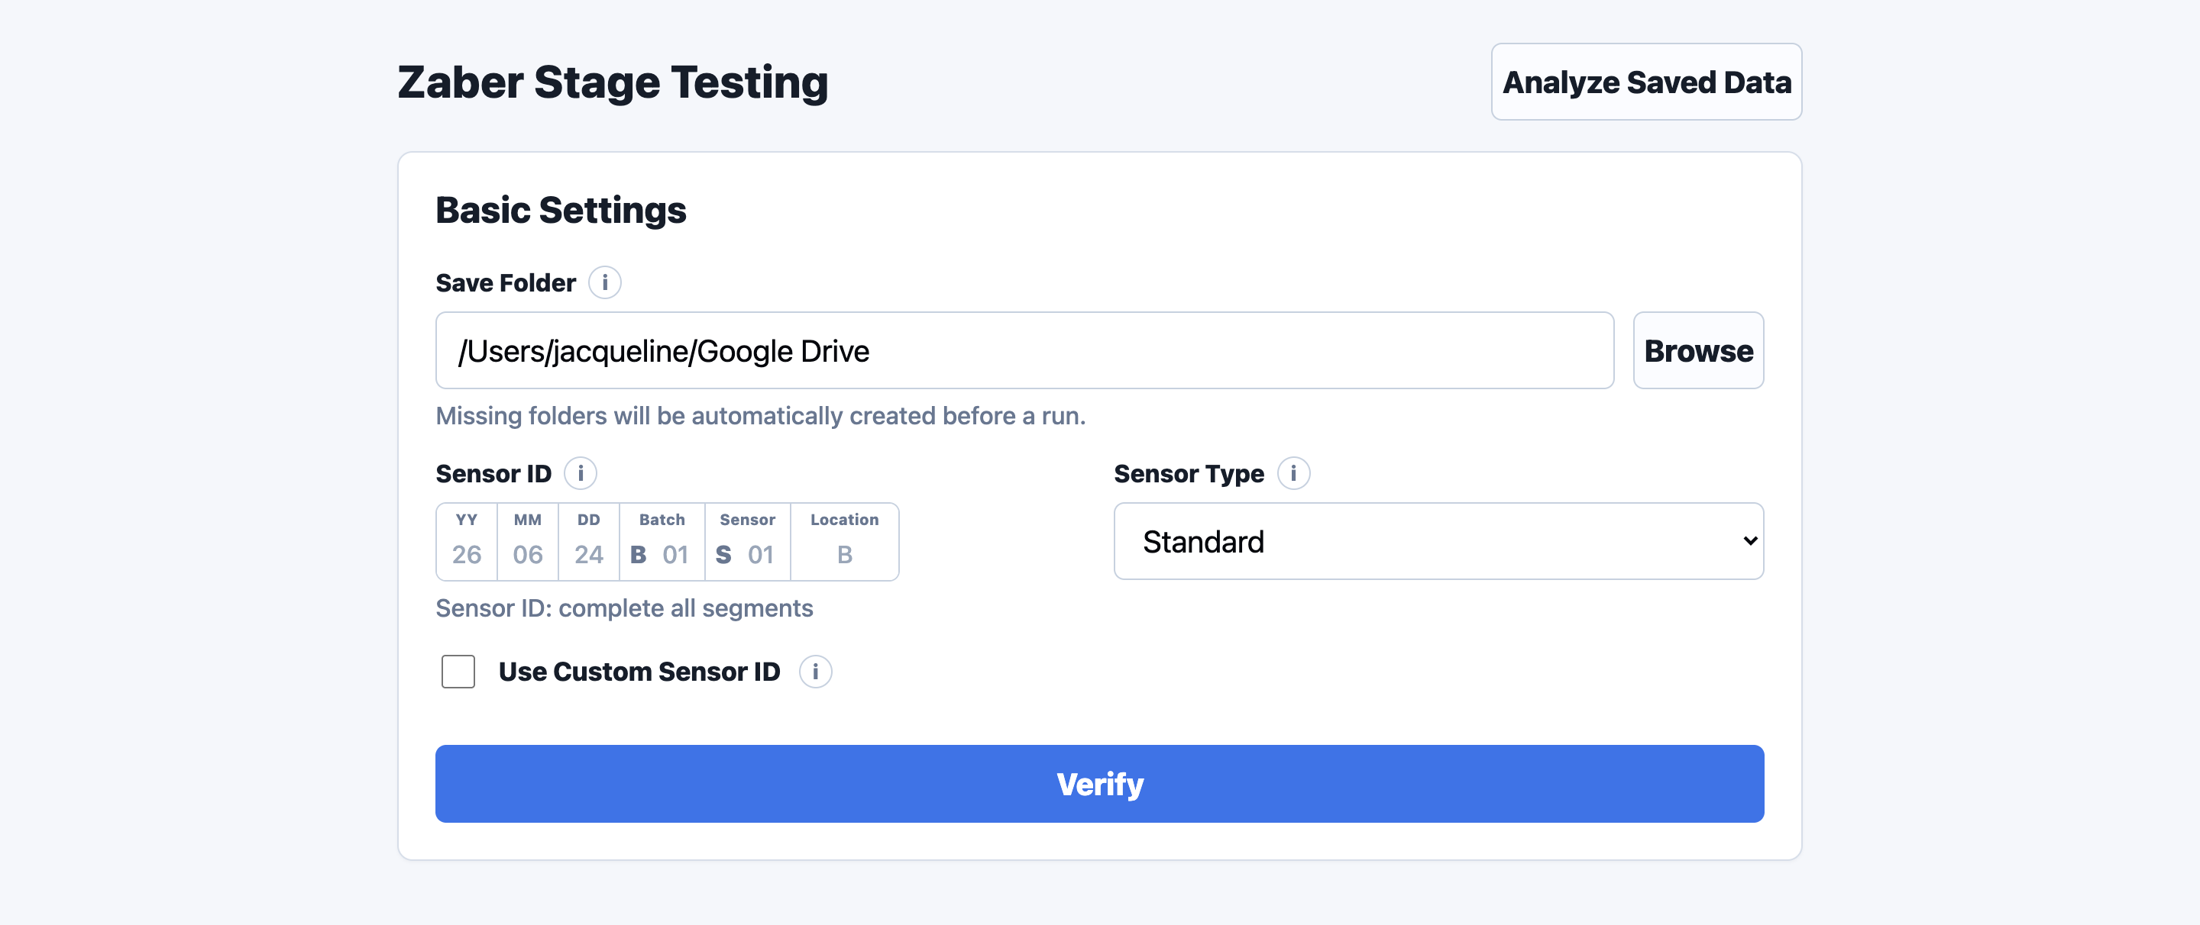
FEATURE 1.1 · MAIN WINDOW
MUST
STORY 1.1.1
Main Window
USER STORY
As a test fixture operator, I want the Main Window to clearly display the basic setup fields so that I can prepare and run a sensor test from one central interface.
ACCEPTANCE CRITERIA
When a user initially opens the application, they should be greeted with the main window that includes the title: "Zaber Stage Testing Setup"
Note: Does not need to create buttons/widgets for the settings; just creates titles for each section on the page

Slide 4
FEATURE 1.1 · MAIN WINDOW
MUST
STORY 1.1.2
Save Folder Field
USER STORY
As a test fixture operator, I want to choose where test outputs are saved so that plots, Excel files, and analysis results are stored in the correct folder.
ACCEPTANCE CRITERIA
The user can type a save folder path
The user can browse and select a save folder
If a save folder is selected, test outputs are saved there
If no save folder is selected, the system uses the default/root directory
If the save folder does not exist, the system creates the needed folders
Info note below the field: "Missing folders will be automatically created before a run"

Slide 5
FEATURE 1.1 · MAIN WINDOW
MUST
STORY 1.1.3
Sensor ID Field
USER STORY
As a test fixture user, I want to enter the Sensor ID through one connected segmented field so that the ID format is easier to follow and less likely to be mistyped.
ACCEPTANCE CRITERIA
Sensor ID input is one connected row with segments: YY, MM, DD, Batch, Sensor, Location
Batch visually includes fixed prefix "B"; user enters only the number. Same for Sensor ("S")
Generated Sensor ID follows: YYMMDDB##S##X
Requirements: Year, Month, Day each 2 digits; Batch and Sensor each 2 numeric digits; Location must be A, B, or AB
Example valid IDs: 250506B01S01A, 250506B01S01B, 250506B01S01AB
Completed Sensor ID is used in test completion messages, saved outputs, and analysis

Slide 6
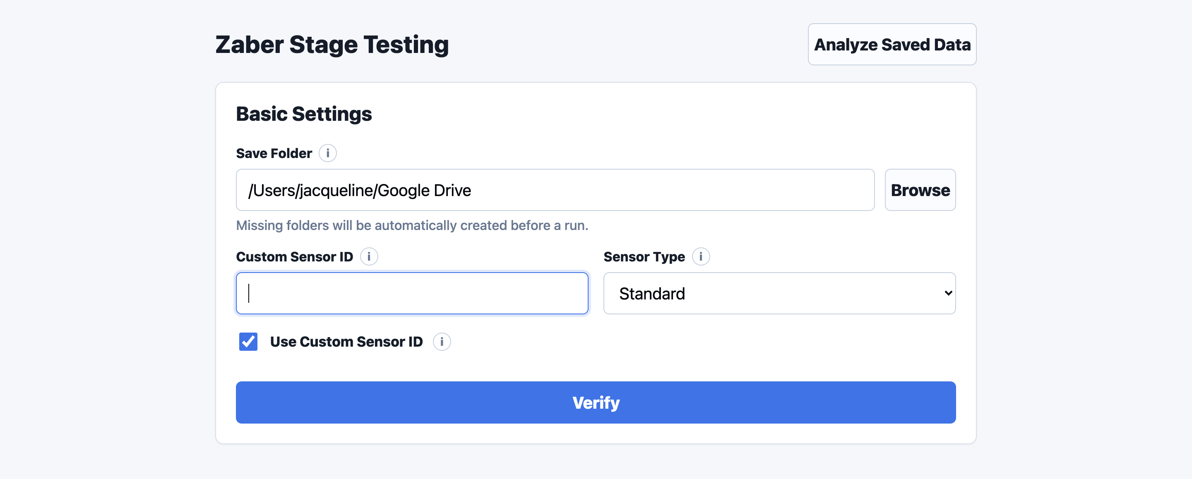
FEATURE 1.1 · MAIN WINDOW
MUST
STORY 1.1.4
Custom Sensor ID Checkbox
USER STORY
As a test fixture user, I want the option to use a custom Sensor ID so that I can test experimental or nonstandard sensors.
ACCEPTANCE CRITERIA
The Main Window includes a checkbox labeled "Use Custom Sensor ID"
When unchecked, the segmented Sensor ID field is active
When checked, the segmented Sensor ID field is disabled and a custom free-text Sensor ID input becomes active
The custom Sensor ID is used for testing, saving, and analysis

Slide 7
FEATURE 1.1 · MAIN WINDOW
MUST
STORY 1.1.5
Sensor ID Validation / Preview
USER STORY
As a test fixture user, I want the GUI to validate Sensor ID formatting so that mistyped sensor IDs do not cause data to be saved under the wrong sensor.
ACCEPTANCE CRITERIA
If all segments are complete, the GUI displays the full generated Sensor ID
If any segment is missing, the GUI displays: "Sensor ID: complete all segments"
The Sensor ID preview updates whenever any segment changes

Slide 8
FEATURE 1.1 · MAIN WINDOW
MUST
STORY 1.1.6
Sensor Type Dropdown
USER STORY
As a test fixture user, I want to select the sensor type so that the system can interpret the sensor data using the correct firmware/channel configuration.
ACCEPTANCE CRITERIA
The user can select a Sensor Type from a dropdown; options: Standard, Inverted
Standard orders the channels [1, 2, 3, 4, 5, 6, 7, 8]
Inverted orders the channels [1, 2, 3, 4, 8, 7, 6, 5]
Standard is selected by default
The selected Sensor Type is passed into the analysis workflow
Info note below the field explains the sensor type per firmware version / channel configuration

Slide 9
FEATURE 1.1 · MAIN WINDOW
MUST
STORY 1.1.7
Verify Settings Button
USER STORY
As a test fixture user, I want to click Verify Settings so that I can confirm the setup parameters before the test begins.
ACCEPTANCE CRITERIA
Clicking Verify Settings proceeds to the Test Configuration page
If Save Folder is blank: block, warn "Fill in Save Folder before continuing"
If Custom Sensor ID enabled and blank: block, warn "Enter a custom sensor ID"
If Sensor Type is blank: block, warn "Fill in Sensor Type"
If Custom Sensor ID disabled and any Sensor ID segment is incomplete: block, warn "Complete all Sensor ID segments before continuing"
If any Sensor ID segment is invalid: block with an appropriate validation message
If Sensor ID already has pre-existing tests from the same day, the Existing Test Found dialog opens (Feature 1.2)
If all required fields are valid, the Test Configuration section becomes visible

Slide 10
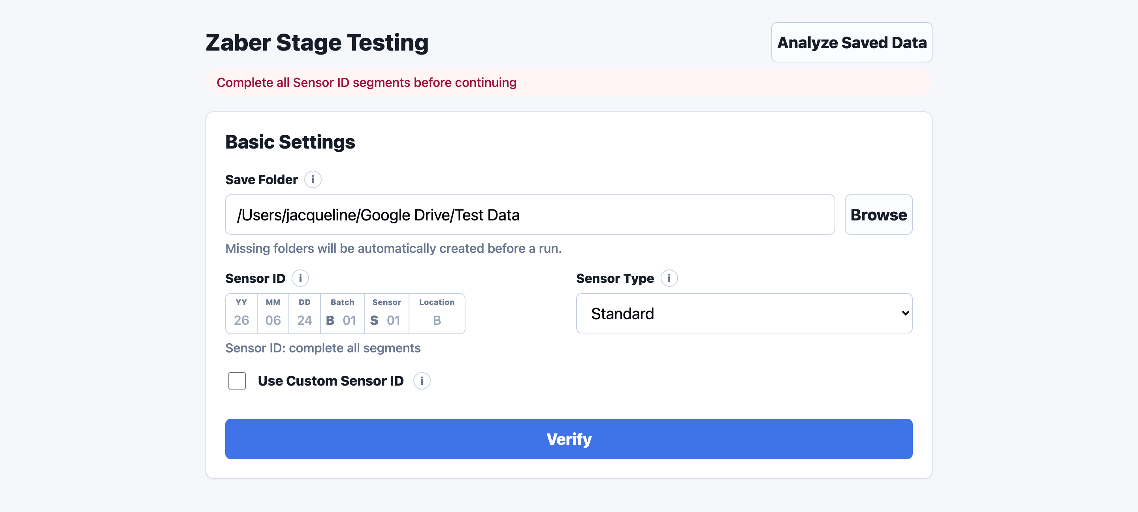
FEATURE 1.1 · MAIN WINDOW
MUST
STORY 1.1.8
Basic Settings Reverification Behavior
USER STORY
As a test fixture user, I want the Test Configuration section to disappear when Basic Settings are changed so that tests cannot begin using outdated or unverified setup information.
ACCEPTANCE CRITERIA
If the user edits any Basic Settings field after verification, the Test Configuration section disappears
The GUI displays: "Basic settings changed. Please click Verify again"
The user must click Verify again before continuing to Test Configuration
Previously entered Test Configuration settings are not used until Basic Settings are reverified

Slide 11
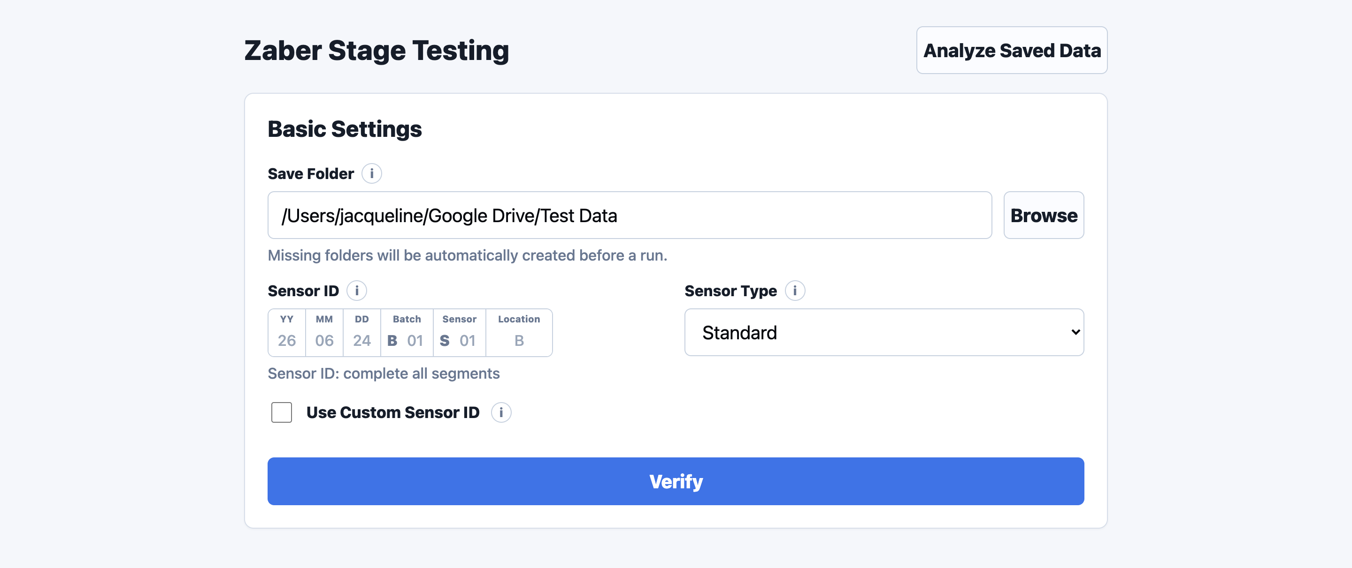
FEATURE 1.1 · MAIN WINDOW
MUST
STORY 1.1.9
Info Icons
USER STORY
As a test fixture user, I want informational help icons throughout the window so that I can quickly understand fields, workflows, and testing terminology without needing external documentation.
INFO ICONS ON THIS PAGE
Save Folder: Folder where run files, exported data, and analysis outputs will be saved.
Sensor ID: Format: YYMMDDB##S##X. Type two digits for date, batch, and sensor. Location can be A, B, AB, or BA.
Use Custom Sensor ID: When enabled, the Sensor ID builder is replaced with a free-text custom Sensor ID field.
Sensor Type: Standard uses normal channel ordering. Inverted reverses the channel order.

Slide 12
FEATURE 1.2
Existing Test Found Page

Slide 13
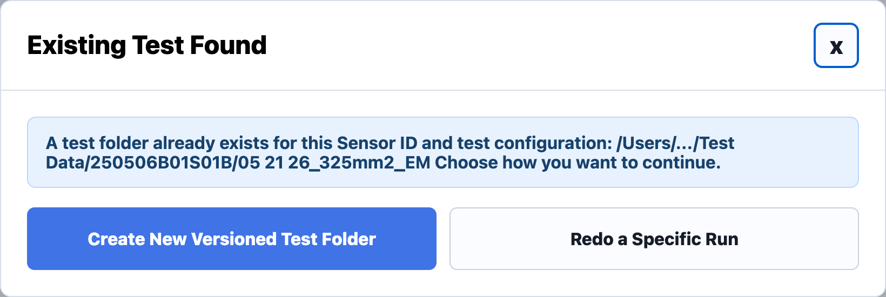
FEATURE 1.2 · EXISTING TEST FOUND
MUST
STORY 1.2.1
Existing Test Found Popup
USER STORY
As a test fixture user, I want the software to warn me when a matching test folder already exists for a specified sensor so that I can decide how to continue without accidentally overwriting previous data.
ACCEPTANCE CRITERIA
If an existing test-session folder already exists, the GUI displays an "Existing Test Found" popup window
The popup displays the full existing test path (e.g., /Users/.../Test Data/12345/05 21 26_325mm2_EM)
The popup displays: "A test folder already exists for this Sensor ID and test configuration. Choose how you want to continue."

Slide 14
FEATURE 1.2 · EXISTING TEST FOUND
MUST
STORY 1.2.2
Redo a Specific Run Button
USER STORY
As a test fixture user, I want to redo a specific run from an existing test so that I can repeat failed or invalid runs without restarting the entire test session.
ACCEPTANCE CRITERIA
The Existing Test Found popup includes a button: "Redo a Specific Run"
Redo a Specific Run functionality only applies to EM Testing workflows (not supported for Shear, Manual, or Cyclical testing).
If the existing test was created from a Shear, Manual, or Cyclical test, the "Redo a Specific Run" button is disabled.
Clicking the button opens the Test Configuration Window in Redo Run mode
In Redo Run mode, EM Test is automatically selected and cannot be modified
In Redo Run mode, Number of Runs is automatically set to 1 and cannot be modified
The "Run to Redo" field becomes enabled; user specifies which run to repeat
The system only repeats the selected run instead of restarting the entire test sequence

Slide 15
FEATURE 1.2 · EXISTING TEST FOUND
MUST
STORY 1.2.3
Overwrite Existing Test Button
USER STORY
As a test fixture user, I want the option to overwrite an existing test folder so that I can intentionally replace previous test data when needed.
ACCEPTANCE CRITERIA
The Existing Test Found popup includes a button: "Overwrite Existing Test"
Clicking the button opens the Test Configuration Window and allows the workflow to overwrite the existing test-session folder and outputs
The system displays a confirmation warning before overwriting existing data

Slide 16
FEATURE 1.2 · EXISTING TEST FOUND
MUST
STORY 1.2.4
Create New Versioned Test Folder Button
USER STORY
As a test fixture user, I want to create a new versioned test folder so that I can preserve previous test data while starting a new test session.
ACCEPTANCE CRITERIA
The Existing Test Found popup includes a button: "Create New Versioned Test Folder"
Clicking the button opens the Test Configuration Window and creates a new versioned test-session folder instead of overwriting
The new versioned folder is used for all new FUT, CAP, and analysis outputs

Slide 17
FEATURE 1.2 · EXISTING TEST FOUND
MUST
STORY 1.2.5
Cancel Button
USER STORY
As a test fixture user, I want to cancel the Existing Test Found workflow so that I can safely stop the current action without modifying any files or starting a test.
ACCEPTANCE CRITERIA
The Existing Test Found popup includes a button: "Cancel"
Clicking the button closes the popup window
No test begins
No files or folders are modified

Slide 18
FEATURE 1.3
Test Configuration Page

Slide 19
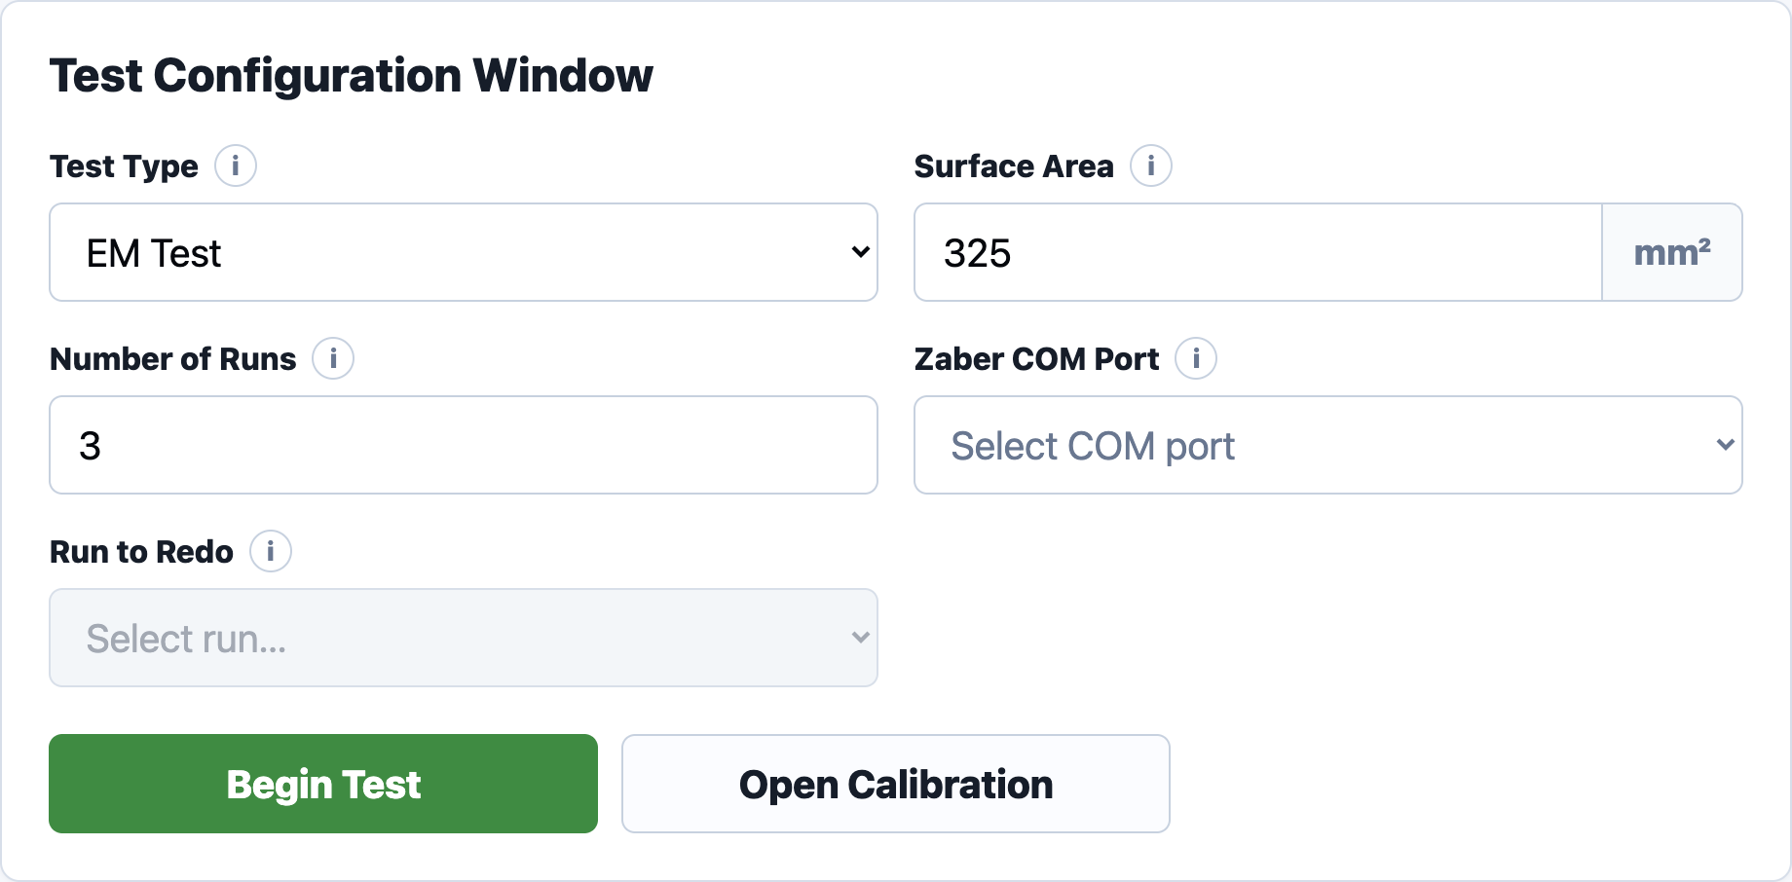
FEATURE 1.3 · TEST CONFIGURATION
MUST
STORY 1.3.1
Test Configuration Window
USER STORY
As a test fixture user, I want the Test Configuration window to clearly display the test setup fields so that I can prepare and run a sensor test.
ACCEPTANCE CRITERIA
Clicking the "Verify Settings" button opens the Test Configuration window with the title: "Test Configuration Window"

Slide 20
FEATURE 1.3 · TEST CONFIGURATION
MUST
STORY 1.3.2
Test Type Dropdown
USER STORY
As a test fixture user, I want to select the Test Type so that the correct testing workflow and analysis pipeline are used.
ACCEPTANCE CRITERIA
User can select Test Type from a dropdown; options: EM Test, Shear Test, Manual Test, Cyclical Test
The selected Test Type is passed into the testing and analysis workflow
EM Test: enables Number of Runs, Zaber COM Port, and Pause Between Runs
Shear Test: disables Number of Runs, Zaber COM Port, and Pause Between Runs
Manual Test: disables Number of Runs and Run to Redo; Zaber COM Port stays enabled
Cyclical Test: disables Number of Runs and Run to Redo; Zaber COM Port stays enabled; cyclical waveform controls become visible

Slide 21
FEATURE 1.3 · TEST CONFIGURATION
MUST
STORY 1.3.3
Number of Runs Integer Field
USER STORY
As a test fixture user, I want to choose the number of runs so that repeated testing can be automated.
ACCEPTANCE CRITERIA
The user can enter the number of runs
Default number of runs = 3
The field only accepts positive integers
The field only enables for the EM Test

Slide 22
FEATURE 1.3 · TEST CONFIGURATION
MUST
STORY 1.3.4
Zaber COM Port Dropdown
USER STORY
As a test fixture user, I want to define the Zaber COM Port so that the software can connect to the correct actuator.
ACCEPTANCE CRITERIA
The user can enter or select a Zaber COM Port
Default value = COM3
The selected COM Port is used during hardware initialization
The field only enables for the EM Test, Manual Test, and Cyclical Test

Slide 23
FEATURE 1.3 · TEST CONFIGURATION
MUST
STORY 1.3.5
Surface Area Integer Field
USER STORY
As a test fixture user, I want to enter the Ecoflex block surface area so that pressure calculations are accurate.
ACCEPTANCE CRITERIA
The user can enter a Surface Area value
Default units are displayed as mm²
The field only accepts positive numeric values
The Surface Area value is passed into the analysis workflow

Slide 24
FEATURE 1.3 · TEST CONFIGURATION
MUST
STORY 1.3.6
Run to Redo Integer Field
USER STORY
As a test fixture user, I want to enter the specific run number I want to redo so that the system repeats only that selected run. Available only when I choose to redo a run from an existing test.
ACCEPTANCE CRITERIA
The Run to Redo field is disabled by default
It becomes enabled only when the user selects "Redo a Specific Run" from the Existing Test Found popup
In Redo Mode, Test Type is automatically set to EM Test and cannot be modified
In Redo Mode, Number of Runs is automatically set to 1 and cannot be modified
The user can enter a positive integer for Run to Redo
When the test begins, the system repeats only the selected run

Slide 25
FEATURE 1.3 · TEST CONFIGURATION
MUST
STORY 1.3.7
Begin Test Button
USER STORY
As a test fixture user, I want to click Begin Test so that the specified test can begin using the selected configuration settings.
ACCEPTANCE CRITERIA
Clicking Begin Test starts the testing workflow and opens the appropriate Testing Window (EM/Shear/Manual/Cyclical)
The system attempts hardware initialization before actuator movement begins
If Test Type is blank: block, warn "Fill in Test Type before continuing"
EM + Number of Runs blank or invalid: block with matching validation message
EM / Manual / Cyclical + Zaber COM Port blank: block, warn "Fill in Zaber COM Port before continuing"
Surface Area blank: block, warn "Fill in Surface Area before continuing"
Surface Area invalid: block, warn "Surface Area must be a positive number"
Redo Mode + Run to Redo blank/invalid: block with matching validation message
If Redo Mode is active, the system begins only the selected run instead of the full test sequence

Slide 26
FEATURE 1.3 · TEST CONFIGURATION
MUST
STORY 1.3.8
Open Calibration Button
USER STORY
As a test fixture user, I want to open the Calibration Window so that I can perform the Fuji Film calibration before testing.
ACCEPTANCE CRITERIA
The user can click Open Calibration to open the Calibration Window popup

Slide 27
FEATURE 1.3 · TEST CONFIGURATION
MUST
STORY 1.3.9
Info Icons
USER STORY
As a test fixture user, I want informational help icons throughout the window so that I can quickly understand fields, workflows, and testing terminology without needing external documentation.
INFO ICONS ON THIS PAGE
Test Type: EM Test performs force-controlled compression testing. Shear Test performs live shear-response testing. Manual Test allows direct actuator control. Fatigue Test repeatedly compresses the sensor over many cycles.
Surface Area: Surface Area of the Ecoflex block used to calculate pressure from force measurements.
Number of Runs: Number of EM test runs to complete.
Zaber COM Port: Select the port connected to the Zaber actuator.
Run to Redo: Redo only a specific EM run from an existing test folder. This is only available when ‘Redo a Specific Run’ is selected from the Existing Test Found popup.

Slide 28
FEATURE 1.4
Calibration Page

Slide 29
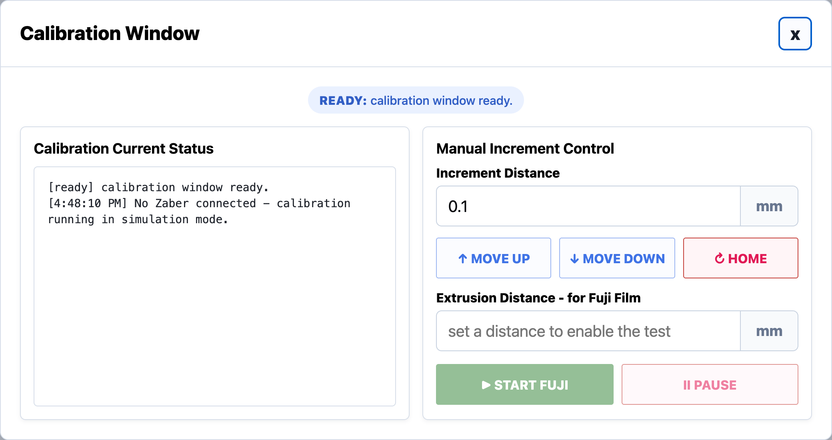
FEATURE 1.4 · CALIBRATION
MUST
STORY 1.4.1
Calibration Configuration Window
USER STORY
As a test fixture user, I want a separate Calibration window so that I can safely perform the Fuji Film Test before beginning the specified test.
ACCEPTANCE CRITERIA
Clicking the "Open Calibration" button opens a popup window titled: "Calibration for Fuji Film Test"

Slide 30
FEATURE 1.4 · CALIBRATION
MUST
STORY 1.4.2
Current Status Display
USER STORY
As a test fixture user, I want to see the current actuator position during calibration so that I can safely adjust the actuator location.
ACCEPTANCE CRITERIA
Current Status displays Position only, in mm
Position updates when the user clicks Move Up, Move Down, or Home

Slide 31
FEATURE 1.4 · CALIBRATION
MUST
STORY 1.4.3
Manual Increment Control
USER STORY
As a test fixture user, I want to move the actuator in small increments so that I can fine-tune the actuator position safely.
ACCEPTANCE CRITERIA
The user can enter an Increment Distance (mm)
The user can click Move Up or Move Down; the actuator moves by the entered increment
Move Up/Down update position step-by-step, with no elapsed-time output
Increment Distance must remain within a specified maximum allowed range
If blank: block, warn "Fill in Increment Distance before continuing"
If exceeds range: block, warn "Increment Distance exceeds the maximum allowed range"
If non-numeric: block, warn "Increment Distance must be a valid number"

Slide 32
FEATURE 1.4 · CALIBRATION
MUST
STORY 1.4.4
Reset to Home Button
USER STORY
As a test fixture user, I want a Home button so that I can safely return the actuator to its original position.
ACCEPTANCE CRITERIA
Clicking Home returns the actuator to the home/original position
The GUI displays that the actuator has reset successfully

Slide 33
FEATURE 1.4 · CALIBRATION
MUST
STORY 1.4.5
Calibration Test Button
USER STORY
As a test fixture user, I want to run a Calibration Test so that I can calibrate the load cell and actuator setup.
ACCEPTANCE CRITERIA
The user can click "Begin Calibration Test"
The actuator moves downward until the target force is reached
Target Force = 20 N
Motion stops when the target force is reached

Slide 34
FEATURE 1.4 · CALIBRATION
MUST
STORY 1.4.6
Calibration Test Output Box
USER STORY
As a test fixture user, I want Calibration Test force readings displayed in a table-like format so that I can clearly track force over time during calibration.
ACCEPTANCE CRITERIA
When the test starts, the output box displays: "Calibration Test started"
Output box includes column headers: Time (s) | Force (N)
While running, force values are displayed in the output box with time values
On reaching target force, the GUI displays under the button: "Calibration Test Completed Successfully"
If the test stops due to a force spike or error, an error status is displayed instead of a success message

Slide 35
FEATURE 1.4 · CALIBRATION
MUST
STORY 1.4.7
Exit Button
USER STORY
As a test fixture user, I want an Exit button on the Calibration popup window so that I can close the Calibration Window.
ACCEPTANCE CRITERIA
The Calibration popup window includes an Exit button
Clicking the Exit button closes only the Calibration popup window
The Exit button is disabled while the Calibration Test is actively running
Once the Calibration Test is complete or stopped, the Exit button becomes enabled again

Slide 36
FEATURE 1.5
EM Test Page

Slide 37
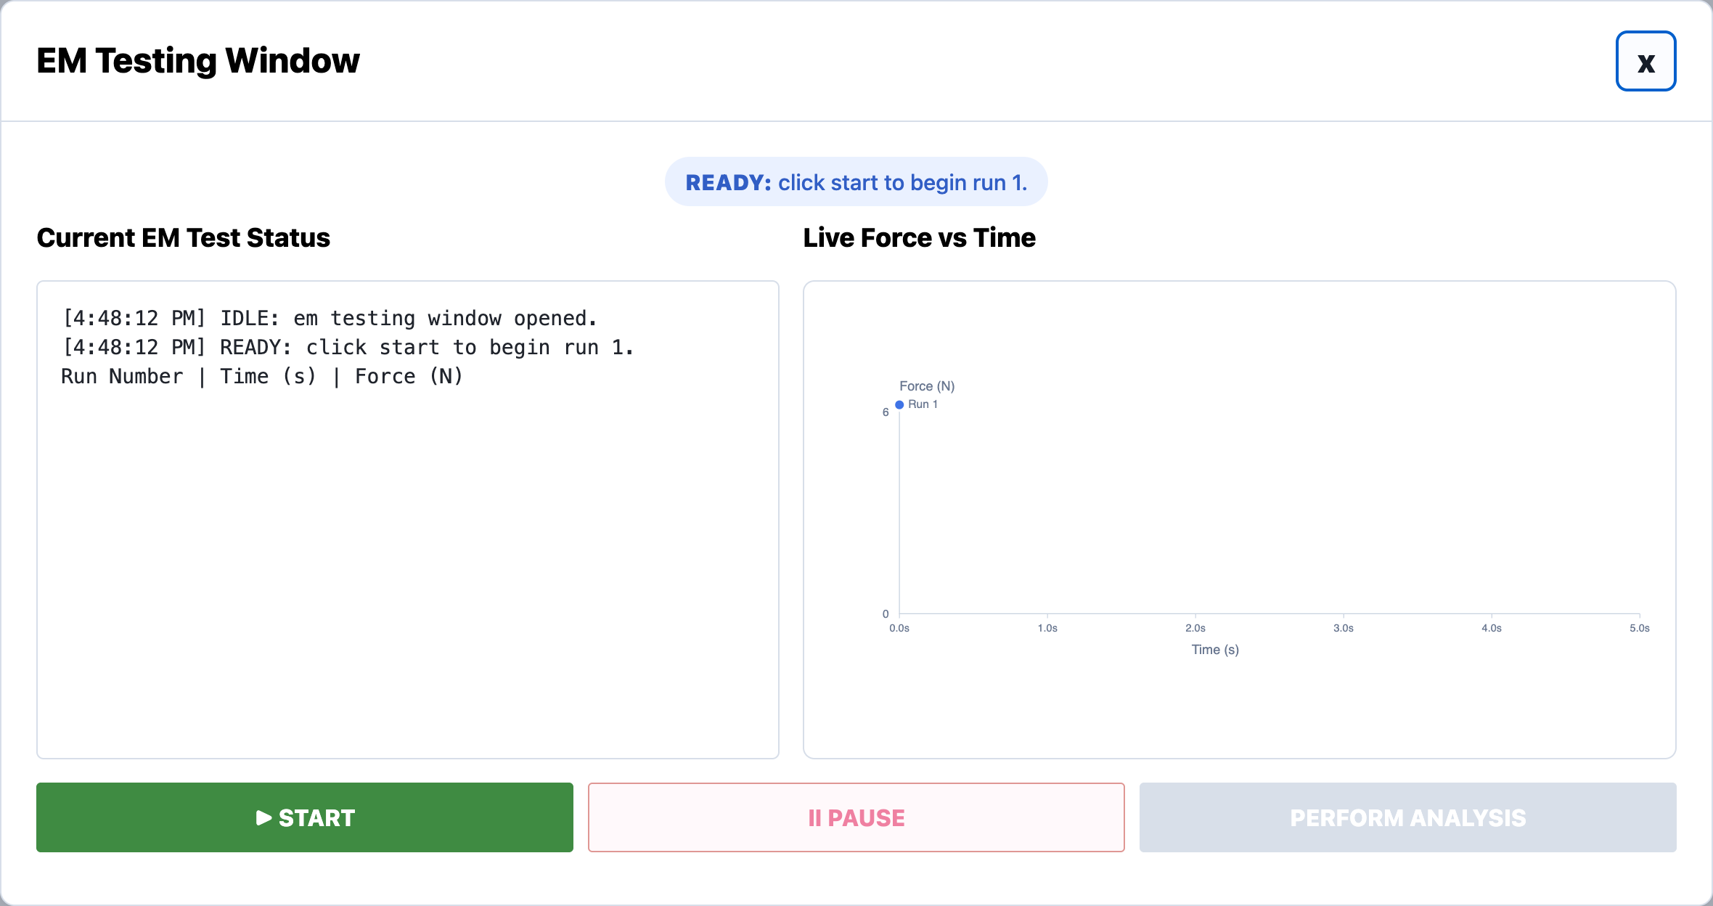
FEATURE 1.5 · EM TEST
MUST
STORY 1.5.1
EM Testing Window
USER STORY
As a test fixture user, I want the EM test to open in a dedicated EM Testing Window so that I can monitor and control the active EM test.
ACCEPTANCE CRITERIA
Clicking Begin Test with Test Type = EM Test opens a new window titled: "EM Testing Window"

Slide 38
FEATURE 1.5 · EM TEST
MUST
STORY 1.5.2
Current EM Test Output Box
USER STORY
As a test fixture user, I want to view the current EM test status so that I can monitor the actuator and testing workflow in real time.
ACCEPTANCE CRITERIA
The EM Testing Window includes a Current EM Test Status display area
The output box includes column headers: Run Number | Time (s) | Force (N)
Force readings are displayed in chronological order (e.g., Run 1 | 4.802 s | 4.941 N)
Status display updates with key states: IDLE, READY, CONNECTING, RUNNING, PAUSED_RESET_REQUIRED, BETWEEN_RUNS_PAUSED, COMPLETED, ERROR

Slide 39
FEATURE 1.5 · EM TEST
MUST
STORY 1.5.3
Start Button
USER STORY
As a test fixture user, I want to click START so that the EM test begins using the selected configuration settings.
ACCEPTANCE CRITERIA
Clicking the Start Button begins the EM testing workflow
The system attempts hardware initialization before movement begins
The actuator does not move unless initialization succeeds
Once testing begins, START becomes disabled

Slide 40
FEATURE 1.5 · EM TEST
MUST
STORY 1.5.4
Pause Button
USER STORY
As a test fixture user, I want to pause the current EM test safely so that actuator motion stops and the current run can be repeated.
ACCEPTANCE CRITERIA
Clicking the Pause Button immediately stops actuator motion
The actuator returns to the home/original position
The current run is marked incomplete
The current run number does not increment
The current run must be repeated before continuing

Slide 41
FEATURE 1.5 · EM TEST
MUST
STORY 1.5.5
Live Force vs Time Graph
USER STORY
As a test fixture user, I want to view a live Force vs Time graph so that I can visually monitor force trends during the EM test.
ACCEPTANCE CRITERIA
The EM Testing Window includes a Live Force vs Time graph
The graph updates in real time while the EM test is running
The graph displays force in N over time in seconds
The graph resets appropriately between runs

Slide 42
FEATURE 1.5 · EM TEST
MUST
STORY 1.5.6
Perform Analysis Button
USER STORY
As a test fixture user, I want to click a Perform Analysis button so that the software can process the completed test data and generate summary statistics and plots.
ACCEPTANCE CRITERIA
The testing window includes a Perform Analysis button
Perform Analysis is disabled until the EM test has completed successfully
Clicking Perform Analysis should show a loading/progress state before opening the EM Analysis Page

Slide 43
FEATURE 1.6
EM Analysis Page

Slide 44
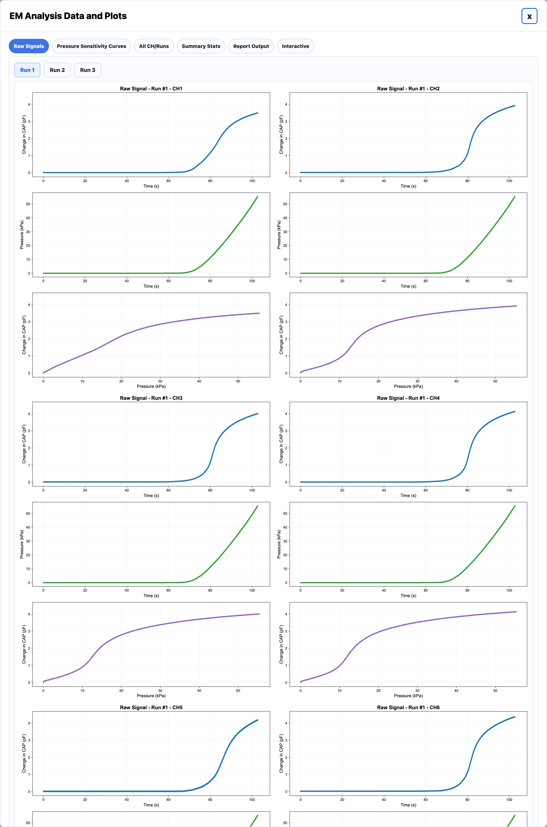
FEATURE 1.6 · EM ANALYSIS
MUST
STORY 1.6.1
EM Analysis Window
USER STORY
As a test fixture user, I want analysis results to open in a dedicated results window so that I can review processed EM test results after testing completes.
ACCEPTANCE CRITERIA
After analysis completes, a new window opens titled: "EM Analysis Data and Plots"
The window displays summary statistics and plots generated from the selected test data
Users can click between tabs to quickly navigate different EM analysis outputs

Slide 45
FEATURE 1.6 · EM ANALYSIS
MUST
STORY 1.6.2
Raw Signals Tab
USER STORY
As a test fixture user, I want to view raw EM test signals so that I can inspect channel behavior before processed analysis is applied.
ACCEPTANCE CRITERIA
The Raw Signals tab displays raw channel plots for the selected run
The tab displays all EM channels simultaneously
Users can switch between runs

Slide 46
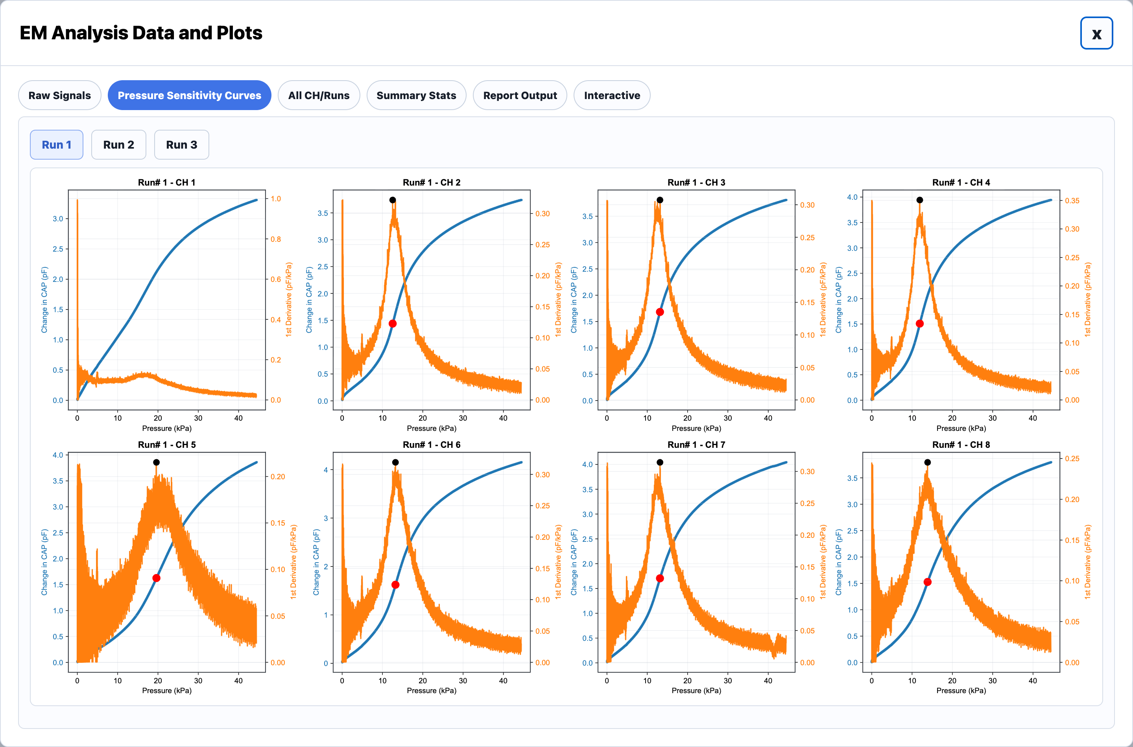
FEATURE 1.6 · EM ANALYSIS
MUST
STORY 1.6.3
Pressure Sensitivity Curves Tab
USER STORY
As a test fixture user, I want to view pressure sensitivity curves so that I can evaluate how capacitance changes relative to pressure.
ACCEPTANCE CRITERIA
The Pressure Sensitivity Curves tab displays processed pressure sensitivity plots for all channels
Each channel plot includes the calculated pressure sensitivity value
Inflection points are visually highlighted on the plots

Slide 47
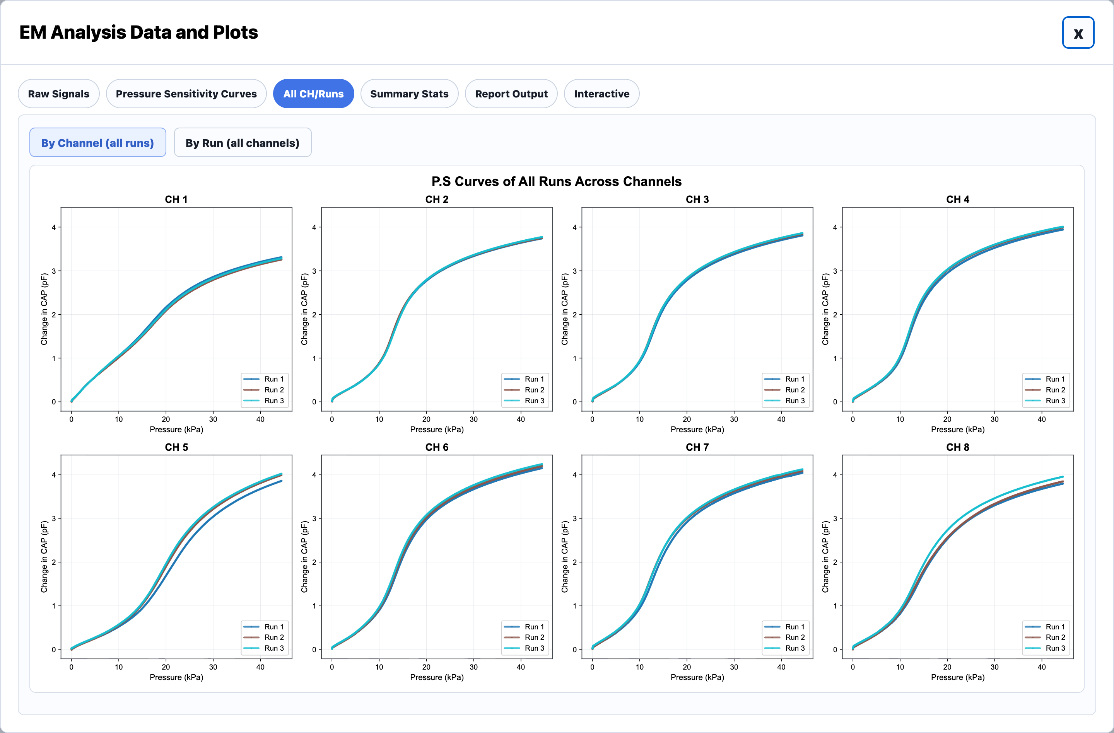
FEATURE 1.6 · EM ANALYSIS
MUST
STORY 1.6.4
All Channels / Runs Comparison Tab
USER STORY
As a test fixture user, I want to compare all runs and channels simultaneously so that I can evaluate consistency and repeatability across the sensor.
ACCEPTANCE CRITERIA
The All CH/Runs tab includes comparison views for: By Channel (all runs), By Run (all channels)
Each plot overlays multiple runs for direct comparison

Slide 48
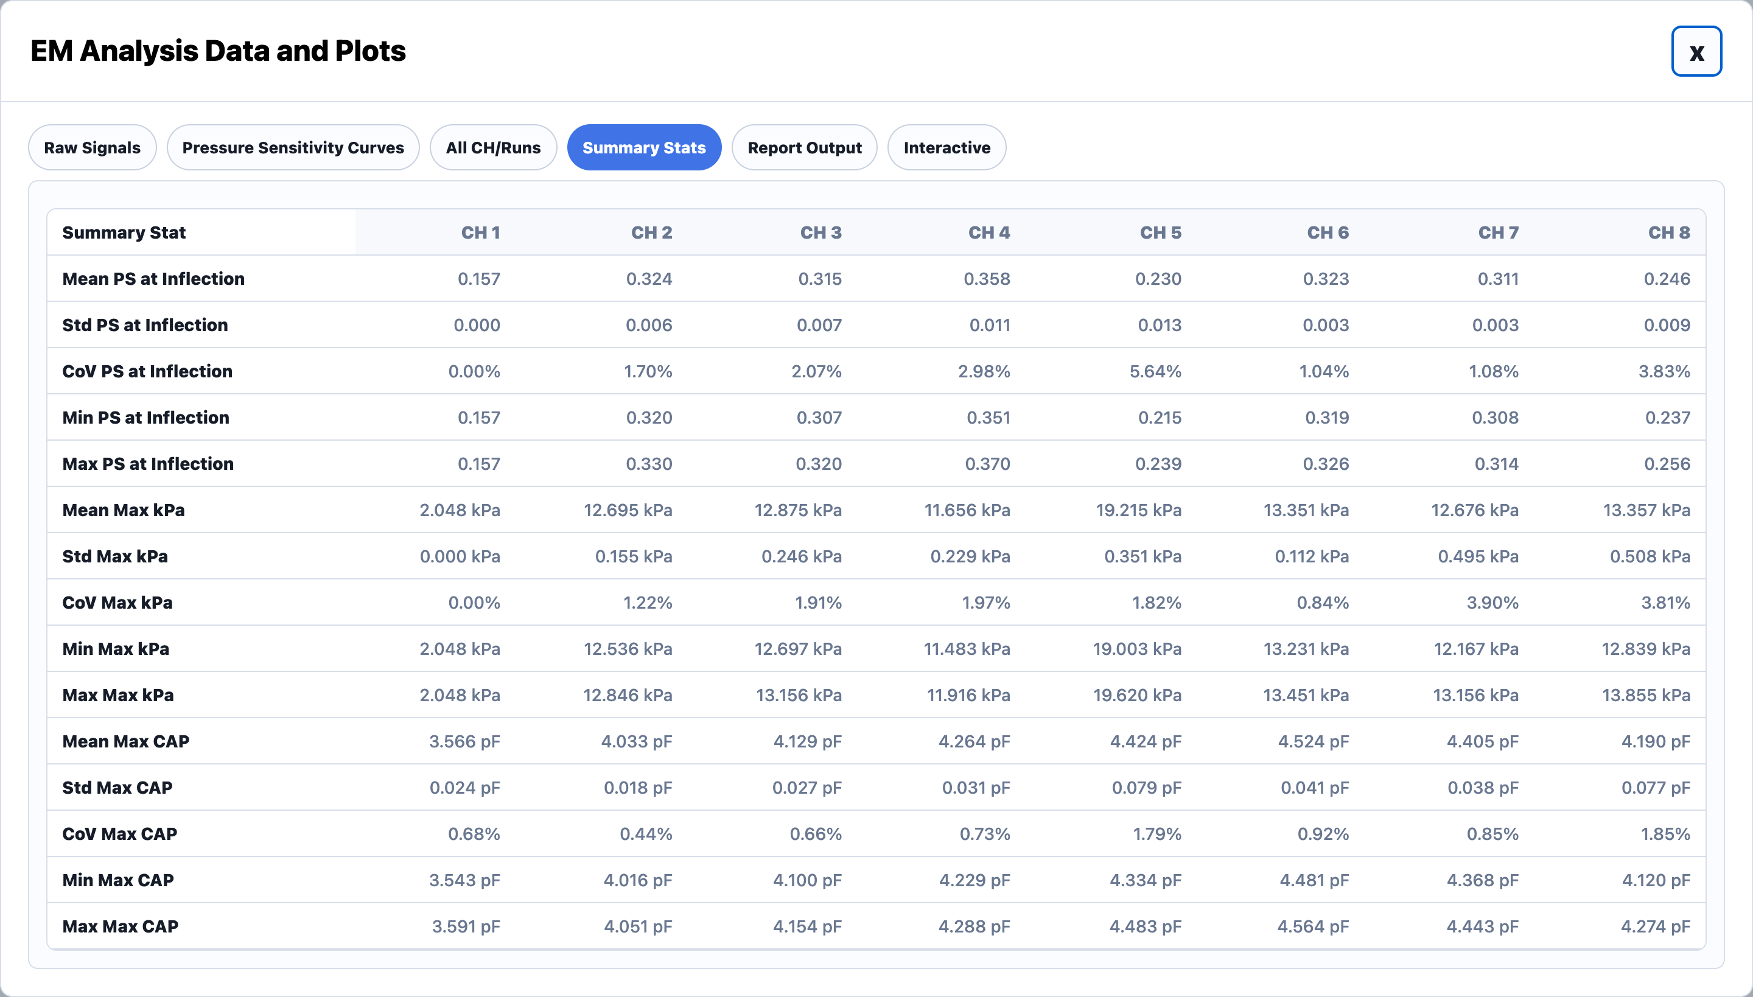
FEATURE 1.6 · EM ANALYSIS
MUST
STORY 1.6.5
Summary Statistics Tab
USER STORY
As a test fixture user, I want to view summary statistics for all EM channels so that I can evaluate sensor quality quantitatively.
ACCEPTANCE CRITERIA
The Summary Statistics tab displays a table of calculated metrics for all channels
Metrics include Mean, Std, COV, Min, and Max for: PS at Inflection, Max kPa, Mean Max CAP
Every displayed average metric also includes standard deviation
Every displayed maximum metric also includes minimum values

Slide 49
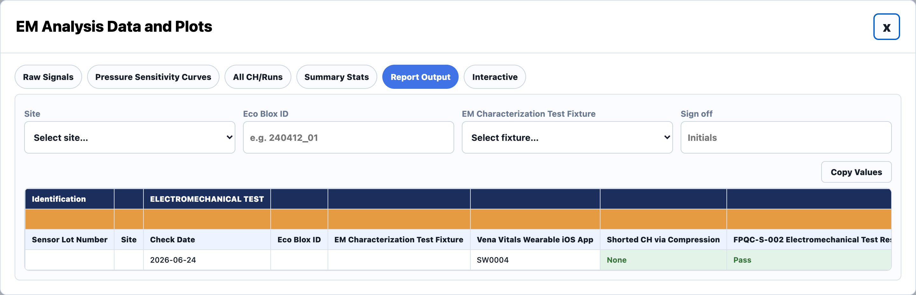
FEATURE 1.6 · EM ANALYSIS
MUST
STORY 1.6.6
Report Output Tab
USER STORY
As a test fixture user, I want a report-style output tab so that I can easily copy, export, and review finalized EM testing results.
ACCEPTANCE CRITERIA
The Report Output tab displays a formatted summary report table
Includes: Lot Number / Sensor ID, Electromechanical Standards Status, Software Version, Date Tested, Fabrication Type, Eco Block ID, Run Number Tested, Run Number Counted
Shorted Channel Status: the analysis pipeline automatically checks for potential channel shorting behavior
The tab includes a "Copy Values" button
Clicking "Copy Values" copies only the data row (not the headers) to quickly transfer results into reports

Slide 50
FEATURE 1.7
Shear Test Page

Slide 51
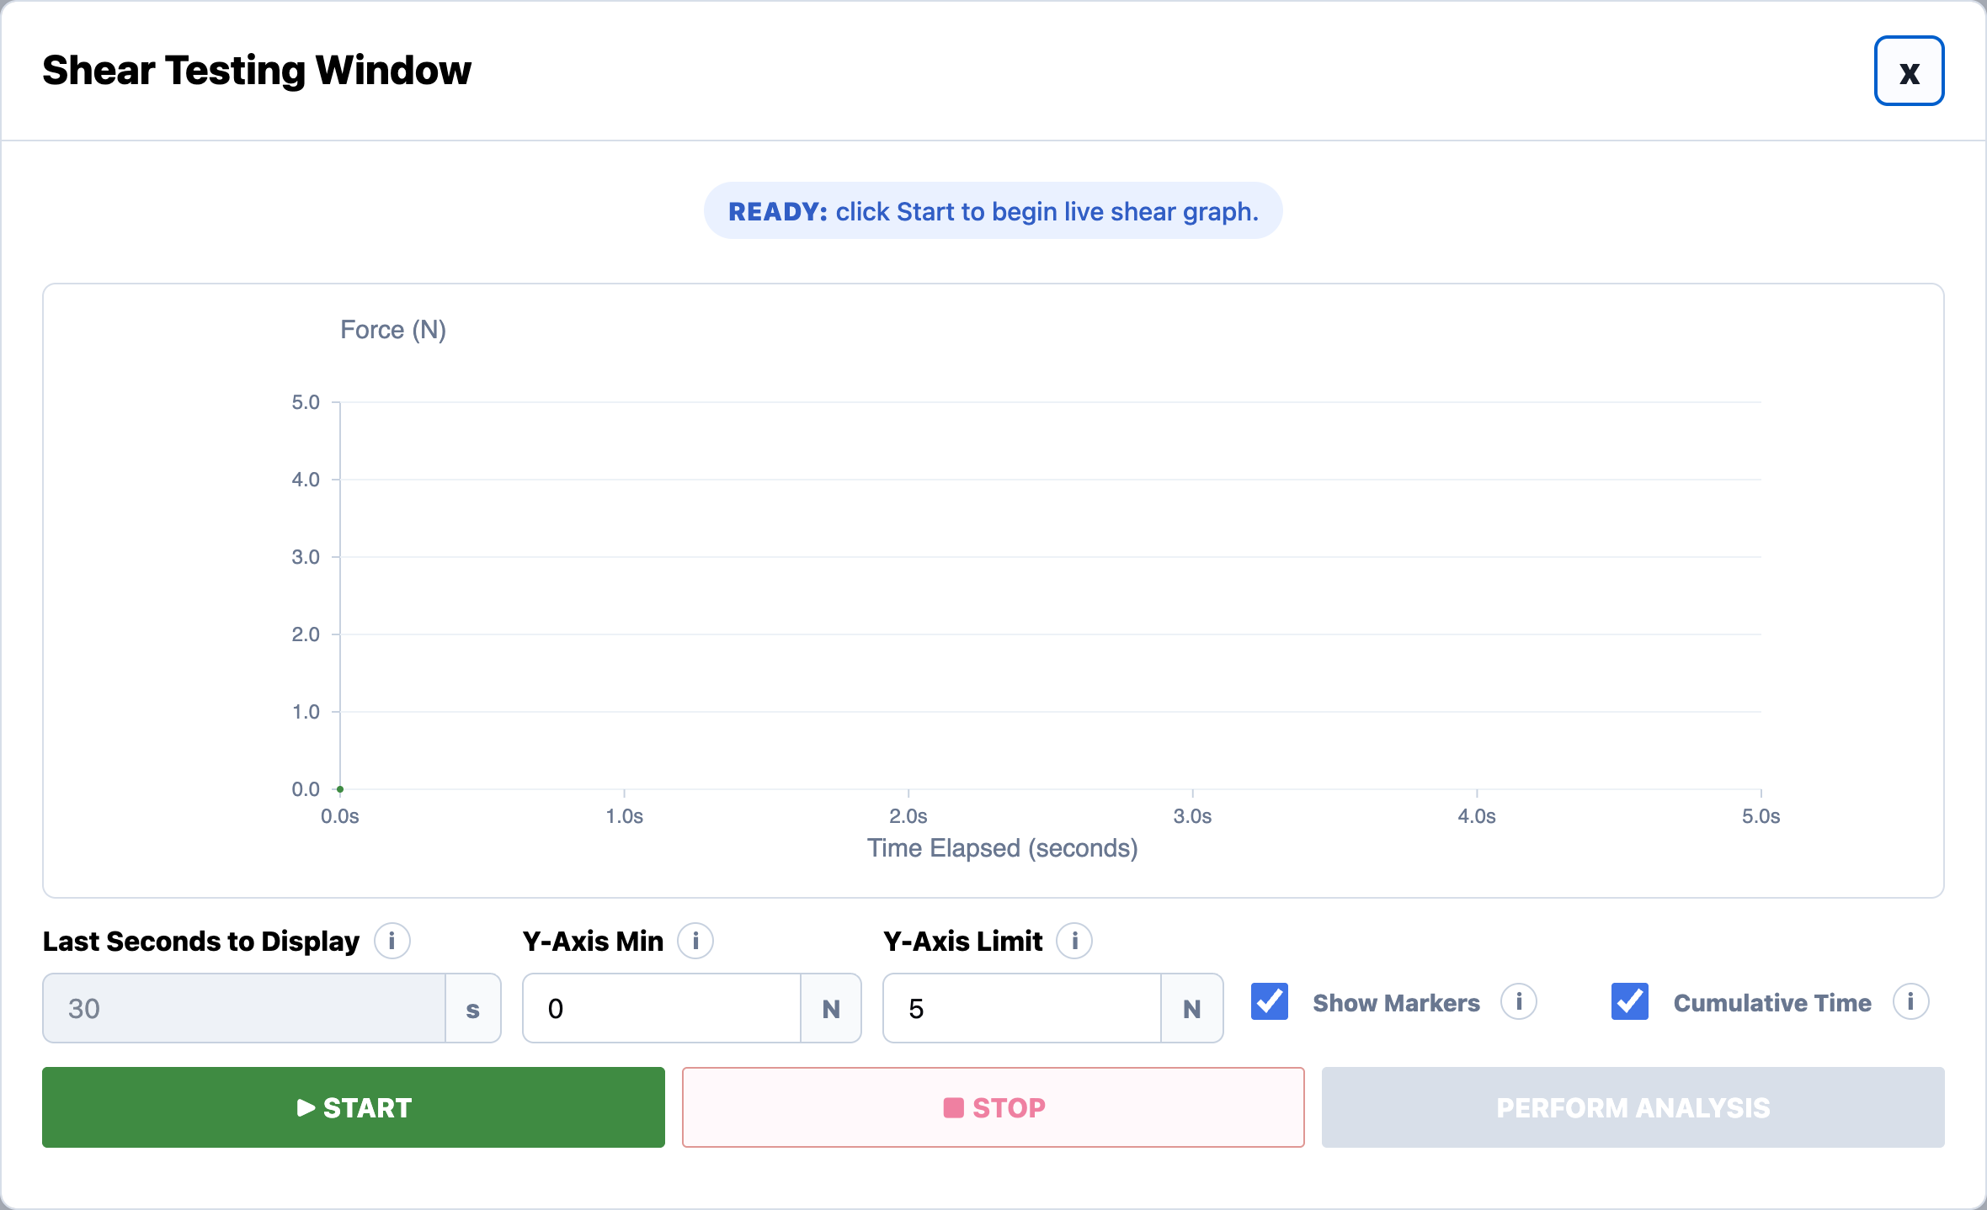
FEATURE 1.7 · SHEAR TEST
MUST
STORY 1.7.1
Shear Testing Window
USER STORY
As a test fixture user, I want the Shear Test to open in a dedicated Shear Testing Window so that I can monitor and control the active Shear test.
ACCEPTANCE CRITERIA
Clicking Begin Test with Test Type = Shear Test opens a new window titled: "Shear Testing Window"

Slide 52
FEATURE 1.7 · SHEAR TEST
MUST
STORY 1.7.2
Live Shear Graph Display
USER STORY
As a test fixture user, I want to view the live Shear graph so that I can monitor force behavior in real time during testing.
ACCEPTANCE CRITERIA
Graph X-axis is labeled: "Time Elapsed (seconds)"
Graph Y-axis is labeled: "Force (N)"
The graph updates in real time during the Shear test
The graph displays live force data from the load cell
Hovering over the graph displays the current time and force values (e.g., Time: 0.000 s, Force: 0.000 N)

Slide 53
FEATURE 1.7 · SHEAR TEST
MUST
STORY 1.7.3
Graph Display Controls
USER STORY
As a test fixture user, I want to control the graph display settings so that I can customize how the Shear test data is visualized.
ACCEPTANCE CRITERIA
The user can edit the "Last Seconds to Display" field
The user can edit the "Y-Axis Min" field
The user can edit the "Y-Axis Limit" field
The user can toggle the "Show Markers" checkbox to display visible graph markers
The user can toggle the "Cumulative Time" checkbox
Changing these settings updates the graph display

Slide 54
FEATURE 1.7 · SHEAR TEST
MUST
STORY 1.7.4
Start Button
USER STORY
As a test fixture user, I want to click START so that the live Shear test begins.
ACCEPTANCE CRITERIA
Clicking START begins the Shear testing workflow
The graph begins updating in real time
START becomes disabled while the test is running, and after PAUSE when the actuator is moving
Clicking Start after a paused/incomplete run begins a new active run dataset

Slide 55
FEATURE 1.7 · SHEAR TEST
MUST
STORY 1.7.5
Stop Button
USER STORY
As a test fixture user, I want to stop the Shear test so that I can stop graph updates and actuator movement safely.
ACCEPTANCE CRITERIA
Clicking STOP stops the active Shear workflow
START becomes enabled after Stop is clicked.
PERFORM ANALYSIS becomes enabled only after START has been clicked, valid data has been collected, and STOP has been clicked.
If the user clicks Start again after stopping, the previous stopped/incomplete graph data is replaced by the newest run dataset.
Perform Analysis uses the newest valid stopped run dataset.

Slide 56
FEATURE 1.7 · SHEAR TEST
MUST
STORY 1.7.6
Perform Analysis Button
USER STORY
As a test fixture user, I want to click Perform Analysis after test data has been collected so that the software can process the latest available test data and generate summary statistics and plots.
ACCEPTANCE CRITERIA
The Testing Window includes a Perform Analysis button
Perform Analysis is disabled before testing starts, then becomes enabled after Start has been clicked, valid test data has been collected, and Stop has been clicked.
If user pauses the test and restarts the run, the previously paused/incomplete graph data is not saved as the active dataset
When clicked, analysis is generated using the newest/latest valid run data
Clicking Perform Analysis shows a loading state before opening the Shear Analysis Page.

Slide 57
FEATURE 1.7 · SHEAR TEST
MUST
STORY 1.7.7
Info Icons
USER STORY
As a test fixture user, I want informational help icons throughout the window so that I can quickly understand fields, workflows, and testing terminology without needing external documentation.
INFO ICONS ON THIS PAGE
Last Seconds to Display: When Cumulative Time is off, the shear graph shows only the last selected number of seconds.
Y-Axis Min: Lowest force value shown on the shear graph y-axis.
Y-Axis Limit: Highest force value shown on the shear graph y-axis.
Show Markers: Shows individual live force readings on top of the graph line.
Cumulative Time: When on, the shear graph shows the entire run from start to finish and ignores Last Seconds to Display.

Slide 58
FEATURE 1.8
Shear Analysis Page

Slide 59
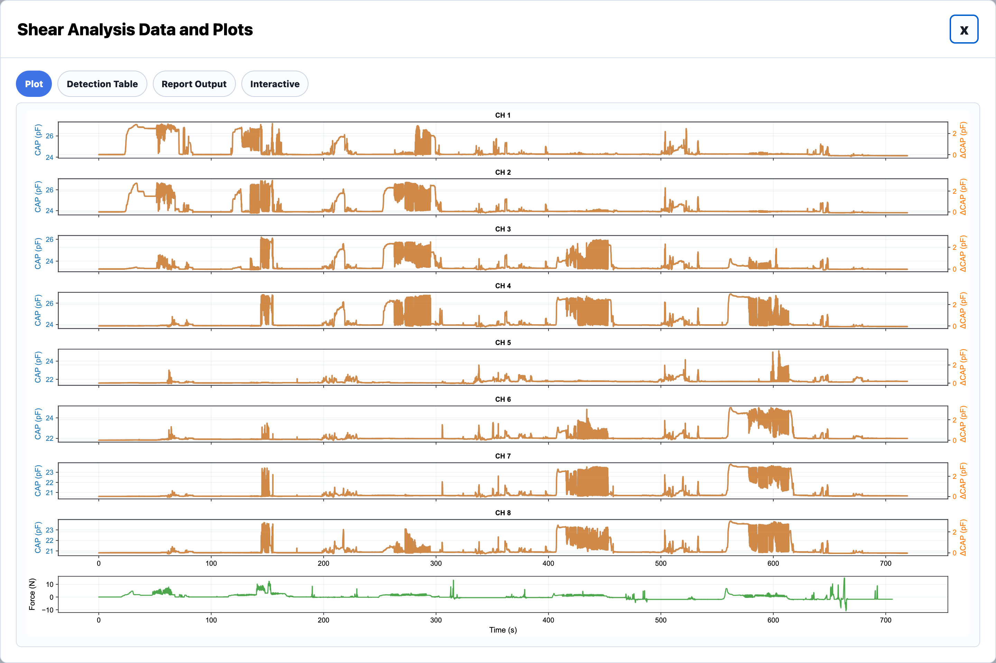
FEATURE 1.8 · SHEAR ANALYSIS
MUST
STORY 1.8.1
Shear Analysis Window
USER STORY
As a test fixture user, I want analysis results to open in a dedicated results window with tabs so that I can review processed Shear Test results in an organized way.
ACCEPTANCE CRITERIA
After analysis completes, a new window opens titled: "Shear Analysis Data and Plots"
Shear Analysis tabs may include: Plots, Failure Checks, Report Output
Users can click between tabs to view different plots and metrics

Slide 60
FEATURE 1.8 · SHEAR ANALYSIS
MUST
STORY 1.8.2
Plot Tab
USER STORY
As a test fixture user, after clicking Perform Analysis on a shear test I want to view a plot summary of the test.
ACCEPTANCE CRITERIA
The tab displays a graph for each capacitance channel and one final graph for outputted force over time
The X axis for each graph is Time (seconds)
The Y axis for each capacitance channel includes both Capacitance (pF) and delta Capacitance (pF)
The final graph Y axis is Force (Newtons)

Slide 61
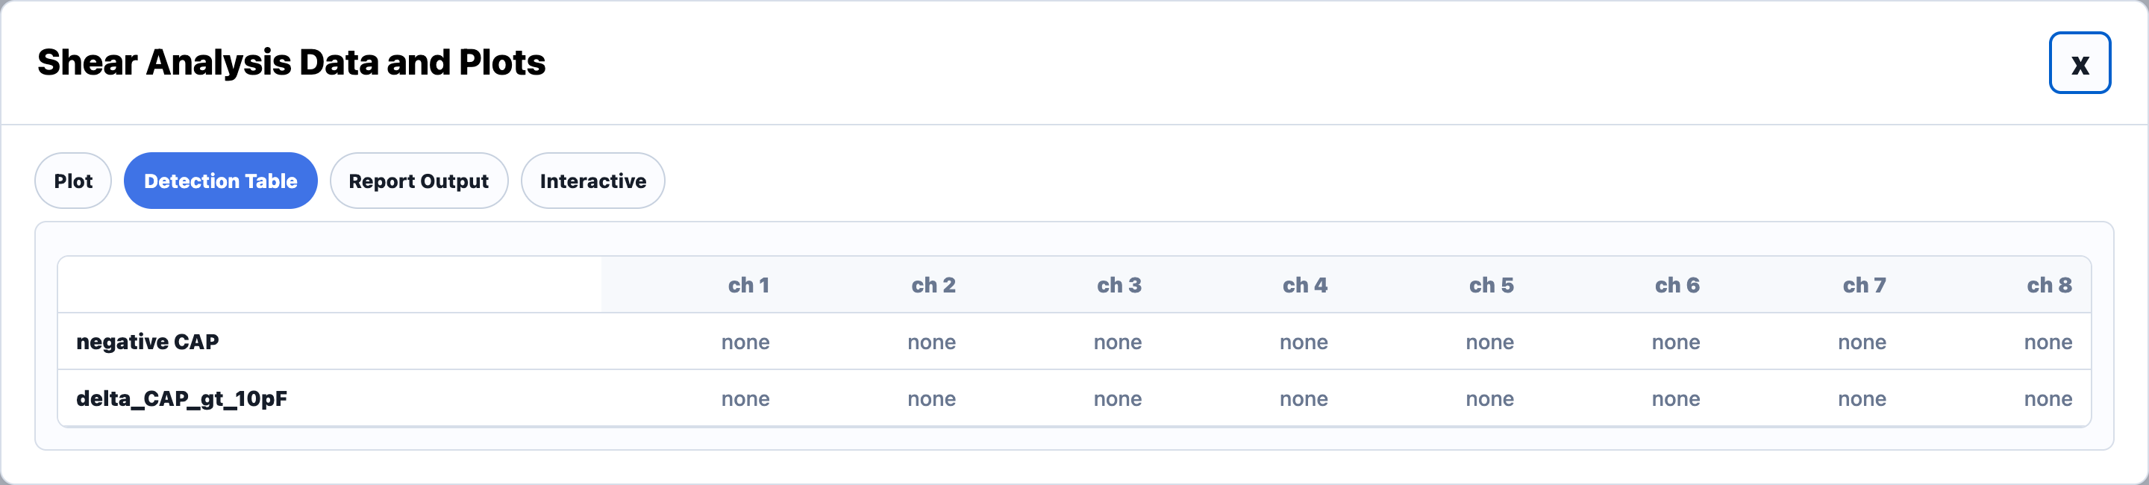
FEATURE 1.8 · SHEAR ANALYSIS
MUST
STORY 1.8.3
Detection Table Tab
USER STORY
As a test fixture user, I want to know which capacitance channels had negative values and which had a large delta after performing a shear test.
ACCEPTANCE CRITERIA
The tab displays a grid where each column is a capacitance channel
One row shows negative values (pF) if detected, or None
One row shows delta values (pF) if a high delta was detected, or None
A high delta is defined as greater than 10 pF

Slide 62
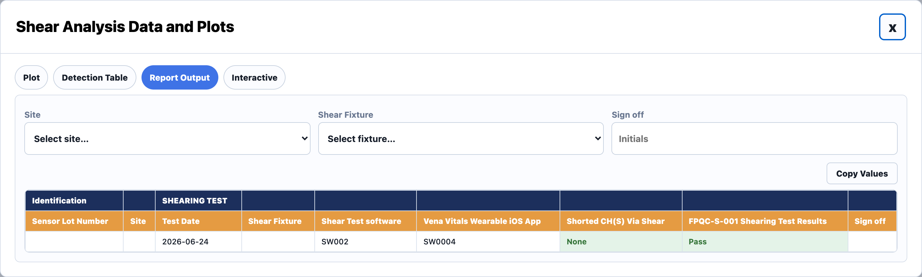
FEATURE 1.8 · SHEAR ANALYSIS
MUST
STORY 1.8.4
Report Outputs Tab
USER STORY
As a test fixture user, I want to easily copy information from the Shear analysis summary so I can document it later.
ACCEPTANCE CRITERIA
The tab includes: Sensor ID, Test Result (Pass/Fail), Shorted Channels Ch 1-N, Test Date DD/MM/YEAR, Test Taker Initials, Test Version
User can copy values via the "Copy Values" button
Copied values should be pastable into Excel format

Slide 63
FEATURE 1.9
Manual Test Page

Slide 64
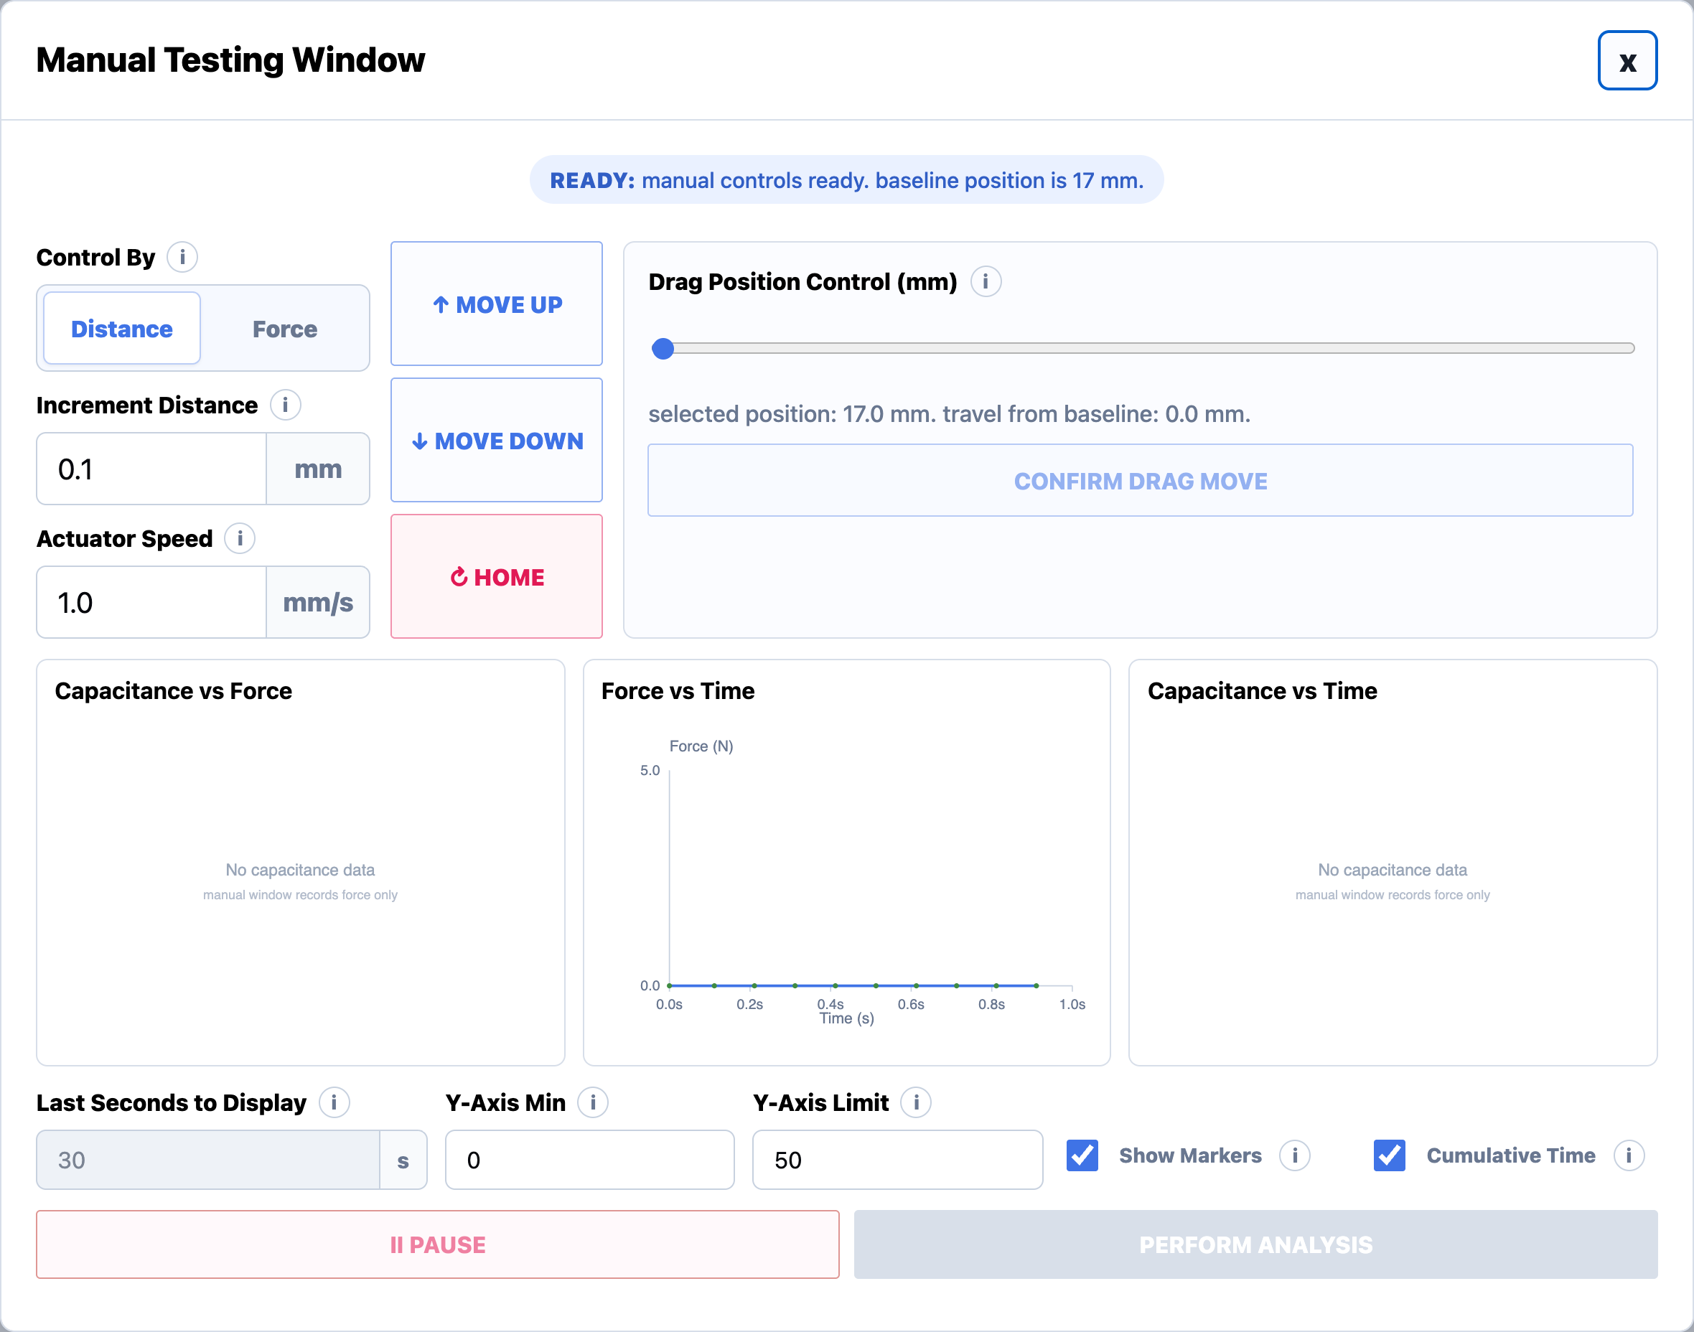
FEATURE 1.9 · MANUAL TEST
MUST
STORY 1.9.1
Manual Testing Window
USER STORY
As a test fixture user, I want the Manual Test to open in a dedicated Manual Testing Window so that I can manually control the Zaber stage and perform custom tests.
ACCEPTANCE CRITERIA
Clicking Begin Test with Test Type = Manual Test opens a new window titled: "Manual Testing Window"
The window includes manual control settings, actuator movement controls, live graphs, graph display controls, Pause, and Perform Analysis

Slide 65
FEATURE 1.9 · MANUAL TEST
MUST
STORY 1.9.2
Control By Distance
USER STORY
As a test fixture user, I want to manually control actuator movement by distance so that I can perform precise step-by-step actuator positioning and exploratory testing.
ACCEPTANCE CRITERIA
When "Control By = Distance" is selected, the window displays: Increment Distance, Actuator Speed, Move Up, Move Down, Home
User enters Increment Distance (mm) and Actuator Speed (mm/s)
Move Up moves the actuator upward using the specified Increment Distance and Actuator Speed
Move Down moves the actuator downward using the specified Increment Distance and Actuator Speed
Home returns the actuator to the home/original position
Current position and live graphs update after movement
Movement controls are temporarily disabled while the actuator is moving; re-enabled when motion completes

Slide 66
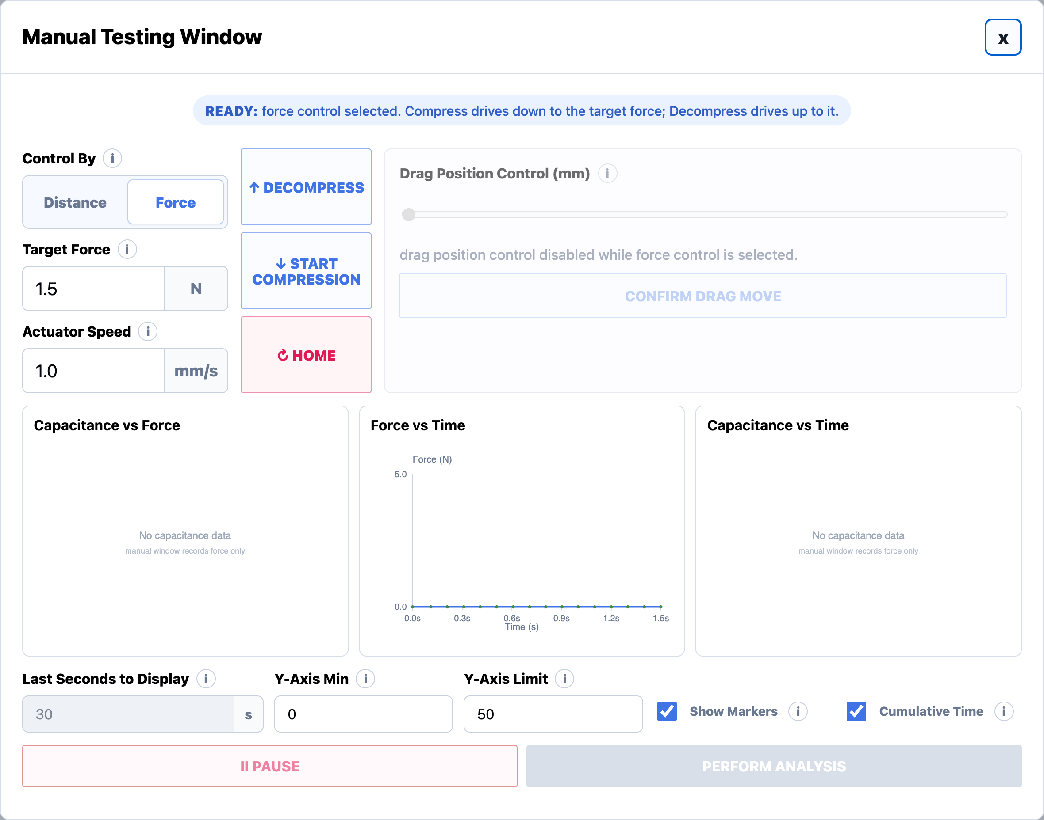
FEATURE 1.9 · MANUAL TEST
MUST
STORY 1.9.3
Control By Force
USER STORY
As a test fixture user, I want to manually control actuator movement by force so that I can perform force-based compression testing and exploratory sensor characterization.
ACCEPTANCE CRITERIA
When "Control By = Force" is selected, the window displays: Target Force, Actuator Speed, Release, Start Compression, Home
User enters Target Force (N) and Actuator Speed (mm/s)
Start Compression begins actuator compression toward the selected Target Force
Release releases the applied compression or moves the actuator upward
Home returns the actuator to the home/original position
Live graphs update during compression and release behavior
Movement controls are temporarily disabled while the actuator is moving or compressing

Slide 67
FEATURE 1.9 · MANUAL TEST
MUST
STORY 1.9.4
Drag Position Control
USER STORY
As a test fixture user, I want to stage actuator movement using a slider so that I can preview the desired position before physically moving the actuator.
ACCEPTANCE CRITERIA
The window includes a Drag Position Control slider
Dragging the slider only stages a move and does not move the actuator
The readout displays the selected position and travel from baseline
Confirm Drag Move remains disabled until the slider changes
The actuator only moves after the user clicks Confirm Drag Move
Movement controls and Confirm Drag Move are disabled during active movement
Current position and live graphs update after movement completes

Slide 68
FEATURE 1.9 · MANUAL TEST
MUST
STORY 1.9.5
Manual Test Live Graphs
USER STORY
As a test fixture user, I want live graphs during manual testing so that I can monitor sensor behavior while manually moving the actuator.
ACCEPTANCE CRITERIA
The window displays three live graphs: Capacitance vs Force, Force vs Time, Capacitance vs Time
Graphs update when movement or compression occurs

Slide 69
FEATURE 1.9 · MANUAL TEST
MUST
STORY 1.9.6
Graph Display Controls
USER STORY
As a test fixture user, I want graph display controls so that I can customize how live data is visualized.
ACCEPTANCE CRITERIA
The user can edit Last Seconds to Display
The user can edit Y-Axis Min
The user can edit Y-Axis Limit
The user can toggle Show Markers
The user can toggle Cumulative Time

Slide 70
FEATURE 1.9 · MANUAL TEST
MUST
STORY 1.9.7
Pause Button
USER STORY
As a test fixture user, I want to pause Manual Testing so that I can stop active movement or graph updates safely.
ACCEPTANCE CRITERIA
Clicking Pause stops active actuator movement
Graph updates pause while the workflow is paused
Movement controls remain locked until the system is safe/ready again

Slide 71
FEATURE 1.9 · MANUAL TEST
MUST
STORY 1.9.8
Perform Analysis Button
USER STORY
As a test fixture user, I want to perform analysis on manual test data so that I can review results from the current preview/manual dataset.
ACCEPTANCE CRITERIA
Perform Analysis becomes available after manual test data exists
Clicking Perform Analysis generates manual analysis from the current preview data
Shows a loading state before opening the Manual Analysis Page

Slide 72
FEATURE 1.9 · MANUAL TEST
MUST
STORY 1.9.9
Info Icons
USER STORY
As a test fixture user, I want informational help icons throughout the window so that I can quickly understand fields, workflows, and testing terminology without needing external documentation.
INFO ICONS ON THIS PAGE
Control By: Distance mode moves the actuator by a chosen millimeter increment. Force mode simulates compression until the selected target force is reached.
Increment Distance: Distance used for each Move Up or Move Down click. Move Down adds distance from the actuator baseline; Move Up subtracts it.
Actuator Speed: Assumed actuator travel speed used to estimate elapsed time on the manual preview graphs. Default is 2.0 mm/s.
Drag Position Control (mm): Drag to choose a target position from 17 mm baseline to 50.8 mm max (full actuator travel). The actuator only moves after Confirm Drag Move is pressed.
Last Seconds to Display: When Cumulative Time is off, time-based graphs show only the last selected number of seconds.
Y-Axis Min: Lowest value shown on the manual test graph y-axis.
Y-Axis Limit: Highest value shown on the manual test graph y-axis.
Show Markers: Shows individual data points on top of the graph line.
Cumulative Time: When on, the graph shows the entire run from start to finish and ignores Seconds to Display.

Slide 73
FEATURE 1.10
Manual Analysis Page

Slide 74
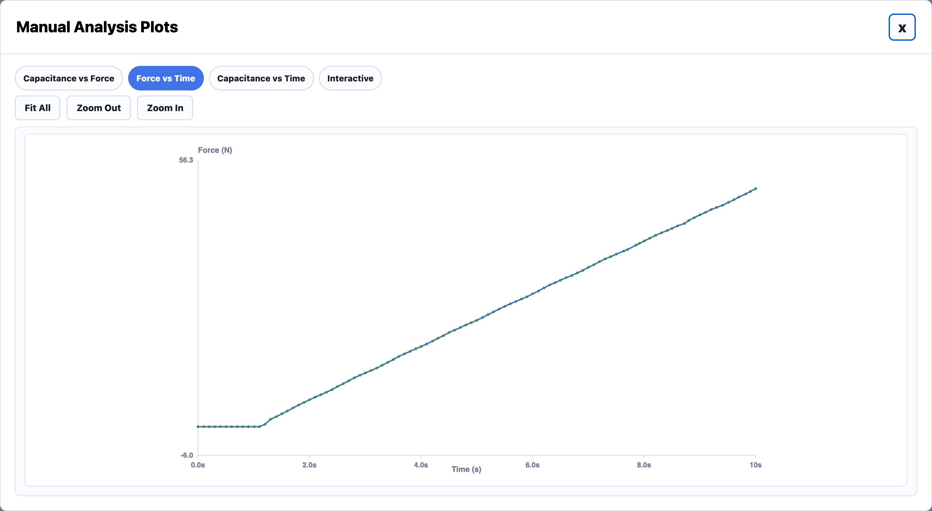
FEATURE 1.10 · MANUAL ANALYSIS
MUST
STORY 1.10.1
Manual Analysis Window
USER STORY
As a test fixture user, I want Manual Test results to open in a dedicated analysis window so that I can review the data collected during manual actuator movement.
ACCEPTANCE CRITERIA
Clicking Perform Analysis from the Manual Testing Window opens a new window titled: "Manual Analysis Data and Plots"
The window displays plots generated from the current manual test data
The window includes tabs for different manual analysis plots

Slide 75
FEATURE 1.10 · MANUAL ANALYSIS
MUST
STORY 1.10.2
Manual Analysis Plot Tabs
USER STORY
As a test fixture user, I want Manual Analysis plots organized into tabs so that I can switch between different sensor relationships easily.
ACCEPTANCE CRITERIA
Tabs include: Capacitance vs Force, Force vs Time, Capacitance vs Time
Clicking each tab updates the displayed plot
Plots are generated from the current manual test data
Data points are shown with markers and connected by a line

Slide 76
FEATURE 1.11
Cyclical Test Page

Slide 77
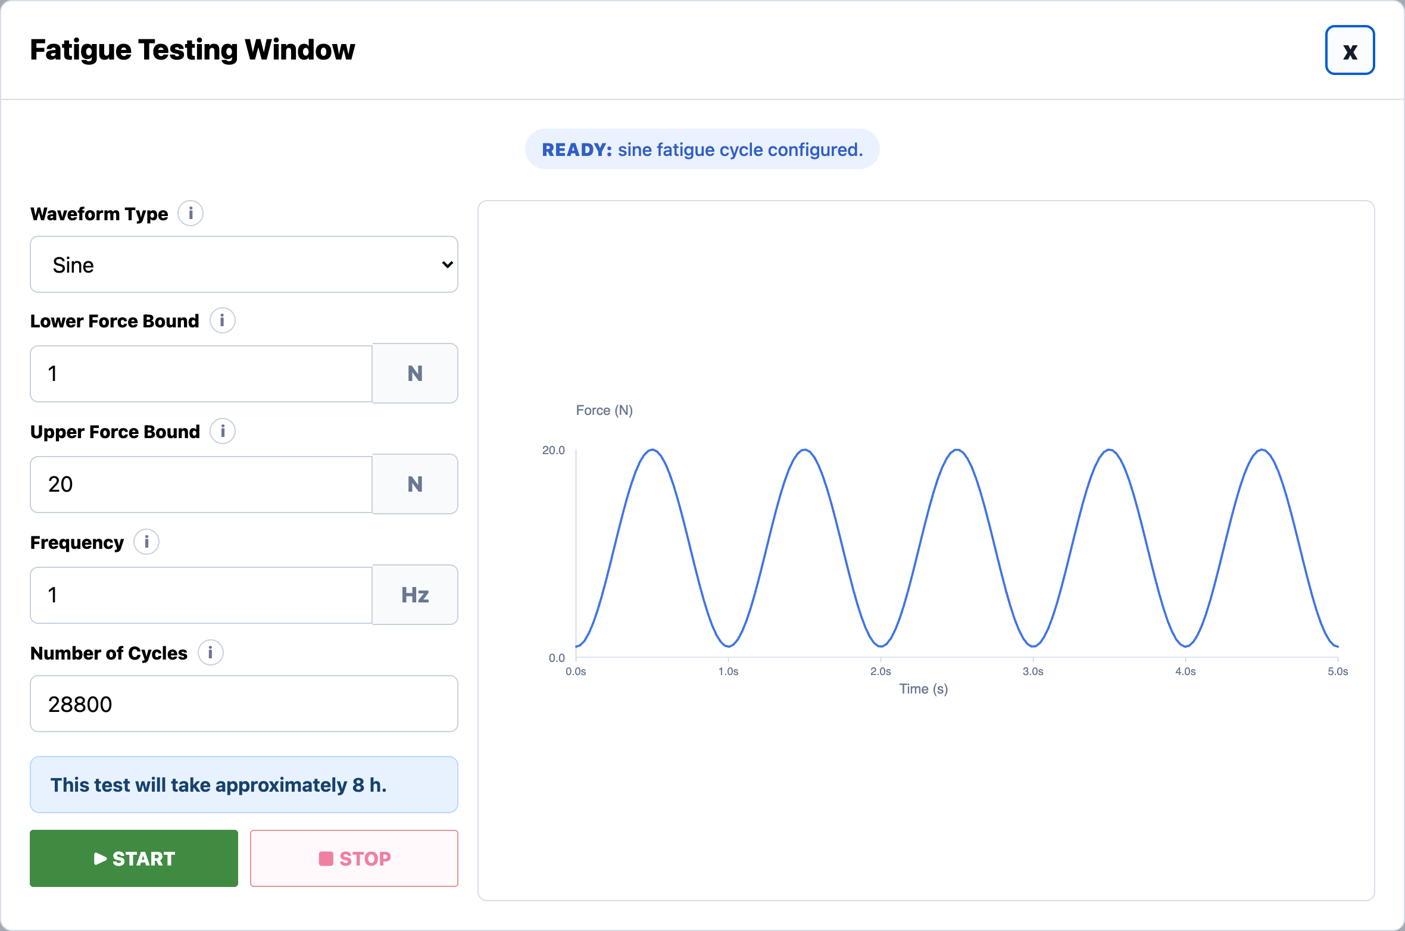
FEATURE 1.11 · CYCLICAL TEST
MUST
STORY 1.11.1
Cyclical Testing Window
USER STORY
As a test fixture user, I want the Cyclical Test to open in a dedicated Cyclical Testing Window so that I can monitor and control a cyclical test.
ACCEPTANCE CRITERIA
Clicking Begin Test with Test Type = Cyclical Test opens a new window titled: "Cyclical Testing Window"

Slide 78
FEATURE 1.11 · CYCLICAL TEST
MUST
STORY 1.11.2
Waveform Type Dropdown
USER STORY
As a test fixture user, I want to perform cyclical tests with different waveform outputs.
ACCEPTANCE CRITERIA
User can click a "Waveform Type" dropdown menu
Options include: Sine, Square

Slide 79
FEATURE 1.11 · CYCLICAL TEST
MUST
STORY 1.11.3
Lower Force Bound Integer Field
USER STORY
As a test fixture user, I want to control the lower bound of the waveform during a cyclical test.
ACCEPTANCE CRITERIA
User enters a positive integer into the "Lower Force Bound (N)" field
The integer must be strictly greater than 0
The integer must be strictly lower than the Upper Force Bound (N) value
Otherwise, an error message displays informing the user the lower bound is larger than the upper bound
Default lower bound is 1 Newton

Slide 80
FEATURE 1.11 · CYCLICAL TEST
MUST
STORY 1.11.4
Upper Force Bound Integer Field
USER STORY
As a test fixture user, I want to control the upper bound of the waveform during a cyclical test.
ACCEPTANCE CRITERIA
User enters a positive integer into the "Upper Force Bound (N)" field
The integer must be lower than or equal to 32 Newtons
The integer must be strictly higher than the Lower Force Bound (N) value
Otherwise, an error message displays informing the user the upper bound is lower than the lower bound
Default upper bound is 20 Newtons

Slide 81
FEATURE 1.11 · CYCLICAL TEST
MUST
STORY 1.11.5
Frequency Integer Field
USER STORY
As a test fixture user, I want to control how many cycles occur per second by manipulating the frequency of the cyclical waveform.
ACCEPTANCE CRITERIA
User enters a positive integer into the "Frequency (Hz)" field
The integer represents the number of wave cycles that occur per second
Default frequency is 1 Hertz

Slide 82
FEATURE 1.11 · CYCLICAL TEST
MUST
STORY 1.11.6
Number of Cycles Integer Field
USER STORY
As a test fixture user, I want to control the number of cycles that should be completed before the test ends.
ACCEPTANCE CRITERIA
User enters a positive integer into the "Number of Cycles" field
A message below the field displays the test duration computed from Frequency and Number of Cycles
Default is 28,800 cycles (8 hours at 1 Hz)

Slide 83
FEATURE 1.11 · CYCLICAL TEST
MUST
STORY 1.11.7
Start Button
USER STORY
As a test fixture user, I want to start a cyclical test.
ACCEPTANCE CRITERIA
User clicks a "Start" button to begin the Cyclical test
All input fields must be filled in with valid values for the test to begin
Once Start is clicked, all input fields are disabled

Slide 84
FEATURE 1.11 · CYCLICAL TEST
MUST
STORY 1.11.8
Stop Button
USER STORY
As a test fixture user, I want to pause a cyclical test while it is running.
ACCEPTANCE CRITERIA
User clicks a "Stop" button to pause the Cyclical test while it is occurring
Stopping deletes the previous data and restarts the cyclical test

Slide 85
FEATURE 1.11 · CYCLICAL TEST
MUST
STORY 1.11.9
Display Graph
USER STORY
As a test fixture user, I want to look at a live graph of the Cyclical test while it is running.
ACCEPTANCE CRITERIA
The right side of the page displays a live Force vs Time graph while a cyclical test is running
The graph is blank when nothing is running
Completing the cyclical test saves the graph to the previously selected save folder

Slide 86
FEATURE 1.11 · CYCLICAL TEST
MUST
STORY 1.11.11
Info Icons
USER STORY
As a test fixture user, I want informational help icons throughout the window so that I can quickly understand fields, workflows, and testing terminology without needing external documentation.
INFO ICONS ON THIS PAGE
Waveform Type: Choose the force waveform used to cycle the actuator between the lower and upper force bounds. Sine is a smooth press/release. Square holds at each bound.
Lower Force Bound: Lowest force target in each fatigue cycle. Example: cycle between 1 N and 20 N.
Upper Force Bound: Highest force target in each fatigue cycle. The actuator compresses the sensor repeatedly up to this force.
Frequency: Number of fatigue cycles per second.
Number of Cycles: Total fatigue cycles to run. Default is 28800 cycles.

