Slide 1
PROGRESS UPDATE · JUNE-JULY 2026
Test Fixture GUI
Bench control software for the sensor-team test fixture
EM · Calibration · Manual · Shear · Fatigue
Jacqueline Chuang

Slide 2
OVERVIEW
What it is
A single browser-based app an operator uses at the bench to run the sensor team's mechanical tests - driving a precision actuator into a sensor while reading a load cell, with every test, safety check, and result in one place.
→
→
GUI
Hardware
Sensor
Operator's laptop
or the bench PC
Zaber actuator +
FUTEK load cell
The sensor
under test
Closed-loop control: the GUI moves the actuator based on the live load-cell reading.

Slide 3
OVERVIEW
Project goals
A platform for configuring, executing, monitoring, and analyzing sensor characterization tests, while keeping ease of use, operator safety, data integrity, and workflow efficiency front and center.
1
Intuitive user experience
2
Safe hardware operation
Easy to learn and operate with minimal training.
Reduces the risk of accidental misuse or unsafe actuator movement.
3
Data integrity & traceability
4
Efficiency
Every test organized, reproducible, and tied to a sensor and configuration.
Minimizes repetitive actions and streamlines characterization.
5
Clear test monitoring
6
Multiple test modes
Test progress and system status are understandable in real time.
Supports EM, Shear, Manual, and Cyclical testing.
7
Extensibility
8
Maintainability
New tests and analysis tools can be added without a major redesign.
Organized so future developers can understand, modify, and extend it.

Slide 4
STATUS
Where the project is
5
6
100+
test workflows
safety systems
user stories
EM, Calibration, Manual,
Shear, and Fatigue
Force, spike, travel, disconnect,
snap-to, single-owner reader
Across 11 features; test
cases done for 7 of 11
MVP built and running end to end - every test type completes.
Packaged as a double-clickable desktop app on Mac and Windows.

Slide 5
PART 1
What I built

Slide 6
CAPABILITIES
Five test workflows
1
EM
Press the sensor and read its response against pressure, automated across repeated runs.
2
Calibration / Fuji
Fuji-film calibration with an operator-set extrusion distance and a fine manual jog.
3
Manual
Free actuator control by distance or force, with live force recording for exploratory tests.
4
Shear
Load-cell-only capture - the operator applies force by hand while the GUI records it.
5
Fatigue
Cyclical loading on a choice of waveforms - sine, square, triangle, sawtooth, or a blood-pressure pulse - for thousands of cycles, with a live preview.

Slide 7
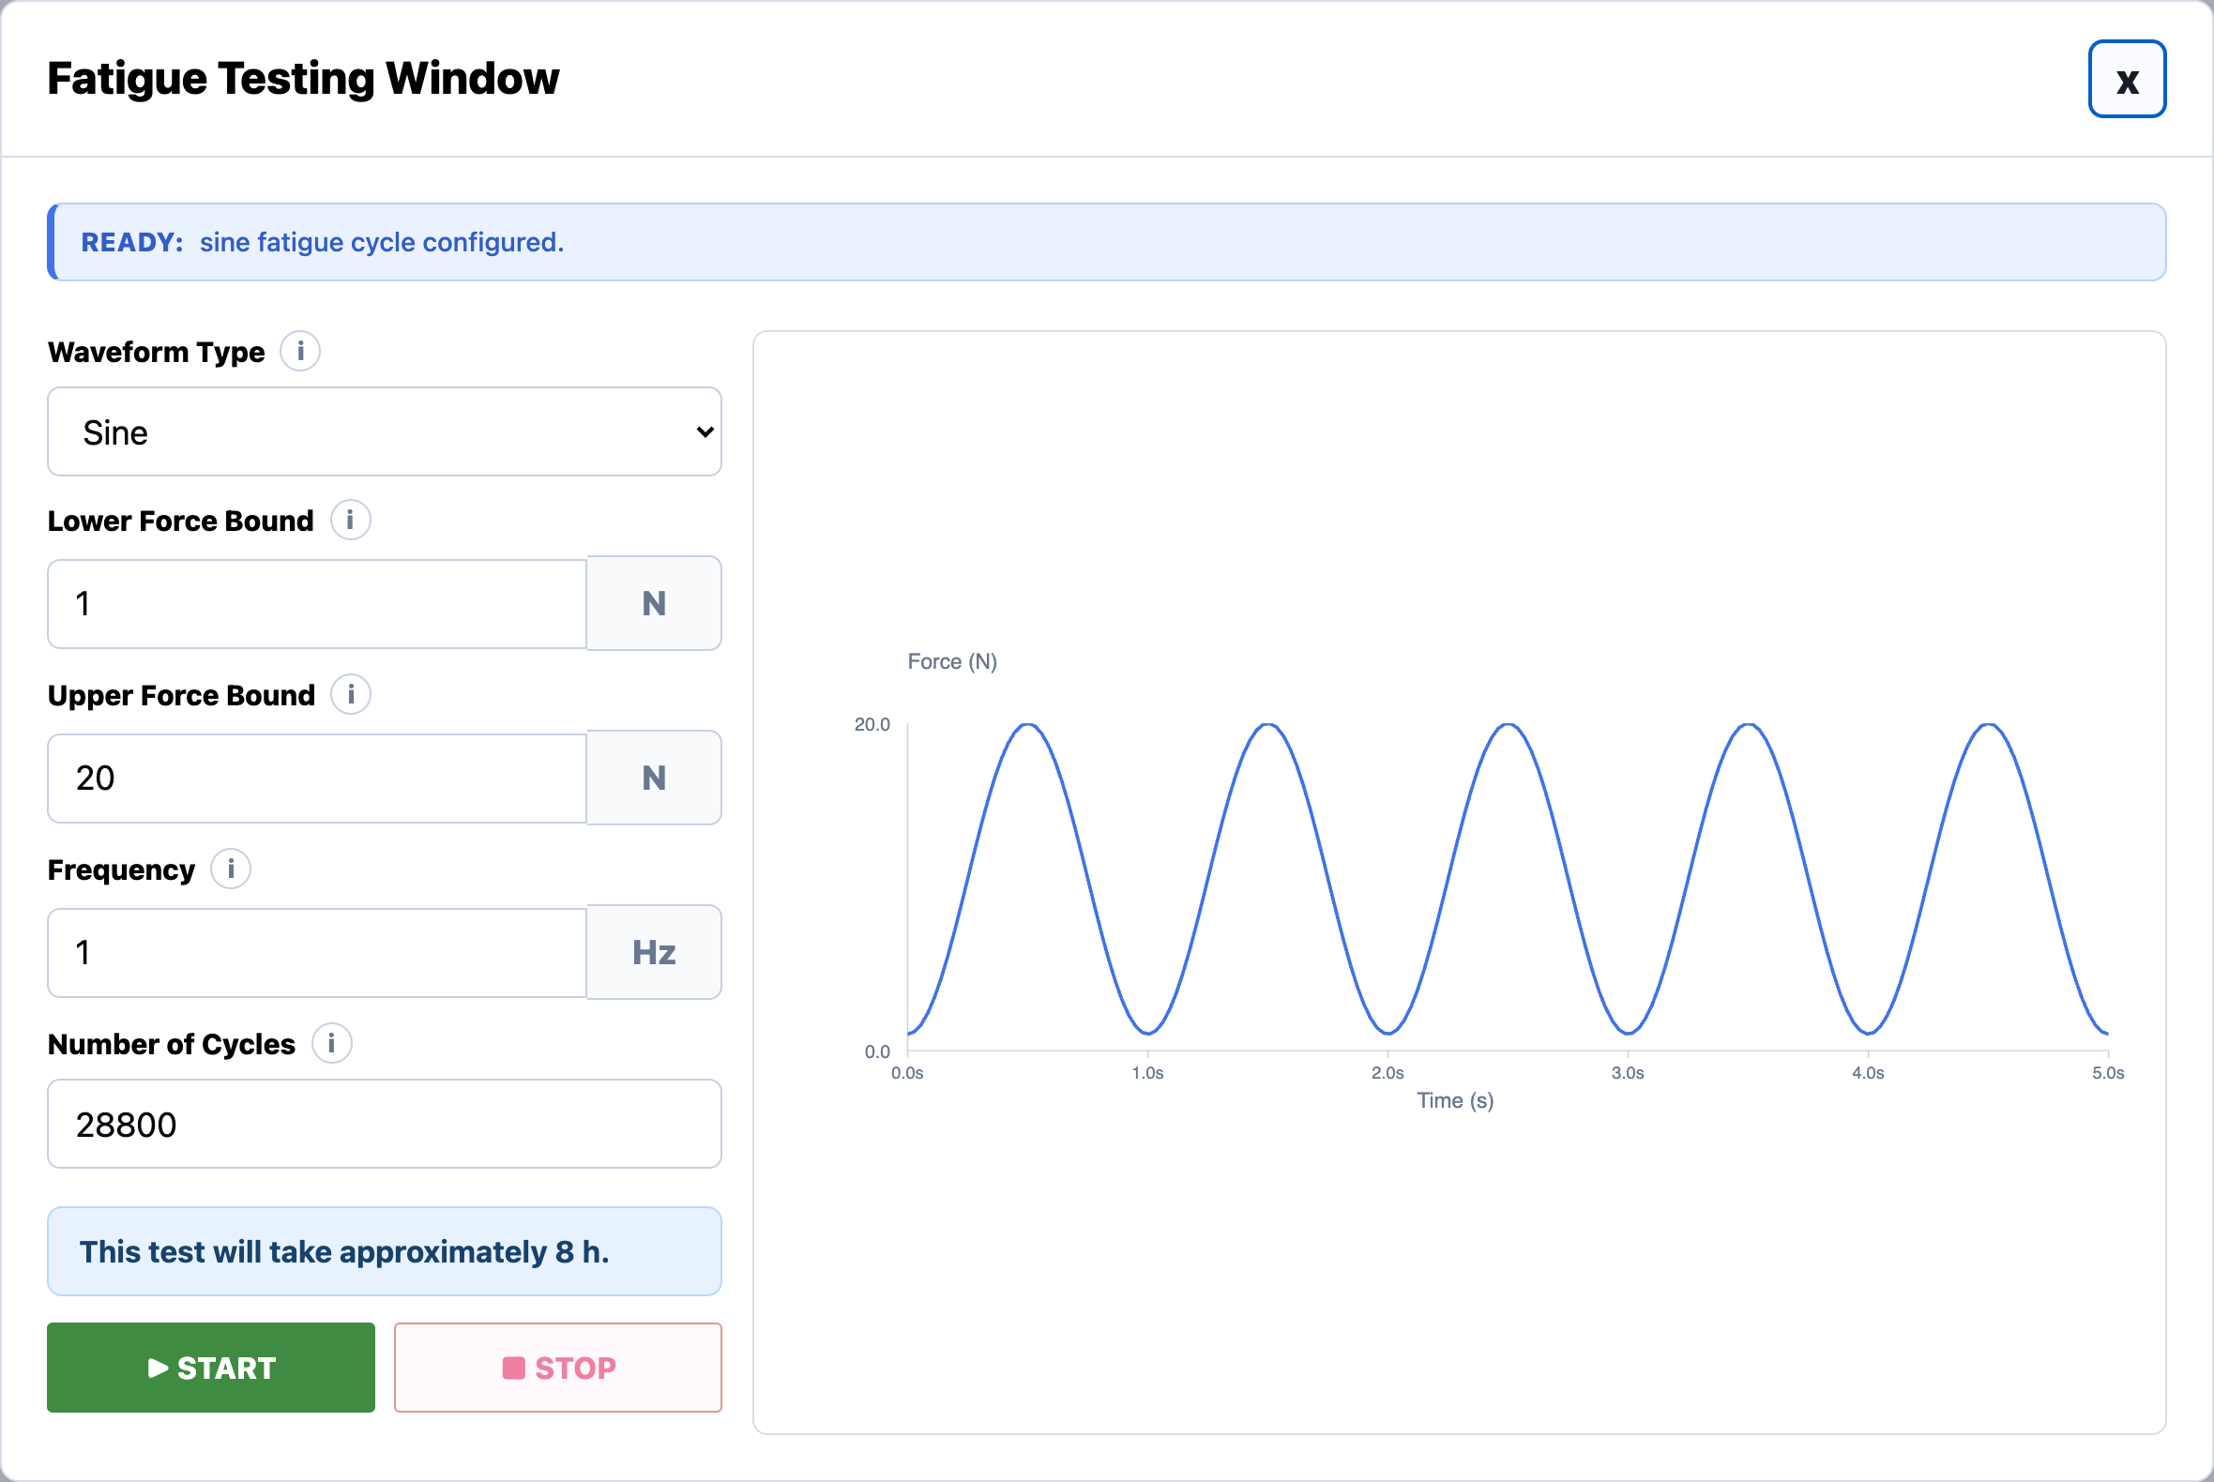
DEMO
Fatigue testing window
Five waveform types
Sine, square, triangle, sawtooth, and a blood-pressure pulse, each redrawn live as the bounds and frequency change.
Whole-number force bounds
Lower and upper force, snapped into the safe range on entry.
Cycle count + duration
Shows the estimated test length - here, ~8 hours for 28,800 cycles.
Force-spike protection
Stops safely if the load ever jumps beyond the configured swing.

Slide 8
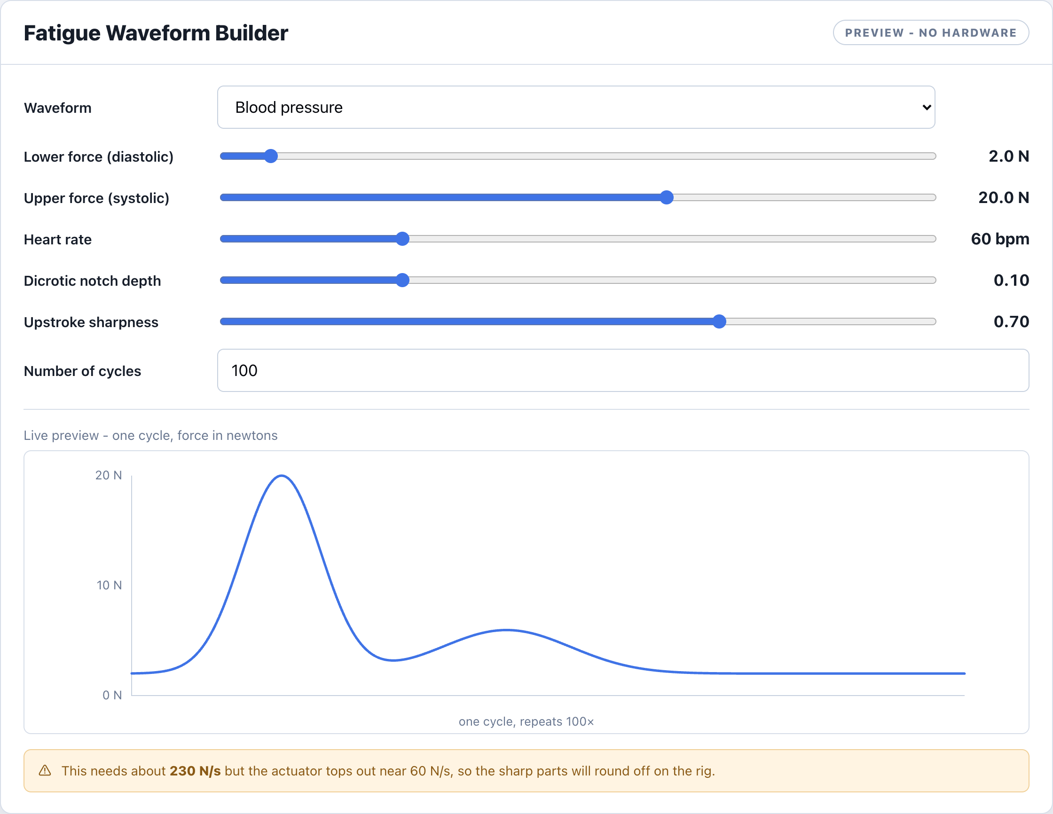
CONCEPT
Fatigue waveform builder
Presets, no math
Sine, square, triangle, sawtooth, or a blood-pressure pulse: pick one and go.
Tunable by slider
Blood pressure adds heart rate, dicrotic notch depth, and upstroke sharpness; the sliders write the equation.
Too-fast-to-track warning
Flags any shape that changes force faster than the actuator can physically follow, before it runs.
Custom equation escape hatch
Power users type a safe expression; live preview and validation, auto-scaled into the bounds.
Mockup, not yet wired into the app. The actuator speed limit is a placeholder until measured on the rig.

Slide 9
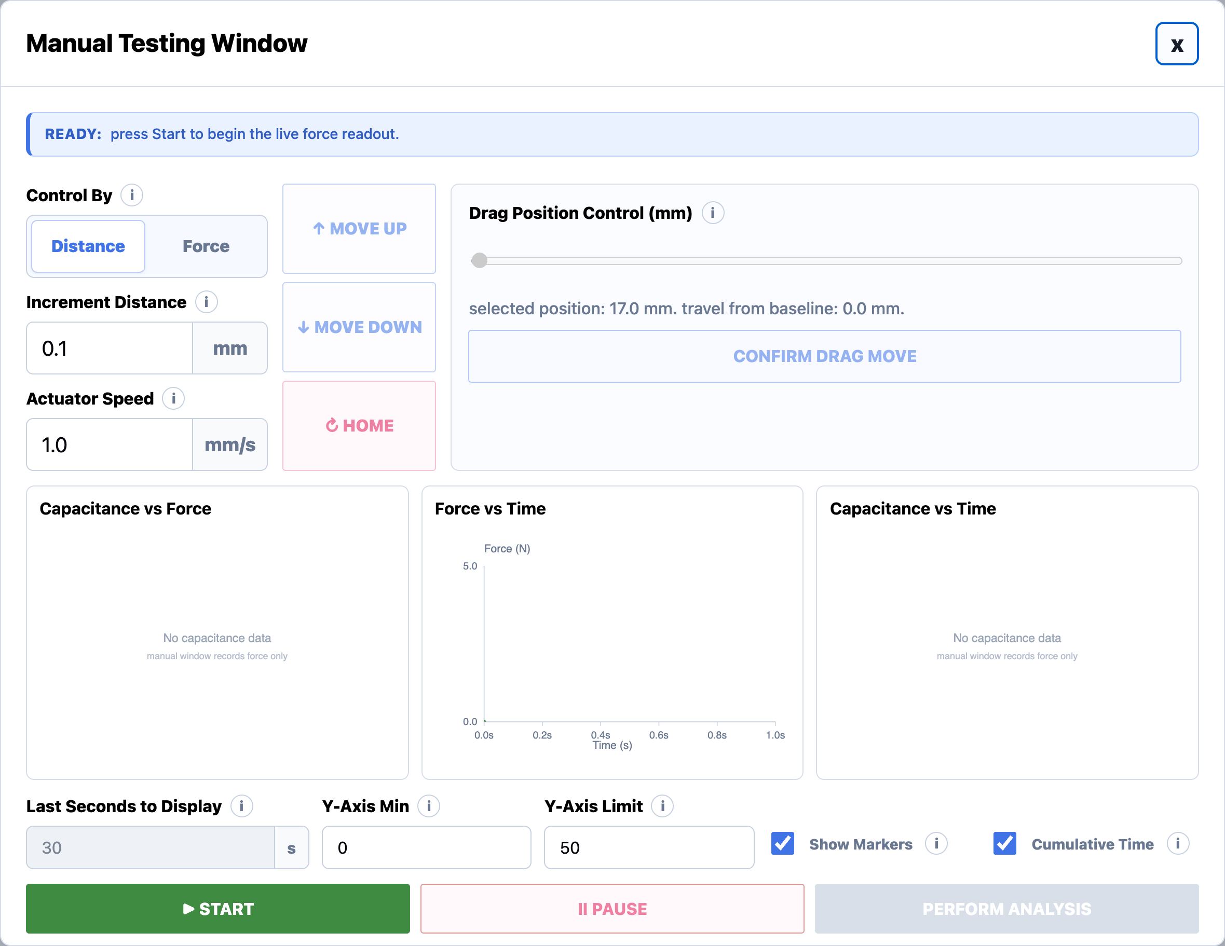
DEMO
Manual testing window
Distance or force control
Jog by a set distance, or drive until the load cell reads a target force.
Compress and decompress
Closed-loop in both directions - press to a force, then release back to one.
Continuous force recording
Force vs time records from the moment the window opens.
Editable while moving
Graph controls stay live mid-move; motion controls lock for safety.

Slide 10
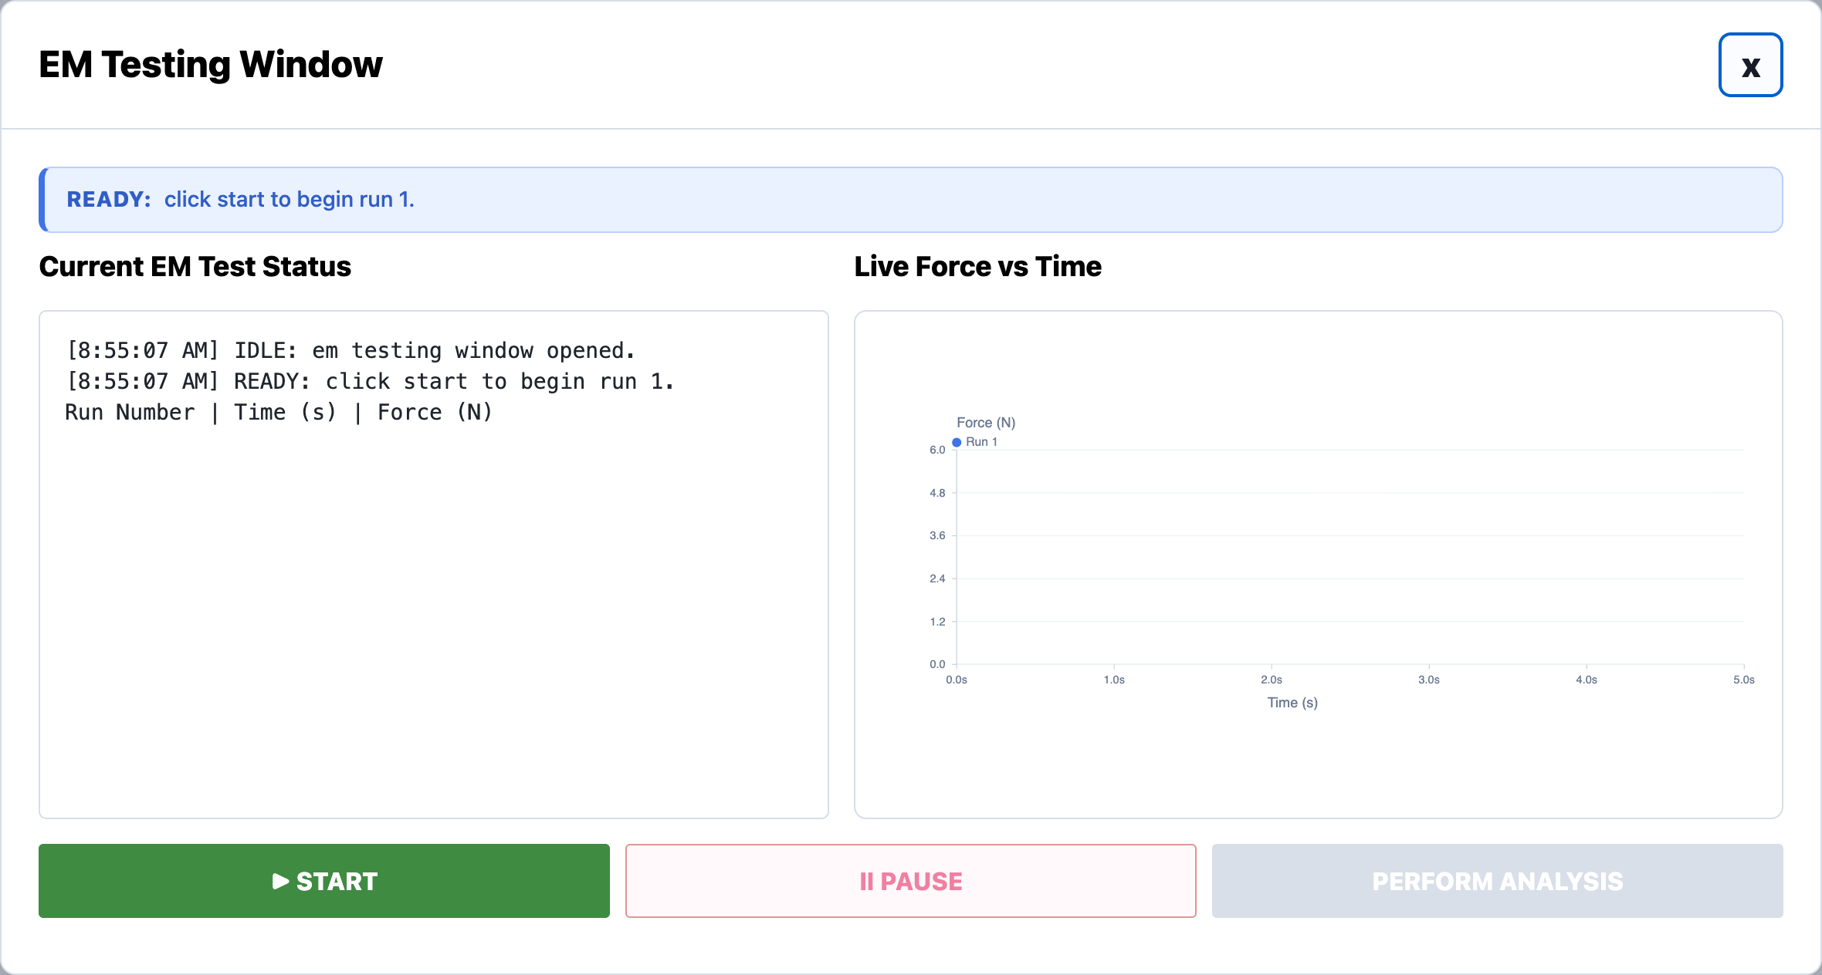
DEMO
EM test & run management
Live state machine
Every run moves through a strict set of states, each one timestamped in the status log.
Automated multi-run
Runs the configured presses back to back, auto-pausing so the sensor can be reset.
Redo without data loss
A redo creates a new superseding run - the original is never overwritten or deleted.
Homes first, every time
Drives to the true baseline before pressing, never starting from an unknown spot.

Slide 11
DETAIL
Calibration & Fuji film
1
Operator-set extrusion distance
A new field controls how far the actuator extrudes for the Fuji-film press, capped at 12 mm and remembering the last value used.
2
Fine manual jog
Step the actuator in small increments to fine-tune position before a calibration press.
3
Press to a calibrated target
The Fuji press drives down until the load cell reaches its target force, then stops.
4
Reliable jog state
Fixed an intermittent bug where the window thought the stage was still moving after a jog finished.

Slide 12
SAFETY
Built into every test
Force ceiling
Spike detection
Travel limits
A hard over-force limit stops the actuator before the load cell can be overloaded.
A sudden force jump - metal-on-metal contact - halts motion immediately.
The stage never drives into its mechanical end stop.
Disconnect handling
Snap-to input limits
Single-owner load cell
Losing the actuator or load cell mid-test stops, retracts to home, and invalidates the run.
Out-of-range entries snap to the nearest limit and say which limit they hit.
Exactly one reader touches the device, so it can't be corrupted mid-session.

Slide 13
RESILIENCE
Surviving a disconnect
Stop and retract home
Load cell self-recovers
Never fakes the force
Any actuator or load-cell drop halts motion and backs the rod off the sensor, never leaving it pressed.
The reader re-initializes the device in place, so a reconnected cell reads again with no app restart.
On a real rig a missing load cell blocks the run instead of quietly recording simulated data.
Fast, honest detection
Right message per sensor
Live COM port list
A stalled reader is caught in a fraction of a second, so the run aborts and the actuator stops promptly.
A load-cell drop and a Zaber drop show different reconnect guidance, not one generic error.
A cable plugged in after the app opens shows up in the port picker on its own.
The load-cell recovery behavior is verified in simulation and by code review; the real-device reopen still needs a bench test on the Windows rig.

Slide 14
REFERENCE
Limits, bounds, and safety stops
Operator inputs - snap into range on commit
Fixed physical and safety limits
Manual position
17 to 50.8 mm
Travel range
17 to 50.8 mm
Target force (manual)
0 to 32 N
Force ceiling (safety)
33 N: stops + homes
Increment distance
0.1 to 12 mm
Actuator peak thrust
25 N hardware max
Actuator speed
0.01 to 2 mm/s
Sudden-jump cutoff
speed-scaled, 1.5 to 500 N
Fatigue force bounds
up to 32 N, upper > lower
Lost connection
safe stop, auto re-home
Fatigue frequency
0.1-5 Hz (square 0.1-1)
Force sampling
100 Hz
EM runs per test
1 to 10
Snap-to rounds each field to its precision and clamps it into range on commit, so you can still type freely while editing. EM run target (32 N) and Fuji target (20 N) are where a good press stops, not limits.

Slide 15
PART 2
Under the hood

Slide 16
ARCHITECTURE
How it's built
Browser GUI
Vanilla HTML / CSS / JS - one file per test tab (em.js, manual.js, fatigue.js, shear.js, calibration.js), plus shared.js and main.js
↓ JSON over local HTTP · the UI polls for live status
Local Python server + test engine
ThreadingHTTPServer (server.py) and run_engine.py - one background thread per test, polled for live status, a single-owner load-cell reader, and a simulation fallback
↓ serial commands · .NET driver calls
Hardware drivers
Zaber actuator over serial (zaber-motion) and the FUTEK load cell over .NET (pythonnet, Windows only)
Packaged as a pywebview desktop window, built into a single .app / .exe with PyInstaller - no terminal, no setup.

Slide 17
ENGINEERING
The hardest bug: the load cell
1
2
3
Problem
Diagnosis
Fix
The load cell kept dropping to simulated data partway through a session - and once it dropped, every test after it read fake values.
The manual window's live graph and the active test were reading the device at the same time, on different threads. The driver can't be read twice at once, so it corrupted.
Re-architected to a single-owner reader: one background loop owns the device and everything else reads its value. Two simultaneous reads are now impossible, in every window.

Slide 18
TIMELINE
Day by day
Days 1-18 went to clinical data validation (OHSU / HFH cases, the MATLAB pipeline, and site decks). The fixture GUI begins on Day 19.
Day 19 · Jun 10
Annotated the test engine (run_engine) end to end - one code path for simulation and real hardware
Day 20 · Jun 11
Reliable motion + serial - killed the 12 s move lag, stopped false disconnects, fixed the 17 mm reference
Day 21 · Jun 12
Safety UI state - the waiting pill, control locking, safety-stop homes; redid the calibration window
Day 22 · Jun 15
Run management + reporting - made the report numbers match the graphs; the redo-run workflow
Day 23 · Jun 16
Other track - UCI data-parsing script and website planning (no GUI)
Day 24 · Jun 17
Real-hardware behavior - true home each test, Shear wired to the load cell, manual force-feedback
Day 25 · Jun 18
Load-cell reliability - the single-owner reader, plus fatigue and EM safety fixes
Day 26 · Jun 19
Other track - competitor research and a clinical-affairs interview (no GUI)
Day 27 · Jun 22
Snap-to input limits, the limits and bounds reference, and user-story reconciliation
Day 28 · Jun 23
Formal test plan done - 45 EM test cases across functional, negative, interruption, boundary, and journey paths
Day 29-30 · Jun 24-25
Connection gating and deferred EM run files, square-wave characterization, shear CAP-file prompt, travel limit to 41 mm
Day 33-36 · Jun 30-Jul 3
Interactive live graphs and Manual Start button; disconnect recovery, retract-to-home, and load-cell reopen; waveform-dependent fatigue frequency; live COM port list

Slide 19
DOCUMENTATION
It's all tracked in one workbook
Every requirement, change, and check lives in a single documentation workbook, so nothing is only in someone's head.
Section | What it documents | Size
Verification checklist | Per-area pass/fail checks: when it happens, pass condition, status, verified | 84 checks
GUI Updates Log | Every visual, backend, hardware, and documentation change, with files touched and test status | 60+ entries
User Story Tracker | Feature requirements with priority, status, and acceptance criteria | 100+ stories
Limits and bounds | Every input range and fixed physical / safety limit, per test | reference
Testing info + folder workflow | Test setup notes and the analysis save workflow | reference
Across 14 sheets. The checklist drives the formal test pass; the updates log is the change history.

Slide 20
DOCUMENTATION
The documentation folder
Beyond the tracking workbook, the reader-facing docs are organized into six guides - each written for a specific reader.
Document | What's inside
1 · Project overview | What the GUI is, the goals it serves, and the scope of each test workflow
2 · Operator guide | Step by step: how to set up, run, and analyze each test at the bench
3 · Technical reference | Every limit, bound, safety stop, and force formula, per test
4 · Developer guide | Architecture, code layout, and how to build and extend the app
5 · Test plan and verification | Formal test cases plus the pass/fail verification checklist
6 · Design concepts and proposals | Mockups, future-feature proposals, and the design decisions behind them
Formal test cases done for 7 of 11 features - 4 to go.

Slide 21
STATUS
Where it stands & what's next
Solid now
Next
Every test type runs end to end
Safety behaviors verified in simulation
Verified on the rig where hardware was available
Documentation organized into 6 guides
Packaged and runnable without a terminal
Finish the formal test cases - 7 of 11 features done, 4 to go
Confirm safety-critical cases on the real rig
Reconcile the user-stories doc to the current GUI

Slide 22
RESOURCES
Documentation & code
User stories
Test plan
Source code
11 features, 100+ stories - every happy and unhappy path, safety handling, and a verification method for each.
Formal test cases traced to each story, organized by technique and tagged simulation vs real rig.
The full GUI, test engine, and hardware drivers, version-controlled.
[ add link ]
[ add link ]
github.com/jacqchuang09/test_fixture
Thank you · Jacqueline Chuang

Slide 23
APPENDIX
Deep dives & backup

Slide 24
ANTICIPATED QUESTION
Is the live graph behind the real force?
During a fast fatigue cycle (up to 5 Hz), the on-screen trace can sit a few tens of milliseconds behind the true load. That is real, so here is why it does not put the test at risk.
Safety never looks at the graph
Spike and force-limit cutoffs run on the raw sample stream in the backend, before any point is drawn. Display lag cannot delay a safety stop.
The actuator follows the backend, not the screen
The waveform is generated and driven in Python. The live graph is a read-only mirror of that same stream.
So the lag is only a UX number
It changes how live the graph feels, never whether the test is safe or the saved data is correct.

Slide 25
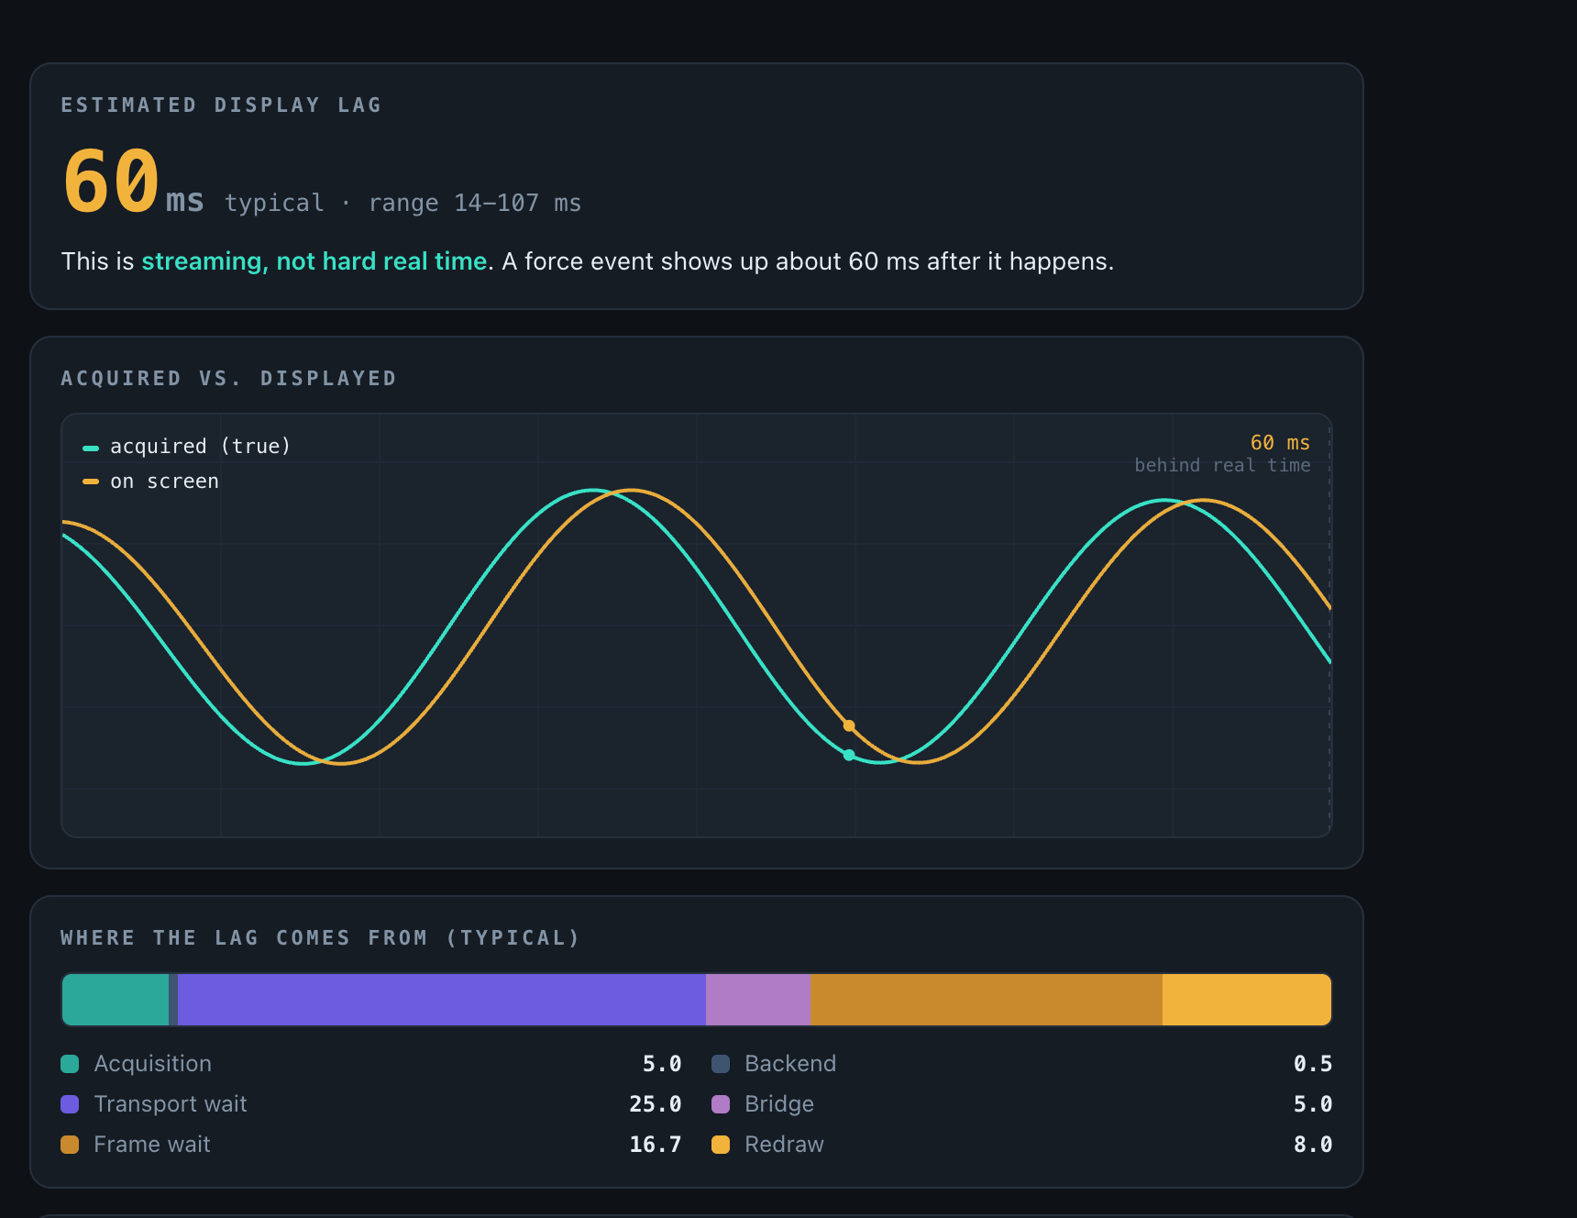
TOOL
Live graph latency simulator
A standalone page (opens in any browser, no backend) that models how far the live graph trails the real force, so the number is honest instead of a guess.
Models the whole path
Load cell sample, backend read, pywebview bridge, then redraw. Each stage is a slider you can dial in.
Gives a ballpark
A typical setup lands near 60 ms (range 14-107 ms): streaming, not hard real time.
Measure the real number
Stamp perf_counter() in Python and performance.now() at draw, then report the median and 95th-percentile gap over a 30-60 s run.

Slide 26
DOCUMENTATION
Live force graph: values
Current values for the live force display. Estimates for now; replace with measured numbers once profiled on the rig.
Property | Value | Notes
Y axis | Force (N) | live load-cell reading
X axis | Time (s) | scrolling window
Sample rate | 100 Hz | one reading every 10 ms
Display lag (typical) | ~60 ms | acquisition to drawn (estimate)
Display lag (range) | 14 to 107 ms | best to worst case (estimate)
Update cadence | ~10 / second | browser polls the status endpoint
Data source | raw backend stream | safety reads this, not the graph

Slide 27
DOCUMENTATION
Live force graph: lag breakdown
Stage | Typical (ms) | What it is
Acquisition | 5.0 | half a sample period
Backend read | 0.5 | per-sample processing
Transport wait | 25.0 | half the push interval
Bridge | 5.0 | Python to JS hand-off
Frame wait | 16.7 | half a redraw frame
Redraw | 8.0 | paint one frame
Total (typical) | ~60 | sum of the stages
How the typical figure is built:
typical = sample/2 + backend + batch/2 + bridge + frame/2 + redraw
= 5.0 + 0.5 + 25.0 + 5.0 + 16.7 + 8.0 ~= 60 ms

Slide 28
DOCUMENTATION
Fatigue simulator: force calculation
How a shape becomes the force the actuator targets, cycle after cycle.
Step | Calculation | Result
Shape | f(phase), phase 0 to 1 | the waveform you picked or typed
Normalize | (v - min) / (max - min) | shape squashed to 0 to 1
Scale to bounds | lower + (upper - lower) * shape | force in newtons
Top-off (clamp) | min(force, 33 N ceiling) | never exceeds the safety ceiling
Repeat | one cycle per 1 / frequency | thousands of cycles
In code:
shape = normalize(f(phase)) // 0 to 1
force = lower + (upper - lower) * shape // newtons
force = min(force, FORCE_CEILING_N) // 33 N top-off

Slide 29
DOCUMENTATION
Fatigue simulator: round-off check
Whether the actuator can physically follow the curve, or whether the sharp parts round off on the rig.
period = 1 / frequency // seconds per cycle
dt = period / samples // time between points
slope = abs(f[i] - f[i-1]) / dt // newtons per second
maxSlew = max(slope over one cycle) // steepest demand
limit = stiffness * max_speed // actuator ceiling (placeholder 60 N/s)
verdict = maxSlew <= limit // green, else amber: rounds off
Worked examples (same 2 to 20 N bounds):
Waveform | Needs | Verdict
Sine, 1 Hz | ~57 N/s | green, follows faithfully
Blood pressure, 60 bpm | ~230 N/s | amber, upstroke rounds off
Square | very large (instant jump) | amber, comes out like a sine
limit = block stiffness (N/mm) x max actuator speed (mm/s). The 60 N/s is a placeholder until the block stiffness is measured on the rig.

Slide 30
DOCUMENTATION
Fatigue square-wave frequency limit
A rig frequency sweep (tools/zaber_square_wave_characterization.py) measures where a square wave stops holding its flats. Flat-hold - the fraction of each half-cycle held at the commanded level - is the decider: a true square holds most of it, a triangle almost none.
Frequency | Flat-hold | Reaches bounds | Shape
≤ 0.25 Hz | 50-81% | yes (100%) | square - holds a flat
0.3-0.45 Hz | 13-42% | yes (100%) | rounding into a triangle
0.5 Hz | ~1% | barely (98%) | triangle - no flat
≥ 0.75 Hz | 0% | no (60-46%) | cannot reach amplitude
Faithful square: keep it at or below 0.25 Hz. The frequency field allows a square up to 1 Hz, but above ~0.25 Hz the wave rounds into a triangle and above ~0.5 Hz it no longer reaches its bounds. The rod slews a 2 mm swing in about 1 s and lags the command ~165 ms - so the measured limit lands far below the naive speed-only ceiling of a few hertz (which wrongly assumes the rod reaches full speed instantly).

