Slide 2
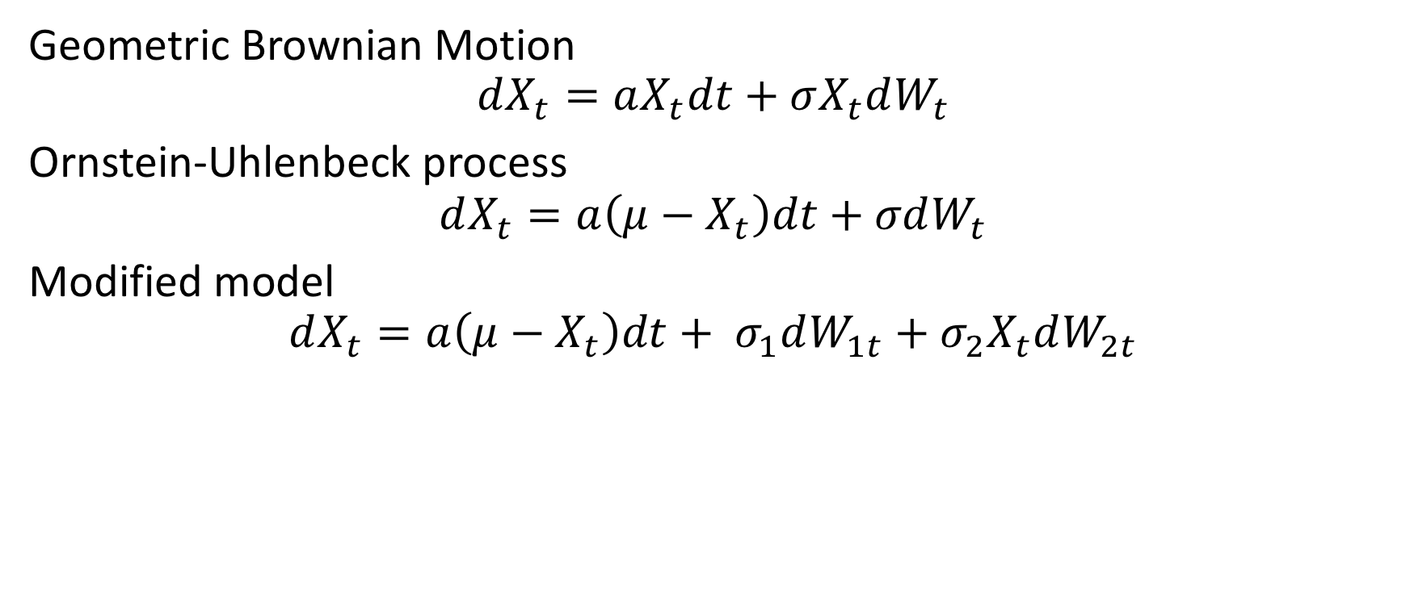
Brownian motion model
Geometric Brownian Motion
$$dX_{t}=aX_{t}dt+σX_{t}dW_{t}$$
Ornstein-Uhlenbeck process
$$dX_{t}=a\left(μ−X_{t}\right)dt+σdW_{t}$$
Modified model
$$dX_{t}=a\left(μ−X_{t}\right)dt+ σ_{1}dW_{1t}+σ_{2}X_{t}dW_{2t}$$

