Slide 1
A comparison of stock return distribution models
Jacqueline Garrahan

Slide 2
Modeling Stock Returns
Significant body of research re market forecasting
Stochastic models are used to capture random events
Investment portfolios often developed around simulation outcomes
I replicated two models used in prior work (QHO and GBM), and propose a third modified model (GBM ft. Ornstein-Uhlenbeck term)
Applied to S&P 500 index (1-day returns & 20 day returns)

Slide 3
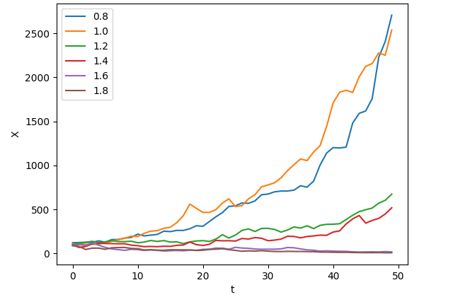
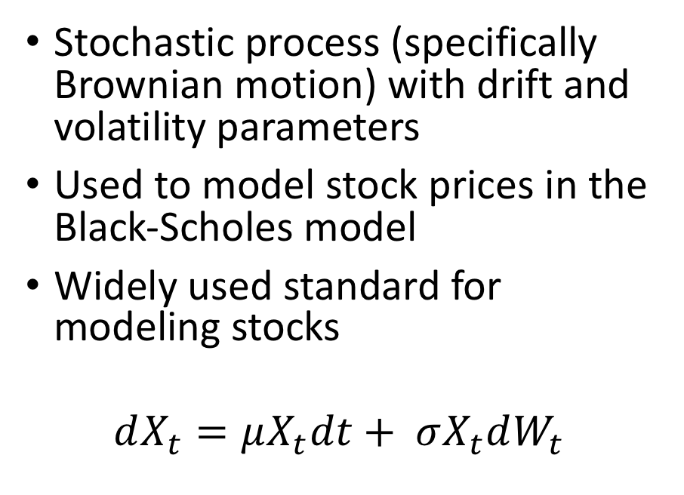

Geometric Brownian Motion
Stochastic process (specifically Brownian motion) with drift and volatility parameters
Used to model stock prices in the Black-Scholes model
Widely used standard for modeling stocks
$$dX_{t}=μX_{t}dt+ σX_{t}dW_{t}$$
Geometric Brownian motion with $μ=1$, and different variances
https://en.wikipedia.org/wiki/Geometric_Brownian_motion

Slide 4
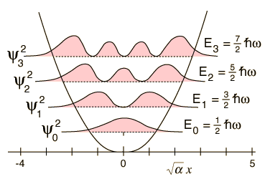
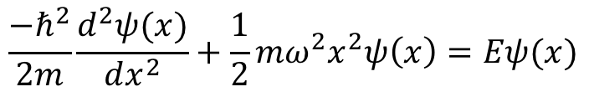
Quantum Harmonic Oscillator
Ahn and colleagues propose the quantum harmonic oscillator for modeling stock returns
Motivation is to capture local oscillations due to restorative market forces after big events
The wavefunction of the quantum harmonic oscillator is a probability amplitude
Wavefunctions of the Quantum Harmonic Oscillator
$$\frac{−ℏ^{2}}{2m}\frac{d^{2}ψ(x)}{dx^{2}}+\frac{1}{2}mω^{2}x^{2}ψ\left(x\right)=Eψ(x)$$
http://hyperphysics.phy-astr.gsu.edu/hbase/quantum/hosc5.html

Slide 5
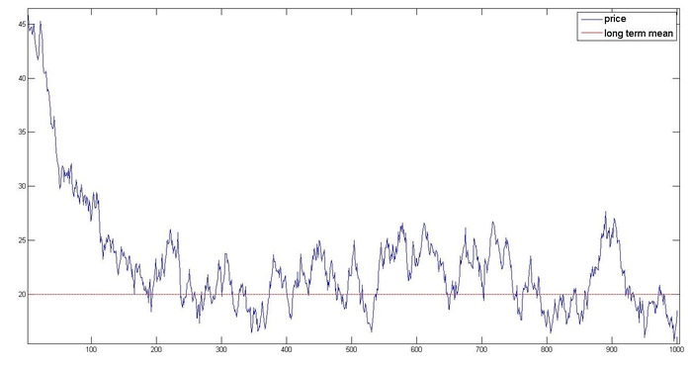
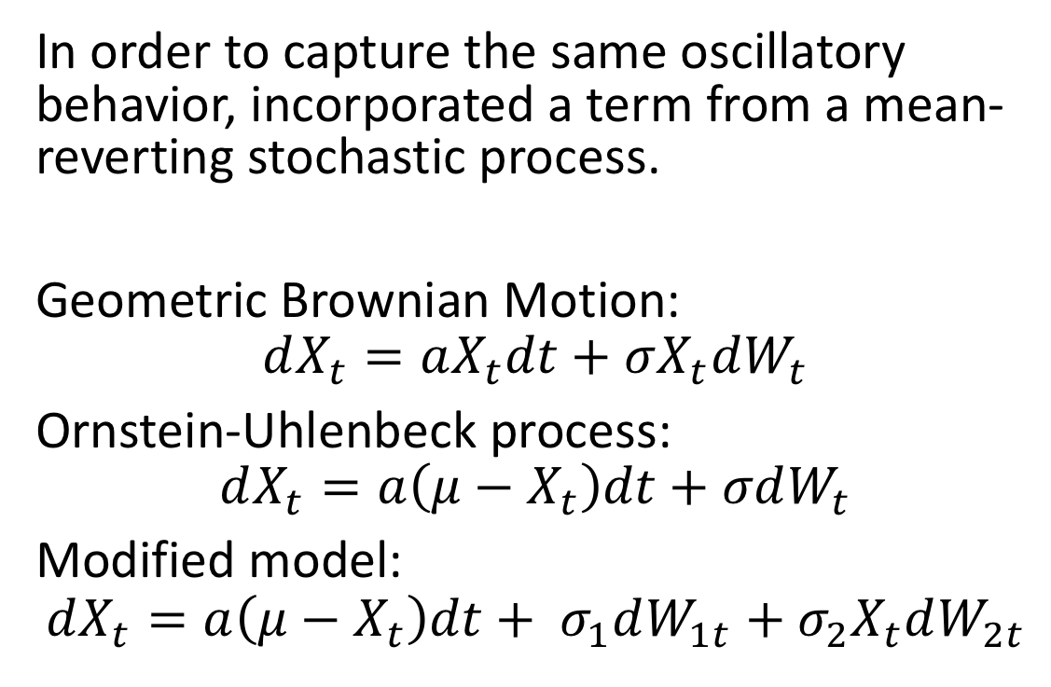
Model formulation
In order to capture the same oscillatory behavior, incorporated a term from a mean-reverting stochastic process.
Geometric Brownian Motion:
$$dX_{t}=aX_{t}dt+σX_{t}dW_{t}$$
Ornstein-Uhlenbeck process:
$$dX_{t}=a\left(μ−X_{t}\right)dt+σdW_{t}$$
Modified model:
$$dX_{t}=a\left(μ−X_{t}\right)dt+ σ_{1}dW_{1t}+σ_{2}X_{t}dW_{2t}$$
The Ornstein-Uhlenbeck process
https://www.researchgate.net/figure/Trajectory-Ornstein-Uhlenbeck-process-observe-the-reversion-rate-b-3-towards-the_fig1_281965169

Slide 6
Methods
Created a framework for simulating each of the models
Searched against first five eigenstates of the QHO, variance and drift for the GBM, and the two variance parameters, mean inclusion window (how many recent vals to account for), and alpha
Performed parameter search against S&P 500 index returns from last five years (particle swarm, simulated anneal). This searched against minimizing the Cramér von Mises test statistic.
Compared test statistic for best parameter fit of each model.

Slide 7
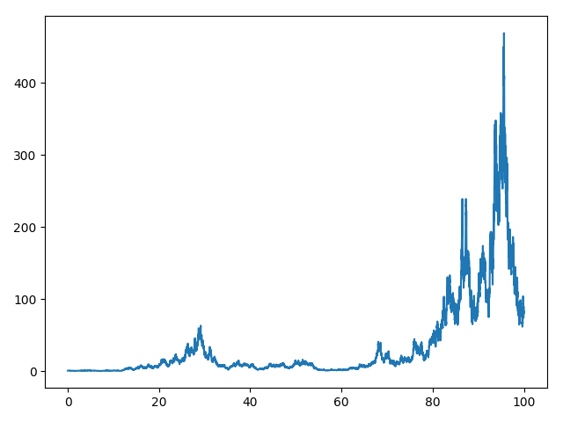
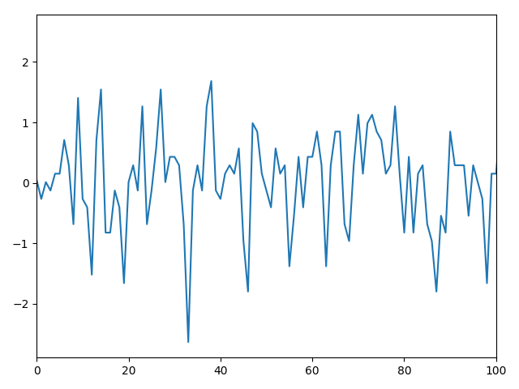
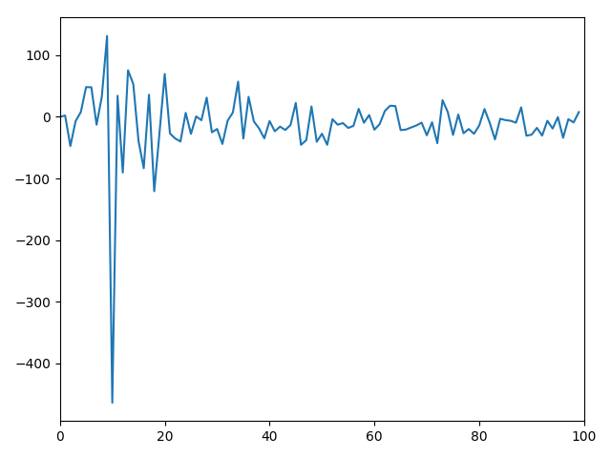
Results
Geometric Brownian Motion
Quantum Harmonic Oscillator
Modified Geometric Brownian Motion

Slide 8
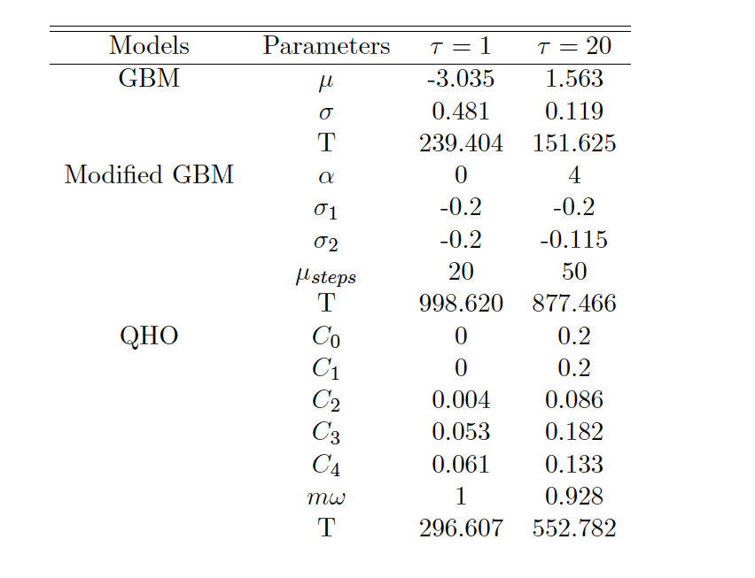
Results

Slide 9
Discussion/Conclusion
Traditional GBM performs best; however, parameter search results are not super reliable due to computation demands of stochastic integration
Also some results had parameter-range edge cases, suggests better results with expansion
The QHO also performs well for the 1-day returns
Modified GBM accomplished mean reversion of the QHO
Underscores options other than GBM, which is the standard tool used in deriving Black-Scholes etc.

Slide 10
Questions/Comments?

