Slide 1


Farm Manager Database
By Jacquelyn Bradshaw

Slide 2
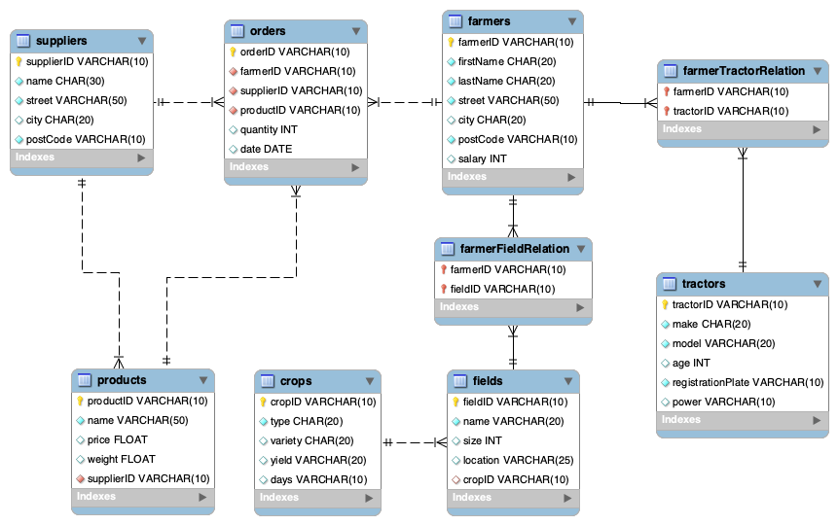
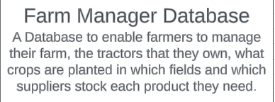
EER diagram
Foreign Key
Primary Key & Foreign Key – Many to many relation between farmers and tractors
Primary Key

Slide 3
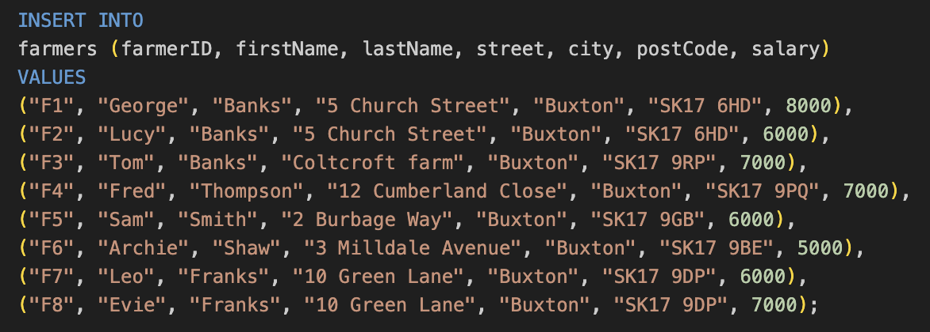
An example of inserting data into the farmers table

Slide 4
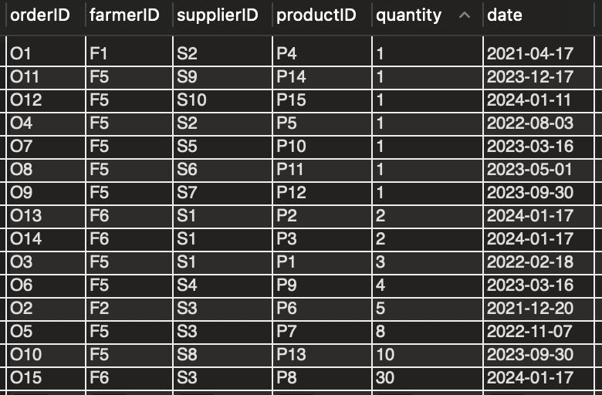
An example of data stored in the orders table

Slide 5
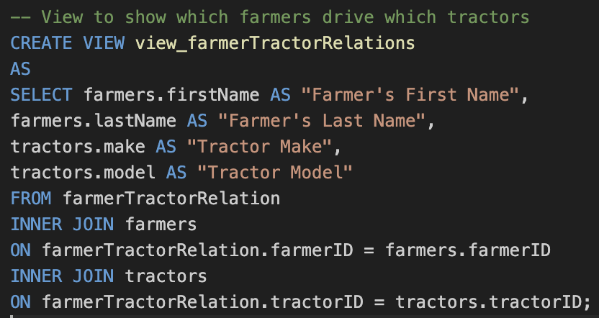
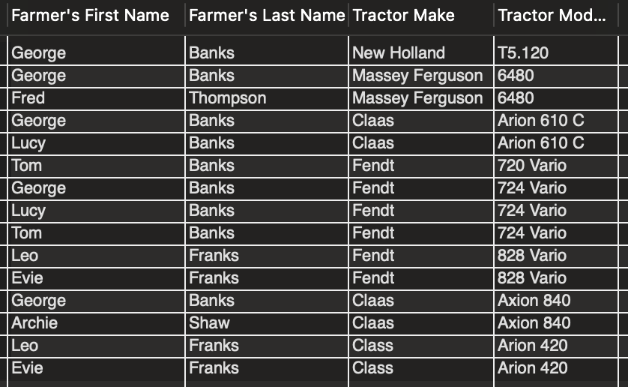
A view that shows which farmers drive which tractors combining three tables using two inner joins

Slide 6
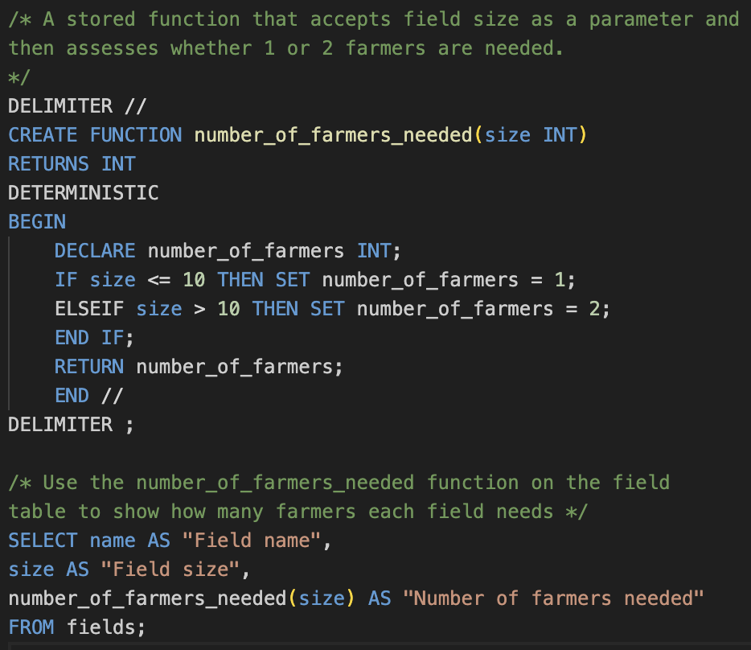
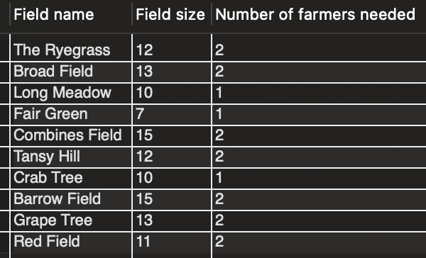
A stored function

Slide 7

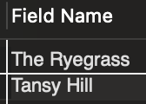
An example query with a subquery
Two fields currently have wheat planted

Slide 8
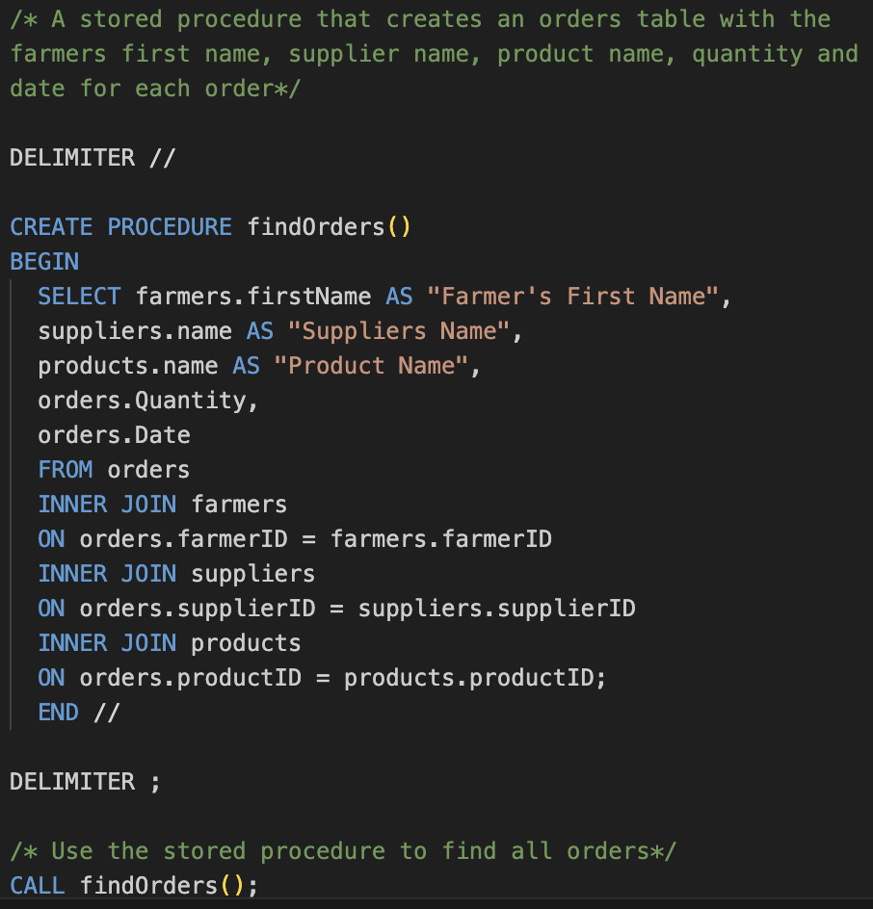
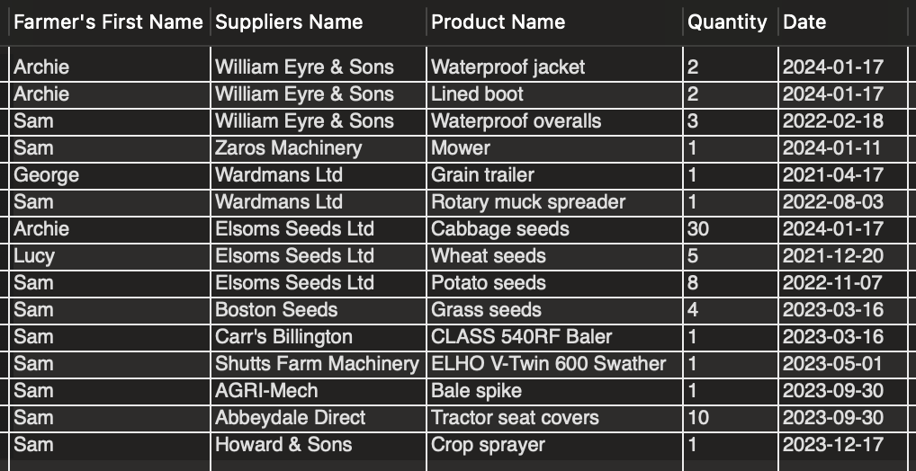
A stored procedure
Joins four tables to create one output table for easy readability for all orders

Slide 9
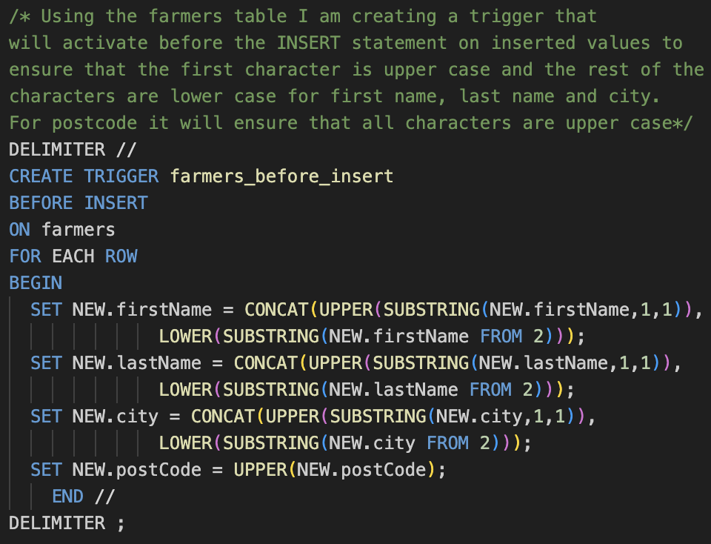
A trigger

Slide 10

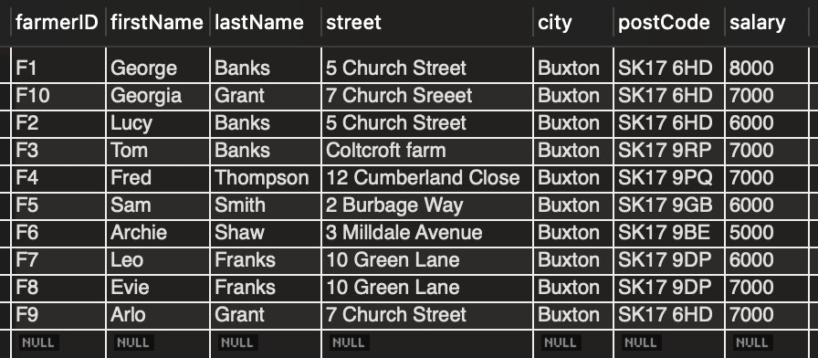

Slide 11
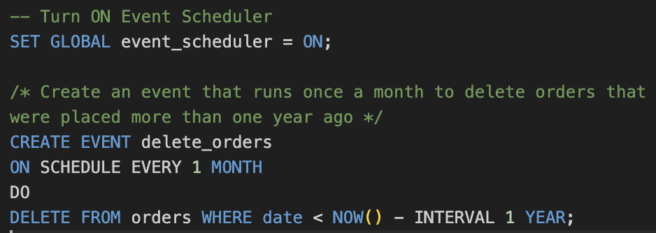
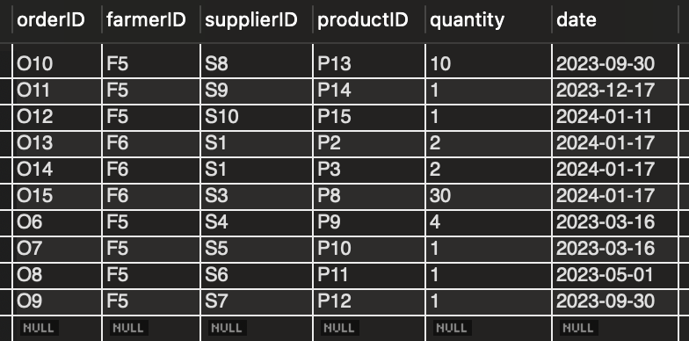
An event

Slide 12
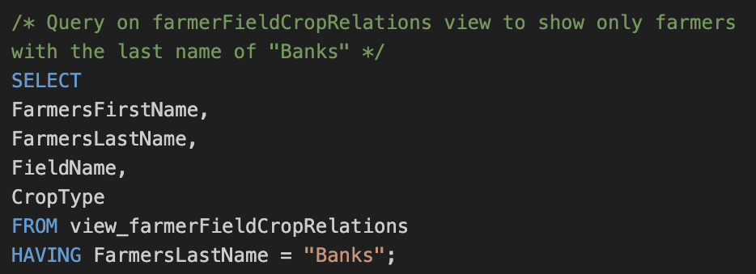
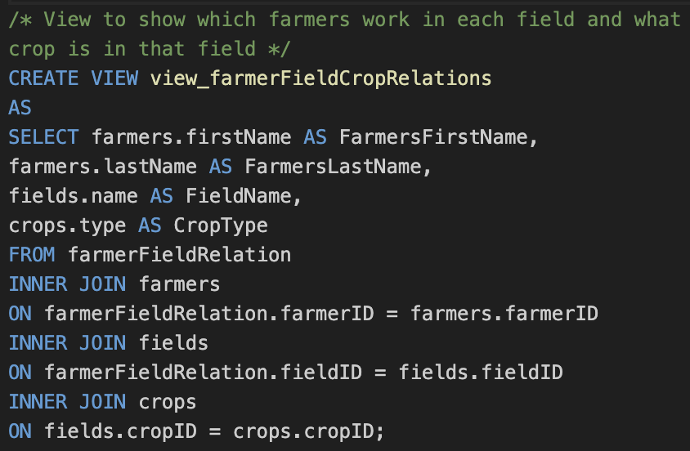
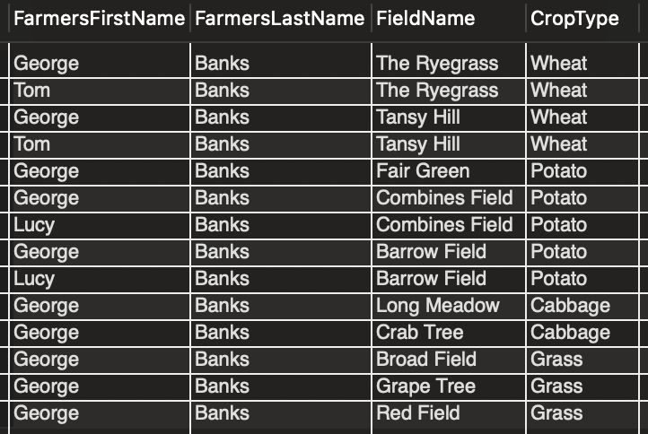
A view that uses four base tables and two queries that use the view

Slide 13
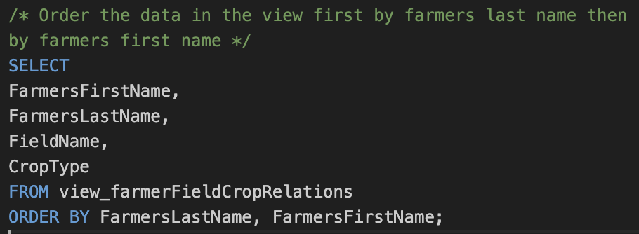
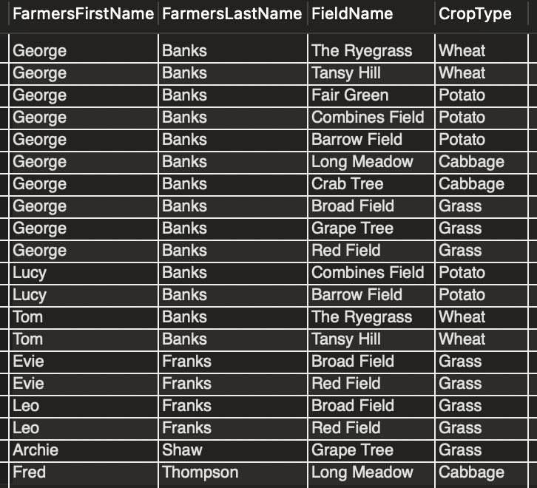

Slide 14
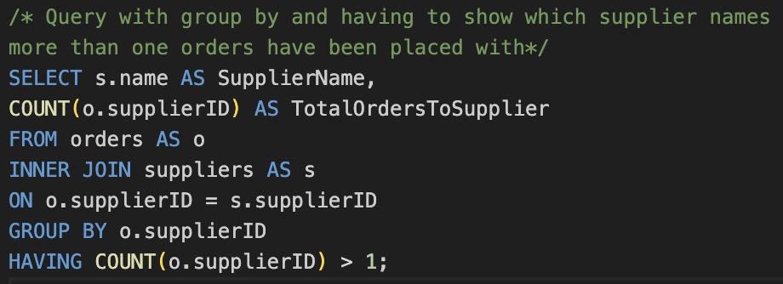

An example query with group by and having

Slide 15
Thank you
https://github.com/jacquelyn-bradshaw/farm-manager-database

