Slide 1

Science Question:
Where can soil moisture improve rainfall-triggered landslide predictability?
Jacquie Witte
Mentor: Elsa Culler

Slide 2
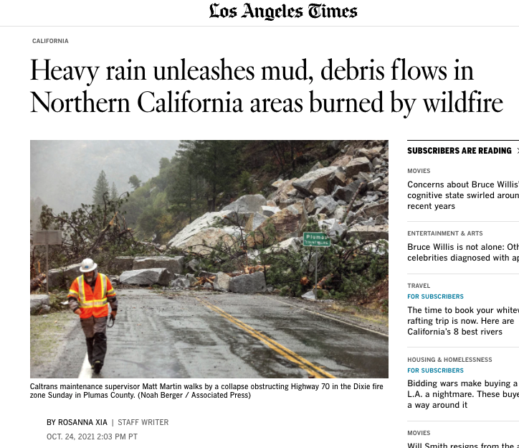
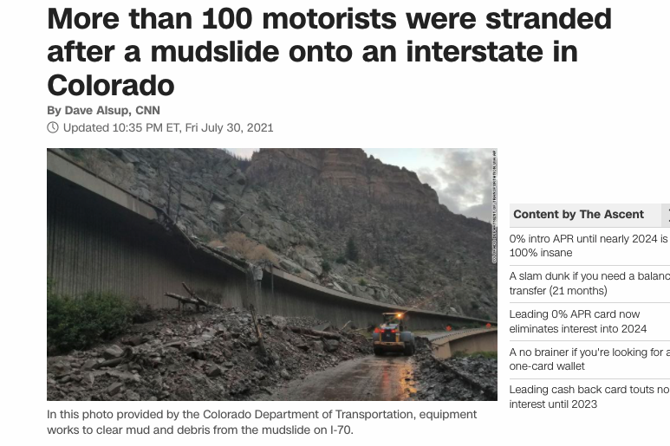
Why do care about landslides ?
Significant economic impacts
Loss of life
Transportation is affected
Landslides are a serious geologic hazard common to may areas in the UC and Canada - yet not as well understood.
Climate change affecting weather patterns, wildfires, droughts, floods is altering our ability to forecast landslides effectively.

Slide 3
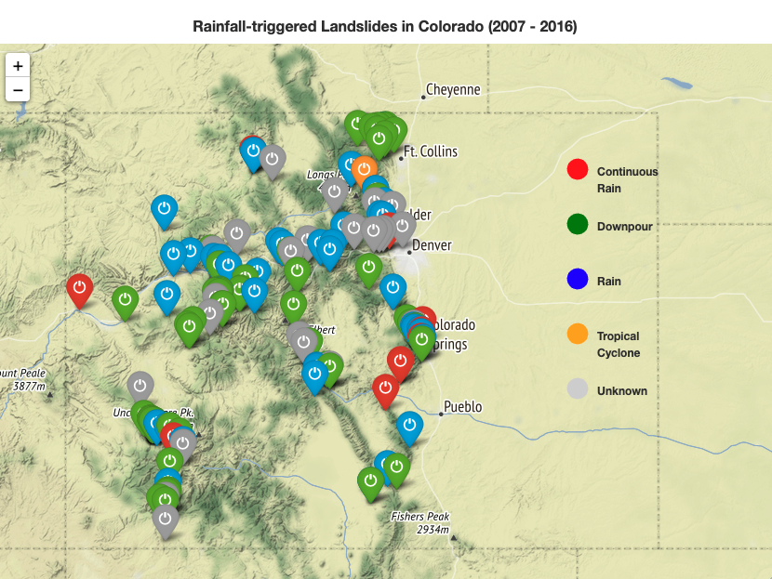
Study Region
Place: Colorado
Time period: 2007-2016
Source: Global Landslide Catalog

Slide 4
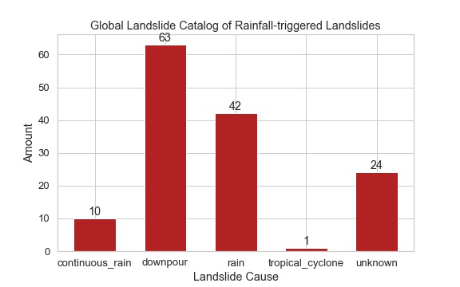
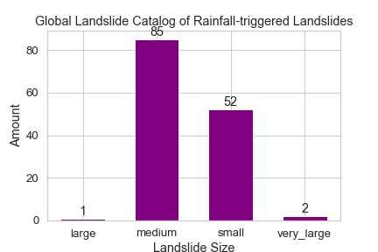
Data Sources - What I have
NASA Global Landslide Catalog (2007-2016)
Provided by Elsa Culler in CSV format
Presumably there is a formal definition of ‘small’ to ‘very-large’ classification in terms of footprint
‘Unknown’ landslides will be interesting to look at in terms of soil moisture.

Slide 5
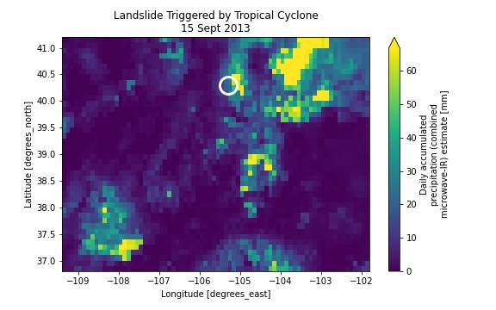
Data Sources - What I have
NASA GPM IMERG (Integrated Multi-satellitE Retrievals for GPM) Rainfall
GPM IMERG Late Precipitation L3 1 day 0.1 degree x 0.1 degree V06
netCDF4 files downloaded via URL-requests through EARTHDATA

Slide 6
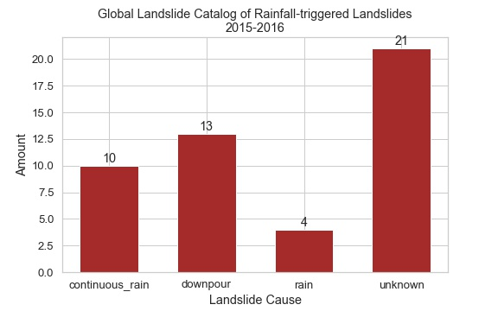
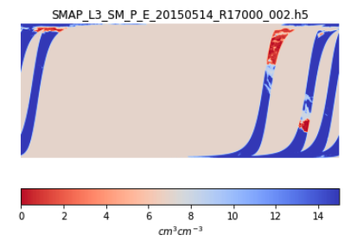
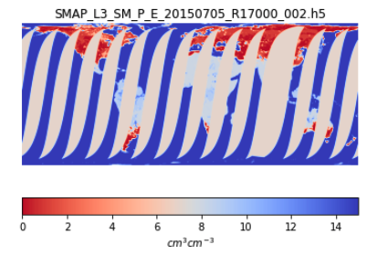
Data Sources - What I have
NASA SMAP Enhanced L3 Radiometer Global Daily 9 km EASE-Grid Soil Moisture V004
HDF5 format downloaded via sh script from EARTHDATA
BUT there is only data from 2015
HOWEVER, Colorado does have 48 Landslides cataloged since 2015-04-01
BUT data are in swaths so coverage over Colorado is not guaranteed

Slide 7
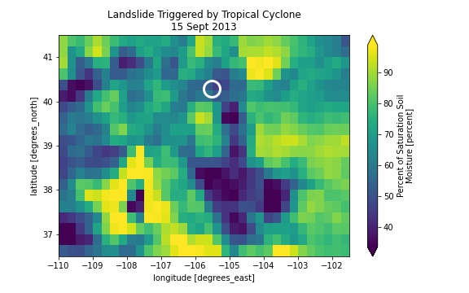
Data Sources - What I have
ESA Climate Change Initiative soil moisture version 03.3
Scatterometer-based soil moisture data derived from AMI-WS and ASCAT (Metop-A and Metop-B).
1978 to present
BUT coarse resolution: 0.25degx0.25deg (~30km²)
netCDF3 format downloaded via tar file
Data Source: Copernicus Climate Change Service (C3S)

Slide 8
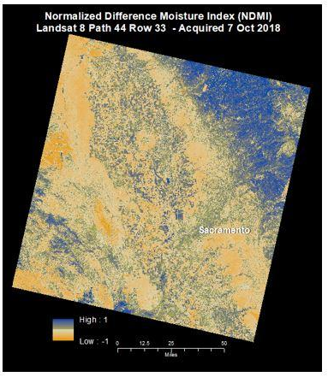
Data Sources - What I need
Soil Classification
USDA Soil Series Classification ?
Format is in ESRI GeoDataBase (python readable?)
Still looking …
Landsat Normalized Difference Moisture Index
Output from a typical Landslide model that uses precipitation as the primary driver.
What does it predict? What doesn’t it predict?
I know model output is not data but it should be mentioned this output is a critical piece of information.
Image credit:
https://www.usgs.gov/landsat-missions/normalized-difference-moisture-index

Slide 9
Expected results
There is a correlation between rainfall amount and soil moisture. This is a proof-of-concept check.
There is a correlation between soil moisture and shallow slope failures (i.e. mudslides).
Soil moisture may be able to explain some of the ‘Unknown’ landslides.
Quantify the uncertainty in rainfall-triggered landslide predictions using soil moisture.

