Slide 1
Digital Portfolio
STUDENT NAME: S.Jacquline
REGISTER NO AND NMID: 212402033/asunm293212402033
DEPARTMENT: Computer Application
COLLEGE: Vidhya sagar women’s college/ Madras University

Slide 2
PROJECT TITLE
Interactive digital protfolio using front end web development

Slide 3
AGENDA
Problem Statement
Project Overview
End Users
Tools and Technologies
Portfolio design and Layout
Features and Functionality
Results and Screenshots
Conclusion
Github Link
3/21/2024 Annual Review

Slide 4
PROBLEM STATEMENT
Problem Statement
Design and develop a personal portfolio website using HTML, CSS, and JavaScript that showcases a student’s profile, education, skills, and projects in a clean and professional layout.
Requirements:
1. Header Section
Display name, profession (e.g., Computer Science Student), and profile picture.
2. Navigation Bar
Provide a sticky navigation bar with links to different sections (About, Education, Skills, Projects, Contact).
Smooth scrolling between sections.
3. About Section
Brief introduction about the student.
4. Education Section
List academic qualifications in a structured format.
5. Skills Section
Display technical skills as styled tags/badges.

Slide 5
6. Projects Section
Mention at least two sample projects with descriptions.
7. Contact Section
Provide email, phone, and LinkedIn details with clickable links.
8. Footer
Contain copyright information.
9. Interactive Feature
Add a “Back to Top” button that appears on scrolling down and smoothly scrolls the page back to the top when clicked.
10. Styling
Use CSS to create a clean, modern, and responsive design.
Highlight section titles with consistent color themes.
Essentially, the problem is:
“Create a responsive portfolio webpage for a Computer Science student using HTML, CSS, and JavaScript, which includes sections for About.

Slide 6
PROJECT OVERVIEW
Problem Statement
In today’s digital era, having an online presence is essential for students and professionals to showcase their skills, achievements, and projects. Traditional resumes are limited in interactivity and fail to highlight practical abilities effectively. Therefore, there is a need for a personal portfolio website that allows an individual to display their academic background, technical skills, and projects in an engaging and structured way.
Project Overview
The Personal Portfolio Website is a responsive web application built using HTML, CSS, and JavaScript. It is designed for S. Shalini, a Computer Science student, to highlight her professional profile.
The website provides the following features:
About Section – Introduces the user with a professional summary.
Education Section – Displays academic qualifications in a structured format.
Skills Section – Showcases technical skills like HTML, CSS, JavaScript, Python, and C++.
Projects Section – Lists key projects with short descriptions.
Contact Section – Provides email, phone number, and LinkedIn details for networking.
Navigation Bar – Sticky navigation for smooth section access.
Back to Top Button – Improves user experience by enabling quick scrolling.
The portfolio emphasizes simplicity, responsiveness, and clarity, ensuring that recruiters, teachers, or collaborators can easily explore Shalini’s project

Slide 7
WHO ARE THE END USERS?
The Portfolio Website is a personal web application designed to showcase academic background, technical skills, projects, and contact details in a professional and visually appealing format. It serves as a digital resume and an online presence for Shalini, a Computer Science student. The website is fully responsive, user-friendly, and includes modern web features such as smooth navigation, a sticky navigation bar, and a "Back to Top" button.
Problem Statement
In today’s competitive world, students and professionals need a platform to highlight their achievements, skills, and projects beyond traditional paper resumes. A static resume often fails to reflect personality, interactivity, and technical expertise.
Without an online portfolio:
Recruiters and hiring managers may not get a clear understanding of the candidate’s technical capabilities.
Students miss opportunities to showcase hands-on projects and coding skills effectively.
Networking through platforms like LinkedIn is limited without a personal website to redirect to.
This project addresses the need for an interactive, structured, and professional personal portfolio website that acts as a digital identity for students and job seekers.

Slide 8
End Users
The end users of this project include:
1. Students & Job Seekers – To present their skills, education, and projects in a professional format.
2. Recruiters & Hiring Managers – To quickly view and evaluate the candidate’s profile, skills, and achievements.
3. Peers & Mentors – To explore academic background, technical expertise, and project contributions.
4. Networking Connections (LinkedIn, GitHub, etc.) – To get a quick overview of the candidate’s work and reach out for collaboration or opportunities.

Slide 9
TOOLS AND TECHNIQUES
1. Responsive Layout Basics
Content centered with max-width.
Simple, mobile-friendly design.
Sticky navigation bar at the top.
2. Navigation System
Internal links (<a href="#section">) allow smooth scrolling to sections.
scroll-behavior: smooth; in CSS makes scrolling animated.
3. Profile Section (Header)
Displays name, role, and profile picture.
4. About Section
Short introduction about yourself.
5. Education Section
Timeline of your academic background.
6. Skills Section
Tag-style skill labels for quick visualization.

Slide 10
7. Projects Section
List of projects with small descriptions.
8. Contact Section
Email, phone, and LinkedIn provided.
9. Footer
Copyright notice.
10. Back-to-Top Button
Appears after scrolling down.
Smoothly takes the user back to top.
Functionalities & Possible Improvements
Already Present:
Smooth scrolling navigation.
Back-to-top button logic using JavaScript.
Sticky navigation bar.

Slide 11
POTFOLIO DESIGN AND LAYOUT
Layout & Structure (HTML Theory)
<header> → Introduces you (name, title, profile picture). Creates the first impression.
<nav> → Navigation menu with internal links (#about, #skills, etc.), making it easy to jump across sections.
<section> → Each section is separated for clarity (About, Education, Skills, Projects, Contact). Helps in semantic organization.
<footer> → Closing section with copyright info.
This structure follows semantic HTML5 principles, which improves readability, SEO, and accessibility.
Design Principles (CSS Theory)
1. Color Scheme
Primary color: #4CAF50 (green) → fresh, professional, and consistent.
Background: light gray (#f4f4f4) → provides contrast against white content cards.
Navigation bar: black (#333) → improves visibility of menu items.
2. Typography
Font: Arial, sans-serif → clean and simple.
Consistent text sizes → improves readability.
3. Layout Techniques
Centered Header → draws focus to your name and photo.
Sticky Navigation Bar → always accessible while scrolling.
11

Slide 12
4. Skills Styling
Each skill is displayed as a badge (<span>) with green background → highlights technical strengths quickly.
5. Responsiveness
The layout uses max-width for sections → content doesn’t stretch too wide on large scr
Viewport meta tag → ensures it adapts to mobile screens.
Interactive Features (JavaScript Theory)
Back to Top Button
Appears after scrolling (on scroll event).
Uses scroll To({ top: 0,behavior: 'smooth' }) for smooth scrolling.
Improves user experience (UX) when navigating long pages.
Portfolio Design Theory (Why it Works)
1. First Impression (Header) → Profile picture + name builds trust.
2. Easy Navigation → Sticky navbar helps quick access.
3. Readable Sections → Clear division of About, Education, Skills, Projects, Contact.
4. Minimalistic Look → Light colors, consistent spacing, not overloaded.
5. Call-to-Action → Contact details + LinkedIn encourage networking
---

Slide 13
FEATURES AND FUNCTIONALITY
Features in Your Code
1. Responsive Design Basics
Uses meta viewport for mobile-friendly layout.
Content is centered and adapts to screen sizes.
2. Header Section
Displays your name, title, and profile picture in a clean way.
3. Sticky Navigation Bar
Navigation links (About, Education, Skills, etc.) stay on top when scrolling.
Smooth scrolling between sections.
4. Sections with Content
About Me: Short introduction.
Education: Academic history.
Skills: Highlighted with styled tags.
Projects: Lists practical works.
Contact: Email, phone, and LinkedIn.

Slide 14
5. Back-to-Top Button
Appears when you scroll down.
Smooth scrolls to the top when clicked.
6. Styling
Clean and modern design using CSS.
Shadows, rounded corners, and hover effects.
Green (#4CAF50) theme color for consistency.
Functionalities Already Present
Scroll behavior (smooth).
Interactive navigation with hover effect.
Back-to-top button with JavaScript.
Clickable email & LinkedIn links.
Suggested Enhancement
Here’s what you can add to make it more professional and interactive:
Design Improvements
Add profile background banner behind the profile picture.
Use Google Fonts (e.g., Poppins, Roboto) for better typography.
Add hover animation to skill tags and project items.
Functional Features
Download Resume Button (PDF)
Contact Form (Name, Email, Message) with simple validation.
Dark Mode Toggle using JavaScript.

Slide 15
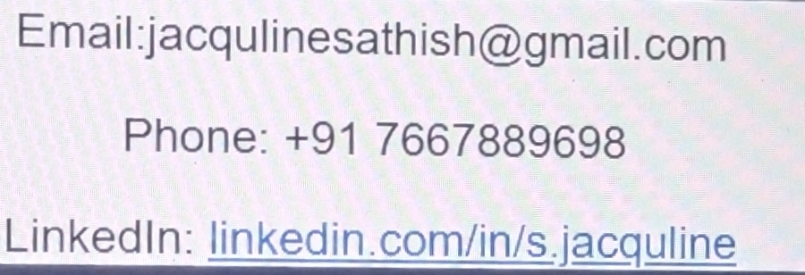
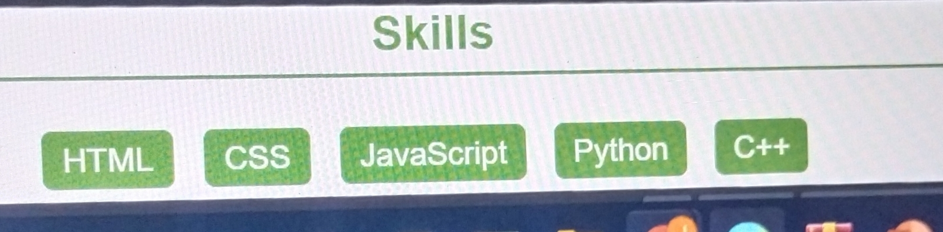
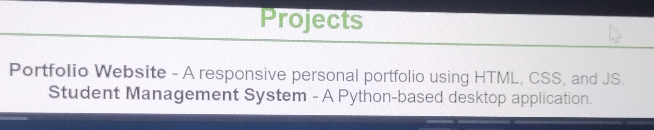
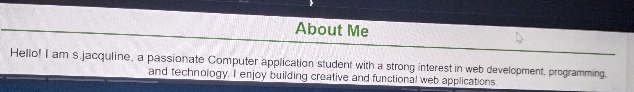
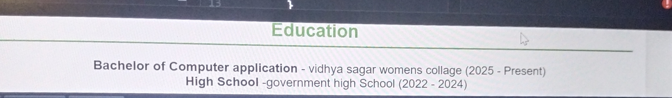
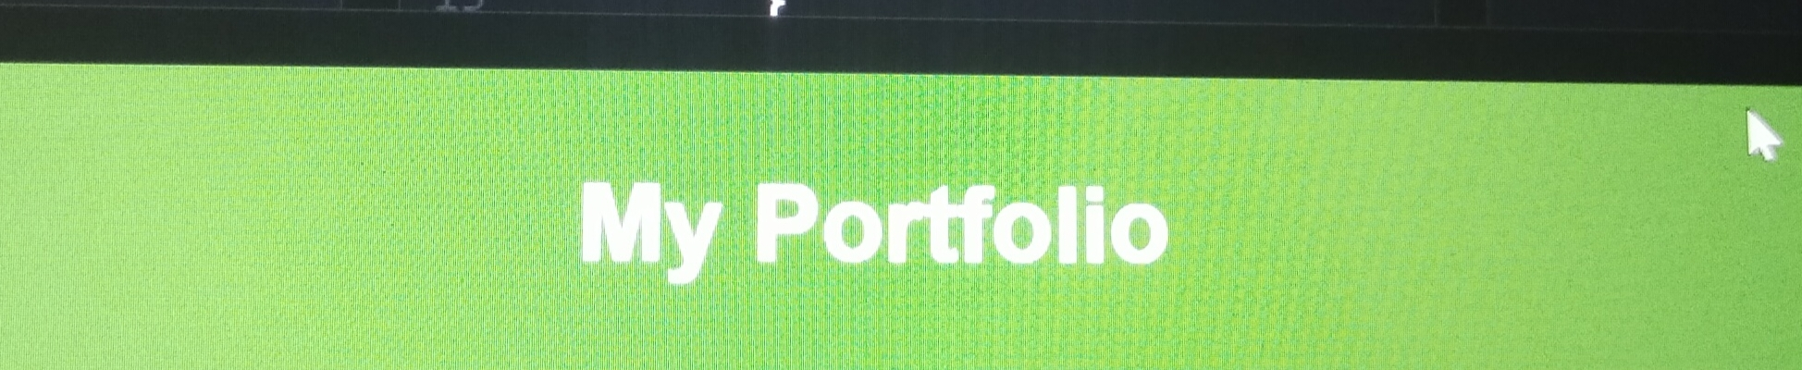
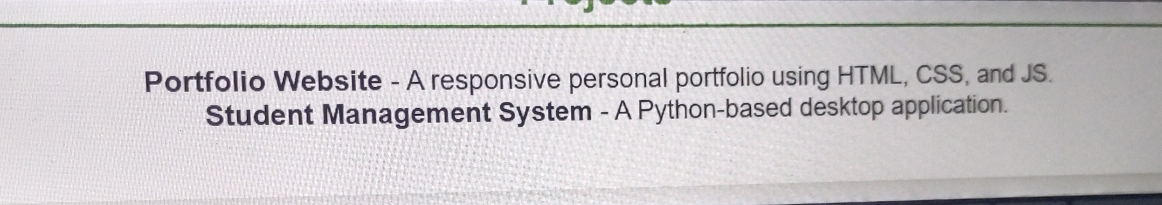
RESULTS AND SCREENSHOTS
3/21/2024 Annual Review
15

Slide 16
CONCLUSION
This portfolio website is a simple yet effective way to showcase personal details, education, skills, projects, and contact information in one place. By using HTML for structure, CSS for styling, and JavaScript for interactivity (like the back-to-top button), the site is both user-friendly and responsive.
It highlights professional identity while maintaining a clean and attractive design. Such a portfolio is very useful for students, freshers, or professionals to present themselves online and can be expanded in the future with more projects, animations, or backend integration.
16

