Slide 1
Welcome to SmartMeal
a Human Computer Interface project

Slide 2
Who are we and why are we here?
We’re a small, passionate team of students with a shared mission: to make healthy eating more accessible, personalized, and sustainable.
Thus, we created SmartMeal, an innovative food app designed to help users create personalized meal plans based on their calorie goals and available ingredients.
Meet the Team:
Balba Tudor-Neculai:
- interviews, market research, presentations, Balsamiq, testing, presentation
Jac Raul-Anton:
- Figma, testing

Slide 3
The Problems – What Are We Solving? And how?
Millions of people want to eat healthier, but they struggle because:
SmartMeal simplifies
meal planning in four steps:
Meal planning is time-consuming – Searching for the “right” recipe is overwhelming | Set Your Daily Calorie Target
Generic apps aren’t helpful – Most recipe apps don’t consider your calorie goals or what you already have at home | Select 1–2 Ingredients You Already Have
Health information is vague – Users rarely get detailed nutritional insights | Receive Tailored Meal Suggestions aligned with fitness or health goals
Food waste is common – People throw away ingredients they don’t know how to use | Get Detailed Nutrition + Alternatives and save meals you love

Slide 4

What Makes SmartMeal Unique?
Unlike generic food and recipe apps, SmartMeal is:
Personalised – Recipes adapt to your calorie goals and ingredients you already own.
Efficient – Smart substitutions suggest alternatives when you're missing something.
Informative – Each meal includes a full nutritional breakdown (macros + micros).
Focused – The UI is minimalist, fast, and tailored for people who don’t want to waste time.
We’re not just about recipes—we’re about relevant, healthy decisions.

Slide 5
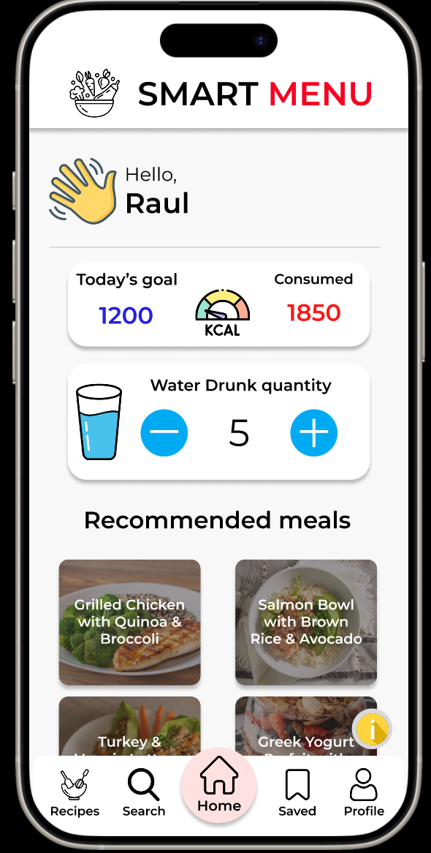
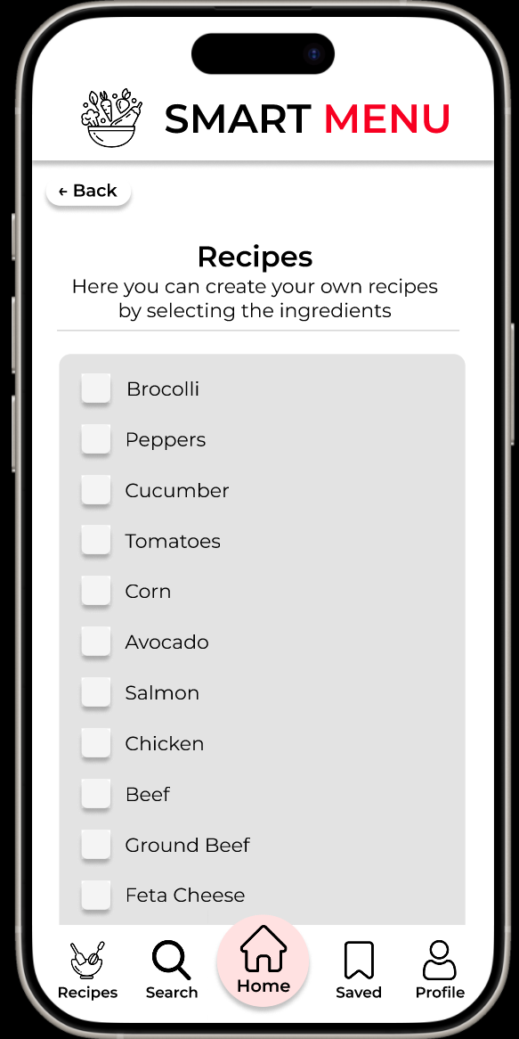
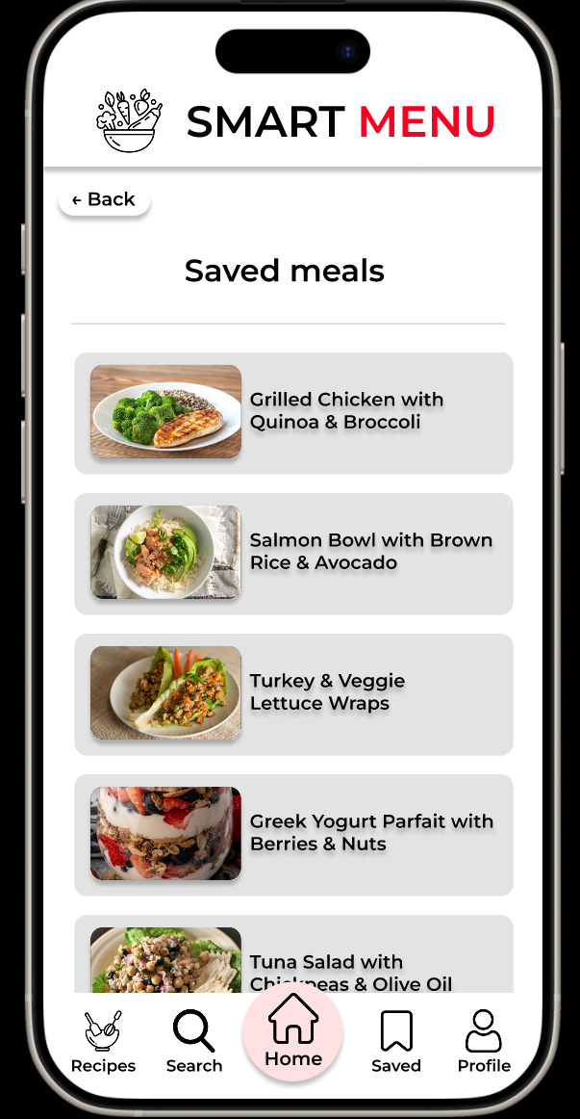
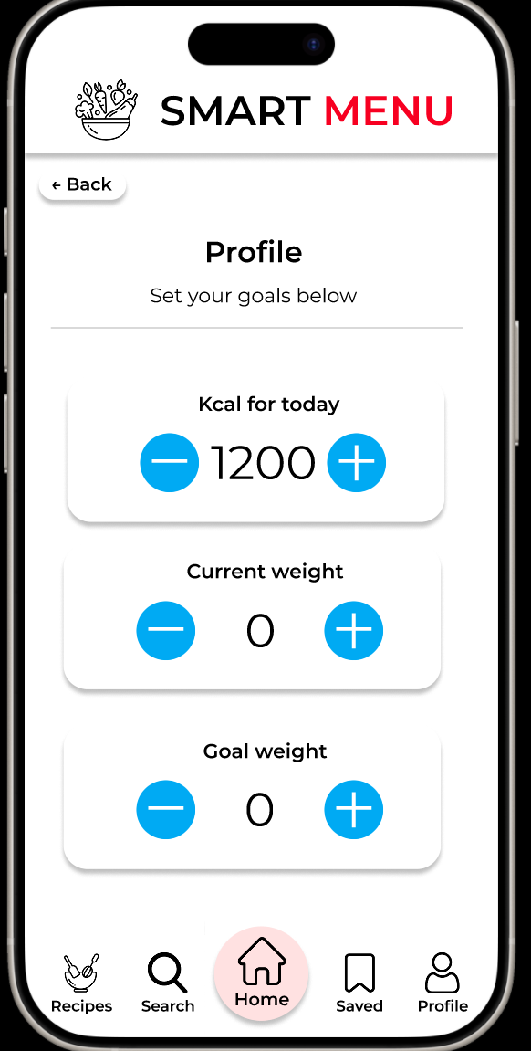
The Product – How It Works
SmartMeal App Features :
Home Screen: Set your calorie goal
Ingredient Input: Add up to 2 available ingredients
Meal Suggestions: Curated meals based on your inputs
Smart Substitutions: Suggested alternatives if you're missing something
Nutritional View: Macros, micros, and health scores
Save & Share: Bookmark your favorite meals

Slide 6
Traction – Is There Real Potential?
10+ Interviewed Users across 3 target personas (fitness, professionals, health-conscious)
Consistent Feedback: “Easy to use,” “Quick recipes,” “Love the nutrition info”
Tested Figma Prototype with early interest from students and gym-goers
Strong Validation during UX research phase (low task error, high satisfaction)

Slide 7
Competitor Landscape
Current Options:
MyFitnessPal: Great tracking, but no ingredient-based meal suggestions
Yummly: Recipe database, but not goal-driven
Tasty: High entertainment value, low personalization
SmartMeal Advantages:
Combines ingredient input + nutrition goals
Optimised for speed and simplicity
Ideal for people who don’t want to plan or think too hard

Slide 8
Market Size – Who Are We Targeting?
$100M
Primary Market Segments:
Fitness Enthusiasts
Busy Professionals
Health-Conscious Individuals
Students & Families
Estimated Global Market:
200 M+ users of health/fitness/diet-related apps
$ 4 B+ projected revenue in health-focused app space by 2026 (source: Statista)
We’re targeting a scalable, growing, and engaged user base.
$20M
$5M

Slide 9
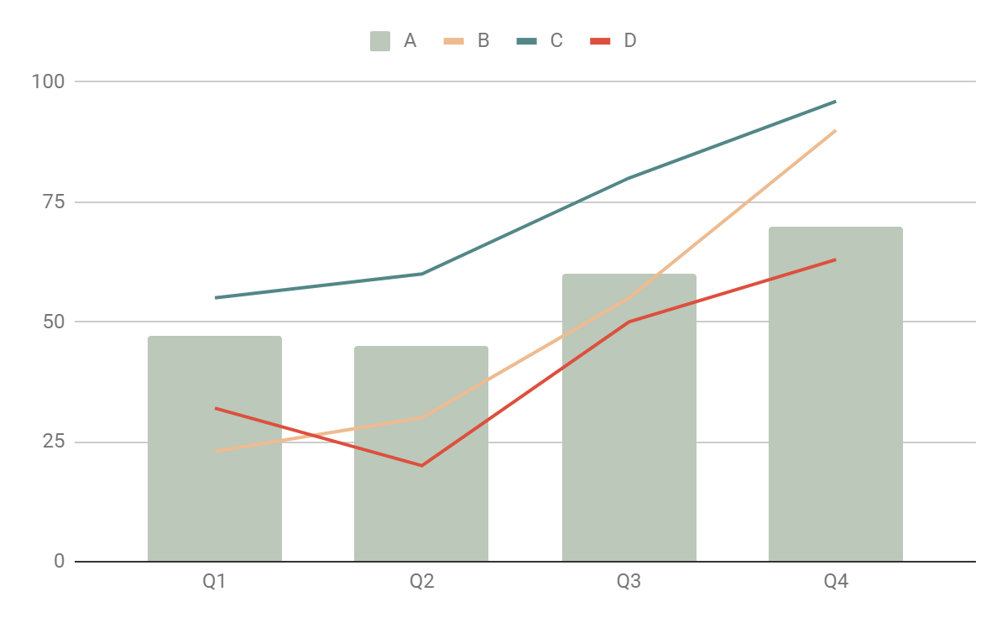
Business Model – How We'll Make Money
Freemium App:
-> Basic features (daily limit, ingredient input, basic suggestions) -> Premium: Advanced filters (keto, vegan), weekly meal plans, custom macros
In-App PurchasesRecipe packs, special diets (diabetic-friendly, workout boosters)
Affiliate/Partner DealsNutritional supplements, fitness apps, healthy food delivery

Slide 10

Funding & Next Steps
What We Need:
Looking for: €10,000–€20,000 in seed investment
Use of Funds:
MVP App Development
Nutritional Database Licensing
User Testing & UI Refinement
Launch & Marketing
Goal: MVP launch within 6 months, with 1000+ active users in Year 1.

Slide 11
Thank you!

