Slide 1


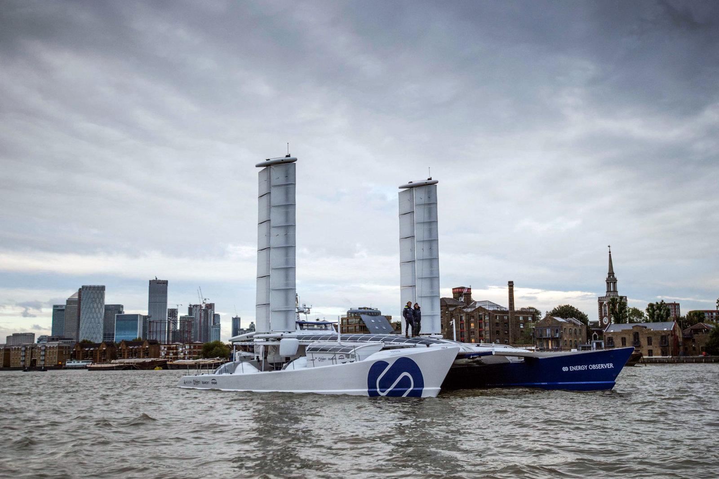
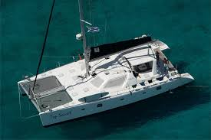
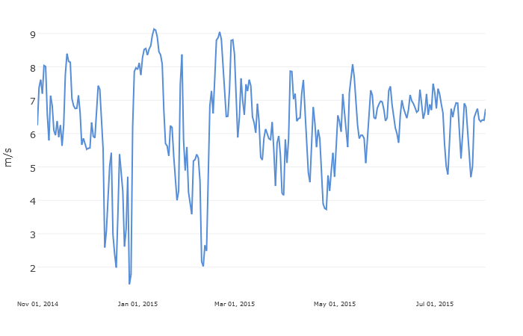
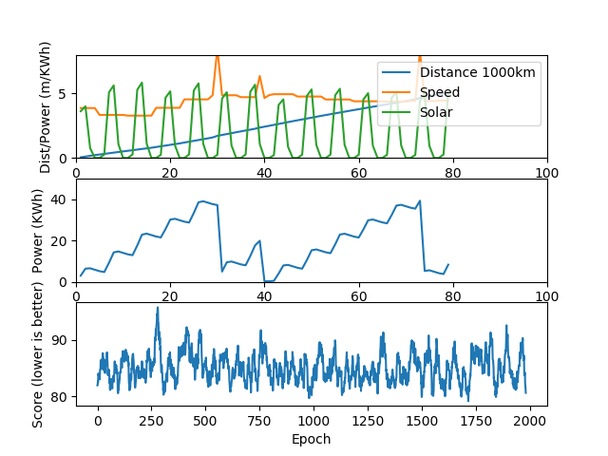
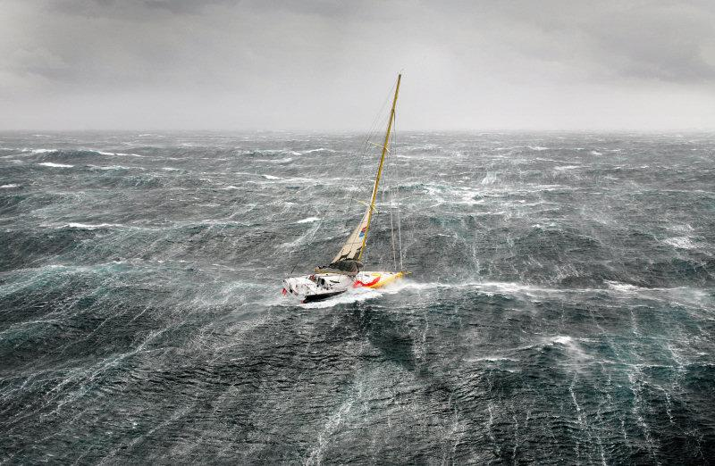
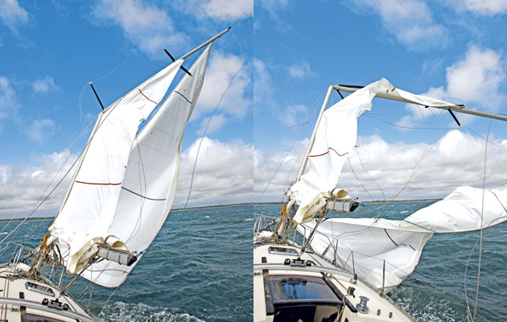
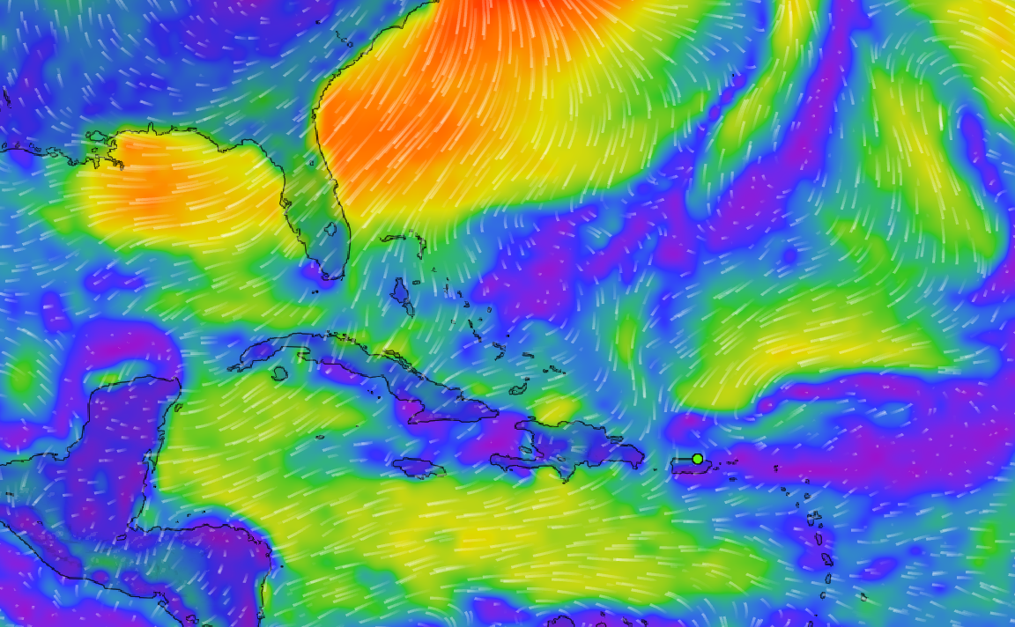
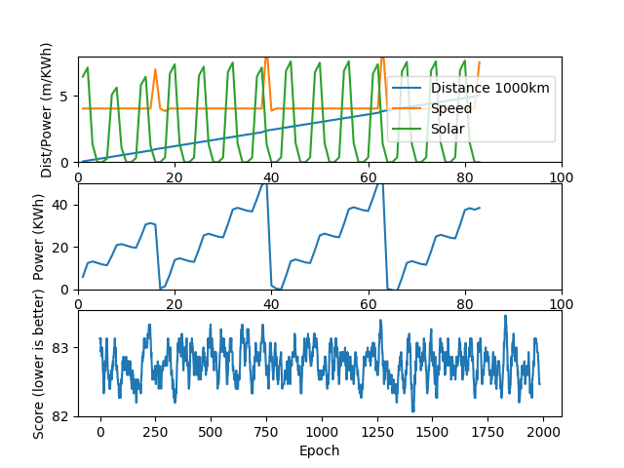
All Electric Sailboat
Jacob Strong
Machine Intelligence in Clean Energy ----- Fall 2019
Abstract
Learning Method
Summary
Many families and individuals abandon civilization to live on small yachts and sail boats. Nearly all are reliant on large diesel motors and generators for both mobility and powering boat systems. This project will prove or disprove the effectiveness and safety of implementing a battery system to replace the diesel motors. By implementing simple simulations of a sail boat then using regression learning to optimize run-time of the boat. Hopefully the results will lead to small scale implementations that can further prove that a system like this is possible.
Each period we feed to a reinforcement learning model the current state of the sailboat and the next 5 days of weather data. It can then choose how it wants to react. The actions it can take include running hydro regeneration, running the motors and at what speed.
After completing this work we are confident that a sailboat operated solely on renewable energy sources is feasible. In the situation we tested on we feel that it would have no disadvantage compared to a diesel powered system. It may in fact have the advantage that in case of catastrophic sail damage it could continue indefinitely unlike a diesel system.
Results
In the tests even with variation in the testing, the learner usually developed a system where it would save up energy then in a single burst use all of it.
One road block that we had was determining the effectiveness of our model when its performance was so heavily tied to wind speed.
Conclusion
Problem Description
Using a basic simulation of a modern cruising catamaran we simulate an Atlantic crossing with the use of battery energy storage instead of diesel motors/generators. A Reinforcement Learning method will be employed to manage the runtime of the sailboat.
The results were promising however we feel that there is much more work to be done to definitively show that a system similar to this could work for everyone. Things like long term cost effectiveness, maintenance needs, and emergency situations should all be considered moving forward.
This graph shows how wildly the wind speed change day to day. This at times made it hard to know weather our model was performing well on its own or if it just had a lucky pull of data.
Future Work
Energy Observer – hybrid catamaran
Top Secret – fully electric cruising catamaran
Refine simulation
Test against a diesel system for cost performance
Shorten testing period length to increase accuracy
Run simulation on different scenarios that don’t rely so much on wind speed, such as river passages, evading weather, raising/lowering tide, or tight space maneuvering.
Method
Wind speed graph
The sailboat simulation attempts to model a Leopard 45, a popular sailing catamaran. It is equipped with 4 electric 10 kWh motors capable of up to 500 Watt regeneration each. The boat is also equipped with 13 M^2 of solar with an average efficiency of 0.19
Data was gathered from a NASA database about weather conditions in a point along the Atlantic crossing route. Wind speed at 2 meters from the surface and the kWh of energy received per M^2 are used.
To help mitigate this we implemented a rolling average on our results to help smooth out the extremes. We also ran a second experiment that had a fixed wind speed to eliminate the variability that it causes.
Results using wind from data and rolling average over 2000 epochs.
Results with fixed wind and rolling average over 2000 epochs.
References
https://power.larc.nasa.gov/
https://www.leopardcatamarans.com/catamarans/leopard-45

