Slide 1
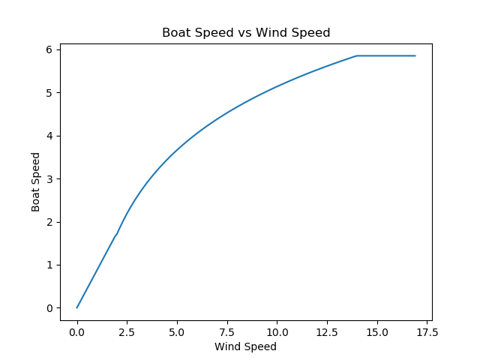
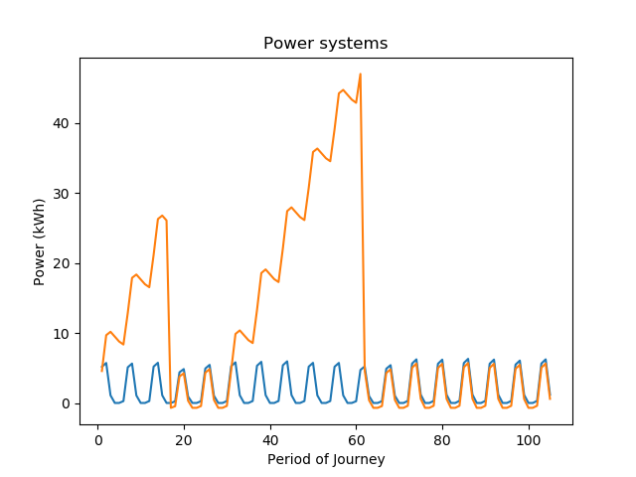
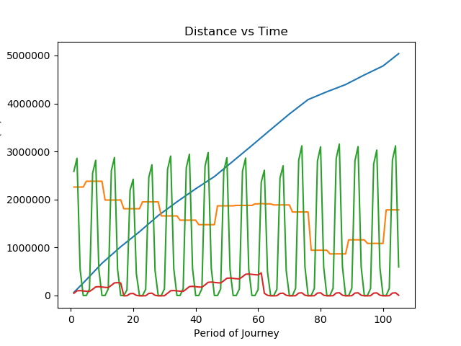
Method
Using a basic simulation of a modern cruising catamaran we simulate an Atlantic crossing with the use of battery and fuel cell energy storage instead of diesel motors/generators. A Reinforcement Learning method will be employed to manage the runtime of the sailboat.
Simulation
The sailboat simulation attempts to model a Leopard 45, a popular sailing catamaran. It is equipped with 4 electric 10 kWh motors capable of up to 500 Watt regeneration each. The boat is also equipped with 13 M^2 of solar with an average efficiency of 0.19
Data was gathered from a NASA database about weather conditions in a point along the Atlantic crossing route. Wind speed at 2 meters from the surface and the kWh of energy received per M^2 are used.
Reinforcement Learning
Each period we feed to a neural network the current state of the sailboat and the next 5 days of weather data. It can then choose how it wants to react. The actions it can take include running hydro regeneration, running the motors and at what speed, and to fill the hydrogen storage tanks and in what quantity.
Abstract
Many cruisers believe that a fully electric sailboat could rival the reliability and performance of a diesel powered boat. This work aims to prove that even under extreme circumstances a battery/fuel cell hybrid system could rival a diesel motor/generator system in performance.
Results
Pending completion
Summary
Many cruisers believe that a fully electric sailboat could rival the reliability and performance of a diesel powered boat. This work aims to prove that even under extreme circumstances a battery/fuel cell hybrid system could rival a diesel motor/generator system in performance.
Future Work
Refine simulation to be more realistic
Shorten period length to increase accuracy
Run simulation on different scenarios that don’t rely so much on sailing
References
https://power.larc.nasa.gov/
https://www.leopardcatamarans.com/catamarans/leopard-45

