Slide 1
LoRaWAN Temperature Sensors Array
Intern Project 4; Innovation Central Perth; City of Melville

Slide 2
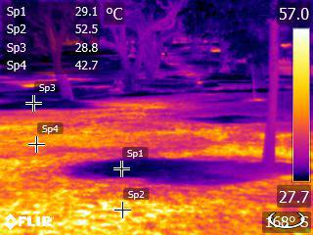
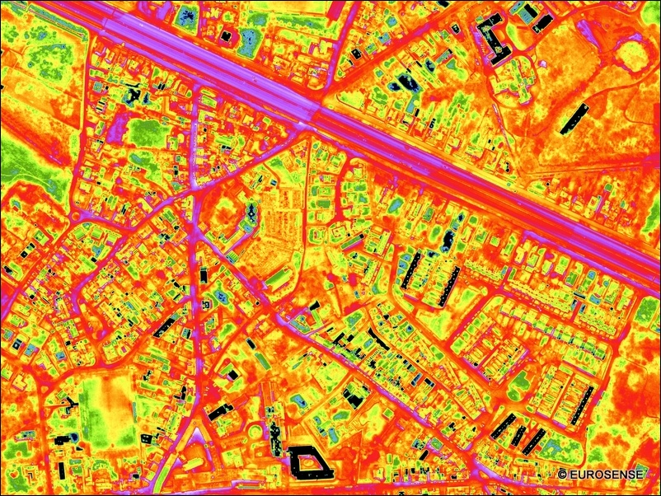
The Problem
Source: https://twitter.com/franvdberg
Source: http://www.eurosense.com/documents/offices/belgium/news-archive/thermo_gent.xml?lang=en-gb

Slide 3
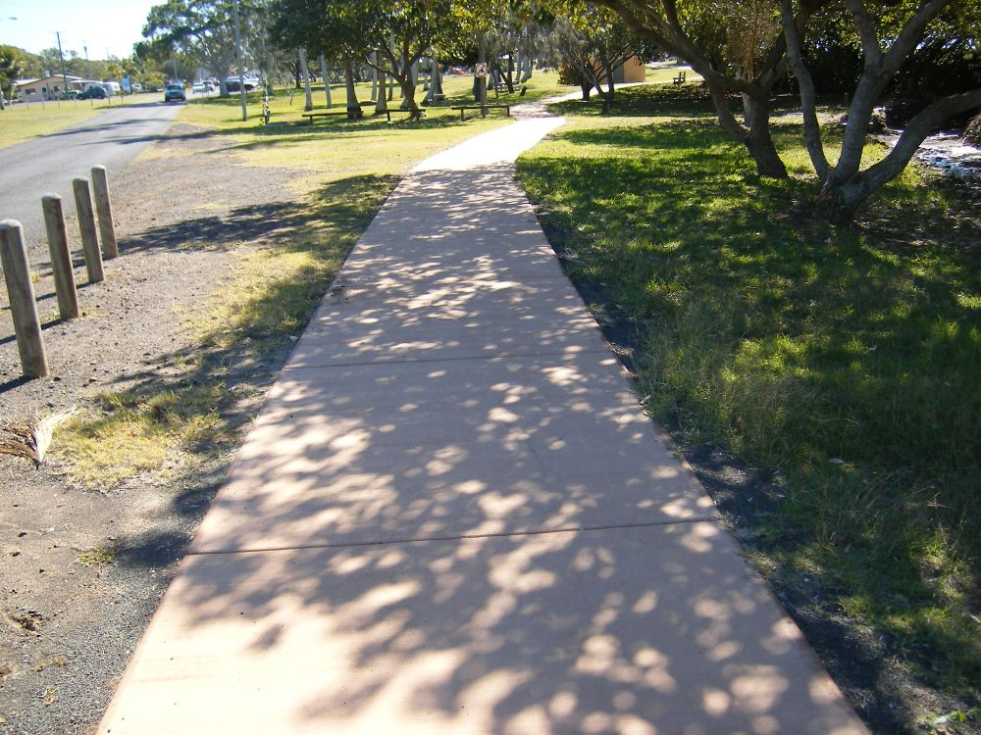
The Problem
Source: https://www.pakistantoday.com.pk/2017/06/07/pedestrian-face-problems-due-to-lack-of-footpaths-in-lahore/

Slide 4
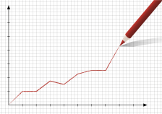
Challenge
Material specific, Temporal data
Source: http://www.casanz2015.com/Picture-Of-Line-Graph-electrical.html

Slide 5
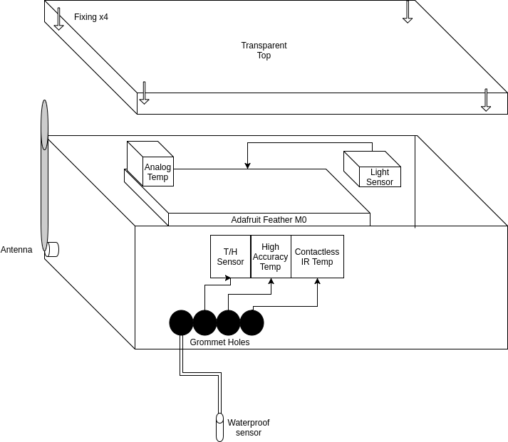
Approach – The Device

Slide 6
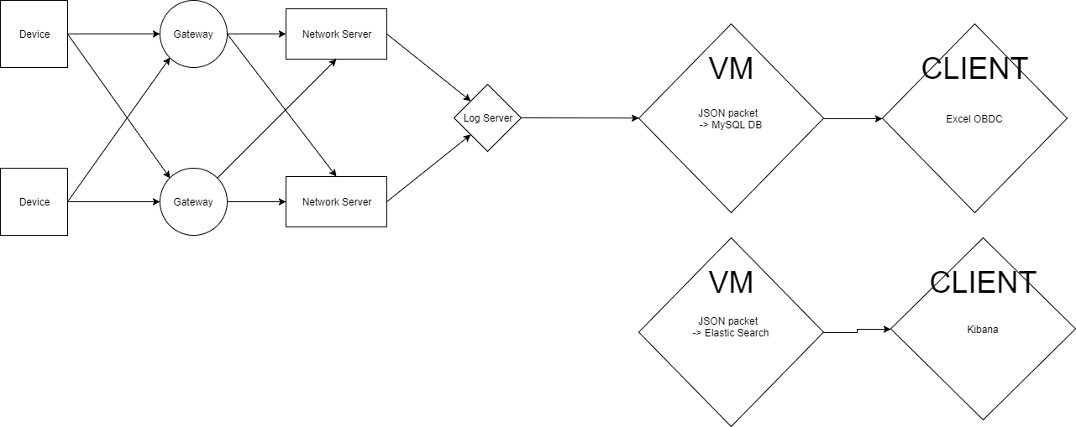
Approach – The Network

Slide 7
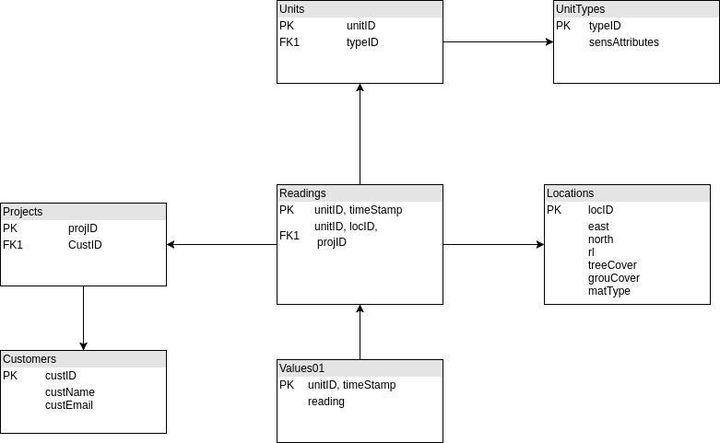
Approach – The Database

Slide 8
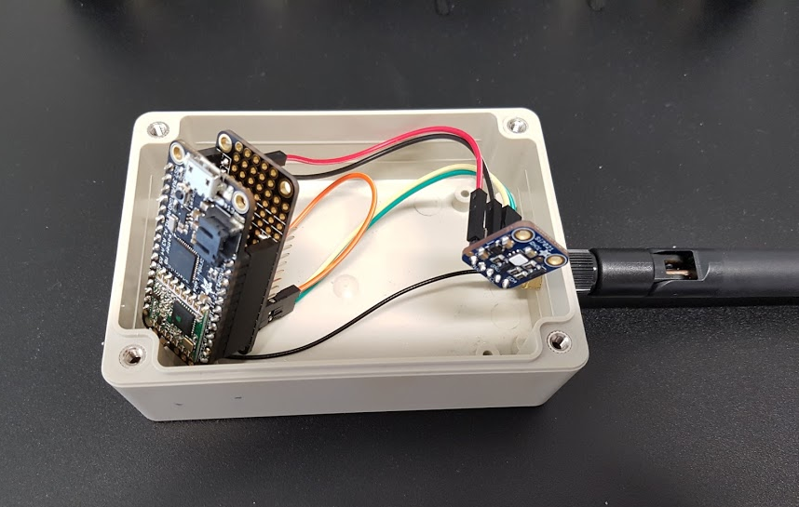
Progress to Date – The Device

Slide 9
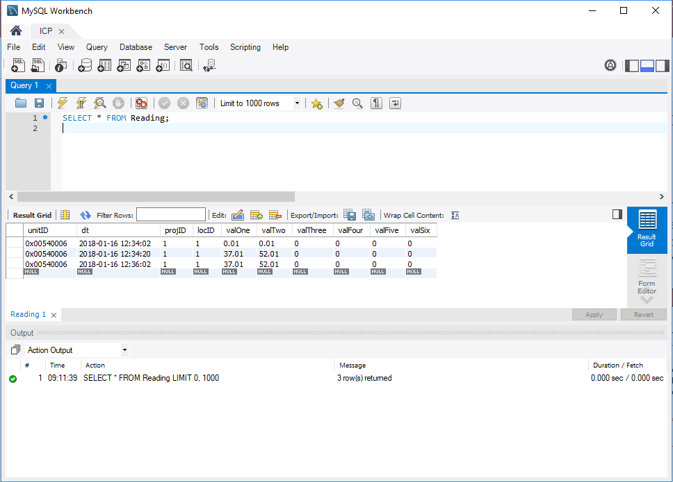
Progress to Date – Data Capture

Slide 10

Next Steps

