Slide 1
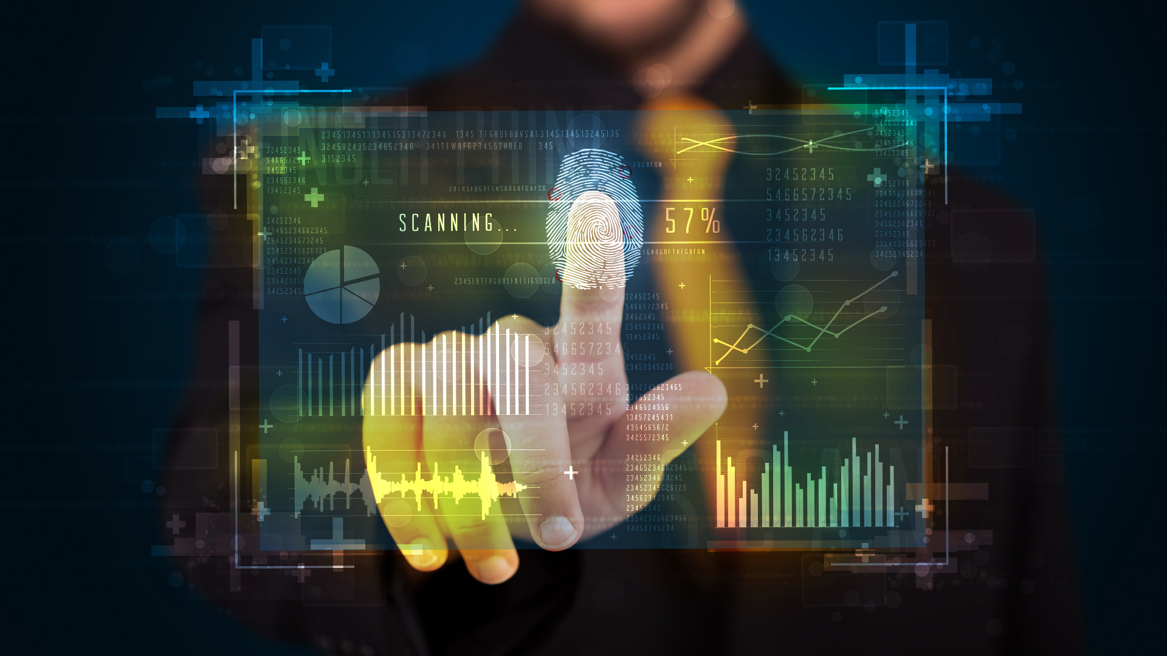
Biometrics

Slide 2
Content
What is biometrics?
History of biometrics
Current use of biometrics
Future of biometrics
Conclusion

Slide 3
What is biometrics?
Definition and functioning
recognition and measurement of unique physical or behavioral characteristics possessed by individuals.
fingerprint
facial recognition
iris scans

Slide 4
History of biometrics
Development over the years
Early Beginning
Ancient civilizations, such as the Babylonians and Egyptians
Modern Era
19th century , fingerprints identification.
Early applications:
anthropometry,
forensic investigations

Slide 5
Current use of biometrics
Applications:
access control, identity verification, fraud prevention
Examples:
Smartphones
Movie vault
airports

Slide 6
Future of biometrics
palm prints, vein patterns, and DNA analysis
Potential developments:
Widespread Adoption
palm prints, vein patterns, and DNA analysis
Challenges and risks:
privacy, security

Slide 7
Conclusion
importance of biometrics and its impact on our daily lives
privacy, security
access control, identity verification, fraud prevention

Slide 8

Are there any questions?

