Slide 1

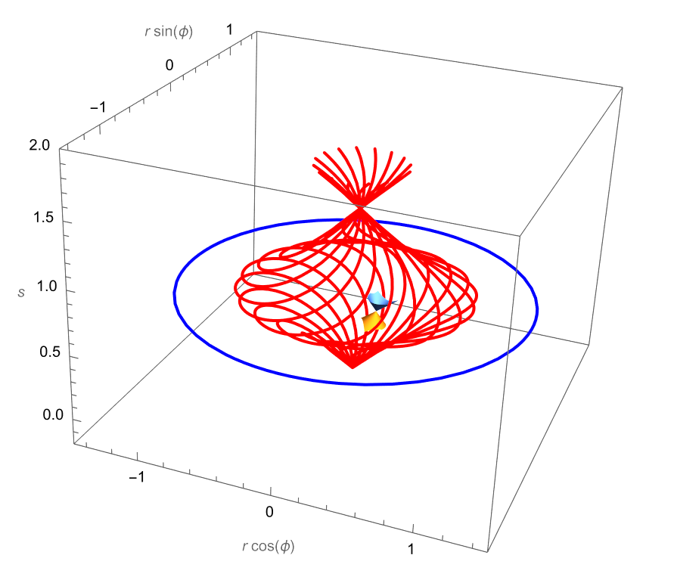
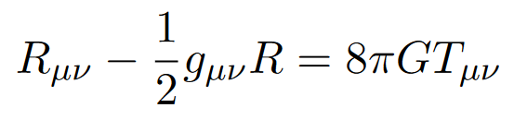
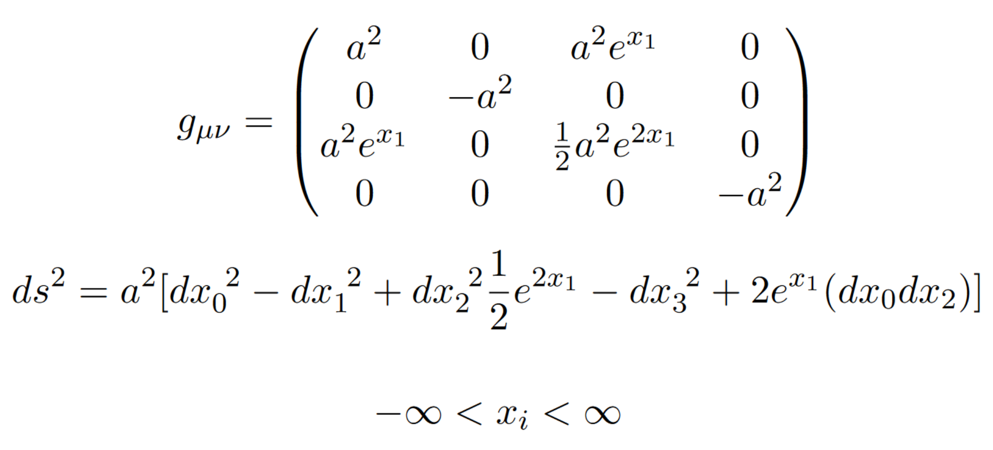
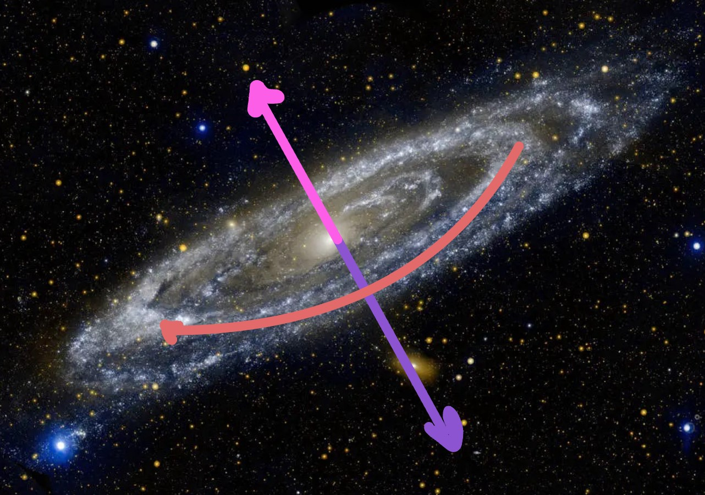

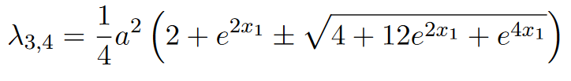



An exploration of xAct as a tool for generating perturbations in the
Gӧdel metric
Jada Garofalo, Andrew Colosimo, under the advising of G. Scott Watson – Syracuse University Physics Department
Background information
In 1949, Kurt Gӧdel proposed an exact solution (i.e. a solution without restrictions for simplification) to Einstein’s field equations for general relativity. This solution assumes a homogeneous and anisotropic distribution of matter that is treated as dust particles moving with rotational symmetry (see Fig. 1). This distribution allows for a pressure-free solution to the stress-energy tensor $T_{μν}$ and a negative Lorentzian cosmological constant, along with a dependence on an angular velocity ω. It is a global chart that is homeomorphic to $R^{4}$.
This solution is important as an example of a metric that (at galactic scales) permits closed time-like curves (CTCs).
Experimenting with perturbations
In general relativity, we define perturbations as changes in our metric, given as $g_{μν}$, as shown in Einstein’s field equations below.
In the linked code, we defined a more general metric and applied a perturbation $h_{ab}$ to the general metric $g_{ab}$. This allowed for us to call functions that would generate the equations of motion in a few lines of code, as opposed to pages of algebraic steps.
Defining the Gӧdel metric
As shown in the linked code, to define the Gӧdel metric in xAct, first we had to establish a manifold, generalize a metric, and define a coordinate basis. We then analyzed how the eigenvalues of the metric (shown below) evolve in space to implement the proper signature (-2) so that we could begin to evaluate values using our definition.
Fig. 1: A graphical representation of the distribution of matter in the Gӧdel metric using cylindrical coordinates [1]
What is xAct?
xAct is a library for Wolfram Mathematica that allows for complex tensor manipulations to be computed rather efficiently. It is effectively the equivalent of upgrading from writing a paper with a crayon to typing it in LaTeX.
This library contains several packages that aid in these calculations, namely xTensor, xPert, xCoba, xPand, etc. Through developing a literacy with such tools, we can effectively do pages upon pages of algebra in a few lines of code.
Next steps!
To further explore the Gӧdel metric, we plan on implementing these principles of perturbation theory to the metric at large scales in order to see how the CTCs respond. This will provide insight into how stable the solution is and what it can tell us about assumptions other metrics implore.
Fig. 2: An illustration of the gravitational force vector (purple), rotation vector (pink), and CTC path (orange) at a galactic scale [3]
Hi! Please scan this QR code to see a GitHub [2] repository with pertinent resources and code!
Acknowledgements
[1] Figure 1 provided by Enrique Zeleny and Wolfram Demo. Project: http://demonstrations.wolfram.com/GoedelsUniverse/
[2] Thank you to GitHub for providing a space for hosting our code: https://github.com/jada-garofalo/godel-perturbations/tree/main
[3] Image for Figure 2 provided by NASA: https://www.nasa.gov/image-article/galaxy-next-door/
[4] And of course, the original paper from Kurt Gӧdel: https://journals.aps.org/rmp/pdf/10.1103/RevModPhys.21.447

