Slide 1

Team 8 – The Hub
Members:
Ahmad Elmahallawy
Jedd Song
Hicham Mazouzi
Anirudh Boddu
Date: 7-Nov-2022

Slide 2


X
The Hub

Slide 3
The Task
Create a web app where young people can share and connect around ideas and issues important to them in their communities.
Few requirements:
Mobile-Friendly
Revolves around Ideas and Challenges
Explore and view all ideas/challenges around the wolrd

Slide 4


Our solution
Demonstration

Slide 5




Our stack

Slide 6
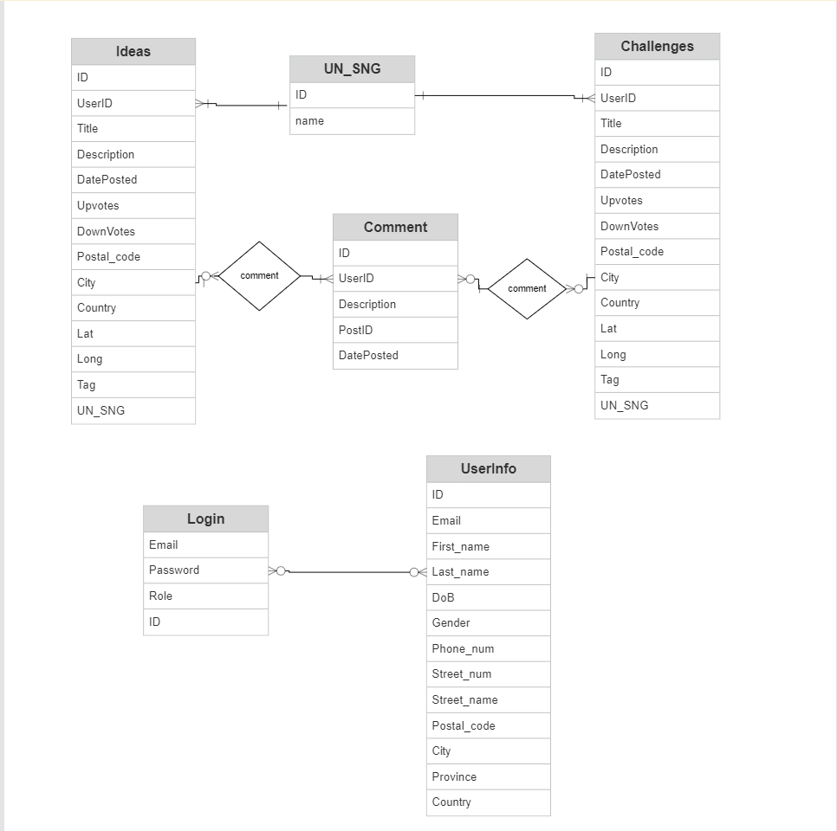
ERD Diagram

Slide 7
Thank You !

