Slide 1
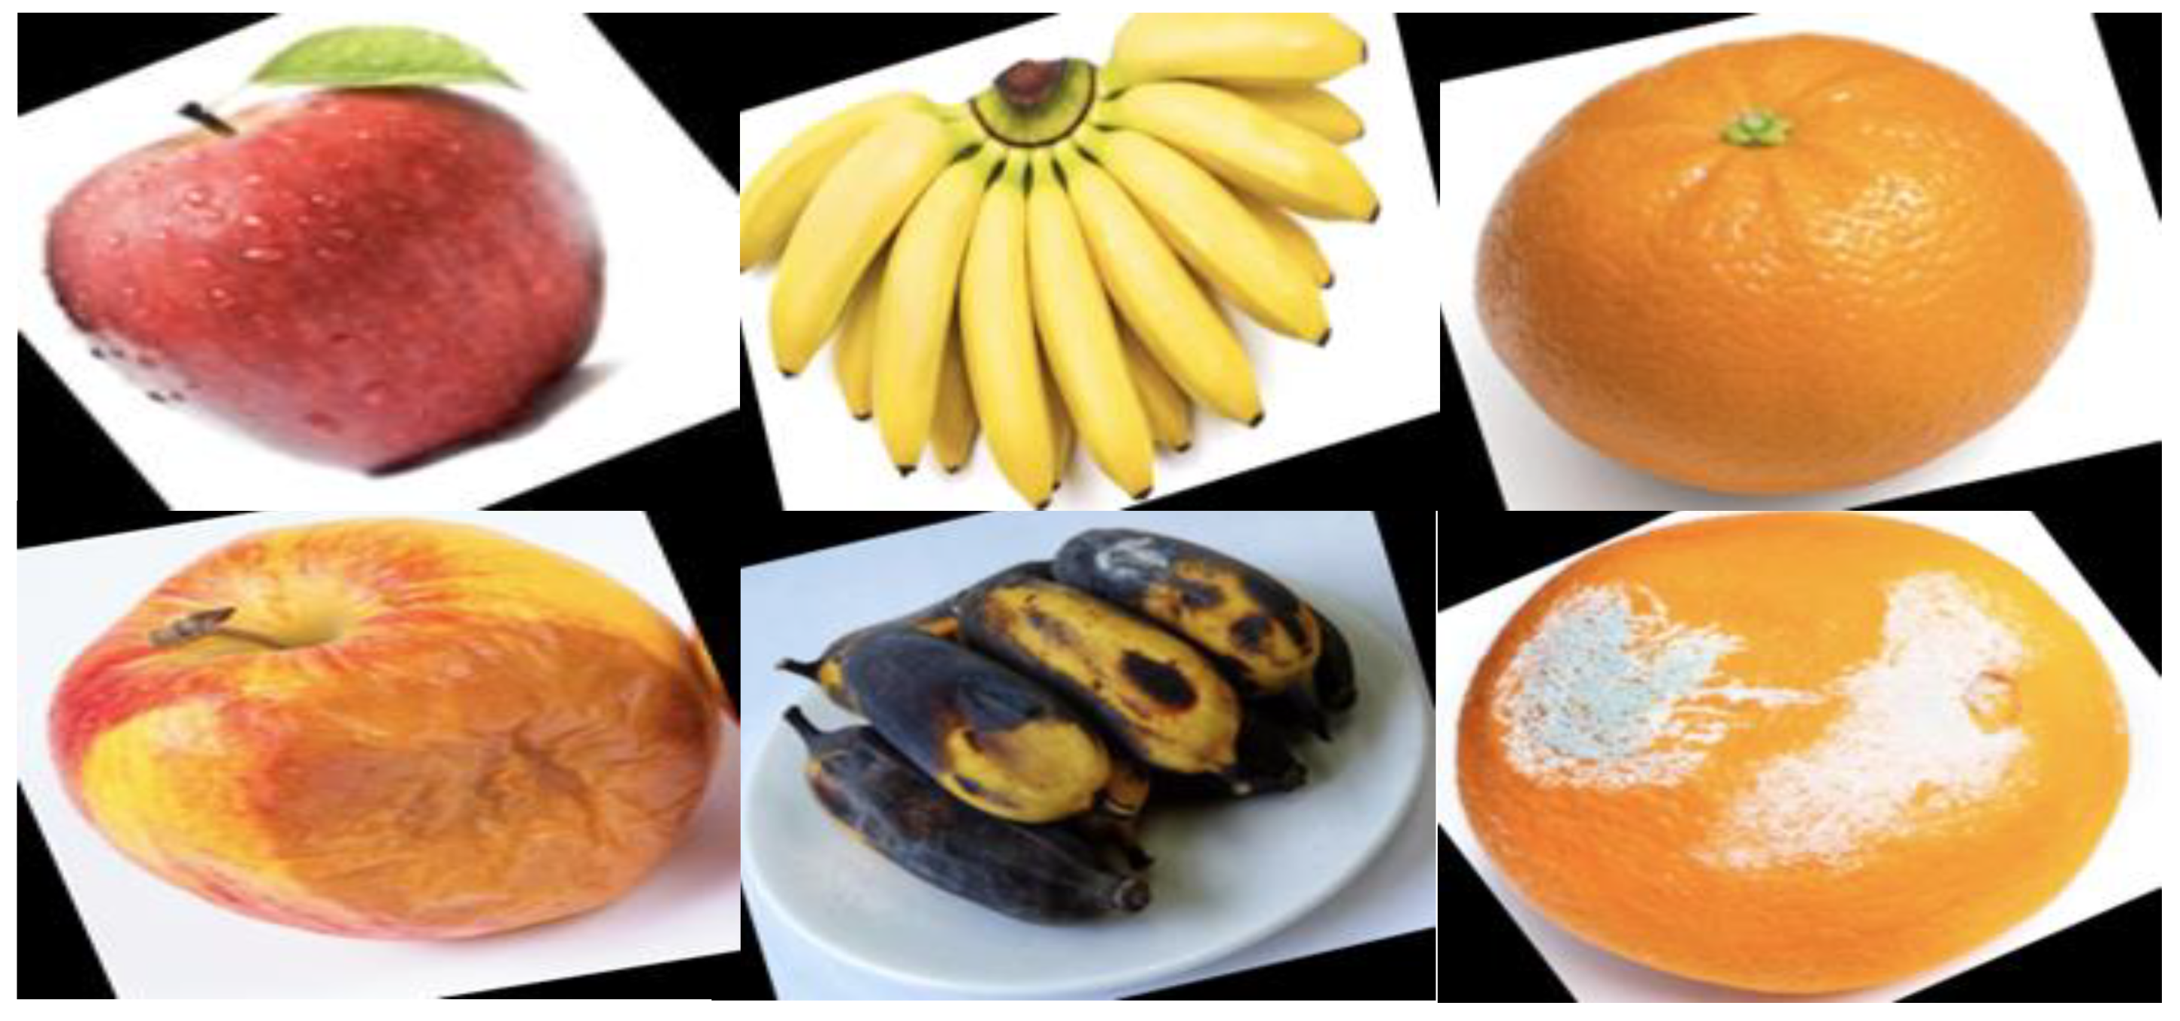
Smart Sorting System Using Flask & VGG16
Intern Name: J Amrutha Lakshmi
Internship Program: APSCHE Short-Term Internship on AI/ML
Roll Number: 22HM1A0545
Demo Video: https://github.com/jadaamruthalakshmi/Smart-Sorting-Project/blob/main/Project%20demonstration%20video/Demo%20video.mp4
Platform: SmartInternz & GitHub

Slide 2
Objectives
- Build a system to classify fruits/vegetables as healthy or rotten
- Apply transfer learning using VGG16
- Deploy the model using Flask
- Complete the ML lifecycle from data to deployment

Slide 3
Tools & Technologies
- Programming Language: Python
- Libraries: TensorFlow, Keras, Pandas, NumPy, Matplotlib, PIL
- Web Framework: Flask
- Model: Pre-trained VGG16
- Dataset Source: Kaggle

Slide 4
Project Workflow
1. Data Collection
2. Data Preparation
3. Model Training (VGG16)
4. Testing & Evaluation
5. Flask App Integration
6. UI & Deployment
7. Documentation & Demo

Slide 5
Dataset Information
- Total Classes: 28 (Fruits & Vegetables)
- Healthy and Rotten samples
- Downloaded from Kaggle
- Pre-augmented dataset
- Data split into Train/Test folders

Slide 6
Model Building
- Base Model: VGG16 (frozen layers)
- Added Layers: Flatten, Dropout, Dense (Softmax)
- Optimizer: Adam
- Loss Function: Sparse Categorical Crossentropy
- Saved Model: healthy_vs_rotten.h5

Slide 7
Testing the Model
- Used predict() function for image classification
- Predicted sample classes:
• Apple_healthy
• Strawberry_rotten
• Tomato_rotten
- Model was accurate across unseen test data

Slide 8
Flask Web Application
- HTML Templates: index.html, output.html
- Upload image through UI
- Display predicted result dynamically
- Integrated with saved model

Slide 9
Demo Video Summary
- Shows Flask app running on localhost
- Image upload interface
- Model predicts and displays class label
- Link: : https://github.com/jadaamruthalakshmi/Smart-Sorting-Project/blob/main/Project%20demonstration%20video/Demo%20video.mp4

Slide 10
Conclusion
- Successfully implemented end-to-end ML project
- Demonstrated image classification with VGG16
- Deployed user-friendly interface with Flask
- Learned full AI pipeline including deployment

Slide 11
References
- Kaggle Fruits & Vegetables Dataset
- TensorFlow & Keras Documentation
- Flask Official Docs
- SmartInternz APSCHE Portal

Slide 12
Thank You!
Any Questions?
GitHub Repository:
https://github.com/jadaamruthalakshmi/Smart-Sorting-Project/tree/main

