Slide 1
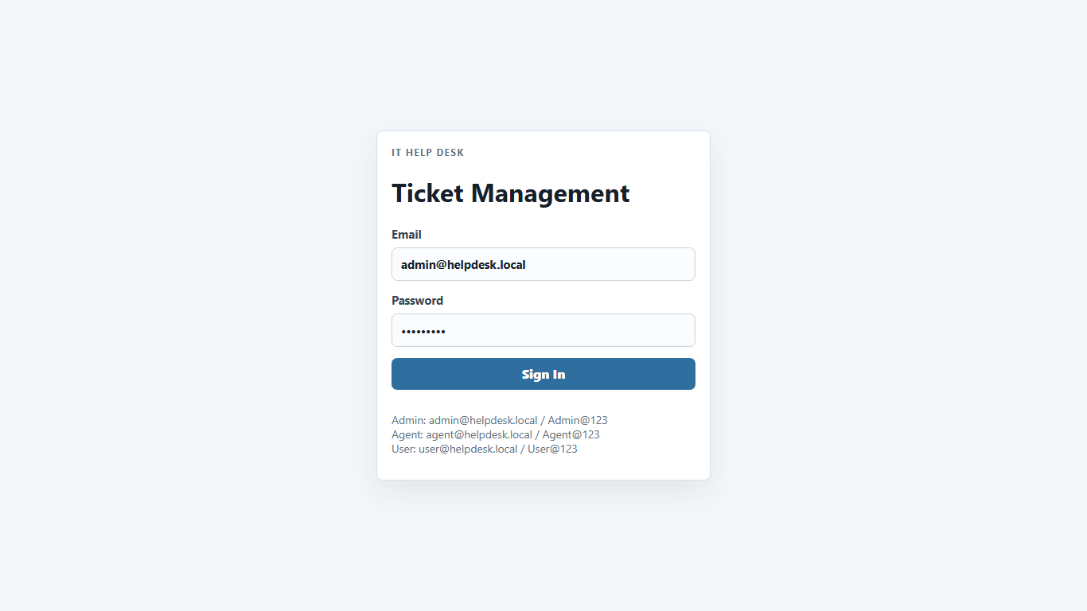
IT Help Desk
Ticket Management System
A full-stack SaaS-style support workflow for tickets, roles, reports, attachments, notifications, and AI assistance.
React + Vite
ASP.NET Core
JWT + SignalR
SQLite / PostgreSQL
IT Help Desk Ticket Management System
01
Notes:
Open with the product story: this is not just CRUD; it is a complete support workflow.
Mention live frontend/backend URLs if presenting online.

Slide 2
WHY IT MATTERS
The operational problem
Requests scatter
Ownership is unclear
Reporting is manual
Issues arrive through chat, email, and hallway conversations without a reliable record.
Support agents need a visible queue, assignment history, and status accountability.
Managers need quick answers about backlog, urgency, workload, and resolution progress.
IT Help Desk Ticket Management System
02
Notes:
Frame the project as a practical operating system for support work.

Slide 3
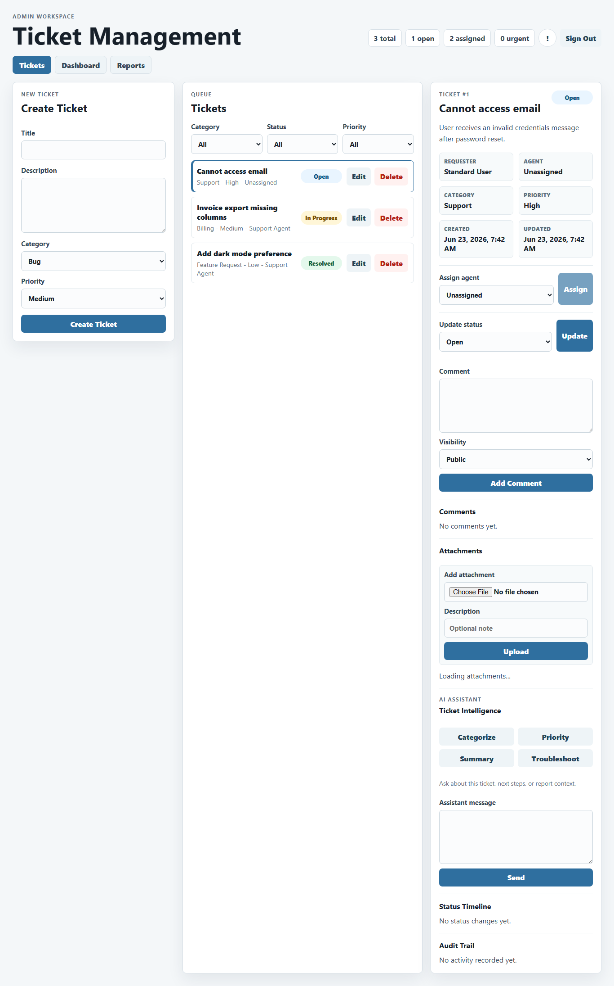
WHAT IT DOES
Product overview
Centralizes tickets from request to resolution.
Separates Admin, Agent, and User experiences.
Tracks comments, attachments, status history, notifications, and audit activity.
Turns support activity into dashboards, filters, PDF exports, and Excel exports.
Integrates optional AI assistance without exposing provider keys to the frontend.
IT Help Desk Ticket Management System
03
Notes:
Keep this slide focused on value: visibility, accountability, and reporting.

Slide 4
IMPLEMENTATION
Technology stack
Frontend
Backend
Security
React 19, Vite, React Query, Recharts
ASP.NET Core / .NET 9 Web API, EF Core
JWT bearer auth, role policies, login rate limiting
Data
Realtime
Deployment
SQLite by default; PostgreSQL provider included
SignalR notification hub and client
GitHub Pages, Docker, Railway, Render example
IT Help Desk Ticket Management System
04
Notes:
Mention that the stack is intentionally deployable: static frontend plus containerized API.

Slide 5
SYSTEM DESIGN
Architecture
React + Vite UI
REST API
ASP.NET Services
EF Core
SQLite / PostgreSQL
Config boundary
SignalR path
AI provider keys, JWT secret, database connection, CORS, and upload limits stay backend-side.
Notifications use a dedicated hub so clients refresh notification state in real time.
IT Help Desk Ticket Management System
05
Notes:
Walk left to right: browser, protected API, services, database, and realtime channel.

Slide 6
PERMISSIONS
User roles
Admin
Agent
User
Full visibility, ticket assignment, metadata edits, deletion, dashboard, reports, and exports.
Assigned + unassigned queue, claim workflow, status changes, internal notes, attachments, and AI support.
Create requests, track own tickets, comment publicly, and attach supporting files.
IT Help Desk Ticket Management System
06
Notes:
Use this to explain why the same app feels different depending on who signs in.

Slide 7
CORE WORKFLOW
Ticket lifecycle
Create
Categorize
Assign / Claim
Work
Resolve
Report
Statuses: Open, Assigned, In Progress, Waiting for User, Resolved, Closed.
Priorities: Low, Medium, High, Urgent.
Every meaningful action is visible through detail, status history, comments, or activity logs.
Agents can claim unassigned tickets without receiving full admin permissions.
IT Help Desk Ticket Management System
07
Notes:
This slide is the bridge from architecture into the live demo flow.

Slide 8
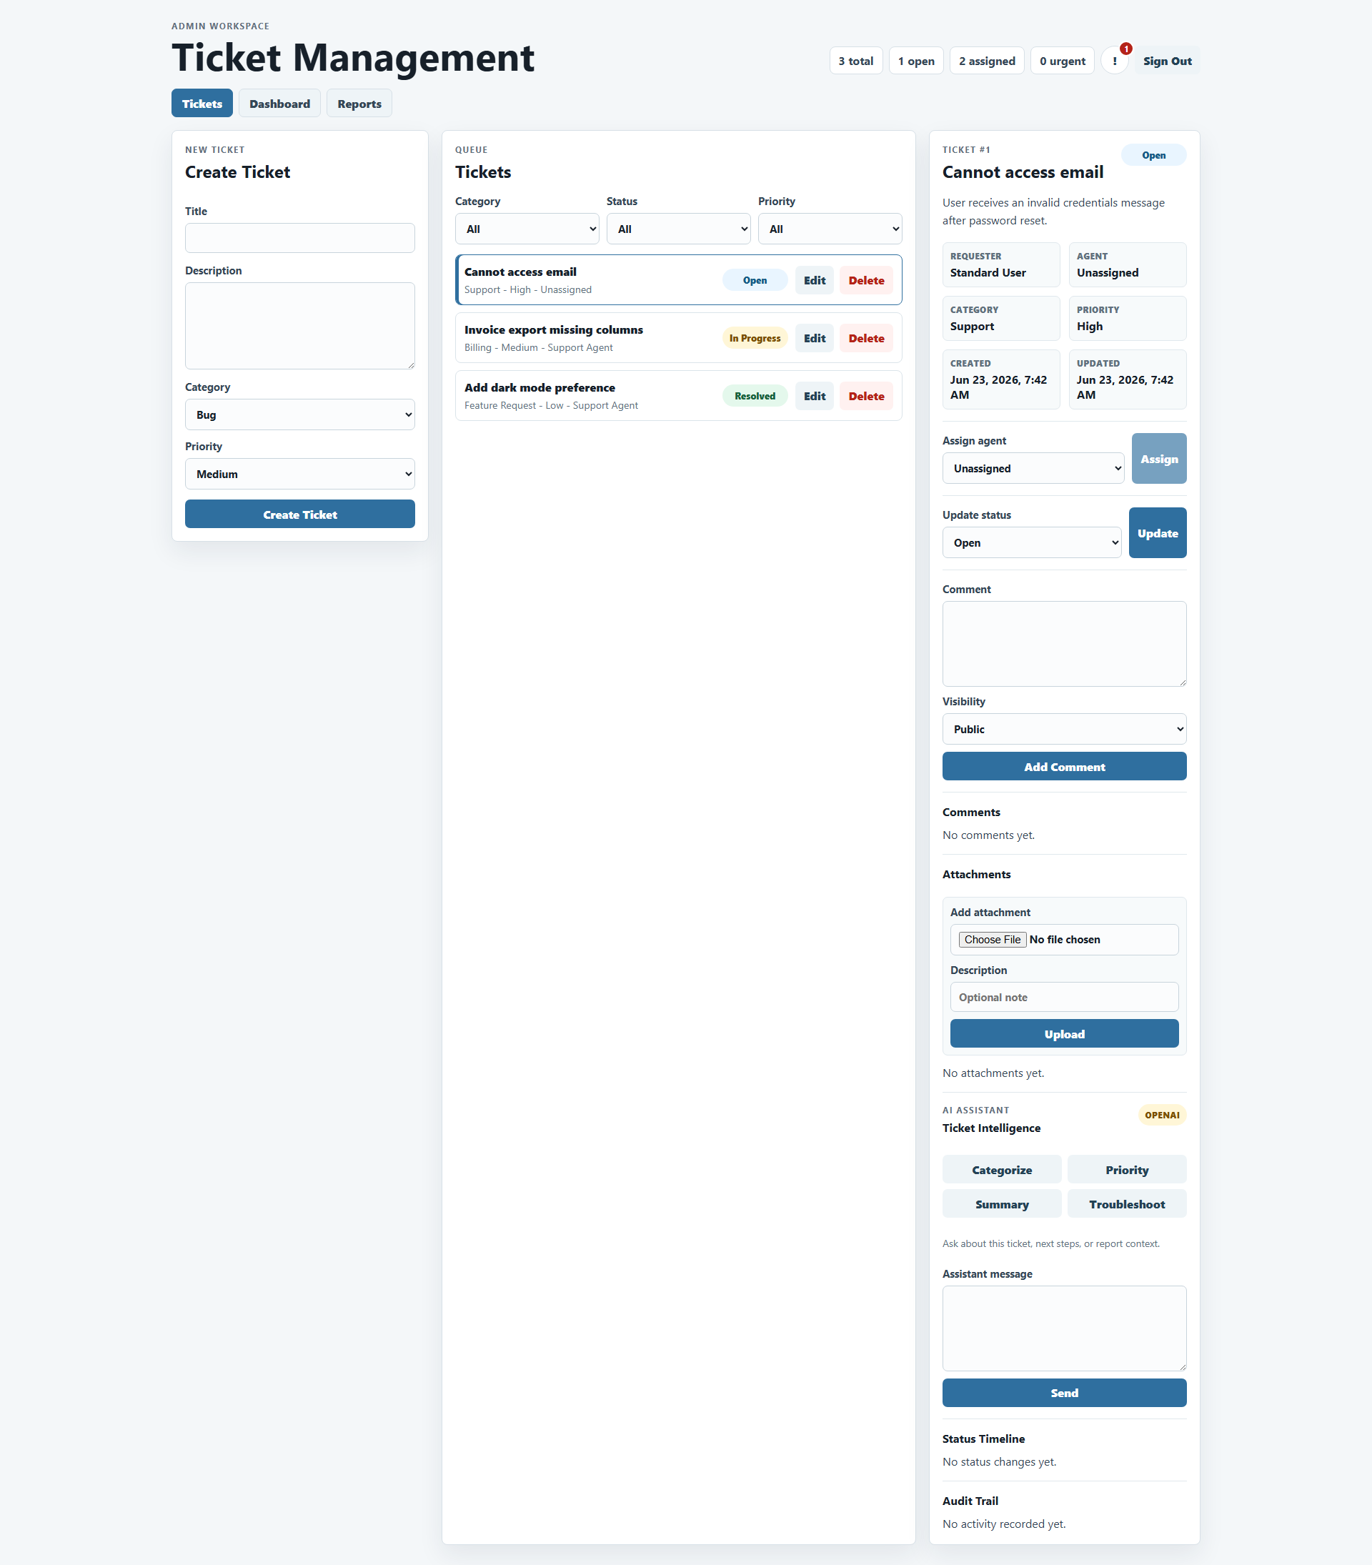
PRODUCT EXPERIENCE
UI showcase
Role shortcuts, responsive layout, readable states, and a SaaS-style visual system.
IT Help Desk Ticket Management System
08
Notes:
Call out that screenshots are repository QA artifacts embedded directly into the deck.

Slide 9
ADMIN VIEW
Admin workspace
Broad ticket visibility.
Assign or reassign agents.
Edit ticket metadata and delete when appropriate.
Open dashboard and reports for operational review.
IT Help Desk Ticket Management System
09
Notes:
In the live demo, show the admin assigning and then moving to reports.

Slide 10
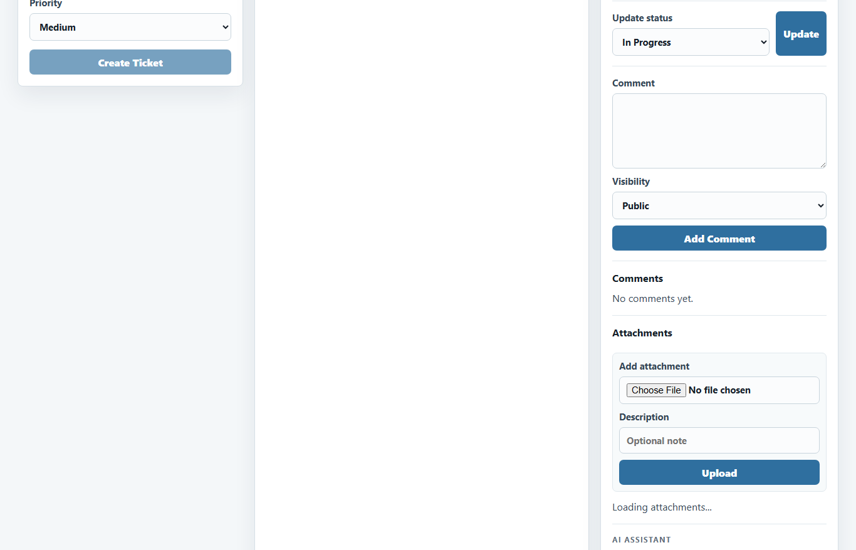
AGENT VIEW
Agent workspace
Assigned and unassigned tickets are visible.
Claim creates ownership without admin power.
Status updates and internal notes support day-to-day work.
AI panel supports summarization and troubleshooting when configured.
IT Help Desk Ticket Management System
10
Notes:
Emphasize the claim workflow: it fixes the common problem of unowned work.

Slide 11
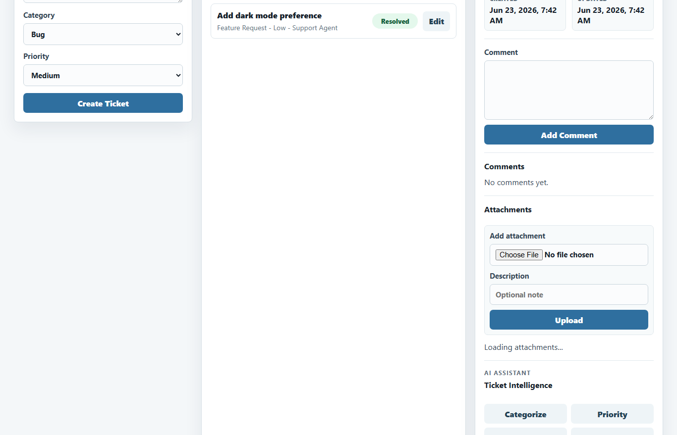
REQUESTER VIEW
User workspace
Simple request creation.
Users see their own tickets.
Public comments support back-and-forth communication.
Attachments keep evidence connected to the request.
IT Help Desk Ticket Management System
11
Notes:
Keep this slide simple: user experience is intentionally low-friction.

Slide 12
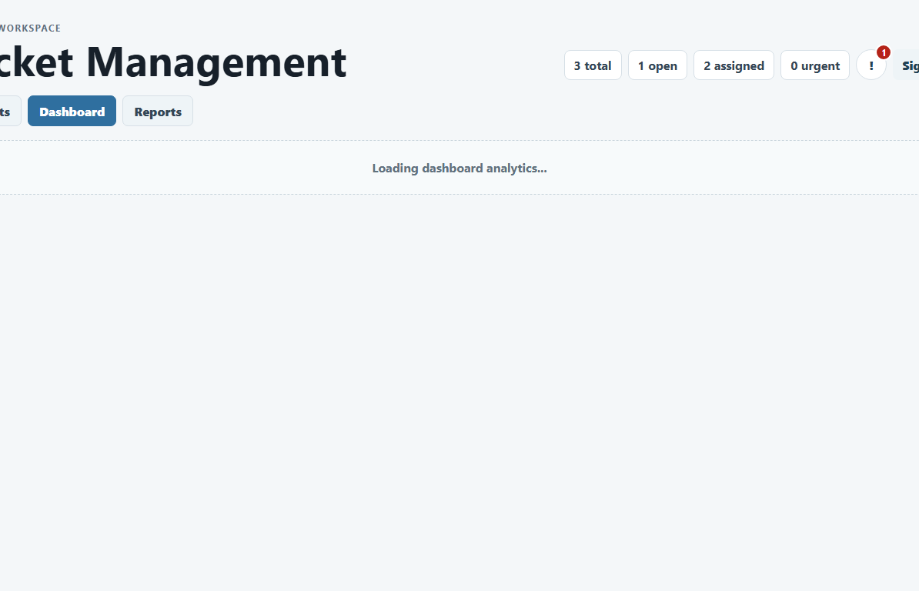
OPERATIONS
Dashboard and analytics
KPIs, status distribution, activity trends, and recent activity provide a fast support-health snapshot.
IT Help Desk Ticket Management System
12
Notes:
Clarify that the chart is illustrative of dashboard concepts; the live dashboard uses backend data.

Slide 13
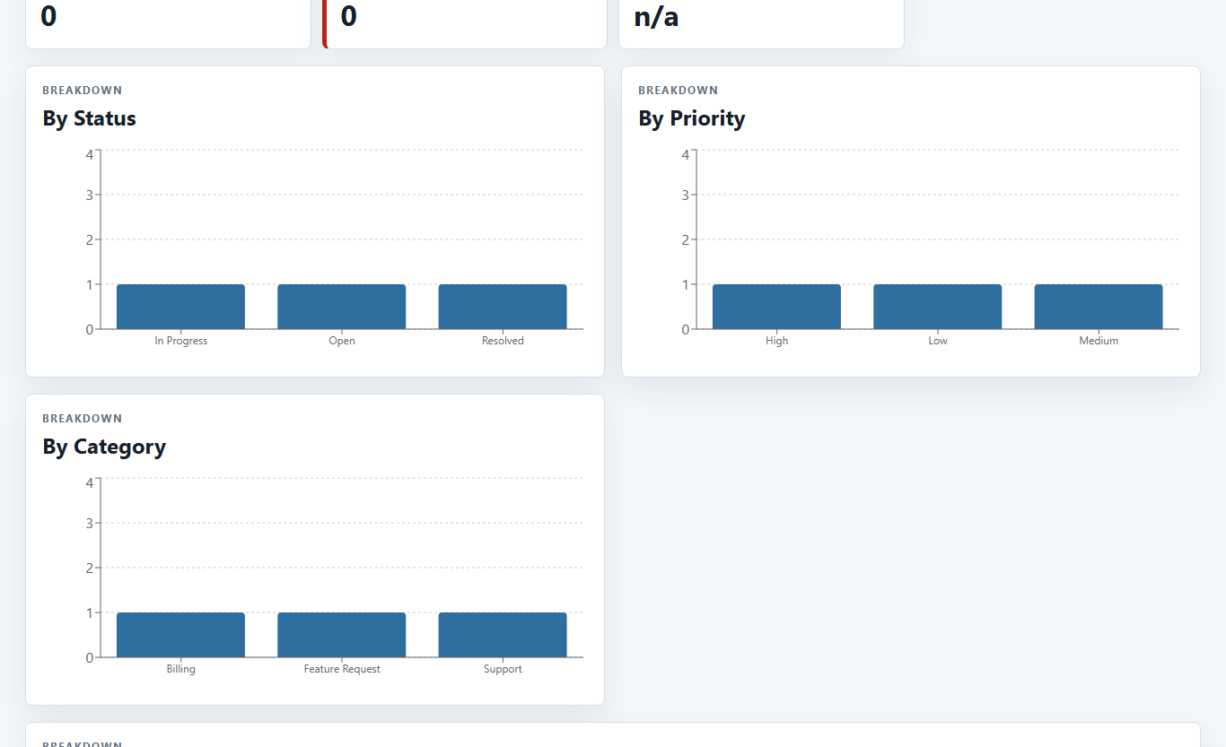
REPORTING
Reports and exports
Report workspace
Filter tickets by operational dimensions, review summaries, and export evidence.
Exports
PDF and Excel outputs are generated by backend report services.
IT Help Desk Ticket Management System
13
Notes:
Demo moment: open Reports, apply a filter, export PDF/Excel.

Slide 14
SIGNALR
Notifications and realtime updates
Ticket action
Notification service
Database
SignalR refresh
Notification center
Read workflow
Demo-safe behavior
Users can mark individual notifications or all notifications as read.
Expired sessions are cleared gracefully so stale JWTs do not leave a fake logged-in state.
IT Help Desk Ticket Management System
14
Notes:
Mention that realtime is used for notification refresh, not for replacing all REST calls.

Slide 15
FILE EVIDENCE
Attachments
Allowed
PNG, JPG/JPEG, WEBP, PDF, DOCX, XLSX, TXT.
Workflow
Upload, download, and delete actions are tied to ticket permissions.
Validation
The backend checks size, MIME type, and file signatures where practical.
IT Help Desk Ticket Management System
15
Notes:
Security angle: attachments are useful, but unsafe uploads are a common risk, so validation matters.

Slide 16
OPTIONAL INTELLIGENCE
AI assistance
Categorize
Recommend priority
Summarize
Troubleshooting
Ticket chat
Knowledge-base ask
Provider keys stay on the backend. If no provider is configured, the UI returns a graceful configuration message instead of pretending the feature is active.
IT Help Desk Ticket Management System
16
Notes:
Do not overclaim: AI is optional and gracefully handles missing provider configuration.

Slide 17
PRODUCTION READINESS
Security and reliability
JWT bearer auth and role-based policies.
Login rate limiting and stale-session cleanup.
CORS origin configuration for deployed frontend.
Health endpoint checks database connectivity.
Environment-driven database, JWT, uploads, AI, and demo-account settings.
Upload validation reduces file handling risk.
IT Help Desk Ticket Management System
17
Notes:
This slide answers the obvious evaluator question: is it just a prototype, or is it deployable?

Slide 18
SHIP PATH
Deployment
GitHub push
Pages workflow
frontend/dist
GitHub Pages
Dockerfile
Railway / Render
/healthz
API online
Runtime link
`VITE_API_BASE` points the static frontend to the hosted API `/api`.
IT Help Desk Ticket Management System
18
Notes:
Mention the actual live URLs only if internet access is available during presentation.

Slide 19
EVIDENCE
QA and verification
Backend
Frontend
Smoke checks
dotnet restore
dotnet build
dotnet test command exits cleanly; no dedicated test project yet.
npm install
npm run lint
npm run build
npm audit: 0 vulnerabilities.
Live frontend HTTP 200.
Backend /healthz ok.
Demo logins verified.
Repository includes QA screenshots, PDF, and spreadsheet artifacts used as presentation evidence.
IT Help Desk Ticket Management System
19
Notes:
Be transparent: there is no formal automated backend test suite yet; build and smoke checks pass.

Slide 20
PRESENTATION FLOW
Live demo script
User creates ticket
Agent claims and updates
Agent comments / attaches
Admin reviews dashboard
Export PDF / Excel
Show notifications / AI
Keep the story simple: request comes in, work is owned, progress is visible, history is auditable, reporting is exportable.
IT Help Desk Ticket Management System
20
Notes:
Use this as the actual live demo order. Do not wander feature-by-feature.

Slide 21
HONEST ROADMAP
Limitations and next steps
Current limitations
Strong next steps
No dedicated backend test project, no EF migrations, local/volume file storage, localStorage JWTs.
Integration tests, Playwright E2E, EF migrations, object storage, SLA/escalation rules, admin user management.
The project is demo-ready now; these are realistic production-hardening improvements.
IT Help Desk Ticket Management System
21
Notes:
This builds trust: acknowledge limitations clearly without undermining the completed work.

Slide 22
IT Help Desk
Demo-ready
support operations
Demo credentials
Admin: admin@helpdesk.local / Admin@123
Agent: agent@helpdesk.local / Agent@123
User: user@helpdesk.local / User@123
Create. Claim. Resolve. Report.
Live URLs
Frontend: jadalhassan.github.io/IT-Help-Desk/
API: helpdesk-api-production-5964.up.railway.app
IT Help Desk Ticket Management System
22
Notes:
Close by inviting the audience into the live demo.

