Slide 1
Plan Pack Repeat
Jenelee Adames, Maram Alroshoud, Saransh Ahlawat, Sai Kondapalli

Slide 2
The vision: To build a platform that provides end users with the best itinerary plan with regards to a location.
Why this project is meaningful? This project is meaningful to our group because we all share a passion for traveling. One can enjoy traveling more when planning becomes easier and less tedious. Just by a few clicks our users will create an amazing itinerary using google maps. Moreover, users will be able to see the itineraries published by other users to quick recommendations.

Slide 3
How does our project make the customer's world a better place?
Our customers will be world travelers. Traveling makes the world a better place because of endless reasons, such as travel is a learning experience and it also forces you to examine yourself. This project will promote tourism around the world, which is a powerful economic force. Also, it will allow users to understand the world a little better and the differences in culture and languages are to be embraced and not feared.

Slide 4
Major features that we are going to be delivering(with priority):
Onboarding and Authentication
Search Capability using Google Maps
Creating and saving itineraries
Copying public itineraries
Budget Tracking
Email Reminders

Slide 5
Requirement gathering using User stories:
As a user, I should be able to sign-up into the application
As a user, I should be able to login to the application
As a user, I should be able to plan my itinerary based on another traveler post
As a user, I should be able to create and customize my itinerary
As a user, I should be able to track my budget based on my trips
As a user, I should be able to receive reminders about my upcoming trips
As a user, I should be able to find places to visit through the Google Maps API
As a user, I should be able to publish my itinerary globally
As a user, I should be able to rate published itineraries

Slide 6
Architecture & Design

Slide 7
Major components (highest to lowest)
Budget service handler
Request authentication handler
Itinerary handler
Email handler service
Search capability handler

Slide 8
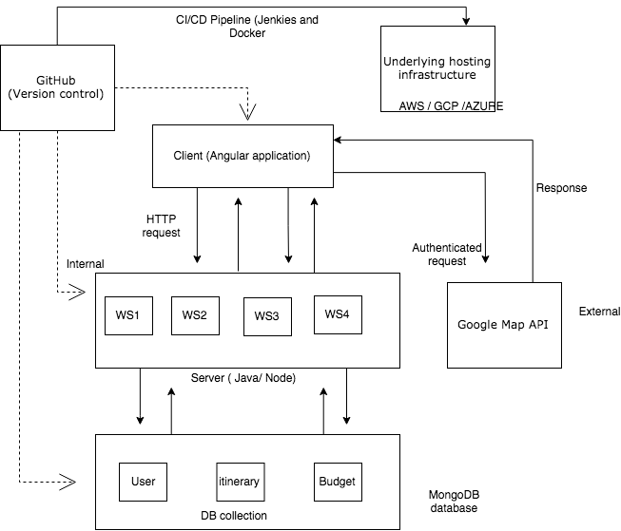
Logical (conceptual) architecture

Slide 9
Physical architecture
The application will be deployed on a cloud provider service using cloud based server instance (such as EC2 on AWS, or instances or Azure or GCP)

Slide 10
Deployment Architecture
The deployment architecture will use the following components:
Underlying infrastructure: AWS, GCP, or Azure
Cloud based server instances will contain the front-end app and back-end microservices

Slide 11
Technology stack
Front-end: Angular
Back-end: Java or Node
Database: MongoDB
Version Control: GitHub
CI Tool: Travis CI
CD Tool: Jenkins with Docker
Hosting Cloud Provider: AWS, GCP, or Azure

Slide 12
Non-Functional Concerns - Usability
Response Time:
The App’s UI navigation shall not take more than 2 seconds under normal operating conditions
All multimedia (photos) shall take no longer than 1 minute to render and process
The app shall process service requests ( CRUD operations Itineraries) in less than 5 seconds under heavy operating conditions.
The app shall update budget automatically in 2 second after the user committed changes

Slide 13
Non-Functional Concerns - Security
Authentication:
The app shall ask user to register for using the app
The app shall ask user to enter username and password for login
The app shall verify the user password and username
Every request to the server must contain JWT tokens to validate the user session

Slide 14
Non-Functional Concerns - Quality
Availability:
The application shall be accessible from any location by using the web-app while having internet access

Slide 15
Development tool stack & processes
VSCode or Eclipse for IDE (front-end and back-end with popular IDE extensions)
Git terminal as well as desktop client for committing changes fast enough
Augury chrome extension for quickly debugging Angular application
Postman for validating backend responses without using the UI

Slide 16
Testing approaches
Automated unit tests using Mocha, and Jasmine as part of the CI pipeline
Regression testing
System testing

Slide 17
Governance & Control
We will be working in an iterative manner following the principles of Agile development. As part of every sprint, we will mark the expectations on Kanban board while planning the sprint. The board will be updated regularly to reflect what has been completed and what is in progress.
We will be using google hangouts/whatsapp/slack for calls and instant messaging.
One of the Slack channels will be integrated with the master branch of our GitHub repository that will publish notifications about changes to master branch including pull requests to master branch.
We will use feature based development strategy for version control to utilize unique branches for every feature development. Also, we will isolate the master branch with rules such as “avoid changes without pull requests” to avoid accidental merges to master.

Slide 18
Thank you!
Questions / Suggestion?

