Slide 1





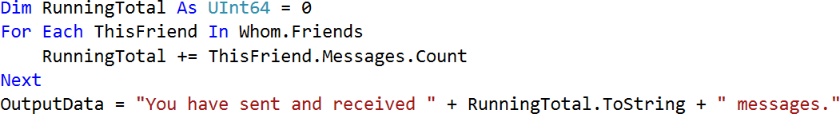
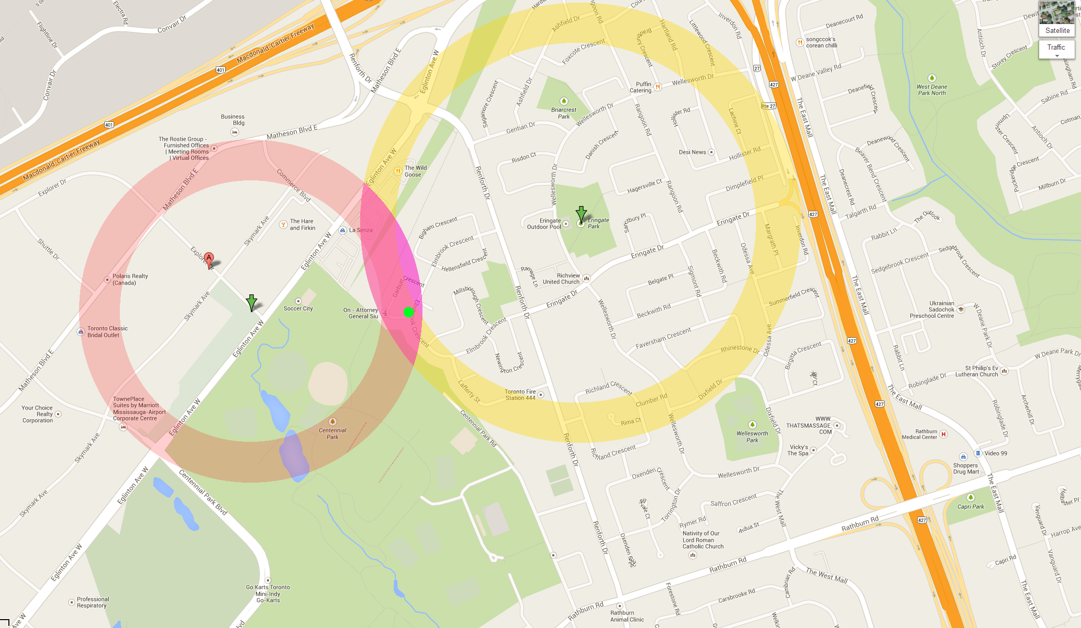
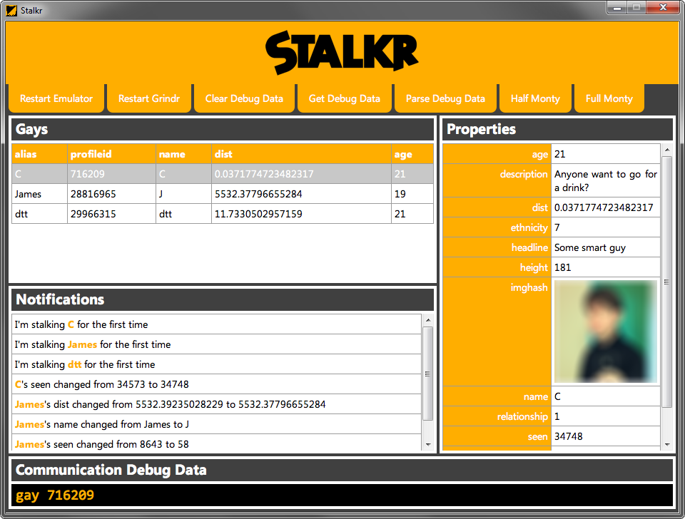

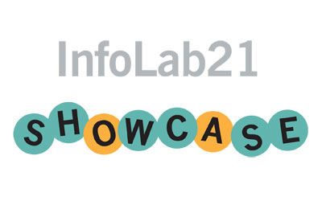
GOING SOCIAL
GEOSOCIAL NETWORKING SECURITY AND FACEBOOK SEMANTIC ANALYSIS
ANALYSIS RESULTS
‘FAVOURITE PEOPLE SINCE 21/12/13’
Friend versus Message Frequency
For each person, the count is taken of each message where its timestamp exceeds 21/12/2013. This query is written in LINQ but could be run by traditional method through looping constructs.
LIMITATIONS
Weighted by time, when one person may be of particular interest (ideally, it should be weighted by the time between the first and the last message, yet this still does not account for long periods of communication absence)
No consideration of message length: many essay-length messages should hold greater significance than ‘kk’, ‘gdgd’, ‘ta’, ‘ohh i see’
FURTHER INVESTIGATIONS
Correlation with ‘perceived popularity’: calculate the correlation co-efficient of message count ranking versus popularity ranking by survey
Correlation with mathematical ‘social models,’ or the Bell curve and Exponential function
‘NEGATIVE PEOPLE SINCE 21/12/13’
Friend versus ‘Negativity Magnitude’ (0-1)
For each person, the count of a static list of ‘negative words’ (‘grr’, ‘annoyed’, ‘hate’, ‘stupid’, ‘tw*t’) occurring is taken. This count is weighted by the total message count for the person. The most 3 significant and insignificant Negativity Magnitudes are graphed right.
FACEBOOK SEMANTIC ANALYSIS
ANALYSIS METHOD
That guy who knows everyone. What's his trick?
Whom should we be talking to less, because they're just so negative?
And who just can't keep their mouth shut, especially when it comes to naughty words?
Facebook Semantic Analysis can reveal these high level details from your messages archive.
Friend Class
Name | String
Status | Byte (Enum)
Messages | List of Message
Frazzlr was created to allow everyday users to analyse their own Facebook data. This is how it works:
STEP 1
The program takes a copy of your personal data archive (downloadable from Facebook), which includes all messages you have ever sent and received. They are contiguously stored in a single huge HTML file:
<div class="contents"><h1>James Garner</h1><div class="thread">Adam Smith, James Garner<div class="message"><div class="message_header"><span class="user">James Garner</span><span class="meta">Friday, 23 November 2012 at 08:56 UTC</span></div></div><p>Are you awake?</p><div class="message"><div class="message_header"><span class="user">Adam Smith</span><span class="meta">Friday, 23 November 2012 at 10:01 UTC</span></div></div><p>Sorry about that, slept right through my alarm :/</p><div class="message"><div class="message_header"><span class="user">James Garner</span><span class="meta">Friday, 23 November 2012 at 10:02 UTC</span></div></div><p>likewise</p> ...
STEP 2
The program utilises a complex parsing algorithm to store data from the archive in classes, such as Friend and Message. The archive also includes data about advertising targeting which isn’t available via the Facebook website, so this data is stored in classes for analysis too, along side event attendance and the friends list.
These classes are linked such that a Subject class contains a list of Friend classes, each of which possesses a list of Message classes, and so on…
STEP 3
The program includes sample basic tests, but you can write your own simple tests in LINQ or by logic (for example, looping through each of a Subject’s Friends and totalling the Messages count, to judge a level of Facebook activity).
More complex tests generate tab-separated value files (plain text spreadsheets) for further sorting, analysis and calculations in Microsoft Excel. Then it’s easy to generate charts!
Message Class
Contents | String
TheOtherPerson | Boolean
DateTime | String
“As a Subject has many Friends, each Friend has many Messages”
GEOSOCIAL NETWORKING SECURITY
LIMITATIONS
No ‘wider semantic analysis’: positivity and negativity are better derived from text semantics than simple character analysis
Of the three most insignificant Negativity Magnitudes, two people are German; this shows the test’s simplistic language dependence
Social networking applications like Tinder and Grindr have contextualised dating and meeting new people through location awareness
Location and immediateness have taken priority such that compatibility and interests are now secondary factors
For security and safety, geosocial networking applications protect users’ privacy by revealing distance instead of exact location…
But this research exploits Grindr to prove insecurities even by nature.
INTRODUCING:
THE SOCIAL GRAPH
BOB
ALICE
EVE
TRUDY
EXPLOITING GRINDR
STEP 1 Run Grindr in a virtual Android machine so its location can be changed. This meant I didn’t have to walk around the world with a phone…
STEP 2 Listen to the debug bridge, over which Grindr reveals its inner workings - especially dumps of users’ profile information. People in whom I was interested I added as ‘Favourites’ for easy tracking (stalking) - Grindr processed these separately.
STEP 3 Parse the debug information, revealed over command line, and form a data structure for each person, logging inside their distance from each mock location at which the virtual machine sits.
STEP 4 Change the mock location automatically and triangulate to find exact locations within each data structure.
This led to Stalkr…
JADA
10:24
Virtualisation and Triangulation
“The social graph in the Internet context is a graph that depicts personal relations of Internet users”
Facebook: One Social Graph to Rule Them All?, July 11, 2010
THE NEXT STEP: CONSTRUCT A SOCIAL GRAPH
Frazzlr’s next task is to create a social graph from messages and events
A simple Social Graph consists of interconnecting nodes (people) which are connected by relations. This Social Graph is mathematically constructed such that it can be rigorously analysed. For example, it is clear that node Alice is related to node Bob. It cannot be determined that node Alice is related to node Trudy, yet it is likely because they share the mutual nodes Eve and Bob. Conversely, an analysis of the Social Graph suggests a relationship between node Eve and node Bob because of their two shared mutual nodes. Hurrah! Friend Suggestions, anyone?
During the development process, developers generally expose information through the Android Debug Bridge. The bridge shows information on the development machine rather than the phone, so it can be analysed easier.
But when the application is ready for the real world, this debugging information is supposed to be hidden. Grindr for Android omitted this, and reveals all.
Stalkr was created to automate parsing the debug information. The program interacts with the virtual machine and presents results visually.
By listening over the debug bridge, we act as a developer of Grindr and see exactly what’s going on. Data sent over its secure connection is shown voiding the point of its end-to-end security. This data includes JSON outputs of users’ profiles, including distance to an accuracy of feet, no matter the location of the virtual machine.
Because the instance of Google Android is virtual, it can be moved anywhere in the world through mock location. By automating these movements and calculating users’ distances from each, we can calculate their exact location by simple mathematical triangulation. Busted.
Triangulation with 2 radii. The green dot is the user’s actual location. This was done from about 5500km away.
JAMES GARNER • 2ND YEAR COMPUTER SCIENCE • LANCASTER UNIVERSITY

