Slide 1
RETAIL SALES ANALYTICS
An End-to-End Business Analytics Project
SQL · Python · Excel · Power BI
50,000 Orders • Jan 2024 – Dec 2025 • 2,000 Customers
Prepared July 2026

Slide 2
AGENDA
What This Deck Covers
01
Project Pipeline
02
Headline KPIs
From raw CSV to ETL, SQL, Python, Excel & Power BI
Sales, profit, orders and margin at a glance
03
Category & Regional Performance
04
Product & Channel Insights
Where revenue and profit are concentrated
Top products, payment modes, shipping behaviour
05
SQL & Python Analysis
06
Insights & Recommendations
How the numbers were derived
What the business should do next
02

Slide 3
PROJECT ARCHITECTURE
From Raw Data to Decision-Ready Dashboards
CSV
ETL.py
SQL
Python
Excel
Power BI
sales_data.csv
›
Python + SQLAlchemy
›
8 analysis scripts
›
Jupyter notebook
›
KPIs + pivot tables
›
.pbix dashboard
50,000 raw order records
Load & clean into PostgreSQL
Aggregation, filtering, window fns
EDA, outliers, correlations
Spreadsheet-native reporting
Interactive executive report
Every layer reads from the same dataset — figures reconcile exactly across SQL, Excel, and Power BI.
03

Slide 4
HEADLINE METRICS
Two Years of Performance at a Glance
₹7.52B
₹1.86B
50,000
24.76%
Total Sales
Total Profit
Total Orders
Avg. Profit Margin
2,000 unique customers • Jan 2024 – Dec 2025 • 0 missing values, 0 duplicates
04

Slide 5
CATEGORY & REGIONAL PERFORMANCE
Revenue Is Evenly Spread Across the Business
Sales by Category (₹ Billions)
Sales by Region (₹ Billions)
05

Slide 6
PRODUCT PERFORMANCE
Desk, Pen & Cabinet Lead Product Sales
TOP SKU
Desk — ₹495.7M
WEAKEST SKUS
Headphones, Keyboard, Mouse
CATEGORY LEADER
Furniture — ₹1.91B total
06

Slide 7
CUSTOMER BEHAVIOUR
Payment & Shipping Preferences
Sales Share by Payment Mode
Orders Share by Shipping Mode
07

Slide 8
SQL ANALYSIS LAYER
Eight Scripts, From Basics to Window Functions
basic-queries.sql
Sorting.sql
filtering.sql
aggerigation.sql
Totals, averages, min/max, unique customer counts
Top/bottom 10 orders, customers, and products
High-value orders, category & state filters, margin & discount thresholds
GROUP BY summaries across category, state, city, region, segment
windows_function.sql
product_analysis.sql
regional_analysis.sql
Bussiness_Problem.sql
RANK, DENSE_RANK, ROW_NUMBER, running totals, LAG/LEAD, top-N per group
Best/least sellers, profit margin leaders, top/bottom per category
Region & state rankings, contribution %, North vs South, East vs West
10 decision-driven questions: payment mode, discounting, discontinuation
08

Slide 9
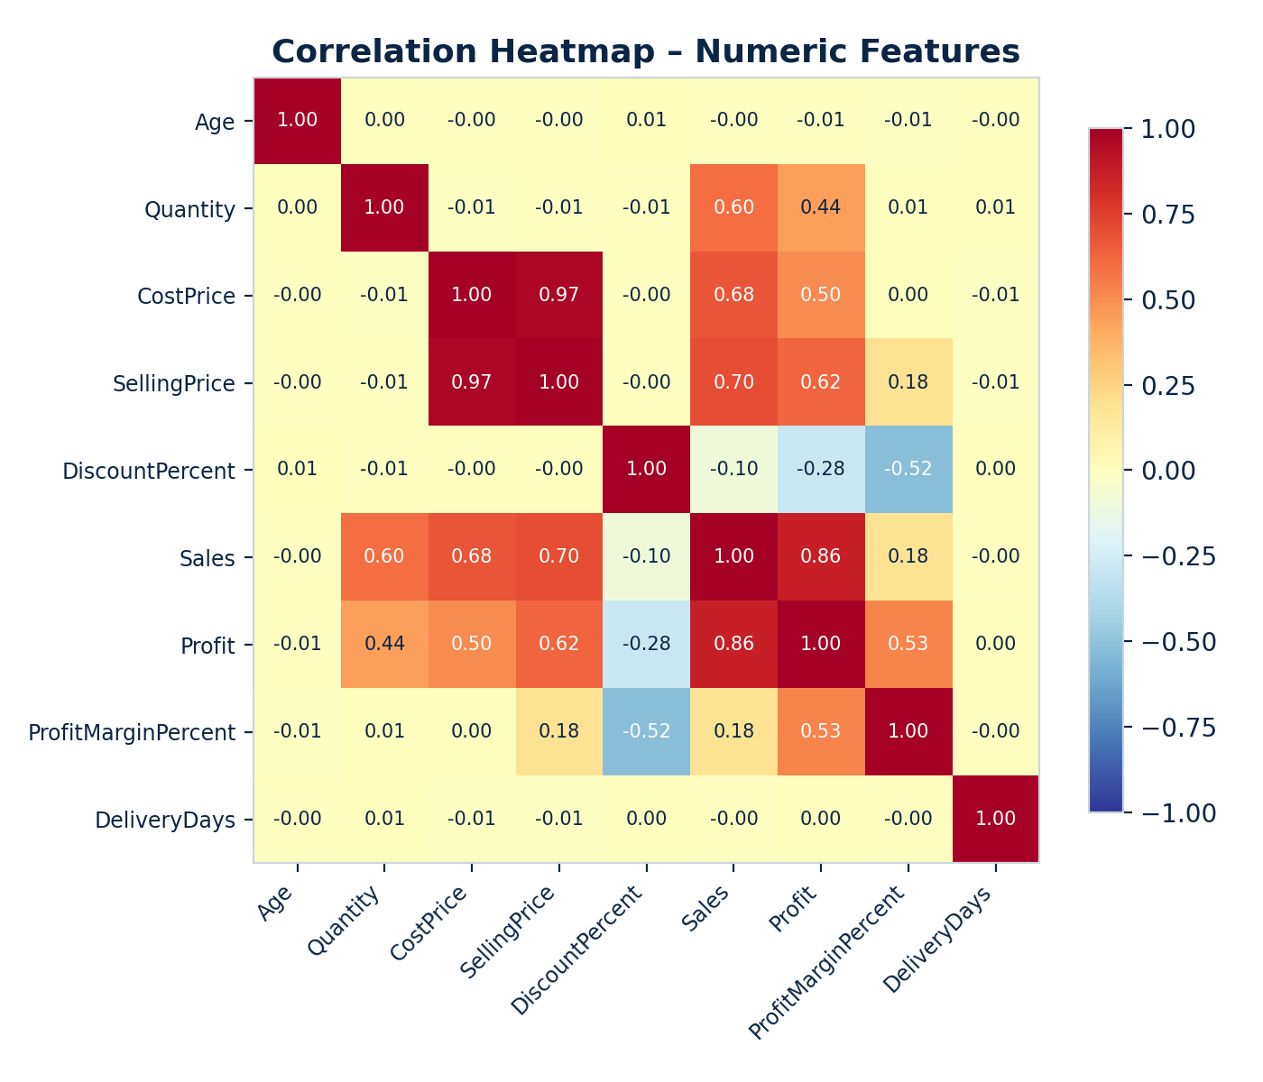
PYTHON EXPLORATORY ANALYSIS
Discounting Is Not Driving Sales
Zero missing values and zero duplicate rows across all 50,000 records — confirmed via pandas EDA.
Box-plot outlier checks run on Sales, Profit, and Discount before deeper analysis.
DiscountPercent correlates only weakly and negatively with Sales (-0.10) and near-zero with Profit Margin.
SellingPrice is the strongest driver of Sales — pricing, not discount depth, moves revenue.
09

Slide 10
SPREADSHEET REPORTING
Excel Workbook: KPIs & Pivot Tables
KPIs
DashBoard
Pivot Table
Detail1
Total Sales, Profit, Orders, AOV, and Margin as single source-of-truth values
One-page executive view with slicers for month, region, and category
7 linked pivots: category, state, region, month, product, payment, segment
Drill-through record-level detail behind any pivot selection
KPI Snapshot
₹7.52B
₹1.86B
50.0K
24.76%
Sales
Profit
Orders
Margin
10

Slide 11
INTERACTIVE BI
Power BI: The Executive-Facing Layer
1
2
3
4
5
Executive Overview
Regional Performance
Product & Category
Customer Insights
Operations
KPI cards, monthly trend, YoY comparison
State/region map, sales & profit slicers
Treemap, top/bottom rankings, discount scatter
Segment & age-band views, top customers
Payment & shipping mix, delivery time by mode
Connected to the same PostgreSQL model as the SQL layer — figures reconcile with every other tool in this project.
11

Slide 12
KEY INSIGHTS
What the Data Is Telling Us
1
2
3
Balanced Portfolio
Card Leads Payments
Discounts Aren't Working
All 4 categories and all 4 regions sit within a few % of each other — no single dependency.
₹1.92B in sales and 12,798 orders — the highest of any payment mode.
-0.10 correlation between discount depth and sales value.
4
5
6
Home Office Is Most Profitable
Shipping Speed Is Flat
Clean, Reliable Data
₹630M profit — narrowly ahead of Corporate and Consumer.
5.46–5.51 avg. delivery days regardless of shipping mode chosen.
0 missing values, 0 duplicates across all 50,000 records.
12

Slide 13
RECOMMENDATIONS
Where to Focus Next
01
Rethink Discounting
02
Audit Shipping SLAs
Shift promo budget away from blanket discounts toward proven segments like Home Office.
Express & Same Day take as long as Standard — review courier performance or re-price tiers.
03
Grow Card Payments
04
Fix Underperforming States
Extend Card-linked offers and loyalty perks given its lead in volume and sales.
Root-cause pricing, mix, and marketing reach in Himachal Pradesh and Nagaland.
05
Review Weak SKUs
06
Operationalise Power BI
Consider bundling, repricing, or phasing out Headphones, Keyboard, and Mouse.
Publish the .pbix with scheduled refresh so stakeholders see live figures.
13

Slide 14
Thank You
Retail Sales Analytics Project — SQL · Python · Excel · Power BI
Full detail available in the companion report: Retail_Sales_Analytics_Report.docx

