Slide 1

BIKE SHARE PREDICTION

Slide 2
OBJECTIVE: PREDICT DEMAND FOR BIKE SHARING SYSTEM UPTO HOUR LEVEL.
BENEFITS:
Reduces cost of excess bike supply like maintenance, inventory, area lease costs, operation costs etc.
Reduces loss of business due to excess demand. This would help in gaining maximum revenue through bike rentals, data generation, data analysis and data selling.

Slide 3
DATA SHARING AGREEMENT:
Name of file
Type of file
Date stamp
Time stamp
Number of columns
Data type of columns

Slide 4
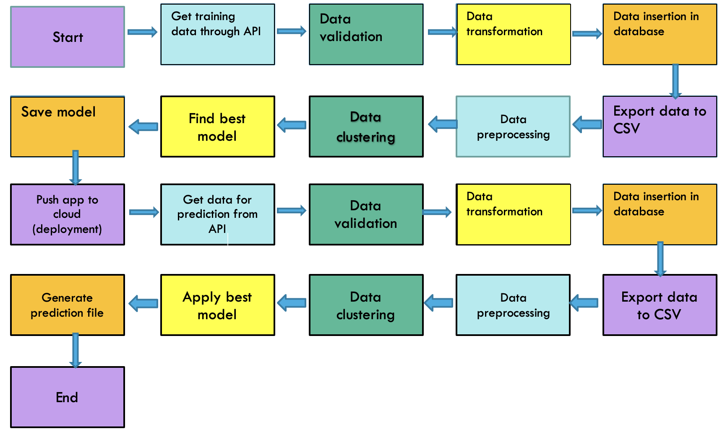
ARCHITECTURE:

Slide 5
DATA VALIDATION, TRANSFORMATION AND INSERTION:
Files are verified as per Data Sharing Agreement (DSA) and null value check. Proper files are transferred to good data folder while improper files are transferred to bad data folder. Good data files are transferred to Cassandra database table. Bad data files are archived.

Slide 6
MODEL TRAINING:
Data is exported from database in csv format.
Data is preprocessed to impute null values, check zero standard deviation and drop unimportant columns (based on lack of business significance, multicollinearity etc).
Clustering is done using kmeans.
Regression models are applied and best model is selected. These regression models include linear, random forest, support vector, decision tree, lasso, ridge and elasticnet.
Model is saved.

Slide 7
PREDICTION:
Data is sent through Postman using API.
Prediction also follows the same procedure of data validation, data transformation, data insertion, exporting to csv file and clustering.
Best model is applied and result is given as csv file in prediction output files.

Slide 8
Q&A:
What is source of data?
A: https://archive.ics.uci.edu/ml/datasets/Bike+Sharing+Dataset
2) What is type of data?
A: Both numerical and categorical data.
3) What is the complete flow of project?
A: Refer slide 4.
4) What happens to files that did not pass validation?
A: Bad files are archived and shared with client and bad file folder is deleted.
5) How are logs managed?
A: Logs are managed in files like training logs, prediction logs etc.

Slide 9
6) What techniques are used for preprocessing?
A: a) Removing umimportant columns (based on business significance, multicollinearity etc).
b) Checking and imputing null values.
c) Checking for zero standard deviation.
d) Converting categorical variables to numerical variables.

Slide 10
7) How training was done? What models were used?
A: Training is done after dividing data into clusters. Regression models are applied to clusters and cluster specific best model is selected. Regression models used are linear, random forest, support vector, decision tree, lasso, ridge and elasticnet.
8) How prediction is done?
A: a) Data is sent through Postman using API.
b) Prediction also follows the same procedure of data validation, data transformation, data insertion, exporting to csv file and clustering.
c) Best model is applied and result is given as csv file in prediction output files.

