Slide 1





DATABASE ENGINEERING • PROJECT REVIEW 2
Research
Papers
SmartResearch Hub
AI-Powered Semantic Knowledge Repository
Semantic
Nodes
PRESENTED BY:
GUIDE:
Dr.Sai Sasidhar
2510030229-Spoorthi
2510030284-Akshitha
Department: CSE
Institution: KLH
Knowledge
Network
Search
Result
SmartResearch Hub — Review 2
1

Slide 2






FROM REVIEW-1 FOUNDATION TO RESEARCH MOTIVATION
From Information Overload to Intelligent Research Discovery
INTRODUCTION
PROBLEM STATEMENT
Rapid growth of digital research literature makes discovery increasingly difficult.
Researchers must examine large volumes of papers to find relevant studies.
Keyword matching can miss conceptually related work using different terminology.
Semantic search represents meaning and context, not just exact words.
SmartResearch Hub combines semantic retrieval with organized paper management.
Research papers are scattered across multiple sources and repositories.
Keyword search can return irrelevant results or miss related research.
Researchers spend significant time filtering, comparing and organizing results.
Existing tools usually focus on a single capability — search, storage or retrieval alone.
An integrated repository supporting semantic retrieval and paper management is needed.
Large
Research Volume
Search
Difficulty
Irrelevant /
Missed Results
Manual
Filtering
Need for Semantic
Research Discovery
SmartResearch Hub — Review 2
2

Slide 3
FOUNDATIONS FROM PRIOR RESEARCH
Literature Review — Semantic Representation & Retrieval
# | Paper / Authors | Year | Method / Approach | Dataset / Technology | Key Finding | Limitation
[1] | Devlin et al. — BERT | 2019 | Bidirectional Transformer pre-training | Large text corpora (Wikipedia, BooksCorpus) | Contextual language representation improves language understanding | Not a retrieval system by itself
[2] | Reimers & Gurevych — Sentence-BERT | 2019 | Siamese BERT network for sentence embeddings | Sentence-pair datasets | Efficient generation and comparison of sentence embeddings | Focused on sentence-level, not full documents
[3] | Beltagy, Lo & Cohan — SciBERT | 2019 | Domain-adapted pretrained language model | Scientific publication corpus | Domain-aware representation improves scientific text understanding | Domain adaptation required for other fields
[4] | Karpukhin et al. — Dense Passage Retrieval | 2020 | Dual-encoder dense vector retrieval | Open-domain QA datasets | Vector-based retrieval outperforms sparse keyword methods | Requires large-scale embedding indexing
[5] | Cohan et al. — SPECTER | 2020 | Citation-informed transformer embeddings | Scientific paper citation graphs | Citation signals improve document-level scientific representation | Depends on availability of citation data
[6] | Khattab & Zaharia — ColBERT | 2020 | Late-interaction contextual retrieval | Passage retrieval benchmarks | Improves retrieval efficiency while preserving contextual detail | Increased indexing complexity
[7] | Gottardi et al. — Semantic Search for Scientific Findability | 2021 | Systematic literature review | Dataset / Corpus — Not specified | Synthesizes semantic search techniques for scientific findability | Review-based; no new system proposed
SmartResearch Hub — Review 2
3

Slide 4
WHERE THE OPPORTUNITY LIES
Research Gap Identified from Literature
EXISTING WORK
OBSERVED LIMITATIONS
IDENTIFIED OPPORTUNITY
Techniques often studied separately
Search & repository management not integrated
Metadata and storage need organized management
Semantic retrieval needs specialized vector indexing
Manual filtering and comparison still needed
Keyword-based retrieval
Semantic representation
Dense retrieval
Scientific document embeddings
Academic repositories
Limited integration of semantic retrieval, research-paper storage, metadata management and vector-based similarity search within a unified academic repository.
LITERATURE
IDENTIFIED GAP
SMARTRESEARCH HUB
Based on the reviewed literature, existing studies primarily address individual aspects of semantic representation and retrieval, while there is an opportunity to integrate these capabilities with structured research-paper management.
SmartResearch Hub — Review 2
7

Slide 5
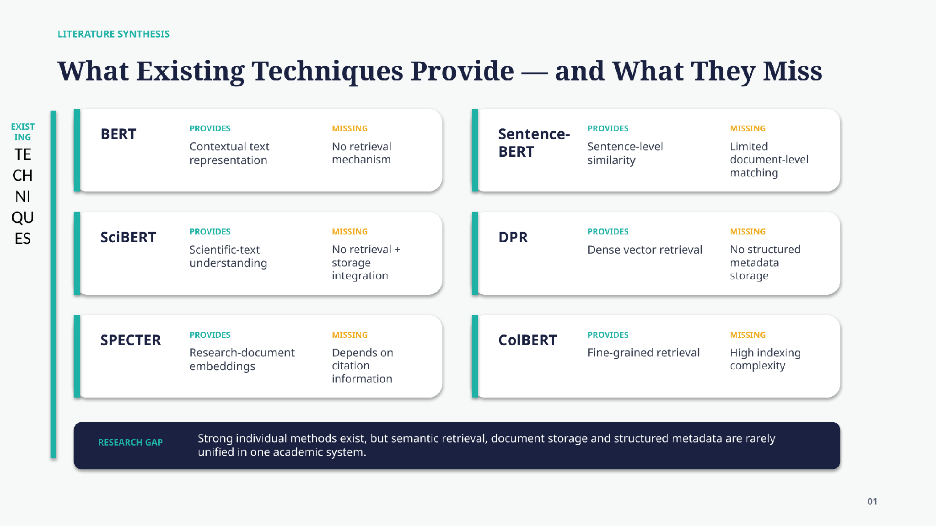

Slide 6
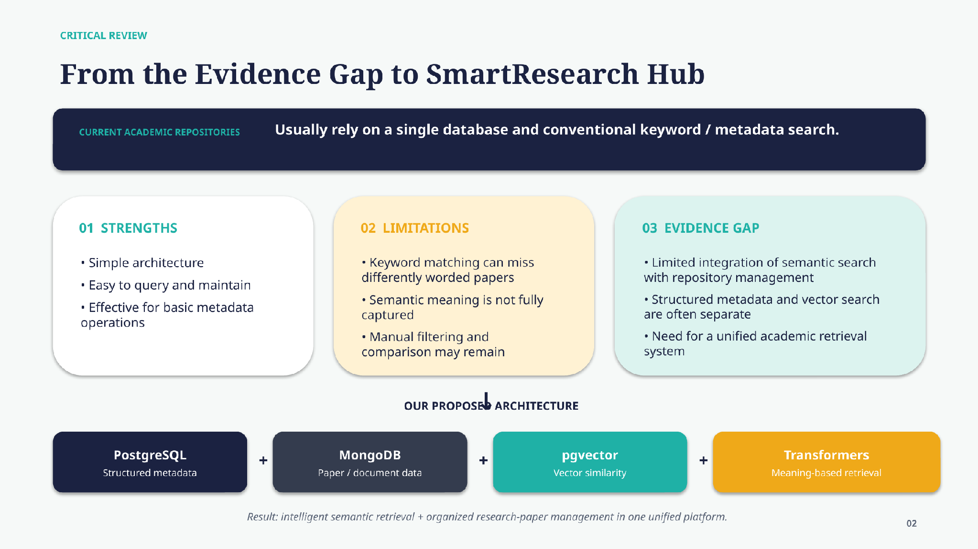

Slide 7


ADDRESSING THE GAP
SmartResearch Hub — Proposed Solution
PROPOSED SYSTEM WORKFLOW
NOVELTY — THE INTEGRATION
FastAPI
PostgreSQL
MongoDB
pgvector
Python
Semantic Embeddings
Meaning-Based Retrieval
USER
Search based on semantic similarity rather than exact keywords alone.
▾
REGISTER / LOGIN
▾
UPLOAD RESEARCH PAPER
Hybrid Data Management
▾
PostgreSQL for structured metadata and MongoDB for document-oriented storage.
PDF TEXT + METADATA EXTRACTION
▾
GENERATE SEMANTIC EMBEDDING
POSTGRESQL
Structured Metadata
▾
MONGODB
Research Documents
Vector-Based Search
pgvector for storing and comparing semantic embeddings.
PGVECTOR — Vector Embeddings
▾
NATURAL-LANGUAGE QUERY
Unified Research Repository
▾
Papers, metadata and semantic retrieval brought together in one system.
SEMANTIC SIMILARITY SEARCH
▾
RELEVANCE RANKING
▾
Research-Oriented Discovery
RELEVANT RESEARCH PAPERS
▾
Designed specifically for academic research-paper discovery.
RESEARCH DISCOVERY
Novelty lies in the proposed integration and application of these technologies for an academic research repository — not in inventing semantic search itself.
SmartResearch Hub — Review 2
8

Slide 8

WHAT WE WILL DELIVER
Expected Product Outcome & Conclusion
A functional web-based SmartResearch Hub that allows users to upload and manage research papers, extract metadata, generate semantic embeddings, and retrieve relevant papers using natural-language semantic search.
EXPECTED CAPABILITIES
EXPECTED IMPACT
User registration and authentication
Research-paper PDF upload
Text and metadata extraction
Semantic embedding generation
Natural-language search
Semantic similarity retrieval
Structured metadata management
Document storage
Vector-based search
Relevant paper display
Faster Discovery
▾
Better Relevance
▾
Organized Research
▾
Reduced Manual Filtering
CONCLUSION
SmartResearch Hub addresses a practical research-discovery problem by combining semantic representation, vector-based retrieval and database-backed document management. The literature review establishes the technical foundation, while the critical analysis and research-gap analysis motivate an integrated repository architecture.
From Searching for Papers → To Discovering Relevant Knowledge
THANK YOU
Questions?
SmartResearch Hub — Review 2
9

