Slide 1
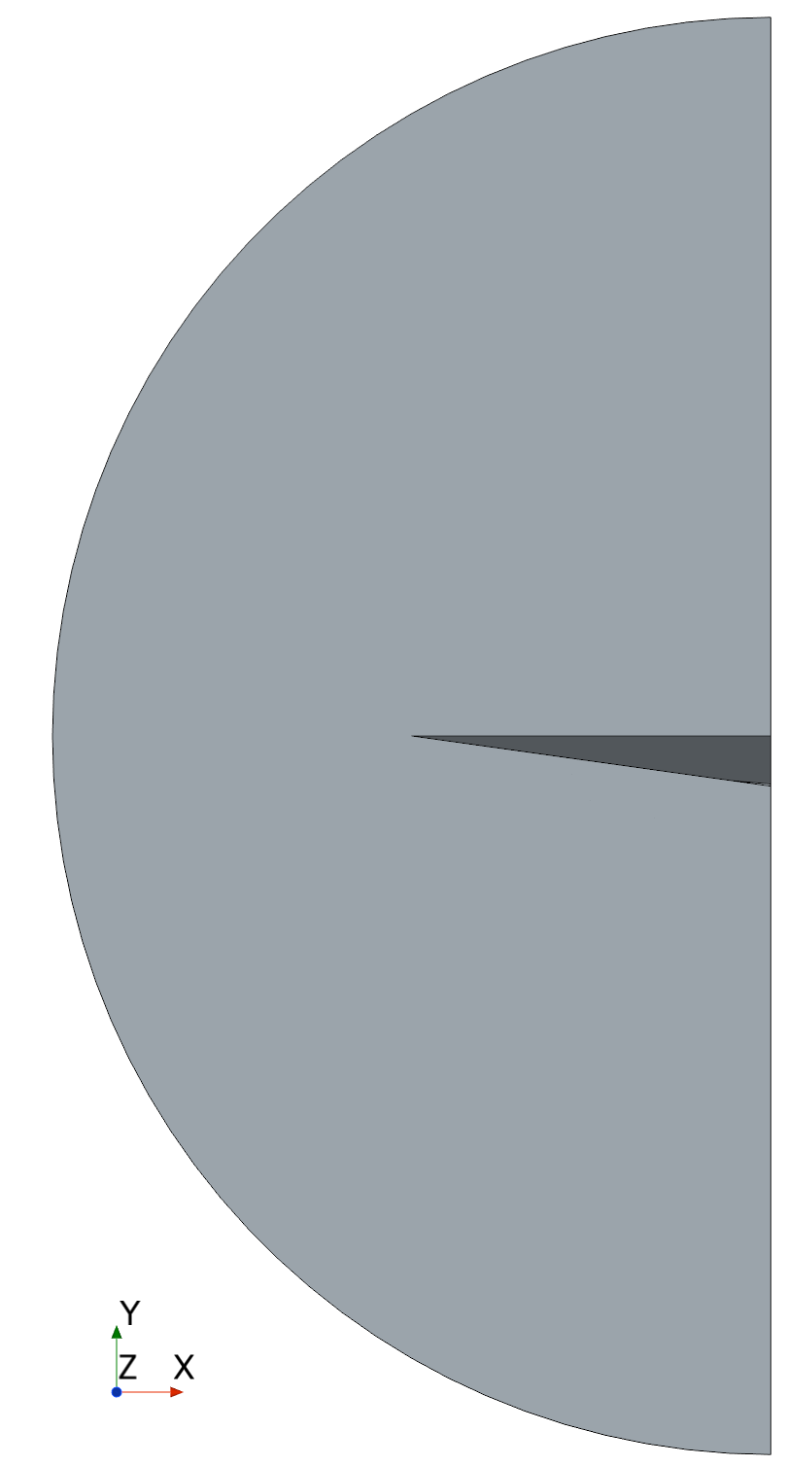
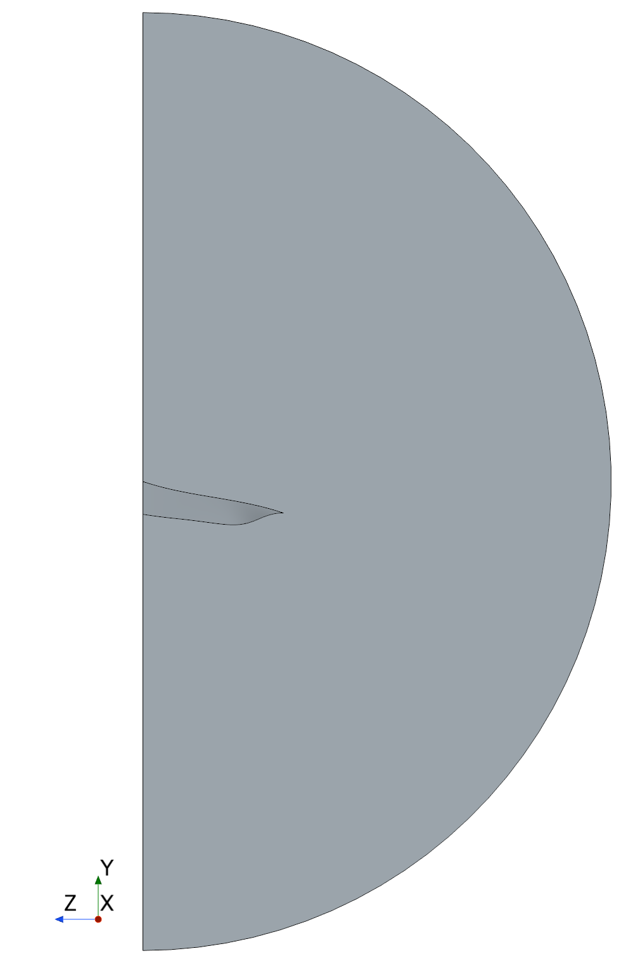
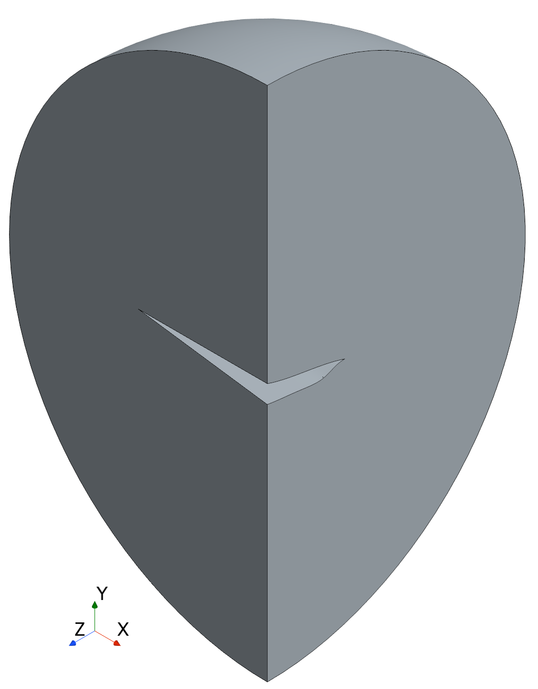

$$\text{Γ}\text{farfield}$$
2l
Γ_{upper surface}
l
l
Γ_{lower surface}
Γ_{sym}
Domain (Ω)

