Slide 1
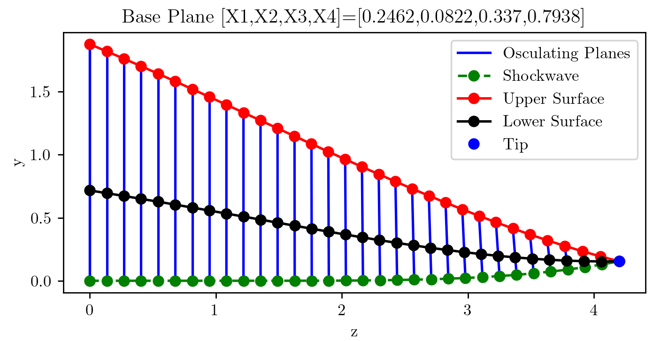
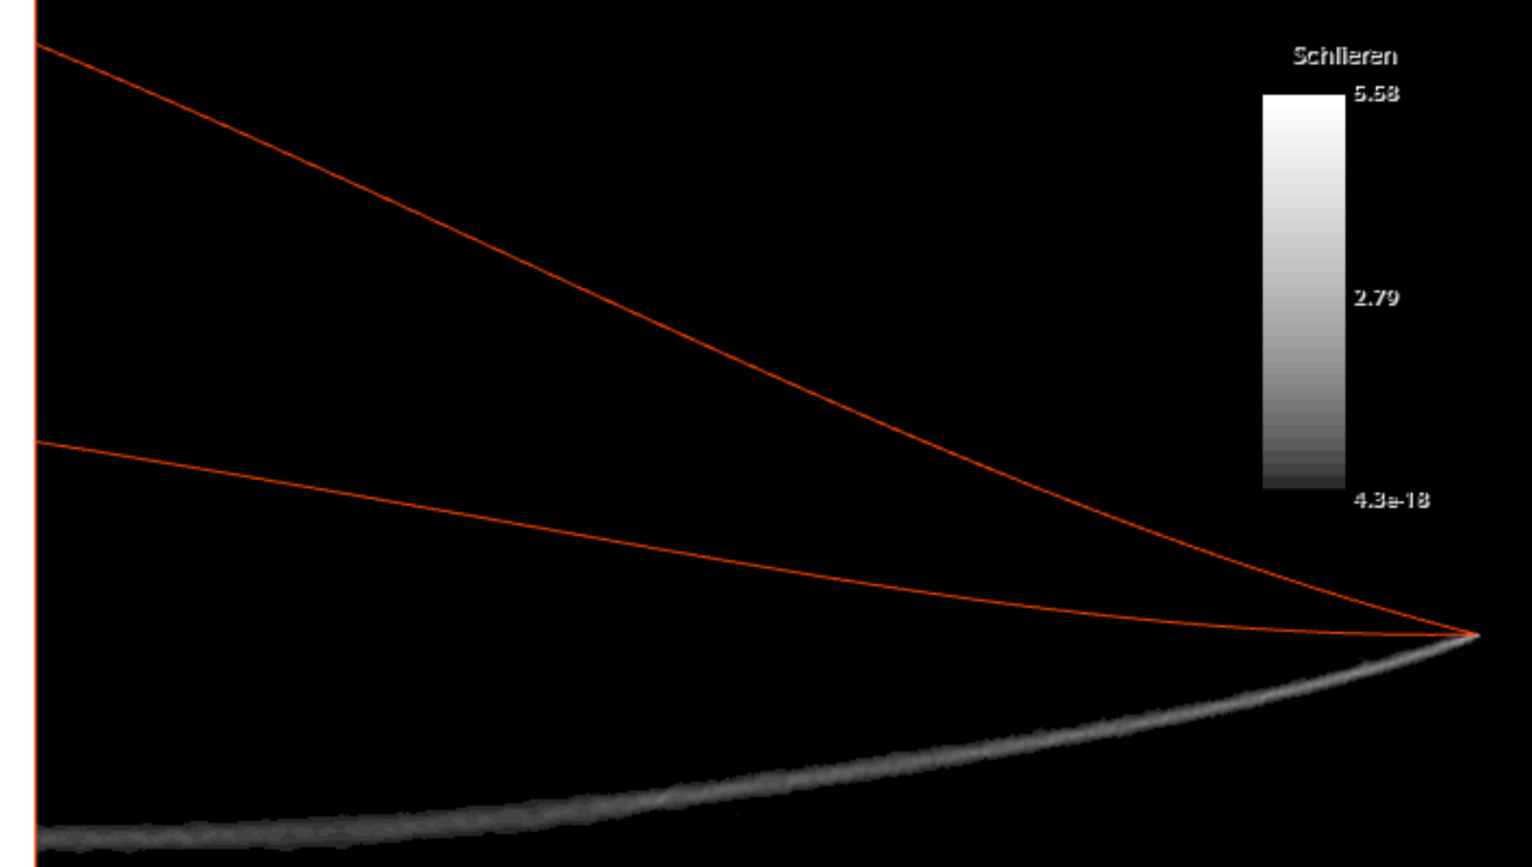
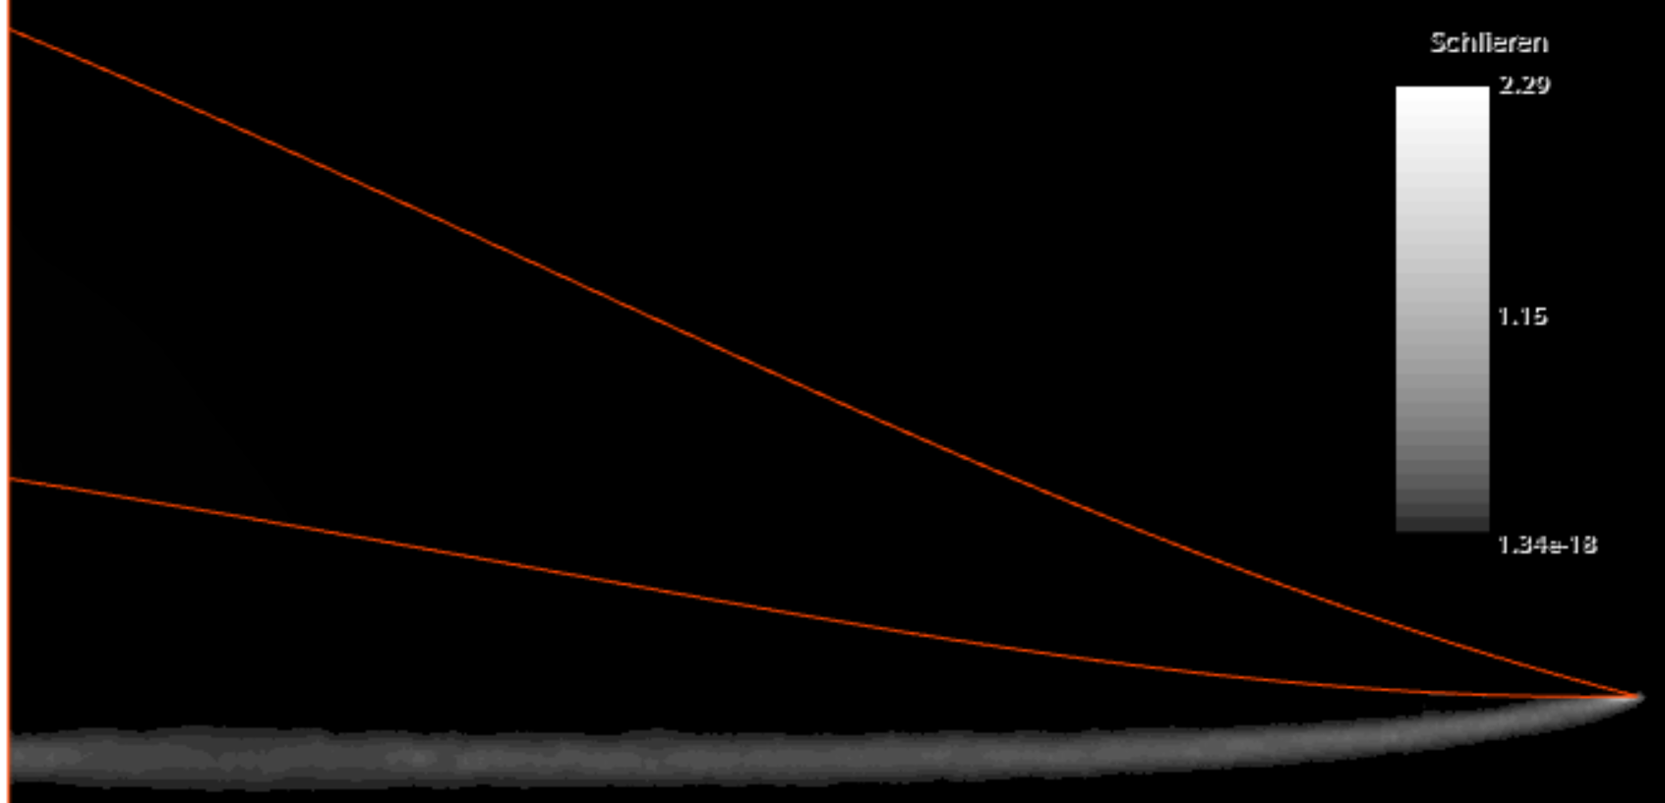
Case 1 : Design Mach Number around 8, waverider #10
M_design | X1 | X2 | X3 | X4
7.907 | 0.2642 | 0.0822 | 0.337 | 0.7938
h=1.876 m
@ Mach5
New shockwave height is h=2.3219 m
@ Mach8
Shockwave is as designed

Slide 2
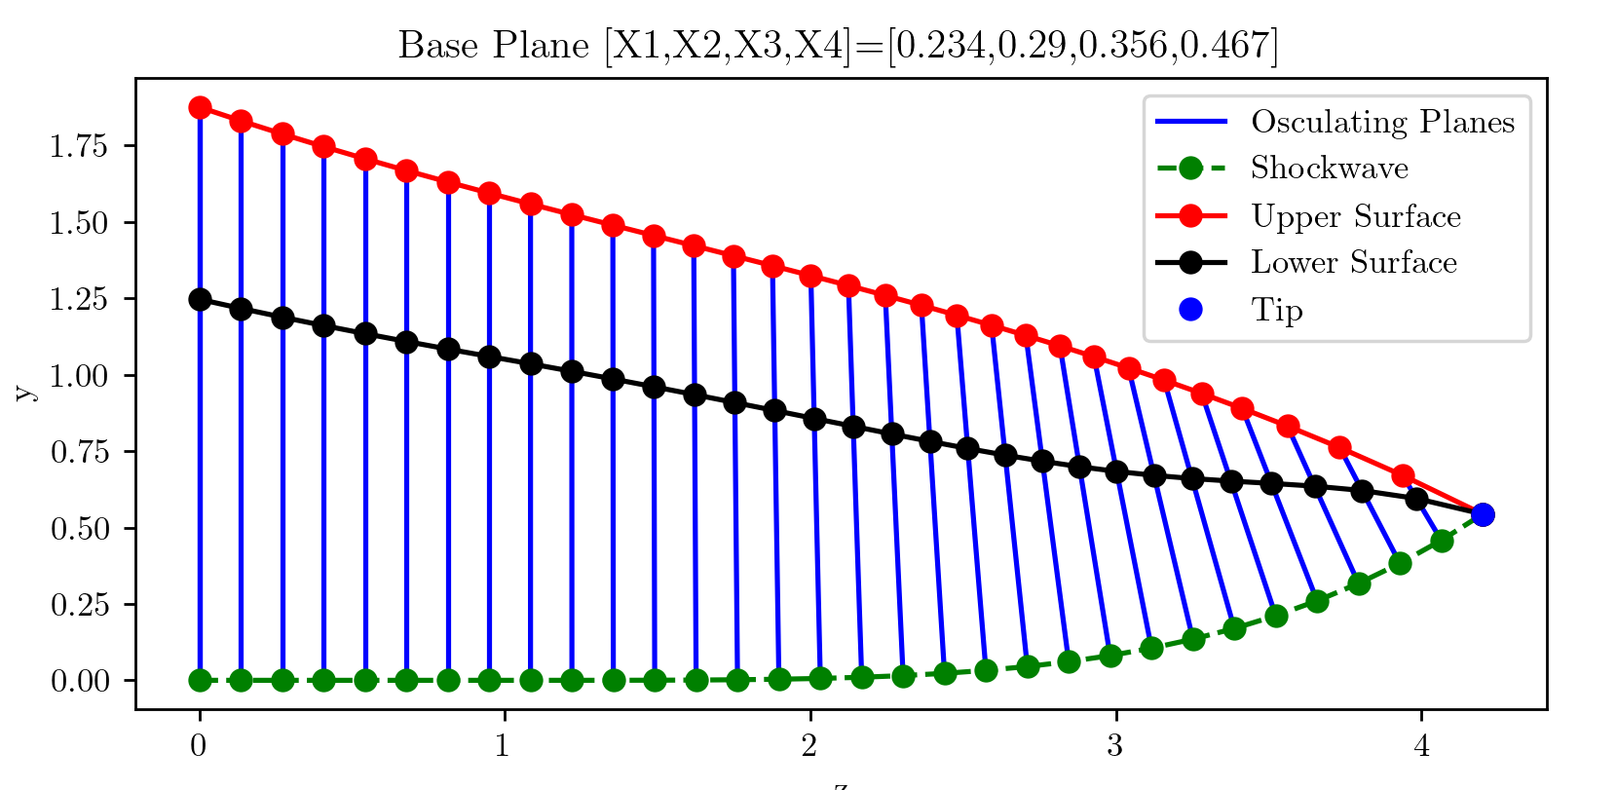
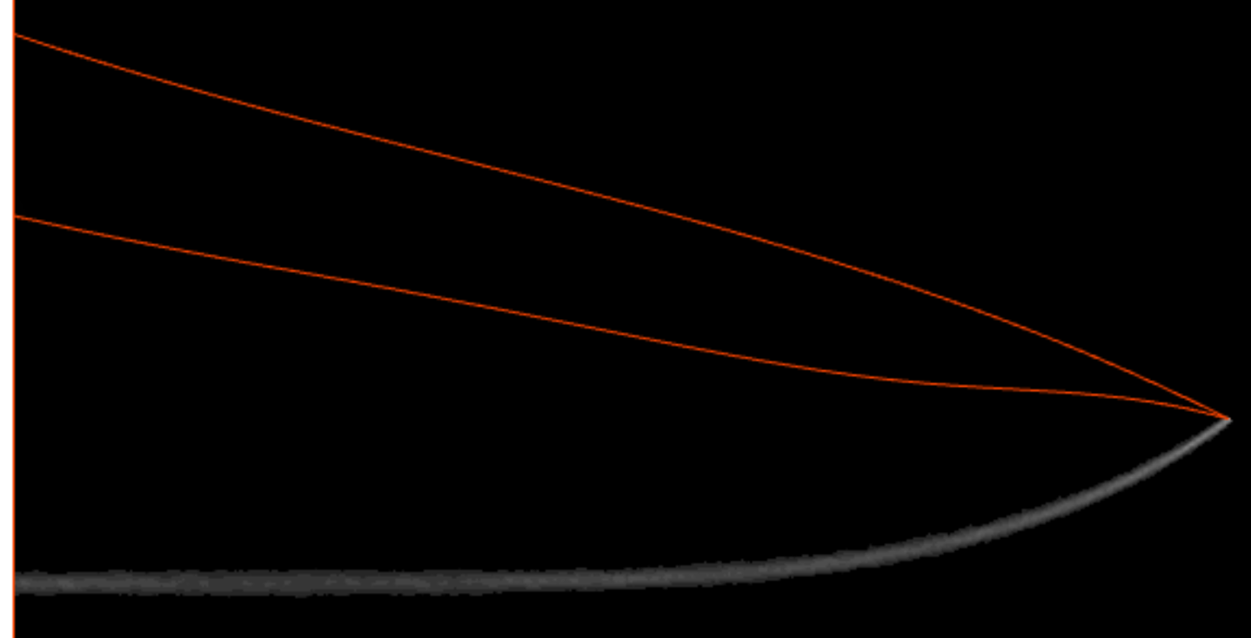
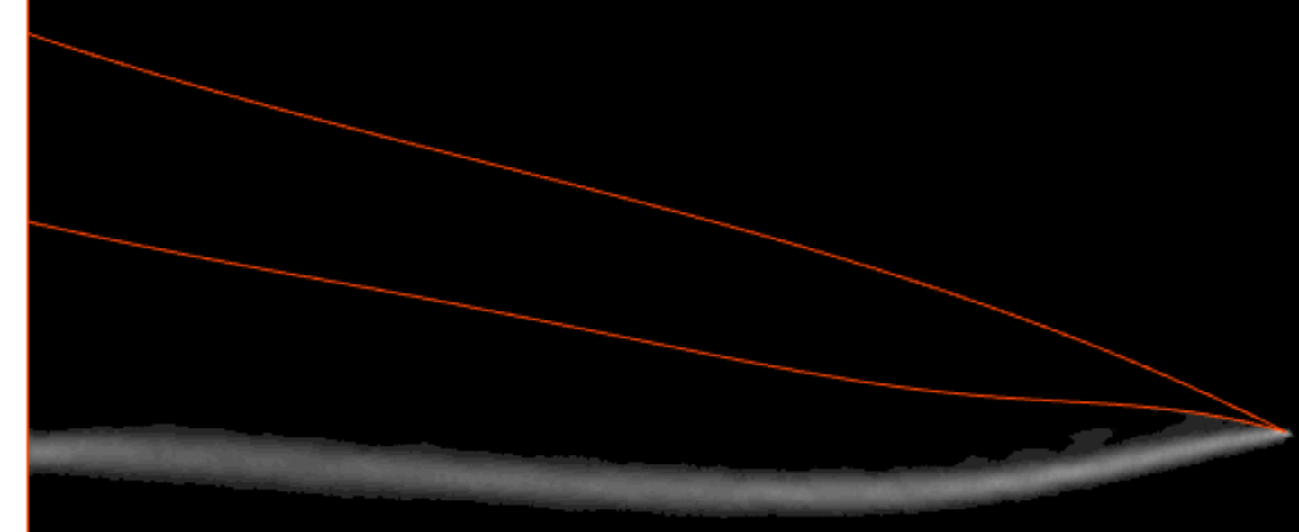
Case 2 : Design Mach Number around 5, waverider #65
M_design | X1 | X2 | X3 | X4
5.078 | 0.234 | 0.29 | 0.356 | 0.467
h=1.876 m
@ Mach5
Shockwave is as designed
@ Mach8
New height is 1.3943 m

Slide 3
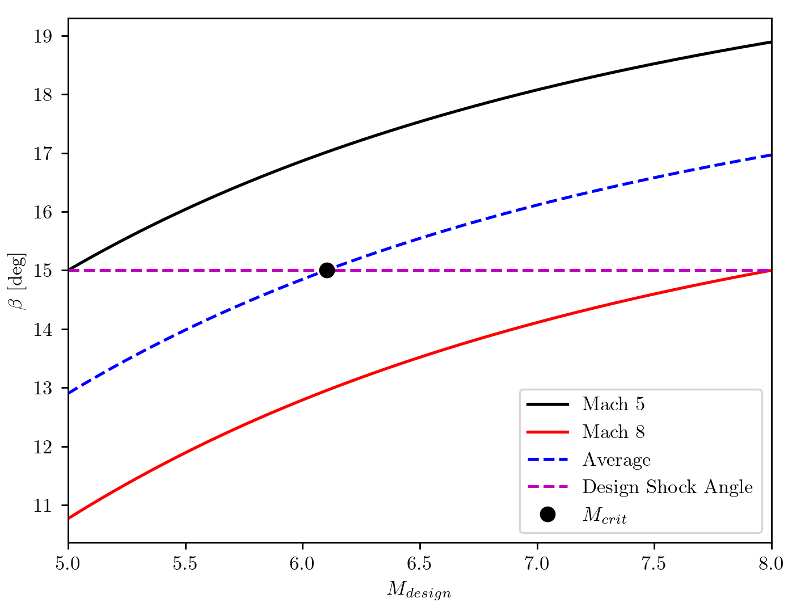

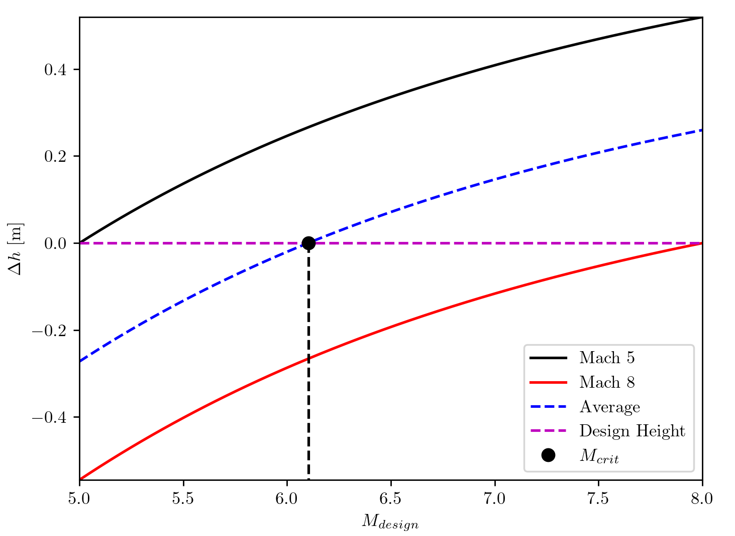

$θ,β,M$ relation
M_crit=6.1027

Slide 4
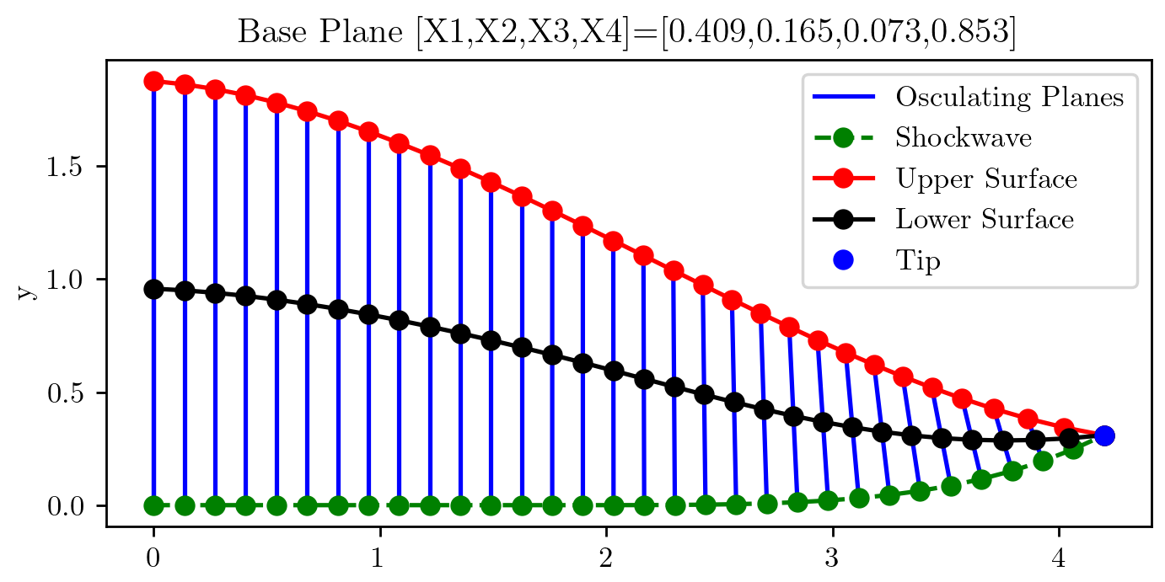
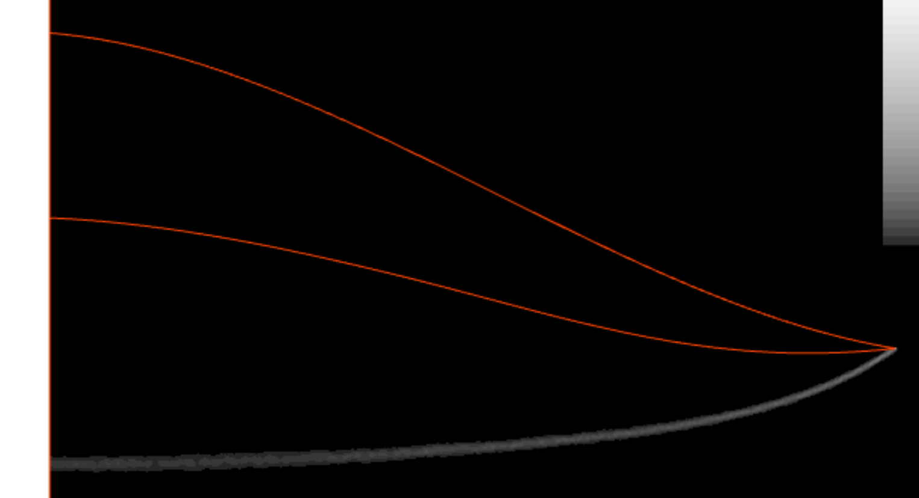
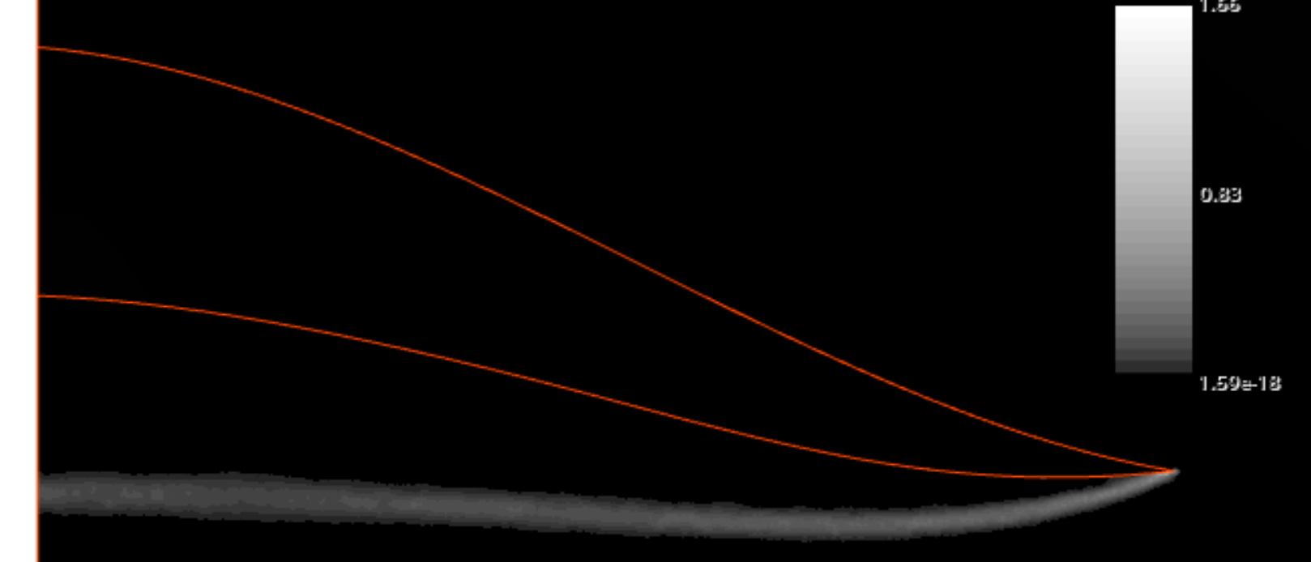
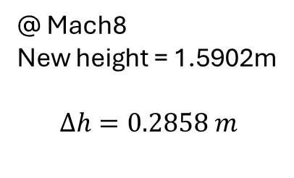
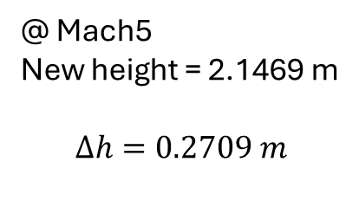
Case 3 : Design Mach Number around M_crit, waverider #100
M_design | X1 | X2 | X3 | X4
6.173 | 0.409 | 0.165 | 0.073 | 0.853
h=1.876 m
@ Mach5
New height = 2.1469 m
$$Δh=0.2709 m$$
@ Mach8
New height = 1.5902m
$$Δh=0.2858 m$$

