Slide 1


Introduction to Bioinformatics
Study program: Bioprocess Engineering
Elective Module (Wahlpflichtmodul)
9th October to 13th October
Responsible: Prof. Dr. Axel Blokesch, blokesch@fb2.fra-uas.de
by Pablo Riesgo-Ferreiro, TRON gGmbH
pablo.riesgoferreiro@tron-mainz.de
Day 1 - Session 2

Slide 2
Organization of the course
Four days
Three sessions of hour and a half per day, between 9 am and 3 pm
Two practical use cases on days 2 and 3
What you‘ll need:
a computer (any system is fine: Windows, Mac, Linux, ...)
internet access and your favourite web browser
a free GitHub account
Final exam on 18th October
If you have participated actively in the course and worked on the practical use case you are allowed to use your written records in the final exam an complete tasks related to these cases with a rating of 15 % (case 1) and 25 % (case 2). If you did not edit these practical use cases (or only one of them), you have to complete another task in the exam instead.
Please, do interrupt me at any time. Your questions are always welcomed

Slide 3
Outline of session
Most popular computational genomics methods
Alignment
Variant calling
Differential gene expression
Epigenetics: methylation and histone modifications
Standard genomic data formats
FASTA
FASTQ
BAM
VCF
Single cell approaches
Proteomics

Slide 4
Main players in bioinformatics
International Society of Computational Biology (ISCB) https://www.iscb.org/
International Nucleotide Sequence Database Collaboration (INSDC)
European Bioinformatics Institute (EBI)
Ensembl
EMBL
NCBI
UCSC
Uniprot
Protein Data Bank

Slide 5
Scripting versus software

Slide 6
NGS methods
Whole Genome Sequencing (WGS): This method sequences the entire genome of an organism.
Targeted Sequencing: This includes whole exome sequencing (WES) and gene or region-specific panels.
RNA Sequencing: This method sequences the RNA in a sample to study cellular responses.
Single-Cell NGS Methods:
Single-Cell DNA Sequencing: This involves isolating a single cell, amplifying the whole genome or region of interest, constructing sequencing libraries, and then applying next-generation DNA sequencing.
Single-Cell RNA Sequencing (scRNA-seq): This method sequences the RNA in a single cell, providing a higher resolution of cellular differences.
Epigenetic Approaches:
Methyl-seq: This method investigates the methylation status of the genome with single-nucleotide resolution.
ChIP-seq: This combines chromatin immunoprecipitation (ChIP) with NGS to identify binding sites of DNA-associated proteins throughout the genome.
ATAC-seq: An assay for transposase-accessible chromatin sequencing, this determines regions of chromatin accessibility and maps DNA binding proteins to identify active promoters, enhancers, and other cis-regulatory elements.

Slide 7
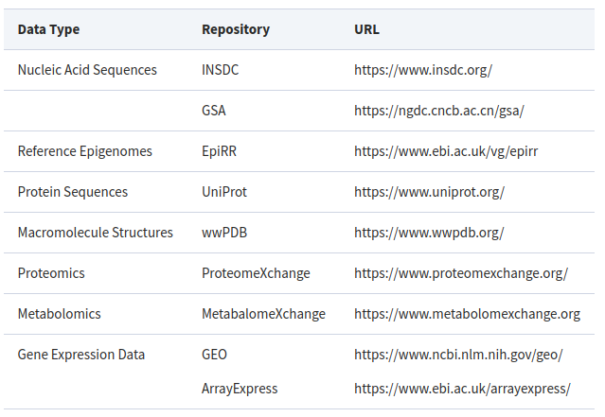
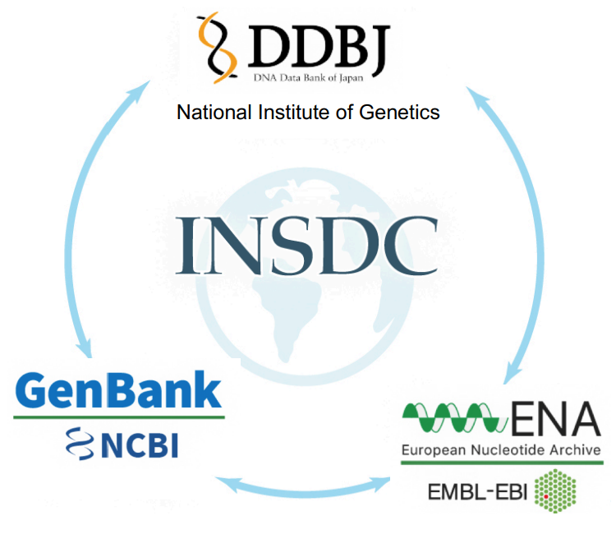
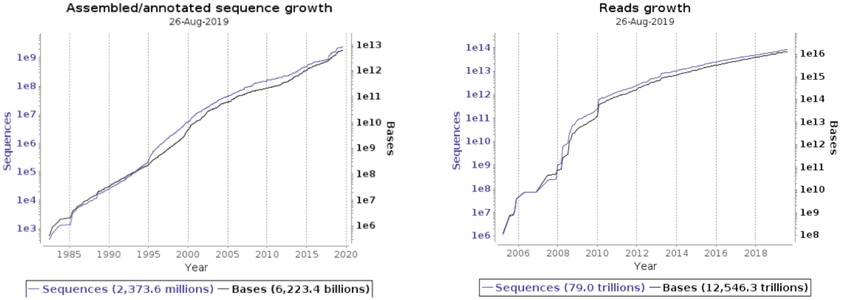
Biological databases
https://academic.oup.com/bioinformaticsadvances/pages/instructions-to-authors
(Amid, 2020)

Slide 8
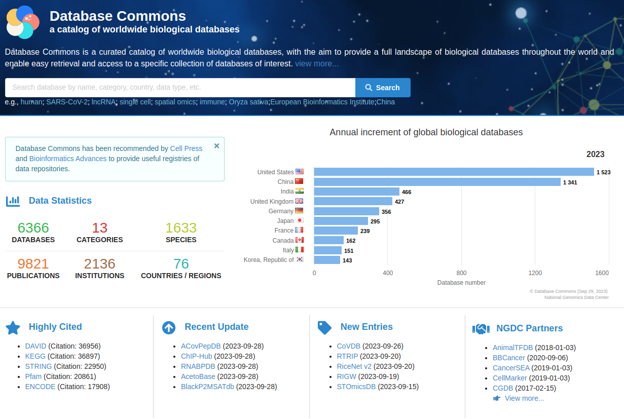
More biological databases
https://ngdc.cncb.ac.cn/databasecommons/
(Ma, 2022)

Slide 9
Computational analysis
Alignment (also known as mapping)
Multiple Sequence Alignment (MSA)
Expression analysis and differential gene expression analysis
Pathways enrichment
Variant calling / peak calling
GWAS
Annotation of genomic features

Slide 10
Data analysis and visualization

Slide 11
Why standard genomic data formats?
Data Management: Standard formats facilitate efficient data management, analysis, and interpretation.
Quality Control: They ensure quality control in the production of data.
Comprehensive Reporting: Standard formats promote comprehensive reporting, which is crucial for understanding and replicating the study.
Effective Communication: They aid in effective communication among researchers.
Reproducibility: Standard formats increase the reproducibility of research by making it easier for other researchers to understand and use the data.
Data Sharing and Storage: They support data sharing and storage, which is essential for open science.
It is a requirement for publication in most journals!

Slide 12
Most used data formats in bioinformatics
FASTA: This is a text-based format for representing either nucleotide sequences or peptide sequences, in which nucleotides or amino acids are represented using single-letter codes.
FASTQ: This format is similar to FASTA, but it also includes sequencing qualities.
SAM/BAM: Sequence Alignment/Map (SAM) is a text-based format that stores large numbers of sequences aligned to a reference. Binary Alignment/Map (BAM) is the binary version of SAM.
VCF: Variant Call Format (VCF) is a text file format for storing gene sequence variations.
GFF/GTF: General Feature Format (GFF) and Gene Transfer Format (GTF) are used to store genes and other features associated with DNA, RNA, and protein sequences.
BED: The Browser Extensible Data (BED) format is a flexible way to define data lines that are displayed in an annotation track.
PDB: The Protein Data Bank (PDB) format provides a standard for files containing atomic coordinates.
GEO: The Gene Expression Omnibus (GEO) is a public functional genomics data repository supporting MIAME-compliant data submissions.
SRA: The Sequence Read Archive (SRA) stores raw sequencing data from the next generation of sequencing platforms.

Slide 13
FASTA format
It may contain amino acid, DNA or RNA sequences
The reference genome is represented in a FASTA file with one sequence per chromosome
Possible format extensions: .fasta, .fna, .ffn, .faa, .frn, .fa
>SEQUENCE_1
MTEITAAMVKELRESTGAGMMDCKNALSETNGDFDKAVQLLREKGLGKAAKKADRLAAEG
LVSVKVSDDFTIAAMRPSYLSYEDLDMTFVENEYKALVAELEKENEERRRLKDPNKPEHK
IPQFASRKQLSDAILKEAEEKIKEELKAQGKPEKIWDNIIPGKMNSFIADNSQLDSKLTL
MGQFYVMDDKKTVEQVIAEKEKEFGGKIKIVEFICFEVGEGLEKKTEDFAAEVAAQL
>SEQUENCE_2
SATVSEINSETDFVAKNDQFIALTKDTTAHIQSNSLQSVEELHSSTINGVKFEEYLKSQI
ATIGENLVVRRFATLKAGANGVVNGYIHTNGRVGVVIAAACDSAEVASKSRDLLRQICMH

Slide 14
FASTQ format
Represents a raw readout from a sequencer
The first line, starting with `@`, is the sequence identifier.
The second line is the raw sequence letters.
The third line starts with a `+` sign and is optionally followed by the same sequence identifier.
The fourth line encodes the quality values for the sequence in line 2, and must contain the same number of symbols as letters in the sequence.
The quality scores are Phred +33 encoded, using ASCII characters to represent the numerical quality scores. This means that each character represents a probability of error for each base call. For example, an ASCII character of 'A' represents a Phred score of 32, which corresponds to a base call accuracy of 99.94%.
@SEQ_ID
GATTTGGGGTTCAAAGCAGTATCGATCAAATAGTAAATCCATTTGTTCAACTCACAGTTT
+
!''*((((***+))%%%++)(%%%%).1***-+*''))**55CCF>>>>>>CCCCCCC65

Slide 15
SAM/BAM format
Represents the alignment of a read to a reference genome
It provides among other things:
the coordinates where the read is mapped in the reference
the mapping quality (MQ)
CIGAR string that encodes if the mapping contains insertions or deletions
@HD VN:1.5 SO:coordinate
@SQ SN:chr22 LN:1000000
r001 99 chr22 7 30 8M2I4M1D3M = 37 39 TTAGATAAAGGATACTG *
r002 0 chr22 9 30 3S6M1P1I4M * 0 0 AAAAGATAAGGATA *
r003 0 chr22 9 30 5S6M * 0 0 GCCTAAGCTAA * SA:Z:ref,29,-,6H5M,17,0;
r004 0 chr22 16 30 6M14N5M * 0 0 ATAGCTTCAGC *

Slide 16
VCF format

Slide 17
BED format

Slide 18
GTF / GFF format

Slide 19
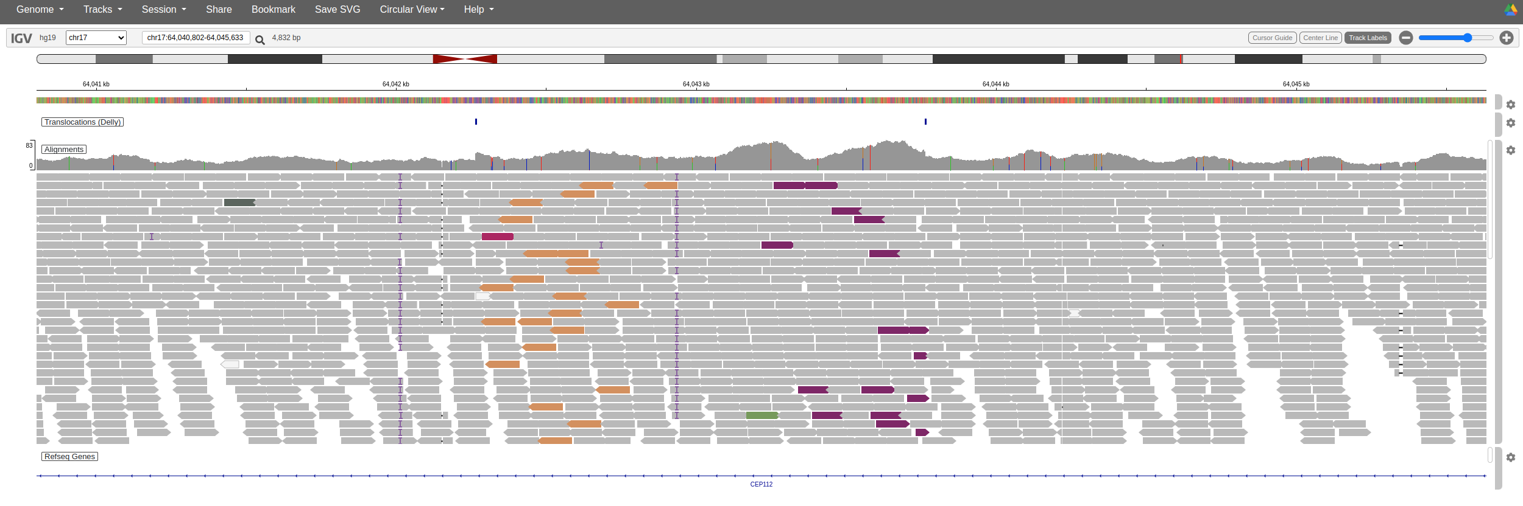
Integrated Genomics Viewer (IGV)
Live demo...
There is a desktop version and the browser version that does not require installation (https://igv.org/app/)

Slide 20
FAIR sharing
https://fairsharing.org/

Slide 21
Bibliography and further reading
Kumuthini, J. et al. Ten simple rules for providing effective bioinformatics research support. PLOS Computational Biology 16, e1007531 (2020).
Ma, L. et al. Database Commons: A Catalog of Worldwide Biological Databases. Genomics, Proteomics & Bioinformatics S1672022922001693 (2022) doi:10.1016/j.gpb.2022.12.004.
Amid, C. et al. The European Nucleotide Archive in 2019. Nucleic Acids Research 48, D70–D76 (2020).

