Slide 1




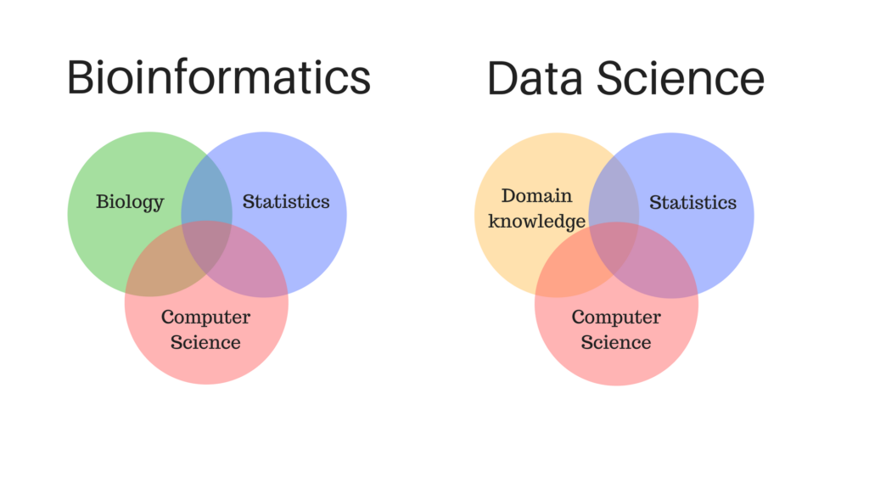

Introduction to Bioinformatics
Study program: Bioprocess Engineering
Elective Module (Wahlpflichtmodul)
9th October to 13th October
Responsible: Prof. Dr. Axel Blokesch, blokesch@fb2.fra-uas.de
by Pablo Riesgo-Ferreiro, TRON gGmbH
pablo.riesgoferreiro@tron-mainz.de
Day 2 - Session 2

Slide 2
Outline of session
Computational genomics pipelines
Variant annotation
Online biological databases
Genome browsers
Single cell approaches
Proteomics

Slide 3
Computational genomics pipelines

Slide 4
Computational genomics pipelines - variant annotation
Given a set of aligned reads (allowing mismatches!) we aim to identify
Challenges:
bla
bla
Applications:
bla
Figure 1 from https://doi.org/10.3390/app11020819 (Pös, 2021)
Standard input: VCF Standard output: VCF

