Slide 1

GREENHOUSE PROJECT TOMATOES

Slide 2
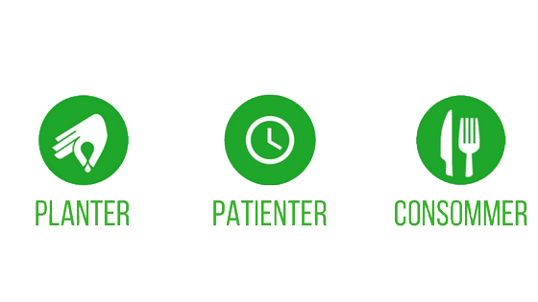
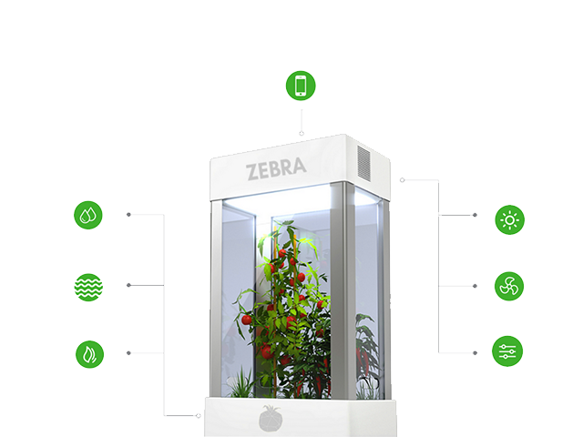
Greenhouse
PLANT
WAIT
EAT

Slide 3

Project
Gary: Mobil application
Antoine: autonomous heating
Guillaume: Lighting and website
Jade: irrigation

Slide 4
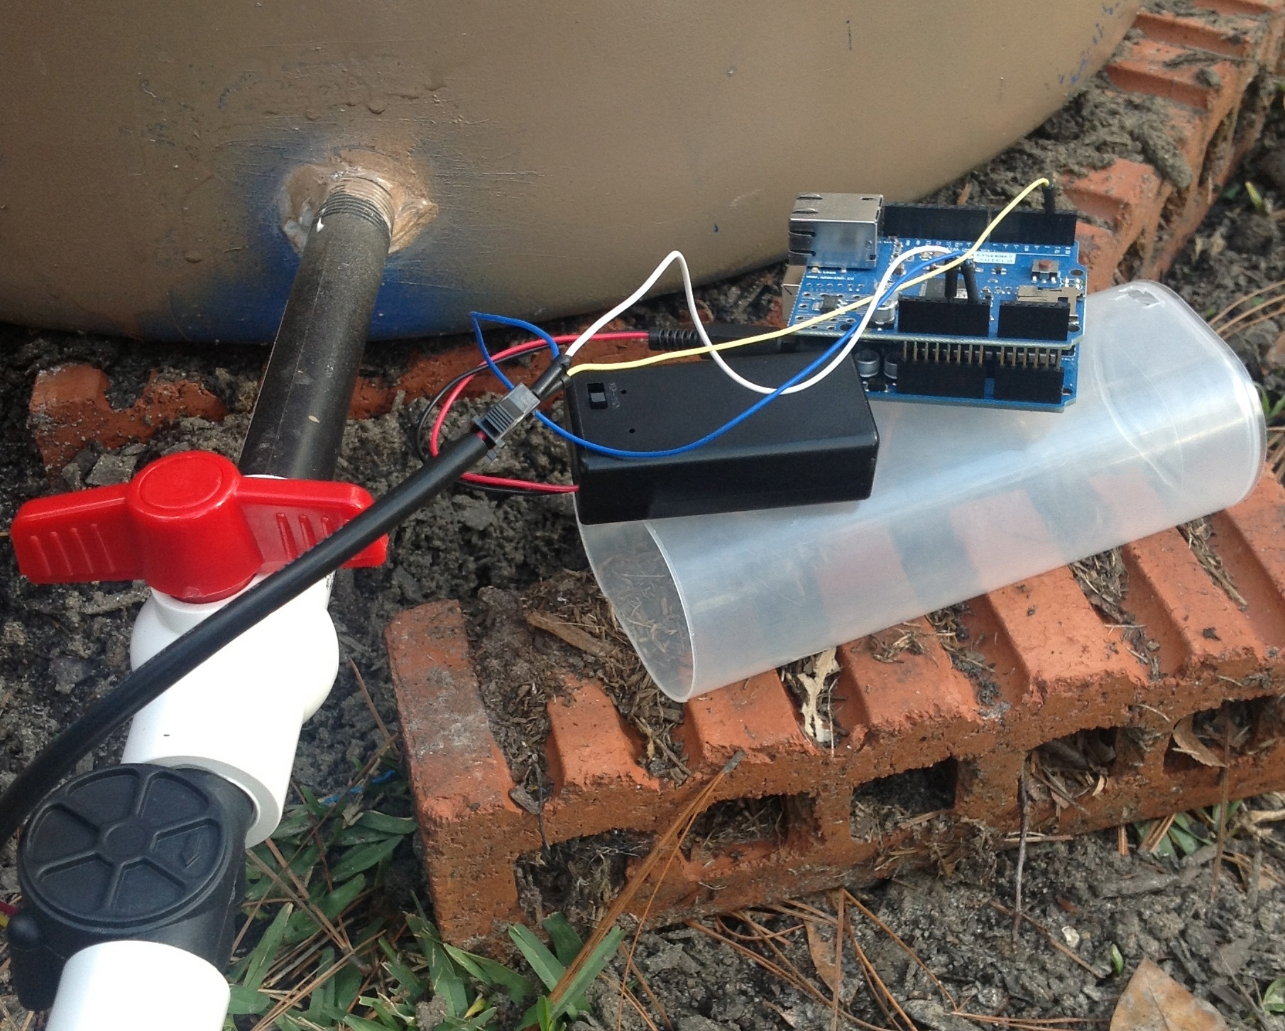
My part

Slide 5
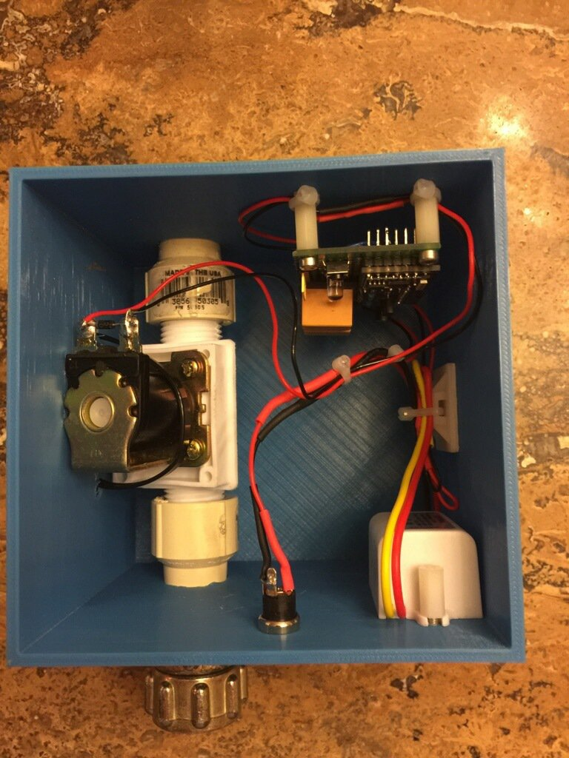
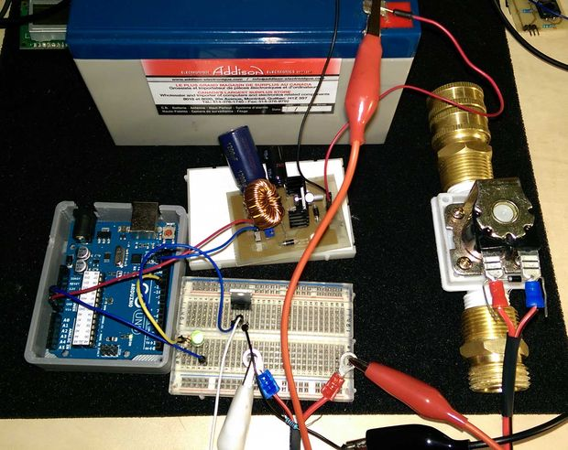
How

Slide 6
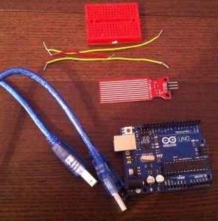
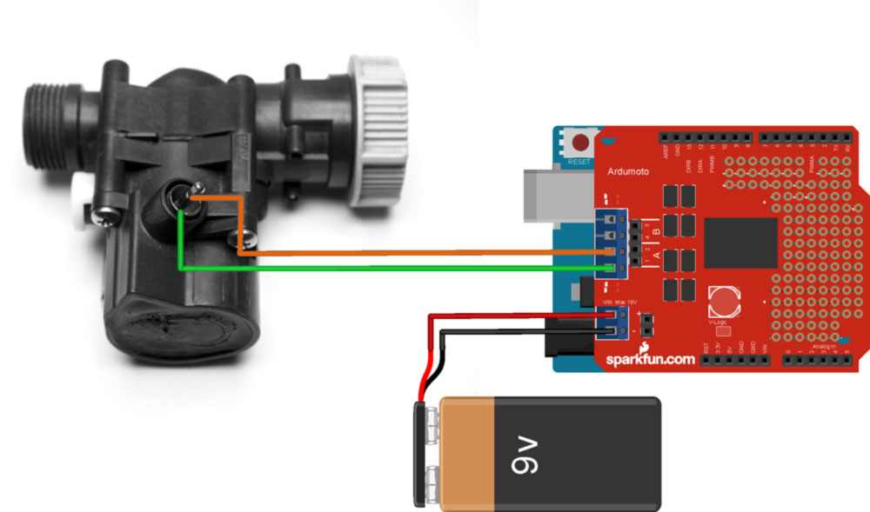

Slide 7
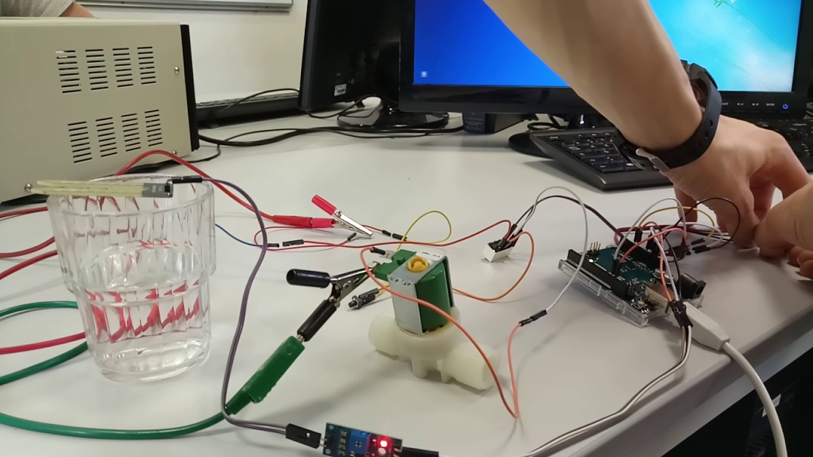
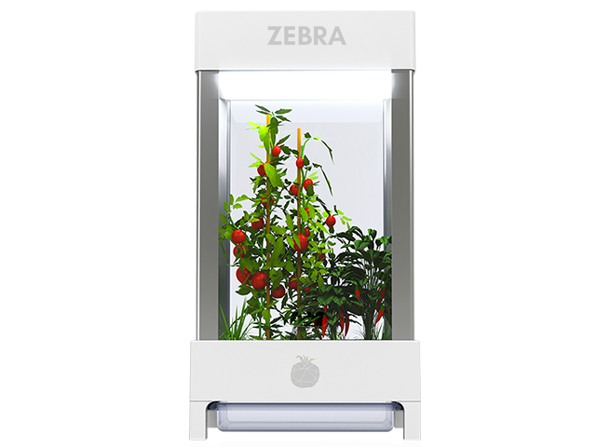
Result

