Slide 1
drtti
Distributed RealTime Target Intelligence

Slide 2
EVE Online
Internet spaceships
Sandbox – mining, production, NPC enemies, player enemies
Things take a long time to build (weeks or months for capital ships)
When things explode, they’re gone
We like to know who’s where, and it’s hard to keep track of people
We’d also like to have submissions of who ELSE is where (future) and
We’d like to figure out how we feel about them (future)

Slide 3
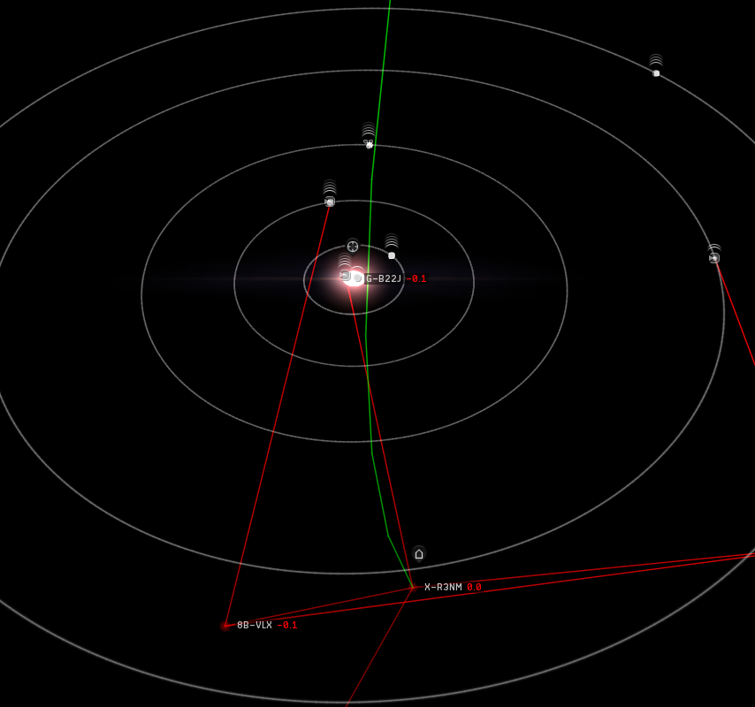
EVE is BIG
You can fly around between all the little planets (and moons) in a solar system…

Slide 4
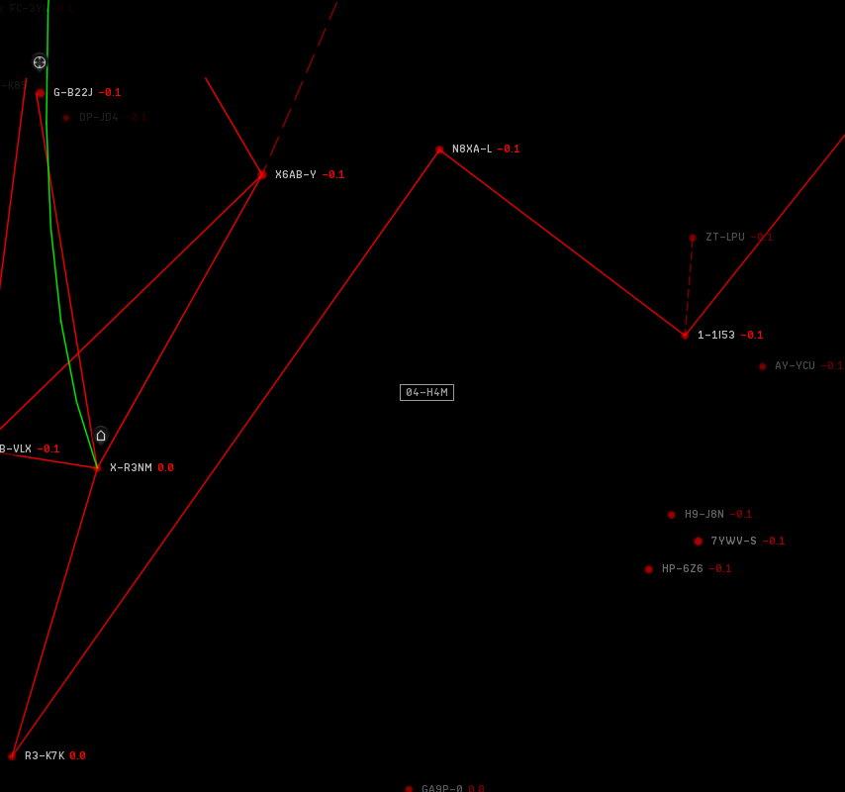
EVE is BIG
…with a bunch of solar systems in a constellation…

Slide 5
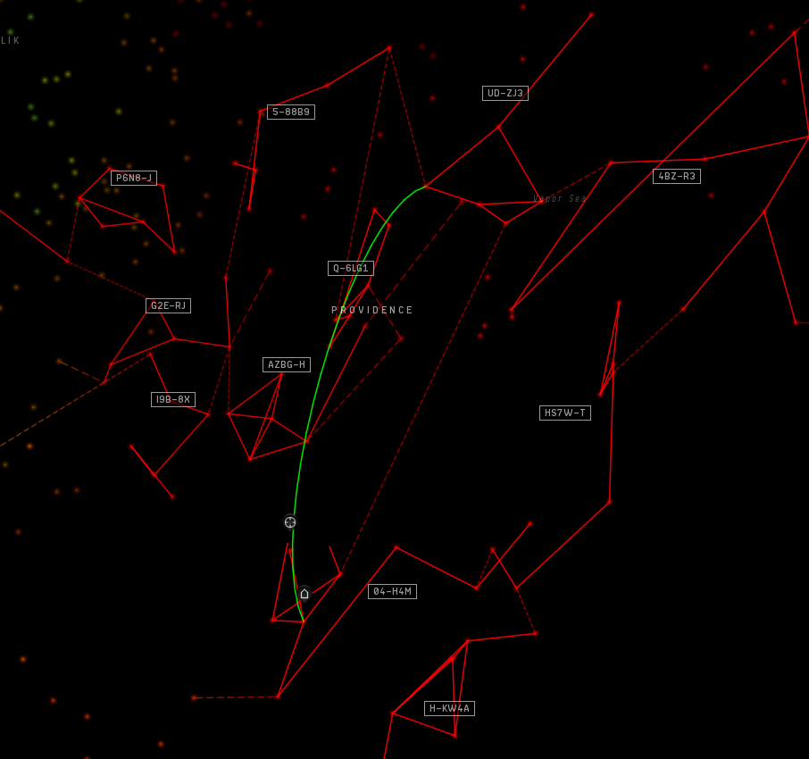
EVE is BIG
…with a bunch of constellations in a region…

Slide 6
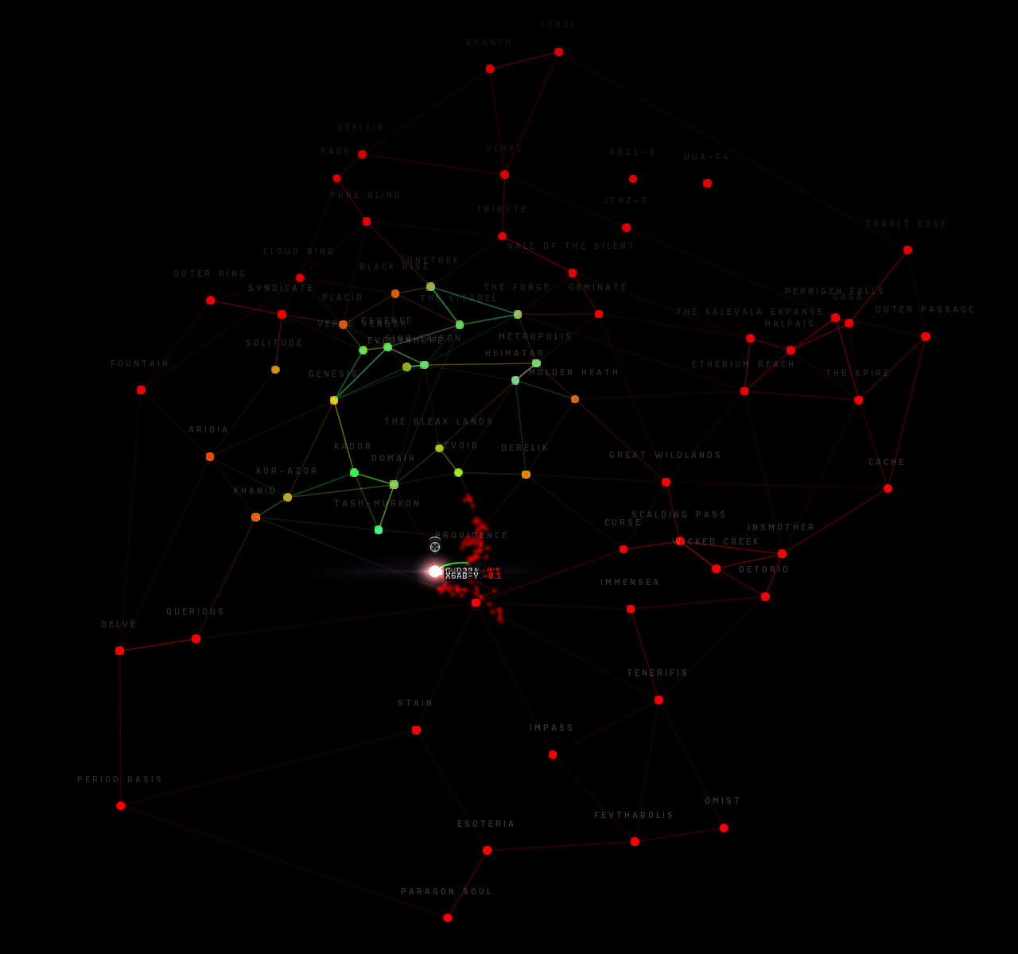
EVE is BIG
…with a bunch of regions that make up the galaxy.
Each large dot is a region
Small dots are solar systems in one region, highlighted

Slide 7
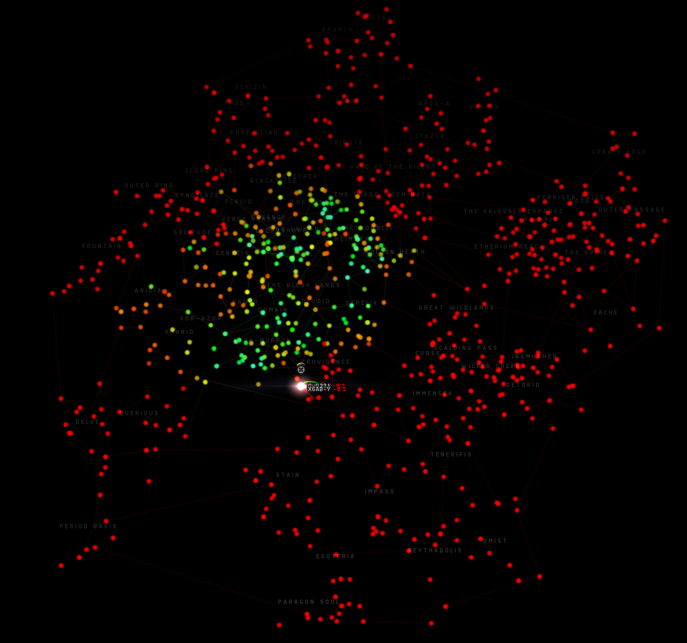
EVE is BIG
All the constellations from all the regions
Each dot is a constellation with several solar systems

Slide 8
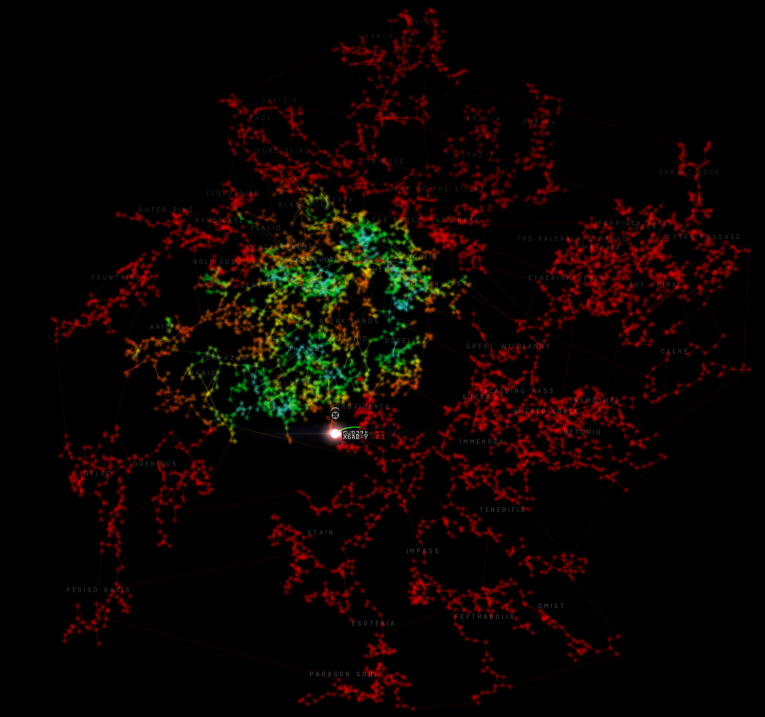
EVE is BIG
All the solar systems.
Hidden layer of interconnected wormholes that are not mapped are not shown
Total 7,930 systems

Slide 9
Problem Statement
When characters in EVE Online are looking at the current list of other characters in the local system, they are not able to get immediate, reliable, up-to-date standings towards all other characters in the local system.
The delay or unavailability of reliable, up-to-date standings results in wasted time "getting safe" (at the best) to destroyed personal, corporate, or alliance assets and loss of morale (at the worst).

Slide 10
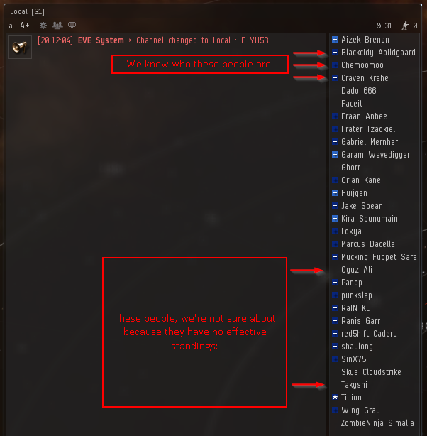
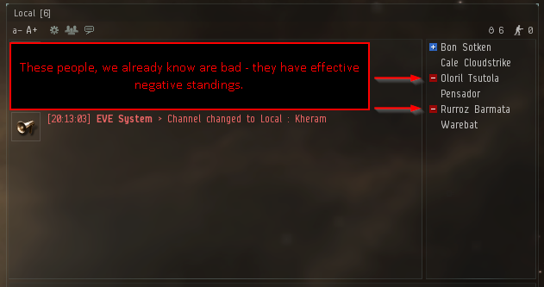
Problem Statement

Slide 11
Independent topic: OAuth2
CCP, EVE’s developer, provides multiple APIs
XML (original/old)
CREST (RESTful, round 1)
ESI (RESTful, distributed, in development)
OAuth2 used to:
Just authenticate (who are you?)
Authenticate and authorize some “scopes”
This application uses
OAuth2 SSO API for logging people in, getting a Bearer token to make API calls
ESI API with the “read_location” scope to see where you are

Slide 12
OAuth2 again…
Redirect user to CCP to log in
CCP returns one-time auth_code
CCP redirects back to application
Application, in background
Sends auth_code to SSO endpoint
Receives 20-minute access_token
Receives refresh_token to refresh
When token expires, application
Sends refresh_token to SSO endpoint
Receives new access/refresh token
SSO endpoint
Who?
Token
Refresh

Slide 13

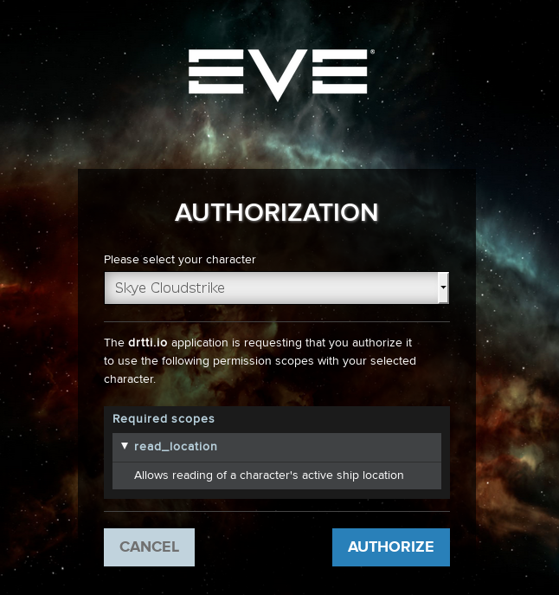
OAuth2 flow
End user experience just like
“Log in with Google,”
but for EVE

Slide 14
Deployed on WildFly 10.x
Full Java Enterprise Edition 7
Undertow web container: pages, content, and Servlets handle SSO flow
EJB container: some Singletons EJBs and some Stateless EJBs
Hibernate 5 in JPA mode with MySQL 5.7 handles database

Slide 15
WildFly: the good
The containers take care of lots of things
Dependency injection
@PersistenceContext – returns EntityManager (equivalent of SessionManager)
@EJB ClassName className – returns an EJB that implements ClassName
Transactional
Implicit, container-managed transactions – no need to set up JPA equivalent of Sessions, or Transactions
@Scheduled
Run a method repeatedly on a timer with @Scheduled(hour=, minute=, second=)

Slide 16
WildFly: the bad
The container injects things based on your annotations in the classes
Can not use the class with the annotations to just run JUnit tests
JBoss Arquillian provides integration with JUnit with embedded containers
Did not get it working successfully
Difficult to get and set up SSL with real certificates, etc.
With OAuth2 and a registered redirection endpoint, have to deploy to cloud
Logs are difficult to read (not in IntelliJ)
Redeployments require special software that monitors/redeploys pieces (JRebel), or repeatedly redeploying entire EAR file

Slide 17
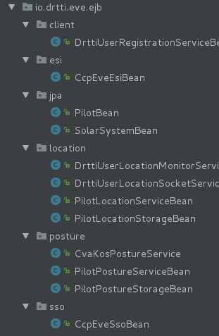
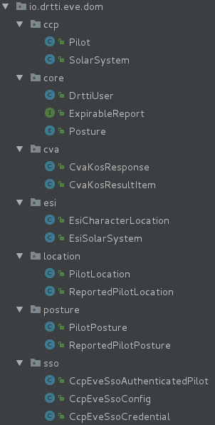
EJB/Domain Deployment

Slide 18
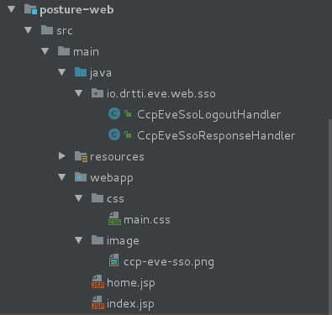
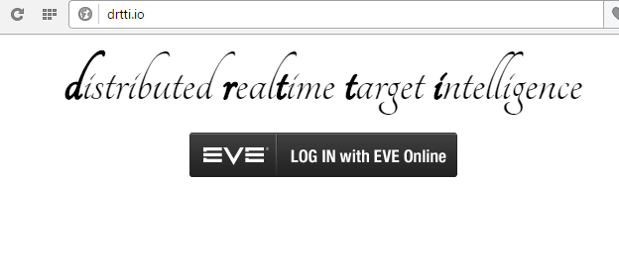
Web Deployment

Slide 19
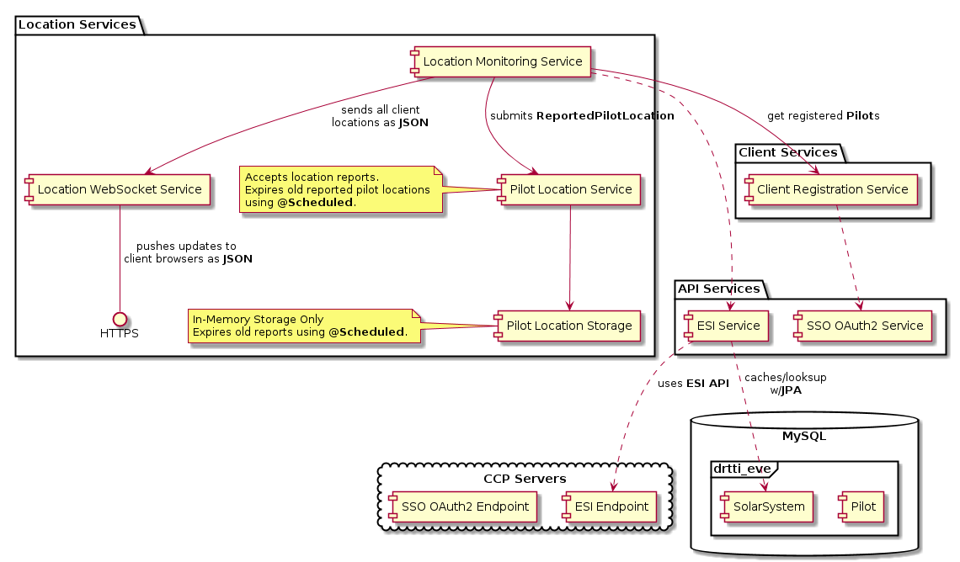
Container Managed EJB Services

Slide 20
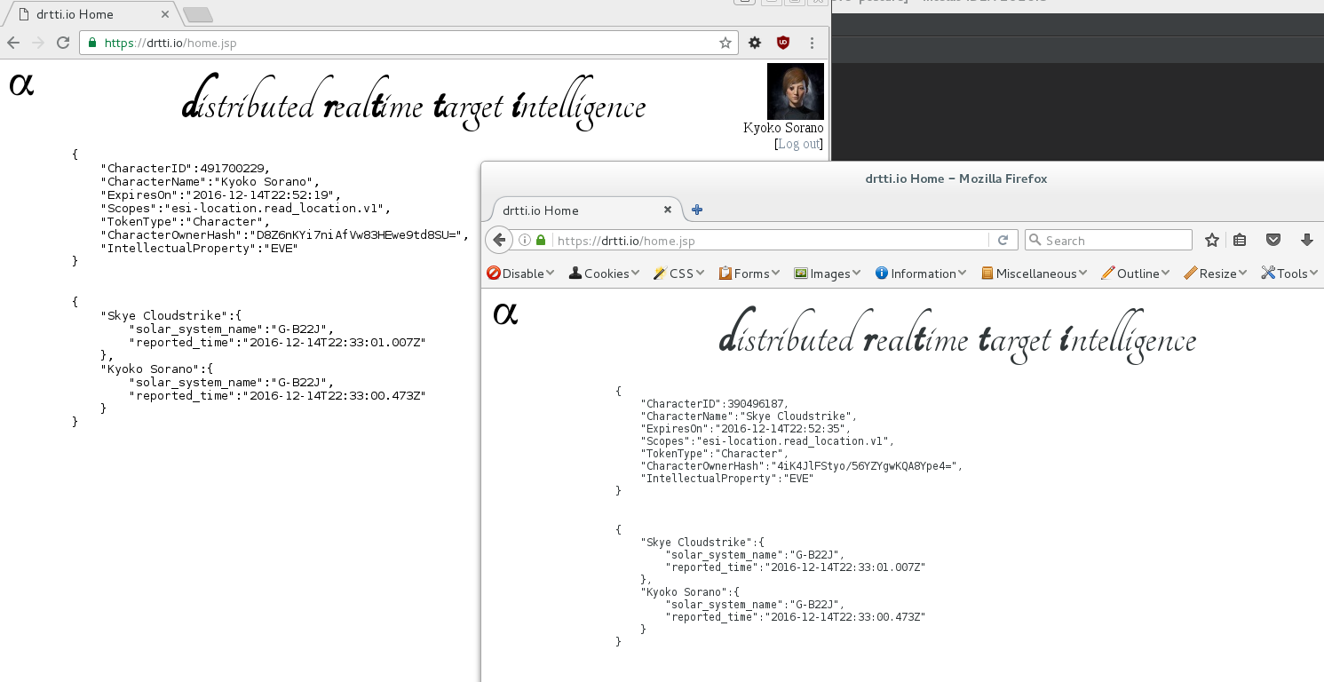
Web Frontend – WebSockets over SSL

Slide 21
Learning
Java EE 7 has a lot of nice features, lots of which drtti does not even use
Problem definition is really important
Once the problem is defined scope should not really be changed without revisiting the problem, and individual projects are hitting the “you need design” point
One should listen to the advice of one’s elders (or at least previous students)
Don’t delay the project, and keep up a steady pace through the semester

