Slide 1
English Words & Sentence
( Simple Python Programming )
Rev. : 1.0v
Date : 5th / Dec. / 2018
Author : JADE IM

Slide 2
001. Main Window Design
001.1 : detailed menu concept
002. Sub Window Design
002.1 : Help Window
002.2 : About Window
002.3 : word typing Game window
002.4 : sentence typing Game window
003. Software architecture
004. Menu action
004. Contents
004. Internet connection
005. Data Storing
006. Authorized
007. DB
008. Image / Video / Sound
009. Payment concept
010. Using period
Contents
Notes:
Whole contents of the project

Slide 3
File
Edit
Game
Help
SHORT CUT TOOL
Manuscript making
Manuscript Loading
Word matching game
Word/sentence typing game
Preview Image
001.
MainWindow
Text viewer for description of shortcut menu
Image | English words | Translated means
Quit program
PRINT TEXT WINDOW
Notes:
Main Window : Always this window is shown when the application is operated. It must be started.

Slide 4
File
Edit
Help
New Ctrl + N
Undo Ctrl + z
Help F1
001.1
Detailed menu concept
SAVE Ctrl + s
Redo Ctrl + y
About
LOAD Ctrl + l
Cut Ctrl + x
SAVE as Ctrl + Shift + s
Copy Ctrl + c
PRINT Ctrl + p
Paste Ctrl + v
EXIT Ctrl + q
Game
Word typing
Sentence Typing
Notes:
Menu concept : main menu organization for main window. The architecture is showing tree structures.

Slide 5
search
Key Words
Preview Image
002.1
HelpWindow
Show a lists
List contents
Text viewer for description of Lists’ contents
Quit Help
PRINT TEXT WINDOW
Notes:
Help window : as one of sub-window , it’ll be enabled when user clicked help menu at top of menu-bar or by pushing F1 key.

Slide 6

002.2
About Window
Quit Help
Notes:
About Window : simple information shown like attached example window.

Slide 7
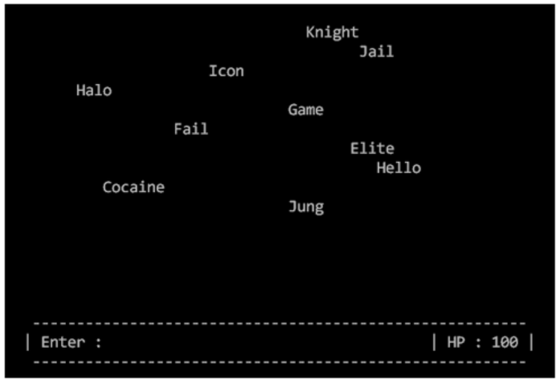
Main screen of the game
Some image of word that is recorded already in manuscript
Will be flowed here.
And the word will be changed to translated means
If words are matched with typed words.
002.3
Word typing game
window
Word typing area
Score
Failed / succeed
Notes:
As Game main screen it will be showing just like example image at the left corner of center screen and word typing area will be at the end of center screen.
Score related succeed or fail will be at the end of right down side.

Slide 8
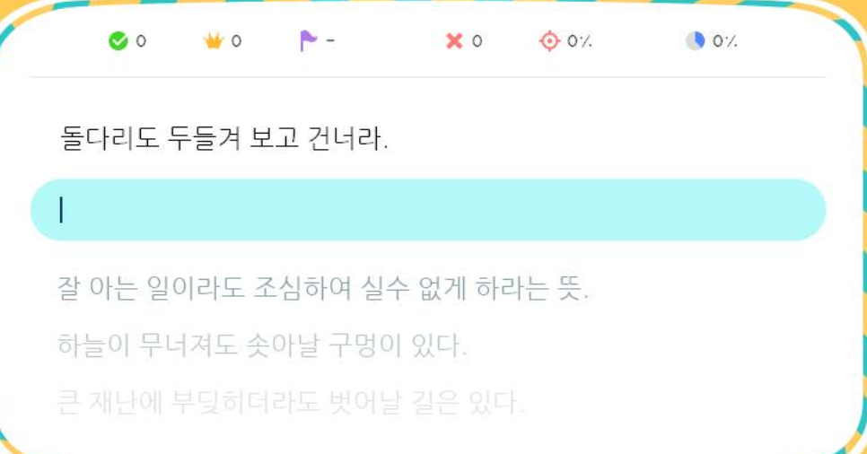
Main screen of the game
Some sentence recorded already in manuscript
Will be here.
And the sentence will be changed to translated means
If sentences are matched with typed words.
Score
Failed / succeed
002.4
Sentence typing game
window
Notes:
As Game main screen it will be showing just like example image at the left up corner of center screen and sentence typing area will be right under the sentence showing
Score related succeed or fail will be right up side.

Slide 9
Menu Icon
Window Icon
Keyboard Input
Random Words with time
003.
Software architecture
Save Manuscript
Main window
Sub window
Scoring output
Quit process
Load manuscript
Notes:
As Game main screen it will be showing just like example image at the left up corner of center screen and sentence typing area will be right under the sentence showing
Score related succeed or fail will be right up side.

Slide 10
Exit
Application
Exit
Exit
toolbar
003.
Each Menu Action
Notes:
As Game main screen it will be showing just like example image at the left up corner of center screen and sentence typing area will be right under the sentence showing
Score related succeed or fail will be right up side.

