Slide 1
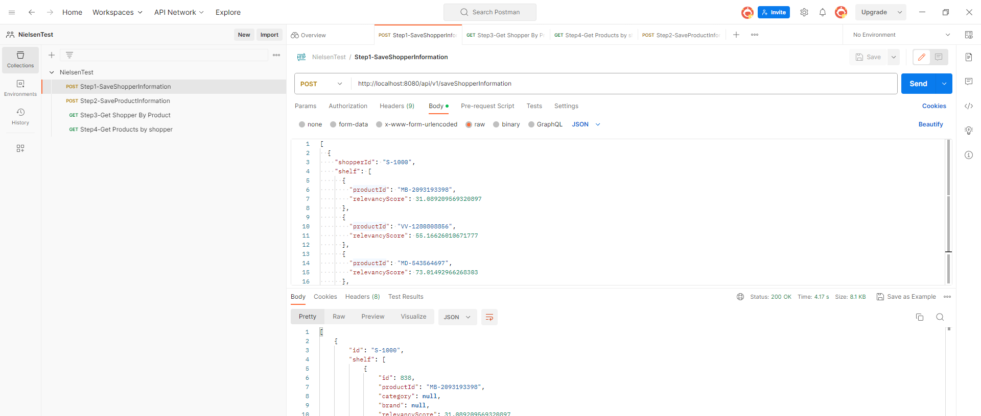
Step1:Location of Postman Collection
Import Postman collection at ->workspace-intellij-NielsenTest\NielsenTest\postman\NielsenTest.postman_collection.json

Slide 2
Step1:Location of Postman Collection
Run step 1 to step 4.

Slide 3
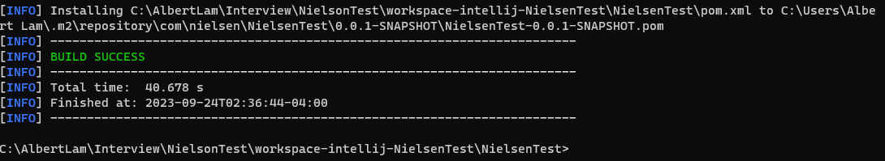
Step 2:How to build in Java
C:\AlbertLam\Interview\NielsonTest\workspace-intellij-NielsenTest\NielsenTest>mvn clean install

Slide 4
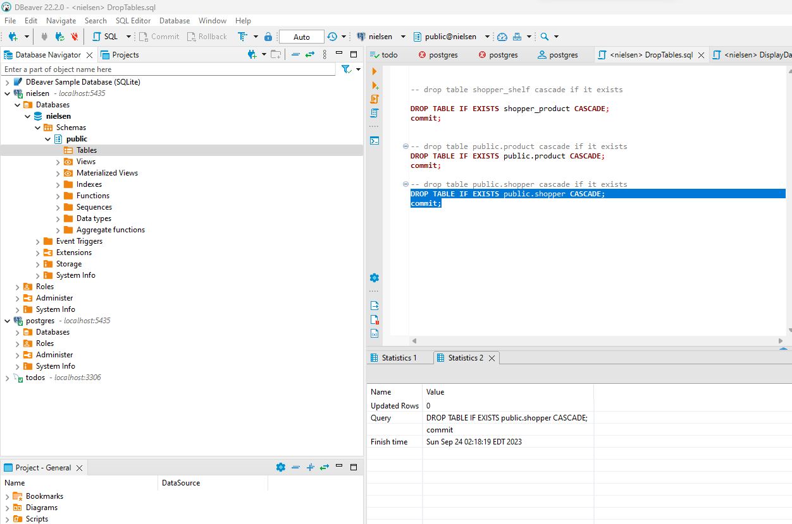
Step 3: Postgres Database
Created a Postgres database called “nielsen”.

Slide 5
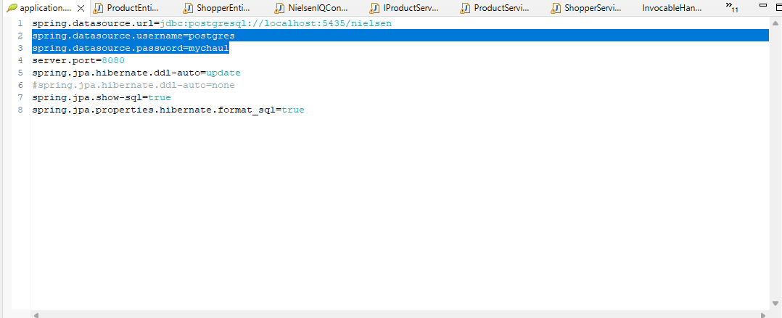
Step 3: Postgres Database
Database id and password location:C:\AlbertLam\Interview\NielsonTest\workspace-intellij-NielsenTest\NielsenTest\src\main\resources\application.properties

Slide 6
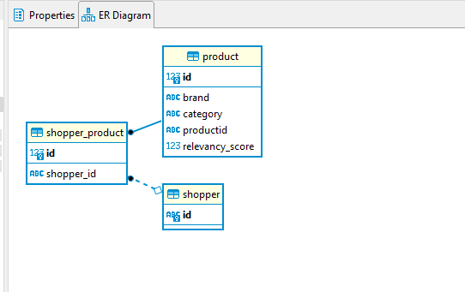
Step 3: Postgres Database
Entity Relationship Diagram Location:
C:\AlbertLam\Interview\NielsonTest\workspace-intellij-NielsenTest\NielsenTest\EntityRelationshipDiagram

Slide 7
Step 3: Postgres Database
DDL Script location.
C:\AlbertLam\Interview\NielsonTest\workspace-intellij-NielsenTest\NielsenTest\sql\DDL-Scripts.sql
NOTE: Do not need to run DDL-Scripts.sql to create the table. Just needed to create the database called “nielsen” and when starting the web service for first time it will generate the tables using JPA.

Slide 8
Step 4: How To Build Docker Image
C:\AlbertLam\Interview\NielsonTest\workspace-intellij-NielsenTest\NielsenTest>docker build . -t jadeite1000/nielsentest

