Slide 1
Brain Tumor Detection using
Deep Learning (Custom CNN vs ResNet50)
Jadeja Mohitrajsinh
Marwadi University

Slide 2
Problem Statement
Brain tumors cause significant morbidity and mortality.
Manual MRI analysis is time-consuming.
Deep learning automates tumor detection.

Slide 3
Objective
• Classify MRI brain images into Tumor vs No Tumor
• Compare Custom CNN and ResNet50 models
• Evaluate metrics: accuracy, recall, and interpretability
• Use Grad-CAM for explainability.

Slide 4
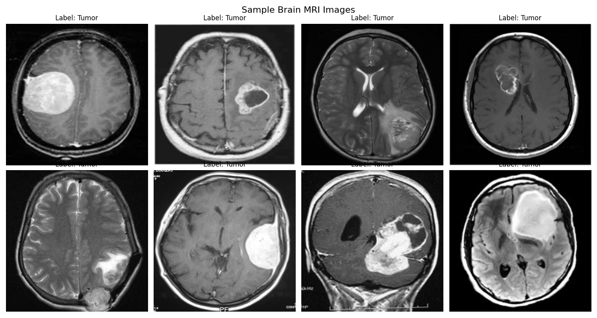
Dataset Overview

Slide 5
Data Preprocessing
• Resize 224×224
• Normalize intensities
• CLAHE contrast enhancement
• Augmentation: rotation, flip, elastic deformation.

Slide 6
Custom CNN Architecture
• 3 Conv blocks (32→64→128)
• BatchNorm + ReLU + MaxPooling
• Dropout (0.3–0.5)
• GlobalAveragePooling + Dense layers
• Sigmoid output layer.

Slide 7
ResNet50 Fine-Tuning
• Pretrained on ImageNet
• Unfreeze top 30 layers
• Dual-branch head (GAP + GMP)
• L2 Regularization & Dropout(0.5)
• Adam optimizer, LR=1e−4.

Slide 8
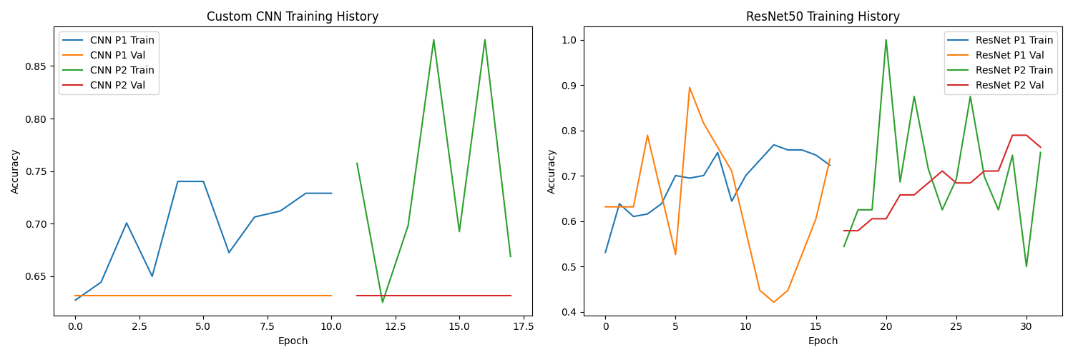
Training Progress

Slide 9
Evaluation Metrics
• Accuracy, Precision, Recall, F1-score
• ROC-AUC for discrimination
• Confusion matrix analysis.

Slide 10
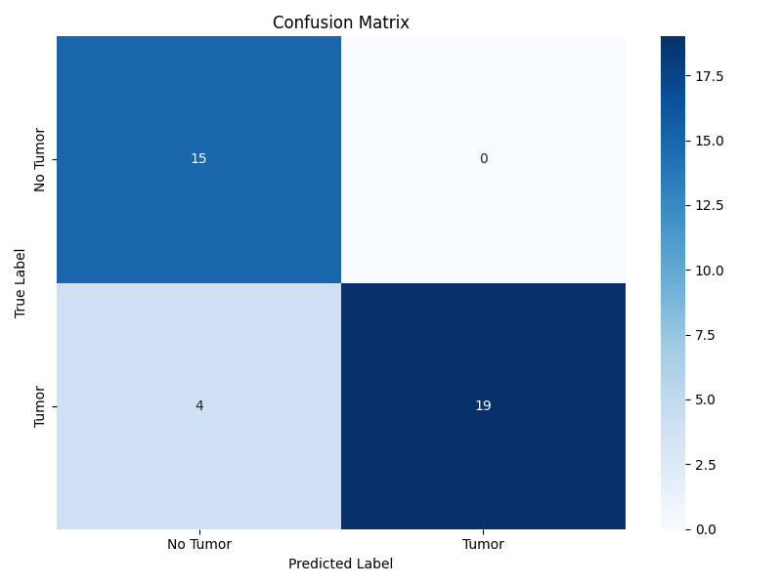
Confusion Matrix

Slide 11
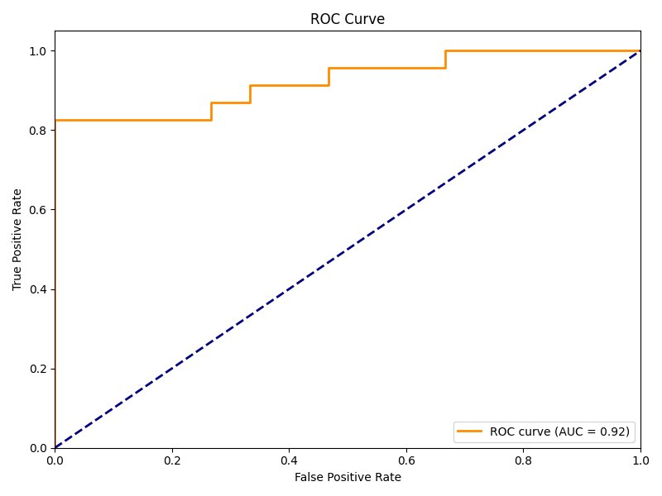
ROC Curve

Slide 12
Grad-CAM Visualization
• Heatmaps show tumor localization.
• Highlights diagnostic regions.
• Improves model interpretability.

Slide 13
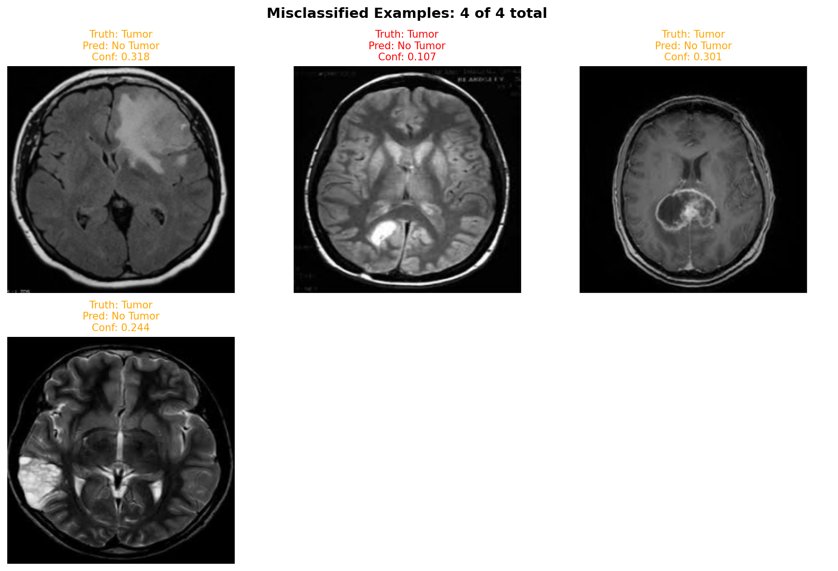
Misclassified Examples

Slide 14
Results Comparison
Custom CNN: Accuracy 81%, AUC 0.81
ResNet50: Accuracy 89%, AUC 0.92
ResNet50 demonstrates higher robustness.

Slide 15
Discussion
• Transfer learning improved convergence.
• Grad-CAM verified correct localization.
• AI aids radiologists in MRI screening.

Slide 16
Limitations & Future Work
• Small dataset; limited MRI modalities.
• Expand to T1/T2/FLAIR sequences.
• Use federated learning for privacy.
• Deploy lightweight ResNet models.

Slide 17
Conclusion
ResNet50 outperformed Custom CNN with higher AUC and interpretability.
Grad-CAM improved transparency.
AI-assisted MRI diagnosis is clinically feasible.

