Slide 1
Jaden Cao
CS 352 Final Project Presentation

Slide 2
Usability Problem & Target Audience
Usability Problem
Students juggling multiple courses, jobs, and life activities struggle to centralize and track tasks across fragmented platforms (Canvas, Gmail, Discord). Without a unified planner, deadlines slip and context-switching creates cognitive overload.
Target Audience
Hybrid and online students balancing coursework with employment. They need a simple, fast way to capture tasks from multiple sources and see their daily and weekly commitments at a glance.

Slide 3
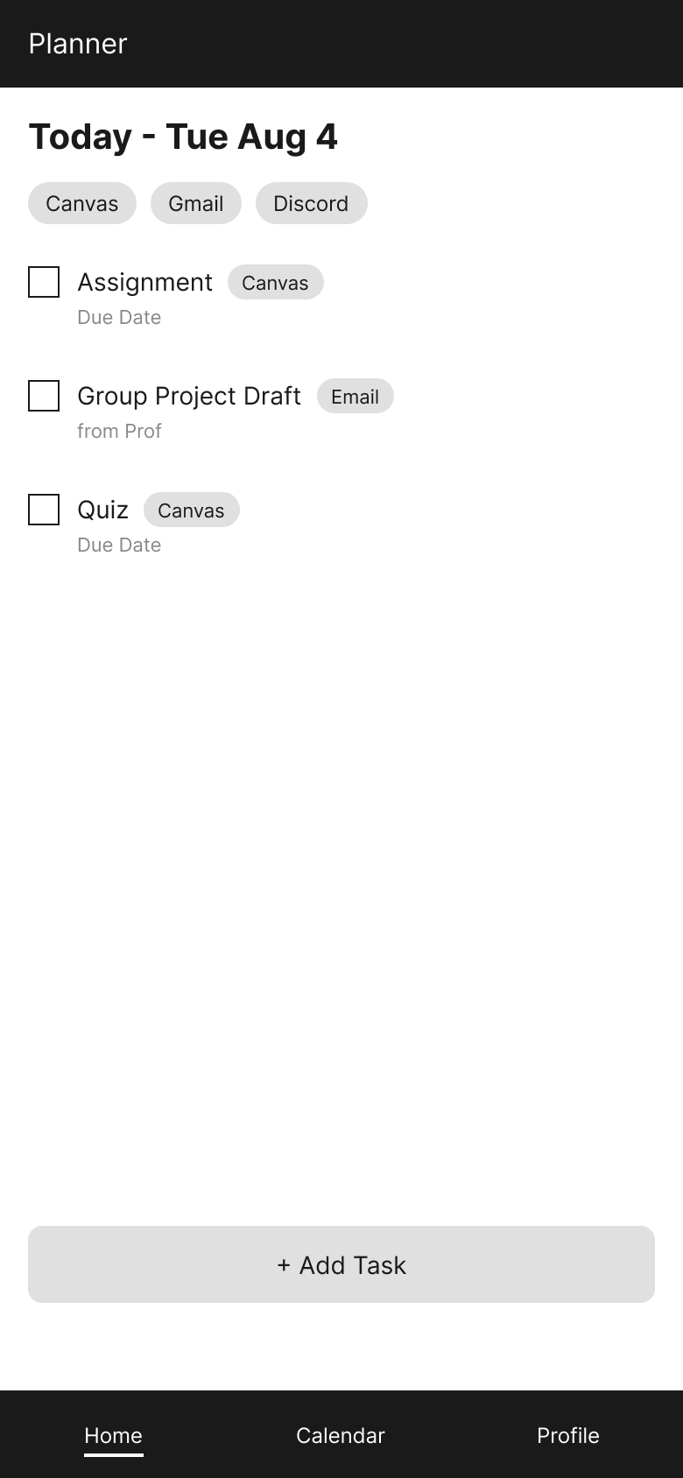
Decision 1: Knowing Where You Are in the App
During our usability tests, both participants had trouble telling which section of the app they were in. One said he had to guess whether he was on Home or Profile. We added an underline beneath the active tab and carried it across every screen so the current section is always marked. This applies the consistency and standards heuristic: users should be able to rely on the same visual cue in the same place to tell them where they are.

Slide 4
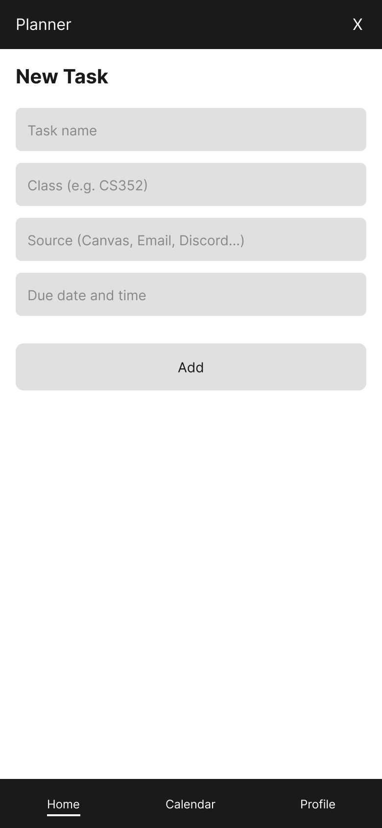
Decision 2: Aesthetic and Minimalist Design
In our interviews and usability tests, users told us the capture flow itself was fine but the steps around it felt long. One participant expected a quick pop-up rather than a whole new page confirming the task saved. We kept the entry form to four fields: task name, class, source, and due date. This follows the aesthetic and minimalist design heuristic: anything beyond what is needed to log a task competes with the information that actually matters.

Slide 5
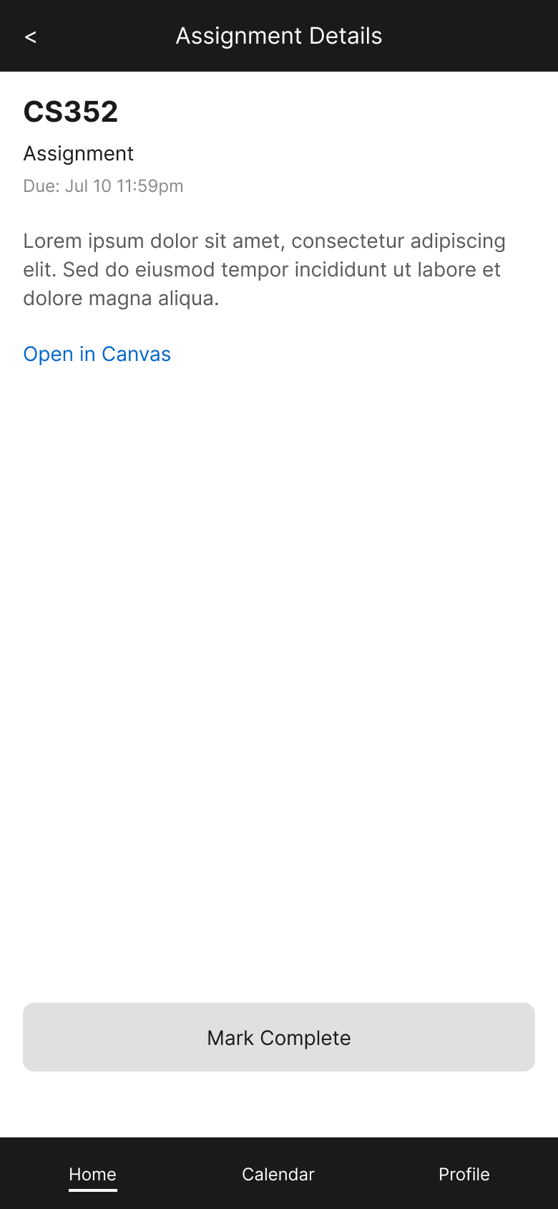
Decision 3: Match System and Real World
Our early screens used grey placeholder bars where the assignment description would go. During usability testing both participants said they understood the bars were meant to be text, but that real words would be easier to read and would feel more like an actual assignment. We replaced the placeholders with real paragraph text. This applies the match between system and real world heuristic: the screen should show users the kind of content they already expect to find there.

Slide 6
Decision 4: Error Prevention
During our research it became clear that students still need to submit their work in Canvas, and our app was never meant to replace that. Rather than build a submit button we could not actually deliver, we ended the details screen with a plain link that names where it goes. This applies the error prevention heuristic: a button that looks like it submits work but does not would cause a mistake at the worst possible moment.

Slide 7
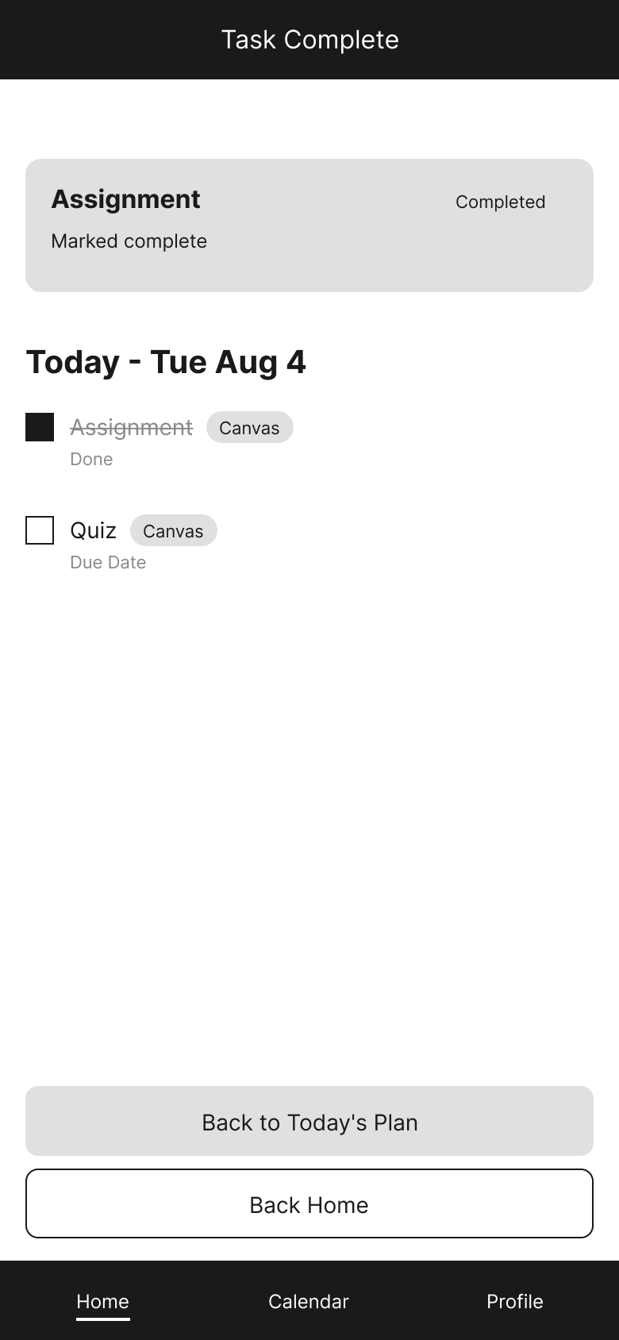
Decision 5: Visibility of System Status
During usability testing, users tapped Mark Complete and nothing on the screen changed. Both participants stopped and asked whether the action had worked, and one said the lack of any response made him worry. We built a confirmation screen where the checkbox fills in and the task title is crossed out. This applies the visibility of system status heuristic: a system that stays silent leaves users guessing, and guessing usually means doing the work twice.

Slide 8
Decision 6: User Control and Freedom
After finishing a task, users need a clear way back into whatever they were doing. Our original screen offered one unlabeled way out, which left people unsure where they would end up. We added two named exits: one returns to the current day's task list, the other goes back to the home screen. This applies the user control and freedom heuristic: users should be able to choose their own way out rather than accept the only one offered.

Slide 9
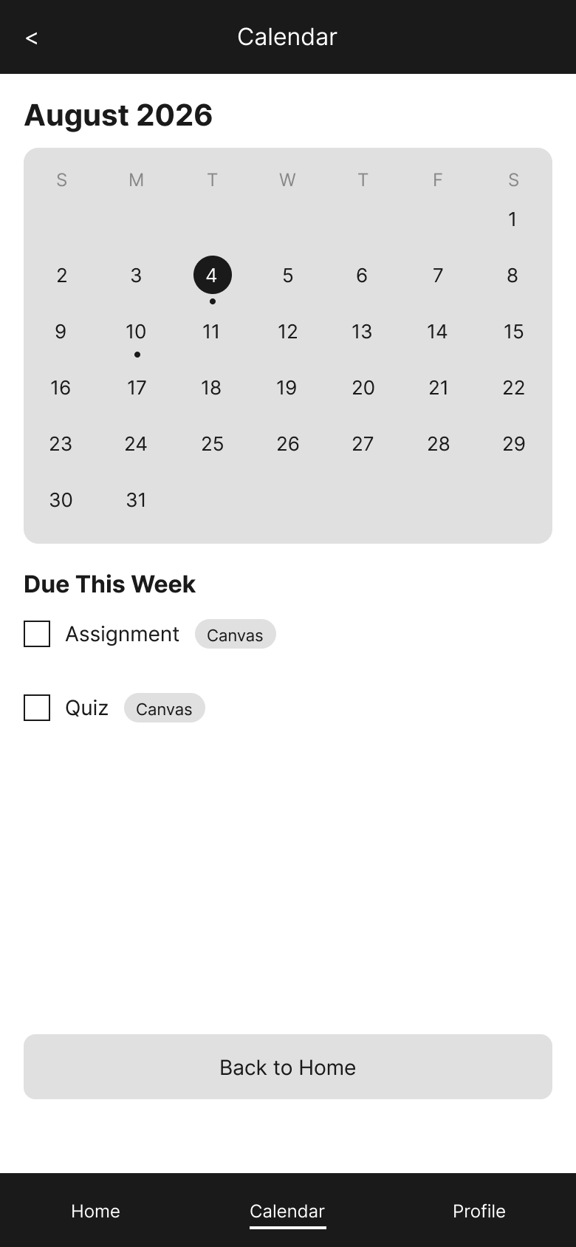
Decision 7: Flexibility and Efficiency of Use
In our usability tests, users wanted to look past today. One participant went to the calendar expecting to tap a specific date to see what was due, and found the dates were only a picture. We built a full month view, marked the current day, added dots under the days that have work due, and made the dates open the assignment. This applies the flexibility and efficiency of use heuristic: an interactive calendar with visual indicators lets users jump directly to relevant dates rather than scrolling through a static view, which is faster and more efficient.

Slide 10
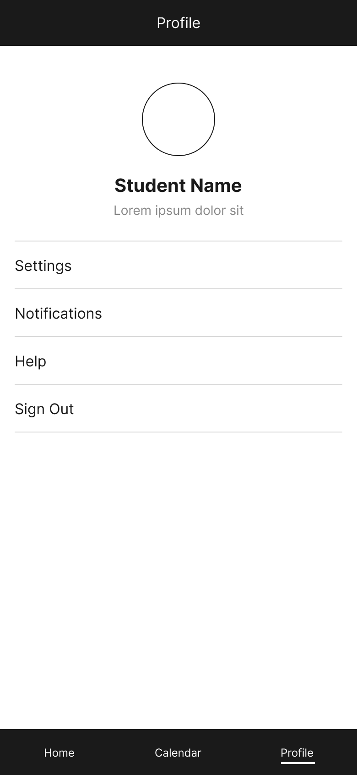
Decision 8: Consistency and Standards
Our early screens did not always keep the navigation bar in reach, and during testing one participant lost track of how to get back. We placed the same three-tab bar on every screen, connected each tab to its destination, and marked the active one. Even the deepest screen in the flow is one tap from anywhere else. This applies the consistency and standards heuristic: the way back should sit in the same place every time.

Slide 11
Decision 9: Plain Language for Task Sources
One of our entry fields was originally labeled with an internal term our team used rather than anything a student would say, and it was not clear what belonged in it. We renamed the field Source and put the examples directly inside it, naming Canvas, email, and Discord. This applies the match between system and real world heuristic: the field that names the platforms students already use should use their words rather than ours.

Slide 12
References
Course Materials Module 1: Exploration: Usability Heuristics -
https://canvas.oregonstate.edu/courses/2051726/pages/exploration-usability-heuristics?module_item_id=26875018 Module 4: Exploration: Empirical Evaluations -
https://canvas.oregonstate.edu/courses/2051726/pages/exploration-empirical-evaluations?module_item_id=26875049 References Brooke, J. (1996). SUS: A 'quick and dirty' usability scale. Usability Evaluation in Industry, 189(194), 4-7. Centre for Excellence in Universal Design. (n.d.). The 7 Principles of Universal Design. http://universaldesign.ie/about-universal-design/the-7-principles Moran, K., & Gordon, K. (2023). How to Conduct a Heuristic Evaluation. Nielsen Norman Group. https://www.nngroup.com/articles/how-to-conduct-a-heuristic-evaluation/ Nielsen, J. (1994). 10 Usability Heuristics for User Interface Design. Nielsen Norman Group. https://www.nngroup.com/articles/ten-usability-heuristics/ Whitenton, K. (2013). Minimize Cognitive Load to Maximize Usability. Nielsen Norman Group. https://www.nngroup.com/articles/minimize-cognitive-load/

