Slide 1
TR / TE / ESP | 2000 ms / 34 ms / 15 ms
ETL | 16
b-values | 100, 200, 300, 400, 500, 600, 700, 800, 900, 1000, 1500, 2000, 2500, 3000
Direction (x,y,z) | (1,0,0)
Delta / delta | 20 ms / 4 ms
tcrush / diff_tcrush | 2000 us / 2000 us
nav_on | True

Slide 2
Direction | ADC (excluding s0) | ADC % difference
Positive x | 1.9067e-03 | +3.51%
Negative x | 1.7345e-03 | -5.83%
Positive y | 1.8494e-03 | +0.40%
Negative y | 1.8202e-03 | -1.18%
Positive z | 1.9118e-03 | +3.79%
Negative z | 1.8292e-03 | -0.69%
Mean | 1.8420e-03 | 0.00%

Slide 3
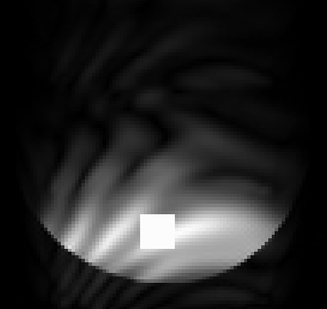
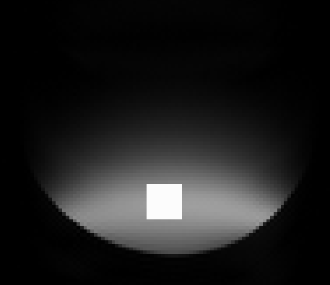
b=0
b=100

Slide 4
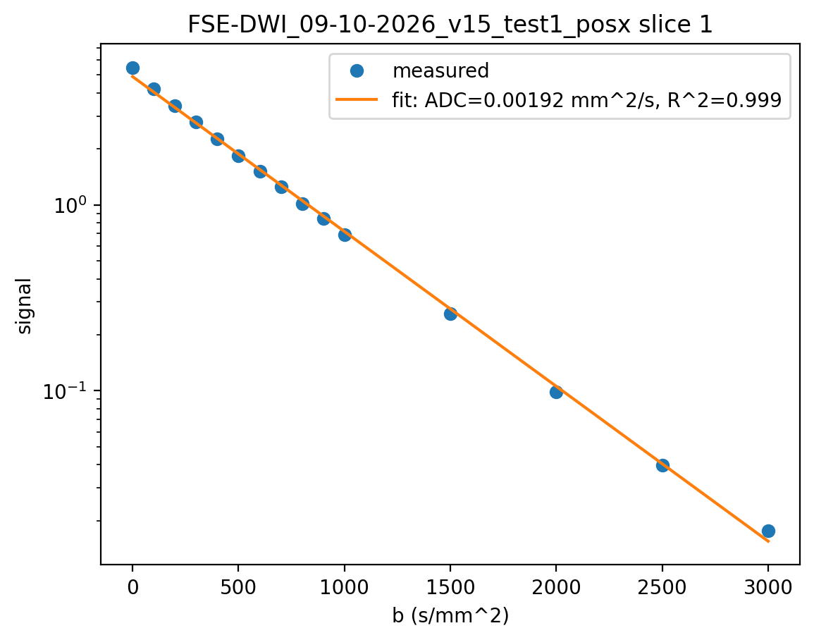
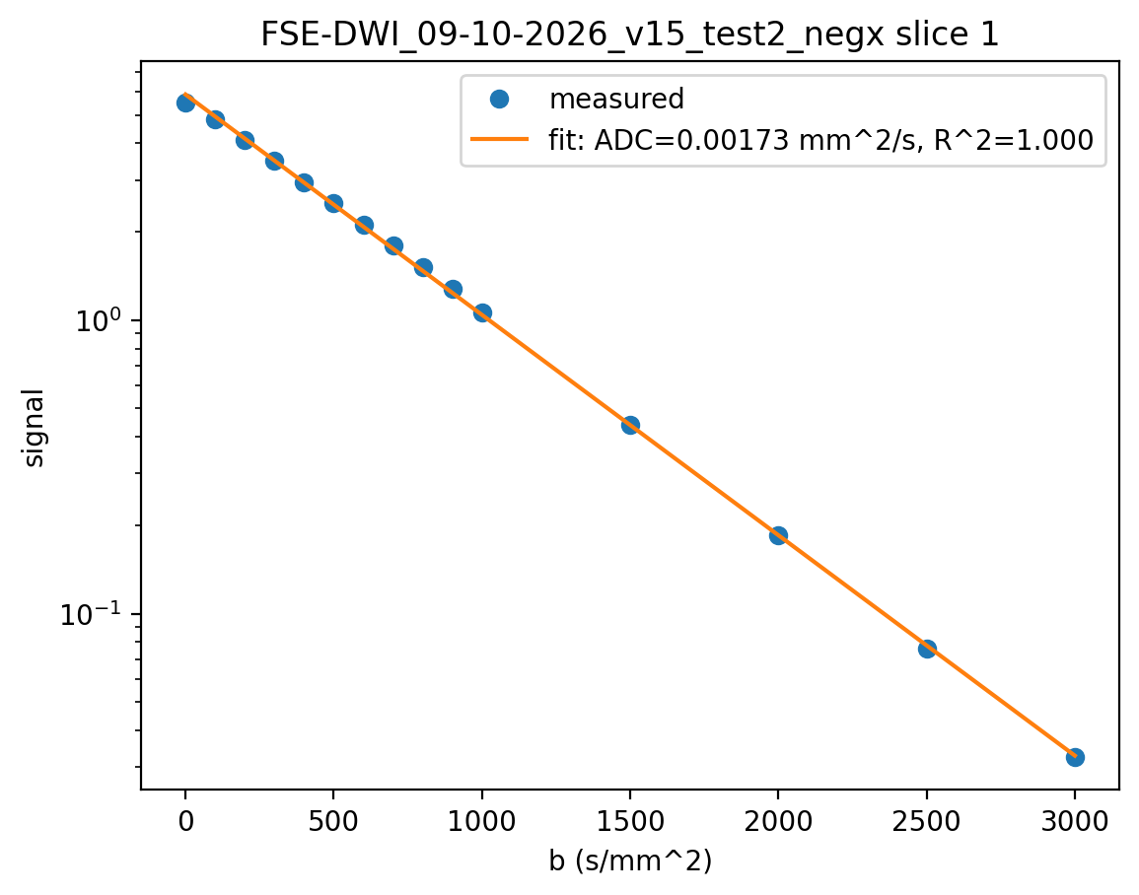

Slide 5
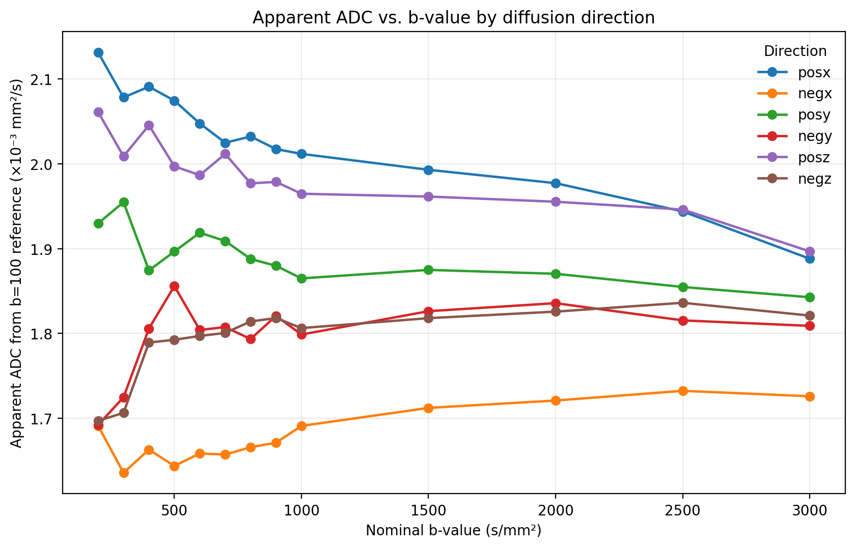

Slide 6
Next Steps
Check Temp in room to know the true ADC value
Calculate the true b-values given the FSE sequence
Determine cause of s0 artifact (only surface coil)
At what b-value does the s0 artifact disappear?

