Slide 1
Test 0 Centric Interleaved: FSE DWI w/ Surface Coil: In-vivo Rat Brain
Total Scan Time | 44 seconds
TR, TE, esp | 2000 ms / 54 ms / 16 ms
PE_order | 1
ETL / Averages | 16 / 1
FOV | 35
b-values | 0, 6000 s/mm²
Diffusion Directions | 1 (x-axis)
Small / Big Delta | 4 ms / 40 ms
diff_tcrush / tcrush | 2000 us / 2000 us
diff_tcrush_amplitude / t_crush_amplitude | 2754 DAC units / 2754 DAC units

Slide 2
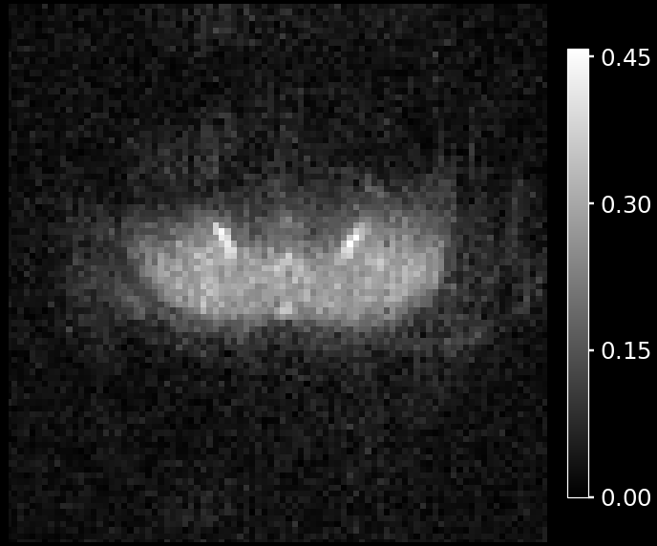
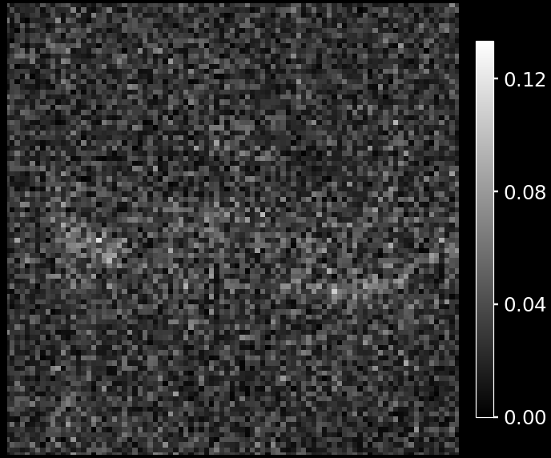
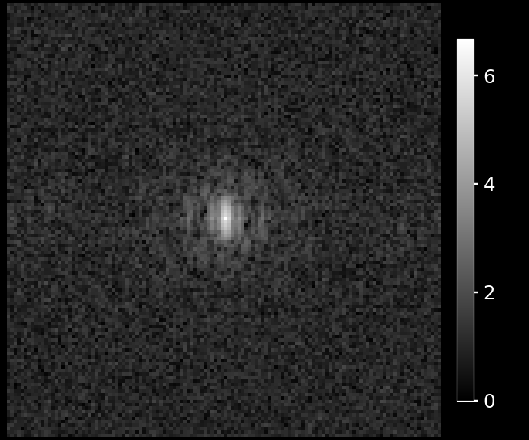
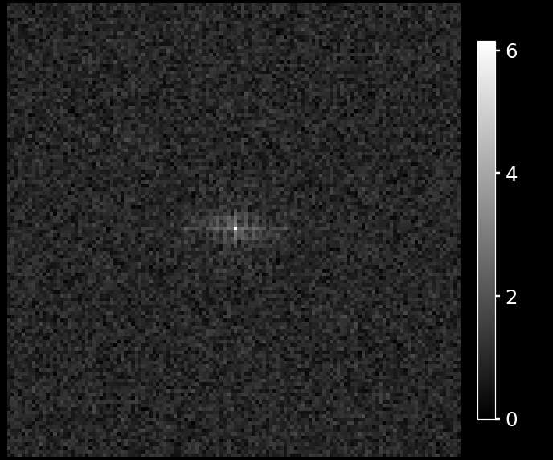
b = 0 s/mm² (SNR 13.9)
b = 6000 s/mm² (SNR 3.6)
Reconstructed
image
Log k-space
Notes:
Source: FSE-DWI_09-29-2026_v16_test0.nii.gz
Shape: (128, 128, 3, 2)
Shell direction index: 0; None means shell mean. Index uses original volume order within each shell, not b-vector matching. When selecting a direction, shells with max b <= 5 s/mm² use the first baseline volume.
Slice index (0-based): 1; voxel axis: 2; axis directions: ('R', 'A', 'S'); canonical: False
Display: transpose, origin lower, rotation 0 degrees, flip_lr=False
Reconstructed-image display zoom: 1.45x; shifts: x=0.3, y=-8.7 source pixels after rotation/flip (positive right/up). K-space full view, no translation.
FFT: fftshift(fft2(ifftshift(slice), norm="backward")); 2D in-plane transform.
K-space display: ln(1 + abs(FFT)).
Color limits: panel; lower=0, image upper percentile=100.0, FFT upper percentile=100.0. Shared limits span all slides.
Per-shell reconstructed-image upper limit overrides: [None, None]. Lower limit=0.
Intensity and Fourier amplitude are arbitrary units; the log transform uses those numeric amplitudes.
FFT of magnitude/real NIfTI image; acquired phase unavailable. Even complex reconstructed images need not reproduce raw scanner data.
When direction selection is disabled, b-value groups use the arithmetic mean of source image slices before FFT. When enabled, the selected volume alone supplies the reconstructed image, Fourier spectrum, and SNR. (complex mean for complex inputs). This is the FFT of the mean image, not mean raw k-space magnitude.
b = 0 s/mm²: source volume indices [0] (0-based)
b = 6000 s/mm²: source volume indices [1] (0-based)
SNR: supplied snr_utils.image_snr on the full selected magnitude slice, before zoom/translation/contrast. noise_width=16; mask_method=max_fraction; mask_level=0.5. For grouped shells this is SNR of the mean image, not mean individual SNR.
b = 0 s/mm²: {'snr': 13.947386028540903, 'signal_mean': 0.2830026573666902, 'noise_sigma': 0.020290730950414254, 'n_signal_px': 535, 'corners_suspect': False}
b = 6000 s/mm²: {'snr': 3.619667410223047, 'signal_mean': 0.07689407025463879, 'noise_sigma': 0.02124340762288448, 'n_signal_px': 320, 'corners_suspect': False}

Slide 3
Test 2 Reverse Centric Interleaved: FSE DWI w/ Surface Coil: In-vivo Rat Brain
Total Scan Time | 44 seconds
TR, TE, esp | 2000 ms / 54 ms / 16 ms
PE_order | 6
ETL / Averages | 16 / 1
FOV | 80
b-values | 0, 6000 s/mm²
Diffusion Directions | 1 (x-axis)
Small / Big Delta | 4 ms / 40 ms
diff_tcrush / tcrush | 2000 us / 2000 us
diff_tcrush_amplitude / t_crush_amplitude | 2754 DAC units / 2754 DAC units

Slide 4
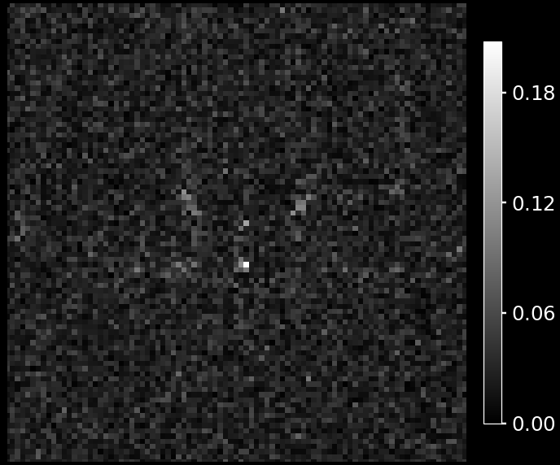
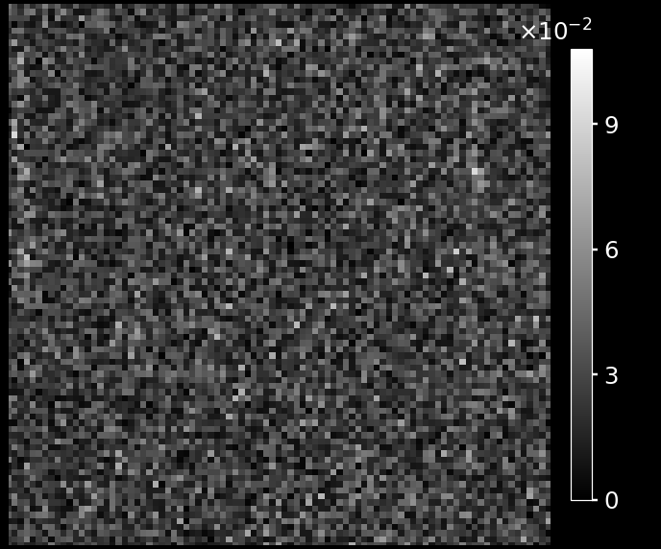
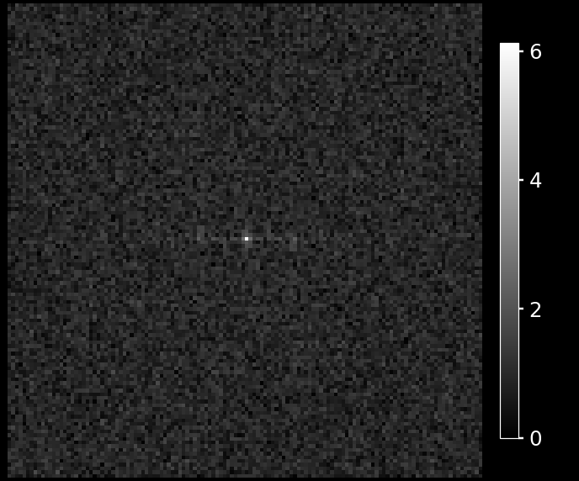
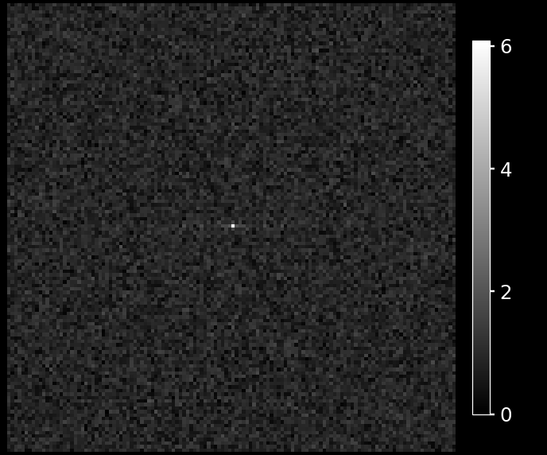
b = 0 s/mm² (SNR 6.2)
b = 6000 s/mm² (SNR 3.1)
Reconstructed
image
Log k-space
Notes:
Source: FSE-DWI_09-29-2026_v16_test2.nii.gz
Shape: (128, 128, 3, 2)
Shell direction index: 0; None means shell mean. Index uses original volume order within each shell, not b-vector matching. When selecting a direction, shells with max b <= 5 s/mm² use the first baseline volume.
Slice index (0-based): 1; voxel axis: 2; axis directions: ('R', 'A', 'S'); canonical: False
Display: transpose, origin lower, rotation 0 degrees, flip_lr=False
Reconstructed-image display zoom: 1.45x; shifts: x=0.3, y=-8.7 source pixels after rotation/flip (positive right/up). K-space full view, no translation.
FFT: fftshift(fft2(ifftshift(slice), norm="backward")); 2D in-plane transform.
K-space display: ln(1 + abs(FFT)).
Color limits: panel; lower=0, image upper percentile=100.0, FFT upper percentile=100.0. Shared limits span all slides.
Per-shell reconstructed-image upper limit overrides: [None, None]. Lower limit=0.
Intensity and Fourier amplitude are arbitrary units; the log transform uses those numeric amplitudes.
FFT of magnitude/real NIfTI image; acquired phase unavailable. Even complex reconstructed images need not reproduce raw scanner data.
When direction selection is disabled, b-value groups use the arithmetic mean of source image slices before FFT. When enabled, the selected volume alone supplies the reconstructed image, Fourier spectrum, and SNR. (complex mean for complex inputs). This is the FFT of the mean image, not mean raw k-space magnitude.
b = 0 s/mm²: source volume indices [0] (0-based)
b = 6000 s/mm²: source volume indices [1] (0-based)
SNR: supplied snr_utils.image_snr on the full selected magnitude slice, before zoom/translation/contrast. noise_width=16; mask_method=max_fraction; mask_level=0.5. For grouped shells this is SNR of the mean image, not mean individual SNR.
b = 0 s/mm²: {'snr': 6.181899506443754, 'signal_mean': 0.1250675469636917, 'noise_sigma': 0.020231248798743252, 'n_signal_px': 8, 'corners_suspect': False}
b = 6000 s/mm²: {'snr': 3.091169288553505, 'signal_mean': 0.061270498936330235, 'noise_sigma': 0.019821139904311554, 'n_signal_px': 666, 'corners_suspect': False}

Slide 5
Test 2 Linear Interleaved: FSE DWI w/ Surface Coil: In-vivo Rat Brain
Total Scan Time | 44 seconds
TR, TE, esp | 2000 ms / 54 ms / 16 ms
PE_order | 7
ETL / Averages | 1 / 1
FOV | 80
b-values | 0, 6000 s/mm²
Diffusion Directions | 1 (x-axis)
Small / Big Delta | 4 ms / 40 ms
diff_tcrush / tcrush | 2000 us / 2000 us
diff_tcrush_amplitude / t_crush_amplitude | 2754 DAC units / 2754 DAC units

Slide 6
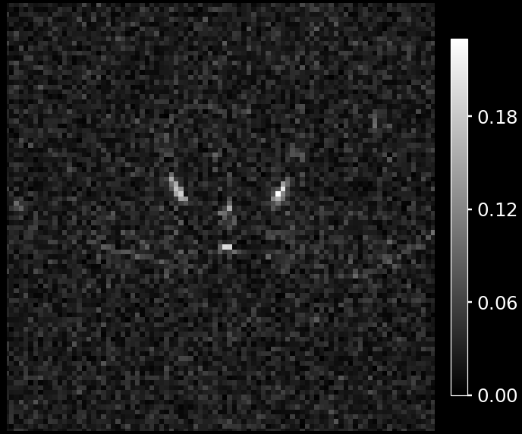
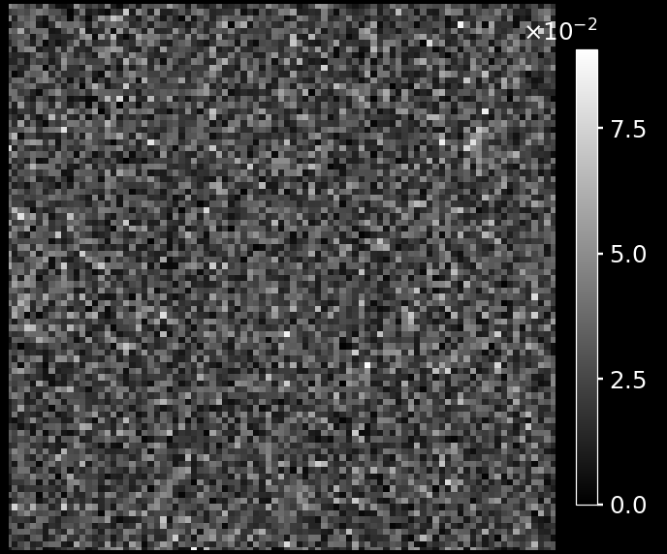
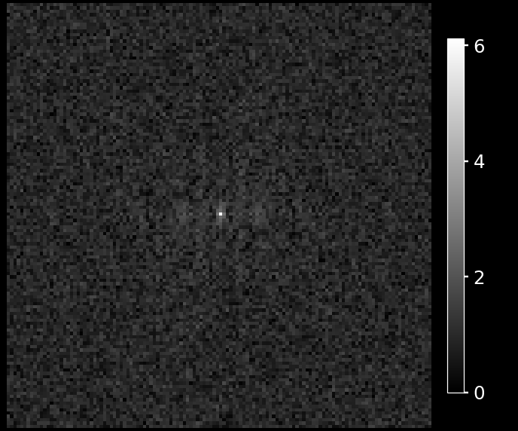
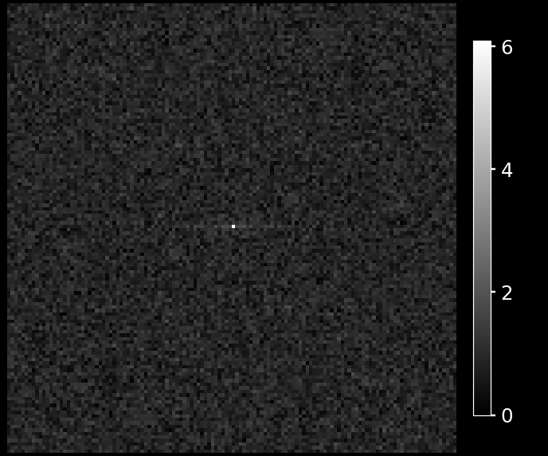
b = 0 s/mm² (SNR 7.9)
b = 6000 s/mm² (SNR 2.5)
Reconstructed
image
Log k-space
Notes:
Source: FSE-DWI_09-29-2026_v16_test4.nii.gz
Shape: (128, 128, 3, 2)
Shell direction index: 0; None means shell mean. Index uses original volume order within each shell, not b-vector matching. When selecting a direction, shells with max b <= 5 s/mm² use the first baseline volume.
Slice index (0-based): 1; voxel axis: 2; axis directions: ('R', 'A', 'S'); canonical: False
Display: transpose, origin lower, rotation 0 degrees, flip_lr=False
Reconstructed-image display zoom: 1.45x; shifts: x=0.3, y=-8.7 source pixels after rotation/flip (positive right/up). K-space full view, no translation.
FFT: fftshift(fft2(ifftshift(slice), norm="backward")); 2D in-plane transform.
K-space display: ln(1 + abs(FFT)).
Color limits: panel; lower=0, image upper percentile=100.0, FFT upper percentile=100.0. Shared limits span all slides.
Per-shell reconstructed-image upper limit overrides: [None, None]. Lower limit=0.
Intensity and Fourier amplitude are arbitrary units; the log transform uses those numeric amplitudes.
FFT of magnitude/real NIfTI image; acquired phase unavailable. Even complex reconstructed images need not reproduce raw scanner data.
When direction selection is disabled, b-value groups use the arithmetic mean of source image slices before FFT. When enabled, the selected volume alone supplies the reconstructed image, Fourier spectrum, and SNR. (complex mean for complex inputs). This is the FFT of the mean image, not mean raw k-space magnitude.
b = 0 s/mm²: source volume indices [0] (0-based)
b = 6000 s/mm²: source volume indices [1] (0-based)
SNR: supplied snr_utils.image_snr on the full selected magnitude slice, before zoom/translation/contrast. noise_width=16; mask_method=max_fraction; mask_level=0.5. For grouped shells this is SNR of the mean image, not mean individual SNR.
b = 0 s/mm²: {'snr': 7.90624326420179, 'signal_mean': 0.16238585508921566, 'noise_sigma': 0.020538939881153535, 'n_signal_px': 17, 'corners_suspect': False}
b = 6000 s/mm²: {'snr': 2.52404615061825, 'signal_mean': 0.05419175096147053, 'noise_sigma': 0.021470190213517523, 'n_signal_px': 1665, 'corners_suspect': False}

Slide 7
Test 3 Reverse Centric Interleaved: FSE DWI w/ Surface Coil: In-vivo Rat Brain
Total Scan Time | 44 seconds
TR, TE, esp | 2000 ms / 54 ms / 16 ms
PE_order | 6
ETL / Averages | 8 / 1
FOV | 80
b-values | 0, 6000 s/mm²
Diffusion Directions | 1 (x-axis)
Small / Big Delta | 4 ms / 40 ms
diff_tcrush / tcrush | 2000 us / 2000 us
diff_tcrush_amplitude / t_crush_amplitude | 2754 DAC units / 2754 DAC units

Slide 8
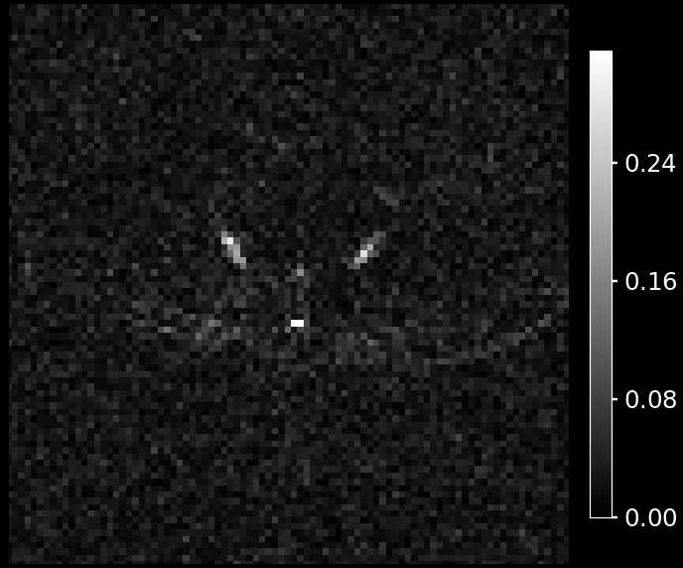
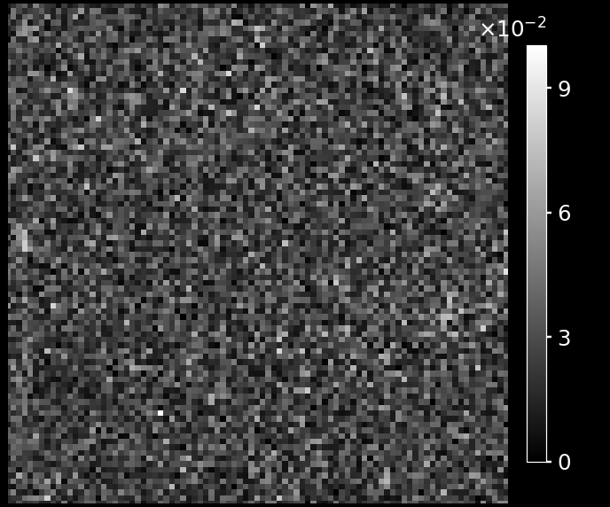
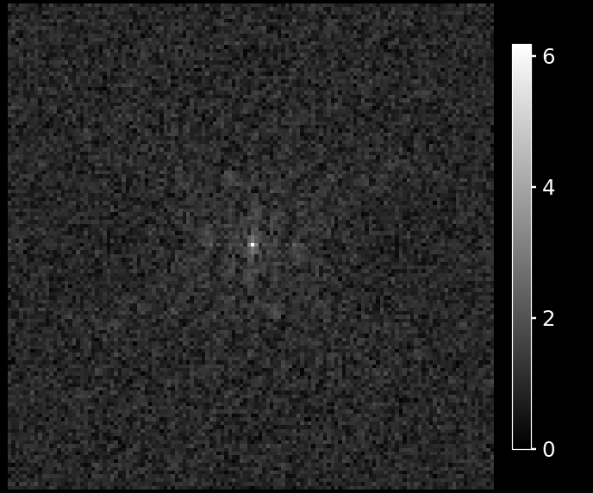
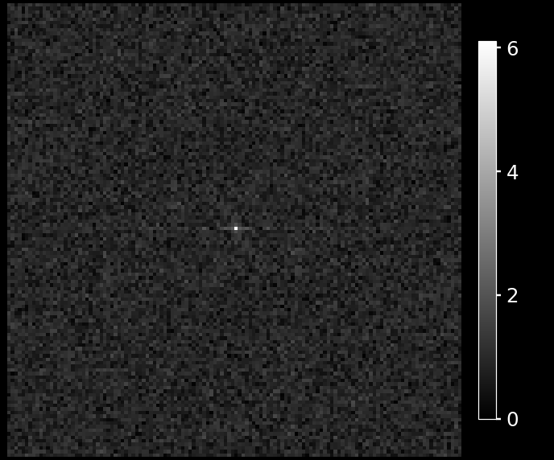
b = 0 s/mm² (SNR 10.8)
b = 6000 s/mm² (SNR 2.9)
Reconstructed
image
Log k-space
Notes:
Source: FSE-DWI_09-29-2026_v16_test3.nii.gz
Shape: (128, 128, 3, 2)
Shell direction index: 0; None means shell mean. Index uses original volume order within each shell, not b-vector matching. When selecting a direction, shells with max b <= 5 s/mm² use the first baseline volume.
Slice index (0-based): 1; voxel axis: 2; axis directions: ('R', 'A', 'S'); canonical: False
Display: transpose, origin lower, rotation 0 degrees, flip_lr=False
Reconstructed-image display zoom: 1.45x; shifts: x=0.3, y=-8.7 source pixels after rotation/flip (positive right/up). K-space full view, no translation.
FFT: fftshift(fft2(ifftshift(slice), norm="backward")); 2D in-plane transform.
K-space display: ln(1 + abs(FFT)).
Color limits: panel; lower=0, image upper percentile=100.0, FFT upper percentile=100.0. Shared limits span all slides.
Per-shell reconstructed-image upper limit overrides: [None, None]. Lower limit=0.
Intensity and Fourier amplitude are arbitrary units; the log transform uses those numeric amplitudes.
FFT of magnitude/real NIfTI image; acquired phase unavailable. Even complex reconstructed images need not reproduce raw scanner data.
When direction selection is disabled, b-value groups use the arithmetic mean of source image slices before FFT. When enabled, the selected volume alone supplies the reconstructed image, Fourier spectrum, and SNR. (complex mean for complex inputs). This is the FFT of the mean image, not mean raw k-space magnitude.
b = 0 s/mm²: source volume indices [0] (0-based)
b = 6000 s/mm²: source volume indices [1] (0-based)
SNR: supplied snr_utils.image_snr on the full selected magnitude slice, before zoom/translation/contrast. noise_width=16; mask_method=max_fraction; mask_level=0.5. For grouped shells this is SNR of the mean image, not mean individual SNR.
b = 0 s/mm²: {'snr': 10.829952827690484, 'signal_mean': 0.21768605411052705, 'noise_sigma': 0.02010036955599087, 'n_signal_px': 15, 'corners_suspect': False}
b = 6000 s/mm²: {'snr': 2.853256593445526, 'signal_mean': 0.0582602731237335, 'noise_sigma': 0.020418869181821377, 'n_signal_px': 1153, 'corners_suspect': False}

Slide 9
Test 1 Centric Interleaved: FSE DWI w/ Surface Coil: In-vivo Rat Brain
Total Scan Time | 44 seconds
TR, TE, esp | 2000 ms / 54 ms / 14 ms
PE_order | 1
ETL / Averages | 16 / 1
FOV | 35
b-values | 0, 6000 s/mm²
Diffusion Directions | 1 (x-axis)
Small / Big Delta | 4 ms / 40 ms
diff_tcrush / tcrush | 2000 us / 1000 us
diff_tcrush_amplitude / t_crush_amplitude | 2754 DAC units / 5508 DAC units

Slide 10
