Slide 1
Test A / B v1.81 vs v1.911: FSE DWI: Water Phantom
Total Scan Time | ~4.5 minutes (7 b-values)
TR, TE, esp | 2000 ms / 54 ms / 14 ms (v1.911: 13 ms)
PE_order | 1
ETL / Averages | 8 / 1
FOV | 35
b-values | 0, 100, 500, 1000, 2000, 3000, 6000 s/mm²
Diffusion Directions | 1 (x-axis)
Small / Big Delta | 4 ms / 40 ms
diff_tcrush / tcrush | 1000 us / 1000 us
diff_tcrush_amplitude / t_crush_amplitude | -5482 DAC units / -8223 DAC units

Slide 2
Direction | v1.81 ADC | v1.81 % diff | v1.911 ADC | v1.911 % diff
Positive x | 1.8235e-03 | -2.35% | 1.8646e-03 | -0.32%
Negative x | 1.8396e-03 | -1.49% | 1.7836e-03 | -4.65%
Positive y | 1.8434e-03 | -1.29% | 1.8357e-03 | -1.87%
Positive z | 1.9634e-03 | +5.14% | 1.9987e-03 | +6.85%
Mean | 1.8675e-03 | 0.00% | 1.8706e-03 | 0.00%

Slide 3
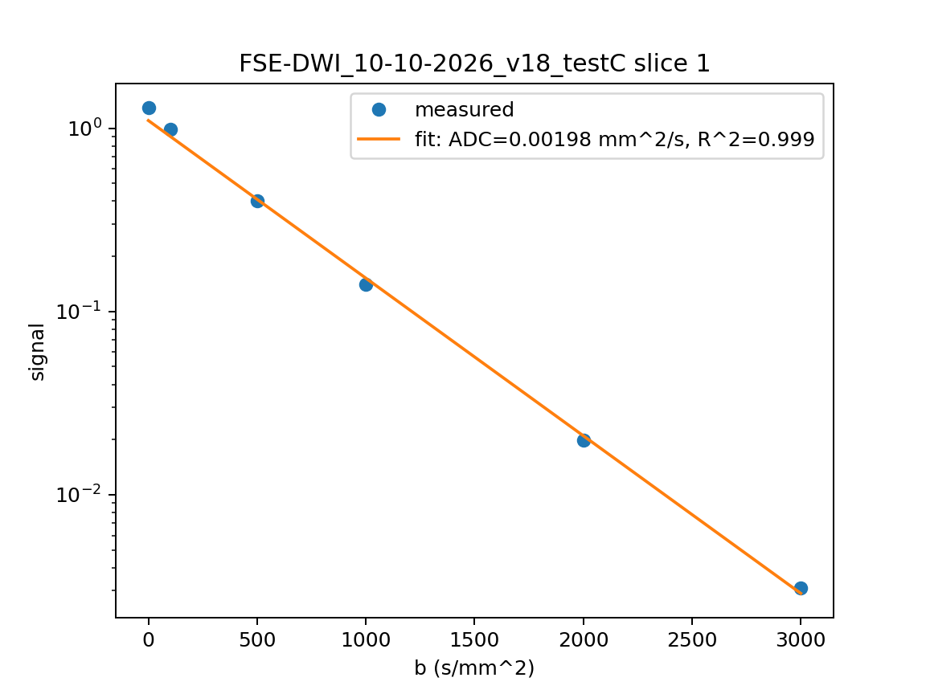
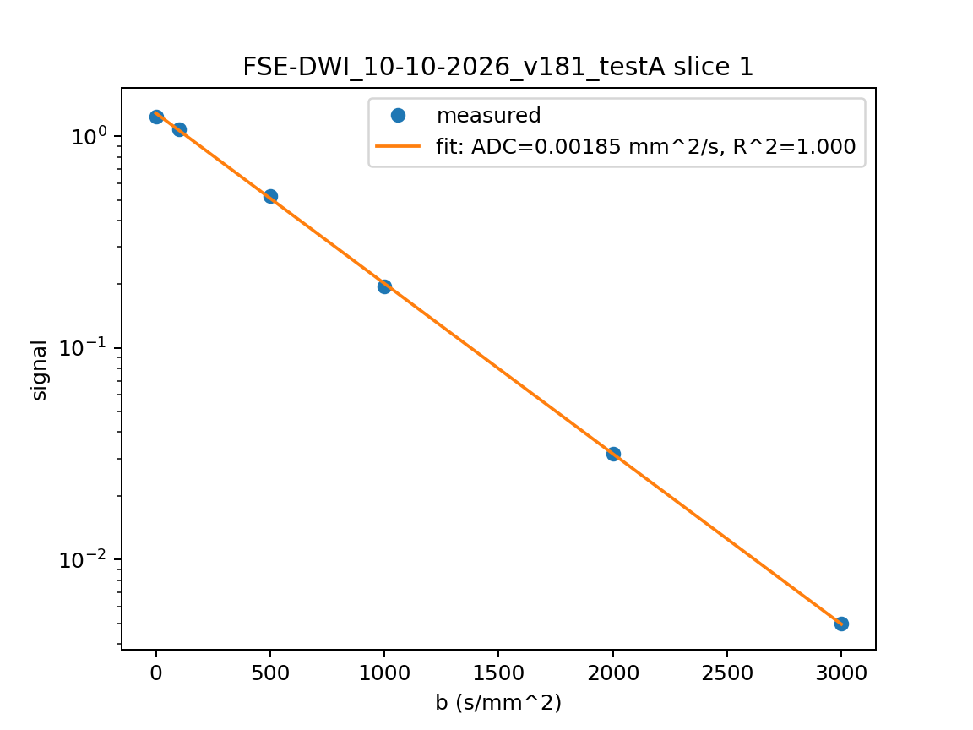

Slide 4
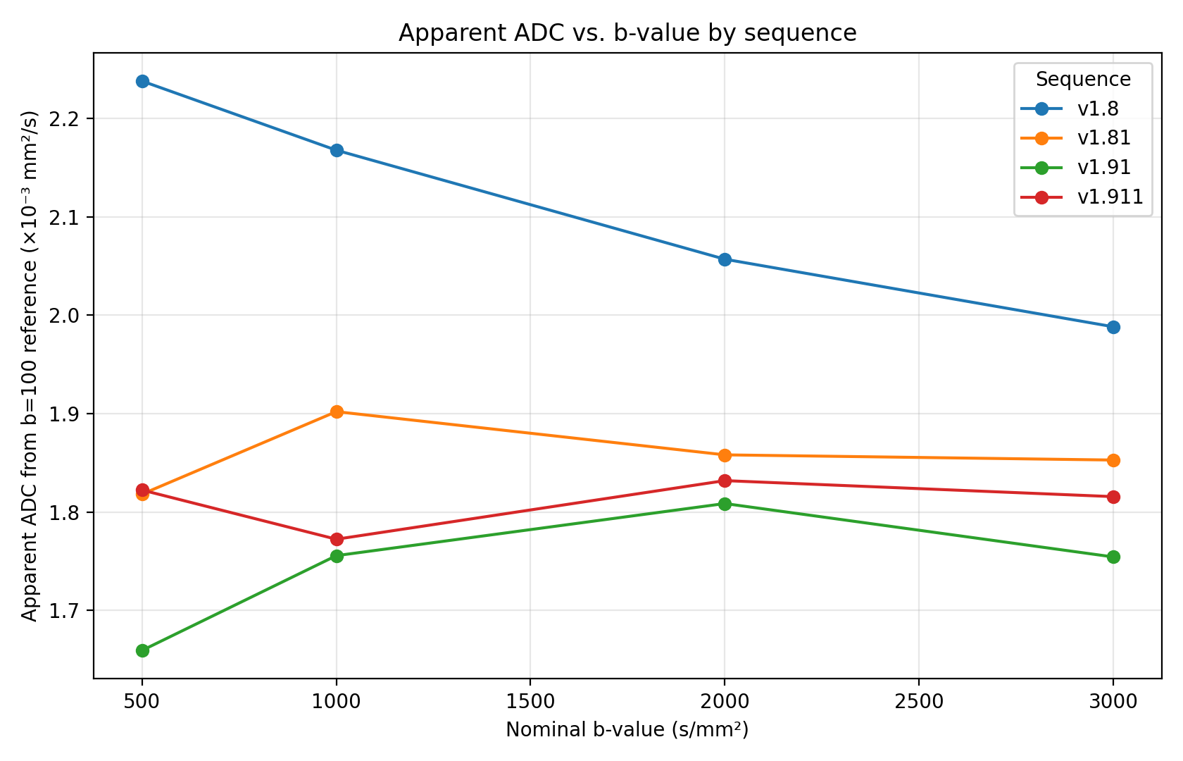

Slide 5
Effective b-value (s/mm²)
ADC (×10⁻³ mm²/s)
Nominal b | v1.8 (+x) | v1.8 (-x) | v1.81 (±x)
0 | 12 | 12 | 4
100 | 165 | 59 | 104
1000 | 1176 | 842 | 1001
6000 | 6398 | 5579 | 5981
Sequence | Nominal b | Effective b
v1.8 | 1.98 | 1.84
v1.81 | 1.85 | 1.86
v1.91 | 1.77 | 1.78
v1.911 | 1.82 | 1.83

Slide 6
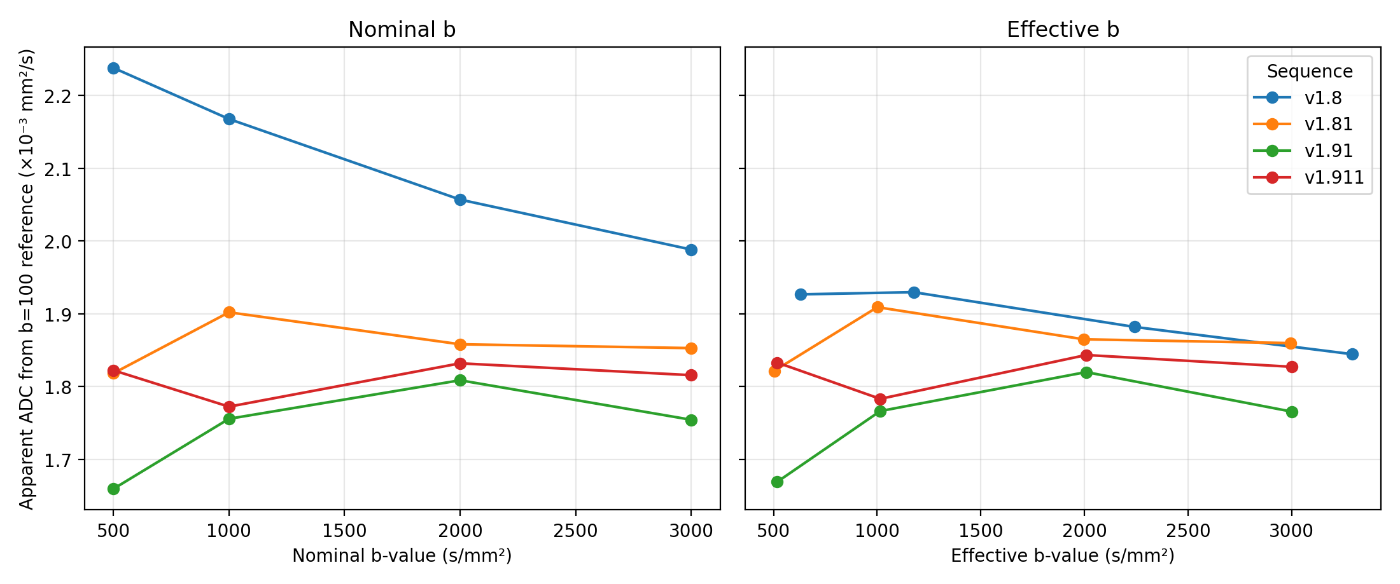

Slide 7
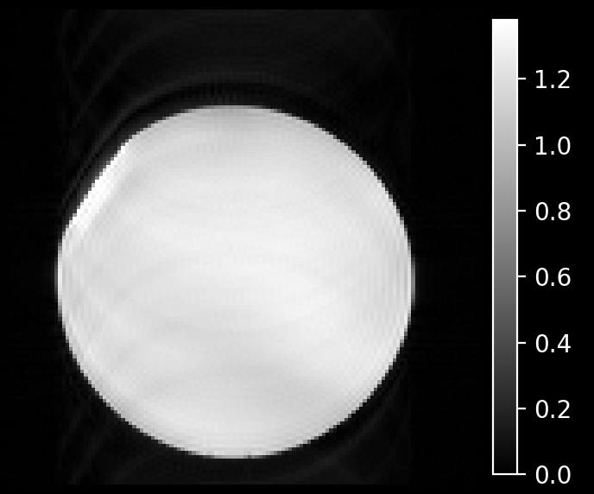
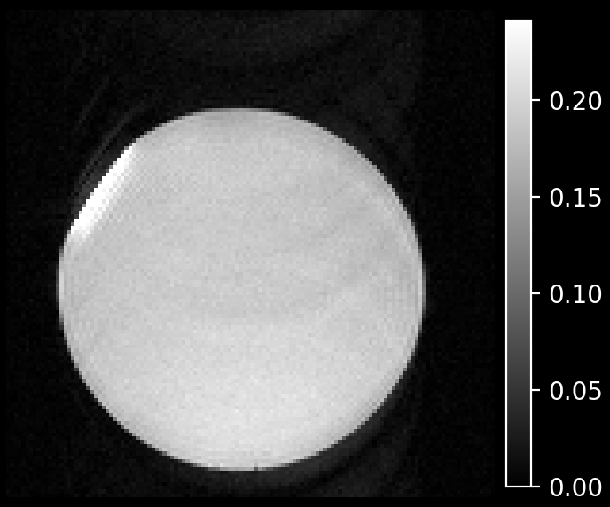
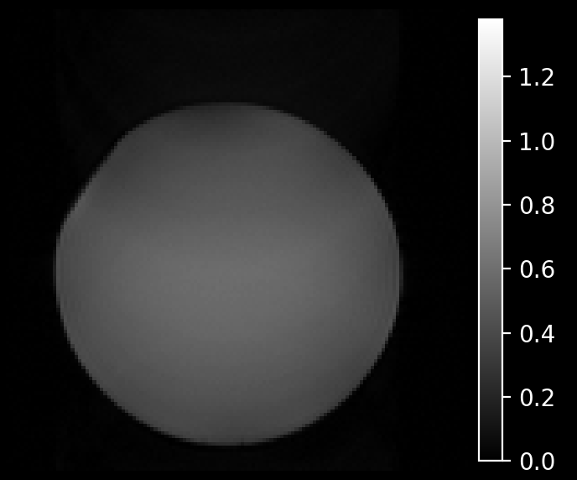
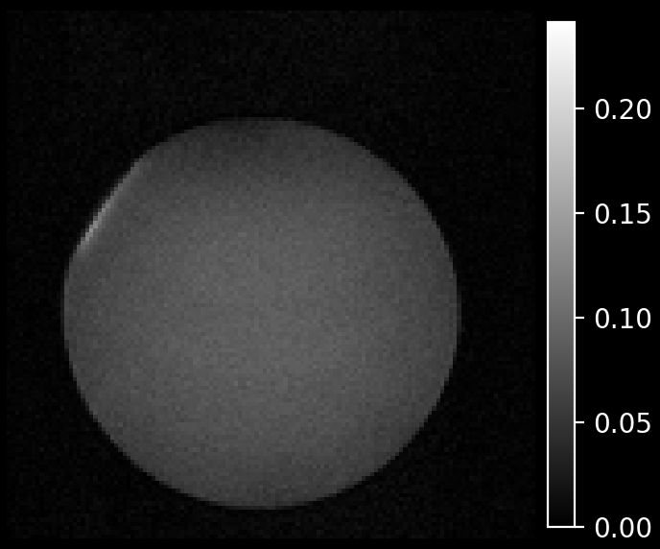
b = 0 s/mm²
b = 1000 s/mm²
v1.81
SNR 101 / 56
v1.911
SNR 92 / 22

Slide 8
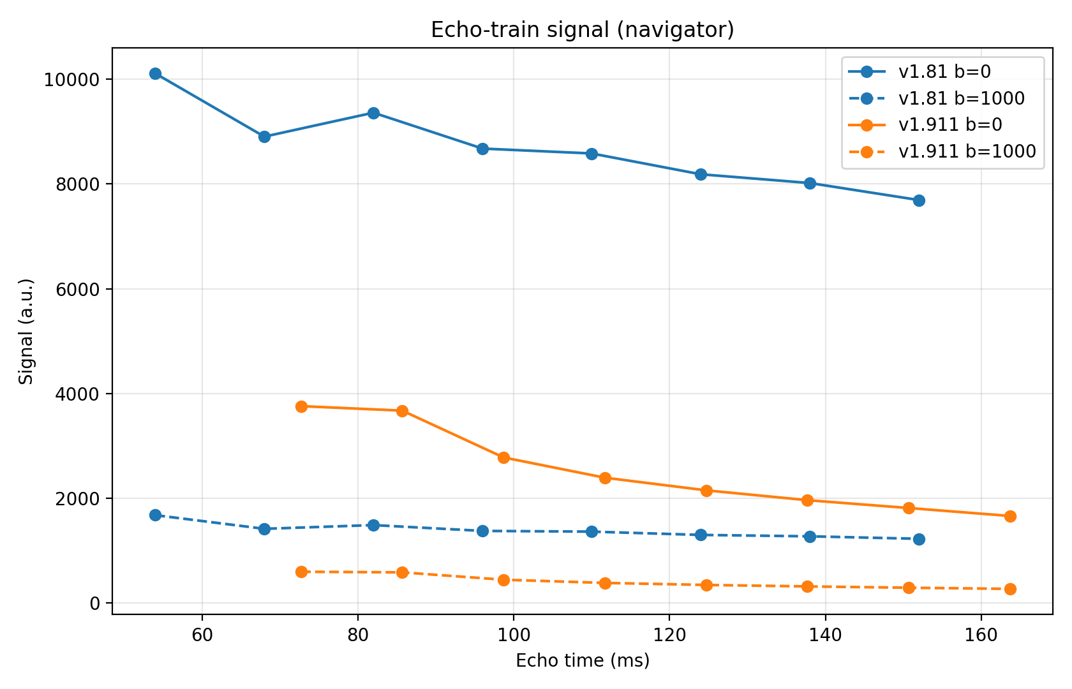
 | v1.81 | v1.911
ESP | 14 ms | 13 ms
First echo | 54 ms | 72.7 ms
b0 signal | 1.00 | 0.37
b1000 / b0 | 0.157 | 0.157
ADC (×10⁻³ mm²/s) | 1.86 | 1.83
Slices | Multi | Single only

Slide 9
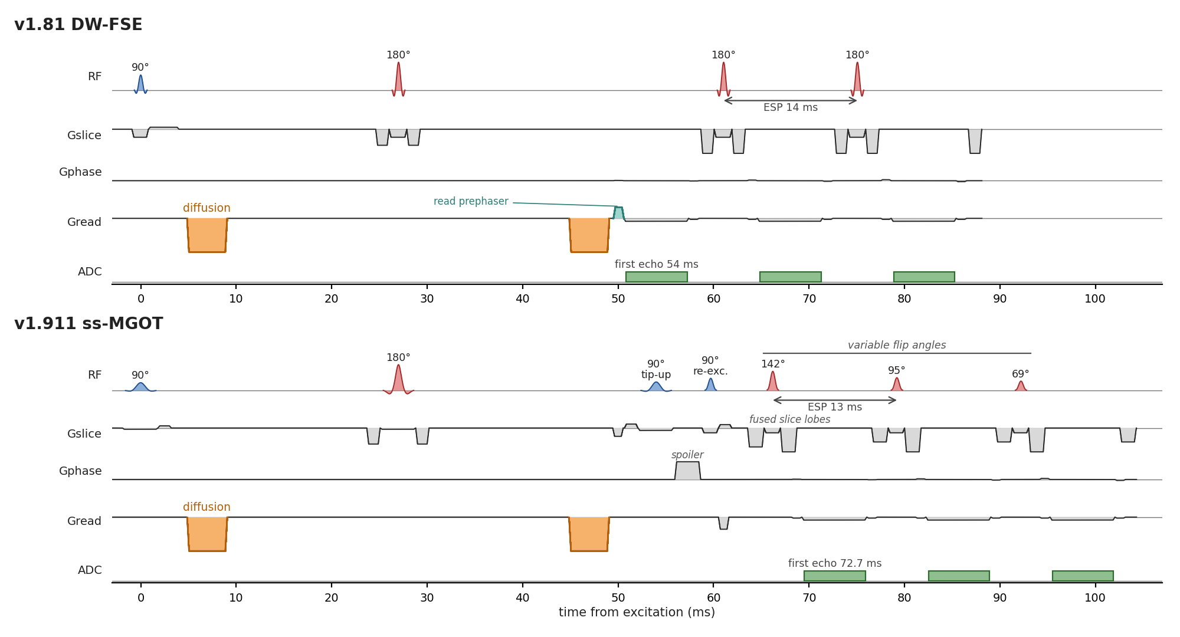

Slide 10
Next Steps
Use b ≈ 10 instead of b = 0 on v1.81 (echo-1 s0 artifact)
Calibrate z-axis b-value (acquire ±z; z reads ~6% high)
Fix off-centre slice phase for multi-slice v1.81
Repeat on ex-vivo brain (v1.81 main, v1.911 comparison)
Motion test v1.81 vs v1.911 to choose the in-vivo sequence

