Slide 1
Physical scanner DWI-FSE
12 October 2026
Ex-vivo and in-vivo sequence comparison
Notes:
Prepared from the approved physical scanner report and figure set dated 12 October 2026.

Slide 2
Acquisition protocols
Three acquisitions per comparison set
 | v1.83 FSE | v1.912 ss-MGOT | Lab EPI
Ex / in vivo | Q / iA | R / iB | test0 / invivoA
Baseline b | 10 s/mm² | 10 s/mm² | 0 s/mm²
TR / TE | 2 s / 44 ms | 2 s / 44 ms | 3 s / 42 ms ex; 44 ms in
Slice thickness | 1 mm | 1 mm | 2 mm
Sampling | 128 PE lines; 16 shots | 128 PE lines; 16 shots | Interleaved; 168 read samples
Scan time | 34 s | 34 s | 48 s
Readout | 40 kHz; 128 samples | 40 kHz; 128 samples | 200 kHz; vendor processed
Notes:
Source: docs/physical_scanner_experiments_2026-10-12.md and acquisition records. EPI reports vendor-processed 168 read samples; native EPI voxel convention is used for normalized SNR efficiency.

Slide 3
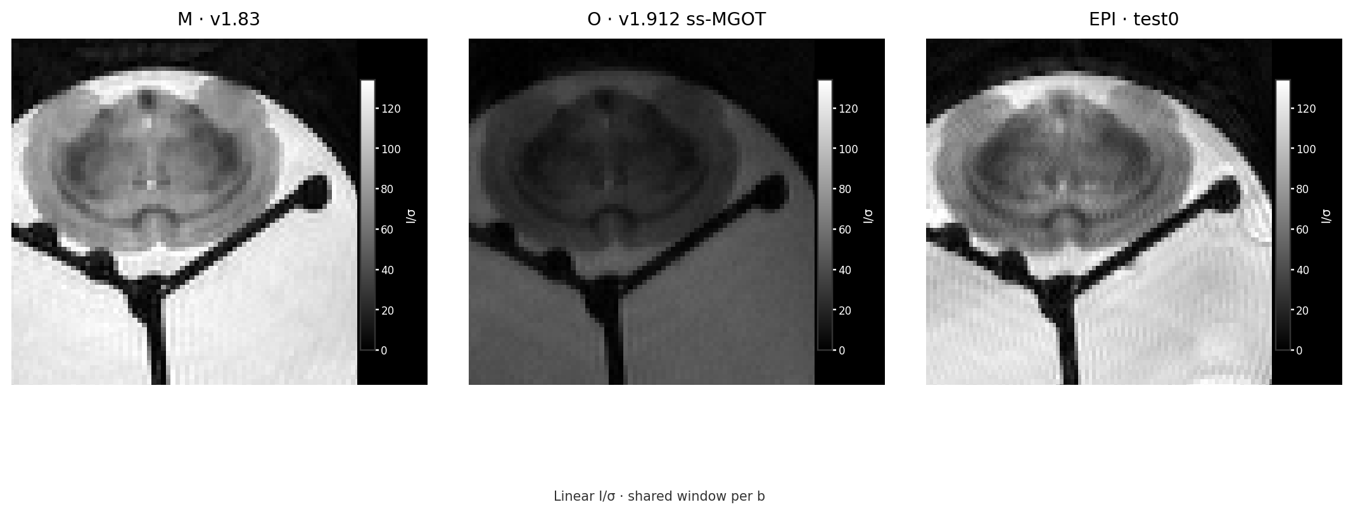
Ex vivo | baseline
FSE b10 · EPI b0
Notes:
Ex-vivo central slices: M v1.83 volume 0 b10 +x, slice 1; O v1.912 ss-MGOT volume 0 b10 +x, slice 1; EPI test0 volume 0 b0 +x, slice 2. Each image is divided by σ = sqrt(mean(magnitude²)/2) from the established Oct 12 side-background ROI (rows 4:124 and scan-specific noise columns). Shared linear I/σ window 0–133.899. FSE baseline b10; EPI baseline b0. Source figure: docs/figures/physical_scanner_2026-10-12/revised_exvivo_baseline.png.

Slide 4
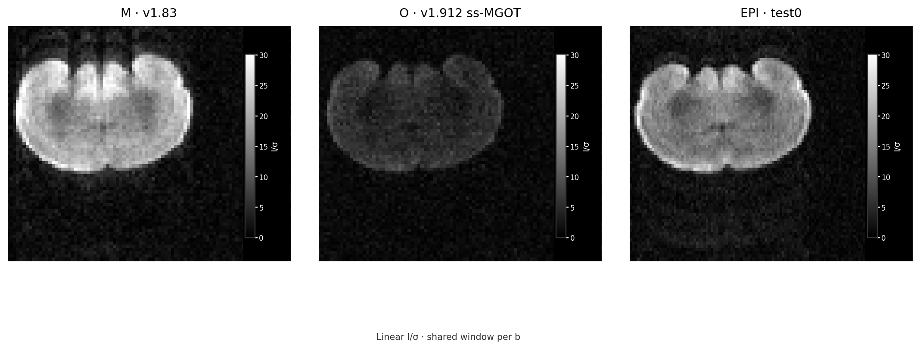
Ex vivo | b6000 +z
M v1.83 · O v1.912 ss-MGOT · EPI test0
Notes:
Ex-vivo central slices: M volume 3 b6000 +z, slice 1; O volume 3 b6000 +z, slice 1; EPI test0 volume 2 b6000 +z, slice 2. Each image is divided by σ = sqrt(mean(magnitude²)/2) from the established Oct 12 side-background ROI (rows 4:124 and scan-specific noise columns). Shared linear I/σ window 0–30.108. Source figure: docs/figures/physical_scanner_2026-10-12/revised_exvivo_b6000.png.

Slide 5
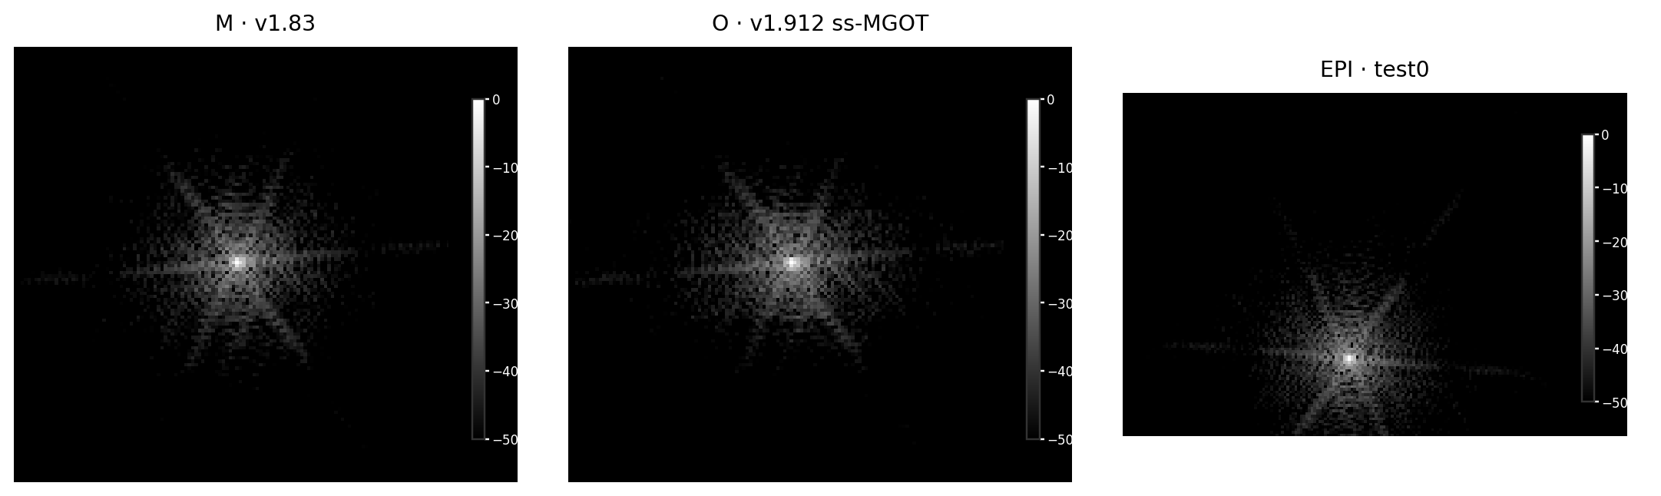
Ex vivo | k-space baseline
−50 to 0 dB · each panel normalized to its peak
Notes:
Actual complex k-space, ex vivo baseline: M volume 0 b10 +x slice 1; O volume 0 b10 +x slice 1; EPI test0 volume 0 b0 +x slice 2. Each panel is shown on native index axes with aspect preserved, normalized independently as 20 log10(|k|/peak) and clipped to −50…0 dB. FSE grids are actual PE-reordered complex MRD data; EPI is vendor-processed complex _o.MRD. Peak-normalized amplitudes are not comparable. Source figure: docs/figures/physical_scanner_2026-10-12/revised_exvivo_kspace_baseline.png.

Slide 6
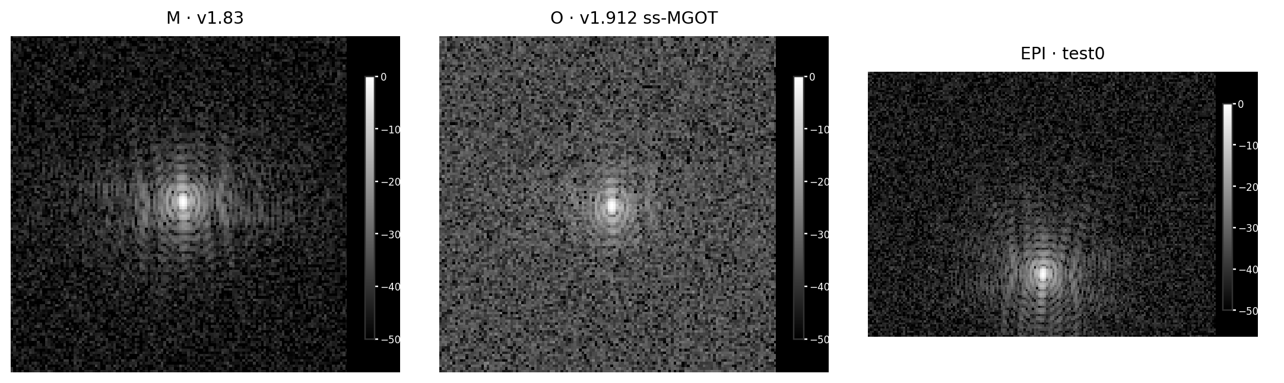
Ex vivo | k-space b6000 +z
−50 to 0 dB · each panel normalized to its peak
Notes:
Actual complex k-space, ex vivo b6000 +z: M volume 3 slice 1; O volume 3 slice 1; EPI test0 volume 2 slice 2. Each panel is shown on native index axes with aspect preserved, normalized independently as 20 log10(|k|/peak) and clipped to −50…0 dB. FSE grids are actual PE-reordered complex MRD data; EPI is vendor-processed complex _o.MRD. Peak-normalized amplitudes are not comparable. Source figure: docs/figures/physical_scanner_2026-10-12/revised_exvivo_kspace_b6000.png.

Slide 7
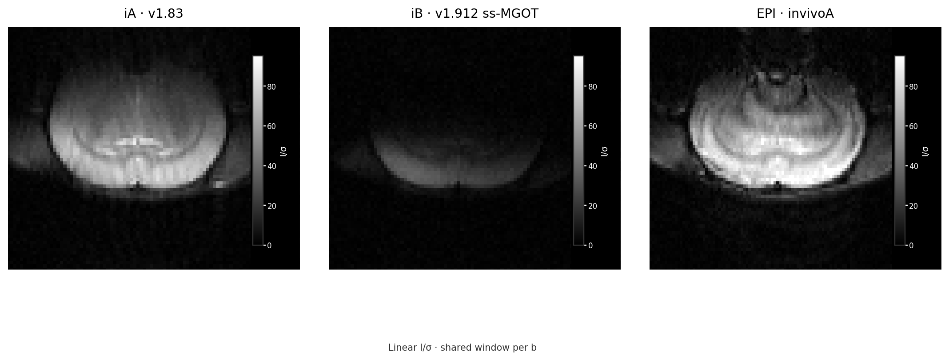
In vivo | baseline
FSE b10 · EPI b0
Notes:
In-vivo central slices: iA v1.83 volume 0 b10 +x, slice 4; iB v1.912 ss-MGOT volume 0 b10 +x, slice 2; EPI invivoA volume 0 b0 +x, slice 2. Each image is divided by σ = sqrt(mean(magnitude²)/2) from the established Oct 12 side-background ROI (rows 4:124 and scan-specific noise columns). Shared linear I/σ window 0–95.162. FSE baseline b10; EPI baseline b0. Source figure: docs/figures/physical_scanner_2026-10-12/revised_invivo_baseline.png.

Slide 8
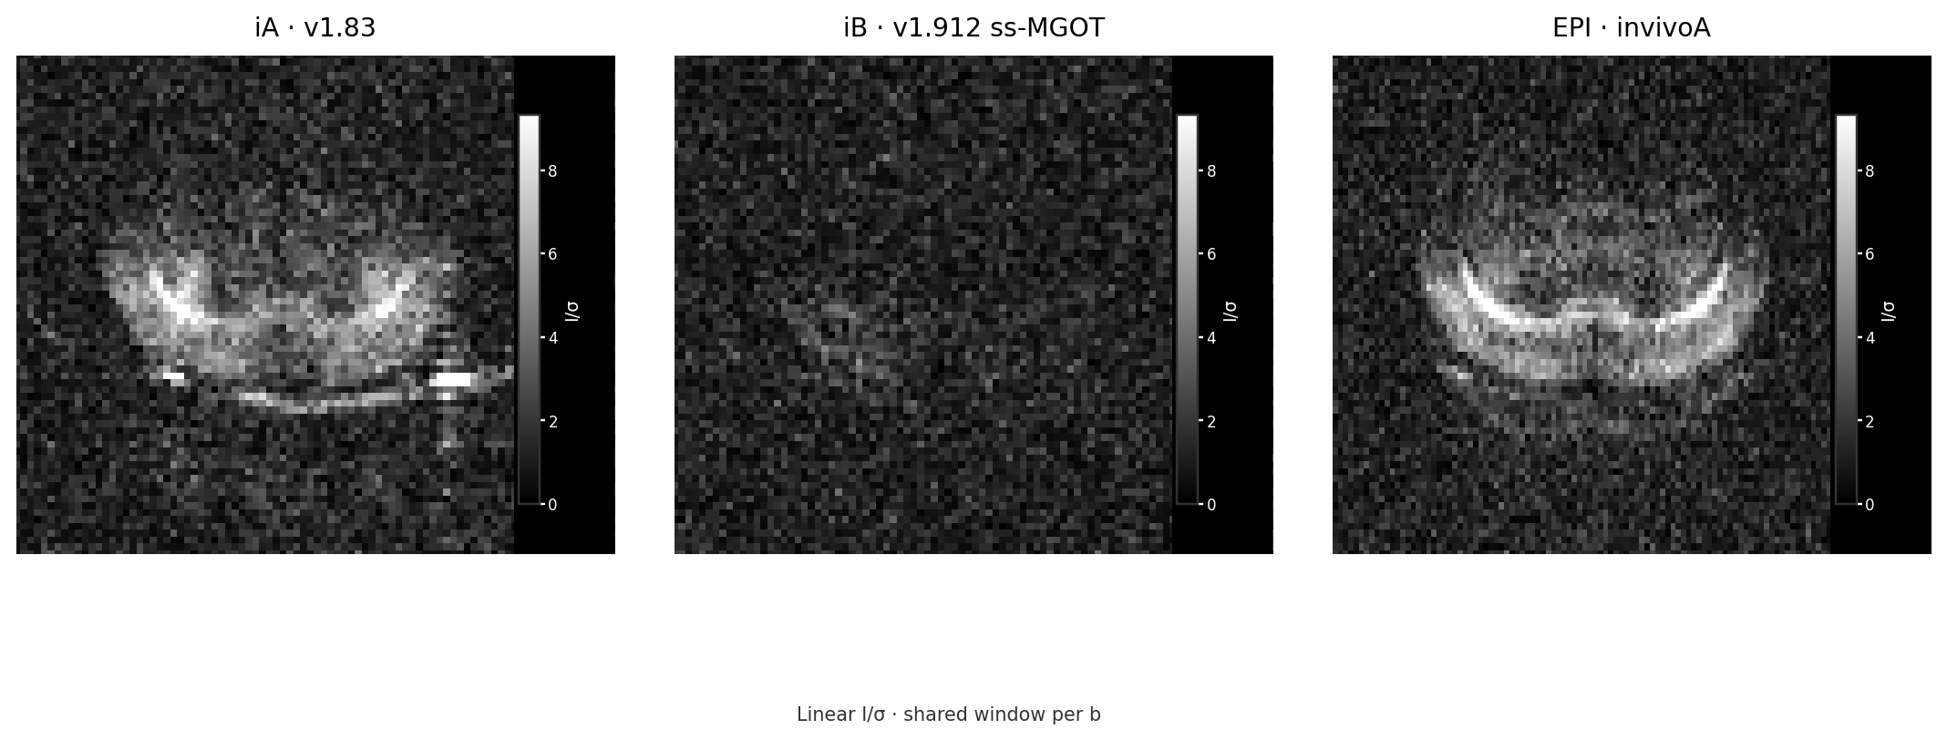
In vivo | b6000 +z
iA v1.83 · iB v1.912 ss-MGOT · EPI invivoA
Notes:
In-vivo central slices: iA volume 9 b6000 +z, slice 4; iB volume 9 b6000 +z, slice 2; EPI invivoA volume 9 b6000 +z, slice 2. Each image is divided by σ = sqrt(mean(magnitude²)/2) from the established Oct 12 side-background ROI (rows 4:124 and scan-specific noise columns). Shared linear I/σ window 0–9.312. Source figure: docs/figures/physical_scanner_2026-10-12/revised_invivo_b6000.png.

Slide 9
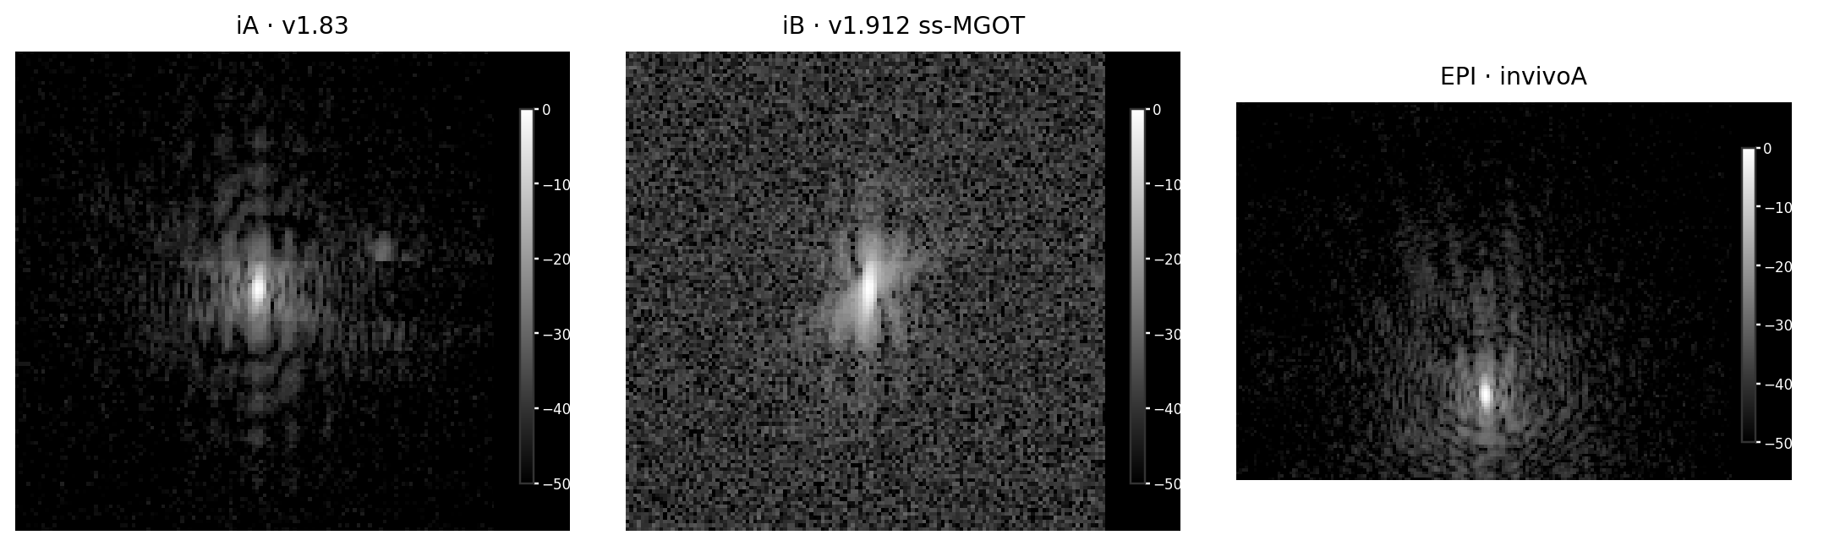
In vivo | k-space baseline
−50 to 0 dB · each panel normalized to its peak
Notes:
Actual complex k-space, in vivo baseline: iA volume 0 b10 +x slice 4; iB volume 0 b10 +x slice 2; EPI invivoA volume 0 b0 +x slice 2. Each panel is shown on native index axes with aspect preserved, normalized independently as 20 log10(|k|/peak) and clipped to −50…0 dB. FSE grids are actual PE-reordered complex MRD data; EPI is vendor-processed complex _o.MRD. Peak-normalized amplitudes are not comparable. Source figure: docs/figures/physical_scanner_2026-10-12/revised_invivo_kspace_baseline.png.

Slide 10
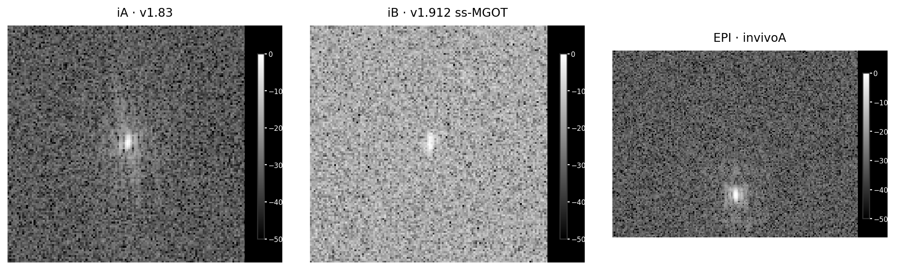
In vivo | k-space b6000 +z
−50 to 0 dB · each panel normalized to its peak
Notes:
Actual complex k-space, in vivo b6000 +z: iA volume 9 slice 4; iB volume 9 slice 2; EPI invivoA volume 9 slice 2. Each panel is shown on native index axes with aspect preserved, normalized independently as 20 log10(|k|/peak) and clipped to −50…0 dB. FSE grids are actual PE-reordered complex MRD data; EPI is vendor-processed complex _o.MRD. Peak-normalized amplitudes are not comparable. Source figure: docs/figures/physical_scanner_2026-10-12/revised_invivo_kspace_b6000.png.

Slide 11
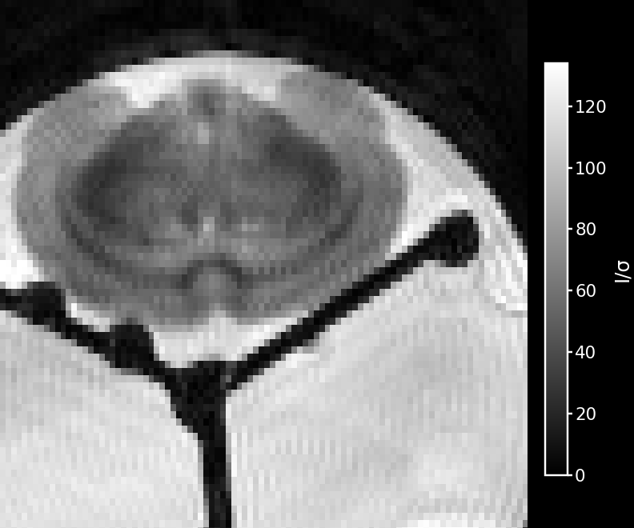
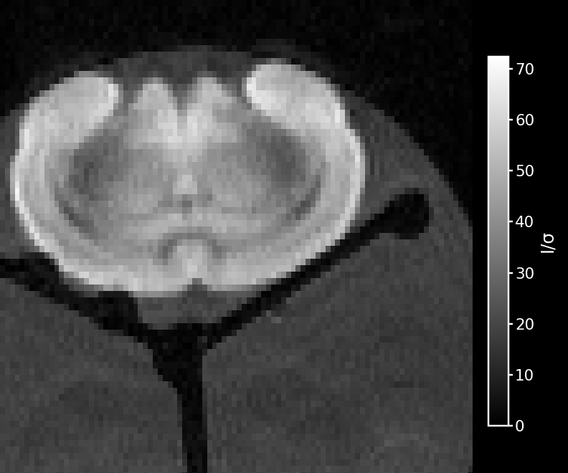
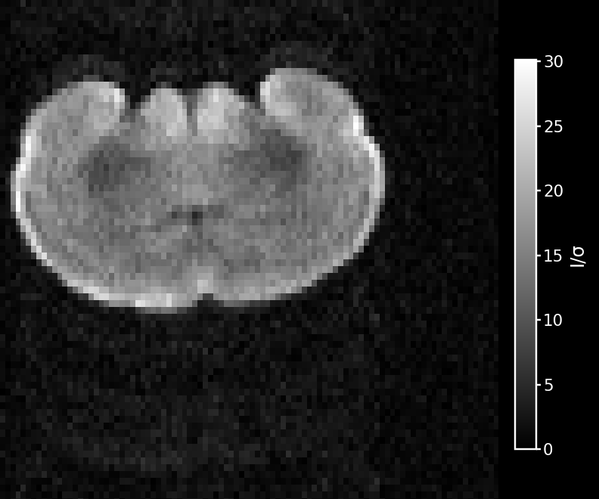
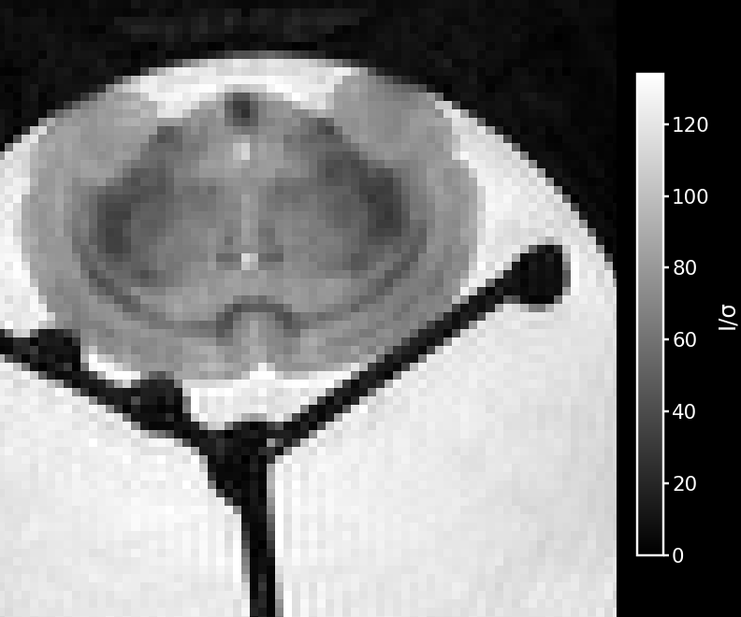
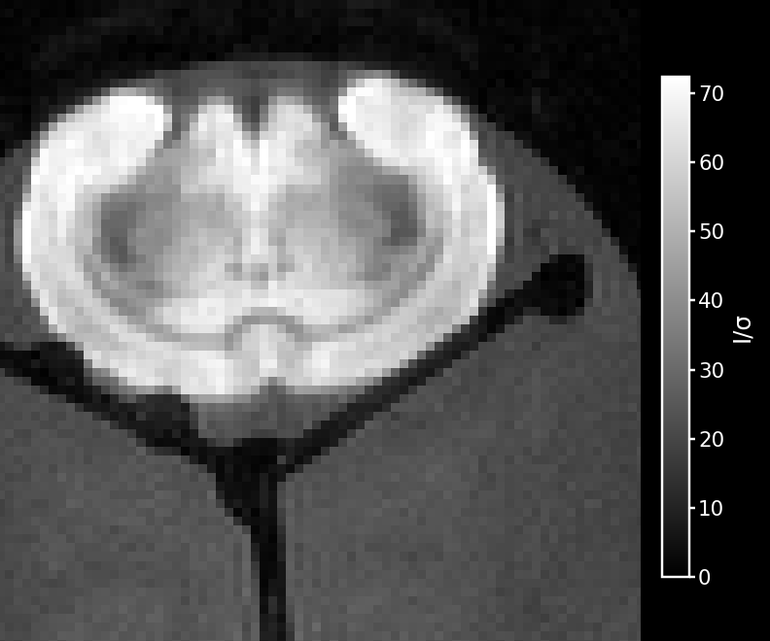
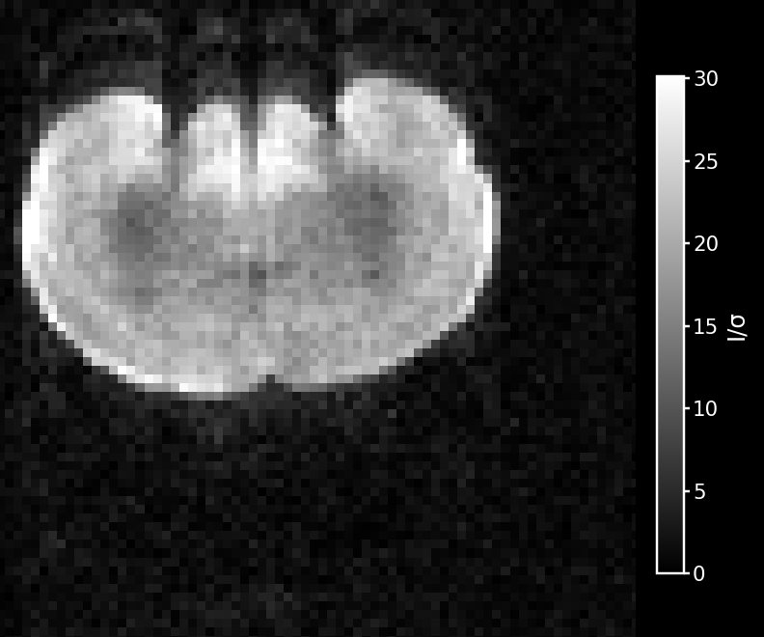
Ex-vivo: EPI and v1.83 FSE
Baseline EPI b0 / FSE b10 · b1000 directions differ (+y / +x)
Baseline
b=1000
b=6000 · +z
Lab EPI
v1.83 FSE
Notes:
Ex-vivo central slice 2: Lab EPI test0 volumes 0/1/2 are b0 +x, b1000 +y, b6000 +z. v1.83 FSE scan M volumes 0/1/3 are b10 +x, b1000 +x, b6000 +z; central slice 1. Baseline protocols differ (EPI b0; FSE b10); b1000 is not direction-matched. Images divided by σ = sqrt(mean(magnitude²)/2) using the established Oct 12 side-background ROI (rows 4:124 and scan-specific noise columns); shared I/σ windows by b are 0–133.899, 0–72.371, and 0–30.108. EPI noise may be correlated.
Source image tile set: docs/figures/physical_scanner_2026-10-12/revised_exvivo_epi_fse_*.png

Slide 12
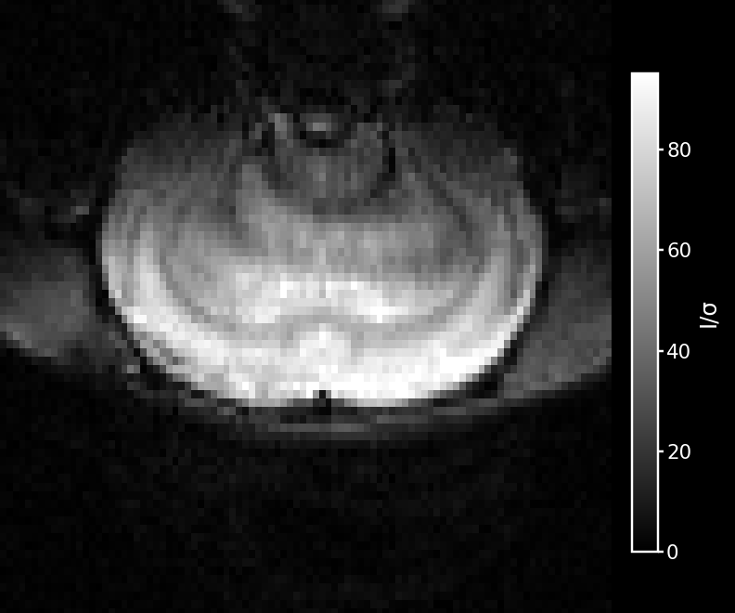
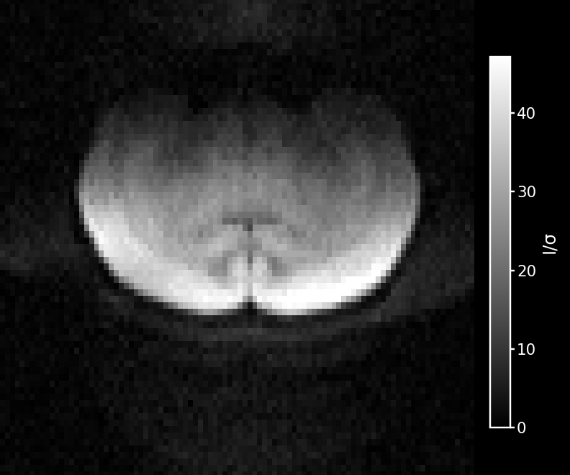
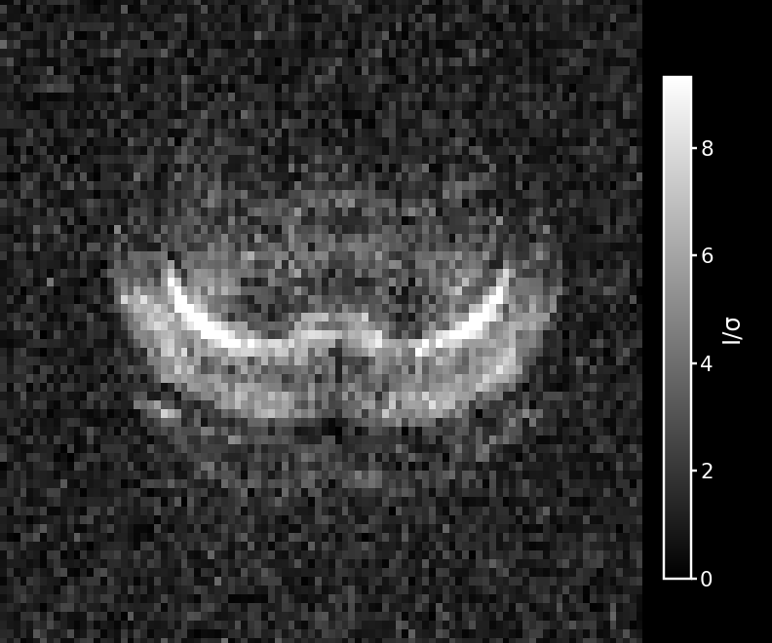
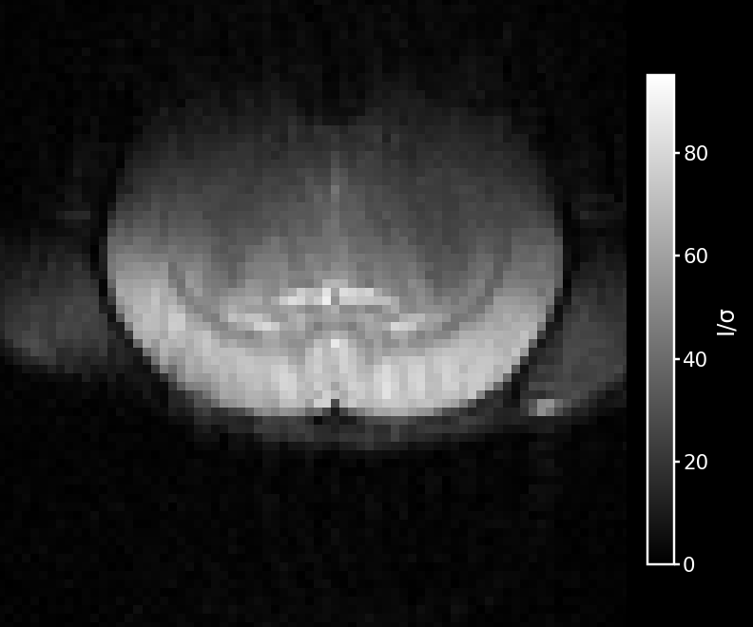
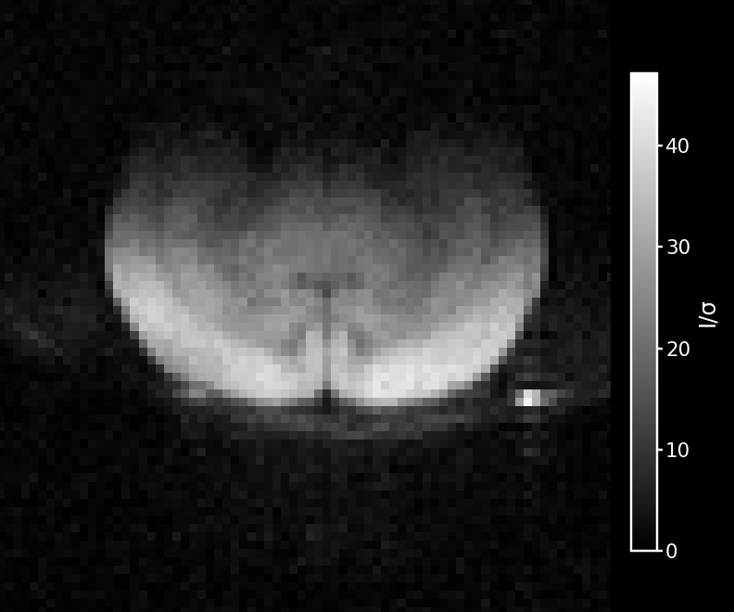
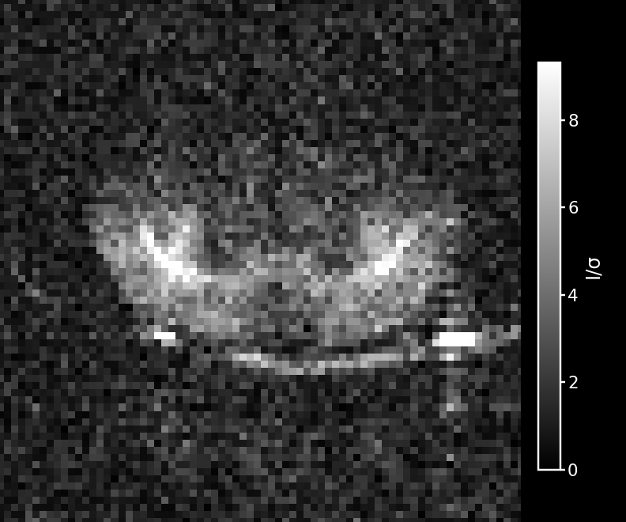
In-vivo: EPI and v1.83 FSE
Baseline EPI b0 / FSE b10 · EPI directions provisional
Baseline
b=1000 · +z
b=6000 · +z
Lab EPI
v1.83 FSE
Notes:
In-vivo central slices: Lab EPI invivoA volumes 0/3/9 are b0 +x, b1000 +z, b6000 +z on slice 2. v1.83 FSE scan iA volumes 0/3/9 are b10 +x, b1000 +z, b6000 +z on slice 4. Baseline protocols differ (EPI b0; FSE b10). Images divided by σ = sqrt(mean(magnitude²)/2) using the established Oct 12 side-background ROI (rows 4:124 and scan-specific noise columns); shared I/σ windows by b are 0–95.162, 0–47.136, and 0–9.312. EPI directions are provisional.
Source image tile set: docs/figures/physical_scanner_2026-10-12/revised_invivo_epi_fse_*.png

Slide 13
Baseline SNR | ex vivo
Single-acquisition comparison | FSE b10 and EPI b0
Notes:
Audited single-acquisition ROI mean SNR. FSE baseline b10 and EPI baseline b0. R values use corrected acquisition geometry (*). Source: docs/data/oct12_quant_audit.json and report.

Slide 14
Baseline SNR | in vivo
Single-acquisition brain ROI | FSE b10 and EPI b0
Notes:
Audited single-acquisition ROI mean SNR. FSE baseline b10 and EPI baseline b0. Source: docs/data/oct12_quant_audit.json and report.

Slide 15
Normalized SNR efficiency | ex-vivo brain
SNR / √(volume time [s]) / voxel volume [µL] · EPI native grid
R: 31.1-mm phase FOV
Notes:
Brain ROI. EPI native voxel convention uses 168 read samples; alternate EPI 128-grid estimate is 54.17. R uses corrected geometry. Source: docs/data/oct12_quant_audit.json.

Slide 16
Normalized SNR efficiency | ex-vivo PBS
SNR / √(volume time [s]) / voxel volume [µL] · EPI native grid
R: 31.1-mm phase FOV
Notes:
PBS ROI from the same acquisitions as the ex-vivo brain comparison. EPI native voxel convention uses 168 read samples. R uses corrected geometry. Source: docs/data/oct12_quant_audit.json.

Slide 17
Normalized SNR efficiency | in vivo
SNR / √(volume time [s]) / voxel volume [µL] · EPI native grid
Notes:
EPI native voxel convention uses 168 read samples. Alternate EPI 128-grid estimate is 54.80. Acquisition-specific normalized comparison. Source: docs/data/oct12_quant_audit.json.

Slide 18
ADC | ex vivo
ROI ADC | whole-brain / PBS | ×10⁻³ mm²/s
Sample / sequence | Baseline → 1000 | 1000 → 3000
Q brain · v1.83 | 0.325 | 0.233
R brain · v1.912* | 0.373 | 0.231
Q PBS · v1.83 | 1.837 | Not reported
R PBS · v1.912* | 1.840 | Not reported
EPI test0 brain | 0.273 +y only | Not acquired
EPI test0 PBS | 1.792 +y only | Not acquired
R* = geometry-adjusted ROI. FSE effective b; EPI nominal b.
Notes:
Approved audited ADC means. FSE values use effective b; R values are geometry-scaled (*). EPI uses recorded nominal b and baseline b0. EPI test0 only acquired b1000 +y and b6000 +z; no b3000 or full directional shell, so the low estimate is a single-direction +y estimate and no high-interval mean exists. Near-noise-floor high-b PBS values are not reported. Direction-specific measurements and coverage are in docs/data/oct12_roi_results.json and docs/data/oct12_adc_quality.json.

Slide 19
ADC | in vivo
ROI ADC | ×10⁻³ mm²/s
Sample / sequence | Baseline → 1000 | 1000 → 3000
iA · v1.83 | 0.689 | 0.509
iB · v1.912 | 0.679 | 0.506
EPI · invivoA | 0.774 | 0.484
FSE uses effective b; EPI uses recorded nominal b.
Notes:
Approved audited quality-masked 3-direction means. FSE values use effective b. EPI values use recorded nominal b. Baselines are FSE b10 and EPI b0, so baseline-to-1000 intervals have different baseline b-values. Direction-specific measurements and coverage are in docs/data/oct12_roi_results.json and docs/data/oct12_adc_quality.json.

Slide 20
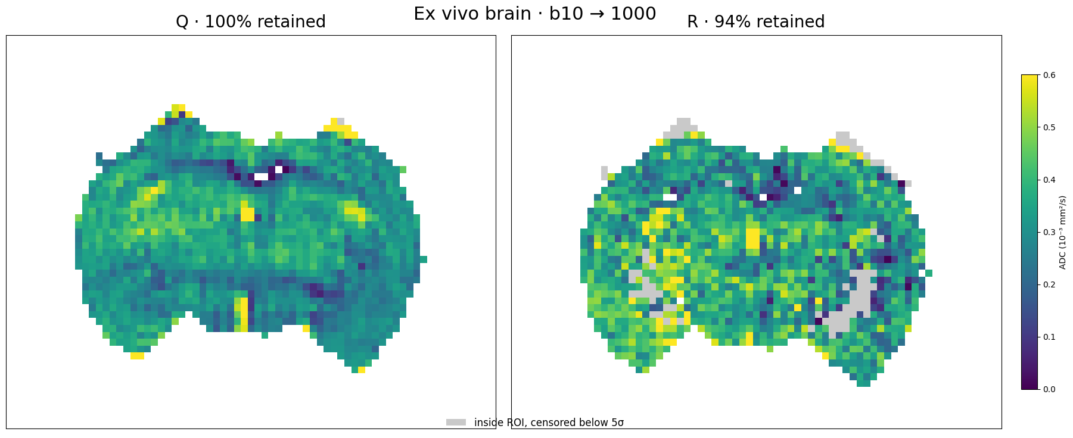
ADC maps | ex-vivo brain
Q and R | baseline → 1000 | shared 0–0.6 scale
Mean x/y/z slopes · endpoints ≥5σ; gray = censored
Notes:
Mean x/y/z slopes; endpoints ≥5σ retained. Gray marks censored voxels. FSE uses effective b. Coverage reflects retained voxels under QC and is not an uncertainty estimate. Source figure: docs/figures/physical_scanner_2026-10-12/slide_adc_exvivo_brain_low.png

Slide 21
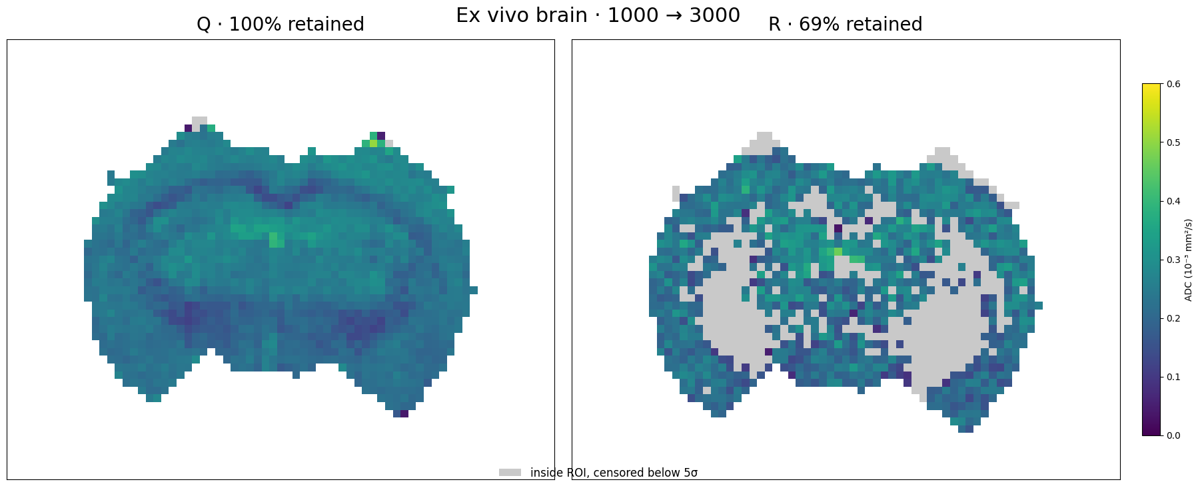
ADC maps | ex-vivo brain
Q and R | 1000 → 3000 | shared 0–0.6 scale
Mean x/y/z slopes · endpoints ≥5σ; gray = censored
Notes:
Mean x/y/z slopes; endpoints ≥5σ retained. Gray marks censored voxels. FSE uses effective b. Coverage reflects retained voxels under QC and is not an uncertainty estimate. Source figure: docs/figures/physical_scanner_2026-10-12/slide_adc_exvivo_brain_high.png

Slide 22
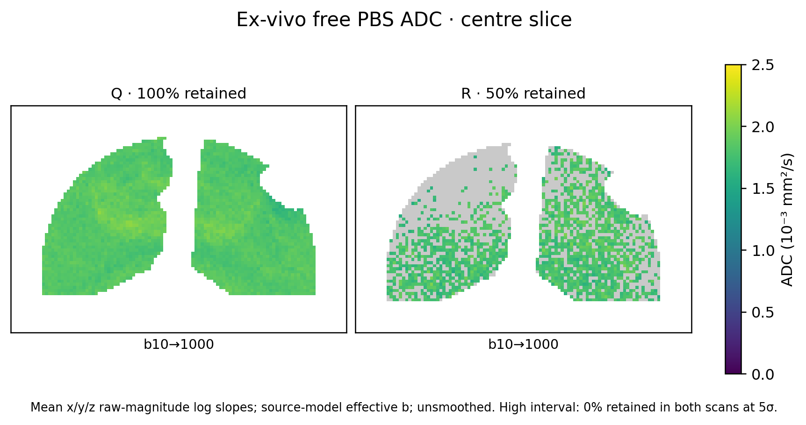
ADC maps | ex-vivo PBS
Q and R | low interval shown; high interval excluded near noise floor
Mean x/y/z slopes · endpoints ≥5σ; gray = censored
Notes:
Mean x/y/z slopes; endpoints ≥5σ retained. Gray marks censored voxels. High interval retained 0% in both scans. Coverage reflects retained voxels under QC and is not an uncertainty estimate. Source figure: docs/figures/physical_scanner_2026-10-12/slide_adc_exvivo_pbs.png

Slide 23
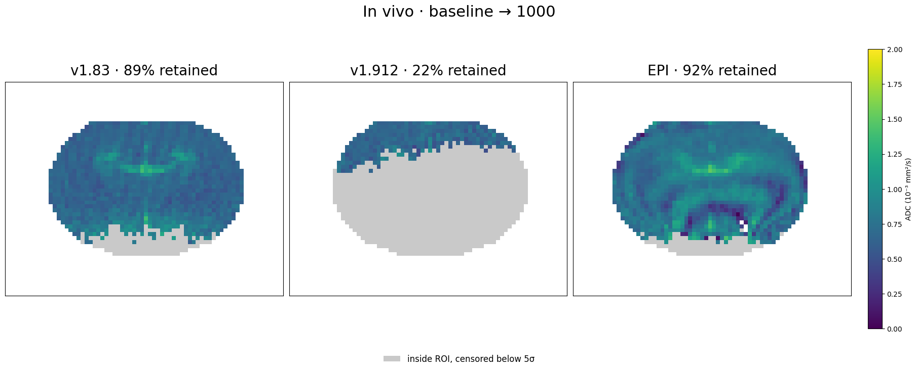
ADC maps | in vivo
iA, iB and EPI | baseline → 1000 | shared 0–2 scale
Mean x/y/z slopes · endpoints ≥5σ; gray = censored
Notes:
Mean x/y/z slopes; endpoints ≥5σ retained. Gray marks censored voxels. FSE uses effective b; EPI uses nominal b. Coverage reflects retained voxels under QC and is not an uncertainty estimate. Source figure: docs/figures/physical_scanner_2026-10-12/slide_adc_invivo_low.png

Slide 24
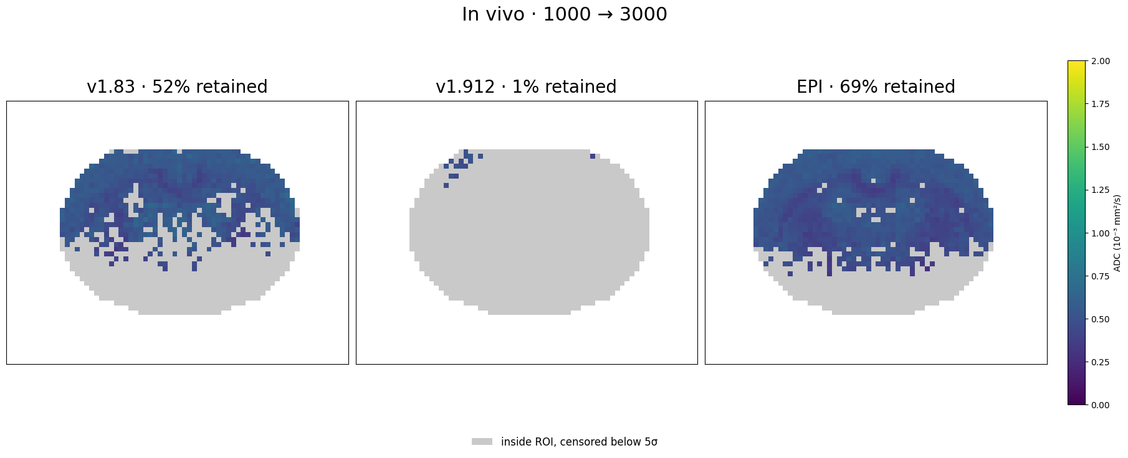
ADC maps | in vivo
iA, iB and EPI | 1000 → 3000 | shared 0–2 scale
Mean x/y/z slopes · endpoints ≥5σ; gray = censored
Notes:
Mean x/y/z slopes; endpoints ≥5σ retained. Gray marks censored voxels. FSE uses effective b; EPI uses nominal b. Coverage reflects retained voxels under QC and is not an uncertainty estimate. Source figure: docs/figures/physical_scanner_2026-10-12/slide_adc_invivo_high.png

Slide 25
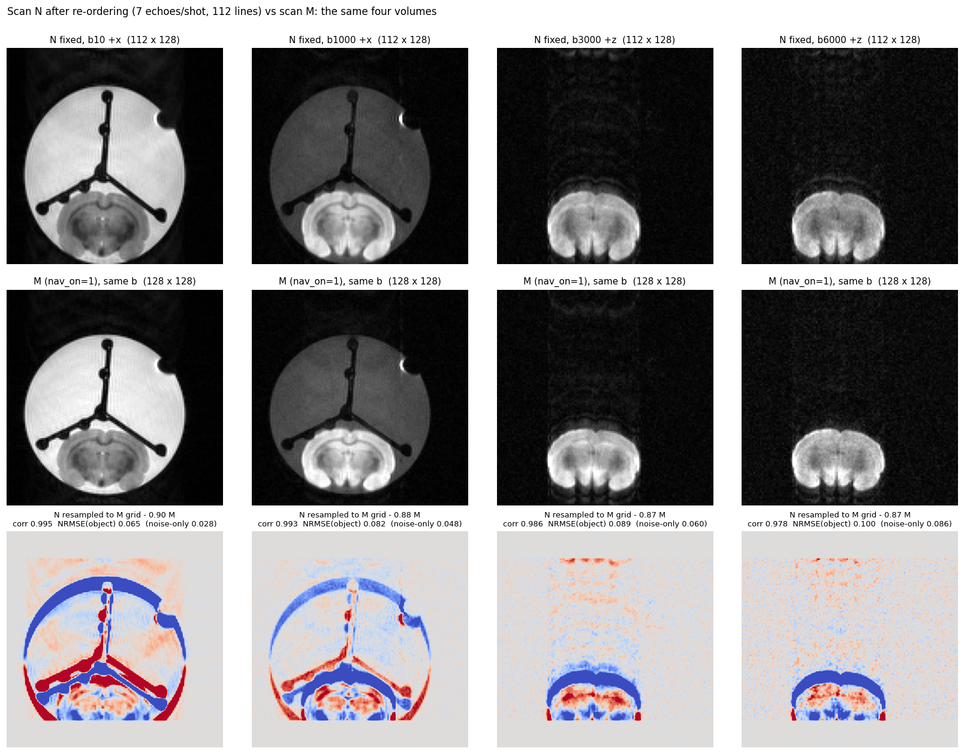
Navigator geometry | scan N
Acquired echo coverage and corrected geometry
Notes:
Scan N recorded 7 echoes / 119 views versus declared 9 / 153. R phase FOV is 31.1 mm versus 35 mm. This is an acquisition/layout limitation, not a recovered full navigator set. Source: docs/figures/physical_scanner_2026-10-12/nav_N_fixed_vs_M.png; report: docs/physical_scanner_experiments_2026-10-12.md.

Slide 26
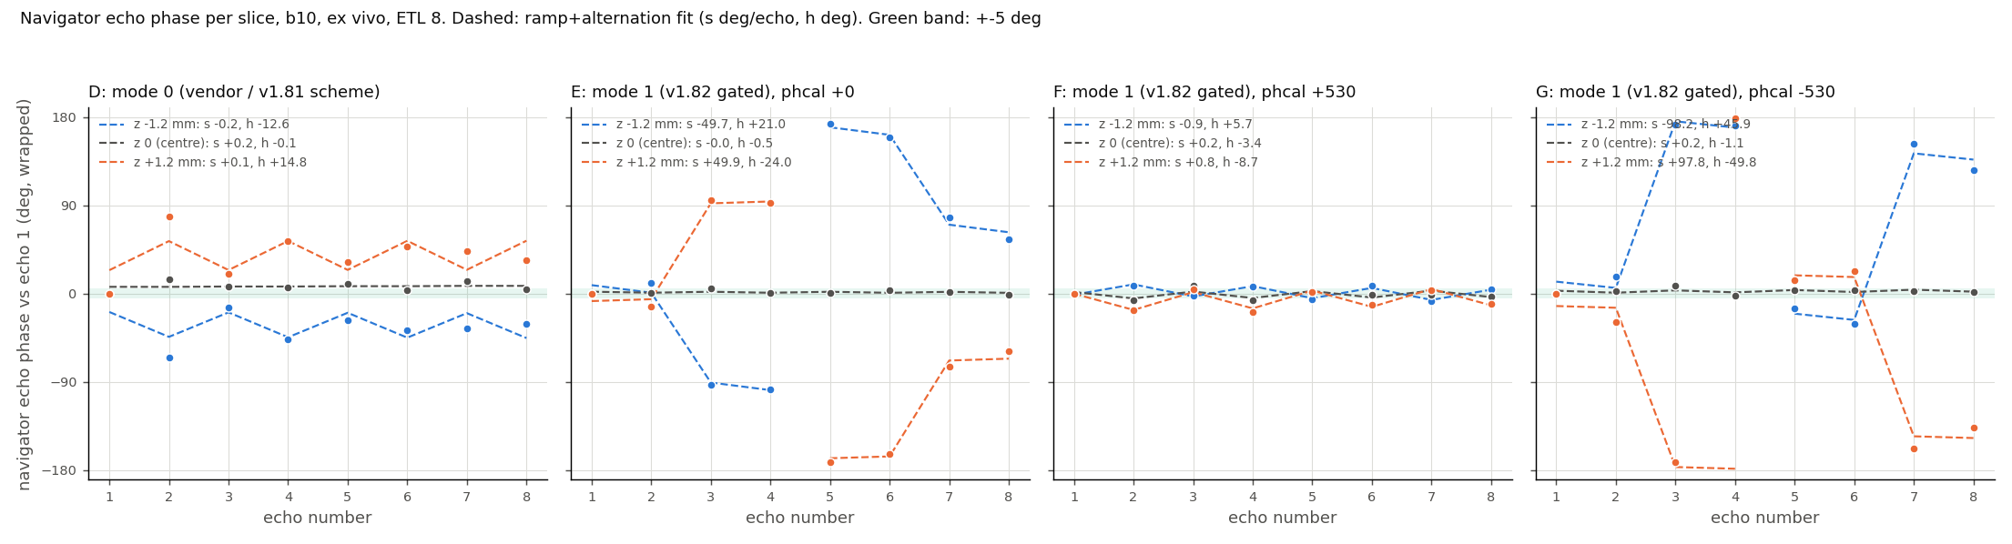
Phase calibration | echo phase
D, E, F and G modes | echo phase and fitted ramp
Notes:
F at +530 is closest among acquired candidates, with ±0.9° ramp and 5.7° / 8.7° alternate offset. It remains above the strict 5° criterion. +540 is an unacquired interpolated candidate. Source: docs/figures/physical_scanner_2026-10-12/phasecal_echo_phase_DEFG.png; report: docs/physical_scanner_experiments_2026-10-12.md.

Slide 27
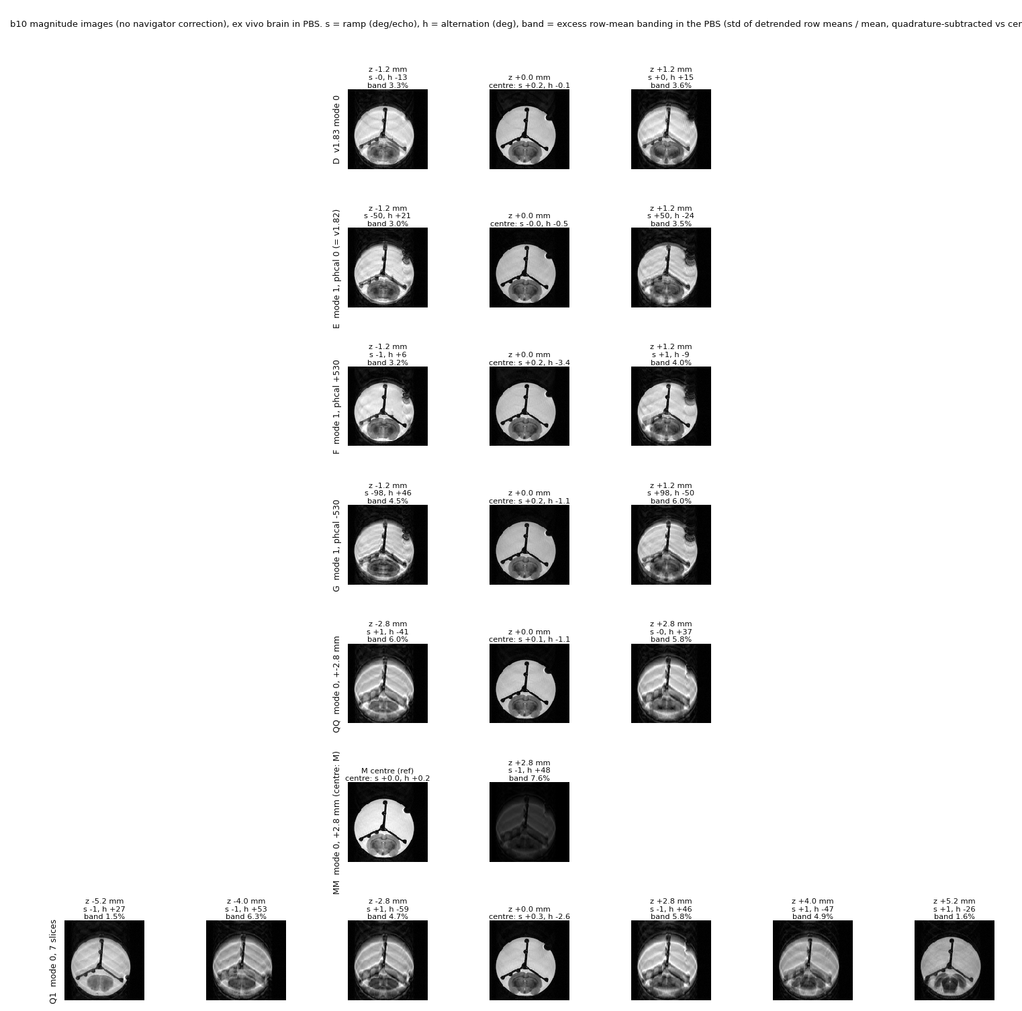
Phase calibration | image effects
Acquired phase calibration comparison
Notes:
A/B shift −0.05 read pixel and 0 PE, nominally −16 Hz; sign is uncalibrated. E and G retain large phase ramps. Source: docs/figures/physical_scanner_2026-10-12/phasecal_image_strips.png; report: docs/physical_scanner_experiments_2026-10-12.md.

Slide 28
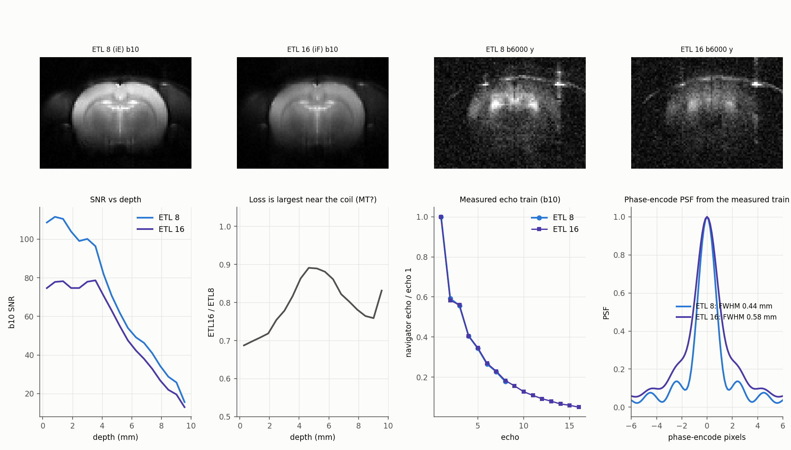
Echo train length | 8 vs 16
Measured image / signal effects
Notes:
Measured ETL comparison. Refer to report for acquisition-specific limitations. Source: docs/figures/physical_scanner_2026-10-12/etl16_vs_etl8.png; report: docs/physical_scanner_experiments_2026-10-12.md.

Slide 29
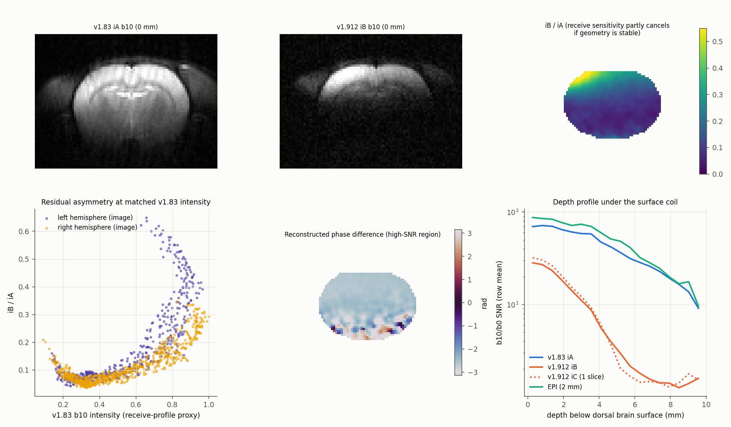
ss-MGOT | measured depth response
Measured left-right profile
Notes:
Measured spatial profile only; no 3D coil simulation or inferred universal depth effect. Source: docs/figures/physical_scanner_2026-10-12/ssmgot_lr.png; report: docs/physical_scanner_experiments_2026-10-12.md.

Slide 30
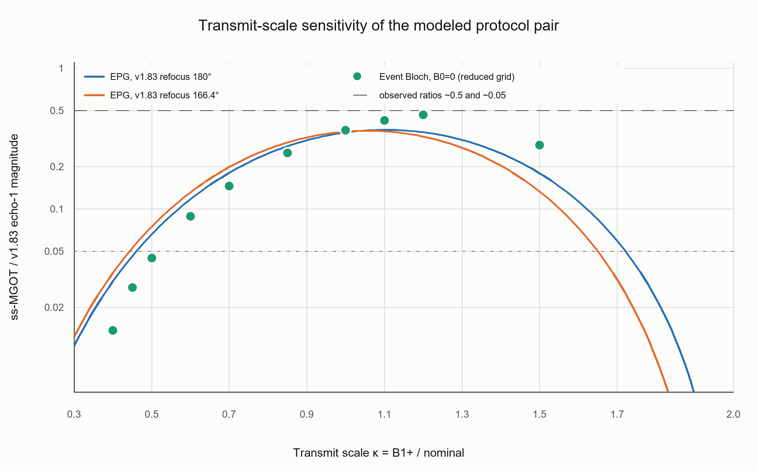
B1 | targeted simulation
Modeled B1 sensitivity | simulation, not measured scanner data
Notes:
Simulation-only result. Do not interpret as measured B1 or scanner performance. Source: docs/figures/physical_scanner_2026-10-12/oct12_b1_targeted.png; report: docs/physical_scanner_experiments_2026-10-12.md.

Slide 31
Decision and next experiment
• Ex vivo: v1.83 ETL8 is the current FSE choice.
• In vivo: retain EPI; test v1.83 with CHESS at matched geometry.
• ss-MGOT: resolve B1 sensitivity and low high-b SNR before whole-brain use.
Notes:
Decision points from the approved report. Follow up by verifying navigator echo and view counts and confirming a phase mode against the strict acceptance criterion. B1 content in this deck is simulation-only and does not establish measured B1 performance. Source: docs/physical_scanner_experiments_2026-10-12.md.

