Slide 1
Vector Search 101
Retrieval-Augmented Generation & Multimodal Systems
Turning text into searchable meaning — the foundation for vector databases and RAG
Notes:
Opening: emphasize that this is the first deep session on embeddings and vector search. The goal is not to build a full RAG app yet, but to understand the retrieval engine that makes RAG work.

Slide 2
Agenda
01
Why keyword search is not enough
02
Embeddings: semantic meaning as vectors
03
Similarity metrics: cosine, dot product, Euclidean
04
Dense vs sparse retrieval — and when each wins
05
Embedding model choices and cost reasoning
06
FAISS: building an in-memory vector index
07
Retrieval quality: precision@k and failure modes
Notes:
Set expectations: the session mixes intuition, diagrams, and code walkthrough. Preview that RAG and multimodal are downstream applications, not the main focus today.

Slide 3
Where vector search fits in the RAG journey
Raw text
Embeddings
Vector search
Retrieved context
LLM answer
documents,
FAQs, tickets
meaning as
numbers
find nearest
chunks
top-k evidence
for the query
grounded
response
Today’s boundary
We focus on the middle of the pipeline: how text becomes vectors, how similarity is computed, and how FAISS retrieves the nearest items. The full RAG chain comes later.
Notes:
Bridge from previous modules to this module. Make the boundary clear: no full RAG chain yet.

Slide 4
The search problem: words can differ while meaning stays the same
User query
Knowledge-base article
“I can’t log in — how do I get back into my account?”
“Steps for password recovery after failed authentication”
No exact phrase: password reset, account recovery, login recovery
Different wording, same intent: regain account access
Keyword search asks
Vector search asks
Production search asks
Do the same words appear?
Is the meaning close?
Can both signals help?
Notes:
Use this slide as the intuitive hook. Do not define embeddings yet; first make the limitation of keyword search visible.

Slide 5
By the end, you can build a meaning-based search engine
Corpus
Embed
Index
Query
Rank
Support articles
MiniLM vectors
FAISS
Vectorize question
Top-k results
•
Explain why semantic retrieval works before connecting an LLM.
•
Choose a similarity metric and know what it is optimizing.
•
Debug retrieval results using top-k scores and precision@k.
Notes:
Tie the deck to the practical notebook. Reinforce that the class will build this system step by step.

Slide 6
PART 1
Embeddings: semantic meaning as vectors
Notes:
Transition slide. Pause and position the next section: Embeddings: semantic meaning as vectors.

Slide 7
Embeddings are coordinates on a learned meaning map
Think of a city map
Simplified 2-D projection of meaning space
A map does not store every detail of a place.
It stores enough coordinates so nearby places can be compared and navigated.
password reset
refund policy
return item
account recovery
payment reversal
login help
Embeddings do the same for meaning
A vector does not expose human-readable columns.
Dimension 1
network outage
It stores learned coordinates so related text lands close together.
dropped calls
Dimension 2
Notes:
Introduce the map analogy. Explain that real embedding spaces have hundreds or thousands of dimensions; the 2-D map is only a projection.

Slide 8
From sentence to vector: what actually happens
Text
Tokenizer
Embedding model
[0.12, -0.34, …]
Key idea: the same model must embed both documents and queries, otherwise their coordinates are not comparable.
Tokenization
Forward pass
Vector output
Text is split into model-readable pieces.
The model compresses meaning into numbers.
Similarity search compares those numbers.
Notes:
Connect to LLM Anatomy: tokenization has already been discussed, but embedding models are used differently from generative LLMs.

Slide 9
Similar sentences cluster even when wording changes
This is the behavior we want from a semantic search system:
Login cluster
Billing cluster
Device cluster
“reset my password”
“recover my account”
“can’t sign in”
“invoice is wrong”
“charged twice”
“payment reversal”
“router keeps dropping”
“network outage”
“no internet signal”
Embedding quality shows up as retrieval quality: the nearest neighbors should match the user’s intent, not just the user’s words.
Notes:
Use this as a check: similar sentences should cluster. If they do not, retrieval will be weak before any LLM sees the context.

Slide 10
Embedding dimensions are useful, but not directly interpretable
What a vector looks like
What matters operationally
•
Vectors from different models are not interchangeable.
[ 0.12, -0.34, 0.88, …, -0.07 ]
•
Higher dimension can store more signal, but also costs more storage.
•
The only real test is retrieval quality on your actual corpus.
Not a manual feature list
A learned coordinate system
Dimension 17 is not simply “billing” or “refund”.
The model learns useful directions from data.
MiniLM example
all-MiniLM-L6-v2 maps text into 384-dimensional dense vectors for semantic search.
Notes:
Do not over-explain the internals. The important operational rule is model consistency and task-specific evaluation.

Slide 11
Three rules of the vector space
Rule 1
Rule 2
Rule 3
Same model for documents and queries
Mixing models is like measuring one map in kilometers and another in miles.
Same preprocessing strategy
Chunking, casing, cleaning and metadata choices change what gets embedded.
Same domain expectation
General embeddings can struggle with legal, medical, product-code or company-specific terms.
Embedding systems fail quietly: the code may run perfectly while the nearest neighbors are wrong.
Notes:
This slide sets up the practical debugging mindset. Emphasize silent failure.

Slide 12
PART 2
Similarity metrics: how “near” is calculated
Notes:
Transition slide. Pause and position the next section: Similarity metrics: how “near” is calculated.

Slide 13
Similarity is a ranking signal, not a truth label
Query
Ranked nearest neighbors
1
Account recovery after failed login
0.84
“How do I get back into my locked account?”
2
Reset password using verified email
0.81
3
Recover deleted user profile
0.63
Interpretation
A high score means “close under this model and metric.” It does not guarantee factual relevance.
Trainer cue
Ask: is result #3 useful, or just superficially related?
Notes:
Clarify that score values are model/metric-specific. The absolute number is less important than the ranking and evaluation.

Slide 14
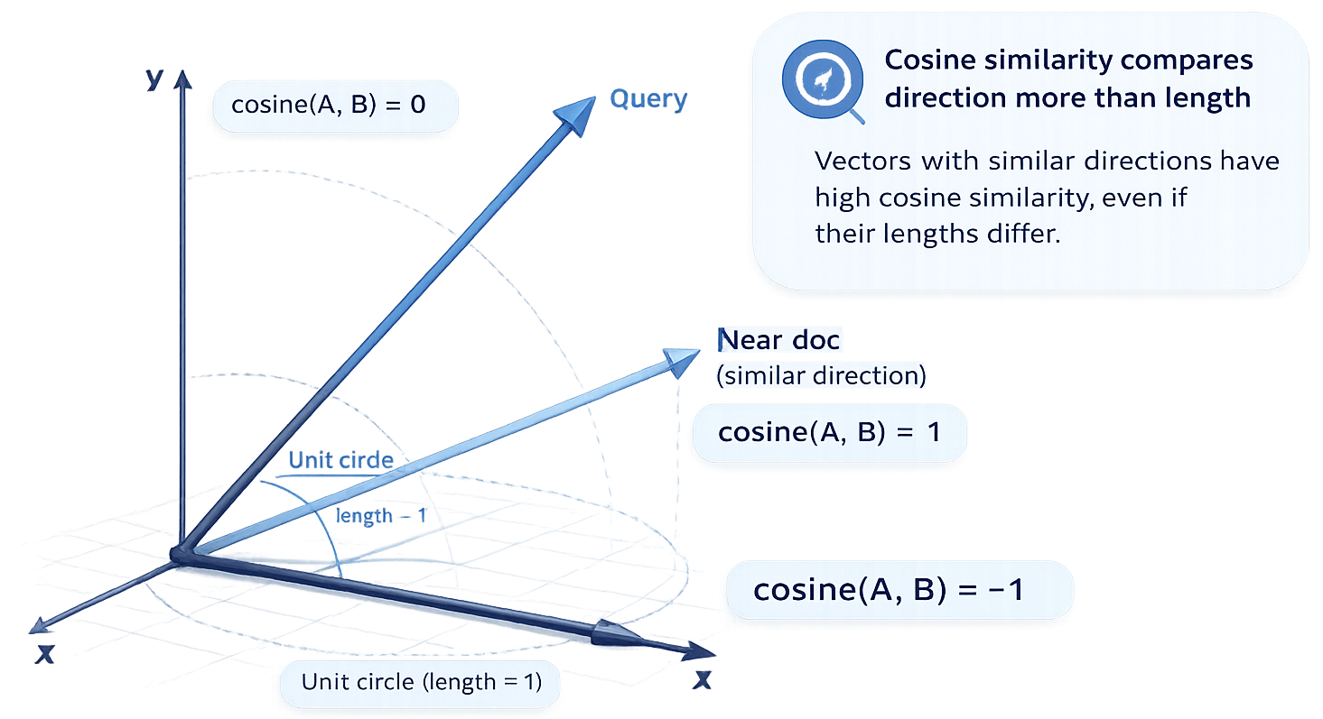
Cosine similarity: compare direction more than length
cosine(A, B) = (A · B) / (||A|| x ||B||)
•
1.0 means same direction.
•
0 means unrelated direction.
•
−1 means opposite direction.
•
Common default for semantic similarity.
Why it is popular
It reduces the effect of vector length and focuses on orientation in meaning space.
Notes:
Explain the angle, not the formula. In practice, normalized dot product is often used for cosine-like retrieval.

Slide 15
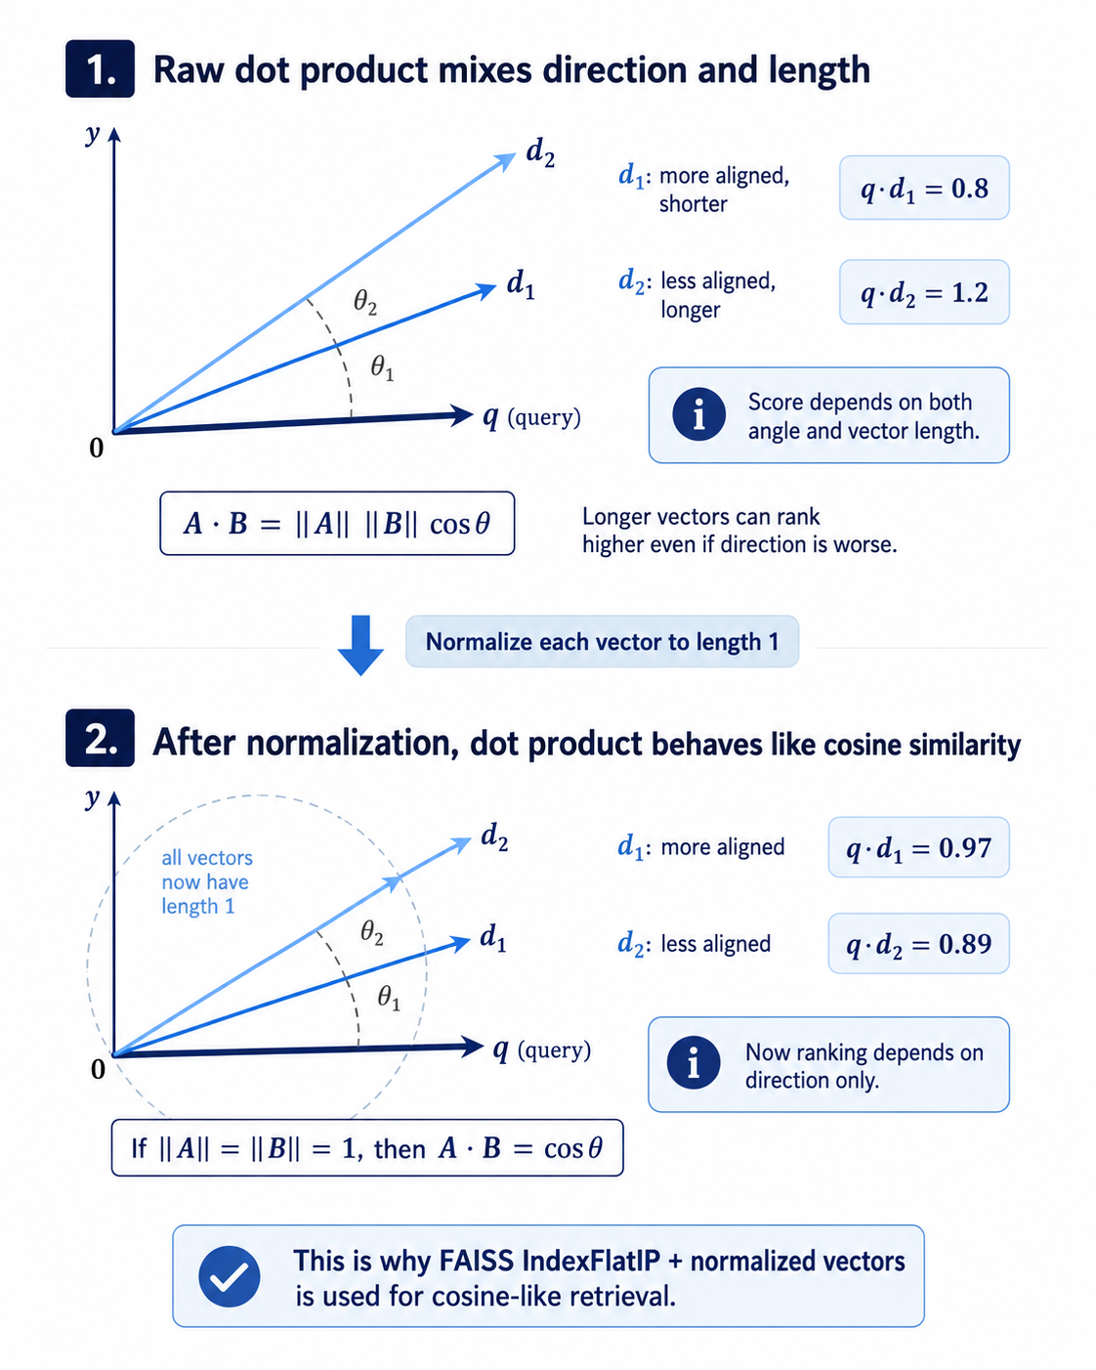
Dot product: fast ranking when vectors are normalized
Notes:
This is the transition from math to implementation. Mention that the notebook will use normalized vectors and inner product search.

Slide 16
Euclidean distance: straight-line distance in vector space
What it measures
y
distance(A, B) = √Σ(ai − bi)²
The lower the distance, the closer the vectors.
C
B
When it is useful
shorter
longer
Clustering, nearest-neighbor baselines, and FAISS IndexFlatL2 examples.
A
0
x
Notes:
Stress that metric choice must match the embedding model and index setup. L2 is simple, but cosine/dot product are more common in semantic text search.

Slide 17
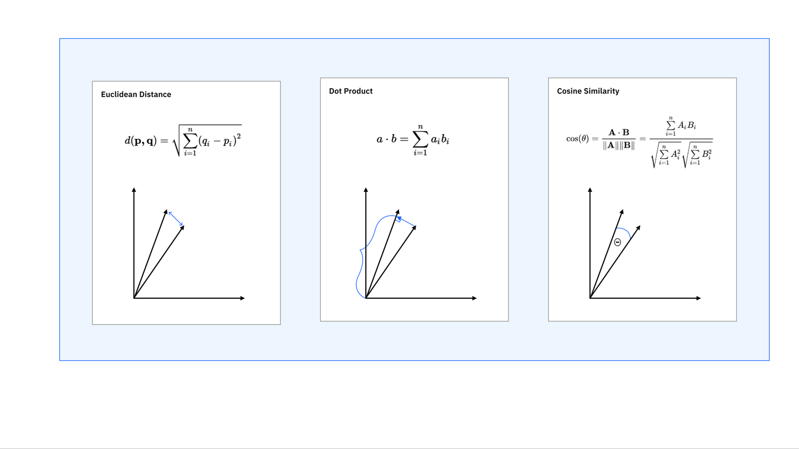
Choosing the metric is a design decision
Cosine
Dot product
Euclidean
Best default for semantic similarity.
Focuses on direction.
Fast with normalized vectors.
Common in vector search engines.
Simple distance baseline.
Useful for L2 indexes and clustering.
Operational rule: document the metric, normalize policy, and embedding model together. Changing any one can change retrieval rankings.
Notes:
Make this practical: this metadata should be tracked with every index build, otherwise debugging becomes very difficult.

Slide 18
PART 3
Dense vs sparse retrieval
Notes:
Transition slide. Pause and position the next section: Dense vs sparse retrieval.

Slide 19
Sparse retrieval: exact terms still matter
Keyword engine mental model
Where sparse wins
refund
doc 2, doc 7, doc 9
•
Product codes and error IDs
•
Names, invoice numbers, policy clause IDs
E1042
doc 4
•
Exact legal or compliance wording
•
Queries where “must contain this term” matters
password
doc 1, doc 6
Notes:
Do not frame keyword search as obsolete. Hybrid retrieval is important because exact identifiers are often mission-critical.

Slide 20
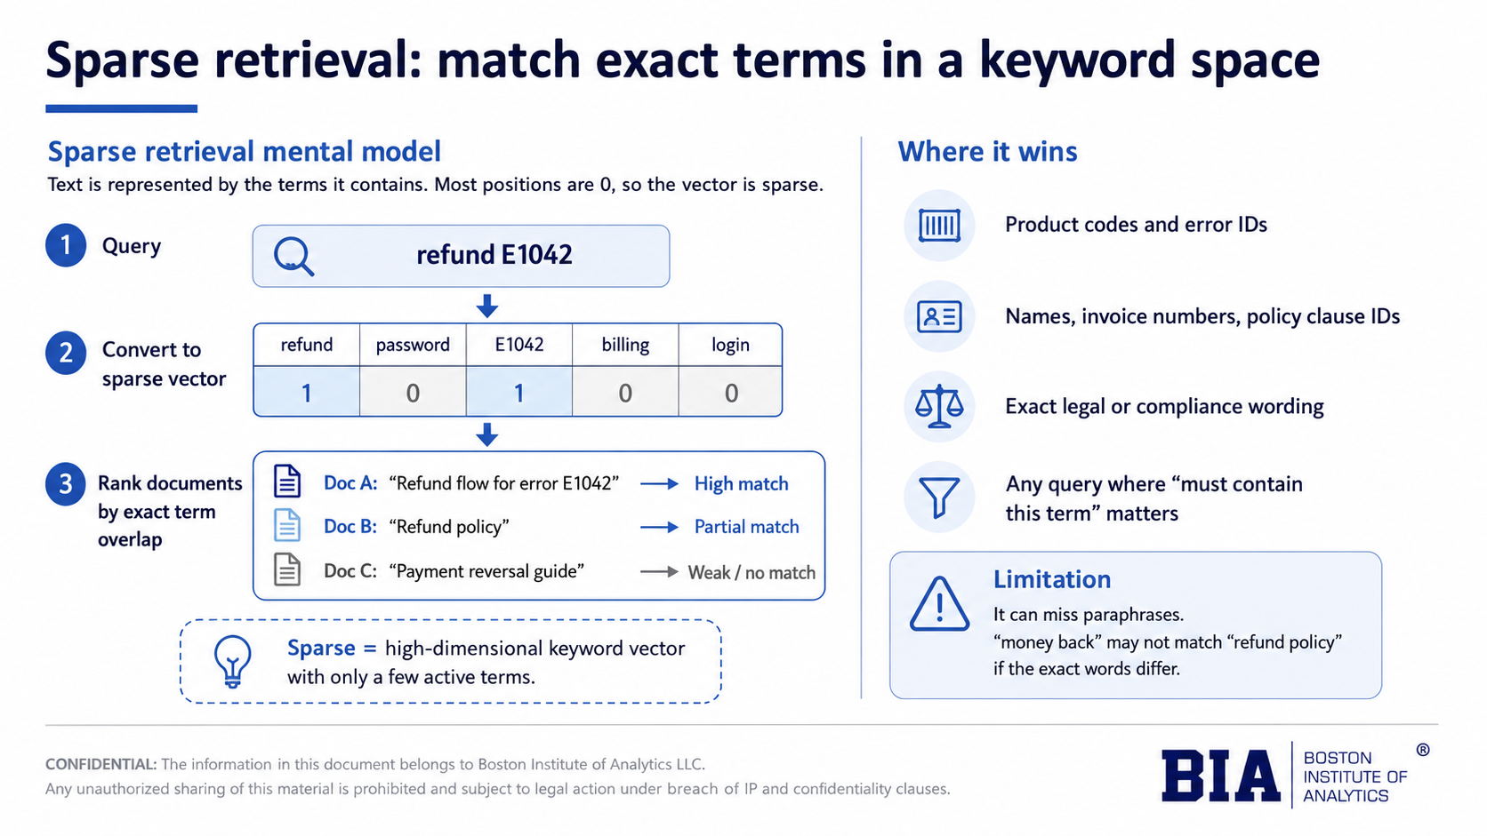
Notes:
Do not frame keyword search as obsolete. Hybrid retrieval is important because exact identifiers are often mission-critical.

Slide 21
Dense retrieval: match intent even when words differ
Dense retrieval converts both documents and query into vectors, then ranks by similarity.
Query
“money back”
Embedding
vector
Nearest
vectors
Refund
articles
Best for
Risk
Fix
Paraphrases, natural questions, vague intent.
Can miss rare exact terms or over-match broad concepts.
Combine with sparse retrieval and metadata filters.
Notes:
Transition: dense search expands beyond keywords but is not sufficient alone.

Slide 22
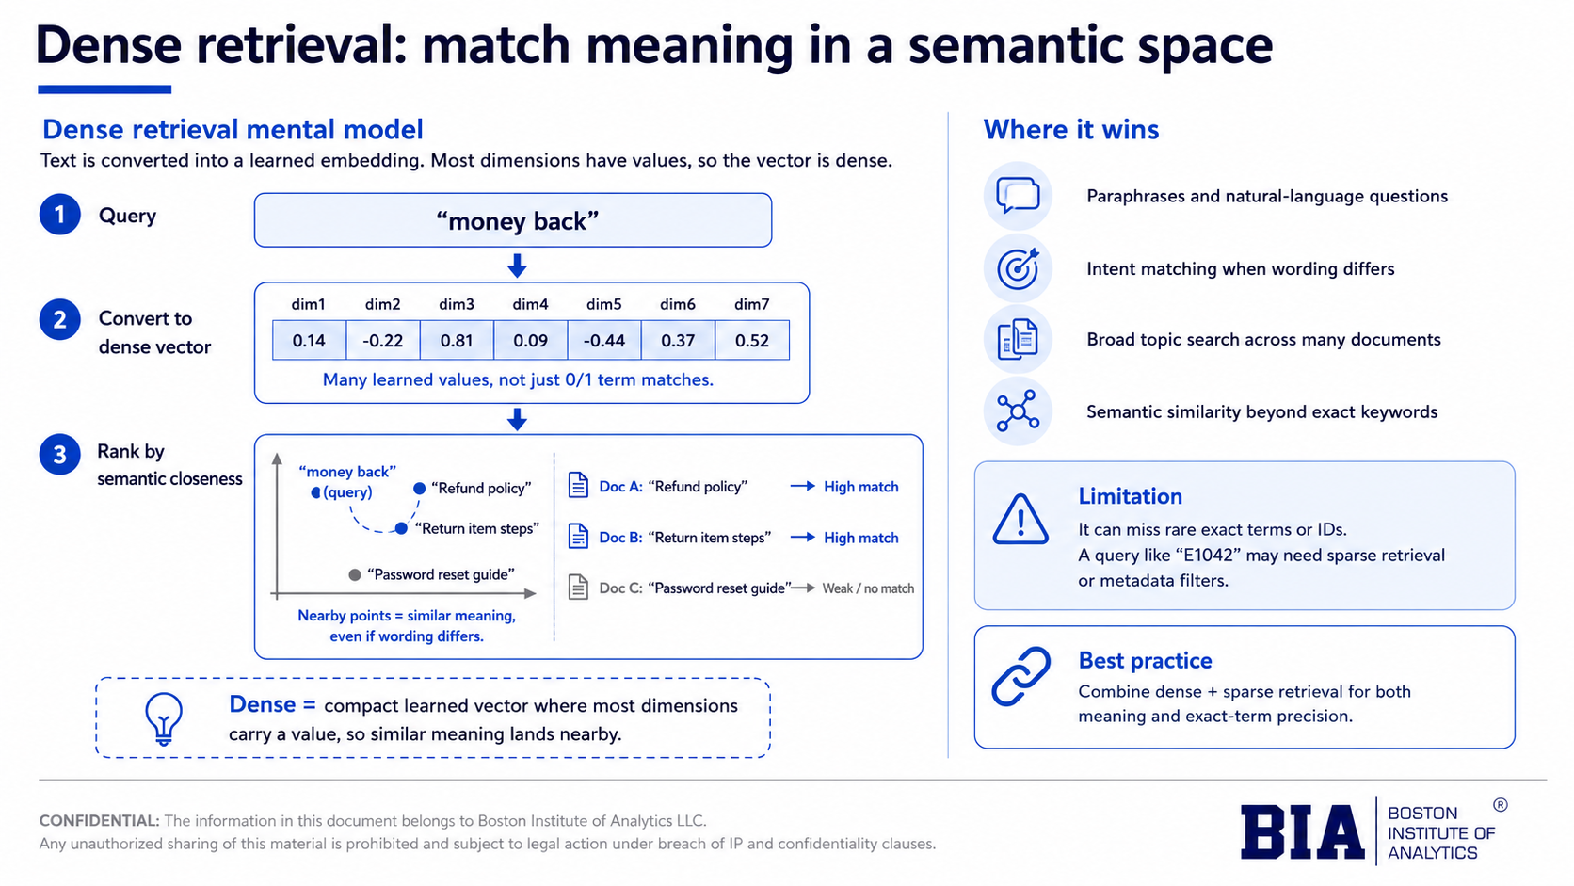
Notes:
Do not frame keyword search as obsolete. Hybrid retrieval is important because exact identifiers are often mission-critical.

Slide 23
Which retrieval style should win?
Query
Best signal
Why
“E1042 payment gateway error”
Sparse
The exact error code is the strongest clue.
“Can I get my money back?”
Dense
Intent maps to refund even without the word “refund”.
“Refund policy for premium plan”
Hybrid
Exact term + semantic context both matter.
“Find the clause about data retention”
Hybrid
Legal search needs precision and meaning.
Notes:
Use this as a quick classroom interaction. Ask for answers before revealing the matrix.

Slide 24
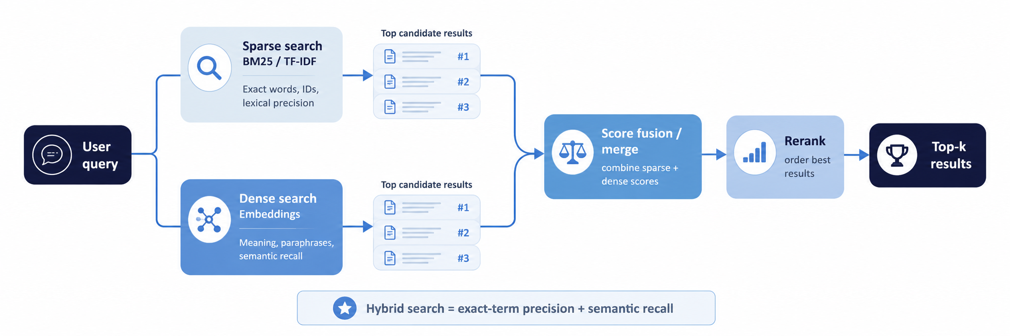
Hybrid search preview: combine lexical precision with semantic recall
Dense retrieval improves recall; sparse retrieval protects precision. Production systems often need both.
Notes:
Preview only. The next sessions will make this concrete with vector databases and RAG.

Slide 25
PART 4
Embedding model choices and cost
Notes:
Transition slide. Pause and position the next section: Embedding model choices and cost.

Slide 26
Choosing an embedding model: quality, cost, control
Local sentence-transformers
OpenAI text-embedding-3-small
Domain-specific / fine-tuned
Free to run locally
Good classroom baseline
No network dependency
Lower ops cost, but you own quality testing
Hosted API
Strong general-purpose retrieval
Low per-token cost
Easy to scale without local model serving
Best when vocabulary is specialized
Needs labelled pairs or contrastive data
More evaluation work
Higher engineering maturity
Notes:
Avoid declaring a universal best model. The right answer depends on corpus, latency, privacy, cost, and evaluation results.

Slide 27
Cost reasoning: embedding 1,000 documents
Estimate cost before committing to an embedding strategy.
Corpus
Tokens
API price
Cost
1,000 documents
× 500 tokens
=
500,000
input tokens
×
$0.02 per
1M tokens
≈
$0.01
•
Query-time embedding cost is tiny for classroom demos, but production volume can grow quickly.
•
Storage and re-indexing matter: every model change requires re-embedding the corpus.
Pricing changes over time. Always verify before budgeting a production system.
Notes:
Use this as a practical budgeting exercise. The exact price should be checked on the provider's official pricing page.

Slide 28
A practical model-selection checklist
1
Start local
Use MiniLM or another sentence-transformers model to learn and prototype.
2
Test on real queries
Create a small labelled query set before judging quality.
3
Compare hosted models
Only pay for better embeddings if retrieval quality improves.
4
Track index metadata
Store model name, dimension, normalization policy, date, and corpus version.
5
Rebuild intentionally
Changing the model invalidates old vectors; plan re-indexing.
Notes:
Use this to tie model choice to evaluation. The checklist doubles as a trainer talking aid.

Slide 29
PART 5
FAISS: an in-memory vector index
Notes:
Transition slide. Pause and position the next section: FAISS: an in-memory vector index.

Slide 30
What FAISS solves
Once every document is a vector, brute-force search becomes expensive at scale.
Without an index
With FAISS
What FAISS is not
Compare query vector against every document vector.
Works for tiny demos. Slows down as the corpus grows.
Store vectors in an optimized index and search nearest neighbors efficiently.
Great for local experiments and custom pipelines.
Not a full vector database: no managed API, auth, metadata filtering, or cloud operations by itself.
FAISS teaches the search engine inside a vector database before adding production infrastructure.
Notes:
This is the bridge to Vector DB Landscape. FAISS is perfect for understanding index mechanics, not full production management.

Slide 31
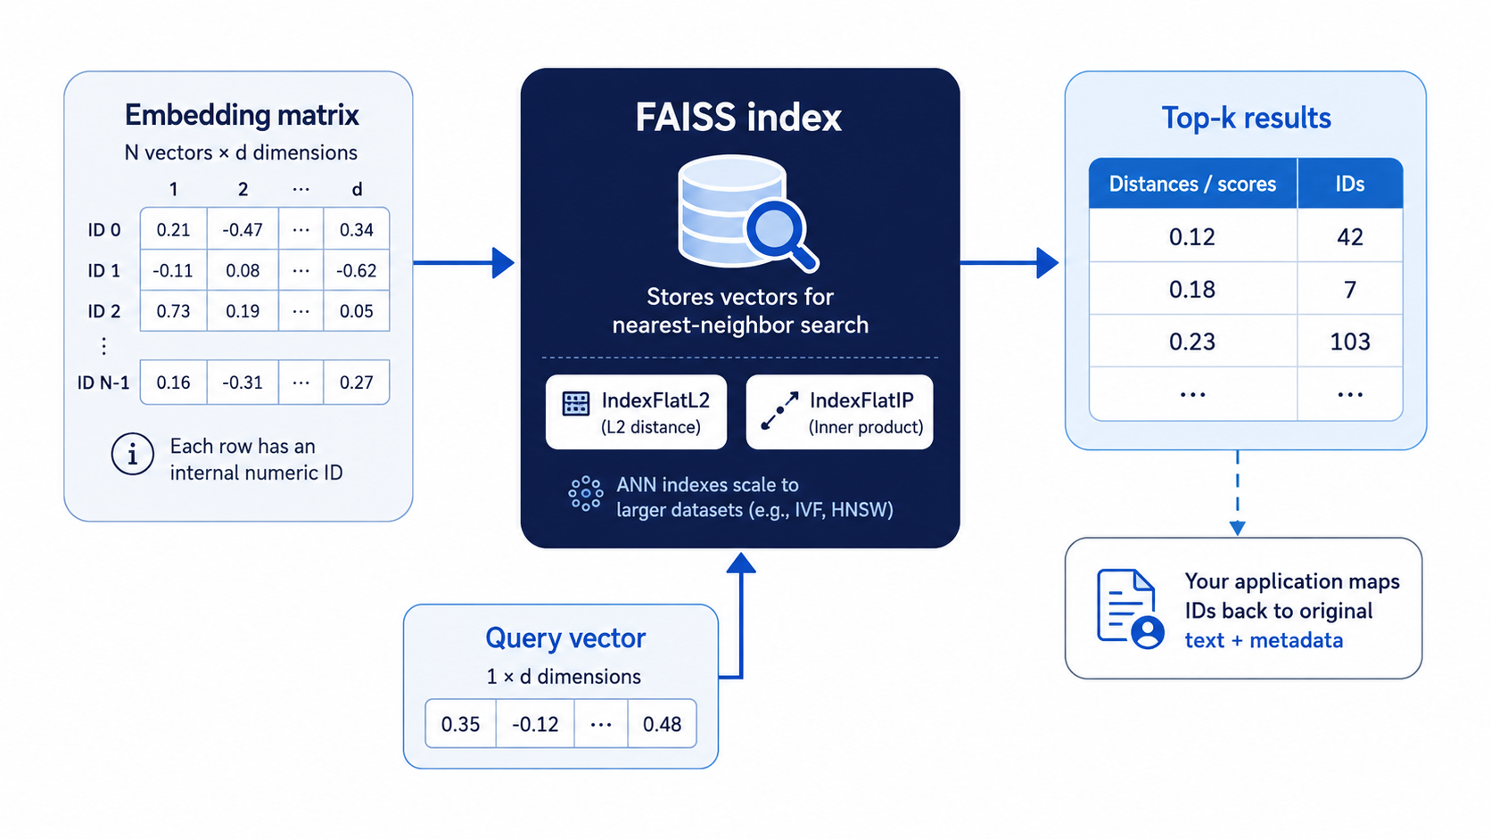
FAISS index anatomy
IndexFlatL2
Exact nearest-neighbor search using Euclidean distance. Best for small datasets, demos, and baselines because it checks all vectors without approximation.
IndexFlatIP
Exact inner-product search. Common for semantic search when vectors are normalized, because inner product then behaves like cosine similarity.
ANN indexes
Approximate nearest-neighbor indexes for scale. IVF, HNSW, and PQ trade a little recall for much faster search on large vector collections.
Notes:
Explain N = number of documents, d = embedding dimensions. IDs must be mapped back to rows in a dataframe or document store.

Slide 32
Code walkthrough: build a cosine-like FAISS search
model = SentenceTransformer("sentence-transformers/all-MiniLM-L6-v2")
doc_vectors = model.encode(documents, normalize_embeddings=True)
query_vector = model.encode([query], normalize_embeddings=True)
index = faiss.IndexFlatIP(doc_vectors.shape[1])
index.add(doc_vectors.astype("float32"))
scores, ids = index.search(query_vector.astype("float32"), k=3)
Same model for docs and query
Normalize vectors so inner product behaves like cosine
FAISS returns scores and row IDs, not text
Application code maps IDs back to documents
Notes:
This slide is a bridge to the notebook. Keep it conceptual: show what each line means rather than debugging syntax.

Slide 33
Retrieval quality: measure top-k, do not eyeball one result
If top-3 returns two relevant articles, precision@3 = 2 / 3 = 0.67
1
Account recovery after failed login
Relevant
2
Reset password using verified email
Relevant
3
Recover deleted user profile
Not relevant
Why this matters
A RAG answer can only be as grounded as the context retrieved. Retrieval evaluation comes before generation evaluation.
Notes:
This prepares for RAG evaluation. Avoid overdoing metrics; precision@k is enough for this first session.

Slide 34
Common vector search failure modes
False positive
False negative
A result is semantically nearby but not useful for the task.
The correct document exists but does not appear in top-k.
Domain mismatch
Chunking problem
General embeddings miss specialized vocabulary or abbreviations.
The right answer is split poorly or buried inside a long chunk.
Stale index
Corpus changed but vectors were not rebuilt.
Debug retrieval before blaming the LLM.
Notes:
Use concrete examples from the support dataset in the practical notebook.

Slide 35
From FAISS to vector databases to RAG
This session builds the retrieval core. The next steps add storage, filtering, operations, and generation.
Now
Next
Then
Later
FAISS in memory
vectors + search
Vector DB Landscape
persistence + metadata
Text-RAG Pipeline
chunking + retriever + LLM
Multimodal RAG
text + images + video
Mental model to carry forward
RAG is not “LLM + documents.” It is a retrieval system feeding evidence into a generation system.
Notes:
Close the narrative arc. Make clear why this session is foundational for upcoming work.

Slide 36
Key takeaways
Embeddings place text in a learned meaning space.
Similarity metrics create rankings, not guarantees.
Dense search handles paraphrases; sparse search protects exact-match precision.
FAISS is a local index for searching dense vectors efficiently.
Retrieval quality must be measured before adding an LLM.
Notes:
Recap. Connect to practical notebook and exercises.

Slide 37
Industry anchor: embeddings power real search and discovery systems
DoorDash example
Why it fits this session
DoorDash describes using LLM-generated profiles and embeddings to improve semantic search, recommendations, cold-start relevance, and discovery across multiple verticals.
The same primitive appears here: convert content into vectors, compare user intent against those vectors, then rank the closest candidates.
Production systems add domain-specific data, ranking layers, safety checks, and evaluation — but the vector-search foundation is the same.
Notes:
Keep the case light. It is an anchor, not a deep case study. The goal is to show that embeddings are used beyond classroom demos.

Slide 38
References
•
FAISS documentation — efficient similarity search and clustering of dense vectors
•
Hugging Face model card — sentence-transformers/all-MiniLM-L6-v2
•
OpenAI API pricing — text-embedding models
•
DoorDash engineering blog — content embeddings for search and recommendations
Trainer note
Re-check provider pricing before delivery. API pricing and model availability can change.
Notes:
Reference slide for trainer and learners. Update URLs if the provider pages change.

Slide 39
DoubtBusters: Go-To Place for Clearing Doubts
Every Thursday
DoubtBusters addresses specific academic doubts and queries.
How to submit doubts/queries
Attending the Thursday session
Log in to the Campus Connect portal. In the left navigation pane, click the DoubtBuster section. Fill in and submit the doubt submission form available there.
After submitting your doubt, attend the Thursday DoubtBuster session at the time specified for your region in the portal.
Important
Doubts submitted must be specific — vague or broad topic mentions will not be addressed in DoubtBusters. If an entire concept or session is unclear, raise it directly with your Campus Coordinator or submit a Support Ticket on the portal.
Notes:
Final slide required by the BIA design spec.

