Slide 1
Participating Project: ‘Machine Learning Prediction of Photoredox Properties’
My Role: Finding the symbolic correlation between properties
Previous Work
Upcoming Work
Linear Correlation: (Using LinearRegression from Scikit-learn)
Apply Exponential and Logarithmic functions to the models whose R^2 are between 0.85 and 0.95 in the Quadratic Correlation results (Using curve_fit from Scipy)
Decide proper models comparing the complexity of formulas, R^2, MAE (Mean Absolute Error) and RMSE (Root Mean Square Error)
Try Multiple Regression to find out the correlation between properties
 | Independent Variable | Dependent Variable | R^2
1 | 0-0_S1 (eV) | Adiabatic_S1-S0 (kcal/mol) | 0.9940
2 | 0-0_T1 (eV) | Adiabatic_T1-S0 (kcal/mol) | 0.9932
3 | Adiabatic_T1-S0 (kcal/mol) | 0-0_T1 (eV) | 0.9932
4 | Adiabatic_S1-S0 (kcal/mol) | 0-0_S1 (eV) | 0.9940
5 | Homo (eV) | Oxidation_S0 (kcal/mol) | 0.9651
6 | Lumo (eV) | Reduction_S0 (kcal/mol) | 0.9766
7 | Reduction_S0 (kcal/mol) | Lumo (eV) | 0.9766
8 | Oxidation_S0 (kcal/mol) | Homo (eV) | 0.9651
9 | Vertical_excitation_energy (eV) | Adiabatic_S1-S0 (kcal/mol) | 0.9001
10 | Dipole_moment_norm_S0 (D) | Dipole_moment_norm_S1 (D) | 0.9189
11 | Dipole_moment_norm_S1 (D) | Dipole_moment_norm_S0 (D) | 0.9189
12 | Adiabatic_S1-S0 (kcal/mol) | Vertical_excitation_energy (eV) | 0.9001
2. Quadratic Correlation: (Using PolynomialFeatures from Scikit-learn)
 | Independent Variable | Dependent Variable | R^2
1 | Lumo-Homo (eV) | Vertical_excitation_energy (eV) | 0.9159
3. Cubic Correlation: (Using PolynomialFeatures from Scikit-learn)
 | Independent Variable | Dependent Variable | R^2
1 | 0-0_S1 (eV) | Vertical_excitation_energy (eV) | 0.9001

Slide 2
Correlation between Photoredox Properties
Changyeob(Jaden) Lee
07/25/2024

Slide 3
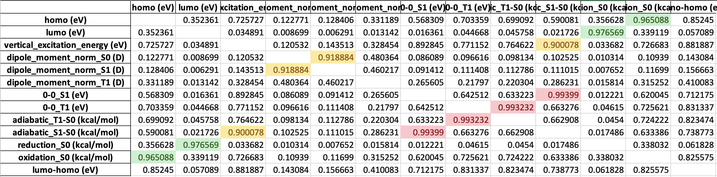
1. Linear Correlation
1.1. R² of the Models
Dependent Variable
Independent Variable

Slide 4
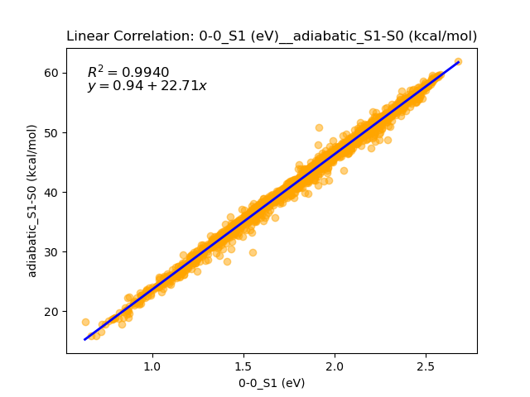
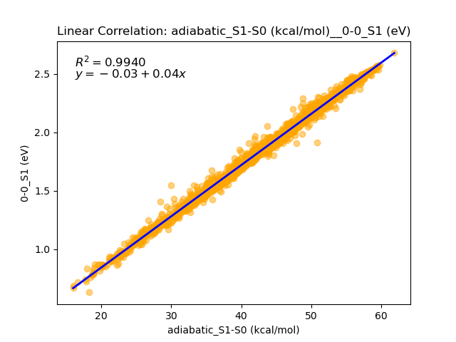
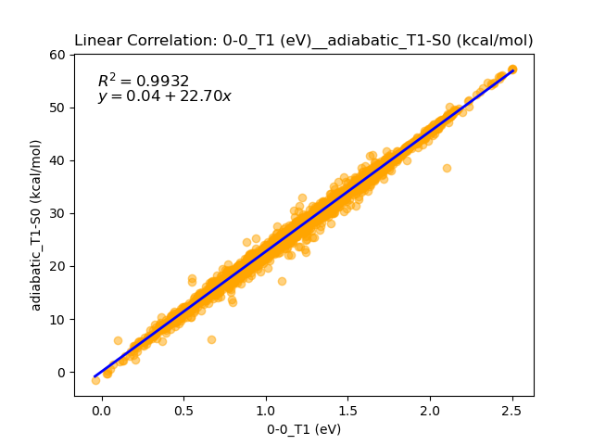
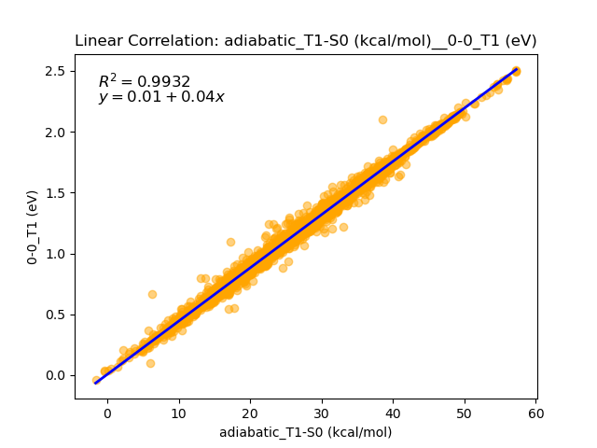
1. Linear Correlation
1.2. Scatter Plot between Properties (R² over 0.99)
Inverse Function

Slide 5
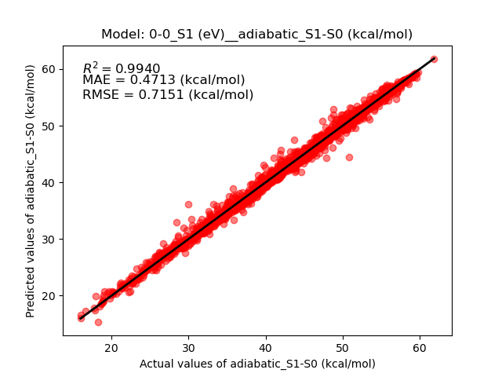
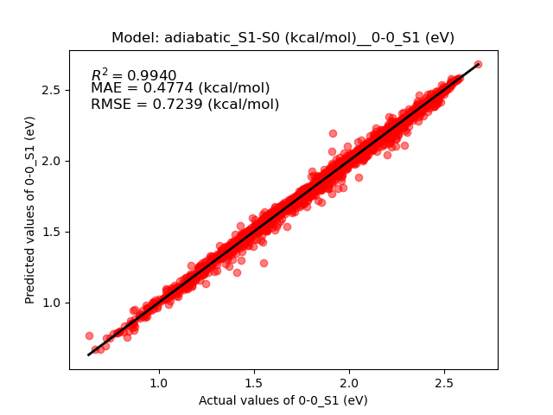
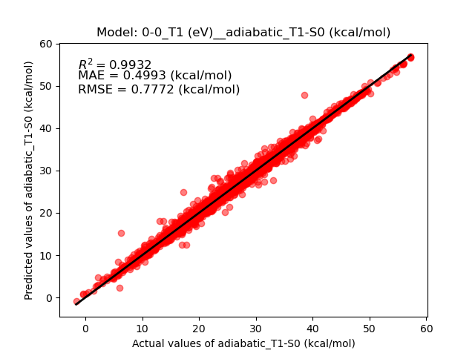
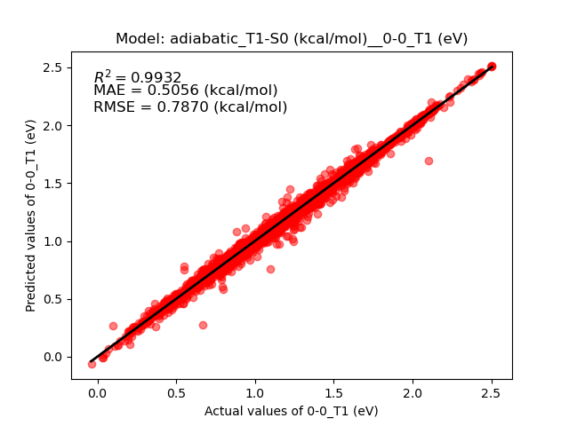
1. Linear Correlation
1.3. Parity Plot of the Models (R² over 0.99)
S.D. = 9.2247 (kcal/mol)
S.D. = 9.3380 (kcal/mol)
S.D. = 9.4473 (kcal/mol)
S.D. = 9.5662 (kcal/mol)

Slide 6
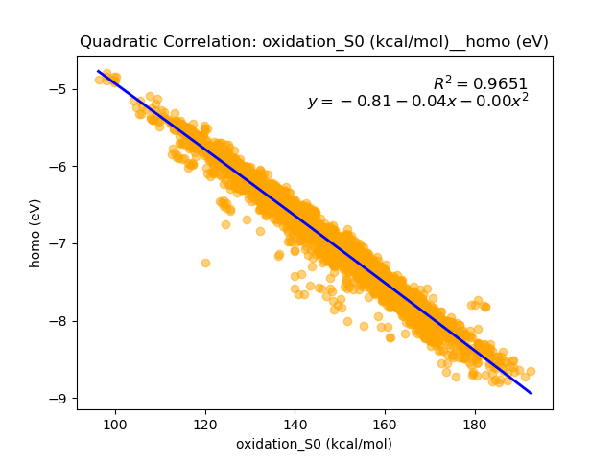
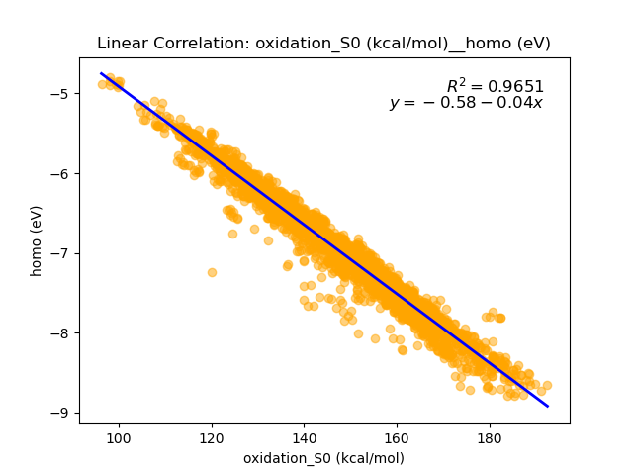
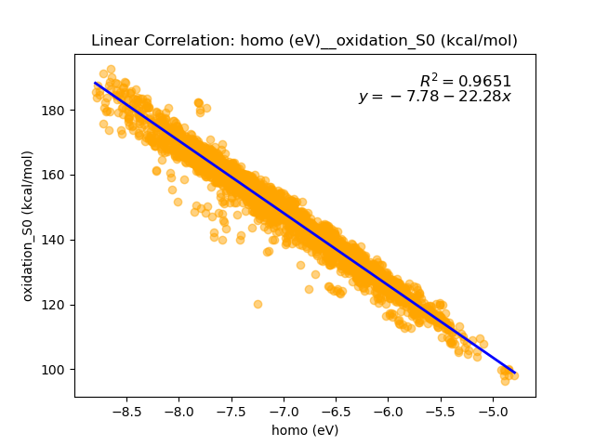
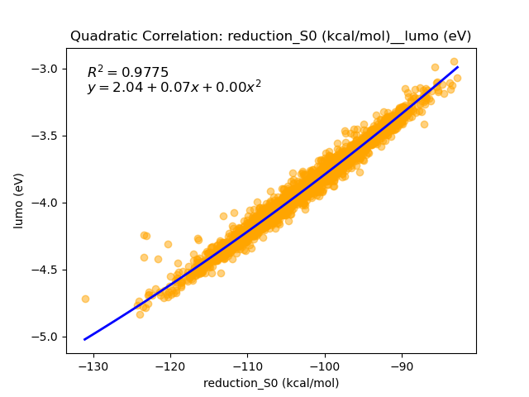
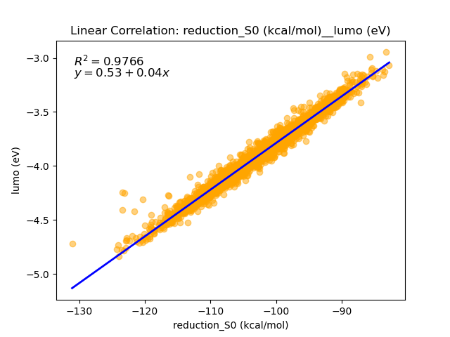
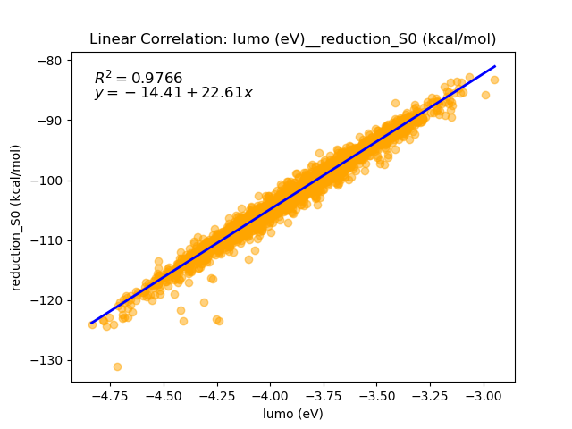
1. Linear Correlation
1.4. Scatter Plot between Properties (Quadratic vs Linear Correlation)
Inverse Function

Slide 7
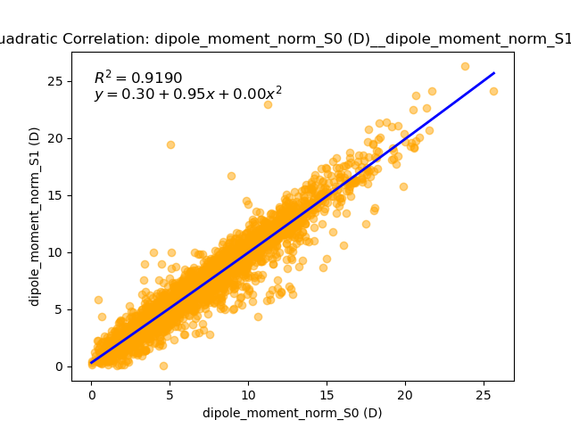
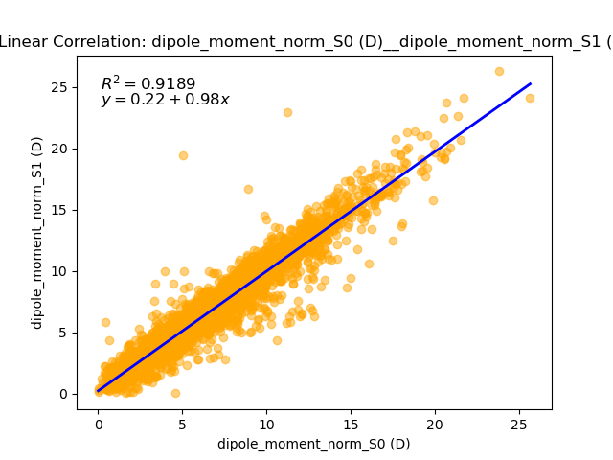
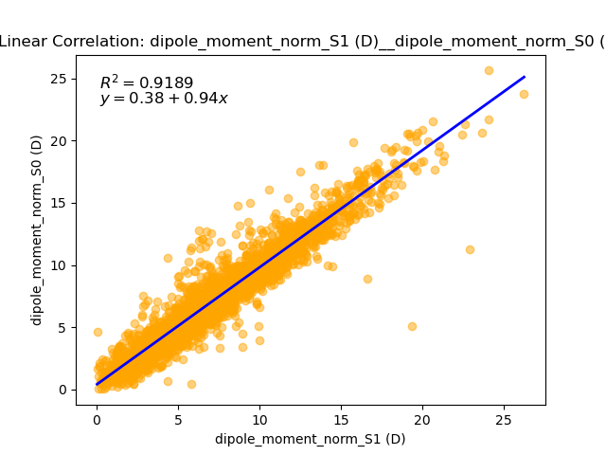
1. Linear Correlation
1.4. Scatter Plot between Properties (Quadratic vs Linear Correlation)
Inverse Function

Slide 8
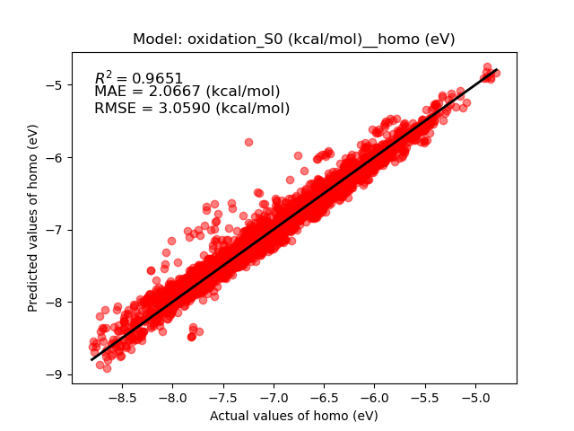
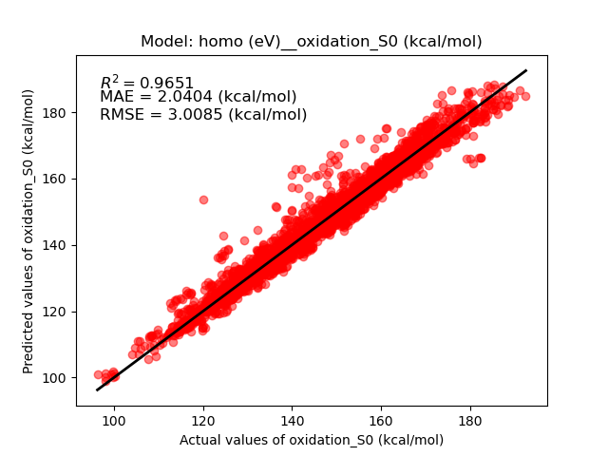
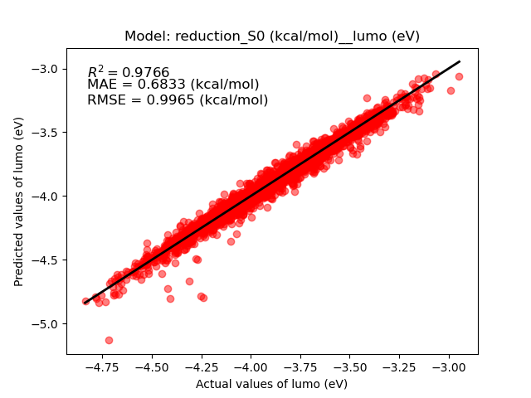
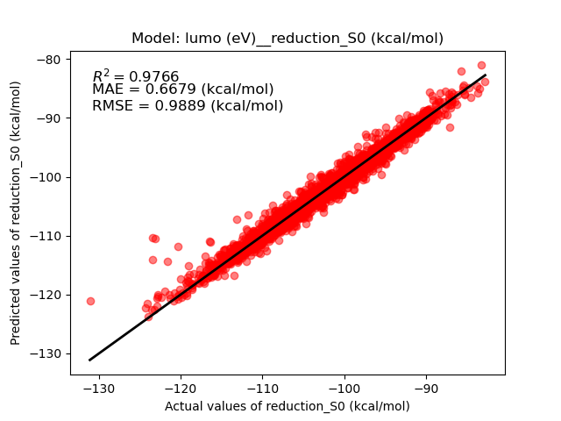
1. Linear Correlation
1.5. Parity Plot of the Models (Quadratic vs Linear Correlation)
S.D. = 16.3715 (kcal/mol)
S.D. = 16.1015 (kcal/mol)
S.D. = 6.5101 (kcal/mol)
S.D. = 6.4601 (kcal/mol)

Slide 9
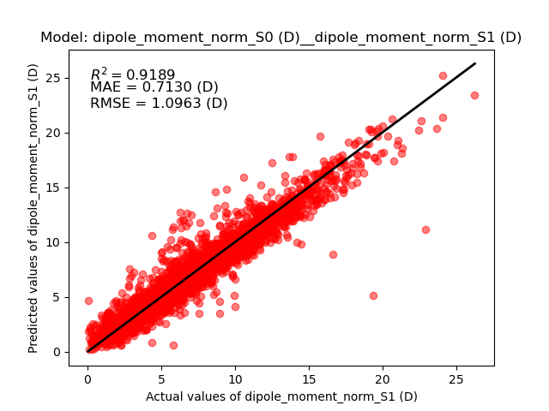
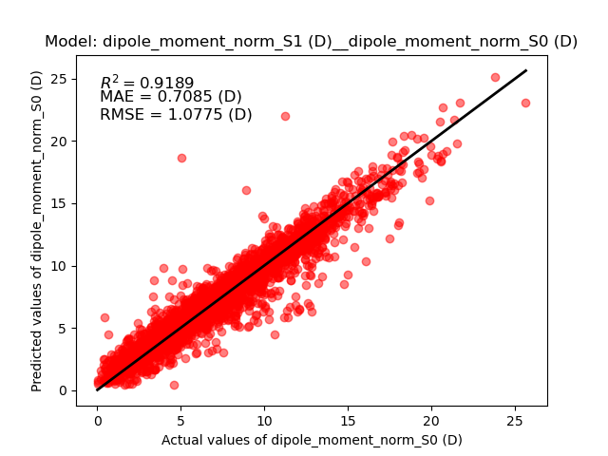
1. Linear Correlation
1.5. Parity Plot of the Models (Quadratic vs Linear Correlation)
S.E. = 3.8493 (D)
S.E. = 3.7831 (D)

Slide 10
1. Linear Correlation
1.6. Summary
Linear Correlation Models
 | Independent Variable | Dependent Variable | R^2 | MAE (kcal/mol) | RMSE (kcal/mol)
1 | 0-0_S1 (eV) | Adiabatic_S1-S0 (kcal/mol) | 0.9940 | 0.4713 | 0.7151
2 | Adiabatic_S1-S0 (kcal/mol) | 0-0_S1 (eV) | 0.9940 | 0.4774 | 0.7239
3 | 0-0_T1 (eV) | Adiabatic_T1-S0 (kcal/mol) | 0.9932 | 0.4993 | 0.7772
4 | Adiabatic_T1-S0 (kcal/mol) | 0-0_T1 (eV) | 0.9932 | 0.5056 | 0.7870
5 | Oxidation_S0 (kcal/mol) | Homo (eV) | 0.9651 | 2.0067 | 3.0590
6 | Homo (eV) | Oxidation_S0 (kcal/mol) | 0.9651 | 2.0404 | 3.0085
7 | Reduction_S0 (kcal/mol) | Lumo (eV) | 0.9766 | 0.6833 | 0.9965
8 | Lumo (eV) | Reduction_S0 (kcal/mol) | 0.9766 | 0.6679 | 0.9889
9 | Dipole_moment_norm_S0 (D) | Dipole_moment_norm_S1 (D) | 0.9189 | 0.7130 (D) | 1.0963 (D)
10 | Dipole_moment_norm_S1 (D) | Dipole_moment_norm_S0 (D) | 0.9189 | 0.7085 (D) | 1.0775 (D)

