Slide 1
Participating Project: ‘Machine Learning Prediction of Photoredox Properties’
My Role: Finding the symbolic correlation between properties
Previous Work
Upcoming Work
Linear Correlation: (Using LinearRegression from Scikit-learn)
Apply Exponential and Logarithmic functions to the models whose R^2 are between 0.85 and 0.95 in the Quadratic Correlation results (Using curve_fit from Scipy)
Decide proper models comparing the complexity of formulas, R^2, MAE (Mean Absolute Error) and RMSE (Root Mean Square Error)
Try Multiple Regression to find out the correlation between properties
 | Independent Variable | Dependent Variable | R^2
1 | 0-0_S1 (eV) | Adiabatic_S1-S0 (kcal/mol) | 0.9940
2 | 0-0_T1 (eV) | Adiabatic_T1-S0 (kcal/mol) | 0.9932
3 | Adiabatic_T1-S0 (kcal/mol) | 0-0_T1 (eV) | 0.9932
4 | Adiabatic_S1-S0 (kcal/mol) | 0-0_S1 (eV) | 0.9940
5 | Homo (eV) | Oxidation_S0 (kcal/mol) | 0.9651
6 | Lumo (eV) | Reduction_S0 (kcal/mol) | 0.9766
7 | Reduction_S0 (kcal/mol) | Lumo (eV) | 0.9766
8 | Oxidation_S0 (kcal/mol) | Homo (eV) | 0.9651
9 | Vertical_excitation_energy (eV) | Adiabatic_S1-S0 (kcal/mol) | 0.9001
10 | Dipole_moment_norm_S0 (D) | Dipole_moment_norm_S1 (D) | 0.9189
11 | Dipole_moment_norm_S1 (D) | Dipole_moment_norm_S0 (D) | 0.9189
12 | Adiabatic_S1-S0 (kcal/mol) | Vertical_excitation_energy (eV) | 0.9001
2. Quadratic Correlation: (Using PolynomialFeatures from Scikit-learn)
 | Independent Variable | Dependent Variable | R^2
1 | Lumo-Homo (eV) | Vertical_excitation_energy (eV) | 0.9159
3. Cubic Correlation: (Using PolynomialFeatures from Scikit-learn)
 | Independent Variable | Dependent Variable | R^2
1 | 0-0_S1 (eV) | Vertical_excitation_energy (eV) | 0.9001

Slide 2
Correlation between Photoredox Properties
Changyeob(Jaden) Lee
07/25/2024

Slide 3
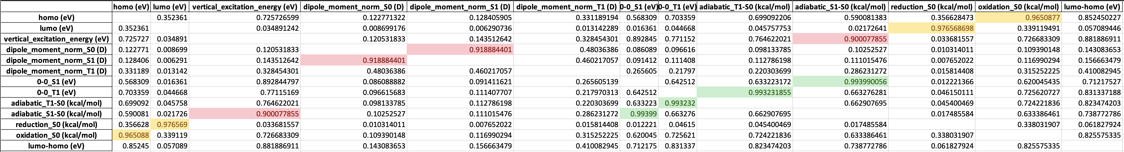
1. Linear Correlation
1.1. R² of the Models
Dependent Variable
Independent Variable

Slide 4
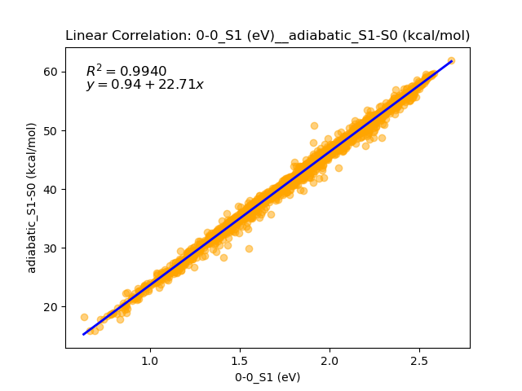
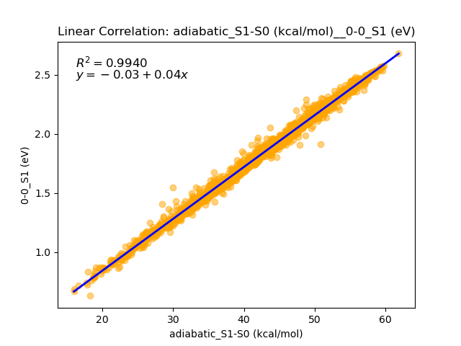
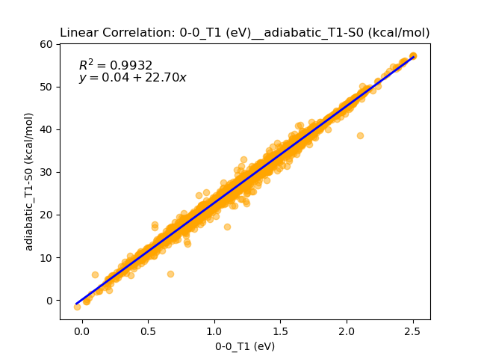
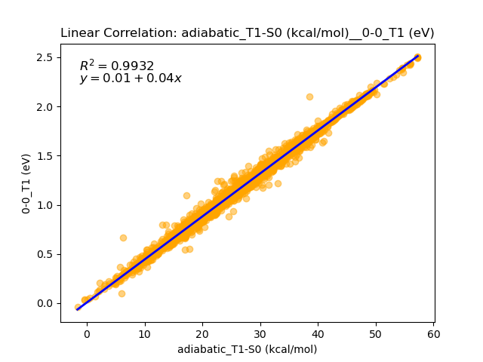
1. Linear Correlation
1.2. Scatter Plot between Properties (R² over 0.99)
Inverse Function

Slide 5
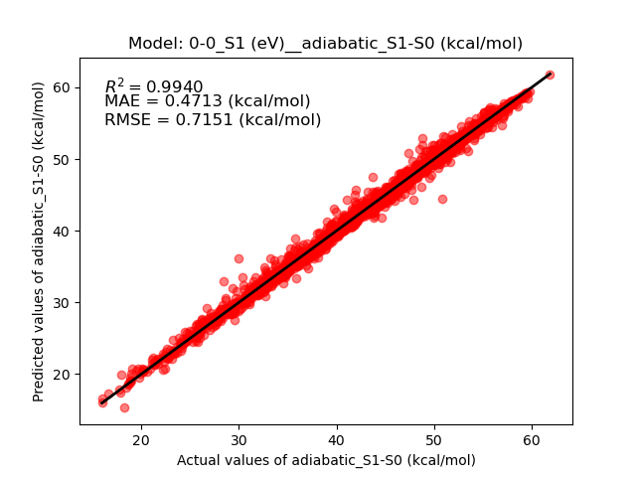
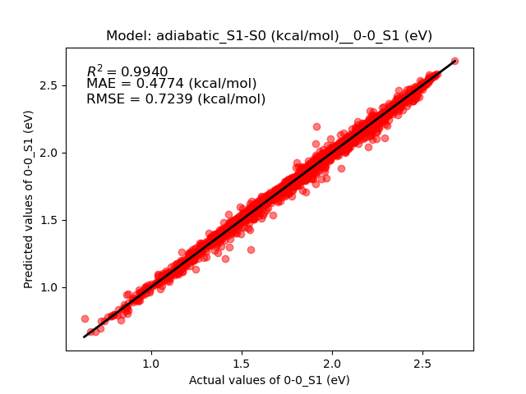
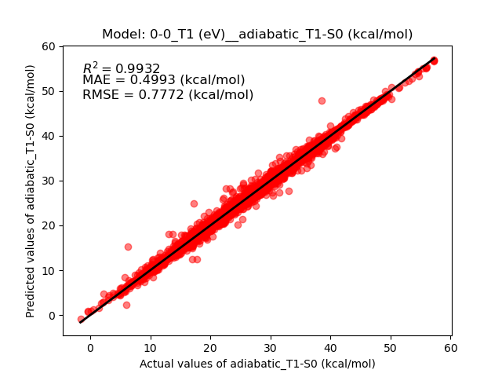
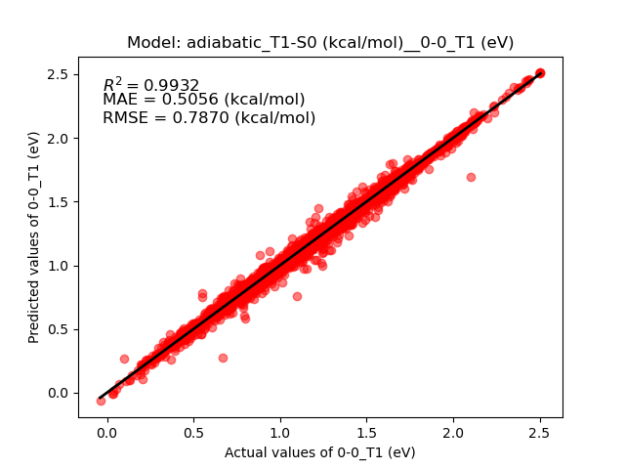
1. Linear Correlation
1.3. Parity Plot of the Models (R² over 0.99)
S.D. = 9.2247 (kcal/mol)
S.D. = 9.3380 (kcal/mol)
S.D. = 9.4473 (kcal/mol)
S.D. = 9.5662 (kcal/mol)

Slide 6
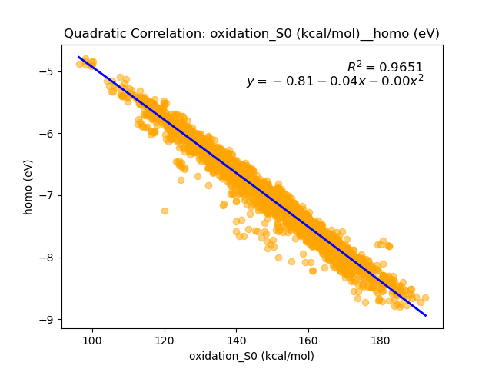
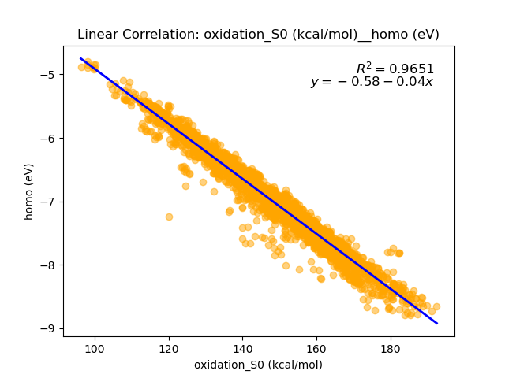
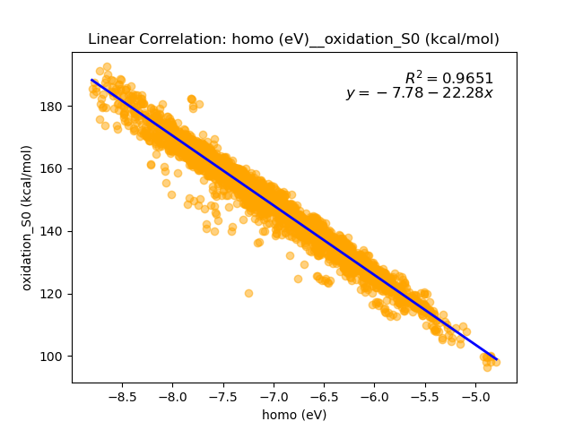
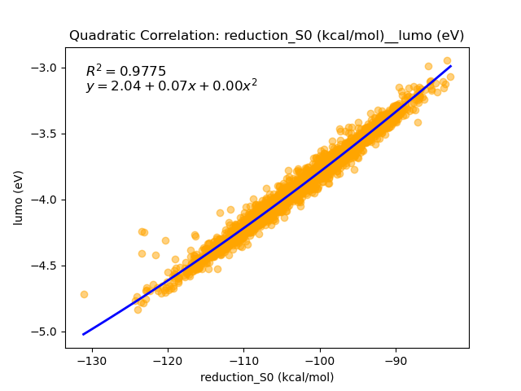
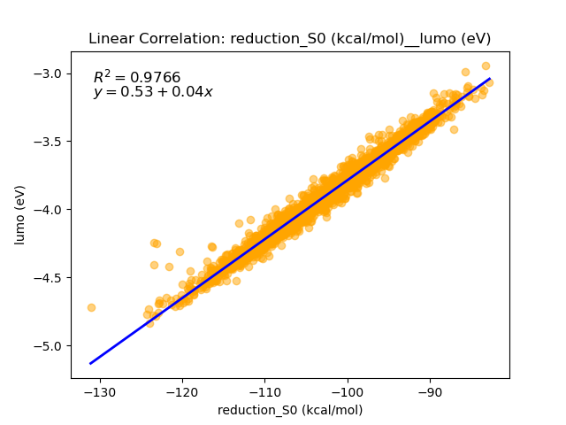
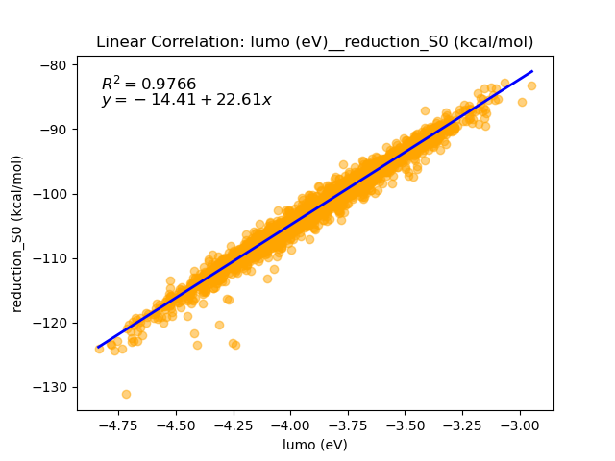
1. Linear Correlation
1.4. Scatter Plot between Properties (Quadratic vs Linear Correlation)
Inverse Function

Slide 7
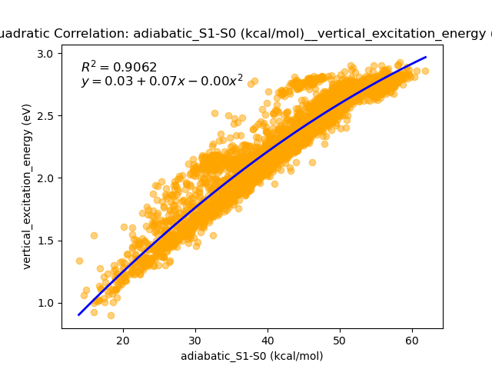
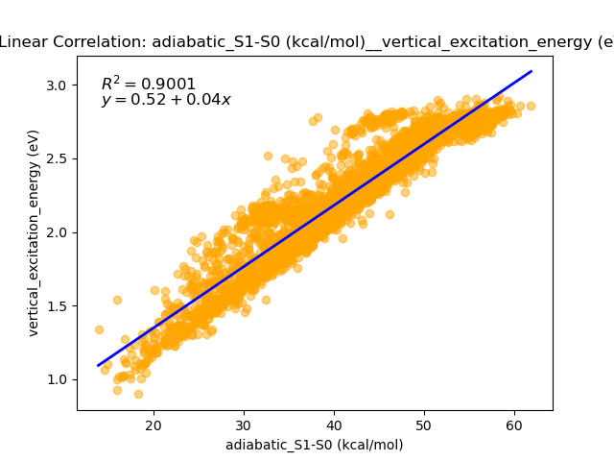
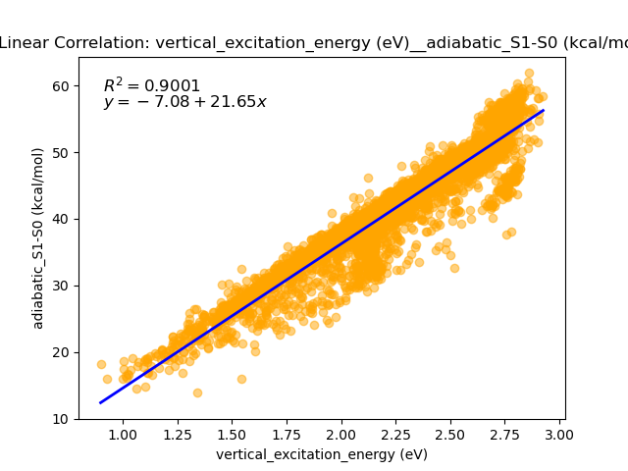
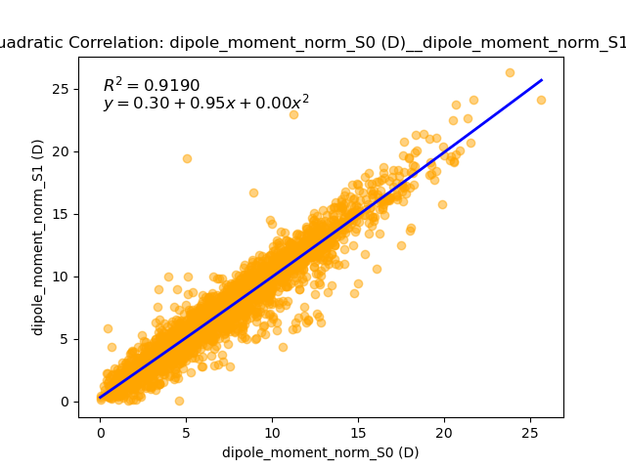
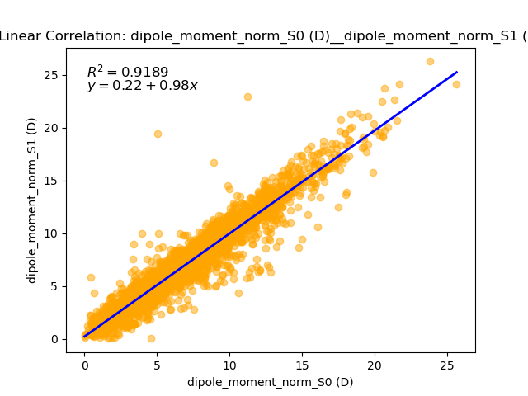
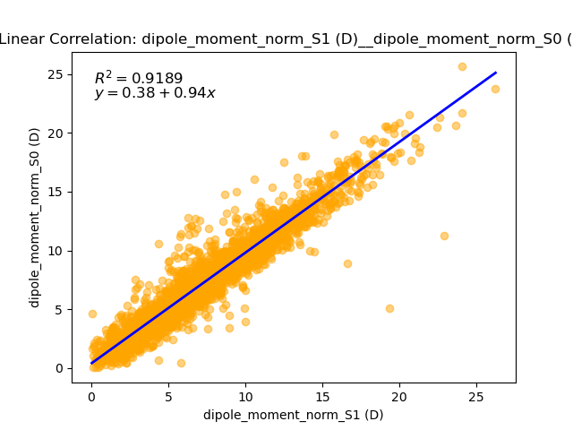
1. Linear Correlation
1.4. Scatter Plot between Properties (Quadratic vs Linear Correlation)
Inverse Function

Slide 8
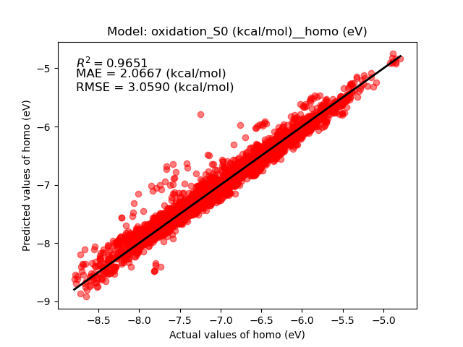
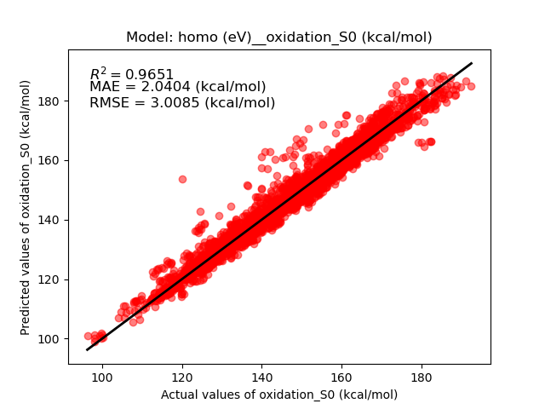
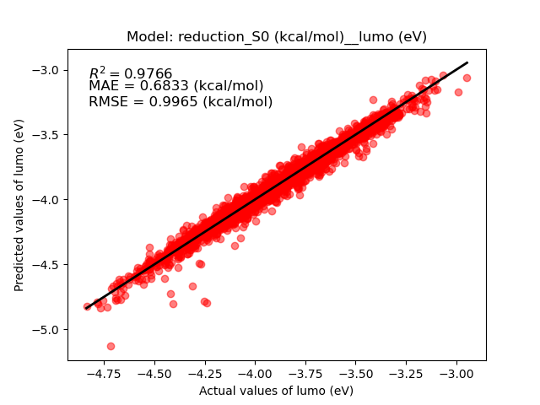
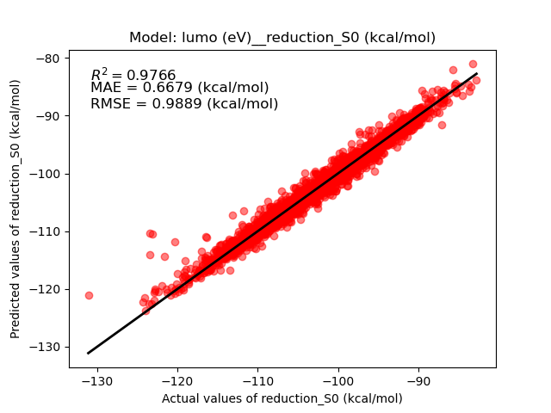
1. Linear Correlation
1.5. Parity Plot of the Models (Quadratic vs Linear Correlation)
S.D. = 16.3715 (kcal/mol)
S.D. = 16.1015 (kcal/mol)
S.D. = 6.5101 (kcal/mol)
S.D. = 6.4601 (kcal/mol)

Slide 9
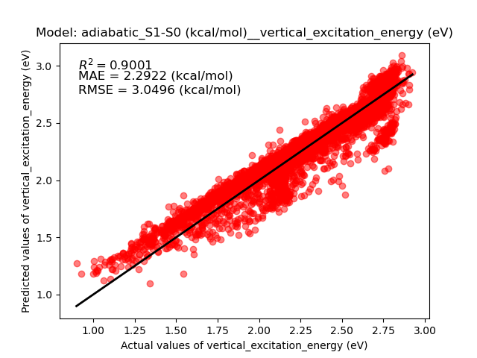
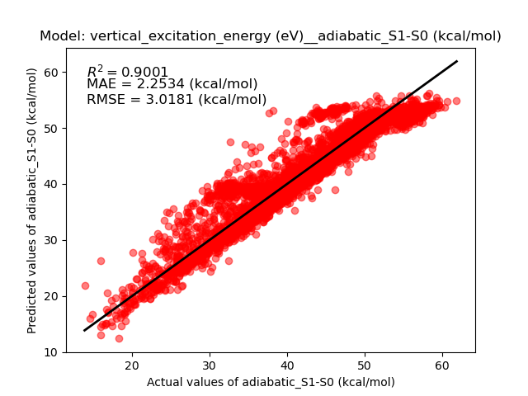
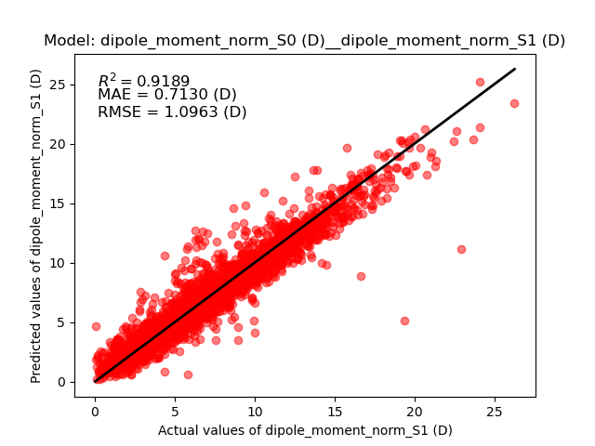
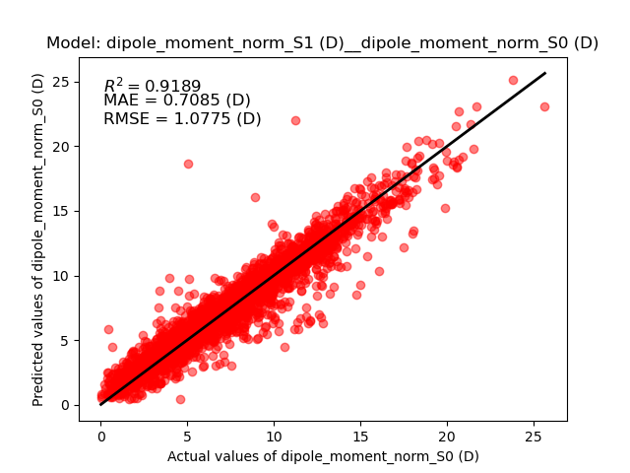
1. Linear Correlation
1.5. Parity Plot of the Models (Quadratic vs Linear Correlation)
S.D. = 9.6476 (kcal/mol)
S.D. = 9.5477 (kcal/mol)
S.D. = 3.8493 (D)
S.D. = 3.7831 (D)

Slide 10
1. Linear Correlation
1.6. Summary
Linear Correlation Models
 | Independent Variable | Dependent Variable | R^2 | MAE (kcal/mol) | RMSE (kcal/mol)
1 | 0-0_S1 (eV) | Adiabatic_S1-S0 (kcal/mol) | 0.9940 | 0.4713 | 0.7151
2 | Adiabatic_S1-S0 (kcal/mol) | 0-0_S1 (eV) | 0.9940 | 0.4774 | 0.7239
3 | 0-0_T1 (eV) | Adiabatic_T1-S0 (kcal/mol) | 0.9932 | 0.4993 | 0.7772
4 | Adiabatic_T1-S0 (kcal/mol) | 0-0_T1 (eV) | 0.9932 | 0.5056 | 0.7870
5 | Oxidation_S0 (kcal/mol) | Homo (eV) | 0.9651 | 2.0067 | 3.0590
6 | Homo (eV) | Oxidation_S0 (kcal/mol) | 0.9651 | 2.0404 | 3.0085
7 | Reduction_S0 (kcal/mol) | Lumo (eV) | 0.9766 | 0.6833 | 0.9965
8 | Lumo (eV) | Reduction_S0 (kcal/mol) | 0.9766 | 0.6679 | 0.9889
9 | Adiabatic_S1-S0 (kcal/mol) | Vertical_excitation_energy (eV) | 0.9001 | 2.2922 | 3.0496
10 | Vertical_excitation_energy (eV) | Adiabatic_S1-S0 (kcal/mol) | 0.9001 | 2.2534 | 3.0181
11 | Dipole_moment_norm_S0 (D) | Dipole_moment_norm_S1 (D) | 0.9189 | 0.7130 (D) | 1.0963 (D)
12 | Dipole_moment_norm_S1 (D) | Dipole_moment_norm_S0 (D) | 0.9189 | 0.7085 (D) | 1.0775 (D)

Slide 11
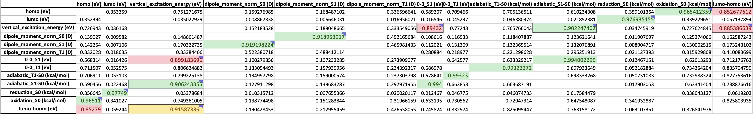
2. Quadratic Correlation
2.1. R² of the Models
Dependent Variable
Independent Variable

Slide 12
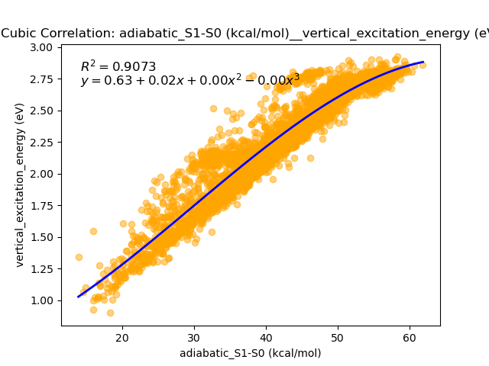
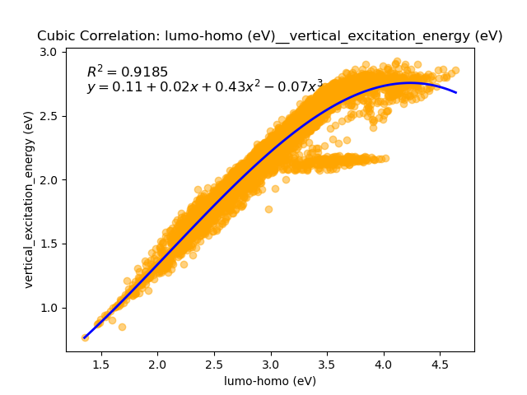
2. Quadratic Correlation
2.1. Scatter Plot between Properties (Cubic vs Quadratic vs Correlation)
Inverse Function

Slide 13
1. Linear Correlation
1.4. Scatter Plot between Properties (Quadratic vs Linear Correlation)
Inverse Function

