Slide 1
Correlation between Photoredox Properties
Changyeob(Jaden) Lee
08/01/2024

Slide 2
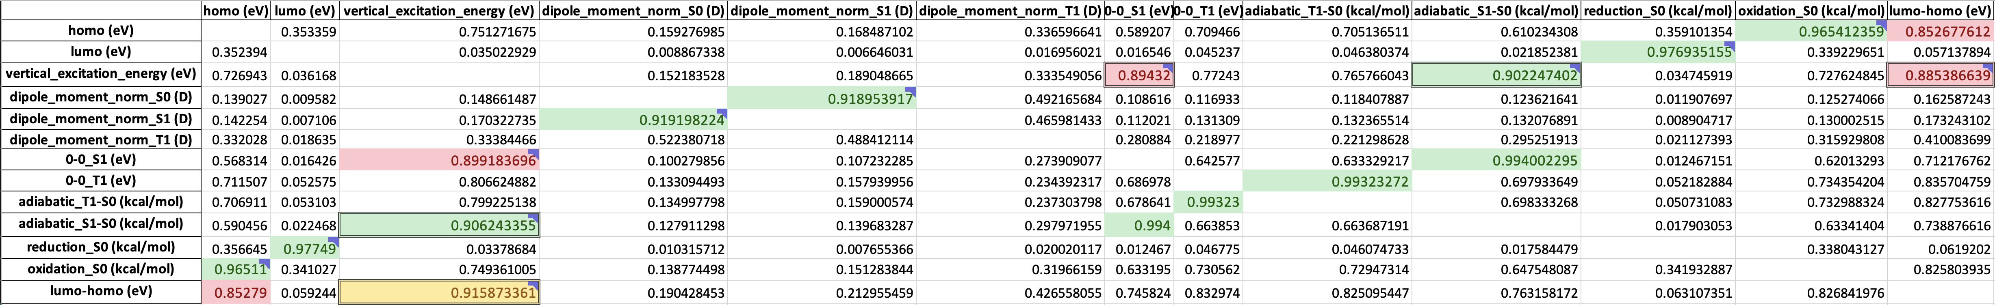
Participating Project: ‘Machine Learning Prediction of Photoredox Properties’
My Role: Finding correlation between the properties
Previous Work
Upcoming Work
Applied exponential and logarithmic functions to undecided models which R² are over 0.85 in the quadratic correlation results
Decided proper models by comparing the complexity of formulas, R², MAE (Mean Absolute Error) and RMSE (Root Mean Square Error) (Found 12 Linear models, 1 Quadratic model, 1 Cubic model)
Developed multiple regression models of adiabatic_S1-S0, reduction_S0, and oxidation_S0 (kcal/mol) to see multi-variable correlation between properties
Apply Symbolic Regressor function from gplearn to optimize the multi-variable correlation between properties
R² of the Quadratic Models
: Decided Linear Models
: Undecided Models’ R² over 0.9
: Undecided Models’ R² between 0.85 and 0.9

Slide 3
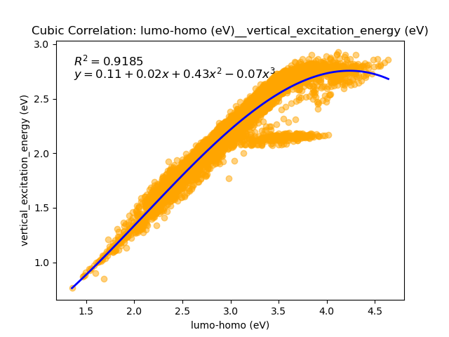
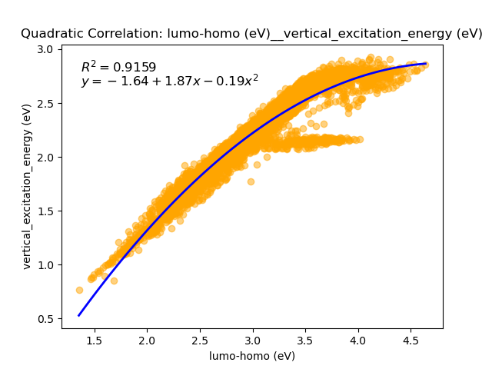
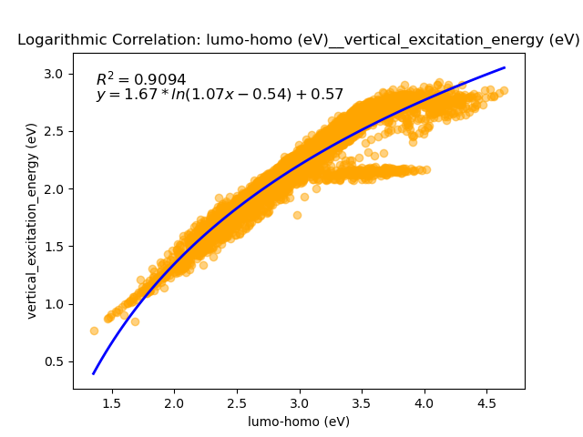
Quadratic Correlation
Scatter Plot between Properties (Cubic vs Quadratic vs Logarithmic Correlation)

Slide 4
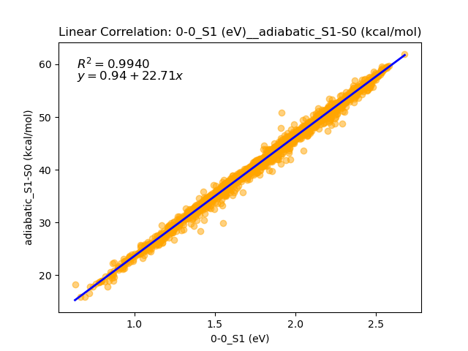
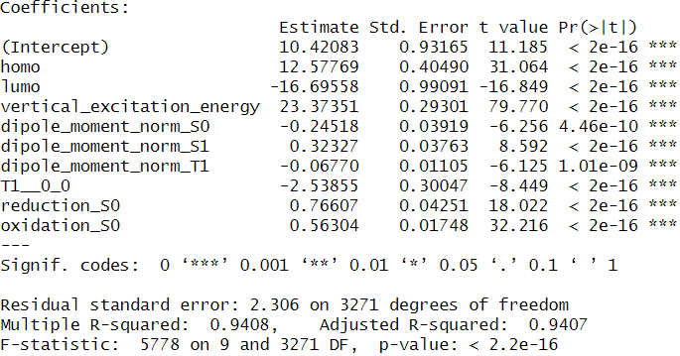
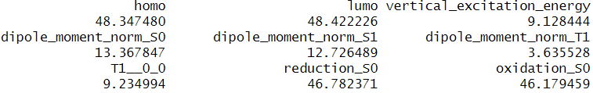
Methodology of Multiple Regression
Independent Variable
Backward Elimination
Multicollinearity Diagnostics
Eliminate the independent variable from
decided models
Put all variables into the model
Eliminate the highest variable which p-value is
over 0.05
Iterate until when all variables’ p-values are
below 0.05
Check multicollinearity among the variables using
VIF(Variance Inflation Factor)
Eliminate the highest variable which VIF is over 10
Iterate until when all variables’ VIFs are below 10

