Slide 1
Correlation between Photoredox Properties
Changyeob(Jaden) Lee
08/01/2024

Slide 2
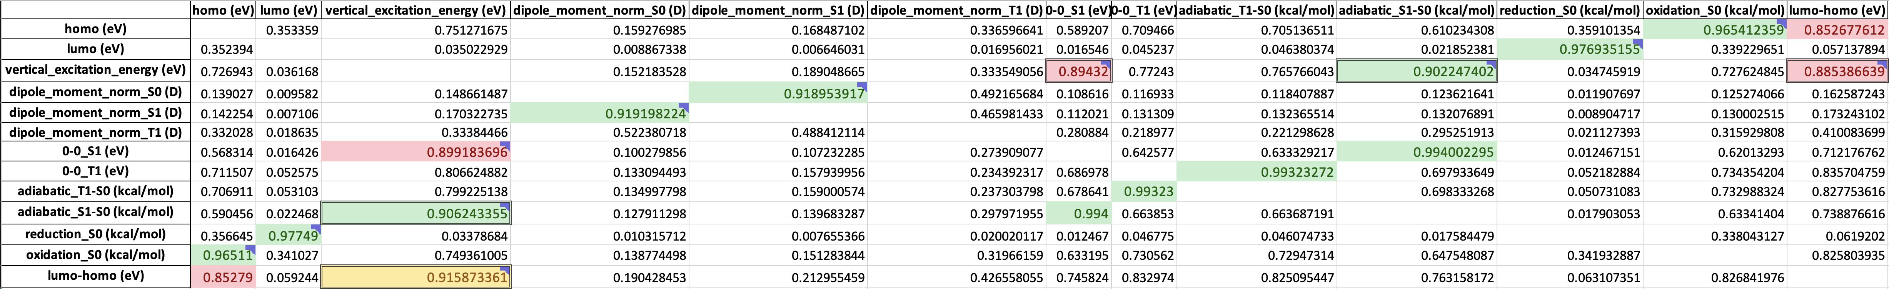
Participating Project: ‘Machine Learning Prediction of Photoredox Properties’
My Role: Finding correlation between photoredox properties
Previous Work
Upcoming Work
Applied exponential and logarithmic functions to undecided models which R² are over 0.85 in the quadratic correlation results
Decided proper models by comparing the complexity of formulas, R², MAE (Mean Absolute Error) and RMSE (Root Mean Square Error) (Found 12 Linear models, 1 Quadratic model, 1 Cubic model)
Developed multiple regression models of adiabatic_S1-S0, reduction_S0, and oxidation_S0 (kcal/mol) to see multi-variable correlation between properties
Apply Symbolic Regressor function from gplearn to optimize the multi-variable correlation between properties
R² of the Quadratic Models
: Decided Linear Models
: Undecided Models’ R² over 0.9
: Undecided Models’ R² between 0.85 and 0.9

Slide 3
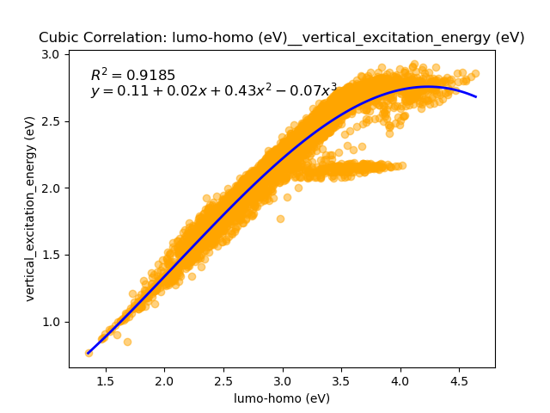
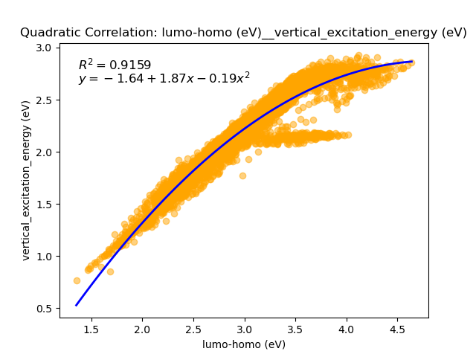
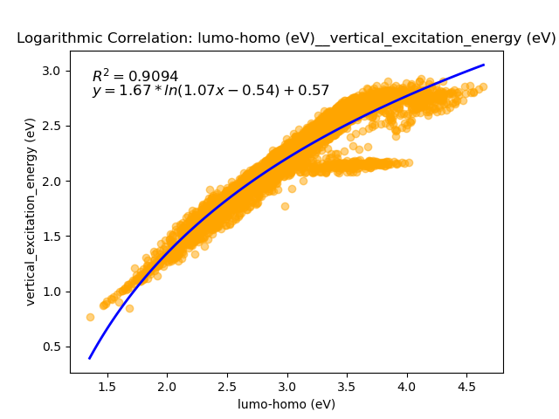
Quadratic Correlation
Scatter Plot between Properties (Cubic vs Quadratic vs Logarithmic Correlation)

Slide 4
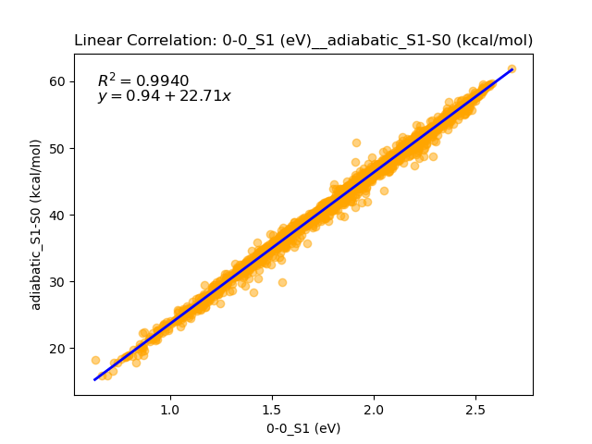
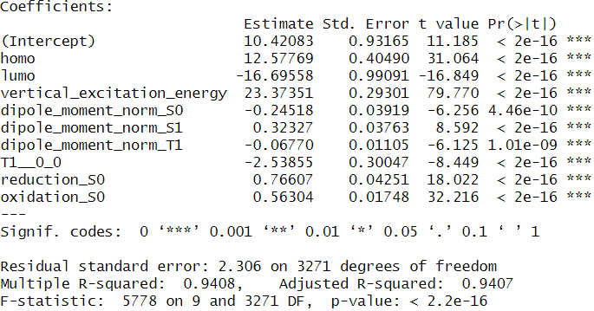
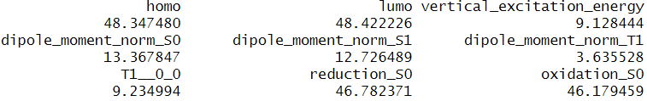
Methodology of Multiple Regression
Independent Variable
Backward Elimination
Multicollinearity Diagnostics
Eliminate the independent variable from
decided models
Put all variables into the model
Eliminate the highest variable which p-value is
over 0.05
Iterate until when all variables’ p-values are
below 0.05
Check multicollinearity among the variables using
VIF(Variance Inflation Factor)
Eliminate the highest variable which VIF is over 10
Iterate

Slide 5
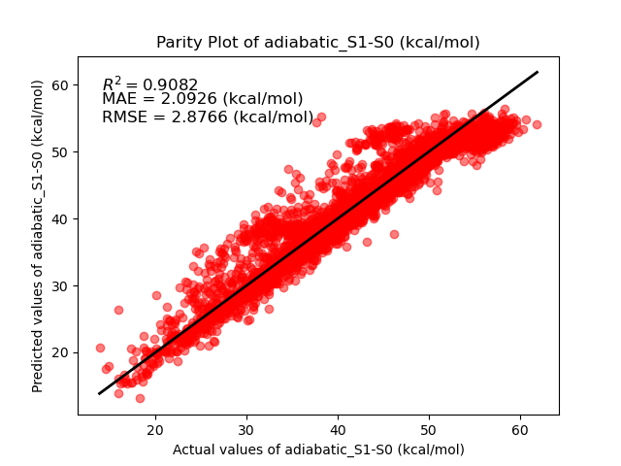
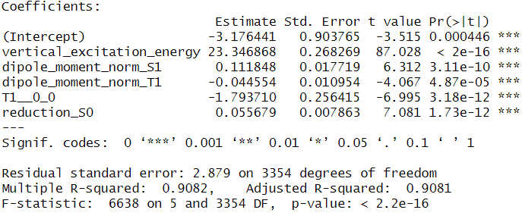
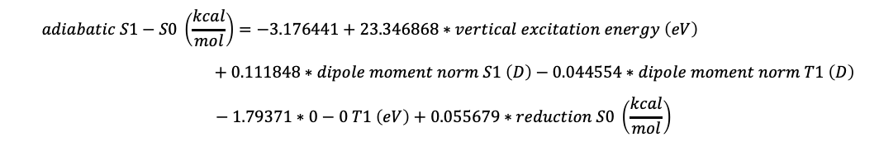
Multiple Regression Model of Adiabatic_S1-S0 (kcal/mol)
$$adiabatic S1−S0 \left(\frac{kcal}{mol}\right)=−3.176441+23.346868∗vertical excitation energy \left(eV\right)$$
$$+ 0.111848∗dipole moment norm S1 \left(D\right)−0.044554∗dipole moment norm T1 \left(D\right)$$
$$− 1.79371∗0−0 T1 \left(eV\right)+0.055679∗reduction S0 \left(\frac{kcal}{mol}\right)$$
S.D. = 9.5480 (kcal/mol)
When Vertical_excitation_energy (eV) increases, Adiabatic_S1-S0 (kcal/mol) increases
When Dipole_moment_norm_S1 (D) increases, Adiabatic_S1-S0 (kcal/mol) increases
When Dipole_moment_norm_T1 (D) increases, Adiabatic_S1-S0 (kcal/mol) decreases
When 0-0_T1 (eV) increases, Adiabatic_S1-S0 (kcal/mol) decreases
When Reduction_S0 (kcal/mol) increases, Adiabatic_S1-S0 (kcal/mol) increases

