Slide 1
GPT 3.5 Chatbot
Jaden Tran
Project’s GITHUB

Slide 2
OBJECTIVE
The objective of this application is to create a chatbot using OpenAI's GPT-3.5 model. The chatbot interacts with users by receiving input messages and generating responses based on the conversation history. The chatbot continuously prompts the user for input until the user enters "quit()".

Slide 3
How it works
The user provides a system message indicating the type of chatbot they want to create.
The chatbot initializes by storing the system message and setting up an empty list to hold the conversation history.
The application enters a loop where it waits for user input.
The user enters a message, which is then added to the conversation history with the role "user".
The chatbot uses OpenAI's ChatCompletion API to generate a response based on the conversation history.
The generated response is extracted from the API response and added to the conversation history with the role "assistant".
The generated response is printed to the console.
Steps 4-7 are repeated until the user enters "quit()" to exit the loop.

Slide 4
DESIGN (1)
Chatbot Class: This class serves as the main component of the application and contains the necessary methods for interacting with the chatbot.
a. __init__(): Initializes the Chatbot object by setting the OpenAI API key and creating an empty list to store the conversation history.
b. add_message(): Adds a new message to the conversation history. Each message consists of a role ("system", "user", or "assistant") and the content of the message.
c. run_chatbot(): Executes the chatbot by continuously prompting the user for input and generating responses using the OpenAI API. It maintains the conversation history and terminates when the user enters "quit()".

Slide 5
DESIGN (2)
API Key: An API key is provided as a parameter when creating an instance of the Chatbot class. This key is used to authenticate the application with the OpenAI services.

Slide 6
DESIGN (3)
Conversation Loop: The run_chatbot() method contains a while loop that continuously waits for user input. It appends the user's message to the conversation history, sends the conversation history to the OpenAI API to generate a response, appends the generated response to the conversation history, and prints the response to the console. The loop continues until the user enters "quit()" to exit the application.

Slide 7
DESIGN (4)
Error Handling: The application includes a try-except block to catch and print any exceptions that may occur during the execution of the chatbot.

Slide 8
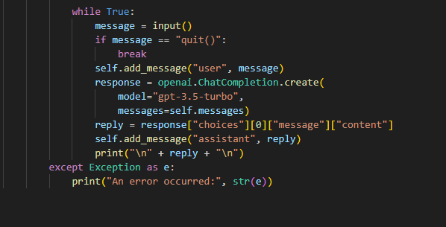
LOOP
-There is a loop in the code. The loop is implemented using a while statement:
-This loop will continue running until the user enters "quit()". Inside the loop, the user's input message is collected, sent to the OpenAI API for a response, and the assistant's reply is printed.

Slide 9
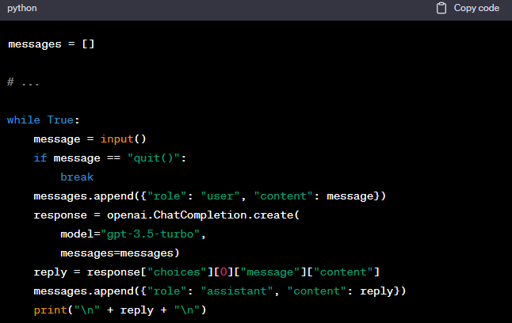
LIST
There is a list used in the code. The messages variable is a list that is used to store the chat messages exchanged between the user and the chatbot.

Slide 10
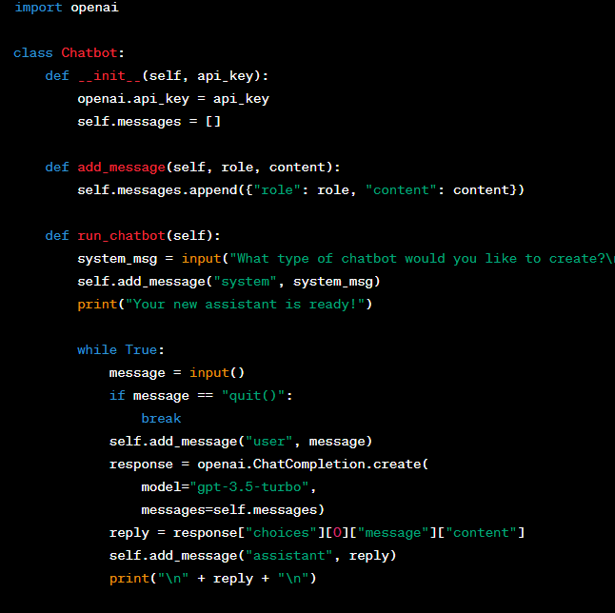
DICTIONARY
-There are dictionaries used in the provided code snippet. Dictionaries are used to represent the messages exchanged between the user and the chatbot, with keys such as "role" and "content“.
-In this code, dictionaries are used to represent each message with keys "role" and "content". The add_message method appends dictionaries to the messages list, and the OpenAI API call expects the messages parameter to be a list of dictionaries.

Slide 11
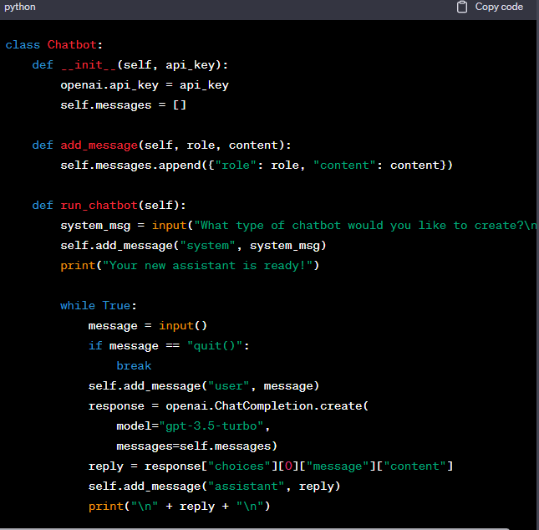
FUNCTION
-There is a function defined in the code. The function is run_chatbot within the Chatbot class.
-The run_chatbot function is responsible for running the chatbot's main loop. It prompts the user for a system message, initializes the chat history by adding the system message, and then enters a while loop to repeatedly accept user input, generate a response using OpenAI API, and display the assistant's reply.

Slide 12
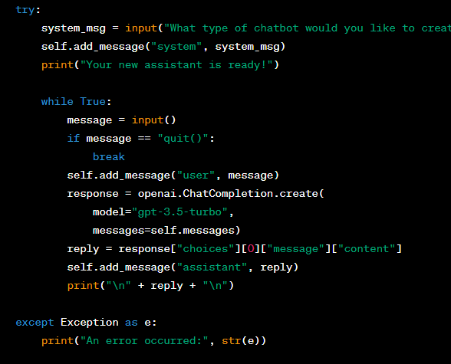
EXCEPTIONAL HANDLING
-In this modified code, the run_chatbot function is enclosed within a try block, and a corresponding except block follows it. Any exceptions that occur within the try block will be caught by the except block, allowing you to handle the exception gracefully.
-The exception handling ensures that if any error occurs during the execution of the chatbot, it will print an error message along with the specific exception information. This helps to identify and troubleshoot any issues that may arise during runtime.

Slide 13
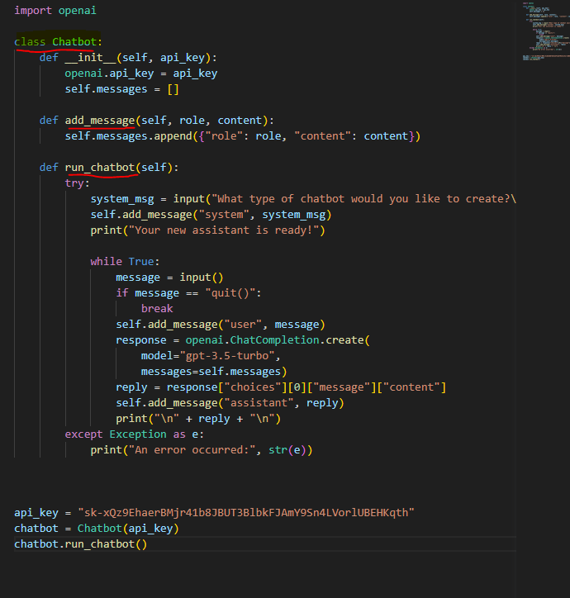
OBJECT ORIENTED
-The program demonstrates object-oriented programming (OOP) principles. It utilizes a class called Chatbot to encapsulate related data and functionality.
-The Chatbot class has attributes such as api_key and messages, and it defines methods like add_message and run_chatbot. This class serves as a blueprint for creating chatbot objects with specific attributes and behavior.
-In this code, the Chatbot class defines a constructor method __init__, which initializes the api_key attribute and the messages attribute as an empty list. The add_message method adds a new message to the messages list, and the run_chatbot method runs the main loop for the chatbot.
-By using the Chatbot class, you can create multiple instances of chatbots, each with its own set of attributes and the ability to execute the chatbot functionality independently.

Slide 14
How the application was tested
The application was primarily tested through manual interaction with the chatbot in a command-line environment. The testing process likely involved the following steps:
1) Ensure the required dependencies are installed: The code snippet relies on the openai package, so it's important to have it installed before running the application. Additionally, the code assumes the availability of Python and its standard libraries.
2) Obtain a valid API key: The application requires a valid OpenAI API key to make requests to the ChatCompletion API. It's important to obtain a valid API key and replace the placeholder key in the code snippet with the actual key.
3) Execute the application: Run the Python script that contains the chatbot code in a command-line environment. The application will prompt for the type of chatbot to create.
4) Interact with the chatbot: Once the chatbot is initialized, interact with it by entering messages in the command line. The chatbot will generate responses based on the conversation history and display them on the console.
5) Test various scenarios: During manual testing, different scenarios and inputs can be tried to evaluate the chatbot's performance. This may include asking questions, providing statements, testing edge cases, and evaluating the accuracy and relevance of the generated responses.
6) Verify functionality and error handling: Ensure that the application behaves as expected, produces appropriate responses, and handles any exceptions or errors gracefully. Check if the chatbot terminates correctly when the user enters "quit()".
By manually testing the application through different interactions, scenarios, and inputs, one can assess its behavior, identify potential issues or limitations, and refine the implementation if necessary.

Slide 15
LIVE PRESENTATION

