Slide 1
Missing Children Dataset
Jaden Wilkins

Slide 2
Introduction
Found my dataset on data.world
First dataset was not compatible, lots of missing values, so I switched
Trying to find relationship between case type (the way a child goes missing), and age, sex, and race

Slide 3
Preprocessing
Only had 3 columns with missing variables (hair color, eye color, missing from state)
Created age column
Set race to numerical value (by population)

Slide 4
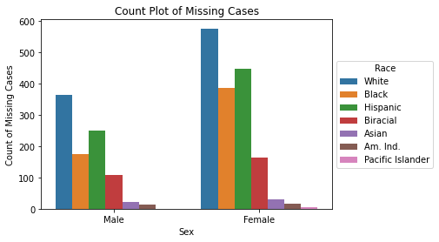
Count of Missing Children by Race

Slide 5
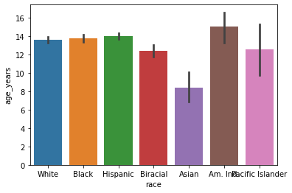
Race vs. Age

Slide 6
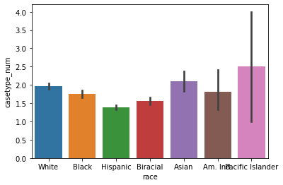
Race vs. Casetype_num

Slide 7
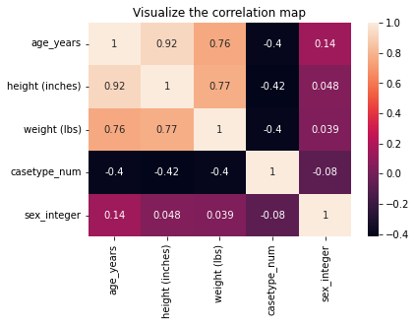
Correlation Heatmap

Slide 8
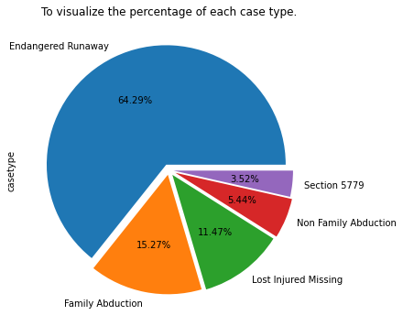
Pie Chart of Case Type

Slide 9
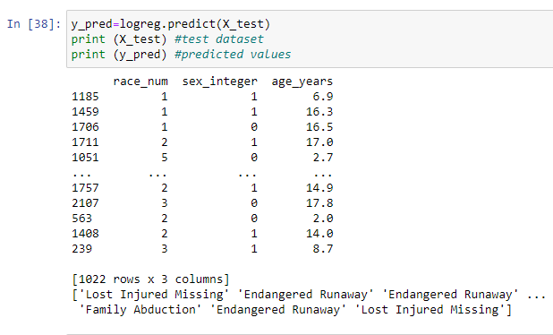
Prediction Model

Slide 10
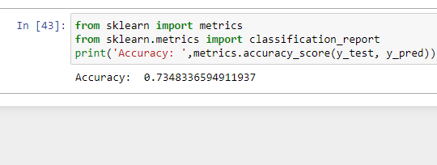
Accuracy

Slide 11
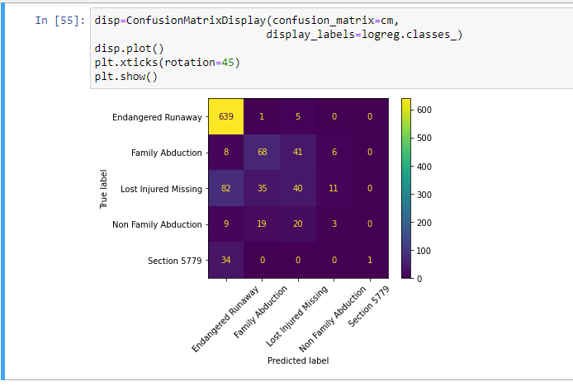
Model Results

