Slide 1

(っ◔◡◔)っ 𝓖𝓲𝓿𝓮 𝓼𝓮𝓬𝓸𝓷𝓭 𝓱𝓪𝓷𝓭𝓼, 𝓪 𝓼𝓮𝓬𝓸𝓷𝓭 𝓵𝓸𝓸𝓴
Revolutionizing Fashion:
Green _____
for Sustainable Clothing Exchange
Fall 2023

Slide 2
Problem Statement:
(っ◔◡◔)っ 𝓖𝓲𝓿𝓮 𝓼𝓮𝓬𝓸𝓷𝓭 𝓱𝓪𝓷𝓭𝓼, 𝓪 𝓼𝓮𝓬𝓸𝓷𝓭 𝓵𝓸𝓸𝓴
Fast fashion dominance prioritizes price over ethical practices and sustainability.
Environmental impact (textile waste, pollution, resource depletion).
Lack of accessible ethical clothing options for consumers.
Minimal awareness about the consequences of fast fashion on the planet and society.
Overconsumption leads to a throwaway culture and frequent disposal of clothing.

Slide 3
Impact of Second-Hand Clothing Exchange
(っ◔◡◔)っ 𝓖𝓲𝓿𝓮 𝓼𝓮𝓬𝓸𝓷𝓭 𝓱𝓪𝓷𝓭𝓼, 𝓪 𝓼𝓮𝓬𝓸𝓷𝓭 𝓵𝓸𝓸𝓴
Reduced waste (extends clothing lifecycle)
Lower carbon footprint (less production and transportation)
Resource conservation (water, energy, raw materials)
Affordability and accessibility (affordable options)
Community building (engagement and connection)

Slide 4
Solution - Green _____ Overview
(っ◔◡◔)っ 𝓖𝓲𝓿𝓮 𝓼𝓮𝓬𝓸𝓷𝓭 𝓱𝓪𝓷𝓭𝓼, 𝓪 𝓼𝓮𝓬𝓸𝓷𝓭 𝓵𝓸𝓸𝓴
Sustainable fashion promotion
Circular economy advocacy
User empowerment (swap, sell, buy)
User-friendly interface
Item listing and search capabilities
Community engagement and social sharing
Notes:
By using data sources such as surveillance cameras, sensors, mobile devices, and historical data, predictive models can estimate crowd density to aid in decision-making and resource allocation.

Slide 5
how users can exchange clothes
(っ◔◡◔)っ 𝓖𝓲𝓿𝓮 𝓼𝓮𝓬𝓸𝓷𝓭 𝓱𝓪𝓷𝓭𝓼, 𝓪 𝓼𝓮𝓬𝓸𝓷𝓭 𝓵𝓸𝓸𝓴
Sign-up process
Listing items for exchange
Initiating exchanges and transactions
Drop the Clothes and get the rewards
Using Rewards in online shopping

Slide 6
Benefits of Green _____
(っ◔◡◔)っ 𝓖𝓲𝓿𝓮 𝓼𝓮𝓬𝓸𝓷𝓭 𝓱𝓪𝓷𝓭𝓼, 𝓪 𝓼𝓮𝓬𝓸𝓷𝓭 𝓵𝓸𝓸𝓴
Environmental benefits (reduced waste, lower carbon footprint)
Economic benefits (saving money, affordable fashion)
Social benefits (community engagement, promoting ethical practices)

Slide 7
Xamarin & Azure Mobile App Service
(っ◔◡◔)っ 𝓖𝓲𝓿𝓮 𝓼𝓮𝓬𝓸𝓷𝓭 𝓱𝓪𝓷𝓭𝓼, 𝓪 𝓼𝓮𝓬𝓸𝓷𝓭 𝓵𝓸𝓸𝓴
C# Language: Xamarin allows developers to use C#, a powerful and versatile programming language, for building mobile applications.
Xamarin.Forms: Simplifies UI development by using a single codebase and sharing a large portion of the UI logic across platforms.
Notes:
Focus on the fact that we have all data sources might increase some hardware to improve zoning only, so that easily we can develop and deploy the prediction model and adjust the control system based on that

Slide 8
Xamarin & Azure Mobile App Service
(っ◔◡◔)っ 𝓖𝓲𝓿𝓮 𝓼𝓮𝓬𝓸𝓷𝓭 𝓱𝓪𝓷𝓭𝓼, 𝓪 𝓼𝓮𝓬𝓸𝓷𝓭 𝓵𝓸𝓸𝓴
Xamarin.iOS and Xamarin.Android: These are platform-specific libraries provided by Xamarin that allow developers to access native APIs and functionalities of iOS and Android devices directly from C#.
Xamarin Test Cloud: This is a cloud-based service for testing mobile apps developed with Xamarin.
Azure Mobile App Service: For backend development, Xamarin apps can leverage Azure Mobile App Service.

Slide 9
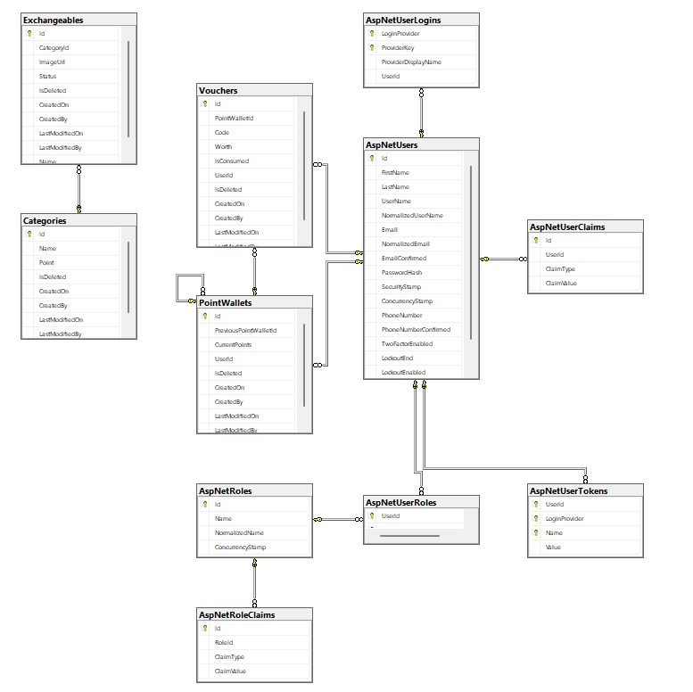
Implemented Backed Model By leveraging MVVM
(っ◔◡◔)っ 𝓖𝓲𝓿𝓮 𝓼𝓮𝓬𝓸𝓷𝓭 𝓱𝓪𝓷𝓭𝓼, 𝓪 𝓼𝓮𝓬𝓸𝓷𝓭 𝓵𝓸𝓸𝓴

Slide 10
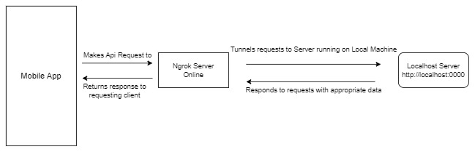
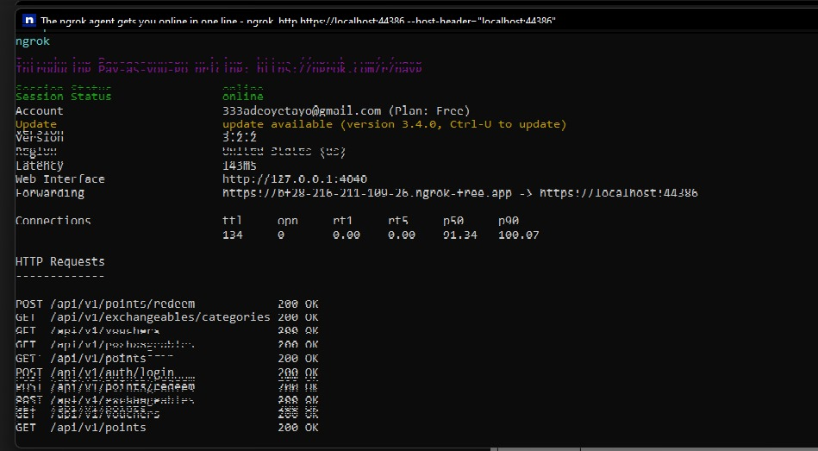
How did we test the backend on the Local Machine
(っ◔◡◔)っ 𝓖𝓲𝓿𝓮 𝓼𝓮𝓬𝓸𝓷𝓭 𝓱𝓪𝓷𝓭𝓼, 𝓪 𝓼𝓮𝓬𝓸𝓷𝓭 𝓵𝓸𝓸𝓴

Slide 11
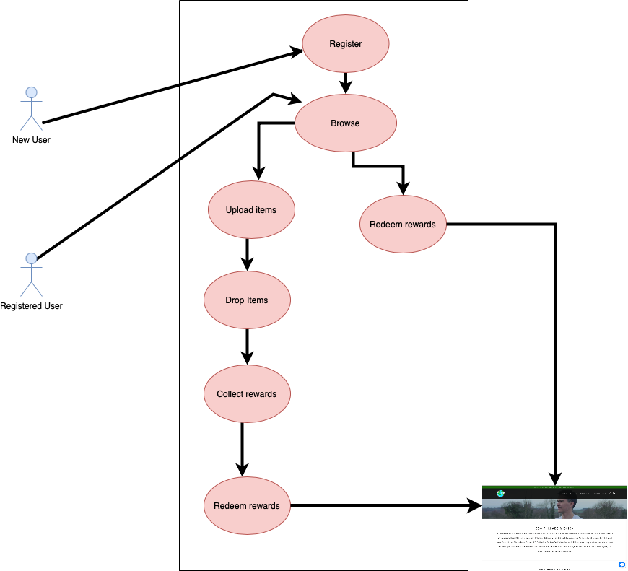
Business Logic
(っ◔◡◔)っ 𝓖𝓲𝓿𝓮 𝓼𝓮𝓬𝓸𝓷𝓭 𝓱𝓪𝓷𝓭𝓼, 𝓪 𝓼𝓮𝓬𝓸𝓷𝓭 𝓵𝓸𝓸𝓴
The Target Market is University and College Students

Slide 12
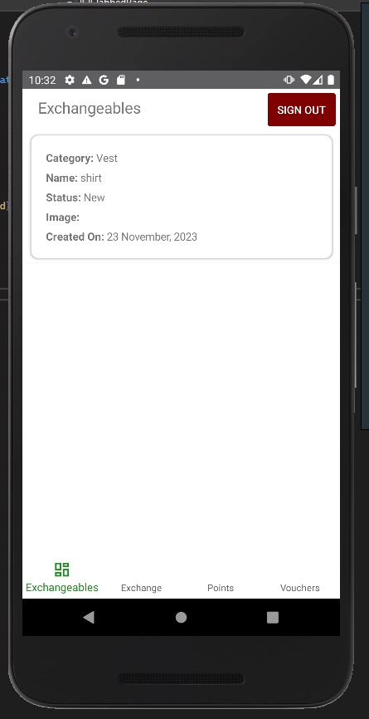
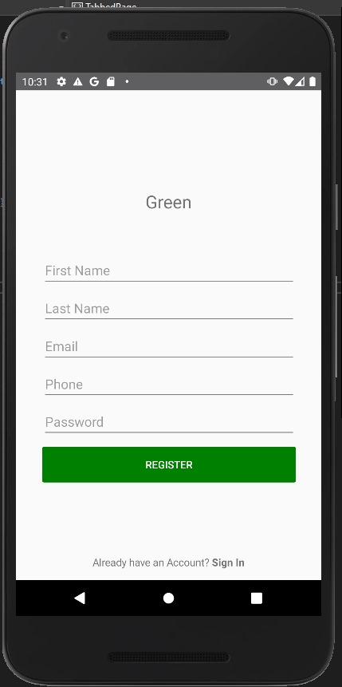
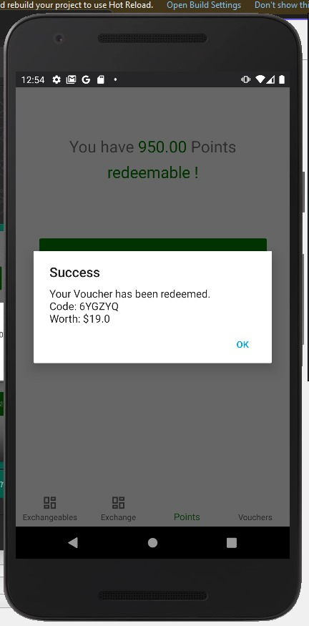
User Interface Designed
(っ◔◡◔)っ 𝓖𝓲𝓿𝓮 𝓼𝓮𝓬𝓸𝓷𝓭 𝓱𝓪𝓷𝓭𝓼, 𝓪 𝓼𝓮𝓬𝓸𝓷𝓭 𝓵𝓸𝓸𝓴

Slide 13
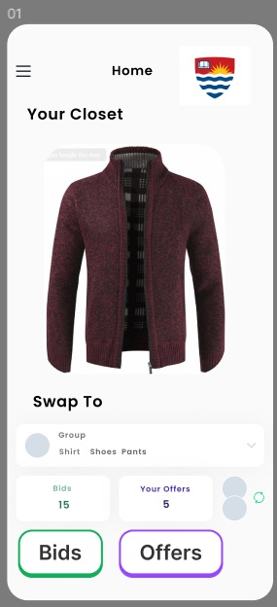
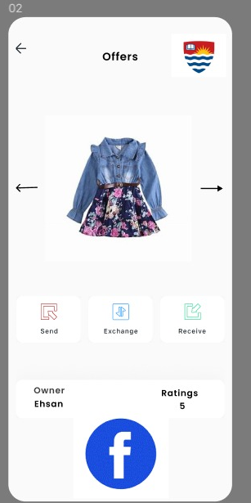
App Mock up Designed on Figma
(っ◔◡◔)っ 𝓖𝓲𝓿𝓮 𝓼𝓮𝓬𝓸𝓷𝓭 𝓱𝓪𝓷𝓭𝓼, 𝓪 𝓼𝓮𝓬𝓸𝓷𝓭 𝓵𝓸𝓸𝓴

Slide 14
Q/A

