Slide 1

INTELLIGENT IMAGE
MAX JADERBERG
SUPERVISOR: ANDREW ZISSERMAN
Introduction etc etc

Slide 2
THE PROBLEM:
RECOGNISE OBJECTS
LINK TO WIKIPEDIA
IN REAL TIME
Outline what the project is, the main aims, and the main challenges

Slide 3
IT’S DEMO TIME!
CLICK ME BABY
Show web demo with *hopefully* the wikilist dataset

Slide 4

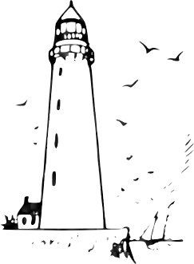



EXTRACT VISUAL WORDS
GOOGLE VECTOR SEARCH
matches = search(Database for Words);
SPATIALLY VERIFY
Outline main process for matching

Slide 5
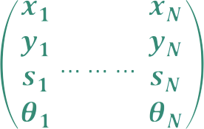





SCALEIINVARIANTFEATURETRANSFORM
QUANTISE
WORDS
Describe SIFT descriptors - matches circle like features
- described as 128-D vector
- all features + positions recorded
Describe Quantization

Slide 6


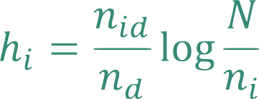
WORDS
HISTOGRAM
TF-IDF WEIGHT:
Talk about representation of image as histogram of visual words
“For example, an image of Keble would have a big peak in its histogram associated with the word red brick, whereas a picture of St Johns would have a big peak relating to the word inbred”

Slide 7

GOOGLE STYLE RETRIEVAL
A
B
Most similar!
C
QUERY
D
Match query image histograms against precomputed database image histograms.
Use inverted file system for super fast lookups
DATABASE

Slide 8


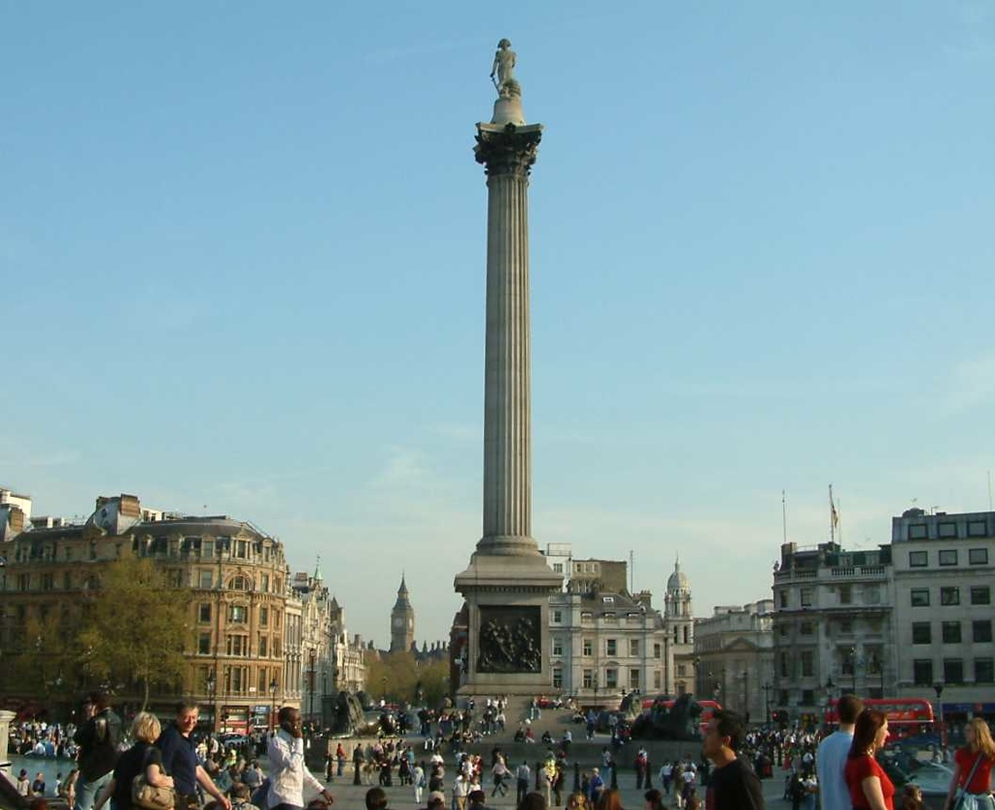
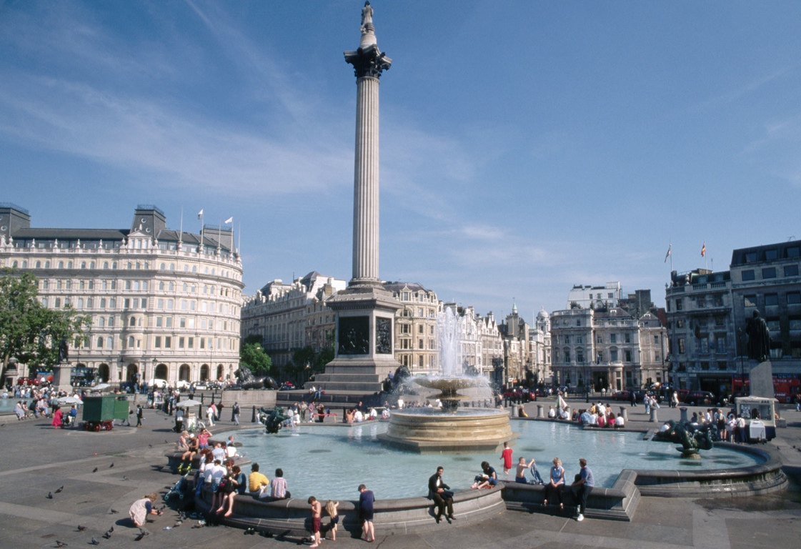


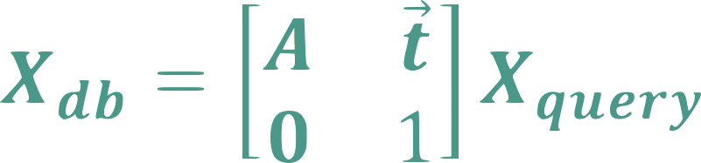
SPACIAL VERIFICATION
Two pictures of rigid bodies - must be transformation between cameras.
Check transformation exists between features in db image to query image
RANSAC

Slide 9



RESEARCH
REDUCE MEMORY
For speed, need in memory - need to reduce the size

Slide 10
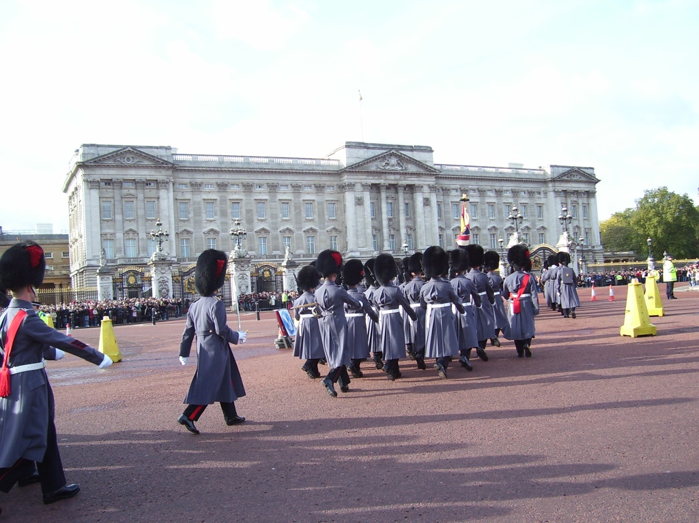




RESEARCH
how to match multiple objects
Buckingham Palace
Silly Hat
MULTIPLE MATCHING

Slide 11
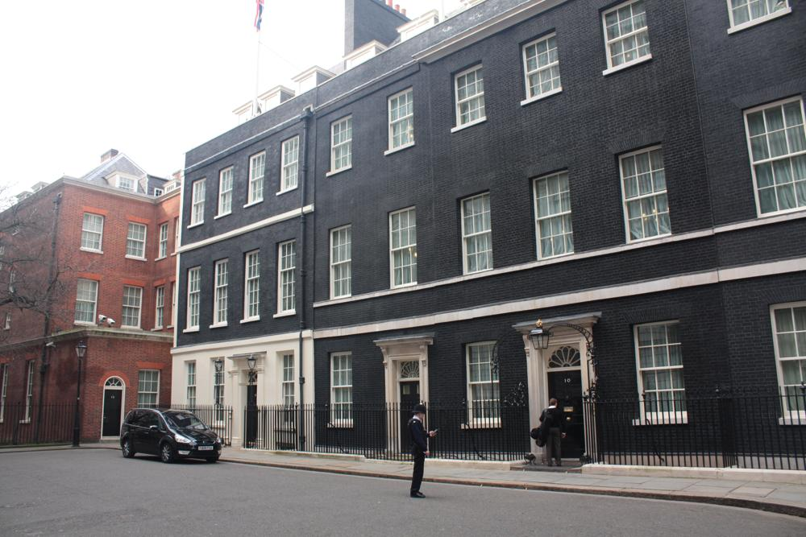
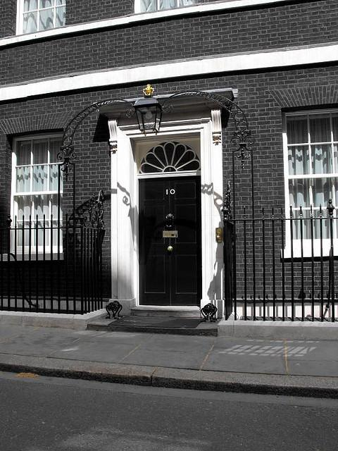

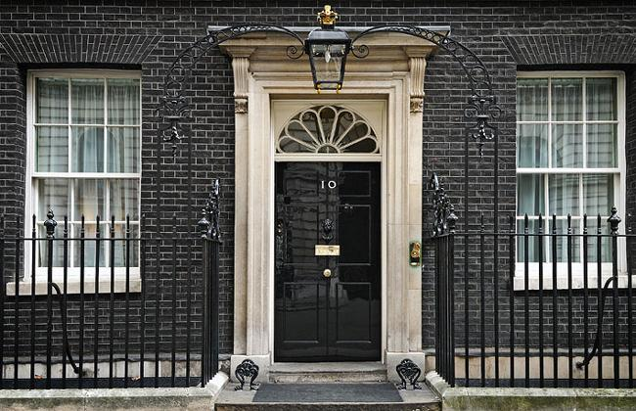

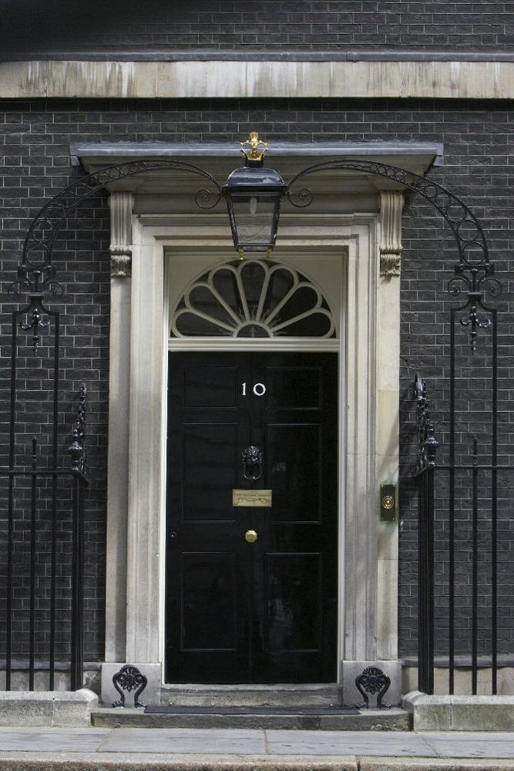

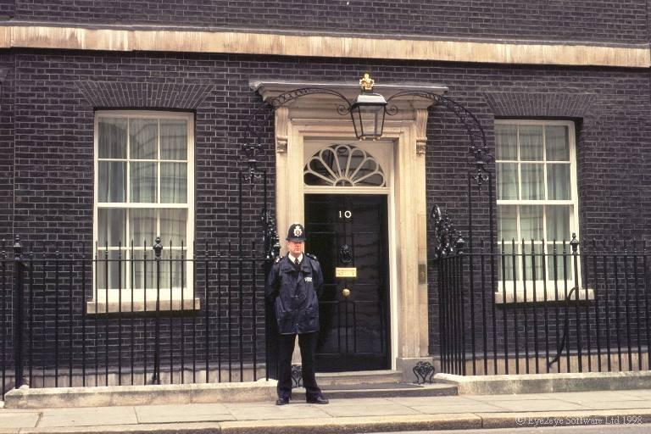
RESEARCH
Adding more information to db images using images from bing image search. add in the features at the proper coords
DATABASE EXPANSION

Slide 12
WTF
?
Welcome the floor to questions

