Slide 1
Who survived the titanic?
Jake Derby

Slide 2

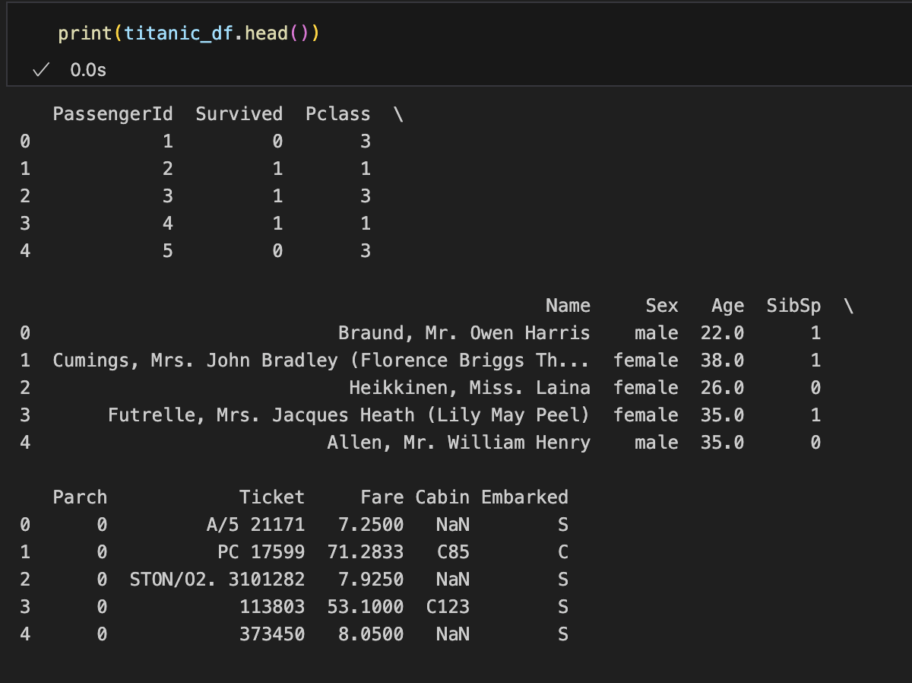
Available variables
Of Interest:
Survived (target variable)
Pclass (1st, 2nd, or 3rd class passenger)
Sex
Age
SibSp (# siblings/spouses onboard)
Parch (# parents/children onboard)
Fare
Embarked (Southampton, Queenstown, Cherbourg)

Slide 3
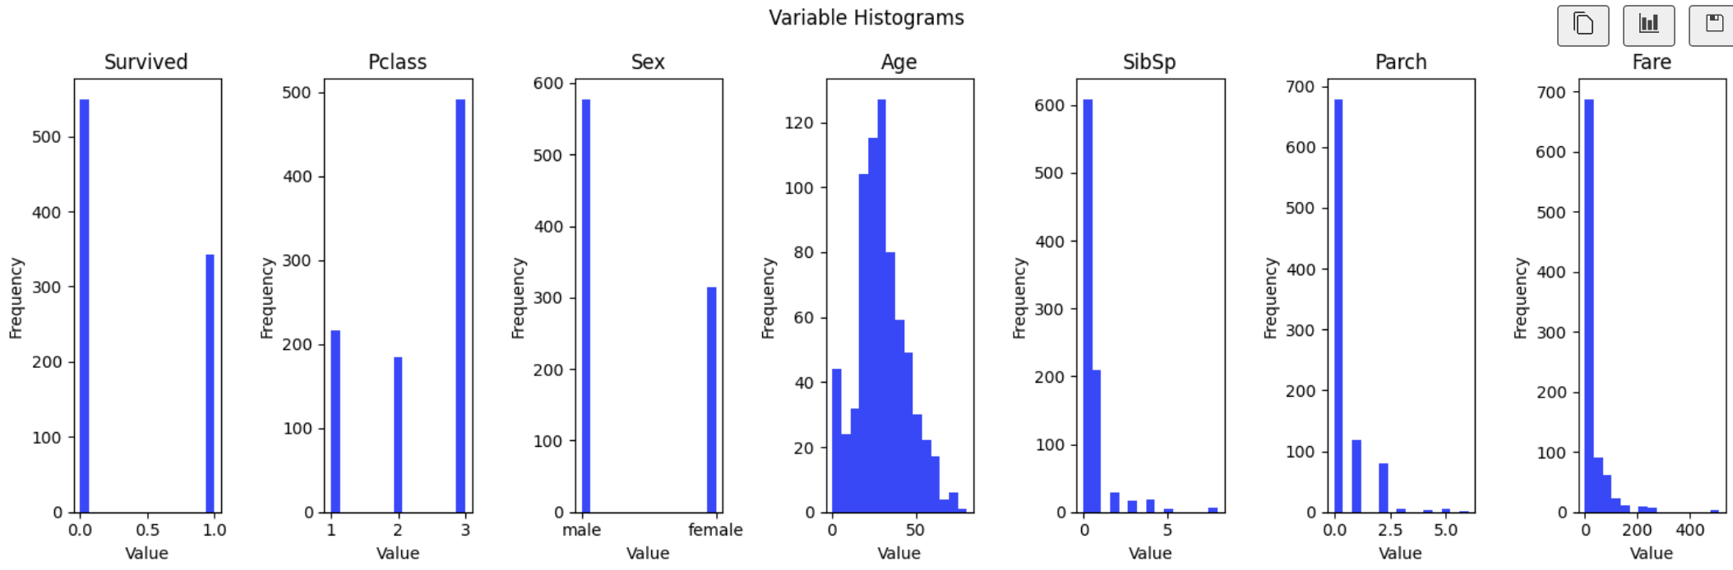
Variable Distributions
Key Takeaways:
Most people died
3rd class tickets most common
# Females > # Males
Fairly young passengers
Fare is heavily skewed to the left, cheaper fares

Slide 4
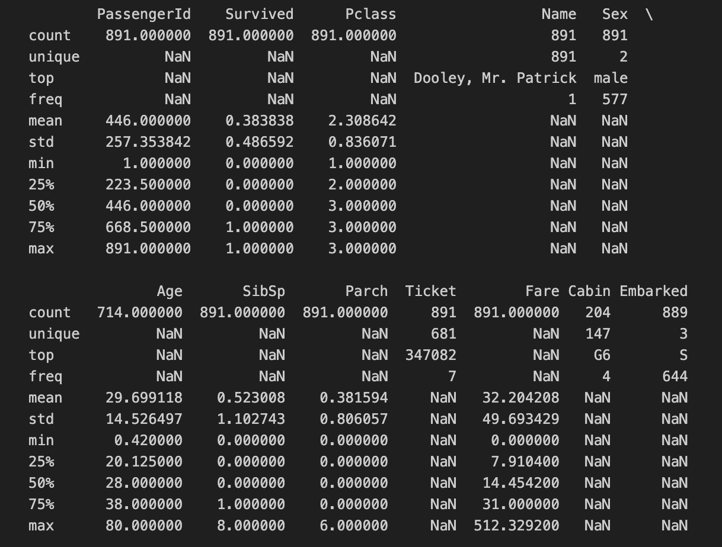
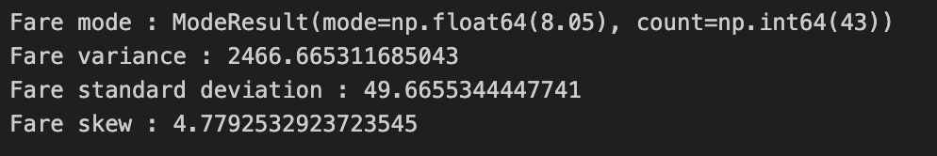
Summary statistics
Key Takeaways:
Judging by counts, we will need to deal with NA’s
Average age just under 30
There were more couples than there were families with children
Average fare is 32, with significant outliers to the upside

Slide 5
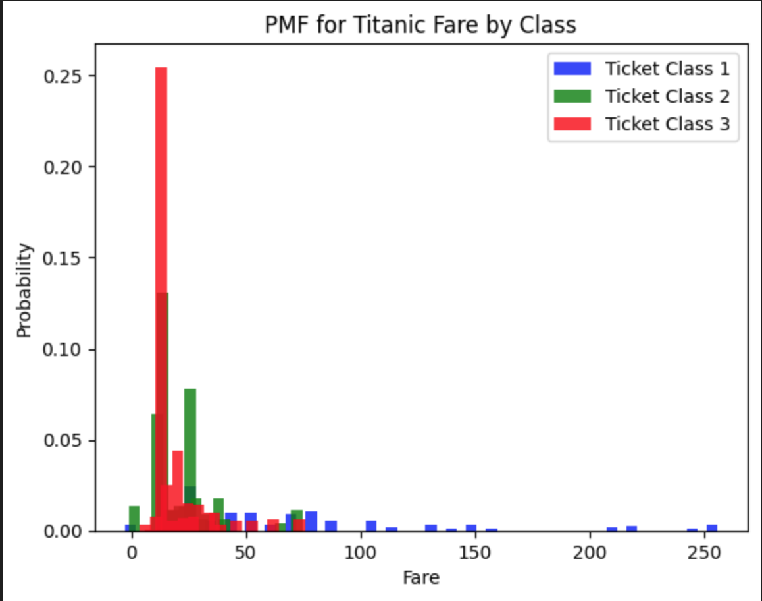
Probability mass function
(A handful of fares > 500 were filtered out for this plot)
Heavy left-skew is apparent
Passenger class by fare confirms what we expected to find

Slide 6
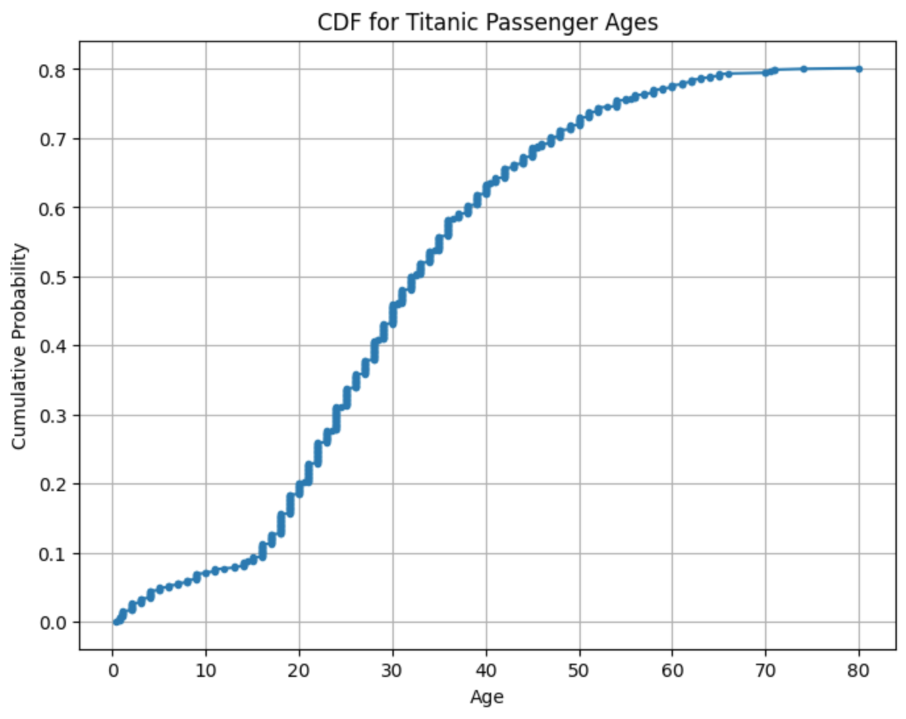
Cumulative distribution function
Not a perfectly normal distribution
Greater # of younger people than we would have expected
Working assumption: folks who were younger and more likely to travel were overrepresented on the Titanic

Slide 7
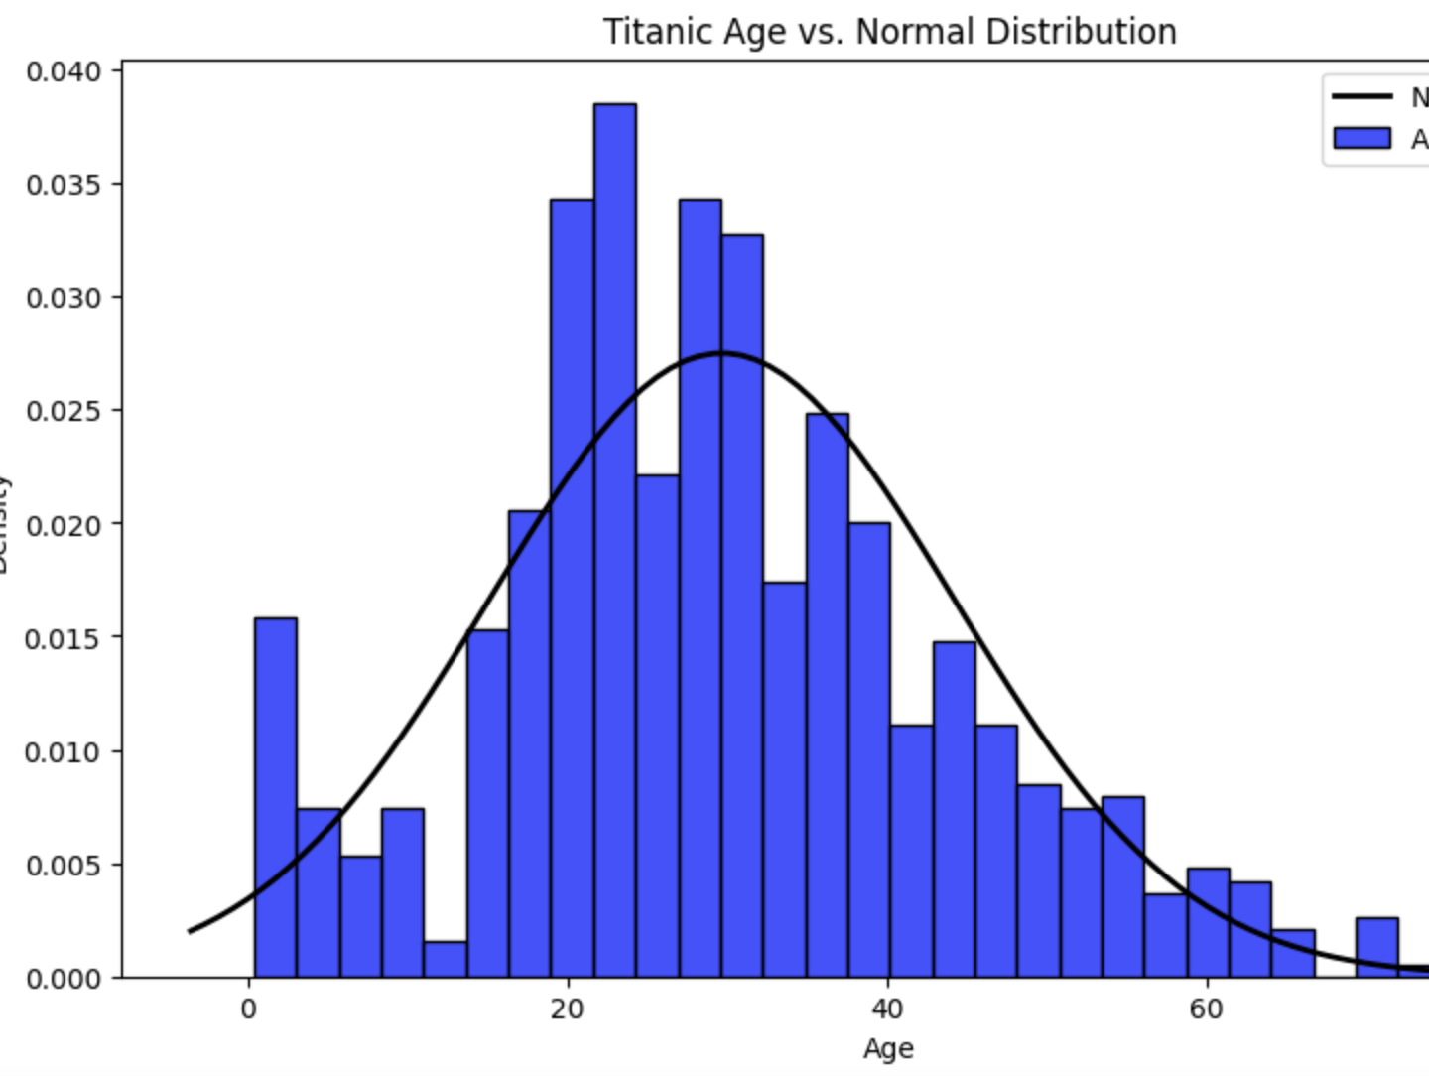
Analytical Distribution
First half of the plot does not appear to be explained well by a normal distribution, as we suspected.
Less 4-7 year-olds than expected from normal distribution
More mid 20-30 year-olds than expected from a normal distribution

Slide 8
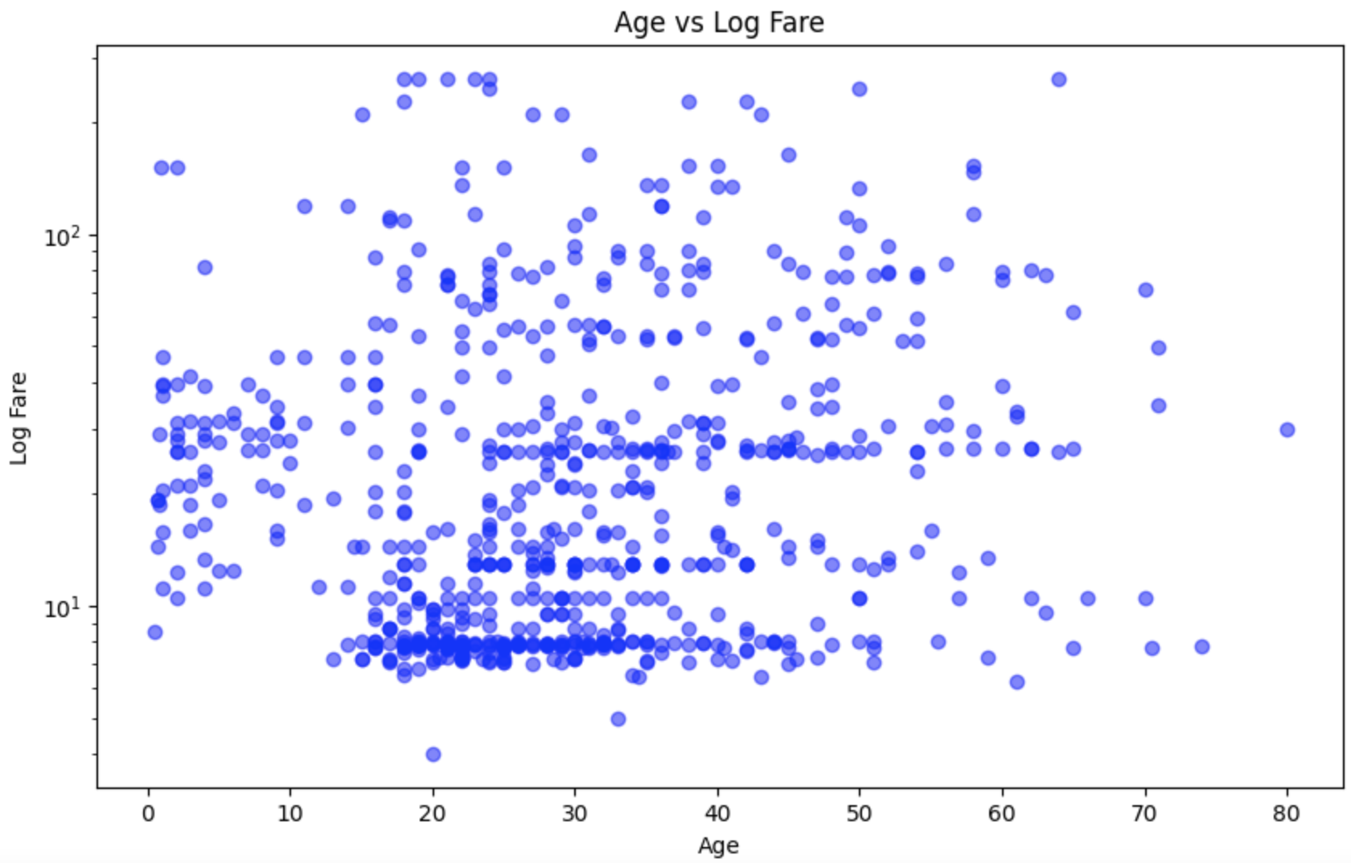
Scatter plot #1
(y-axis, Fare, is log-transformed to better readability)
Fares skew heavily to the cheaper end of the spectrum
Around 40 years of age, that skew seems to level off and normalize
Older passengers tended to pay a greater proportion of high-priced fares

Slide 9
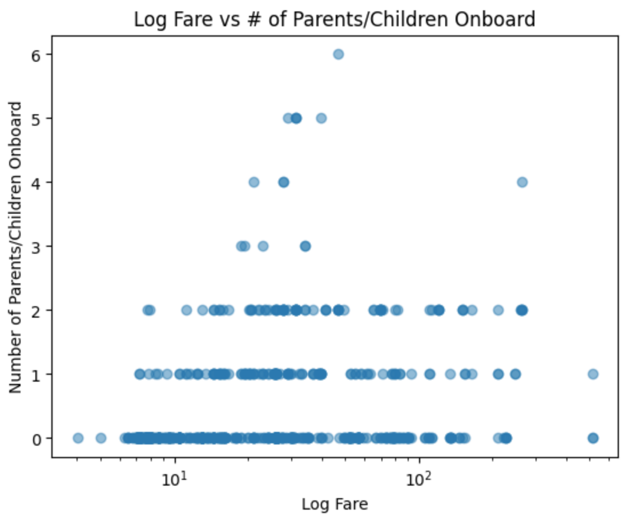
Scatter plot #2
(x-axis, Fare, is once again log-transformed to improve readability)
Generally, an increase in # of parents/children a passenger had onboard with them increased the fare they paid.
The greatest subset of Parch variable were people who did not have any parents or children onboard

Slide 10
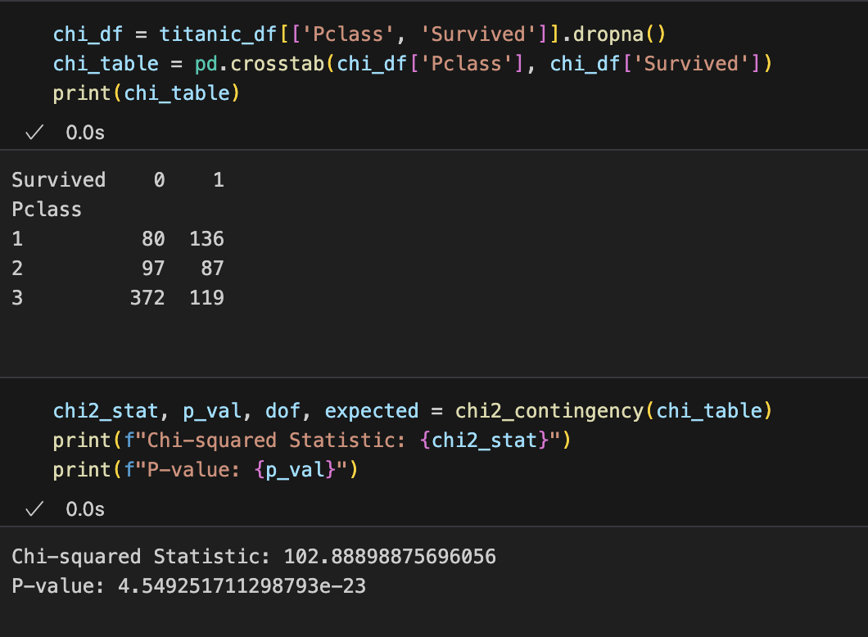
Chi squared analysis
Passenger class (which was heavily positively correlated with fare paid) was compared with survival.
Passenger class significantly relates to survival
Looking at the chi table, we have a pretty good idea of how this relationship worked

Slide 11
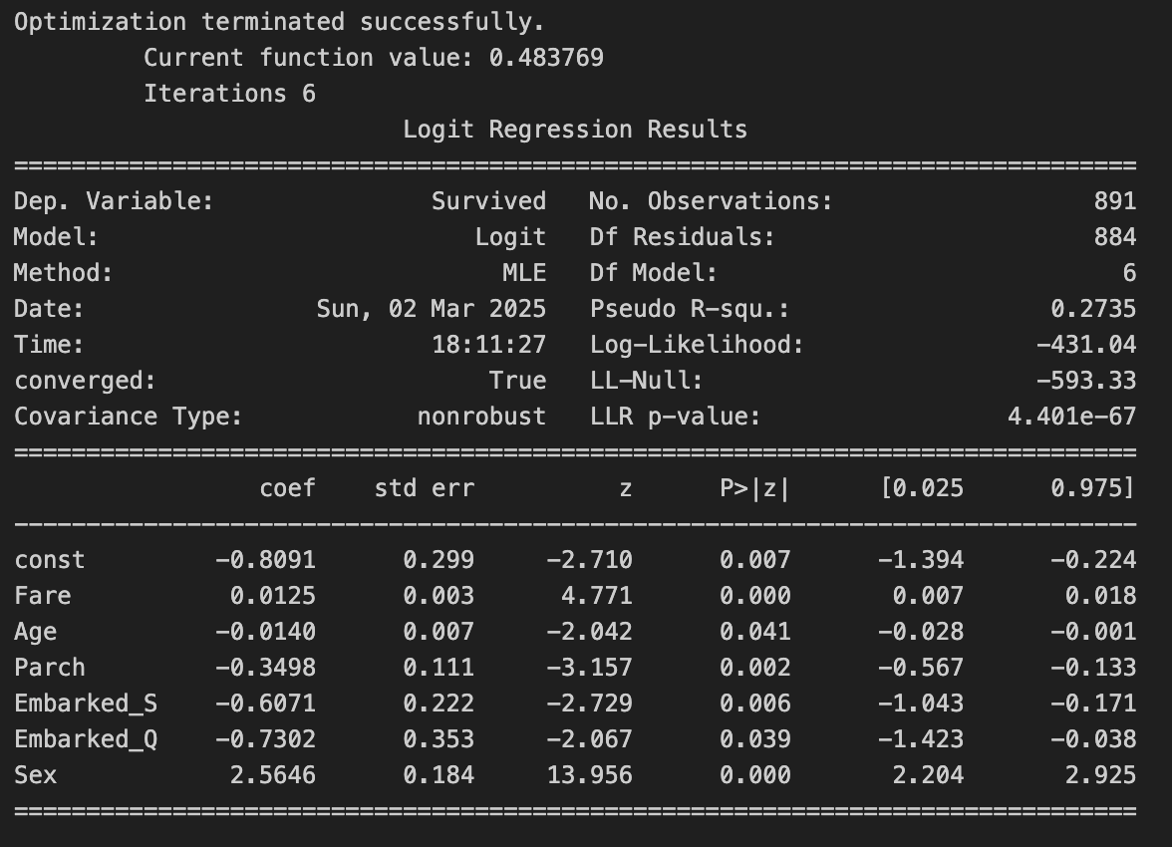

Logistic Regression
Key Takeaways:
Model Accuracy: 79%
Pseudo R2 = 0.27
All predictor variables constant, passenger chances of survival were bleak (const = - 0.81)
Passenger embarked from Southampton and Queenstown were far less likely to survive than Cherbourg
Gender had a disproportionate effect of survival likelihood

Slide 12
Conclusions
As depicted in the movie, Titanic passengers who were of higher classes had a greater likelihood of surviving the shipwreck, confirming our main hypothesis
Age was not nearly as significant of a predictor as expected. Perhaps due to multicollinearity with other predictor variables
The norm of ”women and children” checks out for this incident, generally speaking
Though significant, the chosen variables did not account for all of the variability in survival.
Other event-specific factors are almost certainly missing from this model

