Slide 1
Problem Statement – Draft 1
BPA/BCES Project Intake Discover
Problem Statement - Version 1: How might we create and communicate a clear work-group structure/relationship that leverages skills, knowledge, and expertise across both BCES and BPA to support operational and transformational projects in the MSCC
Executive User Journey Map
Project
Stages
Initiation
Planning
Execution
Transition
Operation
Positive
Experiences
“I go to Gladys and Carrie. I see both fingers pointing at each other”
“Playbooks should be completed and transitioned to MSCC”
“As a whole communication is one of our biggest opportunities”
Negative Experience
“@ Allstate we decided that business impact and expertise were the driving force for project assignments”
“For one project I got very frustrated because it was the capacity issue”
“Do we need two different project review meetings?”
Insights & Pain Points
Users are aware of both BCES and BPA teams, but are not as aware of both team’s support functions and expertise needed for different project types, business needs, or impacts (regardless if project is operational or transformational) | Users suggest that the capacity and resource constraints are likely to influence project assignments as opposed to skill set, business impact, and expertise | User find communication to be a weak point in the organization. User find varying communication methods from various departments of the organization | Users have variations in how they define "transformational" project and that both teams engage, manage, and provide status to both operational and transformation projects which may add to user confusion
Opportunities
Inventory expertise and skill set and collaboratively deploy both BCES/BPA to projects based on business impact, project type, and expertise required. Define/categorize business impact project and ascribe expertise/skills needed | Provide regular insight or visibility to resource/capacity data across MSCC portfolio to help make quality and timely resource decisions for key executive stakeholders | Users value frequent and clear communication, at the right level, at the right time regardless of project (transformation, operational, small, large, etc) and want well crafted and consistent project artifacts to present at all levels (i.e. deliverable formats, timelines, and documentation) | Create more collaborative workgroup structure that helps develop frameworks, templates, playbooks that operations leaders / support staff can implement during transition and operational project phases
Notes:
Suggested BPA/BCES work structure:
https://academy.creatio.com/documents/technic-plc/7-10/independent-implementation#XREF_15771

Slide 2
Problem Statement – Draft 1
BPA/BCES Project Intake Discover
Problem Statement - Version 1: How might we create and communicate a clear work-group structure/relationship that leverages skills, knowledge, and expertise across both BCES and BPA to support operational and transformational projects in the MSCC
Executive User Journey Map
Project
Stages
Initiation
Planning
Execution
Transition
Operation
“Deep subject matter expertise isn't expected of BCES”
“BCES keeps me (ED) informed and in the loop with appropriate level of information shared”
 | Attributes |  | Expertise
BCES Project Attributes & Expertise
“If its a project of some size and complexity that has tentacle in a couple different org/high visibility I would go Gladys”
“The OE project should be managed by Carries Team (playbook should have been completed and transitioned to her team)”
“Constructive pushback and critical thinking about next steps”
“Professional Output, Gantts, and Timelines”
BPA Project Attributes & Expertise
“If it has to do with a LOB or region, ARM related I go to Carrie”
“BPA helps provide guidance on systems, policies, procedures, workflows, health plan products/lines of business”
“BPA more likely to work closely with OMs and TMs on a daily basis”
“Operational projects have a start and stop and should be Managed by Carrie's team”
Insights & Pain Points
Users not aware of both team’s support functions and expertise needed for different project types, business needs/impacts | Capacity and resource constraints are likely to influence project assignments as opposed to skill set, business impact, and expertise | Communication is a weak point in the organization. User find varying communication methods from different teams | No uniform definition of "transformational" vs “operational”
Opportunities
Collaboratively deploy both BCES/BPA to projects based on business impact, project type, and expertise required | Provide regular insight or visibility to resource/capacity data across MSCC project portfolio | Streamline clear project communication for the right level, at the right time regardless of project type or team engaged | Create collaborative workgroup structure that supports MSCC projects. Develop frameworks, templates, playbooks for ops
Notes:
So Gladys,
We took our research and framed our findings and opportunities within the context of the project life cycle (Initiation) and we focused on the differences between BCES and BPA
Generally most of our project fall into this waterfall approach and it validates the belief that both carrie and our team manage projects that support the mscc. However, we we’ve come to understand from our research is that the Project attributes, expertise, and value demonstrated by both team differ greatly
What you see on the slide at this point are those difference in project attributes and expertise per our end-users. Our exec directors.
Project Attributes meaning: According to PMI research this include categories like Technical Complexity, systems, Application (Product/Plan), Geography… Level of uncertainty, Strategic Importance, Geography, Outputs required
The second factor I mentioned is expertise: Communication, planning methodology, change management, frameworks/playbooks, workflows, policies, CRM (What chats can or cannot do)
What else did we learn in terms of insights and opportuntiies….

Slide 3
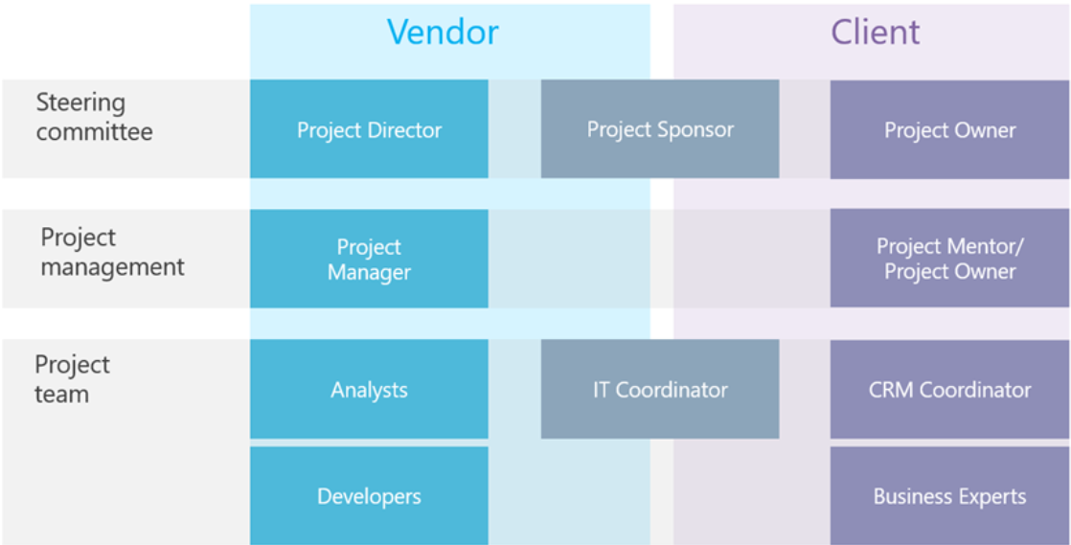
Close-Loop Example
Problem Statement – Draft 1
Problem Statement - Version 1: How might we create and communicate a clear work-group structure/relationship that leverages skills, knowledge, and expertise across both BCES and BPA to support operational and transformational projects in the MSCC
Case Study – BCES/BPA Collaboration on
Close Loop Initiative
BCES
MSCC
Exec Dir
MSCC ED / Sr. Leader
Sponsor
ED
BCES and ARM ED sat on Issue Resolution Steering Committee to oversee close loop efforts across functional areas
Project
Manager Lead
BPC Lead / OM
BCES and BPC leads collaboratively managed efforts to deploy close loop process for On-Ex Refund use case. Framework transitioned from BCES to BPC for remaining use cases
Analytics Team
(Internal)
Contact Center Systems (Reporting, TI, CHATS)
Business Process Consultants / Training
BPC and RS management team supported with work-flow documentation, MA engagement, policies & procedures, template copy, and communication with frontline
BCES project manager provided status updates, project artifacts, training, and coordinated with IT/KANA Team to help execute user interface requirements
Project
Mgr/Coordinator
Business Experts (LOB or Functional Area)
Notes:
Suggested BPA/BCES work structure:
https://academy.creatio.com/documents/technic-plc/7-10/independent-implementation#XREF_15771

Slide 4
Consortium of Schools Example
Problem Statement – Draft 1
Problem Statement - Version 1: How might we create and communicate a clear work-group structure/relationship that leverages skills, knowledge, and expertise across both BCES and BPA to support operational and transformational projects in the MSCC
Case Study – BCES/BPA Collaboration on
Service Recovery for MAS Group
BCES
MSCC
Exec Dir
MSCC ED / Sr. Leader
Sponsor
ED
MAS VP led charge with Fulton and ARM ED to initiate service recovery efforts to keep member group in the MAS Region
Project
Manager Lead
BPC Lead / OM
BCES and OM collaboratively managed cross-functional efforts to brainstorm and implement strategies to evaluate, assess, and empower T3 MAS agents to improve COS experience
Analytics Team
(Internal)
Contact Center Systems (Reporting, TI, CHATS)
Business Process Consultants / Training
BCES project managed Customer Experience workstream by creating service recovery framework for MSCC, facilitating working sessions, drafting project artifacts, and communicating status. Transitioned framework to OM and Fulton ED
BCES coordinated with BPA to 1) launch purchaser alert and 2) establish repeat call routing workflow and procedure for COS members
Project
Mgr/Coordinator
Business Experts (LOB or Functional Area)
Notes:
Suggested BPA/BCES work structure:
https://academy.creatio.com/documents/technic-plc/7-10/independent-implementation#XREF_15771

