Slide 2
Investigating Potential Bias And Discrimination In The Development of A Typical AI Platform For Heart Transplantation Shuyu (Jade) Zhang, Zejian Wu, Chenhao You, Yan Shi, Hamid Ahady, Clark University

Slide 3

Introduction
Heart failure is a global pandemic without cure
Heart transplantation is the most effective treatment for patients with end-stage heart failure
We want to help Decision makers have a predictive tool to facilitate their decision for organ matching
We investigate the results of the latest researches in heart transplantation survival prediction for any evidences of bias in gender or region.

Slide 4
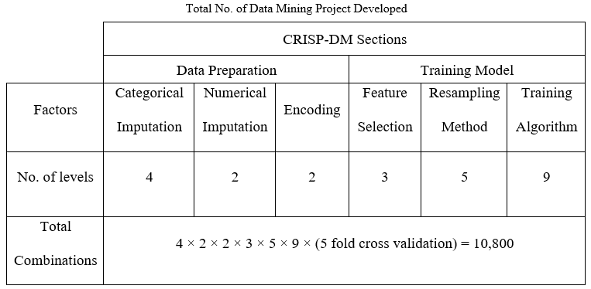
Introduction
Dataset: National registry of U.S. heart transplants from 1987-2016 (UNOS dataset)
Survival of patients after one year from transplantation surgery is predicted.
The best model (the highest AUC) is selected from all of the combinations:
The training algorithm was Logistic Regression (the simplest one)

Slide 5
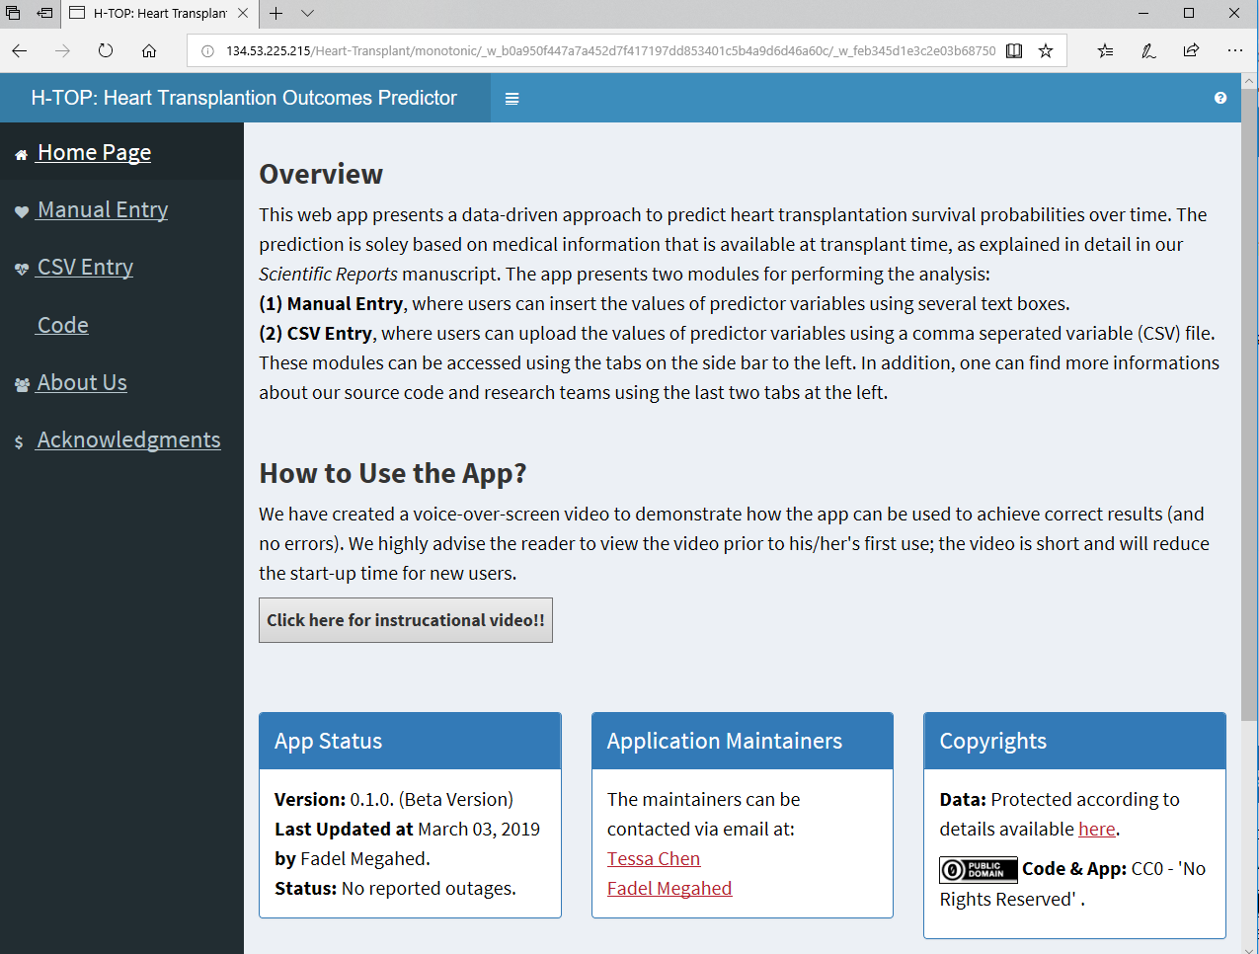
The survival tool
http://134.53.225.215/Heart-Transplant/monotonic/

Slide 6

Definition of Discrimination
Initially originated from Latin for 'distinguishing’
refers to an unjustified treatment of people based on belonging to some groups rather than their individual merits
Human rights laws prohibit discrimination on the grounds of race, national or ethnic origin, color, religion, age, sex, sexual orientation, gender identity or expression, marital status, family status, genetic characteristics, or disability.
Source: In 21st century Philippines, discrimination is still an inescapable way of life. GetRealPost

Slide 7
Discrimination in Machine Learning
Discrimination due to algorithm is sometimes referred to as digital discrimination. In fact, digital discrimination could cause by biased dataset or the algorithm itself when sensitive attributes are included in the model
Direct Discrimination
People that are similar in terms of non-protected characteristics should receive similar predictions
Indirect Discrimination
Differences in predictions across groups of people can only be as large as justified by non-protected characteristics.

Slide 8


Protected Groups & Targets
Survival Status
0
The patient would not survive
1
The patient would survive
Survival Possibility
From 0 to 1
Gender of Patient
Male
Female
Region
Southeast
Middle west
and Northeast
We use statistical tests to investigate the existence of indirect discrimination
in predicted survival status and survival possibility among gender and region

Slide 9
Existence Tests
Regression Slope Test
determine whether there is a significant linear relationship between an independent variable X and a dependent variable Y
Y = Β₀ + Β₁X
Hypothesis:
H_{o}: Β₁ = 0
H_{a}: Β₁ ≠ 0
Mean Differences Test
For two groups:
Ho : there is no difference between the two population means
Ha : there is difference between the two population means
For three groups:
ANOVA

Slide 10
Methodology
Gender
Select the data generated by Logistic Regression
Test if there is significant bias between male and female in the actual survival status (0 and 1)
Test if there is significant bias between male and female in the predicted survival rate (0 and 1)
Test if there is significant bias between male and female in the predicted survival possibility (0 to 1)
Compare the test results
Region
Similar process
Detect the bias between Southeast, Middle west, and Northeast

Slide 11
Methodology
Actual Survival Status
Predicted Survival Status
Predicted Survival Possibilities
( )
( )
Group 1
Group 2
( )
Group 1
Group 2
Group 3
Group 1
Group 2
Group 3
Group 3
Regression Slope Test
Regression Slope Test
Regression Slope Test
Compare
Compare
&
&
&
Mean Differences Test
Mean Differences Test
Mean Differences Test
Compare
Compare

Slide 12
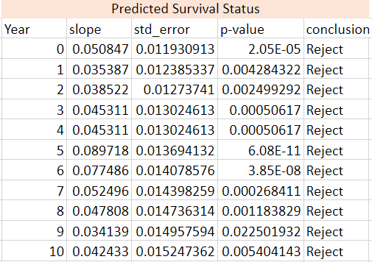
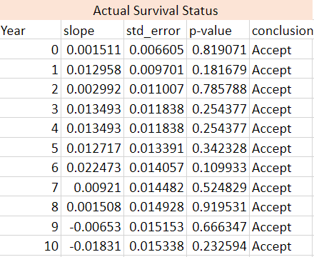
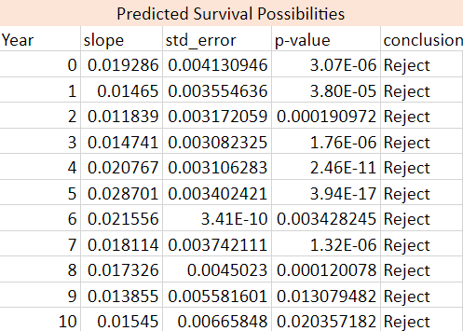
Result: Gender – Regression Test
Y = Β₀ + Β₁X
H_{o}: Β₁ = 0

Slide 13
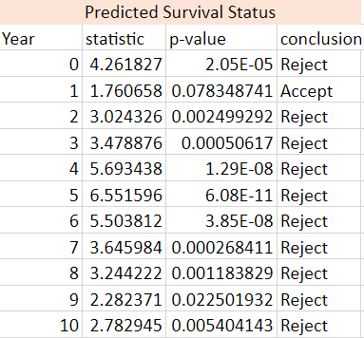
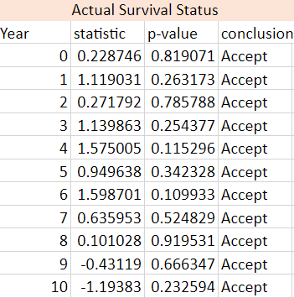
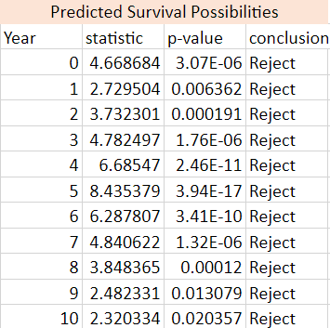
Result: Gender – Mean Differences Test
Ho: there is no difference between the two population means

Slide 14
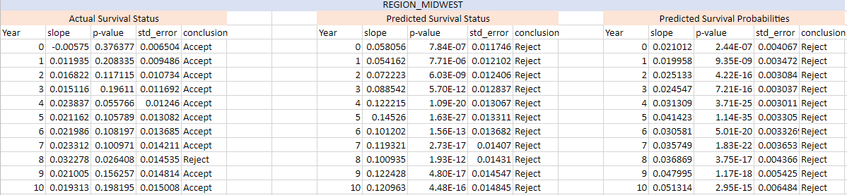
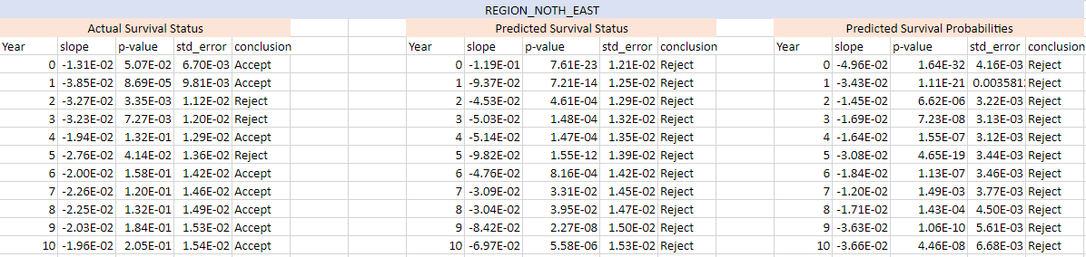
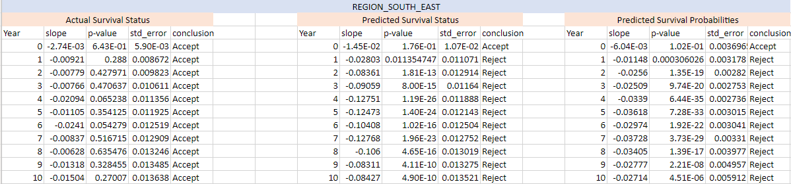
Result: Region – Regression Test

Slide 15
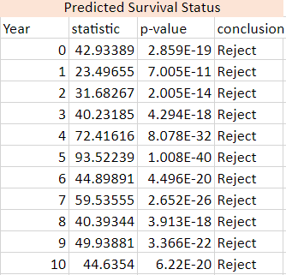
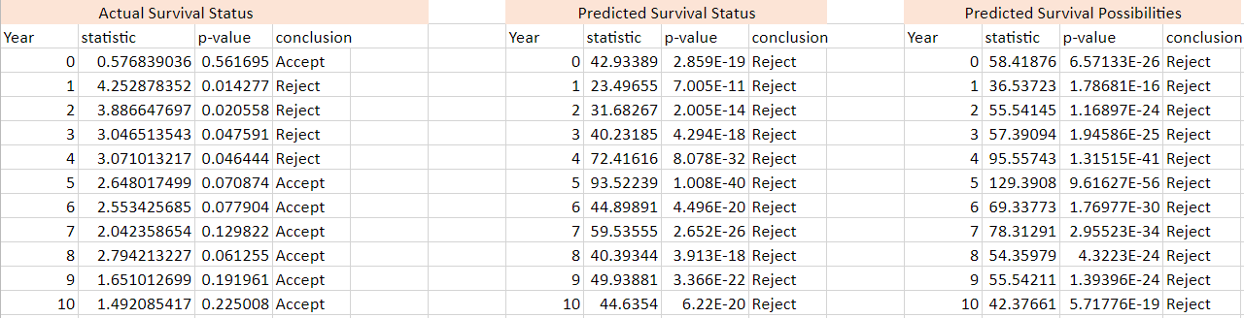
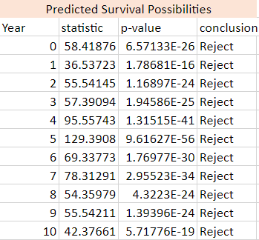
Result: Region – ANOVA
Ho: there is no difference in means

Slide 16
Conclusion
Existence of Gender Bias
Existence of Region Bias
The highest performing Model was in favor of female
The highest performing Model was in favor of region northeast
Any scoring algorithm based on the produced tool is prone to bias and needed to be optimized to reduce bias

Slide 17
Future Studies
Measurement of bias
Mathematical improvements in algorithms: developing cost function for bias
Run algorithm separately for different groups to investigate if there exists overfitting/underfitting problem for some specific groups
Sensitivity analysis of accuracy vs. bias

Slide 18
Thank you!

