Slide 2
Determinants of Car Accident Severity Zejian Wu, Shuyu (Jade) Zhang, Jiayu Fan, Chenhao You, Yue Gao, Clark Univeristy

Slide 3
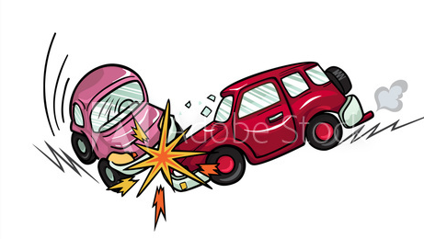

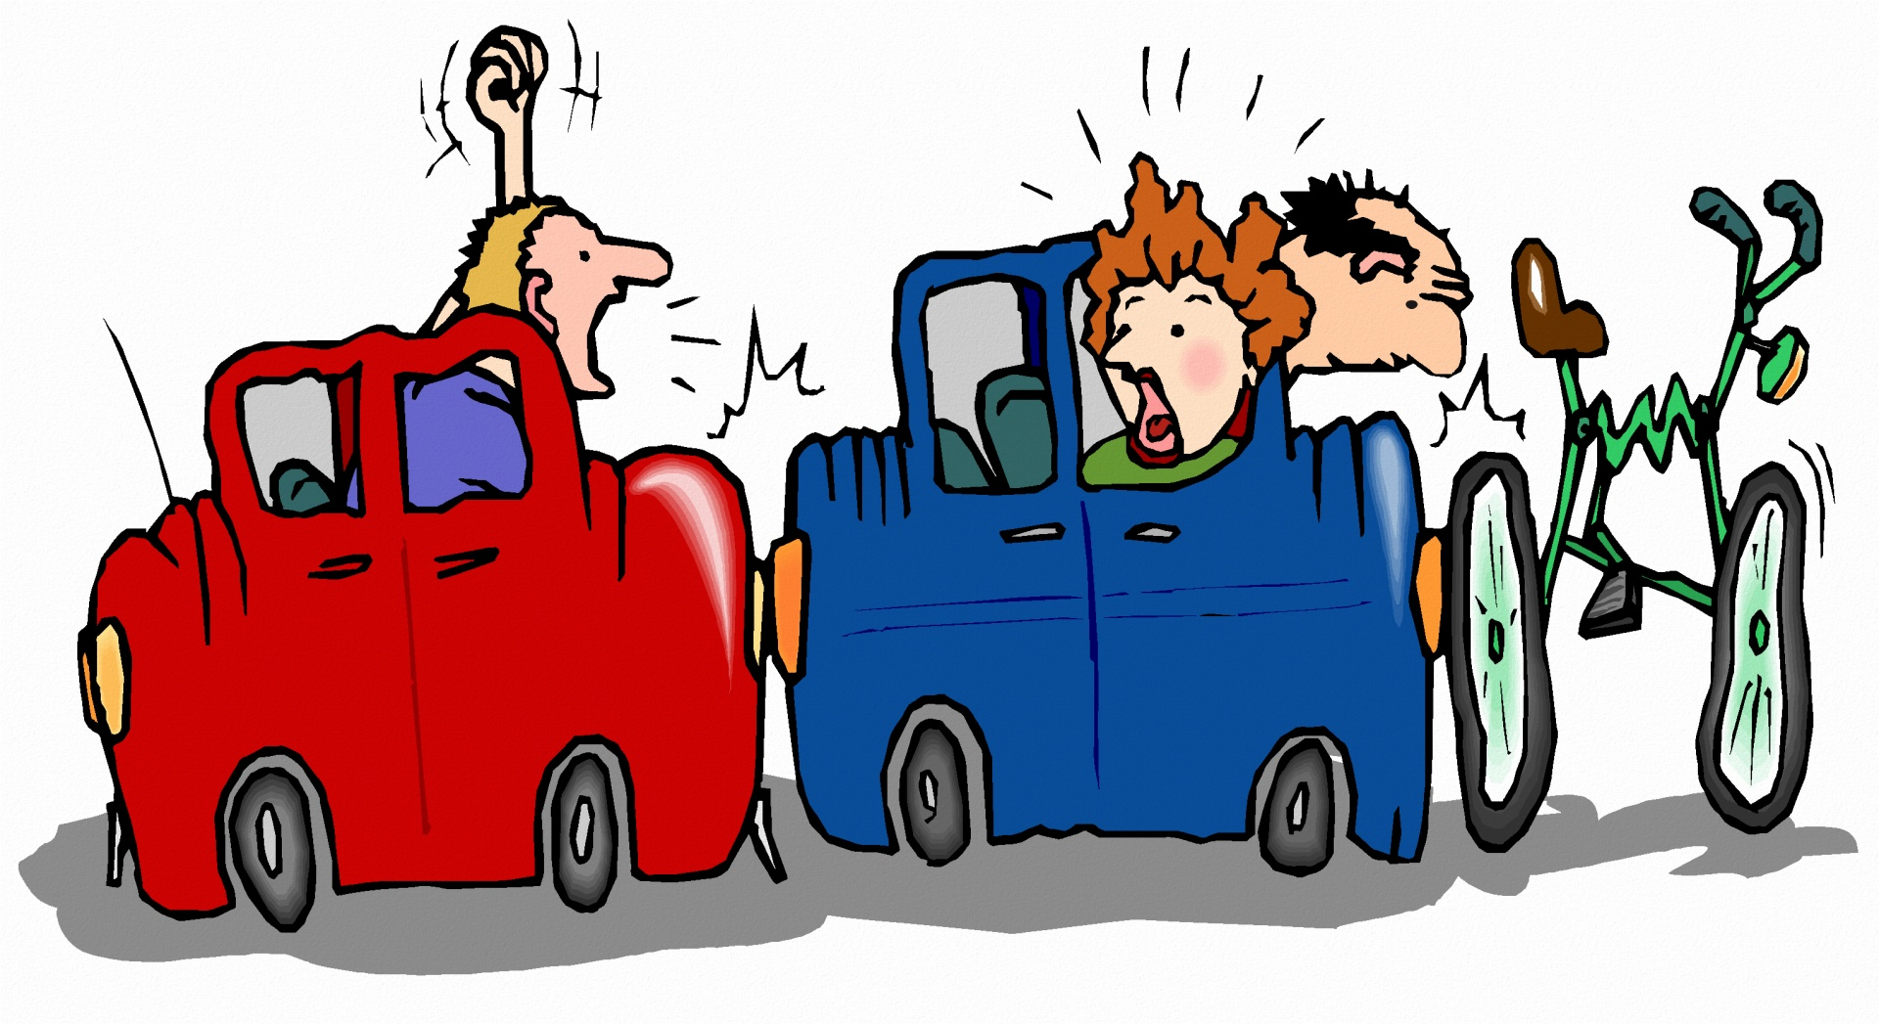
Source: Public Domain Pictures

Slide 4
Damage of Car Accident
36,560 people were killed in traffic crashes in 2018
1,038 children
9,378 speeding-related
4,985 motorcycle fatalities
6,283 pedestrians died
857 bicyclist deaths
885 large-truck occupants died
Over the past 10 years, the number of traffic deaths in urban areas has increased
pedestrian deaths are up 69%
bicyclist fatalities increased 48%
motorcycle deaths are up 33%
United States Department of Transportation

Slide 5
Basic Ideas
Investigate the determinants of car accident
Combined the information of vehicle, involved individuals, and surrounding environment
2018 car accident statistics from Crash Report Sampling System (U.S. Department of Transportation)
Person Level & Vehicle Level
Basic Machine Learning methods
Make contribution to car accident and injury prevention

Slide 6
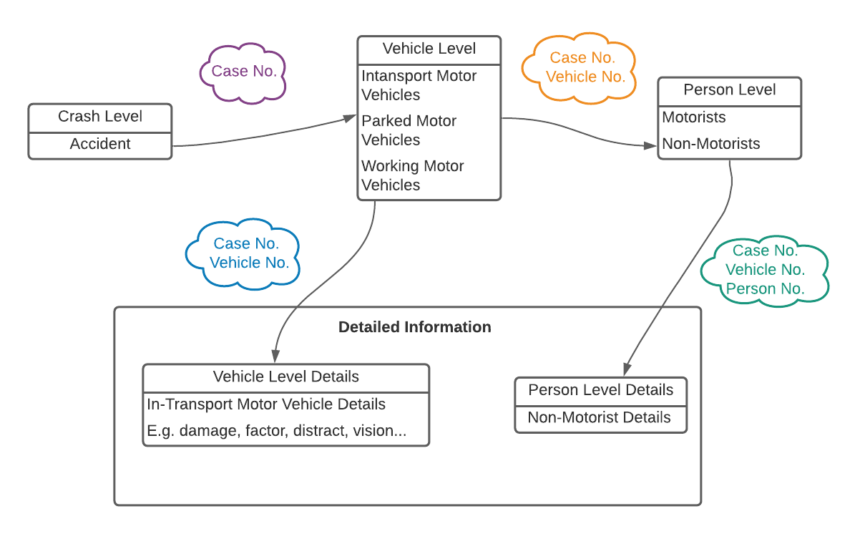
Data Description

Slide 7
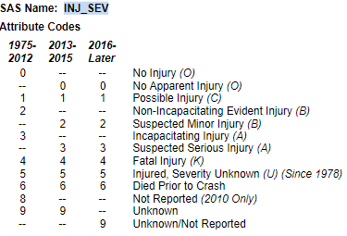
Targets
1. Vehicle Level (N=51,260)
MXVSEV_IM
Maximum Injury Severity in Vehicle
Group 1: No Apparent Injury
Group 2: Injury
MAXSEV_IM
Maximum Injury Severity in Crash
Group 1:No Injury of all Persons
Group 2:Injury
2. Person Level (N=62,933)
INJSEV_IM
Maximum Injury Severity of Person
Group 1:No or No Apparent Injury
Group 2: Injury
Attribute Codes for INJ_SEV

Slide 8
General View of Targets
Vehicle Level
Maximum Injury Severity in Vehicle
Maximum Injury Severity in Crash
Person Level
Maximum Injury Severity of Person
Mean | Medium | Maximum | Minimum | Standard Dev
0.5503 | 0 | 5 | 0 | 0.9483
Mean | Medium | Maximum | Minimum | Standard Dev
0.9180 | 0 | 6 | 0 | 1.1226
Mean | Medium | Maximum | Minimum | Standard Dev
0.4926 | 0 | 6 | 0 | 0.9016

Slide 9

Algorithms
K-Nearest Neighbors
Decision Tree
Random Forest
Logistic Regression
Support Vector Machine
Source: Information Age Automating - data science and machine learning for business insights

Slide 10
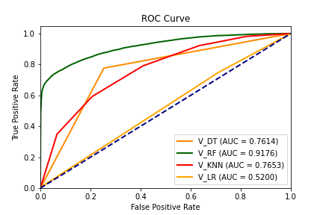
Results - Performance
Vehicle Level
1. Maximum Injury Severity in Vehicle
 | Logistic Regression | SVM | KNN | Decision Tree | Random Forest
Accuracy | 49.81% | 48.52% | 69% | 81.17% | 84.15%
AUC | 0.5200 | 0.5000 | 0.7652 | 0.7614 | 0.9176
Best ROC CURVE – Random Forest
Confusion Matrix – Random Forest
 | Predict: No Injury | Predict: Injury | Sensitivity | Specificity
Actual: No Injury | 9812 | 808 | 75.84% | 92.39%
Actual: Injury | 2547 | 7994

Slide 11
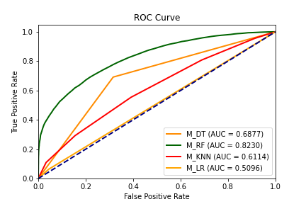
Result - Performance
Vehicle Level
2. Maximum Injury Severity in Crash
 | Logistic Regression | SVM | KNN | Decision Tree | Random Forest
Accuracy | 49.63% | 49.81% | 58.1% | 68.77% | 73.59%
AUC | 0.5096 | 0.5000 | 0.6114 | 0.6877 | 0.8230
Best ROC CURVE – Random Forest
Confusion Matrix – Random Forest
 | Predict: No Injury | Predict: Injury | Sensitivity | Specificity
Actual: No Injury | 5972 | 1660 | 69% | 78.25%
Actual: Injury | 2401 | 5345

Slide 12
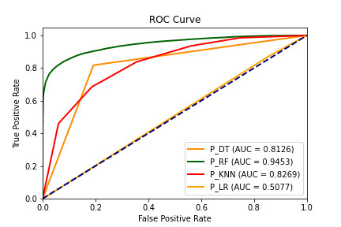
Result - Performance
Person Level
1. Maximum Injury Severity of Person
 | Logistic Regression | SVM | KNN | Decision Tree | Random Forest
Accuracy | 49.77% | 49.77% | 74.05% | 81.17% | 87.99%
AUC | 0.5077 | 0.5000 | 0.8269 | 0.8126 | 0.9453
Best ROC CURVE – Random Forest
Confusion Matrix – Random Forest
 | Predict: No Injury | Predict: Injury | Sensitivity | Specificity
Actual: No Injury | 12620 | 951 | 82.95% | 92.99%
Actual: Injury | 2293 | 11154

Slide 13
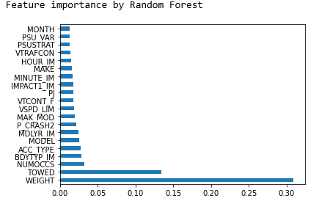
Result – Feature Importance
Vehicle Level
1. Maximum Injury Severity in Vehicle
Variable | Description
NUMOCCS | a count of the number of occupants in this vehicle
ACC_TYPE | the type of crash this vehicle was involved in
BDYTYP_IM | a classification of this vehicle based on its general body configuration, size, shape, doors, etc.
MODEL | the model of this vehicle within a given make

Slide 14
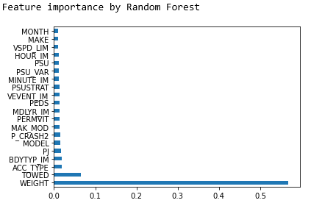
Result – Feature Importance
Vehicle Level
2. Maximum Injury Severity in Crash
Variable | Description | Data Type | Statistics
Variable | Description
ACC_TYPE | the type of crash this vehicle was involved in
MINUTE_IM | the minutes after the hour at which the crash occurred
MAK_MOD | the 5-digit combination of two data elements ("Vehicle Make” code (MAKE) followed by the 3-digit “Vehicle Model” code (MODEL))
MODEL | the model of this vehicle within a given make

Slide 15
Result – Feature Importance
Person Level
1. Maximum Injury Severity of Person
Variable | Description
AIR_BAG | air bag availability and deployment for this person
SEX_IM | the sex of this person involved in the crash
AGE_IM | the age of this person involved in the crash
MINUTE_IM | the minutes after the hour at which the crash occurred
Variable | Description | Data Type | Statistics

Slide 16
Conclusion
Random Forest and Decision Tree obtained the most satisfying results
K-Nearest Neighbors, Logistic Regression, and Support Vector Machine cannot provide good estimation for this problem
At vehicle-level, a count of the number of occupants in this vehicle, the type of crash this vehicle was involved in, and the make and model of the vehicle play important roles in accident severity
At person-level, sex, age, and air bag availability and deployment are the most important indicators.

Slide 17
Future Research
Integrate more data (before and after 2018) at a more detailed-level
Alternative machine learning algorithms: Neural Networks, Naïve Bayes Classifier
More feature engineering: logarithm transformation (age/size), Grouping (model/make), and Categorical Imputation.
Investigate further relationship among the features

Slide 18
Thank you!
zewu@clarku.edu

