Slide 1

Real or not? NLP with Disaster Tweets
Chenhao you, zejian wu, jade zhang
Notes:
Hello everyone, im jade, with my teammates Chenhao and Zejian, we are pleasant to present our final project

Slide 2
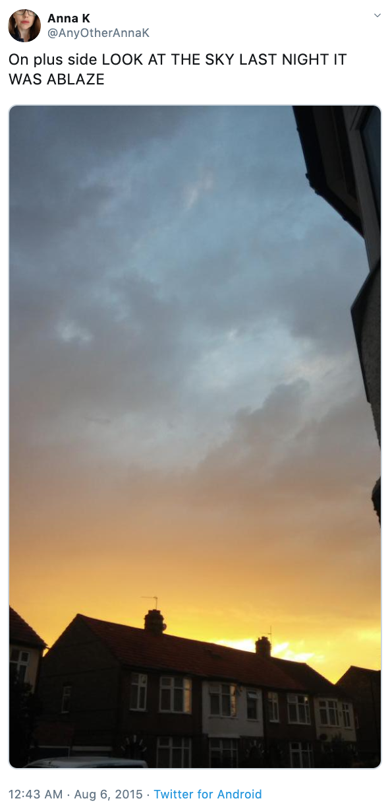
Introduction
Inspired by a Kaggle competition
Determine whether the given Tweets are emergency announcements
Disaster relief organizations and news agencies require information related to disasters on Tweeter often
Human language is not always clear enough
Spark – Visualization & Coding
Google Cloud – Coding
Git – Collaboration
https://www.kaggle.com/c/nlp-getting-started/data?select=test.csv
Notes:
In our project , The Apache Spark was majorly used for both visualization and coding. Due to the limitation of cluster’s Python version, a few of operations were completed in local environment to perform more complicated methods. The Google Cloud was introduced to run the code as well.

Slide 3
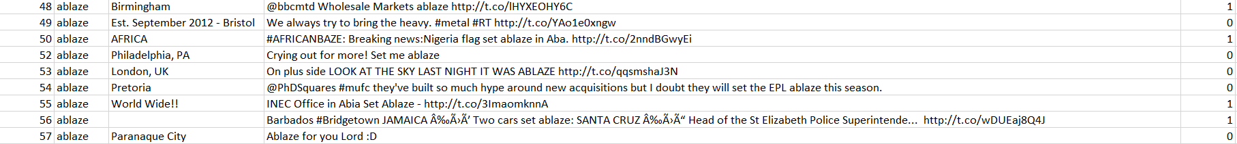
Data Description
5 features and approximately 10,000 data entries
Feature | Description | Type
Id | a unique identifier for each tweet | Integer
text | the text of the tweet | String
location | the location the tweet was sent from | String
keyword | a particular keyword from the tweet | String
target | this denotes whether a tweet is about a real disaster (1) or not (0) | Integer
Notes:
The dataset has 5 features and approximately 10,000 data entries. The features and the corresponding descriptions are listed as follows.
id - a unique identifier for each tweet
text - the text of the tweet
location - the location the tweet was sent from
keyword - a particular keyword from the tweet
target - in train.csv only, this denotes whether a tweet is about a real disaster (1) or not (0)

Slide 4
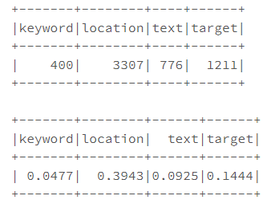
Descriptive Analysis – Missing Values
There are 8387 rows and 5 columns
Number of missing values and emptiness proportion in each column.
Location has ~40% missing values
Target has ~10% missing values
Notes:
There are approximately 8000 rows in total and 5 columns, as we showed. The missing values exist in all the columns. Here we have all the numbers and proportions of missing values for each feature. We noticed that location has around 40% missing values and target has 10% percent missing values, so we started wondering the availability of these two features and further checked it in the later process.

Slide 5
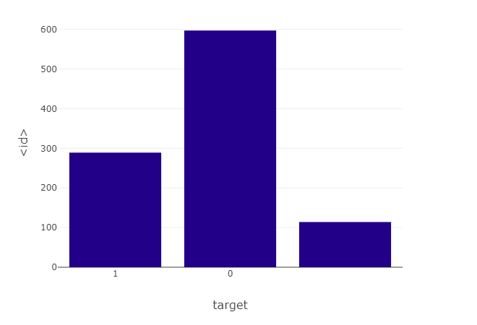
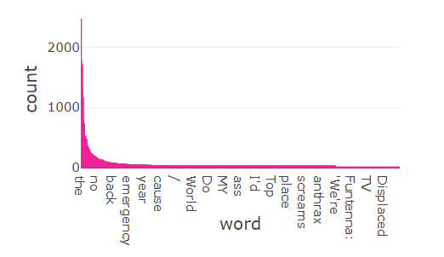
Descriptive Analysis – Target Distribution & Word Frequency
Imbalanced data
More non-related tweets
Requires resampling
Most frequent words
Noisy
Requires detailed cleaning
Notes:
The distribution of targets were checked. Most sample tweets are not related to disaster (class 0), only around a half of those are related to disaster (class 1) It shows that the data is imbanlanced and might need resample method or specific design later.
The word frequency in all the training texts were investigated. As shown in Figure 2, the most common words are “the”, “no”, “back”, “emergency”, “year”, “cause”,”/”, “World”, “Do”, “My”, etc. The result matches the common sense, and also indicates the requirement of proper data cleaning

Slide 6
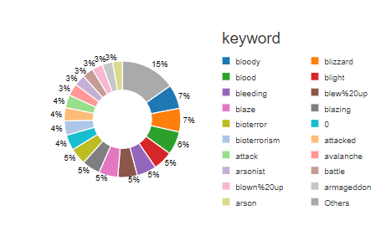
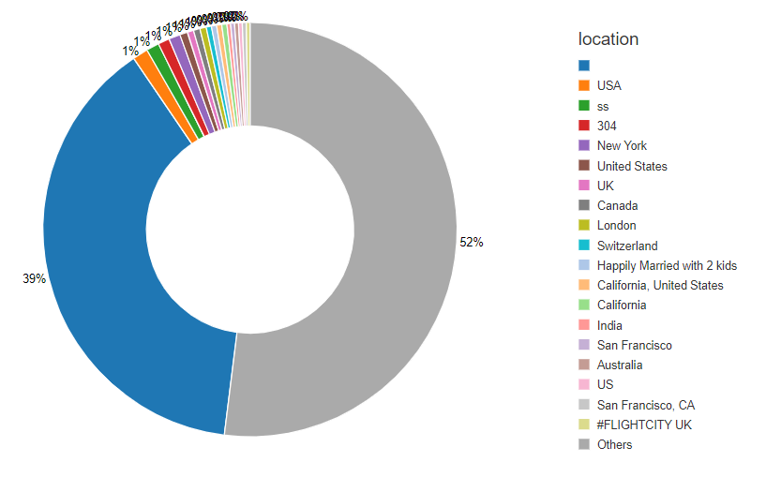
Visualization – Location Distribution & Keyword Distribution
Noisy
Most are non-readable
USA are the most common location among available data
Similar proportions
Invalid data
Notes:
The keywords column contain noisy and broad information. Lots of keywords occupied similar proportions as suggested in Figure 3. The correlation check between keyword and target were performed as well. Due to the high volume and variety of keywords, this column was ignored in the later processes.
The location distribution revealed the similar pattern as keyword distribution did. Most values are missing or not readable, and the categories of location were too many to be analyzed and used as shown in Figure 4. In this case, the location column was abandoned in the later process as well.

Slide 7
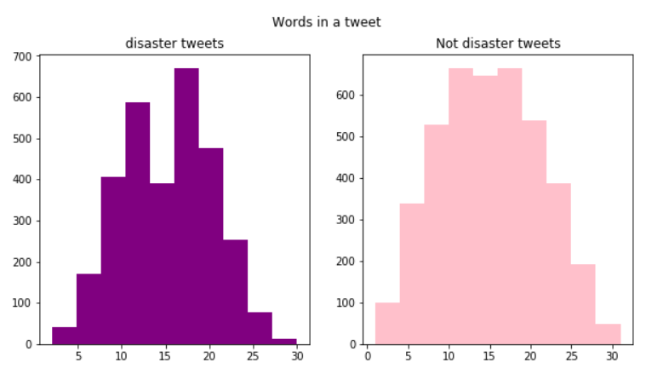
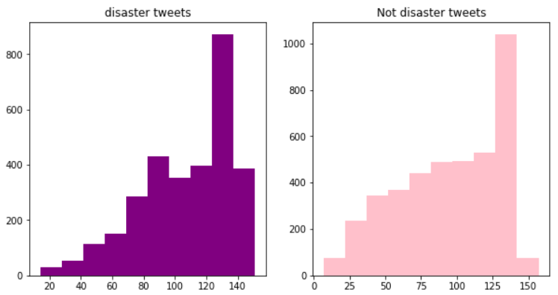
Visualization – Number of Words and Characters
Similar distribution appearing in the two classes
Number of words: 10 – 20
Number of characters: 120 - 140
Notes:
Regarding the number of characters in tweets, there is a similar distribution appearing in the two classes. The most common length of tweets is approximately from 120 to 140 characters, as illustrates in Figure 5.
As for number of words in each tweet, the two classes show similar distribution, which is almost normal. For both classes, the most common number of words is approximately from 10 to 20, as illustrared in Figure 6.

Slide 8
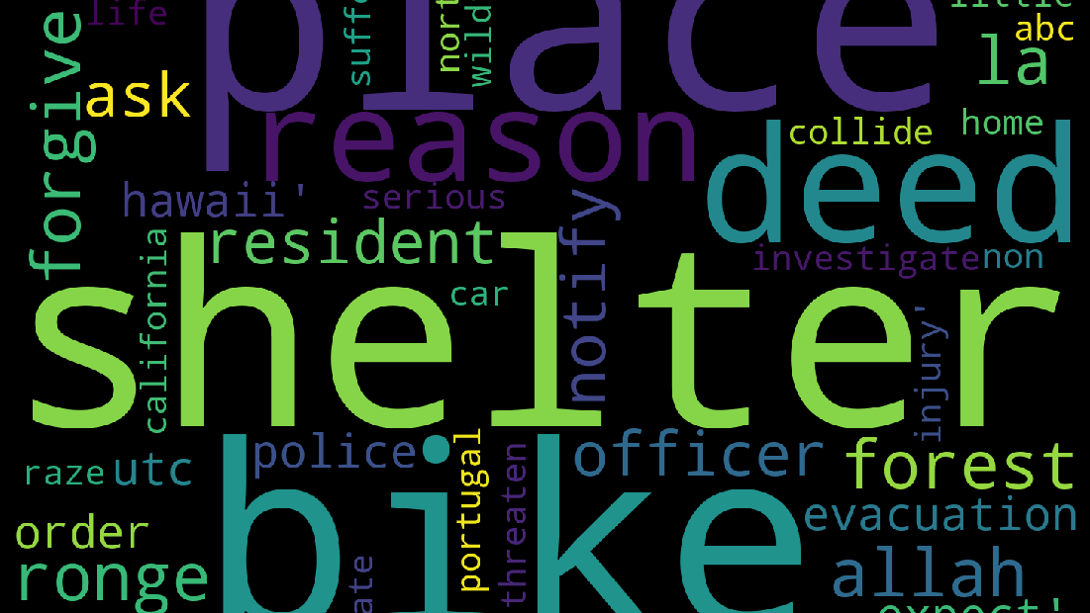
Visualization – Word Cloud
Notes:
After data cleaning process, which will be thoroughly introduced in Methodolody, the word cloud figure was generated based on the clean data as shown in Figure 7. It shows the common words of the texts we analyzed, which provided a general sence of the data’s nature.
My teammate Chenhao will introduce the later process.

Slide 9
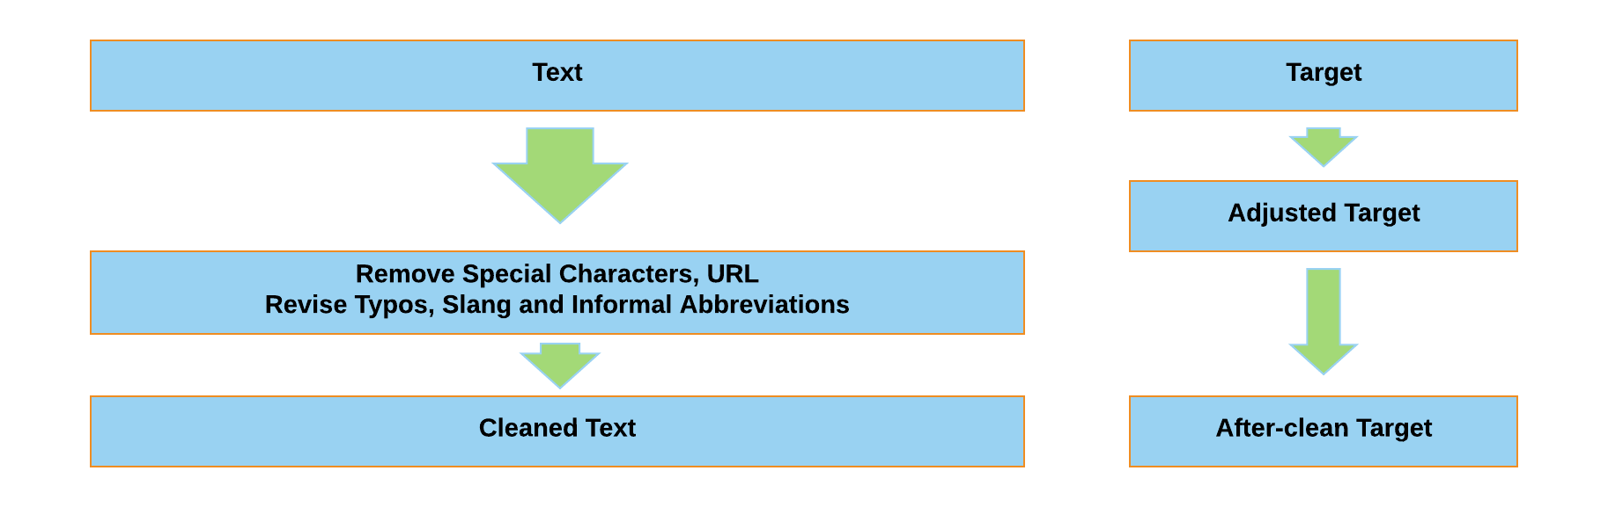
Data Preparation & Feature Engineering
Notes:
After getting an overview of what data looks like, we found that some records have the exactly same text, but the target labels are different. It might because the labeling task are allocated to different persons, and they might have different understanding of the same tweets. The mislabeled targets were replaced by the mode target of that text, because we believe that if most people considered the tweet is related to the disasters, it comes to a greater probability to have a true label.
After adjusting the labels, we start to process the text, because the text is the tweets post, it contains a lot of typos and misspelling, some tweets contains informal abbrevations and internet slangs, for example, “lmao” stand for “laugh my ass off”. In addition, we remove the URL because the URL cannot accurately infer the website content and it would result in error when processed in the tokenlization step.
After the text cleaning, it appears to be more duplicated texts and more mislabeled targets. It is because some tweets are shown as “look at this URL….”, and after removing the URL, those tweets come to the same content. As we did before, the mislabeled targets are replaced by the mode target of that text.

Slide 10
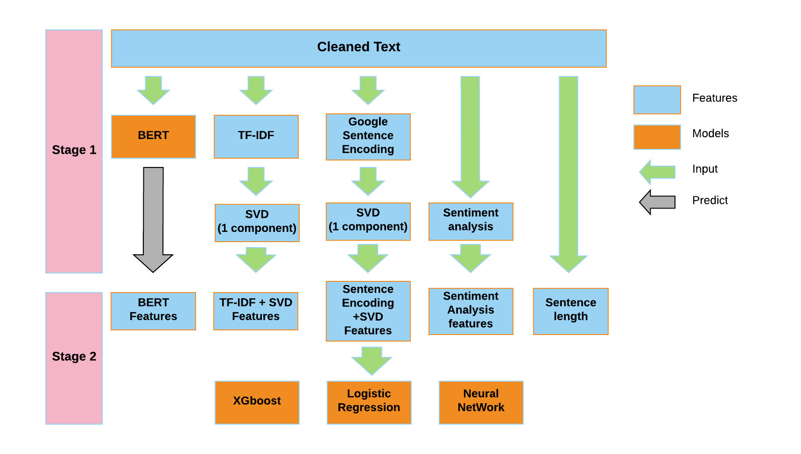
Methodology
Notes:
Then we move to the feature engineering part,
Because the “location” column is in a mass, where some of the location are Country, some of them are State, while some of them are country plus state. It’s hard to process them into a uniform format and keep this features will result in a learning of bad features, so we decided to remove the location column. The keyword column meets the similar situation, which is hard to process and obtaining meaningful features, we dropped it as well.
In the project, five features are extracted from the cleaned text: BERT Features, TF-IDF + SVD Features, Sentence Encoding +SVD Features, Sentiment Analysis features, and Sentence Length feature. BERT is a pre-trained unsupervised natural language processing model. It is proved to have high performance on 11 NLP tasks. In this case, the model will be used to extract features from the text to help to increase the prediction accuracy. Google Sentence Encoding is another pre-trained unsupervised natural language processing model, which uses deep averaging network to encode the text from news, paper both in supervised and unsupervised learning by google. In addition to the encoded features, the TF-IDF (term frequency-inverse document frequency) and sentiment analysis were also applied to help increase the prediction accuracy.
After extracting features from the text, we move to the stage 2—— The prediction. XGboost, Logistic Regression, and Neural Network are applied to predict whether the tweet is related to the disaster or not. XGboost and Neural Network are good at processing a large number of features, while logistic regressions are not so that the feature selection is performed on the logistic regression model to improve the performance

Slide 11
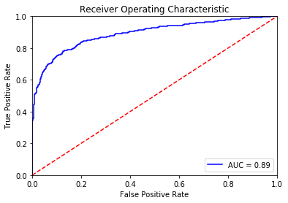
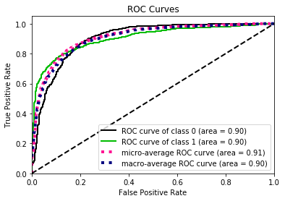
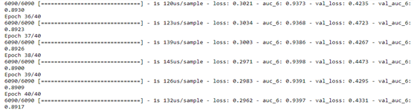
Result
XGBoost
Logistic Regression
Neural Network AUC
Model | Accuracy | AUC
XGBoost | 0.84 | 0.89
Logistic Regression | 0.84 | 0.90
Neural Network |  | 0.89
Notes:
The Accuracy and AUC (Area Under Curve) obtained from XGBoost, Logistic Regression, and Neural Network model are shown correspondingly as listed in Table.
The accuracies and AUCs obtained from the three models are similar – accuracy is approximately 0.85 and AUC is approximately 0.9. All three models achieved high accuracy and satisfying AUC, which indicates that most of the target was explained by the models.

Slide 12

Conclusion
Future Improvements
Introduced the fundamental Tweeter analysis
application in investigating disaster announcements
possible to detect the particular types of tweets among all the information based on the natural language processing methods
Precision of the model
More algorithms
Real-time application
Problem generalization
Notes:
This study introduced the fundamental Tweeter analysis and its application in investigating disaster announcements. The result justified that it is possible to detect the particular types of tweets among all the information based on the natural language processing methods, even though the human language can be very confusing and ambiguous. This type of study is crucial in terms of disaster response and disaster control due to the high efficiency of communication through Tweeter.
There is a huge room for improvement. Firstly, the precision of the model can still be increased by applying a more thorough cleaning process and performing more tuning. Secondly, more algorithms could be used to test efficiency. Thirdly, it would be more helpful to make this application in real-time. Finally, the concept, even some processes, could be properly modified and then generalized to solve similar problems.

Slide 13
Thank you!

