Slide 1

The Impact of Fair Aggregation on Forecast Accuracy and Fairness:
An Application to Enrollment Forecasting
Jade Zhang
Decision Sciences and MIS, Drexel University
Dec 07, 2022

Slide 2
Outline
Introduction & literature review
Methodology & Empirical application
Analysis of results
Conclusions & future work

Slide 3
Introduction & Literature Review

Slide 4
Fairness in enrollment forecasting application
Definition of Fairness
“the absence of any prejudice or favoritism toward an individual or group based on their inherent or acquired characteristics” (Mehrabi et al., 2021).
Fairness in forecasting
An unfair forecasting model may result in different levels of forecast accuracy for different groups (Tsai et al., 2022).
It is necessary to analyze fairness due to some issues associated with certain forecasting problems related to fairness.
Enrollment forecasting
Education sustainability relies on strategic and budget planning of each institution, particularly for student enrollment (Yang et al., 2020)
Essential for institutions to prepare for all enrollment-related activities, such as tuition policy, budget planning, and faculty staffing (Weiler, 1987; Brinkman and McIntyre, 1997).
Needs to consider fairness across racial/ethnic groups
Notes:
Definition of fairness:
Definition
Examples: Google’s photo application once misidentified black people as “gorillas” ; study analyzing three gender classification algorithms found that the algorithms were more accurate when classifying light-skinned men compared with other groups
matters of fairness should be addressed in forecasting applications
an unfair forecasting model may result in different levels of forecast accuracy for different groups In terms of decision-making
it is necessary to analyze fairness due to some issues associated with forecasting certain properties. Consideration of fairness can assist forecasters and decision-makers with more informed planning.
One prototypical example is enrollment forecasting
Enrollment forecasting is essential for institutions to prepare for all enrollment-related activities, such as tuition policy, budget planning, and faculty staffing

Slide 5
Race/ethnicity needs to be considered in enrollment forecasting
Perspective of fairness
Fair enrollment forecasting algorithms for different racial/ethnic groups.
Accurate forecasts can help institutions design plans reflecting their fairness goals.
Society must maintain the fairness of higher education among different racial/ethnic groups because a bachelor’s degree provides one of the best opportunities for an economically secure life (Torche, 2011).
Institutions need to present the fairness level in enrollment to the public and government
Perspective of forecast accuracy
Race/ethnicity has a significant impact on enrollment (Brinkman and McIntyre, 1997), and different racial/ethnic groups might exhibit different historical enrollment patterns and trends.
Baker et al. (2018) discovered that the college enrollment gaps between Black-White and Hispanic-White groups shrank between 1986 and 2014, indicating that enrollment trends over time differ across these racial/ethnic groups.
The percentage of recent high school graduates enrolled in college of different racial/ethnic groups have different patterns
Notes:
Fairness:
institutions may want to design fair algorithms for enrollment forecasting to ensure that different racial/ethnic groups are treated fairly
many institutions want to admit more students from minority groups,institutions can design plans that more accurately reflect their goals.
Institutions need to present the fairness level to the public and government
Accuracy:
It is important to consider race/ethnicity in enrollment forecasting from both the forecasting accuracy and fairness perspectives. Notably, race/ethnicity has a significant impact on enrollment (Brinkman and McIntyre, 1997), and different racial/ethnic groups might exhibit different historical enrollment patterns and trends. For example, Baker et al. (2018) discovered that the college enrollment gaps between Black-White and Hispanic-White groups shrank between 1986 and 2014, indicating that enrollment trends over time differ across these racial/ethnic groups. Figure 1 shows the percentage of recent high school graduates enrolled in college by four racial/ethnic groups from 2010 to 2020 according to the US Census Bureau, highlighting the different patterns and trends among race/ethnic groups. The differences may be discernible for institutions as well. Additionally, because we focus on the enrollment counts instead of percentage in enrollment forecasting and the magnitudes of counts can be large at the institutional level, such differences can have a significant impact in terms of forecasting. Thus, addressing the differences among racial/ethnic groups may be beneficial for enrollment forecasting in terms of forecast accuracy.

Slide 6
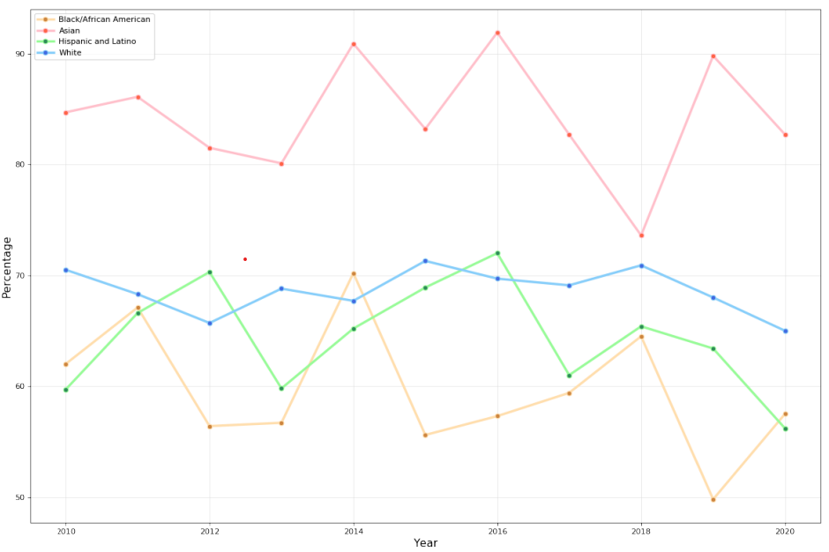
Race/ethnicity needs to be considered in enrollment forecasting (cont’d)
Figure 1: Percentage of recent high school graduates enrolled in college by race/ethnicity from 2010 to 2020
Notes:
It is important to consider race/ethnicity in enrollment forecasting from both the forecasting accuracy and fairness perspectives. Notably, race/ethnicity has a significant impact on enrollment (Brinkman and McIntyre, 1997), and different racial/ethnic groups might exhibit different historical enrollment patterns and trends. For example, Baker et al. (2018) discovered that the college enrollment gaps between Black-White and Hispanic-White groups shrank between 1986 and 2014, indicating that enrollment trends over time differ across these racial/ethnic groups. Figure 1 shows the percentage of recent high school graduates enrolled in college by four racial/ethnic groups from 2010 to 2020 according to the US Census Bureau, highlighting the different patterns and trends among race/ethnic groups. The differences may be discernible for institutions as well. Additionally, because we focus on the enrollment counts instead of percentage in enrollment forecasting and the magnitudes of counts can be large at the institutional level, such differences can have a significant impact in terms of forecasting. Thus, addressing the differences among racial/ethnic groups may be beneficial for enrollment forecasting in terms of forecast accuracy.

Slide 7
To address race/ethnicity in enrollment forecasting
Race/ethnicity in enrollment forecasting
Most enrollment forecasting literature focused on
Finding a proper algorithm and/or comparing the existing ones (e.g., Song and Chissom, 1993; Stallings and Samanta, 2014; Yang et al., 2020)
Choosing appropriate input variables by testing different models (e.g., Walczak and Sincich, 1999; Chen et al., 2019)
Official reports forecast enrollment by race/ethnicity (Hahn et al., 2015; Hussar and Bailey, 2019, 2020).
Bottom-up approach
(Grip, 2009) analyzed if forecasting enrollments for K-12 districts by race can produce more accurate results for total enrollments of New Jersey school districts using a bottom-up approach
Forecasting enrollment by race/ethnicity and aggregating to a total.
Considers that different races/ethnicities might show different patterns.
Hypothesis: forecasting enrollment by race/ethnicity can lead to more accurate results.
Notes:
Current methods and their problems
While most enrollment forecasting literature focused on finding a proper algorithm/compare the existing ones to forecast the total enrollment at the institutional level (e.g., Bousnguar et al., 2022, Yang et al., 2020), several official reports took races/ethnicities in to address race/ethnicity by including forecast enrollment by races/ethnicities (e.g., Texas Higher Education Coordinating Board, 2015, Hussar & Bailey, 2020)
Stricture-wise, the previous study has used a bottom-up approach in order to take the difference across races/ethnicities into account: (Grip, 2009) analyzed if forecasting enrollments for K-12 districts by race can produce more accurate results for total enrollments of New Jersey school districts using a bottom-up approach (forecasting enrollment by race and aggregating to a total) with the consideration that the different races/ethnicities might show different patterns.
The study is specific to the data
as the patterns of historical enrollments of different races/ethnicities can potentially be different.
therefore, there is room to test a similar approach with the same consideration as race/ethnicity is one of the demographic factors that would affect enrollment (Brinkman & McIntyre, 1997),

Slide 8
Aggregation rules for racial/ethnic groups are ambiguous
Race/ethnicity categorization is usually ambiguous and inconsistent
Hussar and Bailey (2020):
“White, Black, Hispanic, American Indian/Alaska Native, Asian/Pacific Islander, Two or more races”
Hahn et al. (2015):
“White, African American, Hispanic, Other”
University of California (UC):
“White, African American, Hispanic Latinx, American Indian/Alaska Native, Asian, Native Hawaiian Pacific Islander, Southwest Asian North African”
They are aggregate racial/ethnic groups
Lack of research on aggregation rules of ethnic/racial groups
How to aggregate the racial/ethnic groups?
How to forecast the enrollment of disaggregate racial/ethnic groups?
Notes:
In addition, the race/ethnicity categorization is usually ambiguous and inconsistent. For example, Hussar and Bailey (2020) followed the US Census Bureau, which uses “White, Black, Asian/Pacific Islander, Hispanic, American Indian/Alaska Native, Two or more races”, whereas Hahn et al. (2015) used “White, African American, Hispanic, Other”. Furthermore, the University of California (UC) defined more categories, such as “African American, American Indian/Alaska Native, Asian, Hispanic Latinx, Native Hawaiian Pacific Islander, Southwest Asian North African, and White” (University of California, 2021). Notably, in all of these examples, the race/ethnicity categories are aggregates. For instance, UC has 68 disaggregate races in total 1

Slide 9
Applying hierarchical forecasting with focus on race/ethnicity
Objectives and concerns
Obtain enrollment forecasts at both the total and disaggregate race/ethnicity levels.
(For forecasts at the total level) Different races/ethnicities might show different patterns in historical enrollment. Such differences should be addressed to increase the forecast accuracy.
(For forecasts at the disaggregate level) Impractical to fit the forecast algorithms at the most disaggregate race/ethnicity level.
Inconsistency and a lack of observations of some groups.
The observations of some groups may have a small magnitude, which can appear to be random
Bottom-up approach
Aggregates the forecasts of each race/ethnicity for the forecasts of total enrollment counts.
The bottom-up approach can reflect individual racial/ethnic groups with different patterns of variation because individual forecasts for each segment are combined to produce a forecast of the aggregate level.

Slide 10
Applying hierarchical forecasting with focus on race/ethnicity (cont’d)
Top-down approach
Forecasts of aggregate data are disaggregated to produce the forecasts for individual segments (at the disaggregate race/ethnicity level).
The top-down approach can overcome the problems encountered when using the disaggregate race/ethnicity data
Forecasts of the aggregate may be relatively more accurate than forecasts of its individual components (Lapide, 2006)
A hierarchical structure combining both approaches
Three levels: total level, aggregate race/ethnicity level, and disaggregate race/ethnicity level.
Forecast at the aggregate race/ethnicity level and aggregate the forecasts to obtain the forecasts at the total level while assigning proportions to obtain the forecasts at the disaggregate race/ethnicity level.
Aggregate groups must include disaggregate with similar patterns to ensure the forecast performance (e.g., Lapide, 2006; Zotteri et al., 2005; Goehry et al., 2019)
Total (Institutional level)
Bottom-up
Aggregated race/ethnicity level
Top-down
Disaggregated race/ethnicity level

Slide 11
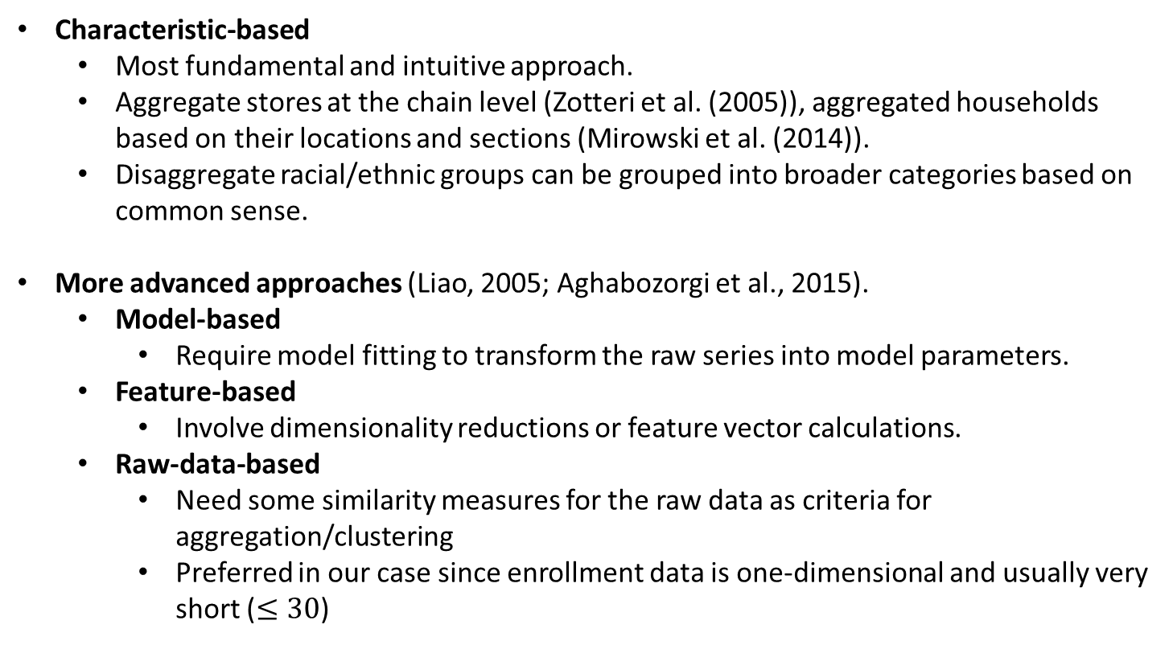
Different approaches to aggregate/cluster time series
Characteristic-based
Most fundamental and intuitive approach.
Aggregate stores at the chain level (Zotteri et al. (2005)), aggregated households based on their locations and sections (Mirowski et al. (2014)).
Disaggregate racial/ethnic groups can be grouped into broader categories based on common sense.
More advanced approaches (Liao, 2005; Aghabozorgi et al., 2015).
Model-based
Require model fitting to transform the raw series into model parameters.
Feature-based
Involve dimensionality reductions or feature vector calculations.
Raw-data-based
Need some similarity measures for the raw data as criteria for aggregation/clustering
Preferred in our case since enrollment data is one-dimensional and usually very short ($≤30$)

Slide 12
(Dis)similarity metrics used in raw-data-based approaches
Euclidean distance and its variants
Most commonly-used
Euclidean distance, Manhattan distance, etc.
Dynamic version: dynamic time warping (Aghabozorgi et al., 2015)
These metrics can capture only the differences between magnitudes, but not the patterns and shapes of a time series
Short time series distance (STS) (Moller-Levet et al. (2003))
STS considers short time series as piecewise linear functions and calculates the difference between the slopes of the functions.
Information about the relative change of different racial/ethnic groups can be included.

Slide 13
Clustering algorithms
Partitioning methods (e.g., K-means, Cmeans) are widely used for clustering purposes
computationally efficient and easy to implement.
K-medoids algorithm
Iterates over two phases:
(1) finding a centroid for each cluster.
(2) assigning data points to their closest centroid until some termination condition is met.
Allows usage of STS instead of Euclidean distance since it uses medoids (existing data points) as the centroids instead of means.
Drawbacks of hard K-medoids
It is challenging to predefine the number of clusters and initial partitions due to a lack of efficient and universal methods (Fei et al., 2009)
The algorithm might fail to recognize relatively small clusters (Kashef and Kamel, 2008).

Slide 14
Clustering algorithms (cont’)
In the case of enrollment forecasting
STS distance is sensitive to the magnitude of the time series and some racial/ethnic groups have much greater magnitudes than others.
We want to avoid the case where the few racial/ethnic groups with large magnitudes are clustered together and the differences across groups with small magnitudes are ignored.
Binary hierarchical K-medoids algorithm
Step 1: considers all the data in the same big cluster.
Step 2 (recursive step): separates one big cluster into two subclusters using K-medoids. Repeat the process at the sub-clusters until certain criteria are met.
Step 3: aggregate the disaggregate racial/ethnic groups in the same cluster

Slide 15
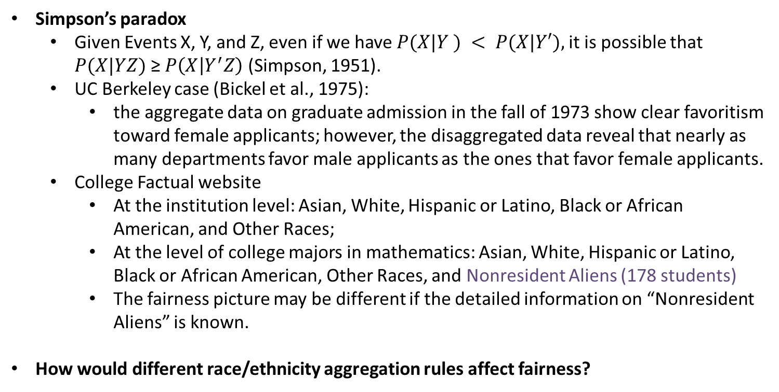
Aggregation can affect not only forecast accuracy but also fairness
Simpson’s paradox
Given Events X, Y, and Z, even if we have $P(X|Y ) < P(X|Y′),$it is possible that $P(X|YZ)$≥ $P\left(X | Y^{′}Z\right)$ (Simpson, 1951).
UC Berkeley case (Bickel et al., 1975):
the aggregate data on graduate admission in the fall of 1973 show clear favoritism toward female applicants; however, the disaggregated data reveal that nearly as many departments favor male applicants as the ones that favor female applicants.
College Factual website
At the institution level: Asian, White, Hispanic or Latino, Black or African American, and Other Races;
At the level of college majors in mathematics: Asian, White, Hispanic or Latino, Black or African American, Other Races, and Nonresident Aliens (178 students)
The fairness picture may be different if the detailed information on “Nonresident Aliens” is known.
How would different race/ethnicity aggregation rules affect fairness?

Slide 16
Fairness metrics
Needs for fairness metrics
We can enhance fairness during modeling and analyze the fairness of the results to stratify fairness (Tsai et al., 2022).
It is important to present a quantitative fairness metric because both a forecast of a phenomenon and its accuracy alongside the forecasting for social good (FSG) metrics are important in the FSG context (Rostami-Tabar et al., 2022).
Different metrics may reveal different perspectives.
Duchemin and Matheus (2021) used multiple metrics for model comparisons, resulting in a different ranking of the model performance than using a single performance metric.
Forecasting results evaluated using fairness metrics combined with forecast accuracy can provide critical and more complete insights to institutions than using only forecast accuracy metrics.

Slide 17
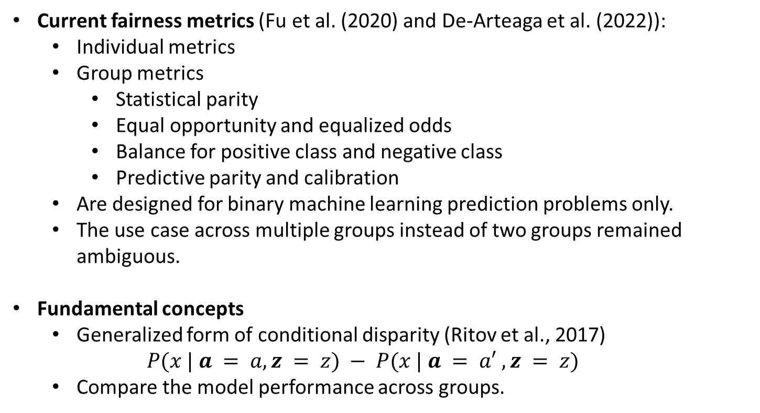
Fairness metrics (cont’d)
Current fairness metrics (Fu et al. (2020) and De-Arteaga et al. (2022)):
Individual metrics
Group metrics
Statistical parity
Equal opportunity and equalized odds
Balance for positive class and negative class
Predictive parity and calibration
Are designed for binary machine learning prediction problems only.
The use case across multiple groups instead of two groups remained ambiguous.
Fundamental concepts
Generalized form of conditional disparity (Ritov et al., 2017)
$$P(x | a = a, z = z) − P(x | a = a′ , z = z)$$
Compare the model performance across groups.

Slide 18
Fairness metrics (cont’d)
Current fairness metrics (Fu et al. (2020) and De-Arteaga et al. (2022)):
Individual metrics
Group metrics
Statistical parity
Equal opportunity and equalized odds
Balance for positive class and negative class
Predictive parity and calibration
Are designed for binary machine learning prediction problems only.
The use case across multiple groups instead of two groups remained ambiguous.
Fundamental concepts
Generalized form of conditional disparity (Ritov et al., 2017)
$$P(x | a = a, z = z) − P(x | a = a′ , z = z)$$
Compare the model performance across groups.

Slide 19
Research Gaps and questions
Research gaps
The bottom-up approach with respect to race/ethnicity has never been used in college enrollment forecasting.
Although race/ethnicity has been considered in enrollment forecasting, the issue has not been investigated with an eye toward fairness.
Previous studies only forecast enrollment at the aggregate race/ethnicity level. There is a lack of forecasting application for disaggregate races/ethnicities.
The aggregation rules of race/ethnicity have been inconsistent. There is no existing literature that discusses the aggregation rules for race/ethnicity with respect to either fairness or forecast accuracy.
Research questions
Will the hierarchical forecasting approach with respect to race/ethnicity increase the forecast accuracy for both total and disaggregate levels in the case of enrollment forecasting?
How would the aggregation rules affect forecast accuracy and fairness?
Can institutions modify the picture of fairness regarding both statistical disparity and forecast accuracy across groups?

Slide 20
Empirical application

Slide 21
Data description
The dataset was originally published by UC, Berkeley (University of California, 2021).
It includes the yearly undergraduate student enrollment counts in the fall semester for 68 disaggregate racial/ethnic groups from 2010 to 2019.
The disaggregate groups are categorized in aggregate categories as
“African American, American Indian/Alaska Native, Asian, Hispanic Latinx,
Native Hawaiian Pacific Islander, Southwest Asian North African, and White”.
We generated synthetic time series with the same format and statistical properties with 25 observations using the synthetic data vault (SDV) (Patki et al., 2016)
The data will be classified into total (institution), aggregate race/ethnicity, and disaggregate race/ethnicity levels, with the most disaggregate level consisting of 68 time series.

Slide 22
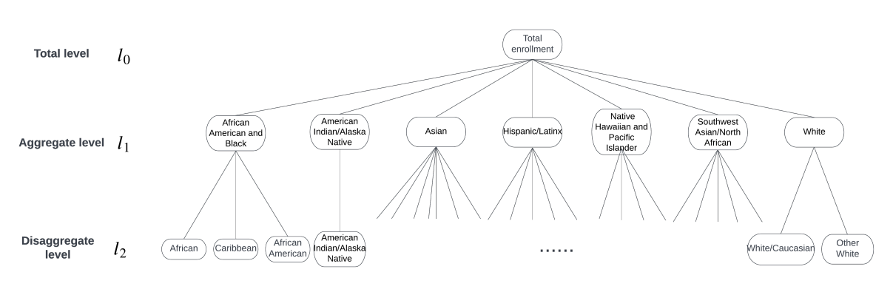
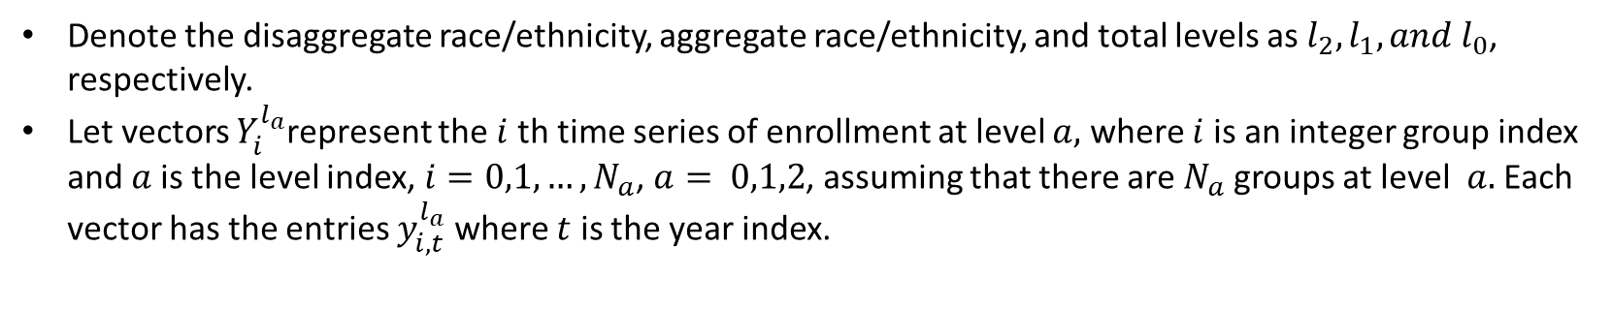
Data description (Cont’d)
Denote the disaggregate race/ethnicity, aggregate race/ethnicity, and total levels as $l_{2}, l_{1}, and l_{0}$, respectively.
Let vectors $Y_{i}^{l_{a}}$represent the $i$ th time series of enrollment at level $a,$ where $i$is an integer group index and $a$is the level index, $i=0,1,…,N_{a}$, $a= 0,1,2$, assuming that there are $N_{a}$groups at level $a.$Each vector has the entries $y_{i, t}^{l_{a}}$where $t$ is the year index.
Figure 2: The hierarchical structure with UC aggregation rule

Slide 23




Forecasting models
Double exponential smoothing
Relatively simple algorithm since we focus on the impact of aggregation levels rather than forecasting algorithms.
One of the most basic methods used in enrollment forecasting (for example, Hussar and Bailey, 2020; Bousnguar et al., 2022).
It implies that recent observations have the most significant impact on the forecasts and considers the trend of historical data.
The parameters α and β between 0 and 1 that generate the least mean absolute percentage error (MAPE) of the forecasting result are chosen as smoothing parameters for the forecasted series.
Forecast horizon: 5 years
Let ${\hat{y}}_{i, t+h}^{l_{a}} \text{represents} \text{the} \text{h}\text{-}\text{step} \text{ahead} \text{forecast} \text{of} \text{the} i \text{th} \text{series} \text{at} \text{level} a, \text{be} \text{the} \text{double} \text{exponential} \text{smoothing} \text{function}$, where $α, β$ are smoothing parameters, then
(level equation)
where
(trend equation)

Slide 24


Forecasting models – disaggregation model
Disaggregation model
Use only the data at the total and disaggregate levels.
Apply exponential smoothing at the total level and disaggregate level.
At the disaggregate level, the forecasting algorithm is applied separately for each racial/ethnic group. The smoothing parameters are chosen individually for each group
The forecast at the total level does not cohere with the forecasts at the disaggregate level
For the forecasts at the total level,
For the forecasts at the disaggregate level,

Slide 25



Forecasting models – standard aggregation model
Standard aggregation model
Aggregate the disaggregate data into seven groups according to the standard categorization rule provided by UC.
Step 1: apply double exponential smoothing on the aggregate level.
Step 2: sum the forecasts to obtain the forecast at the total level.
Step 3: distribute the forecasts at the aggregate level to the forecasts at the disaggregate level.
Based on the average historical proportions of the disaggregate series in the corresponding aggregate group.
Denote the proportion of $Y_{i}^{l_{2}}$ in $Y_{k}^{l_{1}}$as $p_{i,k}$ (giving $that { Y}_{i}^{l_{2}}$ belongs to $Y_{k}^{l_{1}}$),
The forecasts at the total level is
The forecast of group $i$at the disaggregate level is

Slide 26
Forecasting models – fair aggregation models
Fair aggregation models
The forecasting process is similar to the standard aggregation model.
The aggregate level is defined based on different criteria.
(Dis)similarity: STS
Fairness: statistical disparity
Perform binary hierarchical K-medoids clustering and aggregate the disaggregate groups within each cluster.
Use a weighted linear combination of STS and statistical disparity as the pairwise distance between the disaggregate groups.

Slide 27

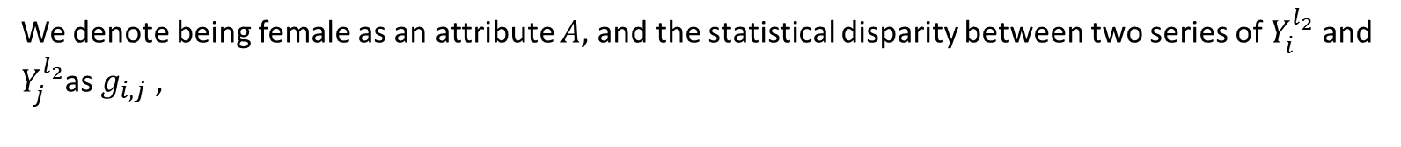
Fair aggregation models – STS and statistical disparity
STS
Considers the short time series as piecewise linear functions.
Calculates the difference between the slopes of the functions in the same period.
Statistical disparity
It makes little sense to consider only the difference between enrollment counts of different groups because such a difference can be perfectly valid because of differences in application numbers.
Consider gender as the additional attribute for fairness.
Measure the difference in the proportion of female students enrolled between the two disaggregate racial/ethnic groups
Use the most recent observation to calculate fairness
Denote the STS between two series of $Y_{i}^{l_{2}}$ and $Y_{j}^{l_{2}}$as $d_{i,j}$,
We denote being female as an attribute $A$, and the statistical disparity between two series of $Y_{i}^{l_{2}}$ and $Y_{j}^{l_{2}}$as $g_{i,j}$ ,

Slide 28
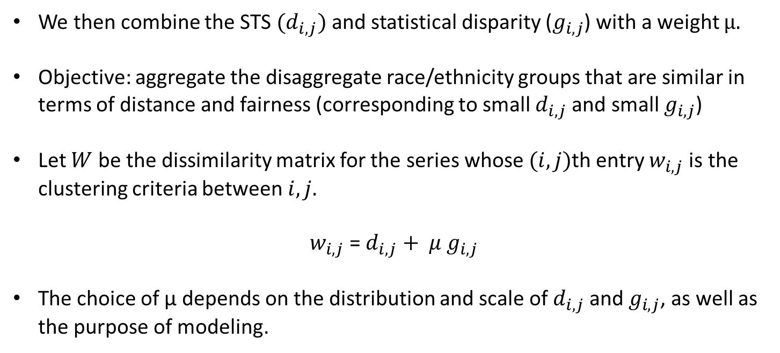
Fair aggregation models – weighted linear combination
We then combine the STS ${(d}_{i,j})$and statistical disparity ($g_{i,j}$) with a weight μ.
Objective: aggregate the disaggregate race/ethnicity groups that are similar in terms of distance and fairness (corresponding to small $d_{i,j}$and small $g_{i,j}$)
Let $W$ be the dissimilarity matrix for the series whose $(i,j)$th entry $w_{i,j}$is the clustering criteria between$i,j.$
$w_{i,j}$ = $d_{i,j}+ μ{ g}_{i,j}$
The choice of µ depends on the distribution and scale of $d_{i,j}$and $g_{i,j}$, as well as the purpose of modeling.

Slide 29
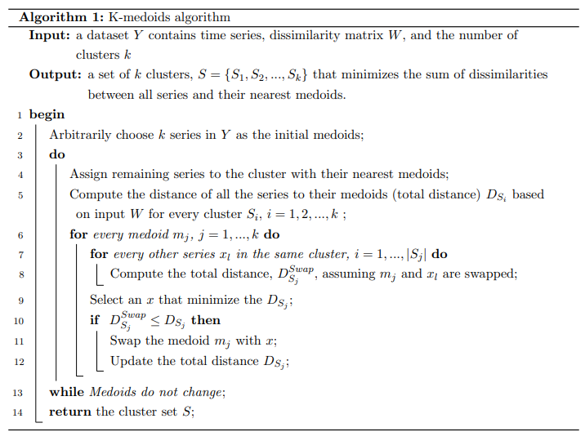
Fair aggregation models – hard K-medoids algorithm

Slide 30
Fair aggregation models – binary hierarchical k-medoids algorithm
Binary hierarchical k-medoids algorithm
Step 1: considers all the data in the same big cluster.
Step 2 (recursive step): separates one big cluster into two subclusters using K-medoids. Repeat the process at the sub-clusters until certain criteria are met.
Step 3: aggregate the disaggregate racial/ethnic groups in the same cluster
Choose the number of the series in the cluster as the stopping criteria
To ensure that each cluster has a reasonable number of time series for the convenience of the forecasting process.
Cannot guarantee that the intracluster distance (the distance among members of a cluster) is minimized.

Slide 31
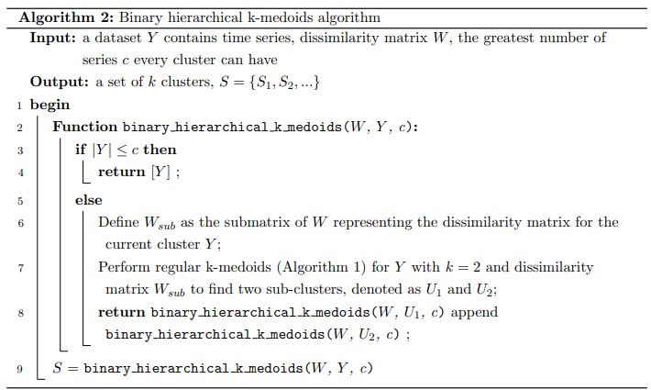
Fair aggregation models – binary hierarchical k-medoids algorithm (Cont’d)

Slide 32


Evaluation criteria - Forecast accuracy
Evaluate the models (i.e., disaggregation, standard aggregation, and fair aggregation models) at each level.
The forecasts are obtained at different levels in all models
Adopt MAPE (mean absolute percentage error) for the forecasts at the total and aggregate levels.
Widely used, easy to interpret, and scale independent
The forecast accuracy at a specific is simply the average of the MAPEs (AvgMAPE) of all series at this level
The MAPE of series $i$at level $a$ is defined as
The AvgMAPE of series $i$at level $a$ is defined as
w$here a$ = 0, 1

Slide 33


Evaluation criteria - Forecast accuracy (Cont’d)
MAPE cannot be adopted at the disaggregate level because a few observations are zero, as well as some forecasted values
Use the sum of actual observations and the sum of the forecasts, defined as weighted MAPE (WMAPE)
Compares the sum of forecast errors over the forecast horizon and the sum of actual observations over the horizon to overcome the infinite error.
The WMAPE of series $i$at level $2$ is defined as
The AvgWMAPE of series $i$at level $2$ is defined as

Slide 34
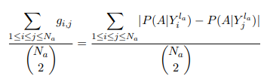
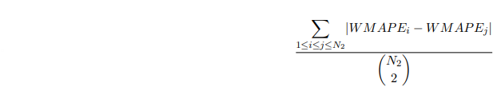
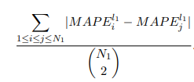
Evaluation criteria - Fairness
Fairness will also be evaluated at different levels (i.e., aggregate and disaggregate levels)
Statistical disparity
To evaluate fairness at one level, we take the average of the statistical disparity of all the pairs of the time series at that level.
Model performance for different racial/ethnic groups
The differences of forecast accuracy across the groups at different levels are evaluated.
Consider the groups as pairs and obtain the difference of forecast accuracy for each pair. To evaluate the difference of MAPEs at the aggregate level, we take the average of the difference of MAPE between all the pairs.
Average statistical disparity
Average difference of MAPEs
Average difference of WMAPEs

Slide 35
Analysis of results

Slide 36
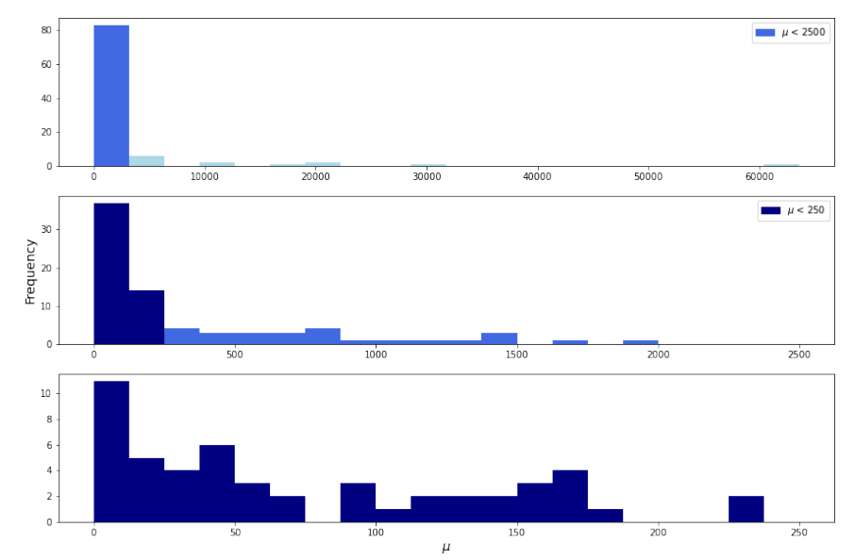
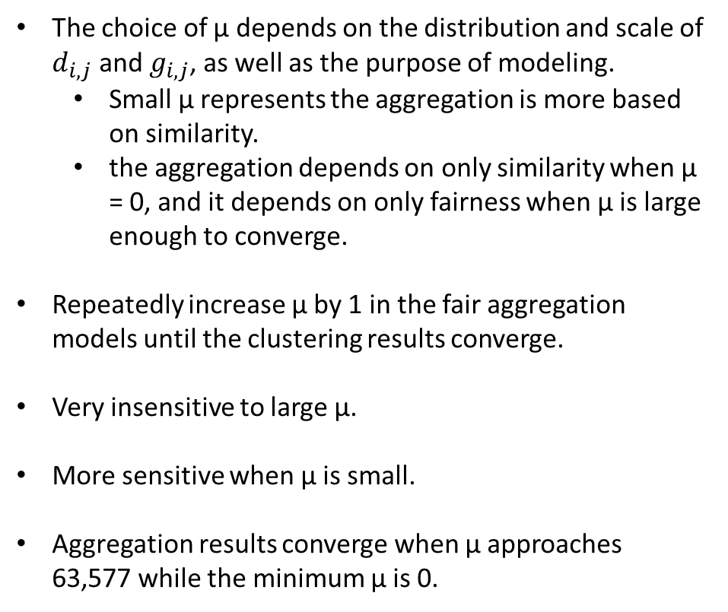
Choice of μ
The choice of µ depends on the distribution and scale of $d_{i,j}$and $g_{i,j}$, as well as the purpose of modeling.
Small µ represents the aggregation is more based on similarity.
the aggregation depends on only similarity when µ = 0, and it depends on only fairness when µ is large enough to converge.
Repeatedly increase µ by 1 in the fair aggregation models until the clustering results converge.
Very insensitive to large µ.
More sensitive when µ is small.
Aggregation results converge when µ approaches 63,577 while the minimum µ is 0.
Figure 3: Number of different aggregation results in fair aggregation with different value of µ

Slide 37
Forecast accuracy – extreme µ’s
Model | Total level (MAPE) | Aggregate level (AvgMAPE) | Disaggregate level (AvgWMAPE)
Disaggregation model | 0.027 |  | 0.083
Standard aggregation model | 0.026 | 0.051 | 0.079
Fair aggregation model (µ = 0) | 0.024 | 0.023 | 0.078
Fair aggregation model (µ ≥ 63,577) | 0.026 | 0.084 | 0.081
Table 1: Forecast accuracy at each level for different models
The fair aggregation model with µ = 0 outperforms other models at all three levels.
The fair aggregation model with µ = 0 outperforms the standard aggregation model by approximately 55%.
The standard aggregation model outperforms the fair aggregation models with µ ≥ 63,577
The standard aggregation model performs relatively well at all levels
Forecast accuracy at the total and disaggregate levels does not vary much as the model varied

Slide 38
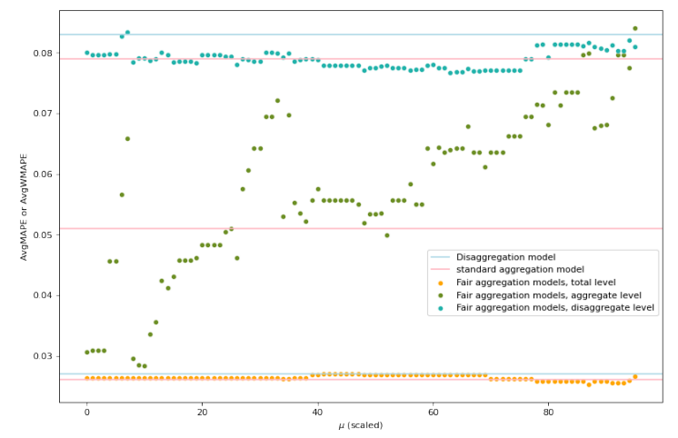
Forecast accuracy – µ versus forecast accuracy
µ has the most significant impact at the aggregate level where the aggregation occurs. In general, forecast accuracy decreases as µ increases at the aggregate level.
At the total level, the forecast accuracy is very stable.
At the disaggregate level, the forecast accuracy appears to be lower for large µ’s.
Almost all fair aggregation models outperform the disaggregation model.
Approximately half of the fair aggregation models outperform the standard aggregation model.
Figure 4: Fair aggregation parameter µ versus forecast accuracy at different levels

Slide 39
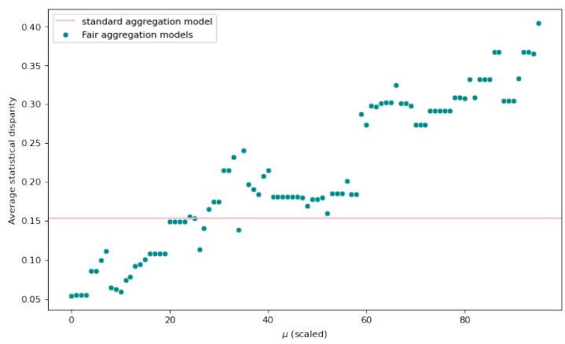
Fairness – statistical disparity
Smaller statistical disparity represents fairer groups; thus, the fair aggregation method aggregates the “fair” groups with small statistical disparity together.
The statistical disparity increases as µ increases (the intra-aggregate statistical disparity is smaller and the inter-aggregate statistical disparity is larger)
Fairness aggregation models are more flexible and capable of presenting various pictures in terms of fairness than the standard aggregation model.
Figure 5: Fair aggregation parameter µ versus statistical disparity between aggregate groups

Slide 40
Fairness – Flexibility of fair aggregation regarding statistical disparity
According to the modeling results, it is easy to see what aggregation rule gives the best (or worst) statistical disparity.
Similar groups in terms of fairness can be easily identified in the aggregation structure.
The institutions can choose their way to aggregate the disaggregate groups based on their purpose.
E.g., for good forecast accuracy and/or fair picture, they can choose to aggregate the data based on the clustering tree with µ = 0.
The relationships between the disaggregate groups are clearly shown in these clustering trees.
One can find the most similar and the fairest groups, as well as the least similar and fair groups.
The clustering (aggregation) tree with µ ≥ 63, 577 is more balanced than that with µ = 0. The statistical parity maybe more stable than STS in our analysis because STS is more sensitive to magnitudes.

Slide 41
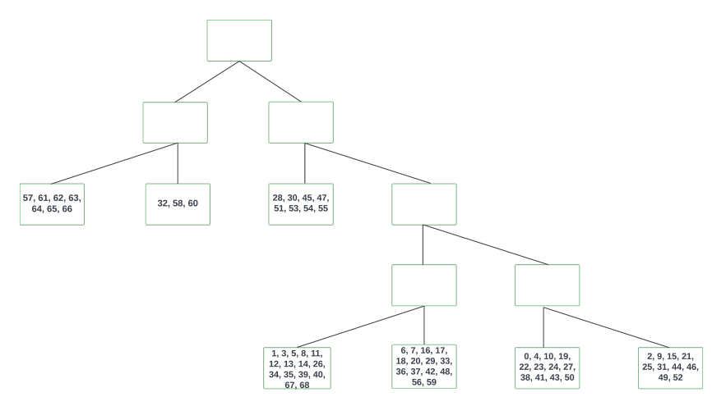
Fairness – Flexibility of fair aggregation regarding statistical disparity (cont’d)
Figure 6: Clustering (aggregation) tree using fair aggregation with µ ≥ 63, 577

Slide 42
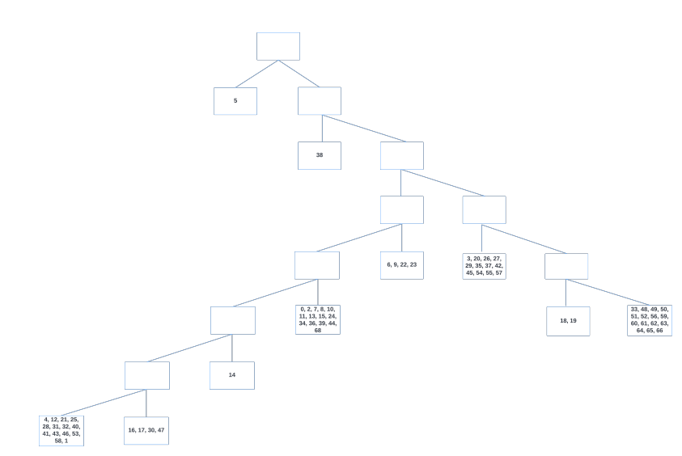
Fairness – Flexibility of fair aggregation regarding statistical disparity (cont’d)
Figure 6: Clustering (aggregation) tree using fair aggregation with µ = 0

Slide 43
Fairness – Flexibility of fair aggregation regarding statistical disparity (cont’d)
Figure 6: Clustering (aggregation) tree using fair aggregation with µ = 0

Slide 44
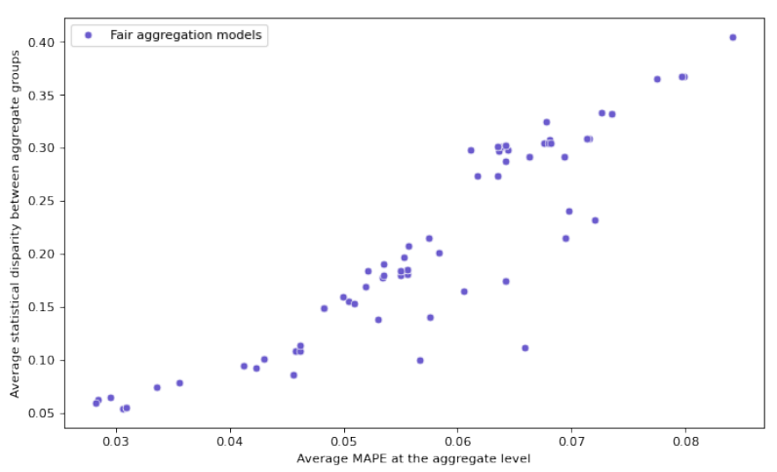
Fairness – statistical disparity versus forecast accuracy
The greater AvgMAPE is associated with greater statistical disparity, which corresponds to the less fair across aggregate groups.
greater µ results more fairness within and less fairness across groups; therefore, the statistical disparity across groups increases as µ increases; meanwhile, as the aggregation weights more on fairness than similarity, the AvgMAPE increases as well.
There is a trade-off between forecast accuracy and fairness at the aggregate level
Figure 7: Average MAPE versus average statistical disparity at aggregate level

Slide 45
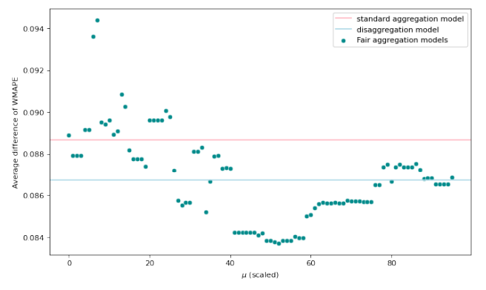
Fairness – difference of forecast accuracy
The average difference of WMAPEs tends to decrease when µ is relatively small, and increases after the scaled µ approaches 50, equivalent to µ approaches approximately 200.
Figure 8: Aggregation parameter µ versus average differences of WMAPE at the disaggregate level

Slide 46
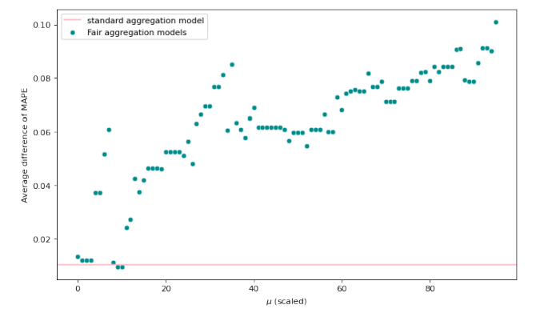
Fairness – difference of forecast accuracy (cont’d)
As µ increases, the fair aggregation model treats the different groups less fairly.
the aggregate groups are treated more fairly by the standard aggregation model than by most fair aggregation models.
Figure 8: Aggregation parameter µ versus average differences of MAPE at the disaggregate level

Slide 47
Conclusions and future work

Slide 48
Conclusions
Considering that fairness across races/ethnicities in enrollment has been an important social topic, though there is a lack of research in a forecasting scheme, we use a hierarchical structure regarding race/ethnicity for enrollment forecasting, where we investigate the impact of the aggregation level on both forecast accuracy and fairness.
Fair aggregation method
Use STS to measure dissimilarity and statistical disparity to measure fairness
Binary hierarchical variant of K-medoid clustering
Forecast accuracy
The hierarchical forecasting structure combined top-down and bottom-up approaches with an aggregate level can improve the forecast accuracy at all levels compared to the disaggregate model.
Fair aggregation results depend on its weight parameter for fairness. With some specifications of the parameter, fair aggregation can outperform standard aggregation model.
The forecast accuracy of fair aggregation models is sensitive to the parameter, especially at the aggregate level where the aggregation occurs.
Notes:
Definition of fairness:
Definition
Examples: Google’s photo application once misidentified black people as “gorillas” ; study analyzing three gender classification algorithms found that the algorithms were more accurate when classifying light-skinned men compared with other groups
matters of fairness should be addressed in forecasting applications
an unfair forecasting model may result in different levels of forecast accuracy for different groups In terms of decision-making
it is necessary to analyze fairness due to some issues associated with forecasting certain properties. Consideration of fairness can assist forecasters and decision-makers with more informed planning.
One prototypical example is enrollment forecasting
Enrollment forecasting is essential for institutions to prepare for all enrollment-related activities, such as tuition policy, budget planning, and faculty staffing

Slide 49
Conclusions (cont’d)
Fairness
The average statistical disparity across the aggregate groups at the aggregate level increases as the parameter increases, which corresponds to the decrease of the average statistical disparity within the groups.
The fairness generated by fair aggregation models is very flexible and can be either smaller or greater than that generated by the standard aggregation model.
The fair aggregation with different parameters can present a very detailed picture of similarity and/or fairness.
Implications in practice
Institutions might want to show the data are fair/unfair, and fairness aggregation can be applied to direct such application.
The fairness across and within groups can be clearly shown based on fair aggregation. Detailed information about fair/unfair groups can assist institutions in making future plans to achieve some specific fairness goal.
In general, the flexibility of fairness representation can be applied to show the strive businesses have made with diversity, equity, and inclusion.
Notes:
Definition of fairness:
Definition
Examples: Google’s photo application once misidentified black people as “gorillas” ; study analyzing three gender classification algorithms found that the algorithms were more accurate when classifying light-skinned men compared with other groups
matters of fairness should be addressed in forecasting applications
an unfair forecasting model may result in different levels of forecast accuracy for different groups In terms of decision-making
it is necessary to analyze fairness due to some issues associated with forecasting certain properties. Consideration of fairness can assist forecasters and decision-makers with more informed planning.
One prototypical example is enrollment forecasting
Enrollment forecasting is essential for institutions to prepare for all enrollment-related activities, such as tuition policy, budget planning, and faculty staffing

Slide 50
Limitations and future studies
The study may not be generally applicable because it is an investigation into a specific case.
It would be beneficial to test different datasets, particularly enrollment data from different universities with different sizes, policies, categorization rules, etc.
It would be interesting to see the fairness aggregation scheme used in other applications.
Both the clustering criteria and the aggregation algorithm can be investigated further.
Criteria
(Dis)similarity metrics that are not sensitive to magnitude.
More general fairness metrics.
Algorithm
Algorithms that are likely to generate clusters with similar sizes can be adopted.
algorithm that can maximize the fairness within the cluster can be applied.
One may find a way to include the difference of forecast accuracy across groups in the modeling stage.
Other forecasting algorithms or techniques used in the literature, such as fuzzy time series and Markov chains, can be applied instead of exponential smoothing.
Notes:
Definition of fairness:
Definition
Examples: Google’s photo application once misidentified black people as “gorillas” ; study analyzing three gender classification algorithms found that the algorithms were more accurate when classifying light-skinned men compared with other groups
matters of fairness should be addressed in forecasting applications
an unfair forecasting model may result in different levels of forecast accuracy for different groups In terms of decision-making
it is necessary to analyze fairness due to some issues associated with forecasting certain properties. Consideration of fairness can assist forecasters and decision-makers with more informed planning.
One prototypical example is enrollment forecasting
Enrollment forecasting is essential for institutions to prepare for all enrollment-related activities, such as tuition policy, budget planning, and faculty staffing

Slide 51
Thank you!
Any questions & comments?

